Slide 1
Java 과제 제출
데이터융합sw과
노을
2023.03.08

Slide 2
목차
P6
P7
P8
P11
P12
P13
P14
P15
A1
A2
A3

Slide 3
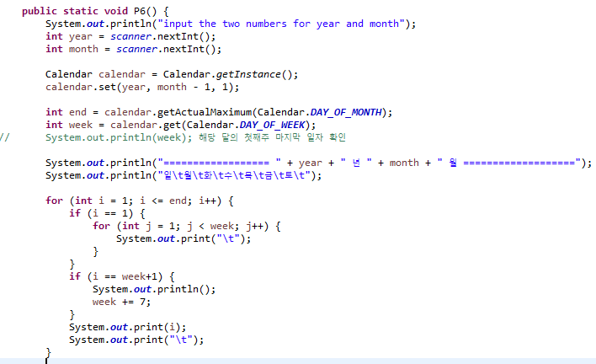
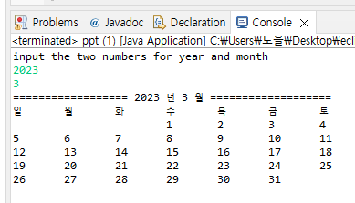
P6 Calendar Application
User inputs the two numbers for year and month
Print the calendar

Slide 4
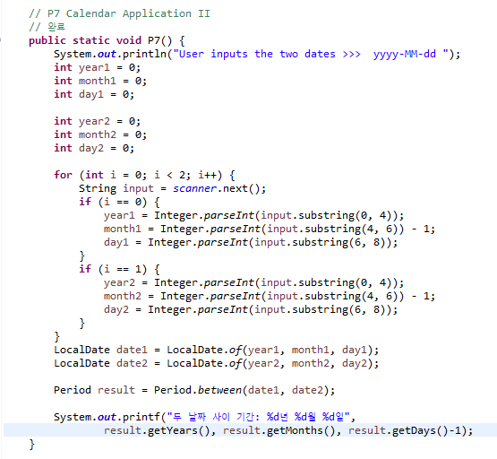
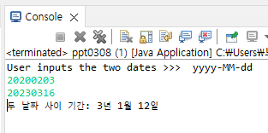
P7 Calendar Application II
User inputs the two dates
Print the days between the first and the second dates

Slide 5
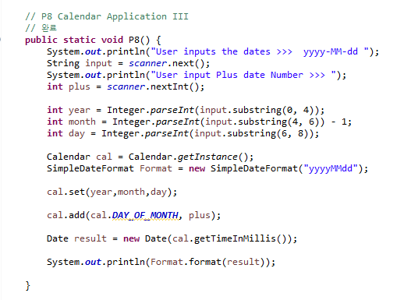
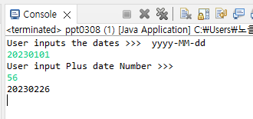
P8 Calendar Application III
User inputs a date and a number for adding days
Print the new date after adding the input day to the start date

Slide 6
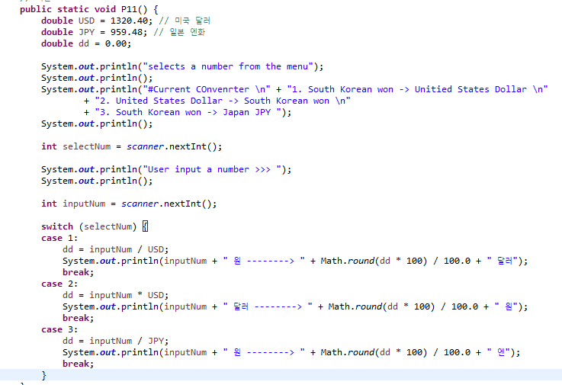
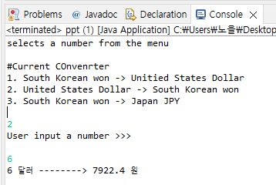
P11 Currency Converter
Print menu for currency conversion
User selects a number from the menu
User input a number
Print the converted currency
The menu should have at least three more options

Slide 7
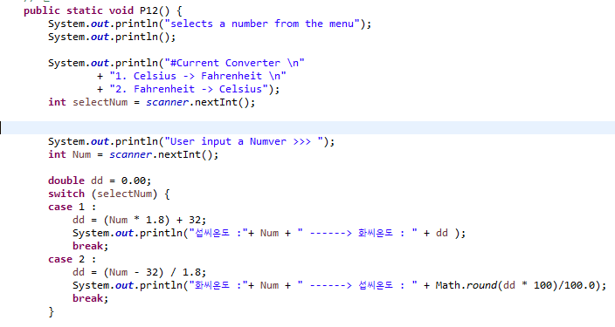
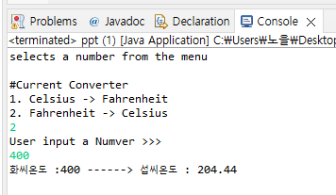
P12 Temperature Converter
Print menu for temperature conversion
User selects a number from the menu
User input a number
Print the converted temperature

Slide 8
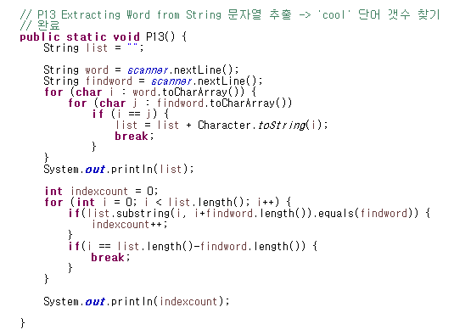
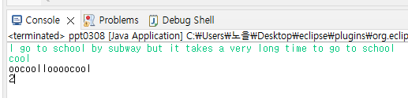
P13 Extracting Word from String
User inputs one sentence and one word
Calculate how many input words can be made from the sentence
No need to change the font color as below, it just helps you understand

Slide 9
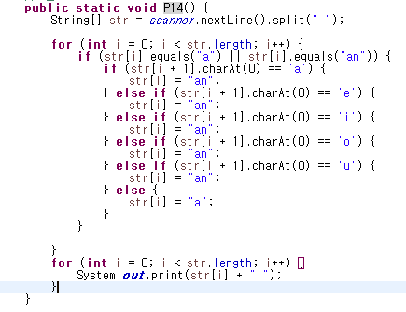
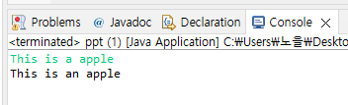
P14 Article before Consonant and Vowel
User inputs a sentence including at least an article
Check if the articles before consonants and vowels are correct
Modify the article if needed

Slide 10
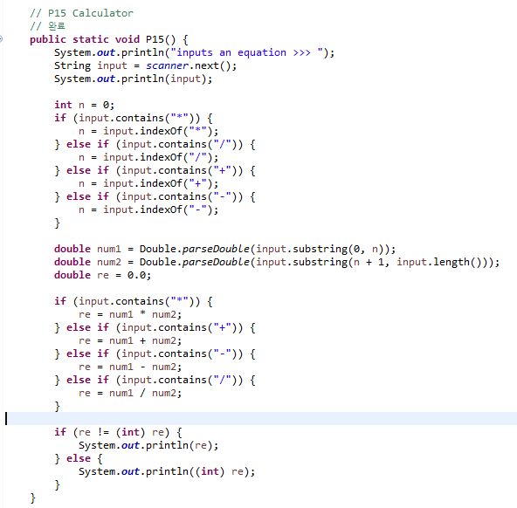
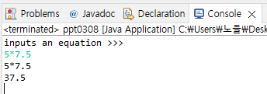
P15 Calculator
User inputs an equation
Print the calculated result
Hint, String.substring(), String.contains()

Slide 11
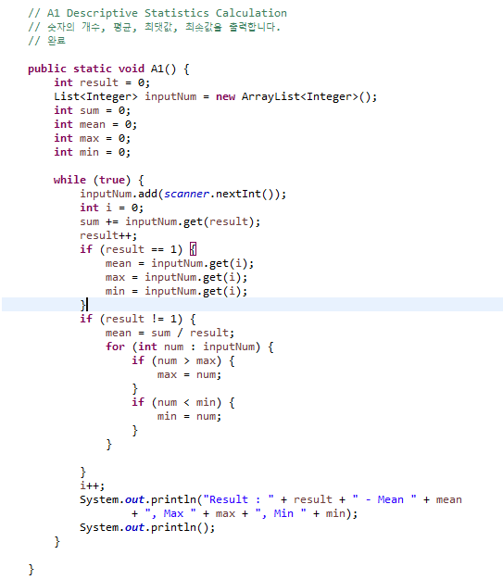
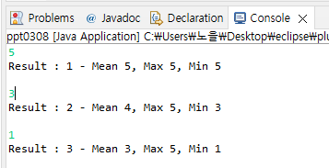
A1 Descriptive Statistics Calculation
User inputs a number
Prints the number of numbers, mean, maximum, minimum
This is performed indefinitely

Slide 12
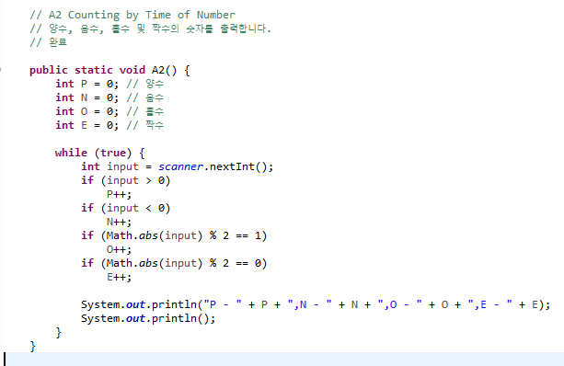
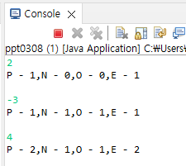
A2 Counting by Time of Number
User inputs a number
Prints the numbers of positive, negative, odd and even numbers
This is performed indefinitely

Slide 13
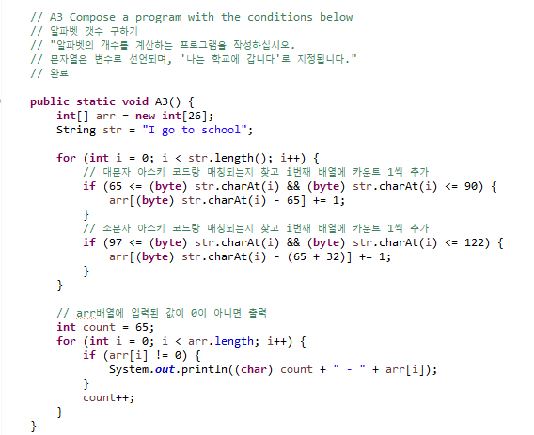
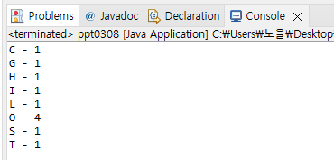
A3 Compose a program with the conditions below
Compose a program calculating the number of alphabets
The string is declared as a variable, “I go to school”

