Slide 1
Instructor: Noha Hazzazi
Intro to the Theory of Computation
1

Slide 2
18.404 Course Outline
Computability Theory 1930s – 1950s
What is computable… or not?
Examples: program verification, mathematical truth
Models of Computation: Finite automata, Turing machines, …
Complexity Theory 1960s – present
What is computable in practice?
Example: factoring problem
P versus NP problem
Measures of complexity: Time and Space
Models: Probabilistic and Interactive computation
2

Slide 3
Role of Theory in Computer Science
Applications
Basic Research
Connections to other fields
What is the nature of computation?
5

Slide 4
Regular Languages
What is a computer?
Real computers are complicated and require too much so to allow us to set up a manageable mathematical theory – computational model
Different computational models
Finite sate machine
Finite automation

Slide 5
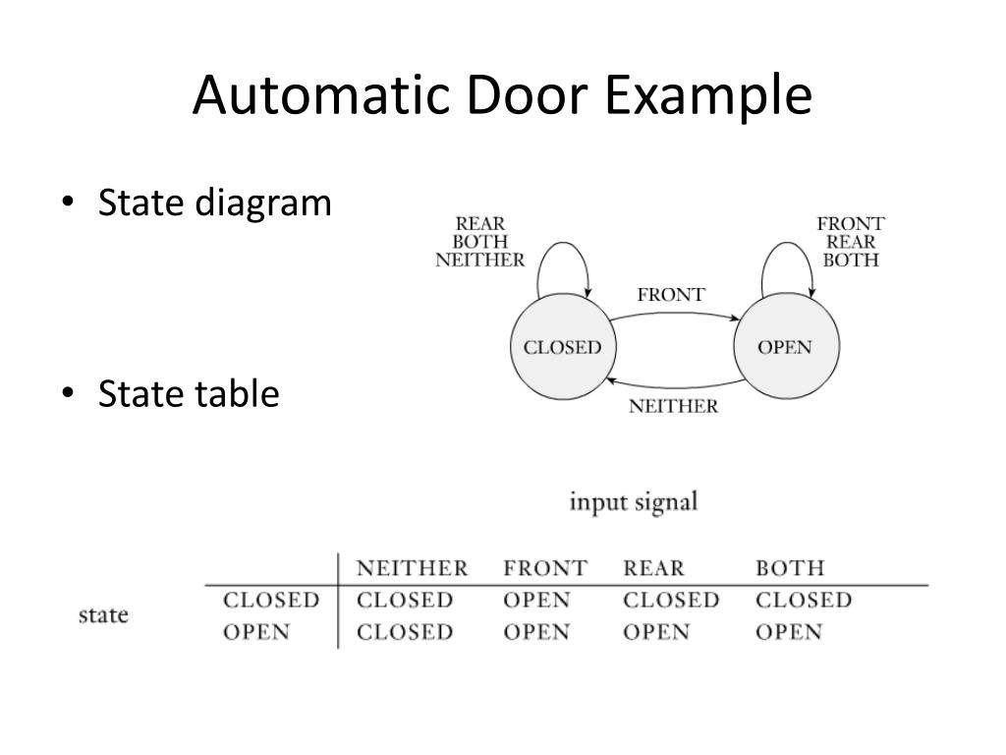
Finite Automata
Good models for computers with an extremely limited amount of memory – Eg. Controller for an automatic door
Notes:
This controller is a computer that has just a single bit of memory, capable of
recording which of the two states the controller is in. Other common devices
have controllers with somewhat larger memories. In an elevator controller a
state may represent the floor the elevator is on and the inputs might be the signals
received from the buttons. This computer might need several bits to keep
track of this information.

Slide 6






Let’s begin: Finite Automata
0
1
$$M1$$
0,1
1
$$q3$$
$$q1$$
$$q2$$
0
Input: finite string Output: Accept or Reject
Computation process: Begin at start state, read input symbols, follow corresponding transitions, Accept if end with accept state, Reject if not.
Examples: 01101 → Accept 00101 → Reject
$M1$ accepts exactly those strings in $A$ where $A = \{w| w$contains substring $11\}.$
States: $q1 q2 q3$
Transitions:
Start state:
Accept states:
1
Say that $A$ is the language of $M1$ and that $M1$ recognizes $A$ and that $A = L(M1)$.
6
Notes:
state diagram of Al . It has three states, labeled q1, q2 ,
and q3 . The start state, q\ , is indicated by the arrow pointing at it from nowhere.
The accept state, q2 , is the one with a double circle. The arrows going from one
state to another are called transitions.
Experimenting with this machine on a variety of input strings reveals that it
accepts the strings 1, 01, 11, and 0101010101. In fact, Ah accepts any string that
ends with a 1, as it goes to its accept state q2 whenever it reads the symbol 1. In
addition, it accepts strings 100, 0100, 110000, and 0101000000, and any string
that ends with an even number of 0s following the last 1. It rejects other strings,
such as 0, 10, 101000. Can you describe the language consisting of all strings
that Mi accepts? We will do so shortly.

Slide 7











Finite Automata – Formal Definition
Defn: A finite automaton $M$ is a 5-tuple $(Q, Σ, δ, q0, F)$
$Q$ finite set of states
$Σ$ finite set of alphabet symbols
$δ$ transition function $δ: Q×Σ → Q$
$q0$ start state
$F$ set of accept states
Example:
$$M1$$
0
1
$δ (q, a) = r$ means
a
$$r$$
0,1
$$q$$
$$q1$$
$$q2$$
1
$$q3$$
0
$M1 = (Q, Σ, δ, q1, F)$
$Q = \{q1, q2, q3\}$
$Σ = \{0, 1\}$
$F = \{q3\}$
$$δ=$$
 | 0 | 1
$$q1$$ | $$q1$$ | $$q2$$
$$q2$$ | $$q1$$ | $$q3$$
$$q3$$ | $$q3$$ | $$q3$$
7
Notes:
Goal- Precise mathematical description
a formal definition is precise. It resolves any uncertainties about what
is allowed in a finite automaton. If you were uncertain about whether finite
automata were allowed to have 0 accept states or whether they must have exactly
one transition exiting every state for each possible input symbol, you could
consult the formal definition and verify that the answer is yes in both cases.
**The language of a formal definition is somewhat arcane, having some similarity
to the language of a legal document. Both need to be precise, and every
detail must be spelled out.
The formal definition says that a finite automaton is a list of those
five objects: set of states, input alphabet, rules for moving, start state, and accept
states.
In mathematical language a list of five elements is often called a 5-tuple.
We use something called a transition function, frequently denoted S , to define
the rules for moving. If the finite automaton has an arrow from a state x to
a state y labeled with the input symbol 1, that means that, if the automaton is
in state x when it reads a 1, it then moves to state y. We can indicate the same
thing with the transition function by saying that S ( x ,1) = y. This notation is a
kind of mathematical shorthand. Putting it all together we arrive at the formal
definition of finite automata.

Slide 8

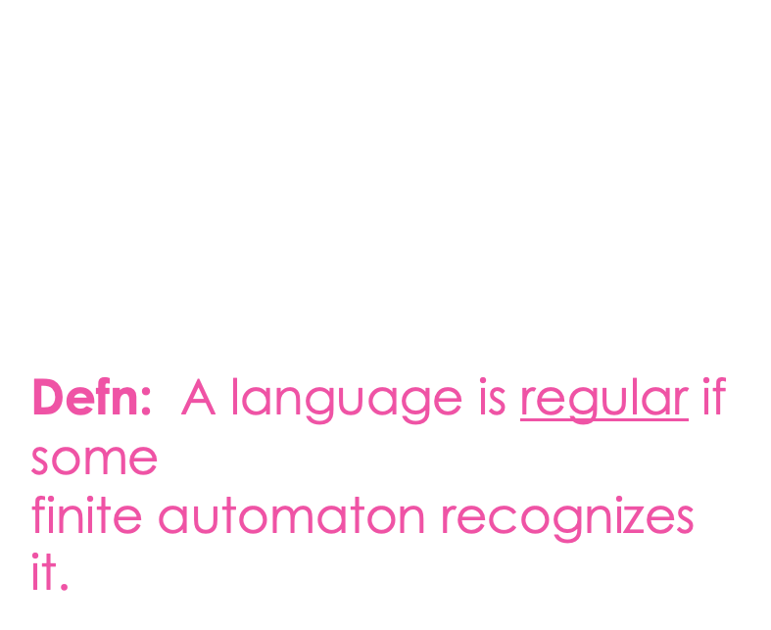
Finite Automata – Computation
Strings and languages
A string is a finite sequence of symbols in $Σ$
A language is a set of strings (finite or infinite)
The empty string ε is the string of length 0
The empty language $ø$ is the set with no strings
Defn: $M$ accepts string $w = w1w2 … wn$each $wi ε Σ$ if there is a sequence of states $r0, r1, r2, ,…, rn ε Q$ where: - $r0 = q0$ - $ri = δ(r_{i−1}, wi)$ for $1≤i≤n$ - $rn ε F$
Recognizing languages
$L(M) = \{w| M accepts w\}$
$L(M)$is the language of $M$
$M$ recognizes $L(M)$
Defn: A language is regular if some finite automaton recognizes it.
8
Notes:
A machine may accept several strings, but it always recognizes only one language.
If the machine accepts no strings, it still recognizes one language— namely, the empty language 0.

Slide 9






Regular Languages – Examples
$$M1$$
0
1
0,1
1
$$q3$$
$$q1$$
$$q2$$
0
More examples:
Let $B=\left\{w\right| w$has an even number of 1s$\}$ $B$ is regular (make automaton for practice).
Let $C=\left\{w\right| w$has equal numbers of 0s and 1s$\}$ $C$ is not regular (we will prove).
$L\left(M_{1}\right)= \{w| w contains substring 11\}=A$
Therefore $A$ is regular
Goal: Understand the regular languages
9

Slide 10


Regular Expressions
Regular operations. Let $A,B$ be languages:
Union: $A∪B=\left\{w\right| w∈A$ or $w∈B\}$
Concatenation: $A∘B=\left\{xy\right| x∈A$ and $y∈B\}=AB$
Star: $A^{∗}=\left\{x_{1}… x_{k}\right|$each$x_{i}∈A$ for $k≥0\}$ Note: $ε∈A^{∗}$ always
Example. Let $A=\{$good, bad$\}$ and $B=\{$boy, girl$\}$.
$A∪B=${good, bad, boy, girl}
$A∘B=AB=$ {goodboy, goodgirl, badboy, badgirl}
$A^{∗}=$ {$ε$, good, bad, goodgood, goodbad, badgood, badbad, goodgoodgood, goodgoodbad, … }
Regular expressions
Built from $Σ$, members $Σ, ∅,ε$ [Atomic]
By using $∪, ∘, ∗$ [Composite]
Examples:
${\left(0∪1\right)}^{∗}=Σ^{∗}$ gives all strings over $Σ$
$Σ^{∗}1$ gives all strings that end with 1
$Σ^{∗}11Σ^{∗}=$all strings that contain 11 $=L\left(M_{1}\right)$
Goal: Show finite automata equivalent to regular expressions
10

Slide 11




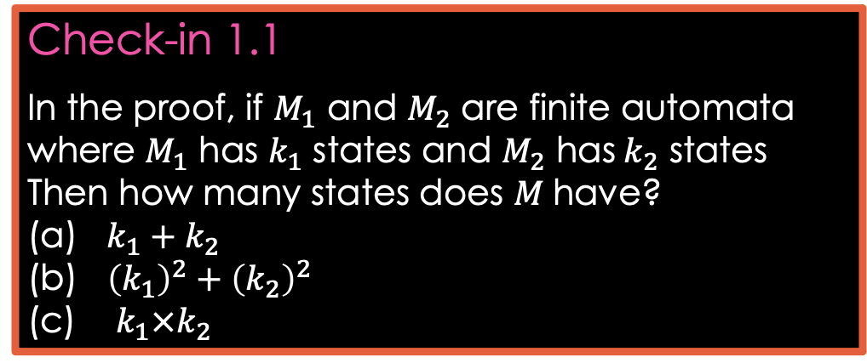




Closure Properties for Regular Languages
Theorem: If ${ A}_{1}, A_{2}$are regular languages, so is $A_{1}∪A_{2}$ (closure under $∪$)
Proof: Let $M_{1}=(Q_{1}, Σ, { δ}_{1}, { q}_{1}, { F}_{1})$ recognize $A_{1}$ $M_{2}=(Q_{2}, Σ, { δ}_{2}, { q}_{2}, { F}_{2})$ recognize $A_{2}$
Construct $M = (Q, Σ, δ, q0, F)$ recognizing ${A_{1}∪A}_{2}$ $M$ should accept input $w$ if either $M_{1}$ or $M_{2}$ accept $w$.
Check-in 1.1
In the proof, if $M_{1}$ and $M_{2}$ are finite automata where $M_{1}$ has $k_{1}$ states and $M_{2}$ has$k_{2}$ states
Then how many states does $M$have?
(a) $k_{1}+k_{2}$
(b) ${\left(k_{1}\right)}^{2}+{\left(k_{2}\right)}^{2}$
(c) $k_{1}×k_{2}$
Components of $M$:
$Q=Q_{1}×Q_{2}$ $=\left\{\left(q_{1},q_{2}\right)\right|q_{1}∈Q_{1}$ and $q_{2}∈Q_{2}\}$
$q_{0}=(q_{1}, q_{2})$
$δ\left(\left(q,r\right),a\right)=\left(δ_{1}\left(q,a\right),δ_{2}\left(r,a\right)\right)$
$F=F_{1}×F_{2}$
$F=\left(F_{1}×Q_{2}\right)∪\left(Q_{1}×F_{2}\right)$
$$M_{1}$$
$$q$$
$$M$$
?
$$q,r$$
$$M_{2}$$
NO! [gives intersection]
$$r$$
11
Check-in 1.1

Slide 12









Closure Properties continued
Theorem: If ${ A}_{1}, A_{2}$are regular languages, so is $A_{1}A_{2}$ (closure under $∘$)
Proof: Let $M_{1}=(Q_{1}, Σ, { δ}_{1}, { q}_{1}, { F}_{1})$ recognize $A_{1}$ $M_{2}=(Q_{2}, Σ, { δ}_{2}, { q}_{2}, { F}_{2})$ recognize $A_{2}$
Construct $M = (Q, Σ, δ, q0, F)$ recognizing ${A_{1}A}_{2}$
$$M_{1}$$
$$M_{2}$$
$M$ should accept input $w$ if $w=xy$ where $M_{1}$ accepts $x$ and $M_{2}$ accepts $y$.
$$M$$
$$w$$
$$x$$
$$y$$
Doesn’t work: Where to split $w$?
12

Slide 13

Quick review
Introduction, outline, mechanics, expectations
Finite Automata, formal definition, regular languages
Regular Operations and Regular Expressions
Proved: Class of regular languages is closed under $∪$
Started: Closure under $∘$ , to be continued…
13

Slide 14
Closure Properties for Regular Languages
Theorem: If ${ A}_{1}, A_{2}$are regular languages, so is $A_{1}A_{2}$ (closure under $∘$)
Recall proof attempt: Let $M_{1}=(Q_{1}, Σ, { δ}_{1}, { q}_{1}, { F}_{1})$ recognize $A_{1}$ $M_{2}=(Q_{2}, Σ, { δ}_{2}, { q}_{2}, { F}_{2})$ recognize $A_{2}$
Construct $M = (Q, Σ, δ, q0, F)$ recognizing ${A_{1}A}_{2}$
$$M_{1}$$
$$M_{2}$$
$M$ should accept input $w$ if $w=xy$ where $M_{1}$ accepts $x$ and $M_{2}$ accepts $y$.
$$M$$
$$w$$
$$x$$
$$y$$
Doesn’t work: Where to split $w$?
Hold off. Need new concept.
3

Slide 15
Nondeterministic Finite Automata
$$N1$$
a
a
b
a,ε
$$q4$$
$$q1$$
$$q2$$
$$q3$$
b
New features of nondeterminism: - multiple paths possible (0, 1 or many at each step)
- ε-transition is a “free” move without reading input
- Accept input if some path leads to accept
Example inputs:
- ab accept
- aa reject
- aba accept
- abb reject
Check-in 2.1
What does $N_{1}$ do on input aab ?
Accept
Reject
Both Accept and Reject
Nondeterminism doesn’t correspond to a physical machine we can build. However, it is useful mathematically.
Check-in 2.1
4

Slide 16
NFA – Formal Definition
$$N1$$
a
a
b
a,ε
$$q4$$
$$q1$$
$$q2$$
$$q3$$
b
Defn: A nondeterministic finite automaton (NFA) $N$ is a 5-tuple $(Q, Σ, δ, q0, F)$
- all same as before except $δ$
- $δ:Q×Σ_{\text{ε}}→𝓟\left(Q\right)=\left\{R\right|R⊆Q\}$
- In the $N_{1}$ example: $δ\left(q_{1},\text{a} \right)=\{q_{1},q_{2}\}$
$δ\left(q_{1},\text{b} \right)= ∅$
Ways to think about nondeterminism:
Computational: Fork new parallel thread and accept if any thread leads to an accept state.
Mathematical: Tree with branches. Accept if any branch leads to an accept state.
Magical: Guess at each nondeterministic step which way to go. Machine always makes the right guess that leads to accepting, if possible.
states
alphabet
start state
accept states
transition function
power set
$$Σ∪\{\text{ε}\}$$
5

Slide 17
Converting NFAs to DFAs
Theorem: If an NFA recognizes $A$ then $A$ is regular
Proof: Let NFA $M=(Q, Σ,δ, { q}_{0}, F)$ recognize $A$ Construct DFA $M′=(Q′, Σ,δ′, { q}_{0}^{′}, F′)$ recognizing $A$
(Ignore the ε-transitions, can easily modify to handle them)
IDEA: DFA $M′$ keeps track of the subset of possible states in NFA $M$.
Check-in 2.2
If $M$ has $n$ states, how many states does $M′$ have by this construction?
$2n$
$n^{2}$
$2^{n}$
$$M′$$
Construction of $M′$:
$Q′=𝓟\left(Q\right)$
$δ^{′}\left(R,a\right)=\left\{q\right| q∈δ(r,a)$ for some $r∈R\}$
$q_{0}^{′}=\{q_{0}\}$
$F′=\left\{R∈Q^{′}\right| R$ intersects $F\}$
$$M$$
$${ q}_{3}$$
${ \{q}_{3}$,$q_{7}\}$
$R∈Q′$
$${ q}_{7}$$
NFA
DFA
Check-in 2.2
6

Slide 18
Return to Closure Properties
Recall Theorem: If $A_{1}, A_{2}$are regular languages, so is $A_{1}∪A_{2}$ (The class of regular languages is closed under union)
New Proof (sketch): Given DFAs $M_{1}$ and $M_{2}$ recognizing $A_{1}$ and$A_{2}$ Construct NFA $M$ recognizing $A_{1}∪A_{2}$
$$M$$
$$M_{1}$$
Nondeterminism parallelism vs guessing
ε
$$M_{2}$$
ε
7

Slide 19
Closure under $∘$ (concatenation)
Theorem: If $A_{1}, A_{2}$are regular languages, so is $A_{1}A_{2}$
Proof sketch: Given DFAs $M_{1}$ and $M_{1}$ recognizing $A_{1}$ and$A_{2}$ Construct NFA $M$ recognizing $A_{1}A_{2}$
$$M$$
$$M_{1}$$
$$M_{2}$$
ε
$M$ should accept input $w$ if $w=xy$ where $M_{1}$ accepts $x$ and $M_{2}$ accepts $y$.
ε
$$w=$$
$$x$$
$$y$$
Nondeterministic $M′$ has the option to jump to $M_{2}$ when $M_{1}$ accepts.
8

Slide 20
Closure under $∗$ (star)
Theorem: If $A$ is a regular language, so is $A^{∗}$
Proof sketch: Given DFA $M$ recognizing $A$ Construct NFA $M′$ recognizing $A^{∗}$
$$M′$$
Check-in 2.3
If $M$ has $n$ states, how many states does $M′$ have by this construction?
$n$
$n+1$
$2n$
$$M$$
ε
$M′$ should accept input $w$
if $w=x_{1}x_{2} … x_{k}$
where $k≥0$ and $M$ accepts each $x_{i}$
ε
ε
$$w=$$
$$x_{1}$$
$$x_{2}$$
$$x_{3}$$
$$x_{4}$$
Make sure $M′$ accepts ε
Check-in 2.3
9

Slide 21
Regular Expressions $→$ NFA
Theorem: If $R$ is a regular expr and $A=L\left(R\right)$ then $A$ is regular
Proof: Convert $R$ to equivalent NFA $M$:
If $R$ is atomic:
$R=a$ for $a∈Σ$
$R=ε$
$R=∅$
If $R$ is composite:
$R=R_{1}∪R_{2}$
$R=R_{1}∘R_{2}$
$R=R_{1}^{∗}$
Equivalent $M$ is:
$$a$$
Example:
Convert ${\left(\text{a}∪\text{ab}\right)}^{∗}$ to equivalent NFA
$\text{a}$:
$\text{b}$:
$\text{ab}$:
$\text{a}∪\text{ab}$:
${\left(\text{a}∪\text{ab}\right)}^{∗}$:
$$\text{a}$$
$$\text{b}$$
$$\text{a}$$
$$ε$$
$$\text{b}$$
}
$$ε$$
$$\text{a}$$
$$\text{a}$$
$$ε$$
$$\text{b}$$
Use closure constructions
$$ε$$
$$ε$$
$$ε$$
$$\text{a}$$
$$ε$$
$$\text{a}$$
$$ε$$
$$\text{b}$$
$$ε$$
10
$$ε$$

Slide 22
Quick review
Nondeterministic finite automata (NFA)
Proved: NFA and DFA are equivalent in power
Proved: Class of regular languages is closed under $∘, ∗$
Conversion of regular expressions to NFA
Check-in 2.4
11

Slide 23

Outline
Last time: - Nondeterminism - NFA → DFA - Closure under $∘$ and $∗$
- Regular expressions → finite automata
(Sipser §1.4 – §2.1) - Finite automata → regular expressions - Proving languages aren’t regular
- Context free grammars
1

Slide 24
DFAs $→$Regular Expressions
Recall Theorem: If $R$ is a regular expressipn and $A=L\left(R\right)$ then $A$ is regular
Proof: Conversion $R$ $→$NFA $M$ $→$ DFA $M′$
$$M$$
Regular expression $R$
Finite automaton
Recall: we did ${\left(\text{a}∪\text{ab}\right)}^{∗}$ as an example
Today’s Theorem: If $A$ is regular then $A=L\left(R\right)$ for some regular expr $R$
Proof: Give conversion DFA $M$ $→$ $R$
WAIT! Need new concept first.
2

Slide 25
Generalized NFA
Defn: A Generalized Nondeterministic Finite Automaton (GNFA) is similar to an NFA, but allows regular expressions as transition labels
$$G1$$
a
$${\text{a}}^{∗}{\text{b}}^{∗}$$
ab
$$q1$$
$$q2$$
b
For convenience we will assume:
- One accept state, separate from the start state
- One arrow from each state to each state, except
a) only exiting the start state b) only entering the accept state
We can easily modify a GNFA to have this special form.
$$\text{ε}$$
$$∅$$
$$\text{a}∪\text{b}$$
aab
$$q3$$
$$\text{ε}$$
$$q4$$
3

Slide 26
GNFA $→$Regular Expressions
Lemma: Every GNFA $G$ has an equivalent regular expression $R$
Proof: By induction on the number of states $k$ of $G$
Basis $(k=2)$:
Let $R=r$
Induction step $(k>2)$: Assume Lemma true for $k−1$ states and prove for $k$ states
IDEA: Convert $k$-state GNFA to equivalent $\left(k−1\right)$ -state GNFA
$$G=$$
$$r$$
Remember: $G$ is in special form
GNFA
GNFA
$k$ states
$k−1$ states
4

Slide 27
$k$-state GNFA $→$ ($k$—1)-state GNFA
Check-in 3.1
We just showed how to convert GNFAs to regular expressions but our goal was to show that how to convert DFAs to regular expressions. How do we finish our goal?
Show how to convert DFAs to GNFAs
Show how to convert GNFAs to DFAs
We are already done. DFAs are a type of GNFAs.
$$x$$
$$r_{2}$$
$$x$$
$$r_{1}$$
$$r_{3}$$
Pick any state $x$ except the start and accept states.
Remove $x$.
Repair the damage by recovering all paths that went through $x$.
Make the indicated change for each pair of states $q_{i}, q_{j}$ .
$$q_{i}$$
$$q_{j}$$
$$q_{i}$$
$$q_{j}$$
$$r_{4}$$
$$r_{1}{\left(r_{2}\right)}^{∗}r_{3}∪r_{4}$$
$k$ states
$k−1$ states
Thus DFAs and regular expressions are equivalent.
Check-in 3.1
5

Slide 28
Non-Regular Languages
How do we show a language is not regular?
- Remember, to show a language is regular, we give a DFA.
- To show a language is not regular, we must give a proof.
- It is not enough to say that you couldn’t find a DFA for it, therefore the language isn’t regular.
Two examples: Here $Σ=\{0,1\}$.
1. Let $B=\left\{w\right| w$ has equal numbers of 0s and 1s$\}$
Intuition: $B$ is not regular because DFAs cannot count unboundedly.
2. Let $C=\left\{w\right| w$ has equal numbers of 01 and 10 substrings$\}$ 0101 $∉C$ 0110 $∈C$
Intuition: $C$ is not regular because DFAs cannot count unboundedly.
However $C$ is regular! Sometimes intuition works, but it can also be wrong.
Moral: You need to give a proof.
]
]
]
]
]
6

Slide 29
Method for Proving Non-regularity
Pumping Lemma: For every regular language $A$, there is a number $p$ (the “pumping length”) such that if $s∈A$ and $\left|s\right|≥p$ then $s=xyz$ where
1) $xy^{i}z∈A$ for all $i≥0$ $y^{i}=yy⋯y$
2) $y≠\text{ε}$
3) $\left|xy\right|≤p$
Informally: $A$ is regular → every long string in $A$ can be pumped and the result stays in $A$.
Proof: Let DFA $M$ recognize $A$. Let $p$ be the number of states in $M$. Pick $s∈A$ where $\left|s\right|≥p$.
}
$$i$$
Check-in 3.2
The Pumping Lemma depends on the fact that if $M$ has $p$ states and it runs for more than $p$ steps then $M$ will enter some state at least twice. We call that fact:
The Pigeonhole Principle
Burnside's Counting Theorem
The Coronavirus Calculation
$$s=$$
$$x$$
$$y$$
$$z$$
$$M$$
$$y$$
$$q_{j}$$
$$q_{j}$$
$$q_{j}$$
The path that $M$ follows when reading $s$.
$M$ will repeat a state $q_{j}$ when reading $s$ because $s$ is so long.
$$x$$
$$z$$
$$x$$
$$y$$
$$y$$
$$z$$
$$q_{j}$$
$$q_{j}$$
$$q_{j}$$
is also accepted
Check-in 3.2
7

Slide 30
Example 1 of Proving Non-regularity
Pumping Lemma: For every regular language $A$, there is a $p$ such that if $s∈A$ and $\left|s\right|≥p$ then $s=xyz$ where
1) $xy^{i}z∈A$ for all $i≥0$ $y^{i}=yy⋯y$
2) $y≠\text{ε}$
3) $\left|xy\right|≤p$
Let $D=\left\{0^{k}1^{k}\right| k≥0\}$
Show: $D$ is not regular
Proof by Contradiction:
Assume (to get a contradiction) that $D$ is regular.
The pumping lemma gives $p$ as above. Let $s=0^{p}1^{p}∈D$.
Pumping lemma says that can divide $s=xyz$ satisfying the 3 conditions.
But $xyyz$ has excess 0s and thus $xyyz∉D$ contradicting the pumping lemma. Therefore our assumption ($D$ is regular) is false. We conclude that $D$ is not regular.
$$s=$$
$$000⋯000111⋯111$$
$$x$$
$$y$$
$$z$$
$$≤p$$
8

Slide 31
Example 2 of Proving Non-regularity
Pumping Lemma: For every regular language $A$, there is a $p$ such that if $s∈A$ and $\left|s\right|≥p$ then $s=xyz$ where
1) $xy^{i}z∈A$ for all $i≥0$ $y^{i}=yy⋯y$
2) $y≠\text{ε}$
3) $\left|xy\right|≤p$
Let $F=\left\{ww\right| w∈Σ^{∗}\} .$ Say $Σ^{∗}=\{0,1\}$.
Show: $F$ is not regular
Proof by Contradiction:
Assume (for contradiction) that $F$ is regular.
The pumping lemma gives $p$ as above. Need to choose $s∈F$. Which $s$?
Try $s=0^{p}0^{p}∈F$. But that $s$ can be pumped and stay inside $F$. Bad choice.
Try $s=0^{p}{10}^{p}1∈F$. Show cannot be pumped $s=xyz$ satisfying the 3 conditions.
$xyyz∉F$ Contradiction! Therefore $F$ is not regular.
$$s=$$
$$000⋯000000⋯000$$
$$x$$
$$y$$
$$z$$
$$≤p$$
$$y=00$$
$$s=$$
$$000⋯001000⋯001$$
$$x$$
$$y$$
$$z$$
$$≤p$$
9

Slide 32
Example 3 of Proving Non-regularity
Variant: Combine closure properties with the Pumping Lemma.
Let $B=\left\{w\right| w$ has equal numbers of 0s and 1s$\}$
Show: $B$ is not regular
Proof by Contradiction:
Assume (for contradiction) that $B$ is regular.
We know that $0^{∗}1^{∗}$ is regular so $B∩0^{∗}1^{∗}$ is regular (closure under intersection).
But $D= B∩0^{∗}1^{∗}$ and we already showed $D$ is not regular. Contradiction!
Therefore our assumption is false, so $B$ is not regular.
10

Slide 33
Context Free Grammars
$$G_{1}$$
}
S $→$ 0S1
S $→$ R
R $→$ $ε$
(Substitution) Rules
In $G_{1}$:
Check-in 3.3
Check all of the strings that are in $L(G_{2}):$
001101
000111
1010
$ε$
Rule: Variable $→$ string of variables and terminals
Variables: Symbols appearing on left-hand side of rule
Terminals: Symbols appearing only on right-hand s$ide$
Start Variable: Top left symbol
Grammars generate strings
Write down start variable
Replace any variable according to a rule Repeat until only terminals remain
Result is the generated string
$L(G)$ is the language of all generated strings.
3 rules
R,S
0,1
S
$$G_{2}$$
S $→$ RR
R $→$ 0R1
R $→$ $ε$
Example of $G_{1}$ generating a string
Tree of substitutions
S
0S1
0S1
R
$$ε$$
S
0S1
00S11
00R11
0011
Resulting string
$$∈L\left(G_{1}\right)$$
$$L\left(G_{1}\right)=\left\{0^{k}1^{k}\right| k≥0\}$$
11
Check-in 3.3

Slide 34
Quick review of today
Conversion of DFAs to regular expressions Summary: DFAs, NFAs, regular expressions are all equivalent
Proving languages not regular by using the pumping lemma and closure properties
Context Free Grammars
12

Slide 35
MIT OpenCourseWare
https://ocw.mit.edu
18.404J Theory of Computation
Fall 2020
For information about citing these materials or our Terms of Use, visit: https://ocw.mit.edu/terms.

Slide 36
18.404/6.840 Lecture 4
Last time: - Finite automata → regular expressions - Proving languages aren’t regular
- Context free grammars
Today: (Sipser §2.2) - Context free grammars (CFGs) – definition
- Context free languages (CFLs)
- Pushdown automata (PDA)
- Converting CFGs to PDAs
1

Slide 37
Context Free Grammars (CFGs)
$$G_{1}$$
S $→$ 0S1
S $→$ R
R $→$ $ε$
Shorthand:
S $→$ 0S1 | R
R $→$ $ε$
Recall that a CFG has terminals, variables, and rules.
Grammars generate strings
Write down start variable
Replace any variable according to a rule Repeat until only terminals remain
Result is the generated string
$L(G)$ is the language of all generated strings
We call $L(G)$ a Context Free Language.
Example of $G_{1}$ generating a string
Tree of substitutions
“parse tree”
S
0S1
0S1
R
$$ε$$
S
0S1
00S11
00R11
0011
Resulting string
$$∈L\left(G_{1}\right)$$
$$L\left(G_{1}\right)=\left\{0^{k}1^{k}\right| k≥0\}$$
2

Slide 38
CFG – Formal Definition
Defn: A Context Free Grammar (CFG) $G$ is a 4-tuple $(V,Σ, R,S)$
$V$ finite set of variables
$Σ$ finite set of terminal symbols
$R$ finite set of rules (rule form: $V→{\left(V∪Σ\right)}^{∗}$ )
$S$ start variable
For $u,v∈{\left(V∪Σ\right)}^{∗}$ write
1) $u⇒v$ if can go from $u$ to $v$ with one substitution step in $G$
2) $u⇒v$ if can go from $u$ to $v$ with some number of substitution steps in $G$
$u⇒u_{1}⇒u_{2}⇒⋯⇒u_{k}=v$ is called a derivation of $v$ from $u$.
If $u=S$ then it is a derivation of $v$.
$L\left(G\right)=\left\{w\right| w∈Σ^{∗}$ and $S⇒w\}$
Defn: $A$ is a Context Free Language (CFL) if $A=L(G)$ for some CFG $G$.
Check-in 4.1
Which of these are valid CFGs?
a) $C_{1}$ only
b) $C_{2}$ only
c) Both $C_{1}$ and $C_{2}$
d) Neither
$$∗$$
$C_{1}$:
B $→$ 0B1 | $ε$
B1 $→$ 1B
0B $→$ 0B
$C_{2}$:
S $→$ 0S | S1
R $→$ RR
$$∗$$
3
Check-in 4.1

Slide 39
CFG – Example
$$G_{2}$$
E $→$ E+T | T
T $→$ T×F | F
F $→$ ( E ) | a
Parse tree
E
E+T
T T× F
F F a
a a a
E
E+T
T+T×F
F+F×a
a+a×a
Resulting string
$V=$ {E, T, F}
$Σ=$ {+, ×, (, ), a}
$R=$ the 6 rules above
$S=$ E
$$∈L\left(G_{2}\right)$$
Check-in 4.2
How many reasonable distinct meanings does the following English sentence have?
The boy saw the girl with the mirror.
1
2
3 or more
Generates a+a×a, (a+a)×a, a, a+a+a, etc.
Observe that the parse tree contains additional information, such as the precedence of × over + .
If a string has two different parse trees then it is derived ambiguously and we say that the grammar is ambiguous.
4
Check-in 4.2

Slide 40
Ambiguity
$$G_{2}$$
$$G_{3}$$
E $→$ E+T | T
T $→$ T×F | F
F $→$ ( E ) | a
E $→$ E+E | E×E | ( E ) | a
E
E E
E E
a + a × a
Both $G_{2}$ and $G_{3}$ recognize the same language, i.e., $L\left(G_{2}\right)=L\left(G_{3}\right).$
However $G_{2}$ is an unambiguous CFG and $G_{3}$ is ambiguous.
E E
E E
E
5

Slide 41
Pushdown Automata (PDA)
“head”
…
a
b
a
b
a
a
Finite control
input appears on a “tape”
c
Schematic diagram for DFA or NFA
d
(pushdown) stack
d
Schematic diagram for PDA
Operates like an NFA except can write-add or read-remove symbols from the top of stack.
push
pop
Example: PDA for $D=\left\{0^{k}1^{k} | k≥0\right\}$
Read 0s from input, push onto stack until read 1.
Read 1s from input, while popping 0s from stack.
Enter accept state if stack is empty. (note: acceptance only at end of input)
6

Slide 42
PDA – Formal Definition
Defn: A Pushdown Automaton (PDA) is a 6-tuple $(Q, Σ, Γ, δ, q0, F)$
$Σ$ input alphabet
$Γ$ stack alphabet
$δ: Q×Σ_{ε}×Γ_{ε}→𝒫(Q×Γ_{ε})$
$δ\left(q,\text{a},\text{c}\right)=\left\{\left(r_{1},\text{d}\right), \left(r_{2}, \text{e}\right)\right\}$
Accept if some thread is in the accept state at the end of the input string.
Example: PDA for $B=\{ww^{ℛ}|$ $w∈{\left\{0,1\right\}}^{∗} \}$
Read and push input symbols. Nondeterministically either repeat or go to (2).
Read input symbols and pop stack symbols, compare. If ever $≠$ then thread rejects.
Enter accept state if stack is empty. (do in “software”)
Sample input:
0
1
1
1
1
0
The nondeterministic forks replicate the stack.
This language requires nondeterminism. Our PDA model is nondeterministic.
7

Slide 43
Converting CFGs to PDAs
Theorem: If $A$ is a CFL then some PDA recognizes $A$
Proof: Convert $A$’s CFG to a PDA
IDEA: PDA begins with starting variable and guesses substitutions. It keeps intermediate generated strings on stack. When done, compare with input.
Problem! Access below the top of stack is cheating!
Instead, only substitute variables when on the top of stack.
If a terminal is on the top of stack, pop it and compare with input. Reject if $≠$.
E $→$ E+T | T
T $→$ …
F $→$ …
PDA
…
CFG
$$G_{2}$$
E $→$ E+T | T
T $→$ T×F | F
F $→$ ( E ) | a
E
E
T
T
+
+
+
Input:
a
+
a
×
a
T
T
T
E
E+T
T+T×F
F+F×a
a+a×a
E
E+T
T T× F
F F a
a a a
×
F
8

Slide 44
Converting CFGs to PDAs (contd)
$$G_{2}$$
E $→$ E+T | T
T $→$ T×F | F
F $→$ ( E ) | a
Theorem: If $A$ is a CFL then some PDA recognizes $A$
Proof construction: Convert the CFG for $A$ to the following PDA.
Push the start symbol on the stack.
If the top of stack is
Variable: replace with right hand side of rule (nondet choice).
Terminal: pop it and match with next input symbol.
If the stack is empty, accept.
Example:
E
E+T
T+T×F
F+F×a
a+a×a
E
E+T
T T× F
F F a
a a a
a
+
a
×
a
E
E
F
T
a
+
T
T
+
+
+
+
T
×
T
T
T
T
F
9

Slide 45
Equivalence of CFGs and PDAs
Theorem: $A$ is a CFL iff* some PDA recognizes $A$
Done.
In book. You are responsible for knowing it is true, but not for knowing the proof.
* “iff” = “if an only if” means the implication goes both ways.
So we need to prove both directions: forward ($→$) and reverse ($←$).
Check-in 4.3
Is every Regular Language also a Context Free Language?
Yes
No
Not sure
Check-in 4.3
10

Slide 46
Recap
 | Recognizer | Generator
Regular language | DFA or NFA | Regular expression
Context Free language | PDA | Context Free Grammar
Context Free languages
Regular languages
11

Slide 47
Quick review of today
Defined Context Free Grammars (CFGs) and Context Free Languages (CFLs)
Defined Pushdown Automata(PDAs)
Gave conversion of CFGs to PDAs.
12

Slide 48
MIT OpenCourseWare
https://ocw.mit.edu
18.404J Theory of Computation
Fall 2020
For information about citing these materials or our Terms of Use, visit: https://ocw.mit.edu/terms.

Slide 49
18.404/6.840 Lecture 5
Last time: - Context free grammars (CFGs)
- Context free languages (CFLs)
- Pushdown automata (PDA)
- Converting CFGs to PDAs
Today: (Sipser §2.3, §3.1) - Proving languages not Context Free
- Turing machines
- T-recognizable and T-decidable languages
1

Slide 50

Equivalence of CFGs and PDAs
Recall Theorem: $A$ is a CFL iff some PDA recognizes $A$
Done.
Need to know the fact, not the proof
Corollaries:
Every regular language is a CFL.
If $A$ is a CFL and $B$ is regular then $A∩B$ is a CFL.
Proof sketch of (2):
While reading the input, the finite control of the PDA for $A$ simulates the DFA for $B$.
Note 1: If $A$ and $B$ are CFLs then $A∩B$ may not be a CFL (will show today).
Therefore the class of CFLs is not closed under $∩$.
Note 2: The class of CFLs is closed under $∪,∘,∗$ (see Pset 2).
2

Slide 51


















Proving languages not Context Free
Let $B=\left\{0^{k}1^{k}2^{k}\right| k≥0\}$. We will show that $B$ isn’t a CFL.
Pumping Lemma for CFLs: For every CFL $A$, there is a $p$ such that if $s∈A$ and $\left|s\right|≥p$ then $s=uvxyz$ where
1) $uv^{i}xy^{i}z∈A$ for all $i≥0$
2) $vy≠\text{ε}$
3) $\left|vxy\right|≤p$
Informally: All long strings in $A$ are pumpable and stay in $A$.
$$≥p$$
$$u$$
$$v$$
$$x$$
$$y$$
$$z$$
$$s=$$
$∈A$
$∈A$
$$u$$
$$v$$
$$v$$
$$x$$
$$y$$
$$y$$
$$z$$
$$≤p$$
3

Slide 52









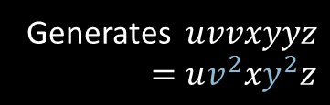












Pumping Lemma – Proof
Pumping Lemma for CFLs: For every CFL $A$, there is a $p$ such that if $s∈A$ and $\left|s\right|≥p$ then $s=uvxyz$ where
1) $uv^{i}xy^{i}z∈A$ for all $i≥0$
2) $vy≠\text{ε}$
3) $\left|vxy\right|≤p$
E
Proof by picture:
E
R
E
R
$$u$$
$$v$$
$$y$$
$$z$$
R
R
R
$$x$$
$$v$$
$$x$$
$$y$$
Generates $uvvxyyz$
$=uv^{2}xy^{2}z$
$$u$$
$$z$$
R
Generates $uxz$
$=uv^{0}xy^{0}z$
$$s=$$
$$u$$
$$v$$
$$x$$
$$y$$
$$z$$
Long $s→$ tall parse tree
“cutting and pasting” argument
4

Slide 53

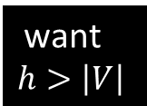
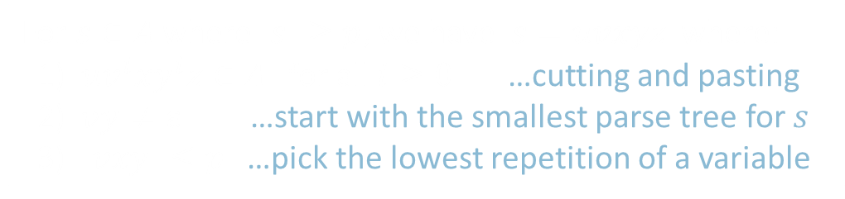








Pumping Lemma – Proof details
For $s∈A$ where $\left|s\right|≥p$, we have $s=uvxyz$ where:
1) $uv^{i}xy^{i}z∈A$ for all $i≥0$ …cutting and pasting
2) $vy≠\text{ε}$ …start with the smallest parse tree for $s$
3) $\left|vxy\right|≤p$ …pick the lowest repetition of a variable
Let $b=$ the length of the longest right hand side of a rule (E $→$ E+T)
$=$ the max branching of the parse tree
Let $h=$the height of the parse tree for $s$.
A tree of height $h$ and max branching $b$ has at most $b^{h}$ leaves.
So $\left|s\right|≤b^{h}$.
Let $p=b^{\left|V\right|}+1$ where $\left|V\right|=$ # variables in the grammar.
So if $\left|s\right|≥p>b^{\left|V\right|}$ then $\left|s\right|>b^{|V|}$ and so $h>\left|V\right|$.
Thus at least $\left|V\right|+1$ variables occur in the longest path.
So some variable $R$ must repeat on a path.
E
E+T
E
want $$h>\left|V\right|$$
R
R
$$s=$$
$$u$$
$$v$$
$$x$$
$$y$$
$$z$$
use $\left|s\right|>b^{\left|V\right|}$
5
set $p=b^{\left|V\right|}+1$

Slide 54







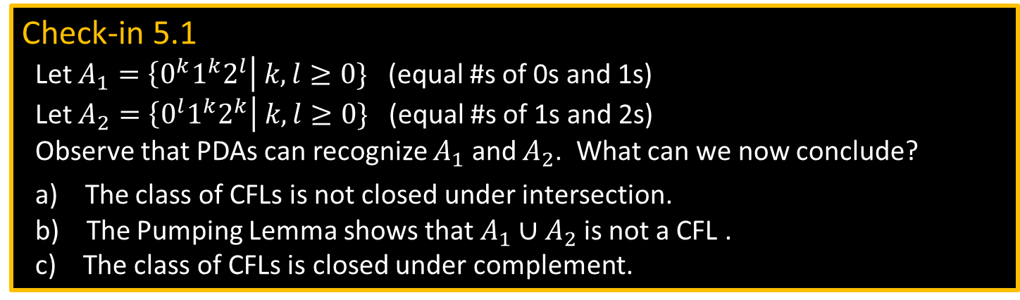


Example 1 of Proving Non-CF
Pumping Lemma for CFLs: For every CFL $A$, there is a $p$ such that if $s∈A$ and $\left|s\right|≥p$ then $s=uvxyz$ where
1) $uv^{i}xy^{i}z∈A$ for all $i≥0$
2) $vy≠\text{ε}$
3) $\left|vxy\right|≤p$
Let $B=\left\{0^{k}1^{k}2^{k}\right| k≥0\}$
Show: $B$ is not a CFL
Proof by Contradiction:
Assume (to get a contradiction) that $B$ is a CFL .
The CFL pumping lemma gives $p$ as above. Let $s=0^{p}1^{p}2^{p}∈B$.
Pumping lemma says that can divide $s=uvxyz$ satisfying the 3 conditions.
Condition 3 ($\left|vxy\right|≤p$) implies that $vxy$cannot contain both 0s and 2s.
So $uv^{2}xy^{2}z$ has unequal numbers of 0s, 1s, and 2s.
Thus $uv^{2}xy^{2}z∉B$, violating Condition 1. Contradiction! Therefore our assumption ($B$ is a CFL) is false. We conclude that $B$ is not a CFL .
Check-in 5.1
Let $A_{1}=\left\{0^{k}1^{k}2^{l}\right| k,l≥0\}$ (equal #s of 0s and 1s)
Let $A_{2}=\left\{0^{l}1^{k}2^{k}\right| k,l≥0\}$ (equal #s of 1s and 2s)
Observe that PDAs can recognize $A_{1}$ and $A_{2}$. What can we now conclude?
a) The class of CFLs is not closed under intersection.
b) The Pumping Lemma shows that $A_{1}∪A_{2}$ is not a CFL .
c) The class of CFLs is closed under complement.
$$s=$$
$$00⋯0011⋯1122⋯22$$
$$u$$
$$v$$
$$x$$
$$y$$
$$z$$
$$≤p$$
6
Check-in 5.1

Slide 55
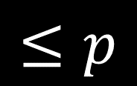










Example 2 of Proving Non-CF
Pumping Lemma for CFLs: For every CFL $A$, there is a $p$ such that if $s∈A$ and $\left|s\right|≥p$ then $s=uvxyz$ where
1) $uv^{i}xy^{i}z∈A$ for all $i≥0$
2) $vy≠\text{ε}$
3) $\left|vxy\right|≤p$
Let $F=\left\{ww\right| w∈Σ^{∗}\} .$ $Σ=\{0,1\}$.
Show: $F$ is not a CFL.
Assume (for contradiction) that $F$ is a CFL.
The CFL pumping lemma gives $p$ as above. Need to choose $s∈F$. Which $s$?
Try $s_{1}=0^{p}10^{p}1∈F$. But $s_{1}$ can be pumped and stay inside $F$. Bad choice of $s$.
Try $s_{2}=0^{p}{1^{p}0}^{p}1^{p}∈F$. Show $s_{2}$ cannot be pumped $s_{2}=uvxyz$ satisfying the 3 conditions.
Condition 3 implies that $vxy$ does not overlap two runs of 0s or two runs of 1s.
Therefore, in $uv^{2}xy^{2}z$, two runs of 0s or two runs of 1s have unequal length.
So $uv^{2}xy^{2}z∉F$ violating Condition 1. Contradiction! Thus $F$ is not a CFL.
$$s_{1}=$$
$$000⋯001000⋯001$$
$$u$$
$$v$$
$$x$$
$$y$$
$$z$$
$$s_{2}=$$
$$0⋯01⋯10⋯01⋯1$$
$$u$$
$$v$$
$$x$$
$$y$$
$$z$$
7

Slide 56
Turing Machines (TMs)
head
a
b
a
b
b
˽
˽
. . .
Finite control
read/write input tape
Head can read and write
Head is two way (can move left or right)
Tape is infinite (to the right)
Infinitely many blanks “˽“ follow input
Can accept or reject any time (not only at end of input)
8

Slide 57

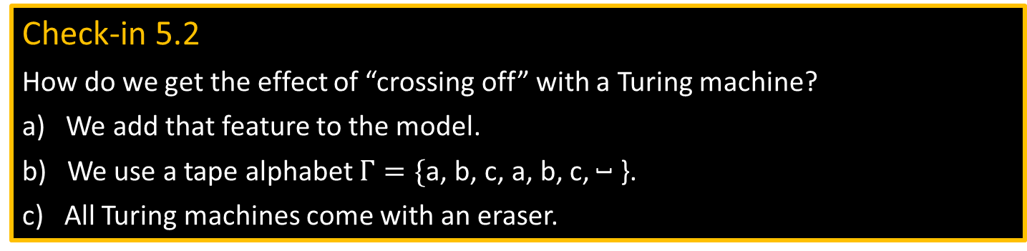
TM – example
TM recognizing $B=\left\{{\text{a}}^{k}{\text{b}}^{k}{\text{c}}^{k} | k≥0\right\}$
Scan right until ˽ while checking if input is in ${\text{a}}^{∗}{\text{b}}^{∗}{\text{c}}^{∗}$, reject if not.
Return head to left end.
Scan right, crossing off single a, b, and c.
If the last one of each symbol, accept.
If the last one of some symbol but not others, reject.
If all symbols remain, return to left end and repeat from (3).
head
input tape
Finite control
a
a
a
b
b
b
c
c
c
˽
˽
accept
Check-in 5.2
How do we get the effect of “crossing off” with a Turing machine?
a) We add that feature to the model.
b) We use a tape alphabet $Γ=\{\text{a}$, $\text{b}$, $\text{c}$, $\text{a}$, $\text{b}$, $\text{c}$, ˽ }.
c) All Turing machines come with an eraser.
9
Check-in 5.2

Slide 58

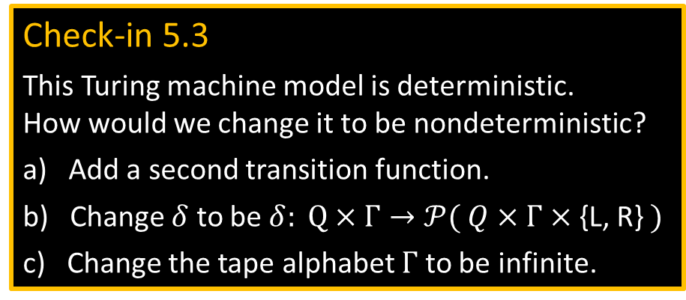

TM – Formal Definition
Defn: A Turing Machine (TM) is a 7-tuple $(Q, Σ, Γ, δ,q_{0}, q\text{acc} , q\text{rej})$
$Σ$ input alphabet
$Γ$ tape alphabet ($Σ⊆Γ$)
$δ: Q×Γ→Q×Γ×$ {L, R} (L = Left, R = Right)
$δ\left(q,\text{a}\right)=(r,\text{b},$ R$)$
On input $w$ a TM $M$ may halt (enter $q\text{acc}$ or $q\text{rej}$) or $M$ may run forever (“loop”).
So $M$ has 3 possible outcomes for each input $w$:
Accept $w$ (enter $q\text{acc}$)
Reject $w$by halting (enter $q\text{rej}$ )
Reject $w$by looping (running forever)
Check-in 5.3
This Turing machine model is deterministic. How would we change it to be nondeterministic?
a) Add a second transition function.
b) Change $δ$ to be $δ: Q×Γ→𝒫( Q×Γ×$ {L, R} $)$
c) Change the tape alphabet $Γ$ to be infinite.
10
Check-in 5.3

Slide 59
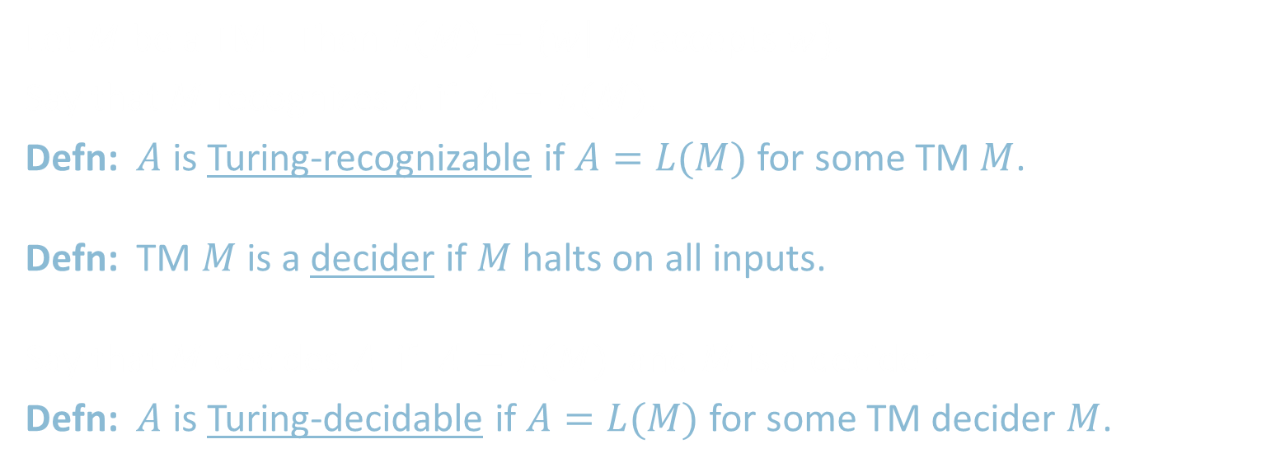
TM Recognizers and Deciders
Let $M$ be a TM. Then $L\left(M\right)=\left\{w\right| M$ accepts $w\}$.
Say that $M$ recognizes $A$ if $A=L(M)$.
Defn: $A$ is Turing-recognizable if $A=L(M)$ for some TM $M$.
Defn: TM $M$ is a decider if $M$ halts on all inputs.
Say that $M$ decides $A$ if $A=L(M)$ and $M$ is a decider.
Defn: $A$ is Turing-decidable if $A=L(M)$ for some TM decider $M$.
T-recognizable
T-decidable
CFLs
regular
11

Slide 60
Quick review
Proved the CFL Pumping Lemma as a tool for showing that languages are not context free.
Defined Turing machines (TMs).
Defined TM deciders (halt on all inputs).
T-recognizable and T-decidable languages.
12

