Slide 1
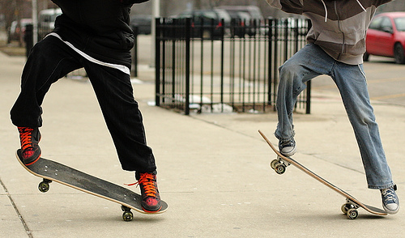


(a) Inputs and vision specialist
(b) Router: five inputs, four states
(c) Budgeted collaboration
Stored
Output
Input image
Trainable
Projection
Image
Linear + LN
Keep
encoder
Hidden state
Concat
Linear + LN
Threshold
2 regions
Set on validation
MLLM example
Prediction
Linear + LN
4-state head
Task text
boxes
MLP · GELU
boxes + valid
fixed
left skateboard
Confidence
Raw logits
and right skater
Linear + LN
Image
Prompt
score + mask
Specialist
Text
MLLM
encoder
Linear + LN
Original image + task prompt
Update
Selected inputs
4-state logits
Offline supervision
Paired correctness
Image / text / MLLM
Data flow
Cached
,
+ ground truth
Four-state label
Loss
Specialist
Call decision
Both correct
Rescue
Harm
Both wrong
Cross-entropy
Trainable router
Offline training
Notes:
gRefCOCO validation example val-73917-203642, image_id 458827. Exact expression: left skateboard and right skater. Input is the original photograph; output overlays the two cached Qwen3.8 detections from the September 9 formal collection. Actual shared-policy validation score -4.980227470397949 is above the saved threshold -5.435944080352783, so this example delegates to the VLM. See sample_evidence.json for source records, ground truth, specialist predictions, VLM output and policy evidence. Five rows are input feature branches (image, specialist hidden state, predicted boxes, confidence, text); the head produces four outcome logits. The four outcome targets are both correct, rescue, harm and both wrong. gRefCOCO, CUB and NLVR2 use one-hot labels, with gRefCOCO correctness judged for the entire expression. Construction alone averages four event states to obtain proportions. All use cross-entropy with natural sampling, no class weighting and no label smoothing. Frozen distilled encoders, branch width 128, 128/GELU head, selected 90-percent specialist layer, and separate weights per pair follow the final shared configuration. The routing statistic is ell_R minus ell_H, with harm coefficient 1. The validation-selected threshold and comparison operator are reused on test. Blue denotes image/text/MLLM paths, green specialist-derived information, amber trainable routing. Solid arrows carry inference data, gray dashed arrows carry the call decision, amber dashed arrows carry offline supervision or parameter updates. The threshold separator is a solid guide, not an arrow. Hidden-state grid colors are a schematic palette from the source photograph, not measured activations. Confidence and feature bars are schematic. The two specialist box outlines and the final VLM localization boxes use their respective actual cached coordinates. Snowflake symbols mark frozen encoders. The unchanged male avatar and the new camera-headed robot are fictional illustrations; the robot was produced by the built-in image generation tool using the male avatar as a style reference. All diagram objects other than the photograph and portraits remain editable native shapes and text.

