Slide 1


UBER BOOKING ANALYSIS
BY. NOHIT HANWAT
USING MYSQL WORKBENCH

Slide 2
PROBLEM STATEMENT
The objective of this project is to analyze Uber booking data using SQL to extract meaningful insights related to ride patterns, customer behavior, driver performance, and revenue generation. The dataset consists of 100,000 records with 19 columns, including details from customer, driver, and ride tables.

Slide 3
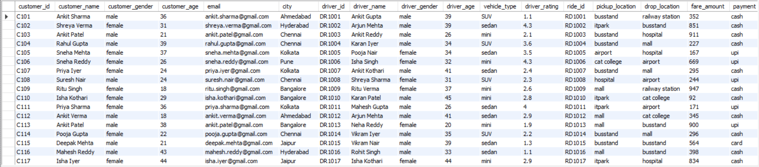
Table Contains
100k Rows
19 Columns

Slide 4
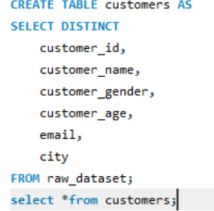
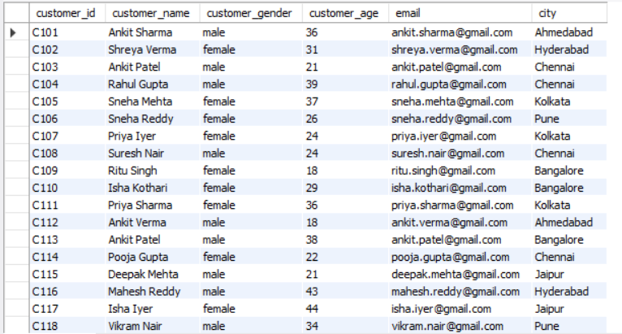
Customer Table

Slide 5
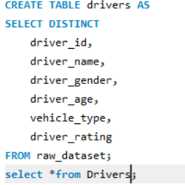
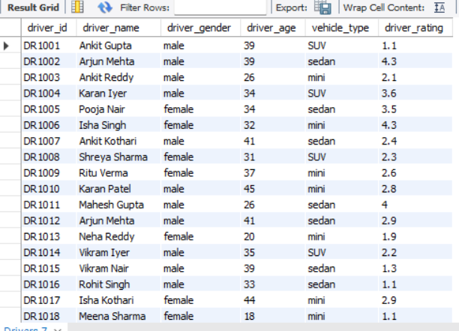
Driver’s Table

Slide 6
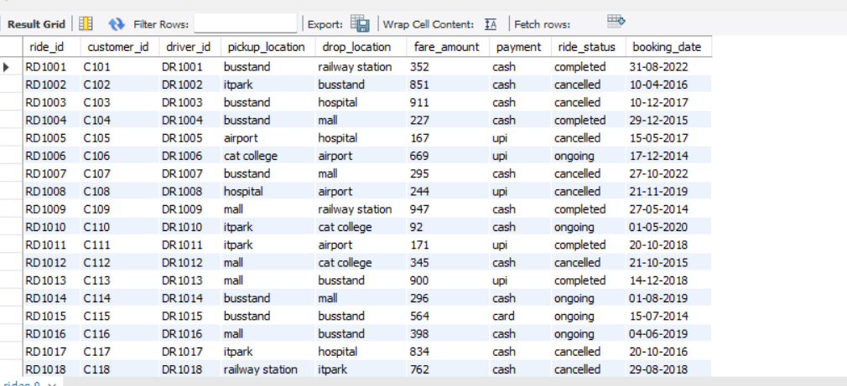
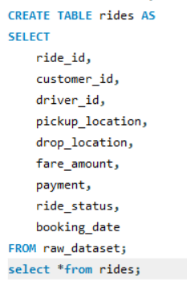
Rides Table

Slide 7

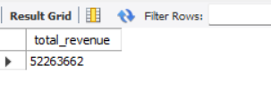
Total Revenue Generated
This SQL query calculates the total revenue by summing the fare amount column using Aggregation Function SUM()

Slide 8
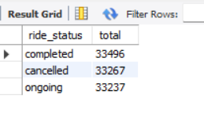
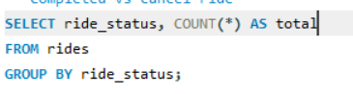
Total Rides by Ride Status
This Query “Counts the number of rides for each ride status by grouping the data on ride_status.”

Slide 9
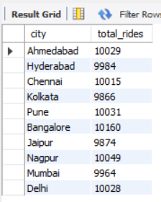
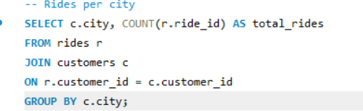
Rides per city
This query shows the total number of rides booked in each city by joining the rides and customers tables and grouping the data by city.

Slide 10
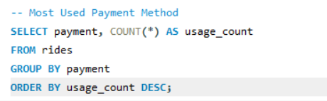
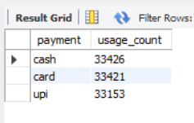
Most Used Payment Method
This query shows which payment method (cash, card, or UPI) is used the most by customers by counting total rides for each payment type.

Slide 11
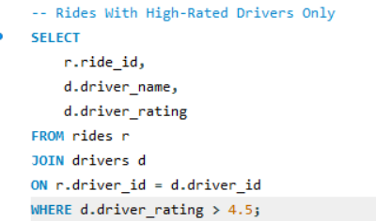
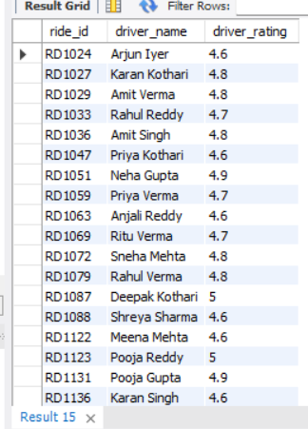
Rides With High-Rated Drivers Only
This query filters rides handled by drivers with ratings above 4.5 using JOIN and WHERE conditions to analyze top driver performance.

Slide 12
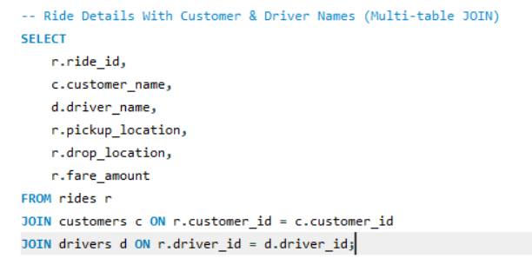
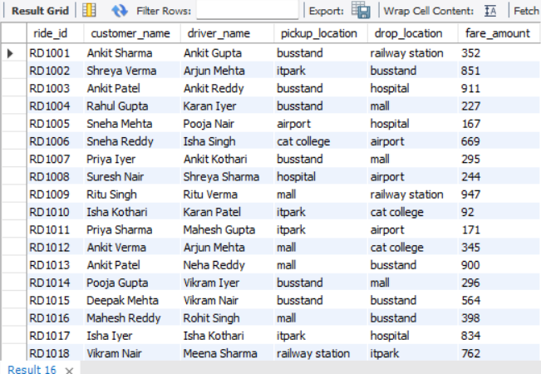
Ride Details With Customer & Driver Names (Multi-table JOIN)
Explanation : This is a 3-table join that shows a full booking record including customer → driver → ride details.

Slide 13
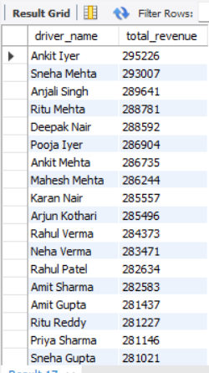
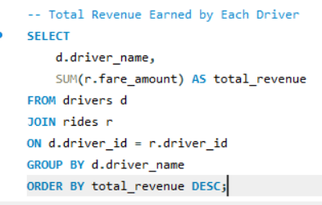
Total Revenue Earned by Each Driver
Explanation : JOIN + SUM() shows how much money each driver earned from all rides.

Slide 14
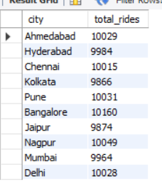
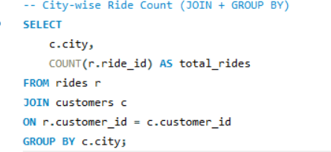
City-wise Ride Count (JOIN + GROUP BY)
Explanation : This tells you which city has the most Uber rides

Slide 15
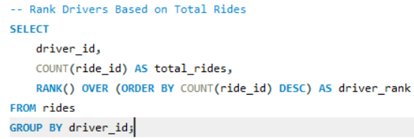
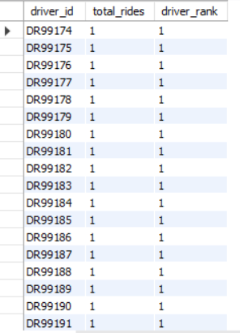
Rank Drivers Based on Total Rides
Explanation : RANK() assigns ranking based on number of rides completed, highest to lowest.

Slide 16
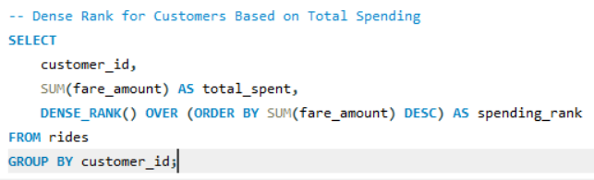
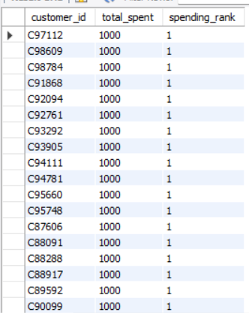
Dense Rank for Customers Based on Total Spending
Explanation : Dense _rank () ranks customers without skipping numbers.

Slide 17
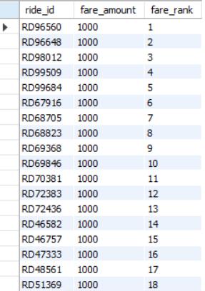
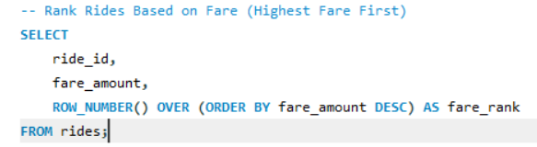
Row _ Number () Rides Based on Fare (Highest Fare First)
Explanation : This assigns row number to rides based on fare amount from highest to lowest.

Slide 18
CONCLUSION
Analyzed Uber booking data using SQL to extract meaningful insights
Identified key metrics such as total revenue, ride trends, and city-wise performance
Determined the most used payment methods
Highlighted top-performing drivers and customers
Used JOINs and window functions to combine and rank data effectively
Demonstrated the role of SQL in real-world data analysis and decision-making

Slide 19
THANK YOU

