Slide 1
repository-naming
there.and.backAgain

Slide 2
There are only two hard things in Computer Science: cache invalidation and naming things.
Phil Karlton

Slide 3
Initial Goals
Our repo names are a mess
Hard to find stuff and understand what pertains to what
We have odh, idm, com, bz.it, java style naming, CamelCase, and even some combinations of the above:
  it.bz.davinci-static-s3
  big-data-for-tourism_KibanaPlugin
Clean this up and define the one true standard

Slide 4


Slide 5
Case study

Slide 6
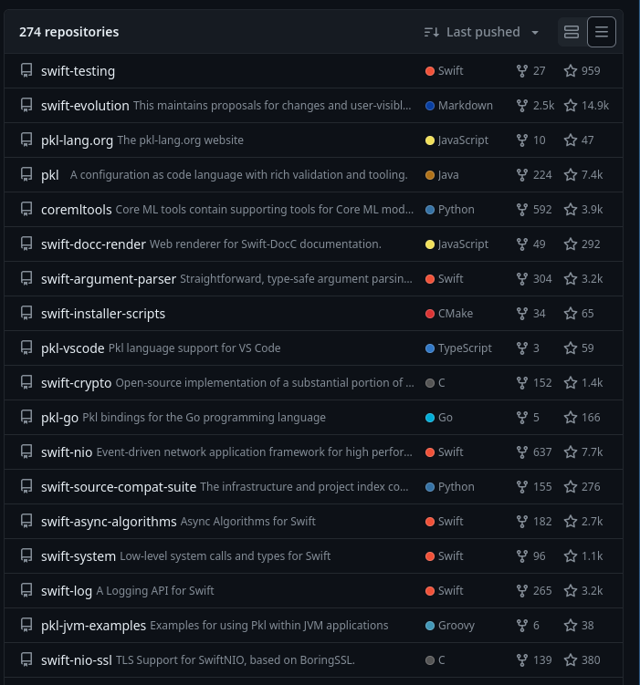
Apple

Slide 7
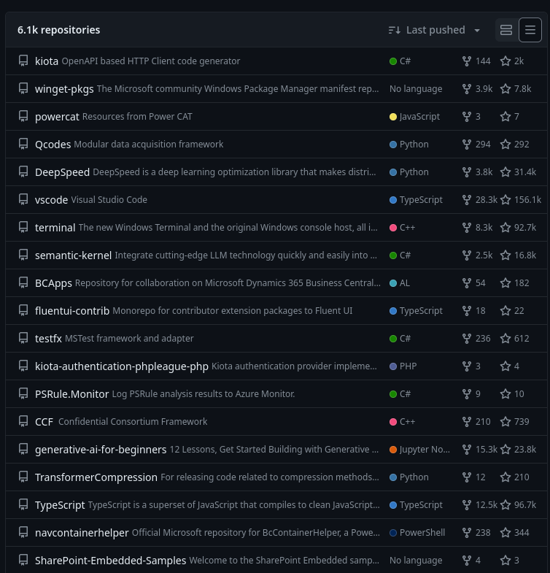
Microsoft

Slide 8
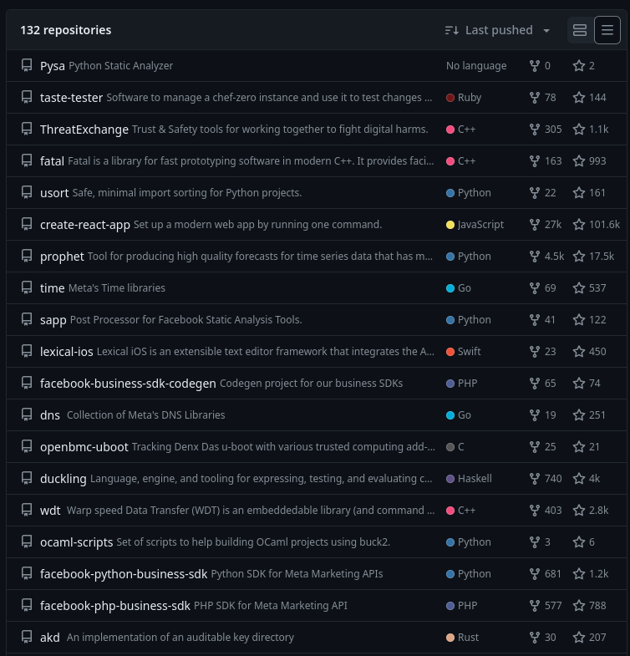
Facebook

Slide 9
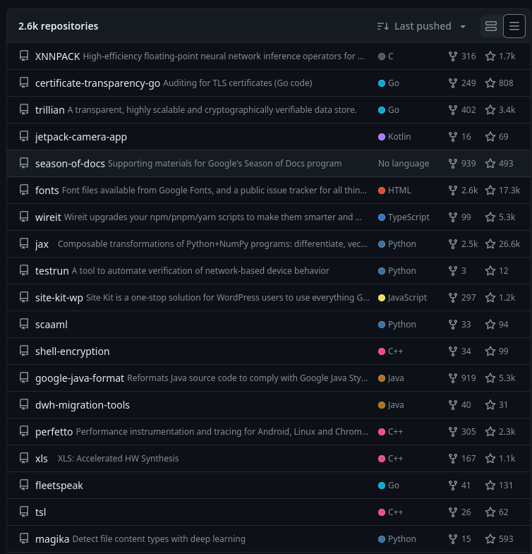
Google

Slide 10
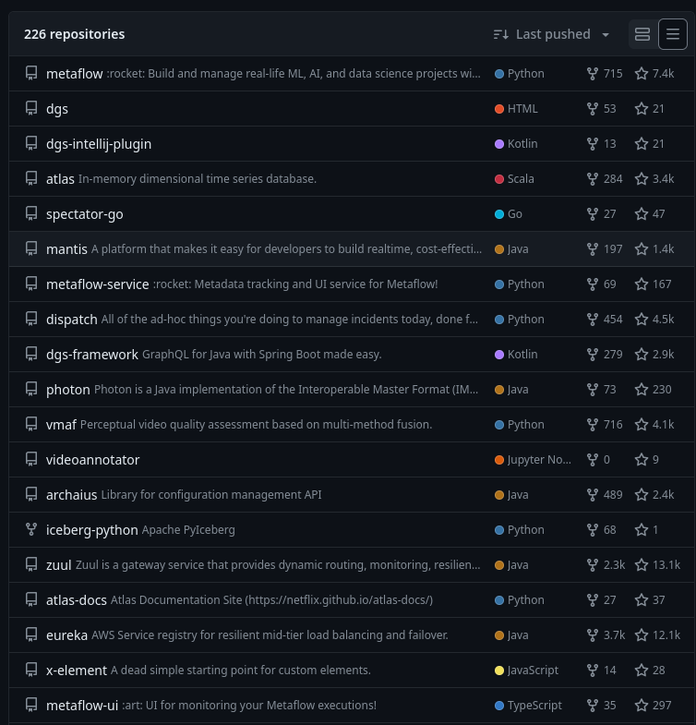
Netflix

Slide 11
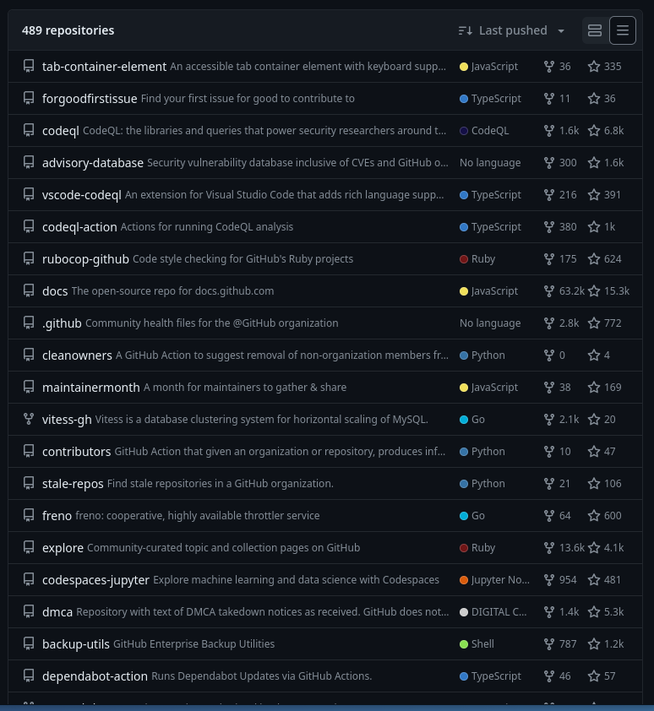
Github

Slide 12
A pattern emerges
Short
Distinctive
Lowercase
Use codenames
Use hyphens to indicate hierarchy
Less is more
Microsoft not respecting standards

Slide 13
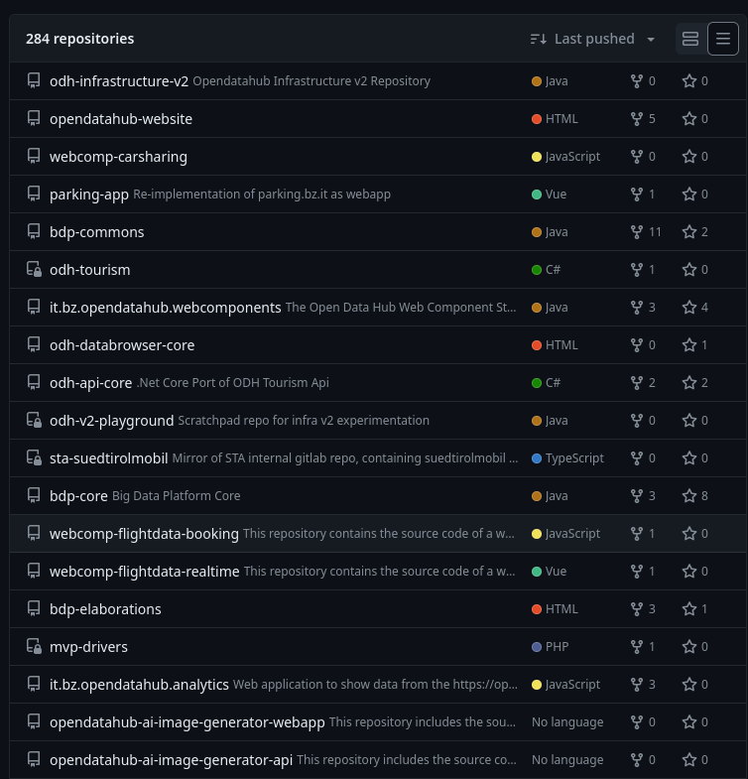
NOI Techpark

Slide 14
Why we shouldn't use a java style naming scheme (anymore)
Nobody big seems to
It adds noise to names and makes them visually harder to parse
Dots in URLs
Hierarchical part will inevitably change (it.bz, idm, bdp, integreen)
Differs starkly from the unwritten convention

Slide 15
Why we probably shouldn't rename
Renaming repos breaks existing links, documentation and sometimes tooling
Code will still not be aligned (package names), perpetuating the confusion
Microsoft doesn't
We're fixing a problem that could be resolved with a proper landing page and documentation

Slide 16
Why code names are good
Don't change with upper-level name changes
Catchy
Allow for replacement without creating confusion (old vs new)
But: should be for technical/internal use only

Slide 17
TL;DR
Embrace codenames for projects
Keep names short and concise
Use lowercase
Use hyphens for multi-word names
For multi-word names: first what it belongs to, then what it is

Slide 18
But what should the actual names be?

Slide 19
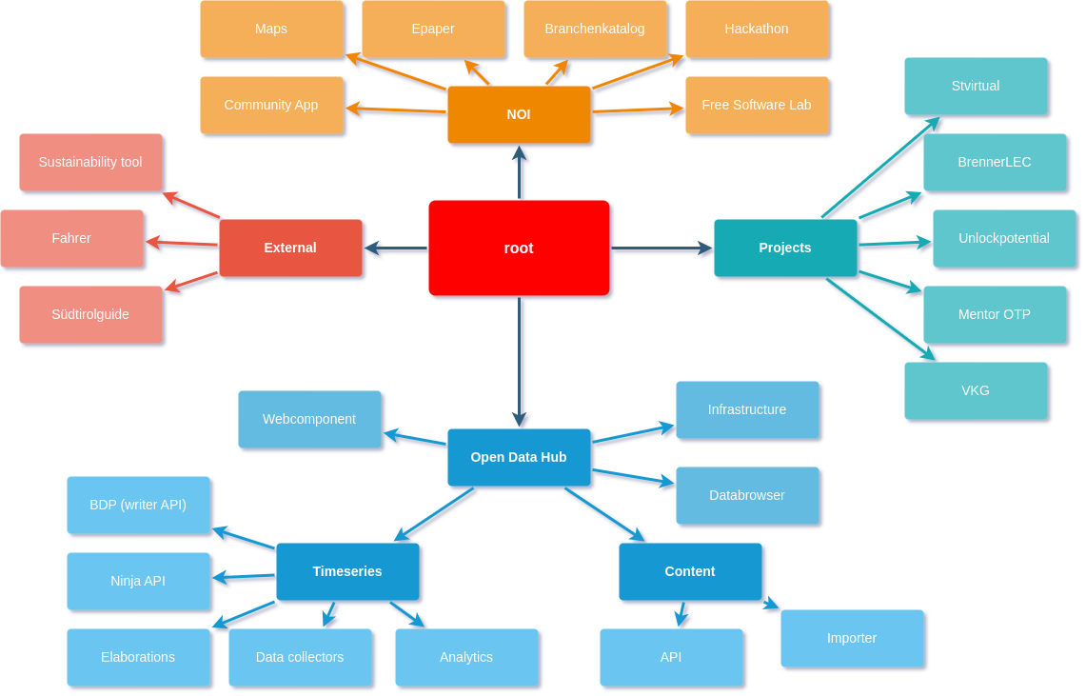

Slide 20
Findings
Mobility domain is now called Timeseries
Tourism domain is now called Content
BDP is now the codename for that generation of writer API
e.g.
Both the Ninja API and BDP writer are part of the timeseries domain
Timeseries data collectors push data to the Open Data Hub using the bdp API
We still have mobility datasets in the timeseries domain
Tourism data is one type of content

