Slide 1
Qualitative predictor variables

Slide 2
Examples of qualitative predictor variables
Gender (male, female)
Smoking status (smoker, nonsmoker)
Socioeconomic status (poor, middle, rich)

Slide 3
An example with one qualitative predictor

Slide 4
On average, do smoking mothers have babies with lower birth weight?
Random sample of n = 32 births.
y = birth weight of baby (in grams)
x₁ = length of gestation (in weeks)
x₂ = smoking status of mother (yes, no)

Slide 5
Coding the two group qualitative predictor
Using a (0,1) indicator variable.
  x_{i2} = 1, if mother smokes
  x_{i2} = 0, if mother does not smoke
Other terms used:
  dummy variable
  binary variable

Slide 6
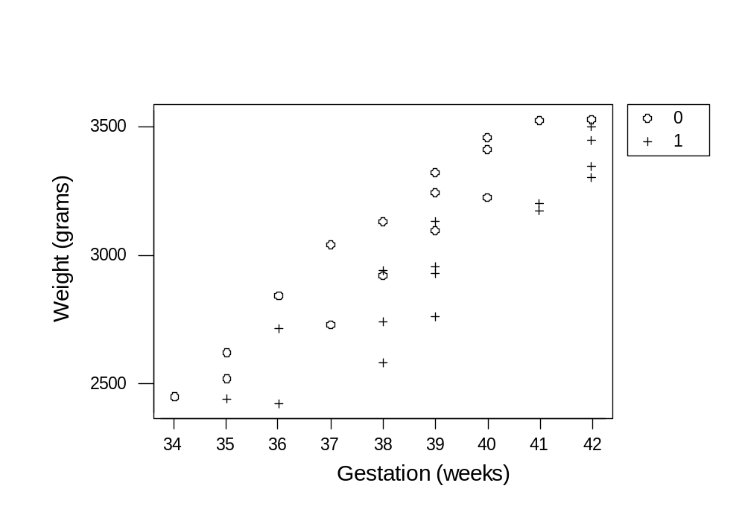
On average, do smoking mothers have babies with lower birth weight?

Slide 7
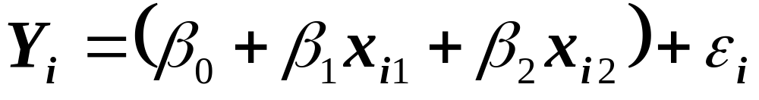
A first order model with one binary predictor
where …
Y_{i} is birth weight of baby i
x_{i1} is length of gestation of baby i
x_{i2} = 1, if mother smokes and x_{i2} = 0, if not
and … the independent error terms _{i} follow a normal distribution with mean 0 and equal variance ².

Slide 8
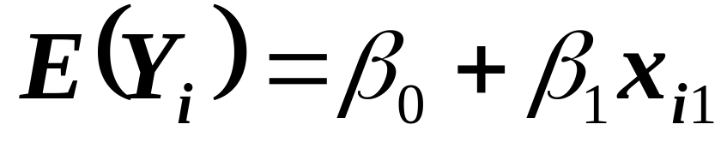
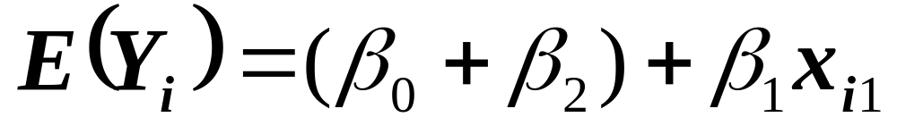
An indicator variable for 2 groups yields 2 response functions
If mother is a nonsmoker (x_{i2} = 0):
If mother is a smoker (x_{i2} = 1):

Slide 9
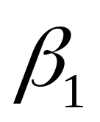
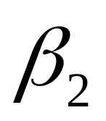
Interpretation of the regression coefficients
represents the change in the mean response E(Y) for every additional unit increase in the quantitative predictor x₁ … for both groups.
represents how much higher (or lower) the mean response function for the second group is than the one for the first group… for any value of x₂.

Slide 10
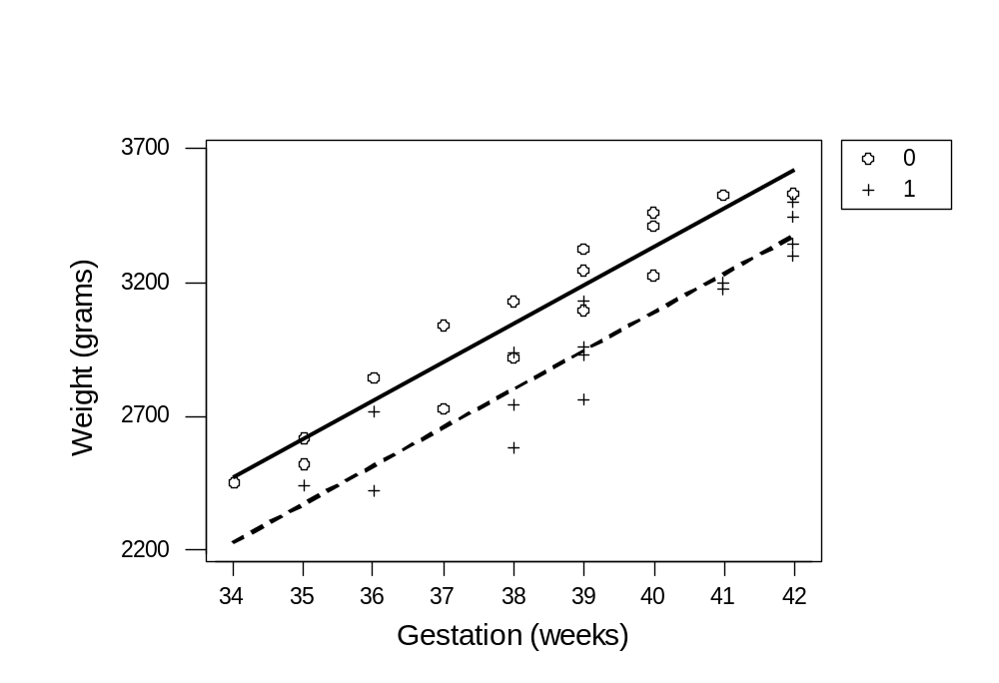


The estimated regression function
The regression equation is
Weight = - 2390 + 143 Gest - 245 Smoking

Slide 11
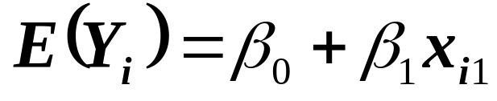
A significant difference in mean birth weights for the two groups?
The regression equation is
Weight = - 2390 + 143 Gest - 245 Smoking
Predictor Coef SE Coef T P
Constant -2389.6 349.2 -6.84 0.000
Gest 143.100 9.128 15.68 0.000
Smoking -244.54 41.98 -5.83 0.000
S = 115.5 R-Sq = 89.6% R-Sq(adj) = 88.9%

Slide 12
Why not instead fit two separate regression functions?

Slide 13
Using indicator variable, fitting one function to 32 data points
The regression equation is
Weight = - 2390 + 143 Gest - 245 Smoking
Predictor Coef SE Coef T P
Constant -2389.6 349.2 -6.84 0.000
Gest 143.100 9.128 15.68 0.000
Smoking -244.54 41.98 -5.83 0.000
S = 115.5 R-Sq = 89.6% R-Sq(adj) = 88.9%

Slide 14
Using indicator variable, fitting one function to 32 data points
Analysis of Variance
Source DF SS MS F P
Regression 2 3348720 1674360 125.45 0.000
Residual Error 29 387070 13347
Total 31 3735789
Predicted Values for New Observations
New Obs Fit SE Fit 95.0% CI 95.0% PI
1 2803.7 30.8 (2740.6, 2866.8) (2559.1, 3048.3)
2 3048.2 28.9 (2989.1, 3107.4) (2804.7, 3291.8)
Values of Predictors for New Observations
New Obs Gest Smoking
1 38.0 1.00
2 38.0 0.00

Slide 15
Fitting function to 16 nonsmokers
The regression equation is
Weight = - 2546 + 147 Gest
Predictor Coef SE Coef T P
Constant -2546.1 457.3 -5.57 0.000
Gest 147.21 11.97 12.29 0.000
S = 106.9 R-Sq = 91.5% R-Sq(adj) = 90.9%

Slide 16
Fitting function to 16 nonsmokers
Analysis of Variance
Source DF SS MS F P
Regression 1 1728172 1728172 151.14 0.000
Residual Error 14 160082 11434
Total 15 1888254
Predicted Values for New Observations
New Obs Fit SE Fit 95.0% CI 95.0% PI
1 3047.7 26.8 (2990.3, 3105.2) (2811.3, 3284.2)
Values of Predictors for New Observations
New Obs Gest
1 38.0

Slide 17
Fitting function to 16 smokers
The regression equation is
Weight = - 2475 + 139 Gest
Predictor Coef SE Coef T P
Constant -2474.6 554.0 -4.47 0.001
Gest 139.03 14.11 9.85 0.000
S = 126.6 R-Sq = 87.4% R-Sq(adj) = 86.5%

Slide 18
Fitting function to 16 smokers
Analysis of Variance
Source DF SS MS F P
Regression 1 1554776 1554776 97.04 0.000
Residual Error 14 224310 16022
Total 15 1779086
Predicted Values for New Observations
New Obs Fit SE Fit 95.0% CI 95.0% PI
1 2808.5 35.8 (2731.7, 2885.3) (2526.4, 3090.7)
Values of Predictors for New Observations
New Obs Gest
1 38.0

Slide 19
Reasons to “pool” the data and to fit one regression function
Model assumes equal slopes for the groups and equal variances for all error terms. It makes sense to use all data to estimate these quantities.
More degrees of freedom associated with MSE, so confidence intervals that are a function of MSE tend to be narrower.

Slide 20
What if instead used two indicator variables?

Slide 21
Definition of two indicator variables – one for each group
Using a (0,1) indicator variable for nonsmokers
  x_{i2} = 1, if mother smokes
  x_{i2} = 0, if mother does not smoke
Using a (0,1) indicator variable for smokers
  x_{i3} = 1, if mother does not smoke
  x_{i3} = 0, if mother smokes

Slide 22
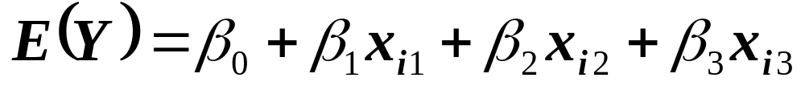
The modified regression function with two binary predictors
where …
Y_{i} is birth weight of baby i
x_{i1} is length of gestation of baby i
x_{i2} = 1, if smokes and x_{i2} = 0, if not
x_{i3} = 1, if not smokes and x_{i3} = 0, if smokes

Slide 23
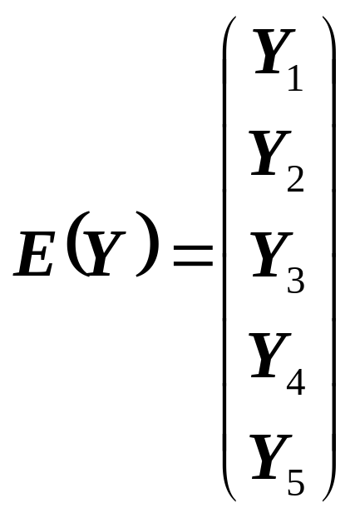
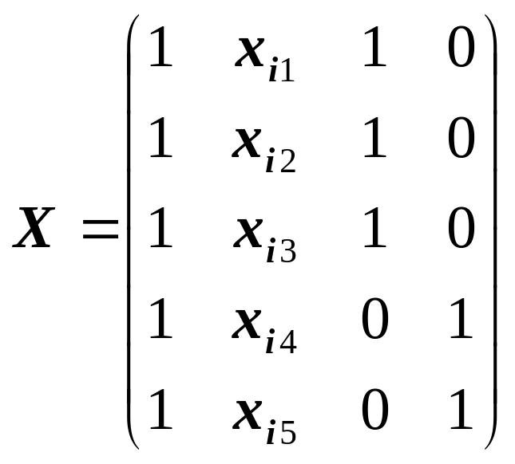
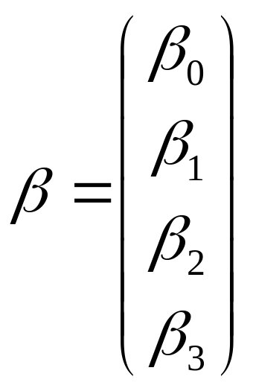
Implication on X matrix

Slide 24
To prevent linear dependencies in the X matrix
A qualitative variable with c groups should be represented by c-1 indicator variables, each taking on values 0 and 1.
  2 groups, 1 indicator variables
  3 groups, 2 indicator variables
  4 groups, 3 indicator variables
  and so on…

Slide 25
What is impact of using a different coding scheme?
… such as (1, -1) coding?

Slide 26
The regression model defined using (1, -1) coding scheme
where …
Y_{i} is birth weight of baby i
x_{i1} is length of gestation of baby i
x_{i2} = 1, if mother smokes and x_{i2} = -1, if not
and … the independent error terms _{i} follow a normal distribution with mean 0 and equal variance ².

Slide 27
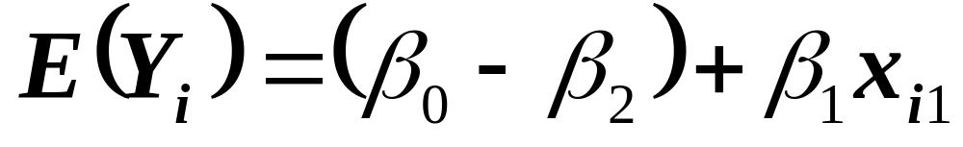
The regression model yields
2 different response functions
If mother is a nonsmoker (x_{i2} = -1):
If mother is a smoker (x_{i2} = 1):

Slide 28
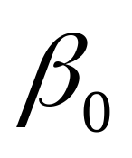

Interpretation of the regression coefficients
represents the change in the mean response E(Y) for every additional unit increase in the quantitative predictor x₁ … for both groups.
represents the “average” intercept
represents how far each group is “offset” from the “average”

Slide 29
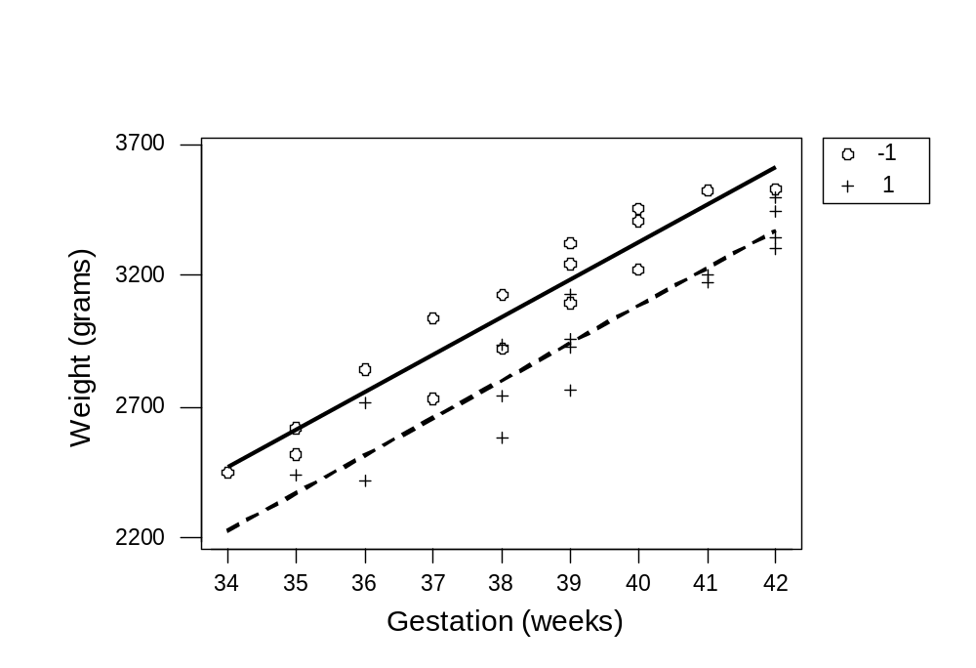
The estimated regression function
The regression equation is
Weight = - 2512 + 143 Gest - 122 Smoking2

Slide 30
What is impact of using different coding scheme?
Interpretation of regression coefficients changes.
When interpreting others results, make sure you know what coding scheme was used.

Slide 31
An example where including an interaction term is appropriate

Slide 32
Compare three treatments (A, B, C) for severe depression
Random sample of n = 36 severely depressed individuals.
y = measure of treatment effectiveness
x₁ = age (in years)
x₂ = 1 if patient received A and 0, if not
x₃ = 1 if patient received B and 0, if not

Slide 33
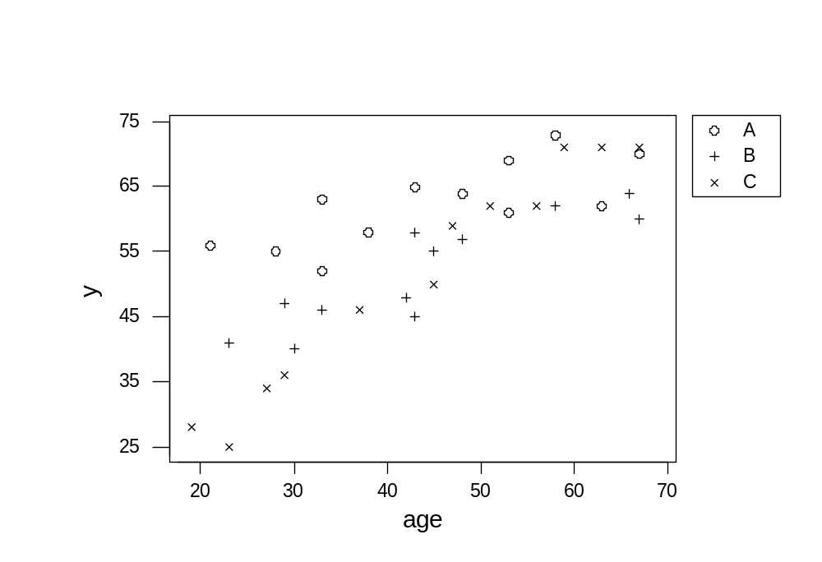
Compare three treatments (A, B, C) for severe depression

Slide 34
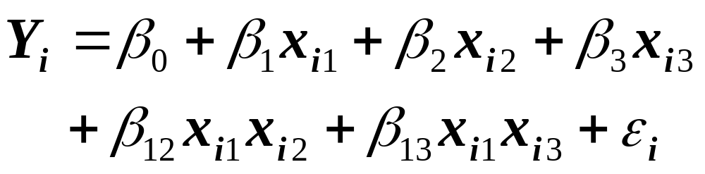
A model with interaction terms
where …
Y_{i} is treatment effectiveness for patient i
x_{i1} is age of patient i
x_{i2} = 1, if treatment A and x_{i2} = 0, if not
x_{i3} = 1, if treatment B and x_{i3} = 0, if not

Slide 35
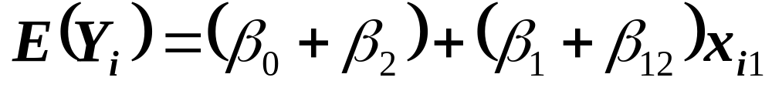
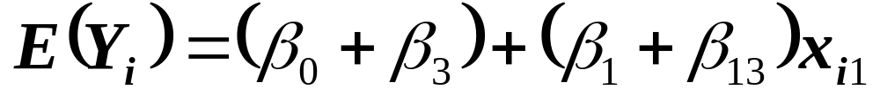

Two indicator variables for 3 groups yield 3 response functions
If patient received A (x_{i2} = 1, x_{i3} = 0):
If patient received B (x_{i2} = 0, x_{i3} = 1):
If patient received C (x_{i2} = 0, x_{i3} = 0):

Slide 36
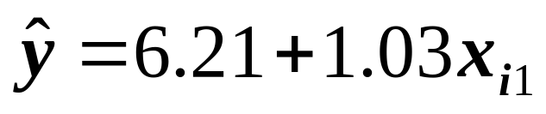
The estimated regression function
The regression equation is
y = 6.21 + 1.03age + 41.3x2 + 22.7x3 - 0.703agex2 - 0.510agex3
If patient received A (x_{i2} = 1, x_{i3} = 0):
If patient received B (x_{i2} = 0, x_{i3} = 1):
If patient received C (x_{i2} = 0, x_{i3} = 0):

Slide 37
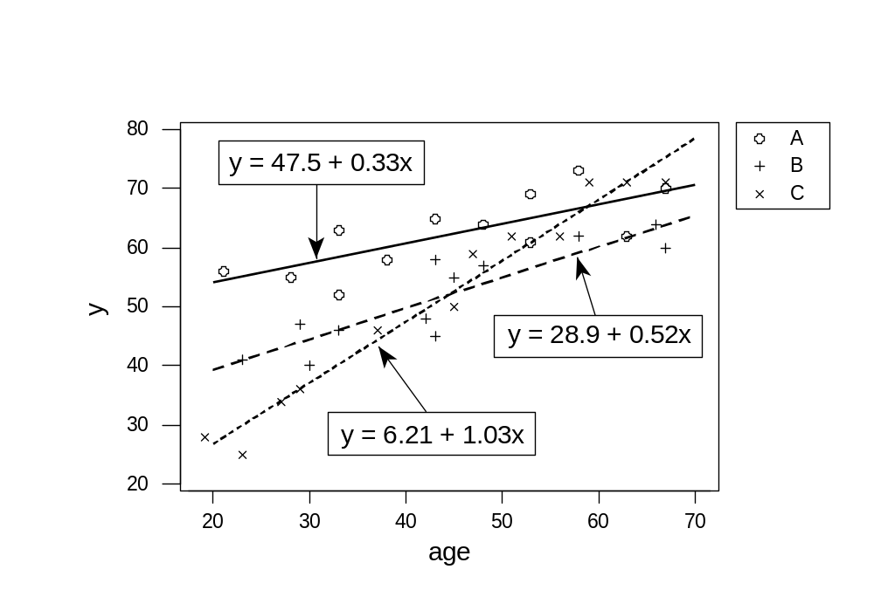
The estimated regression function

Slide 38
How to test whether the three regression functions are identical?
If patient received A (x_{i2} = 1, x_{i3} = 0):
If patient received B (x_{i2} = 0, x_{i3} = 1):
If patient received C (x_{i2} = 0, x_{i3} = 0):

Slide 39
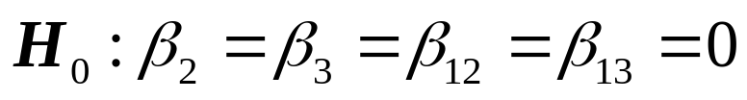
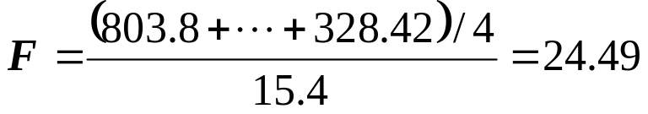
Test for identical regression functions
Analysis of Variance
Source DF SS MS F P
Regression 5 4932.85 986.57 64.04 0.000
Residual Error 30 462.15 15.40
Total 35 5395.00
Source DF Seq SS
age 1 3424.43
x2 1 803.80
x3 1 1.19
agex2 1 375.00
agex3 1 328.42
F distribution with 4 DF in numerator and 30 DF in denominator
x P( X <= x )
24.4900 1.0000

Slide 40
How to test whether there is a significant interaction effect?
If patient received A (x_{i2} = 1, x_{i3} = 0):
If patient received B (x_{i2} = 0, x_{i3} = 1):
If patient received C (x_{i2} = 0, x_{i3} = 0):

Slide 41
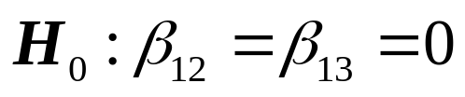
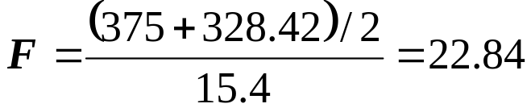
Test for significant interaction
Analysis of Variance
Source DF SS MS F P
Regression 5 4932.85 986.57 64.04 0.000
Residual Error 30 462.15 15.40
Total 35 5395.00
Source DF Seq SS
age 1 3424.43
x2 1 803.80
x3 1 1.19
agex2 1 375.00
agex3 1 328.42
F distribution with 2 DF in numerator and 30 DF in denominator
x P( X <= x )
22.8400 1.0000

