Slide 1
CS 4700 / CS 5700 Network Fundamentals
Lecture 1: Logistics
(a.k.a., setting the ground rules)

Slide 2
Hello!
Welcome to CS 4700 / CS 5700
Are you in the right classroom?
Okay, good.
Who am I?
Professor David Choffnes
choffnes@ccs.neu.edu
West Village H 256
Office Hours: 10am-11am Tuesdays (WVH 256)
Is it 10am-11am on Tuesday?
YES: Feel free to interrupt me and come on in
NO: Urgent? E-mail the TAs. Personal? E-mail me.

Slide 3
Anti-Social Media
Don’t friend me on Facebook
It’s nothing personal
Follow me on Twitter: @proffnes
Pure, unadulterated self-promotion
LinkedIn: I probably won’t add you, so please don’t ask

Slide 4
Your TAs
TAs
Archit Mathur
Salim Ali Siddiq
Prathameth Kirloskar
Email: cs5700sp17-staff@ccs.neu.edu
Office Hours
Wednesday, Friday 2-4pm
WVH Lab Area (but check Piazza for updates)

Slide 5
Why Take This Course?
What else are you doing today between 6-9pm?
How many of you have checked your e-mail, FB, text…
Today?
In the past hour?
Since I started talking?

Slide 6



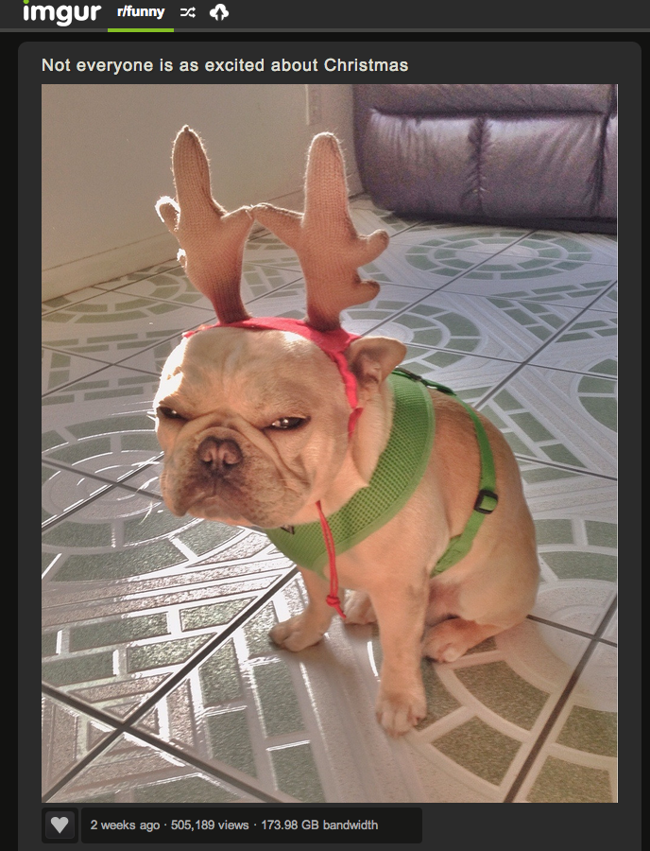

Computer networks are ubiquitous
Networks touch every part of our daily life
Web search
Social networking
Watching movies
Ordering merchandise
Wasting time

Slide 7
Computer networks are ubiquitous
Networking is one of the most critical topics in CS
There would be no…
Big Data
Cloud
Apps or Mobile Computing
Streaming video
WoW
Social Networks
VoIP
…
… without networks

Slide 8
Other reasons to take the class
I’m doing research in this area
I love what I do, and love to tell you about it
I’m going to integrate both classical and new material
Getting a good job
Manager of one of Amazon’s core services (think S3, EC2): “Can I take this class?”
Akamai Manager: “I think your CDN project should be required each new hire for their first 3 months”
Google Manager: “This is really cool.”

Slide 9
Goals
Fundamental understanding about computer networks
All the way from bits on a wire…
… across the ever-evolving Internet…
… to a distributed applications
Focus on software and protocols
Not hardware
Minimal theory
Project-centric, hands on experience
Programming APIs
Network Simulation
Application-level protocols
Globally distributed systems

Slide 10
Online Resources
http://david.choffnes.com/classes/cs4700sp17
Class forum is on Piazza
Sign up today!
Install their iPhone/Android app
When in doubt, post to Piazza
Piazza is preferable to email
If you e-mail me a question, I will tell you to post it on Piazza
Use folders (homework1, lecture2, project3, etc.)

Slide 11
Misnomer
“Fundamentals of Computer Networking”
It’s true, I cover fundamentals
But I’m going to cover much, much more
Perspective
Core fundamentals are essential for working in an networked world
However, what you do with the network is far more interesting than the network itself

Slide 12
Schedule Overview
Jan 11 | Intro, History, Network Architecture
Jan 18 | Physical Layer, Data Link Layer
Jan 25 | Bridging, Network Layer
Feb 1 | Intra-domain Routing, Inter-domain Routing
Feb 8 | Transport Layer, Congestion Control
Feb 15 | DNS, NAT, QoS
Feb 22 | CDNs, IXPs
Mar 1 | Midterm
Mar 8 | No lecture, Spring Break
Mar 15 | Overlay Networks (P2P, BitTorrent)
Mar 22 | Data center networks
Mar 29 | Mobile Networks, Software Defined Networks
Apr 5 | Internet Privacy, Security and Anonymous Communications
Apr 12 | Review/make-up
Apr 19 | Final

Slide 13
Teaching Style
3 hour lectures
Breaks every hour… ish.
I am a network researcher
Things make sense to me that may not make sense to you
I talk fast if nobody stops me
Solution: ask questions!
Seriously, ask questions (interrupting me is OK!)
Standing up here in silence is very awkward
I will stand here until you answer my questions
Help me learn your names
Say your name before each question

Slide 14


Textbook
Computer Networks: A Systems Approach
Peterson and Davie
5th Edition

Slide 15
Workload
Projects (5) | 4%, 8%, 12%, 16%, and 20% (respectively)
Midterm | 15%
Final | 20%
Participation | 5%

Slide 16
Projects
This course is project-centric
Designed to give you real networking experience
Start early!
Seriously, start early!
5 projects
Due at 11:59:59pm on Tuesday of specified week
Use turn-in scripts to submit your code, documentation, etc.
Working code is critical

Slide 17
Project Logistics
Languages
Project 3 will be in TCL/NS2
You may choose the language for the other projects
Code must compile on the CCIS Linux machines
Project 1 is out now (MS only)
Project questions?
Post them on Piazza!

Slide 18
Project Groups
Projects will be completed in groups of two (except Proj 1)
Unless we have odd numbers…
Don’t mix undergrads/MS/PhD (different grading scale)
Partner selection
Pick whoever you want
You may switch partners between projects
Do not complain to me about your lazy partner
Hey, you picked them
Can’t find a partner?
Post a message on Piazza!

Slide 19
Late Policy
Each student is given 4 slip days that they can use at any time to extend a deadline
You don’t need to ask me, just turn-in stuff late
All group members must have unused slip days
i.e. if one member has zero slip days left, the whole group is late
Assignments are due at 11:59:59, no exceptions
1 second late = 1 hour late = 1 day late
20% off per day late

Slide 20
Paper Reading
You will read lots of papers in this class
Some are classics, foundations of existing networks
Others propose newer, more advanced designs
List of papers are on the website
2+ papers per week
If you have questions about them, ask on Piazza
Questions about these papers will be on
In-class exercises
Exams

Slide 21
Participation Grade
Two people will be randomly assigned to lead discussion of each paper
One person is the champion
One person is the critic
Leaders will post summaries and discussion to Piazza
A couple paragraphs summarizing the problem, the approach to solving it, and key results
Champions: defend the solution, talk about why this paper is important
Critics: point out shortcomings, and discuss alternative approaches
Participation is 5% of your grade
Discussion leads will be posted on Piazza shortly

Slide 22
In Class Participation
This is a senior/masters level course
I’m not taking attendance
…but you will want to show up
In-class exercises:
Meant to test knowledge of papers, prepare for exams
Each lecture, at a fairly random time, I will distribute exercises
Points awarded only to students who attend class
At least one group will be asked to present their answer
This will account for most of the participation grade

Slide 23
Exams
Midterm and Final
3 hours, in class
The final will be cumulative
All exams are:
Closed book, closed notes, leave the laptop at home
If I see a smartphone, I will take it and use it for research
Reproducing figures from lectures will earn a 0
Two students with the exact same figure will get a 0

Slide 24
Exams (cont)
Guessing is strongly discouraged
You get 20% of points for leaving a question blank
0% if you have both a right answer and a wrong answer

Slide 25
Final Grades
At the end of the semester, all of your grades will sum to 100 points
4 + 8 + 12 + 16 + 20 + 15 + 20 + 5 = 100
Final grades are based on a simple scale:
A >92, A- 90-92, B+ 87-89, B 83-86, B- 80-82, …
I don’t curve grades
Projects
Exams
Participation

Slide 26
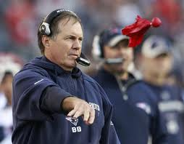
Grade Changes
Each student gets two challenges
Modeled after NFL system
If you ask for a regrade and you are wrong, you lose a challenge
When you are out of challenges, you cannot ask for regrading
Must come to office hours with the following in writing:
Specify the problem(s) you want regraded
For each problem, explain why the grade is in error
Don’t sweat the small stuff
Regrading does not make me a happy Professor
If the change is <5% of the grade, don’t bother
More details on the website

Slide 27
Cheating
Do not do it
Seriously, don’t make me say it again
Cheating is an automatic zero
I will send any and all suspects to OSCCR without exception
CCIS is also tracking cheating, with stricter enforcement
Project code must be original
You and your groupmates only
Unless we give you starter code, obviously
StackOverflow/Quora are not your friends
Copying from public Githubs will get you an F grade
If you have questions about an online resource, ask us

Slide 28
Questions?

