Slide 1
CS 4700 / CS 5700 Network Fundamentals
Lecture 5: Physical Layer
(The layer for EE majors…)
Revised 1/25/16

Slide 2
Physical Layer
Function:
Get bits across a physical medium
Key challenge:
How to represent bits in analog
Ideally, want high-bit rate
But, must avoid desynchronization
Application
Presentation
Session
Transport
Network
Data Link
Physical

Slide 3
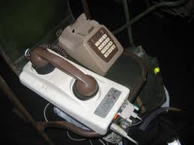
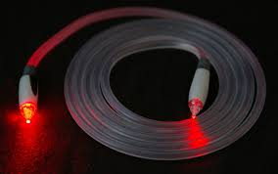
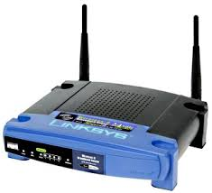

Let’s get ditigal
Digital computers
0s and 1s
Analog world
Amplitudes and frequencies

Slide 4
Assumptions
We have two discrete signals, high and low, to encode 1 and 0
Transmission is synchronous, i.e. there is a clock that controls signal sampling
Amplitude and duration of signal must be significant
Sample
Time

Slide 5
Non-Return to Zero (NRZ)
1 → high signal, 0 → low signal
0
0
1
0
1
0
1
1
0
0
NRZ
Clock
Problem: long strings of 0 or 1 cause desynchronization
How to distinguish lots of 0s from no signal?
How to recover the clock during lots of 1s?

Slide 6
Desynchronization
Problem: how to recover the clock during sequences of 0’s or 1’s?
0
1
1
1
1
1
1
1
1
0
NRZ
0
1
1
1
1
1
1
1
0
Transitions signify clock ticks
Receiver misses a 1 due to skew

Slide 7
Non-Return to Zero Inverted (NRZI)
1 → make transition, 0 → remain the same
0
0
1
0
1
0
1
1
0
0
NRZI
Clock
Solves the problem for sequences of 1s, but not 0s

Slide 8
4-bit/5-bit (100 Mbps Ethernet)
Observation: NRZI works as long as no sequences of 0
Idea: encode all 4-bit sequences as 5-bit sequences with no more than one leading 0 and two trailing 0
Tradeoff: efficiency drops to 80%
8-bit / 10-bit used in Gigabit Ethernet
4-bit 5-bit
4-bit 5-bit
0000 11110
0001 01001
0010 10100
0011 10101
0100 01010
0101 01011
0110 01110
0111 01111
1000 10010
1001 10011
1010 10110
1011 10111
1100 11010
1101 11011
1110 11100
1111 11101

Slide 9
Manchester
1 → high-to-low, 0 → low-to-high
0
0
1
1
0
NRZI
Clock
Good: Solves clock skew (every bit is a transition)
Bad: Halves throughput (two clock cycles per bit)

Slide 10
General comment
Physical layer is the lowest, so…
We tend not to worry about where to place functionality
There aren’t other layers that could interfere
We tend to care about it only when things go wrong
Physical layer characteristics are still fundamentally important to building reliable Internet systems
Insulated media vs, wireless
Packet vs. circuit switched media
Propagation speed, energy consumption, cost, …

