Slide 1
2019 fall final project (done)
Team member: B08901072 王友廷
B08901156 何明翰
B08901107 詹景翔

Slide 2
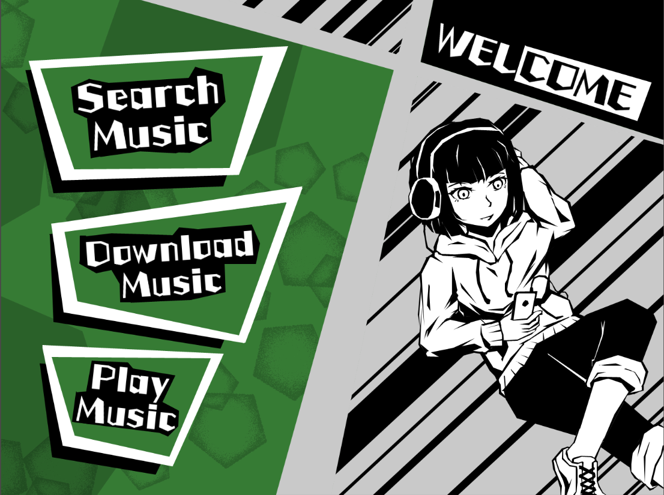
Our topic…
Design a YouTube mp3 downloader and player
presenting with GUI
Our Result (Main Page)

Slide 3
Main Method
Selenium —— realize automatic browsing with Python.
In order to satisfy users’ demands, we have these functions as follows:
Single download : Paste video’s url to our downloader and download.
Playlist : Paste video’s url which is belong to specific playlist, users can choose among them and download.
Search : Input keyword and search Top 20 most popular video related to keyword, users can choose among them and download.
Player : Play what you download beforehand.

Slide 4
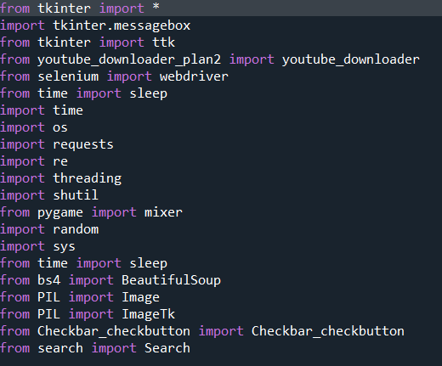
Subsidiary Method
Tkinter —— customizing primitive GUI with Python
Pygame —— play music with Python
You have known them before

Slide 5
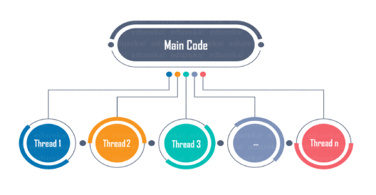
Module intro —— Threading
Threading is a powerful module enabling you to capitalize on your CPU to the greatest, with multithreading(多執行緒) or multiprocessing which comes from parallel computing, you can do lots of cool things like:
Write a program running behind the background while the others working
Write a event-listener-like program, to check the program state and respond accordingly
Threading can communicate with each other by exchange data in Queue(佇列)

Slide 6
Module intro —— PIL(pillow)
PIL(Python Image Library) is a powerful image processing library, providing many functions which can collect photo’s information, transform and store photo even change photo’s format.
In our project, we introduce two function:
Image: it can open and resize photo which we locate with absolute path in computer.
ImageTk: it connect with Tkinter and even can replace Tkinter’s PhotoImage function.

Slide 7
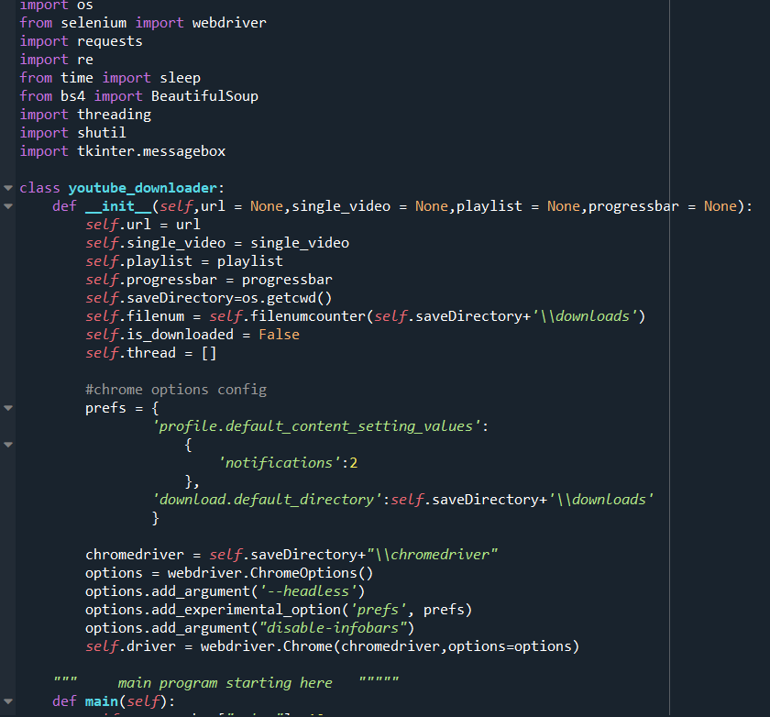
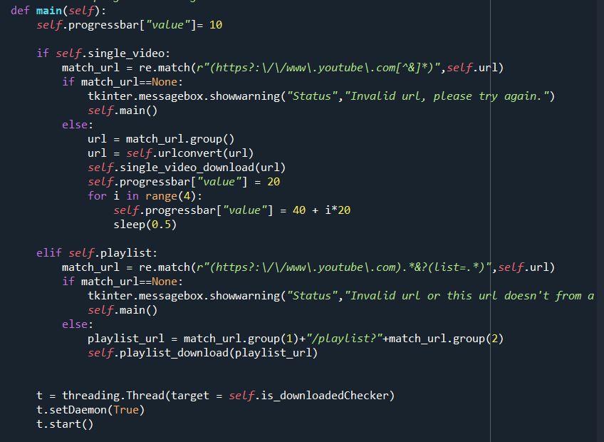
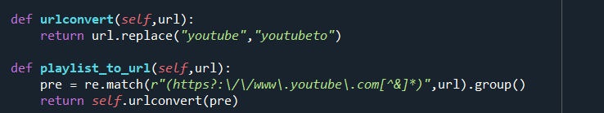
Program Detail

Slide 8
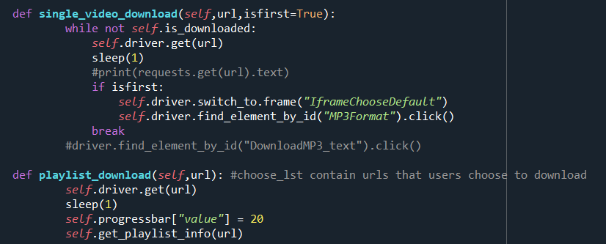
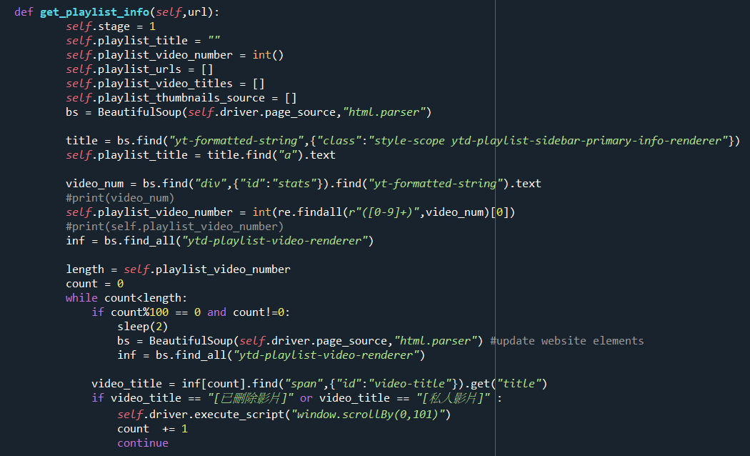
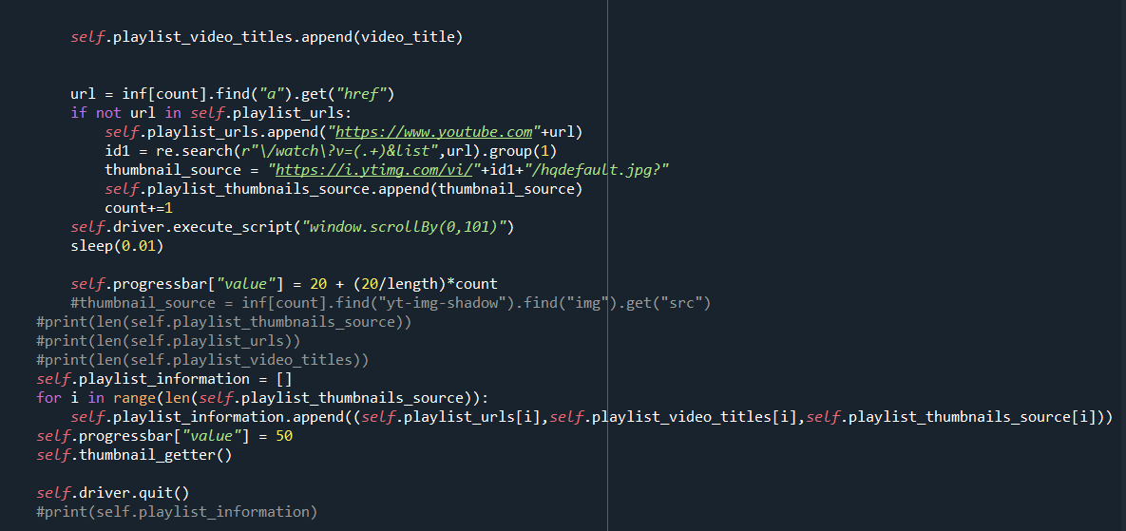

Slide 9
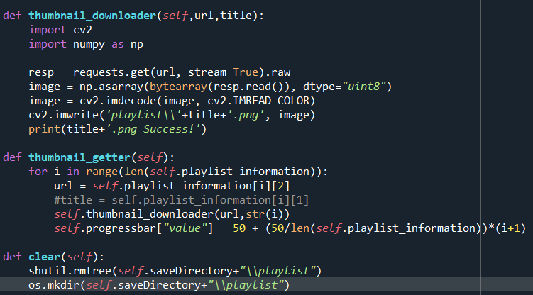
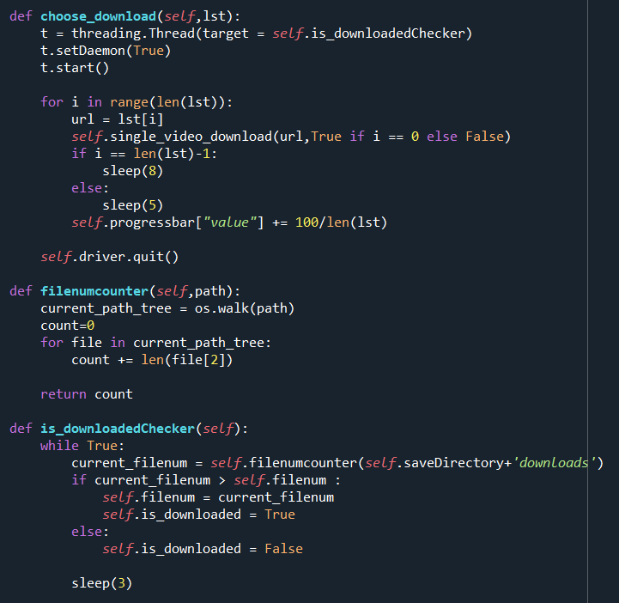

Slide 10
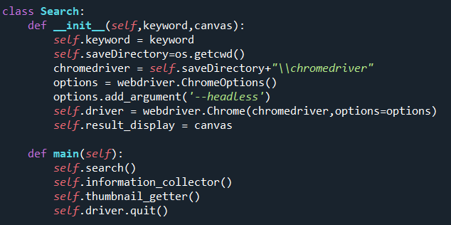
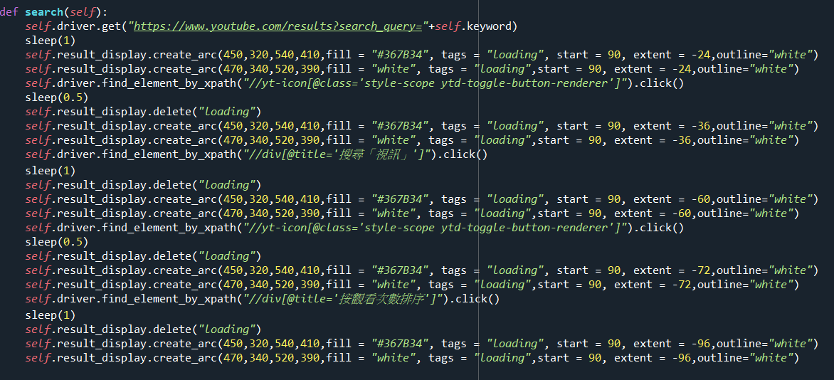

Slide 11
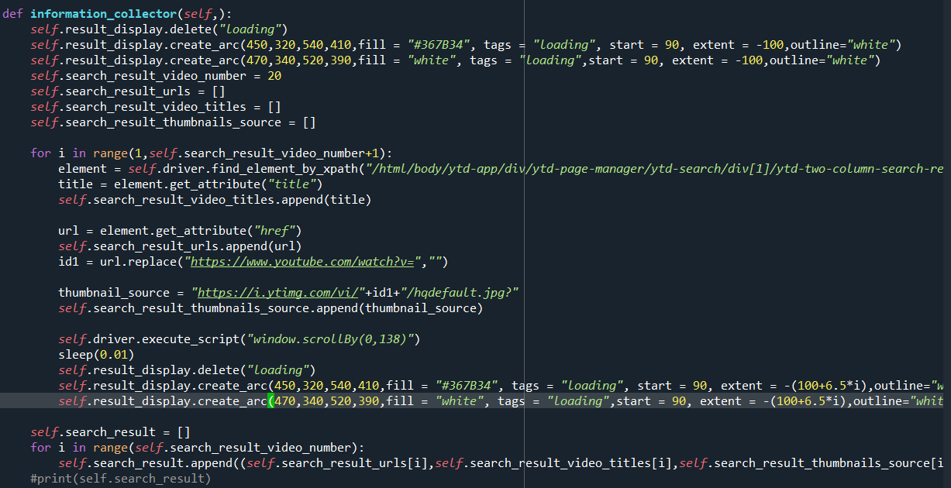
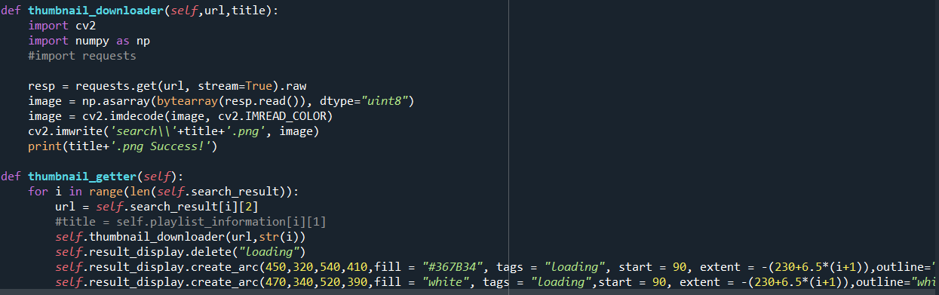

Slide 12
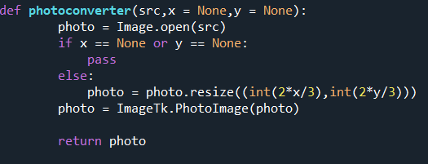
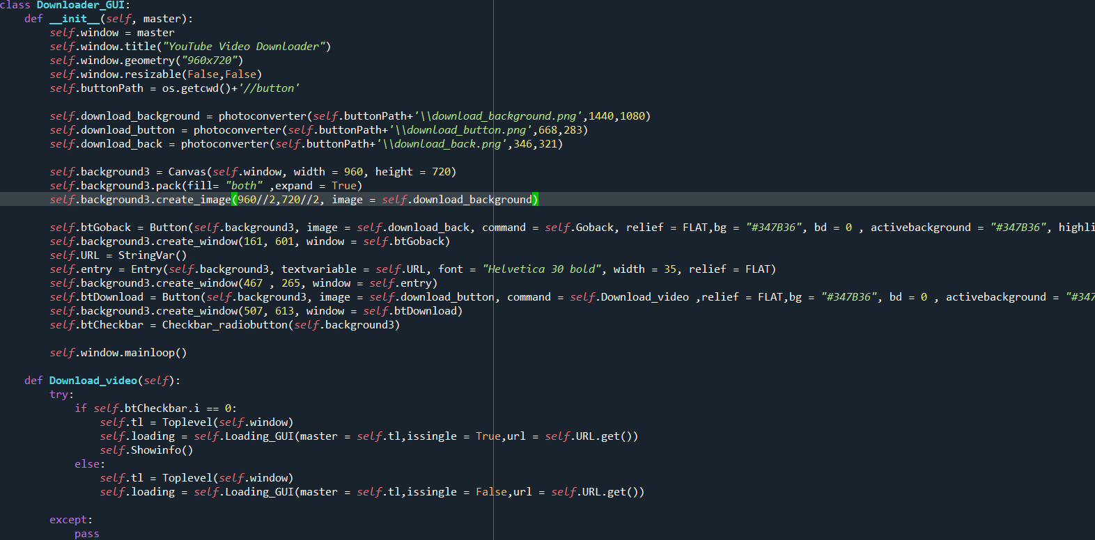

Slide 13
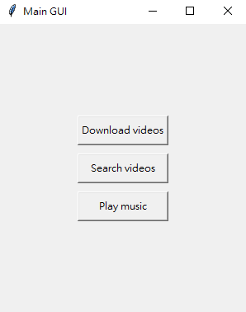

Slide 14
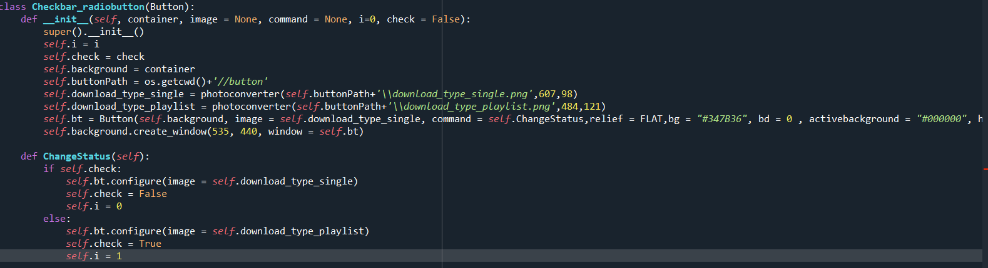
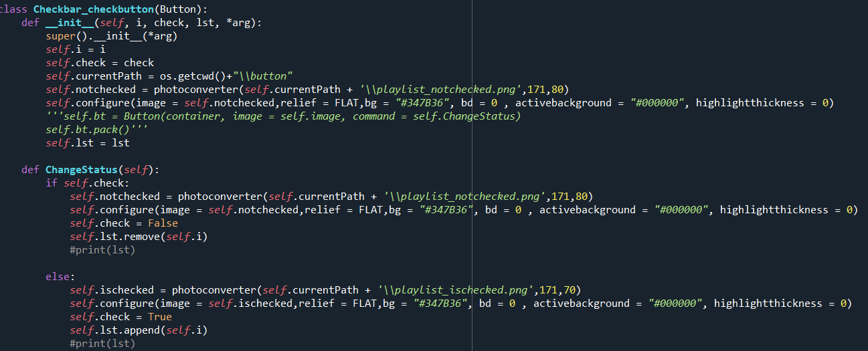

Slide 15
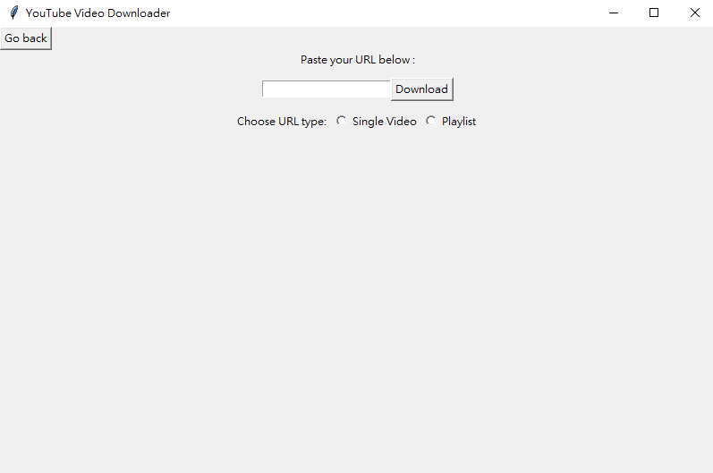



Slide 16
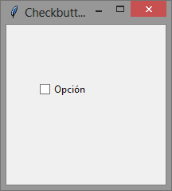



Slide 17
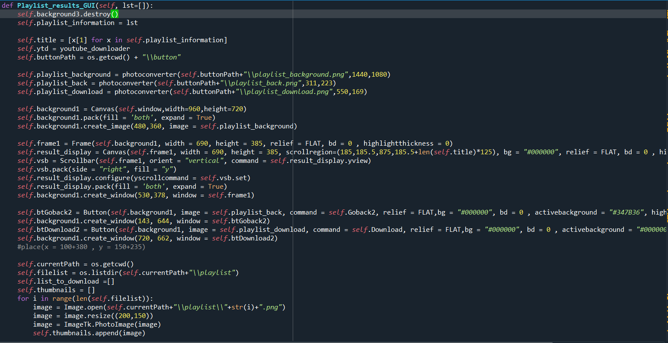
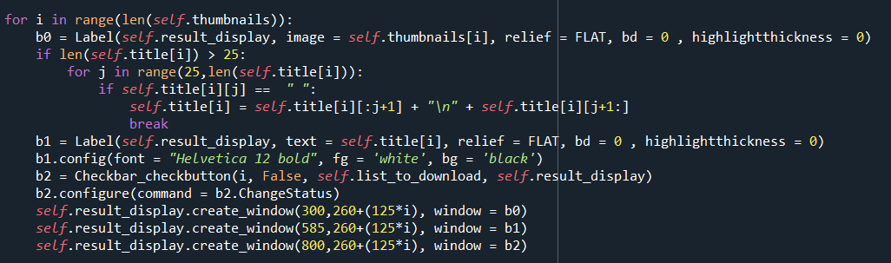

Slide 18
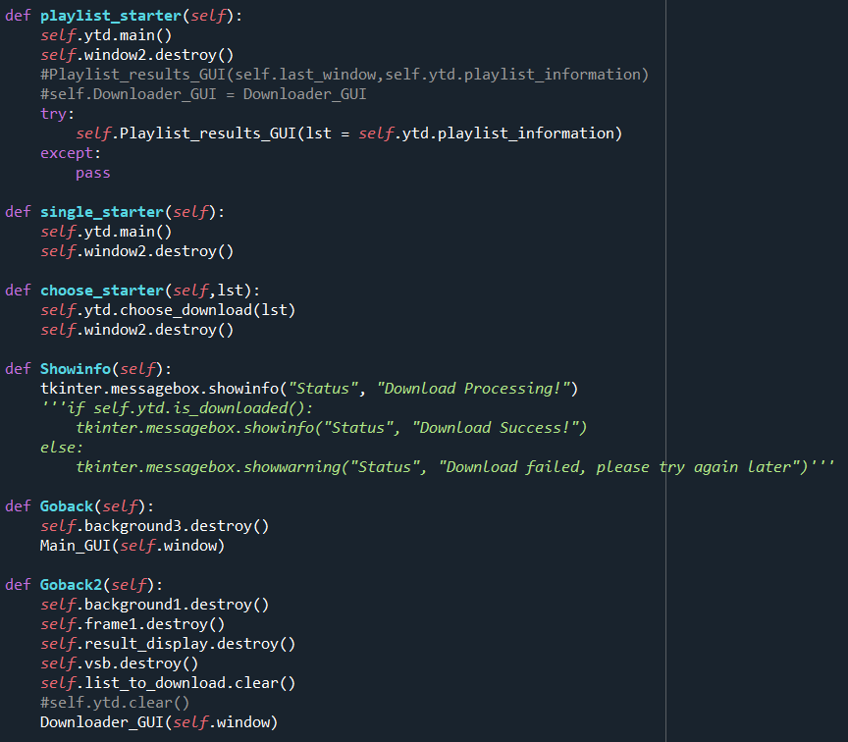
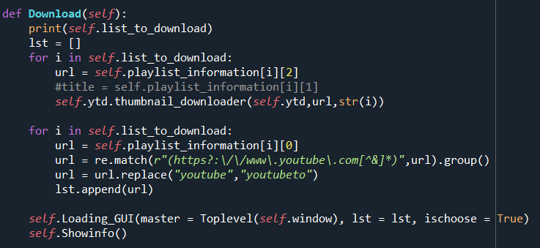

Slide 19
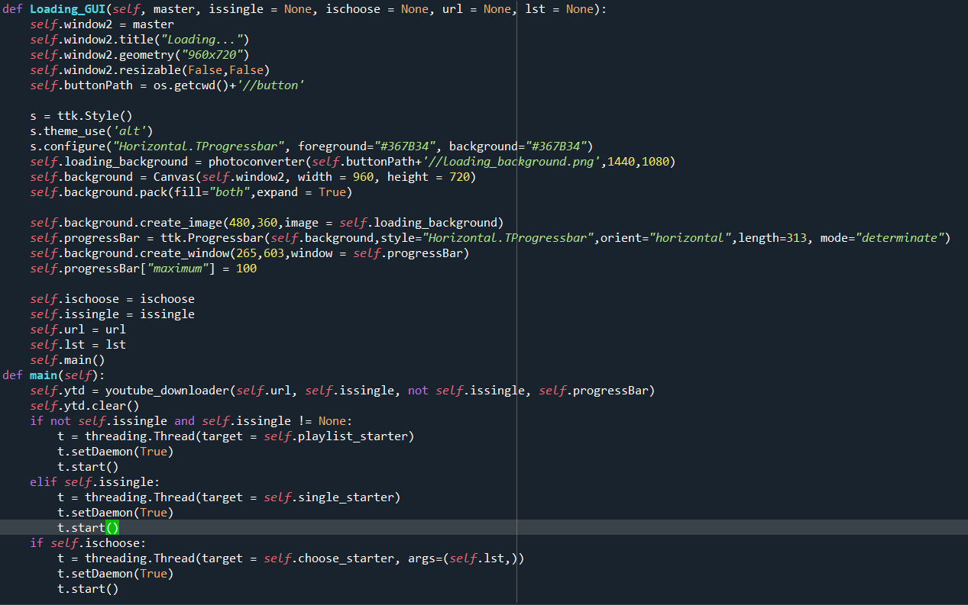

Slide 20
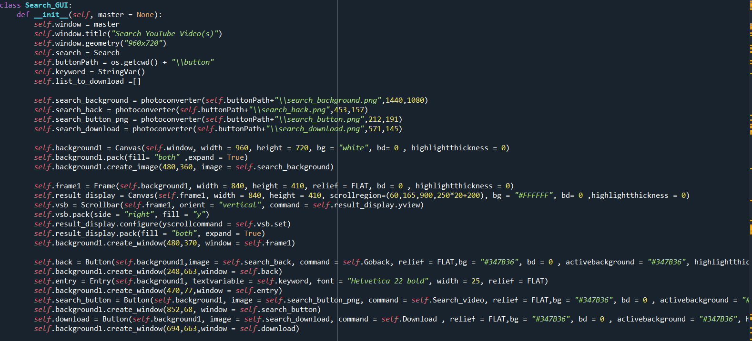

Slide 21
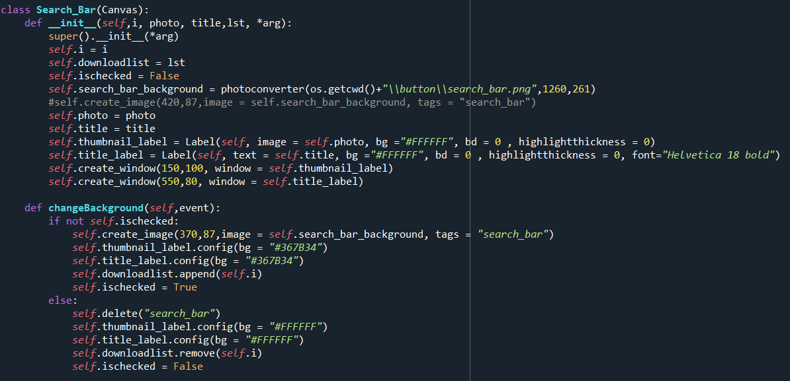
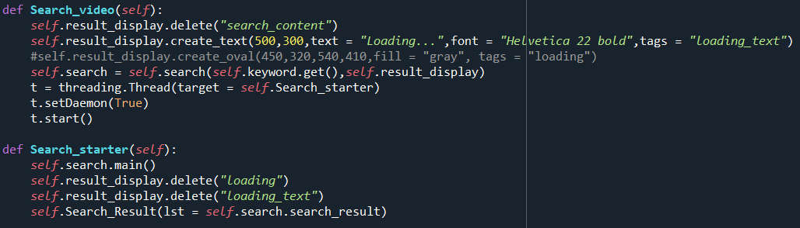

Slide 22
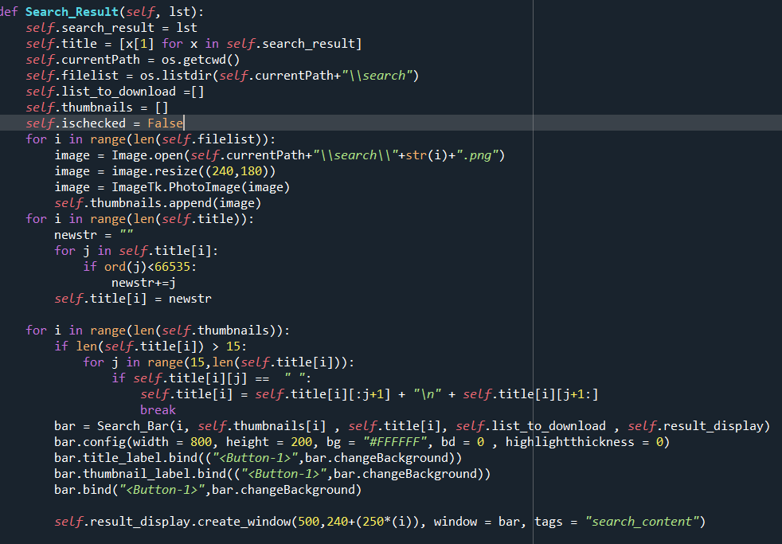

Slide 23
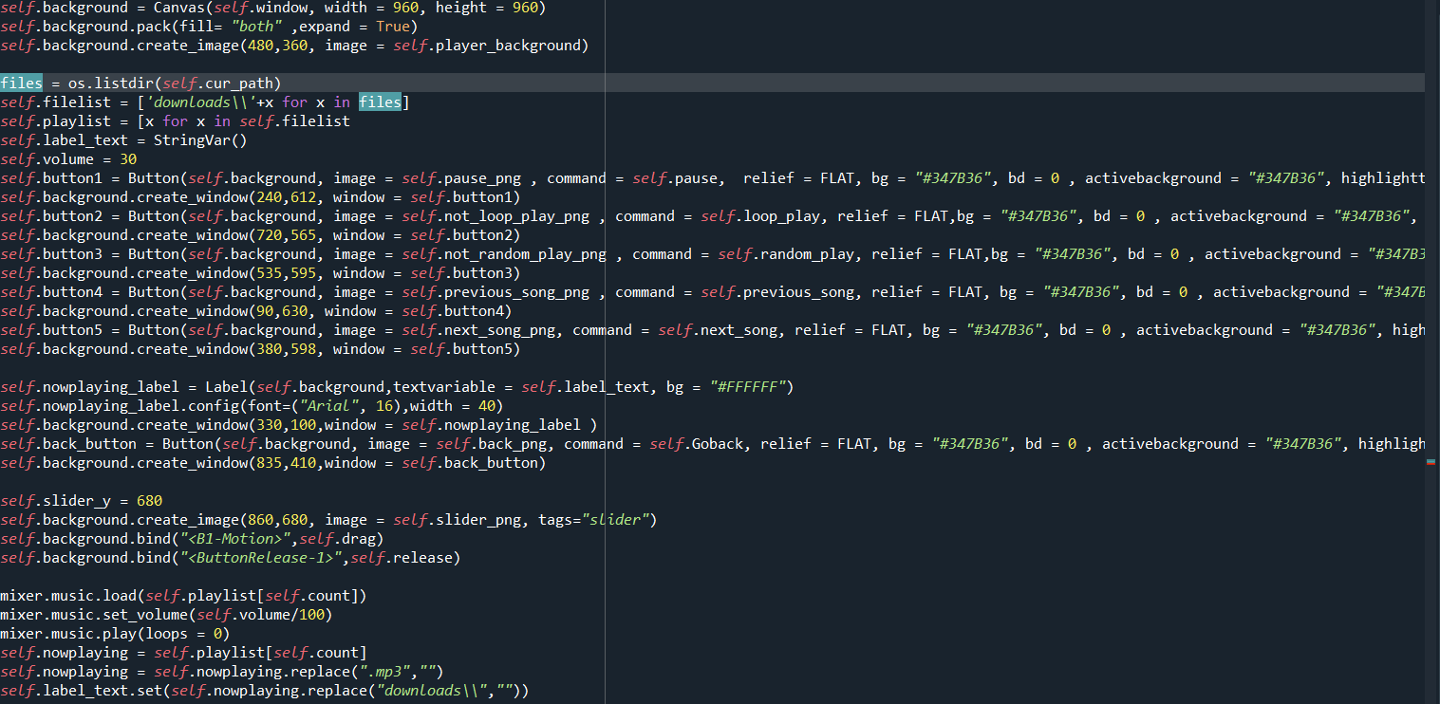
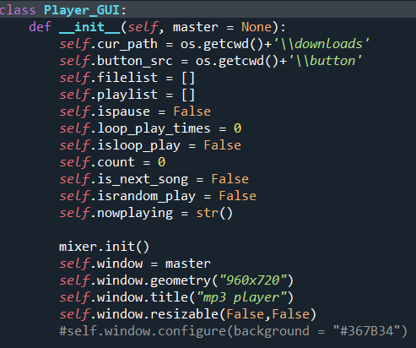

Slide 24
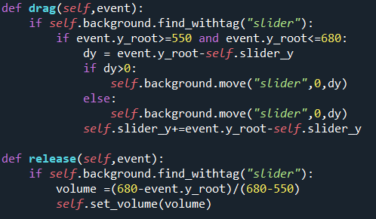
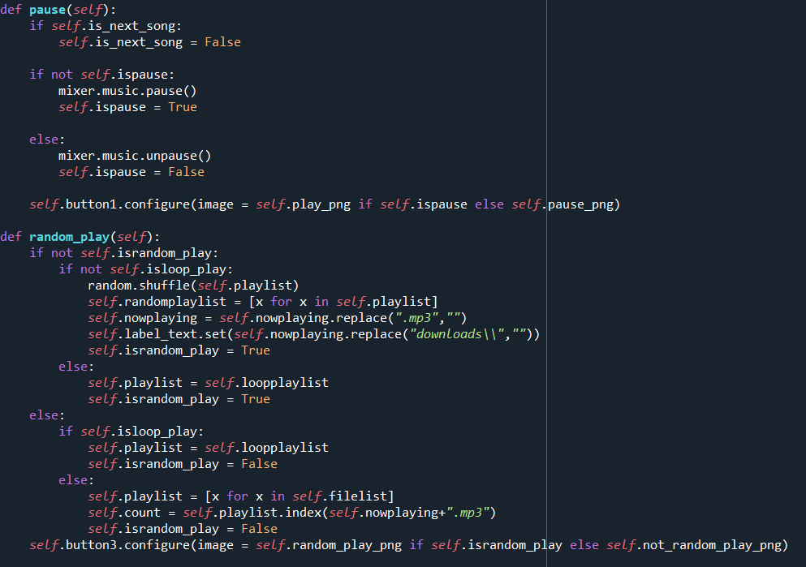
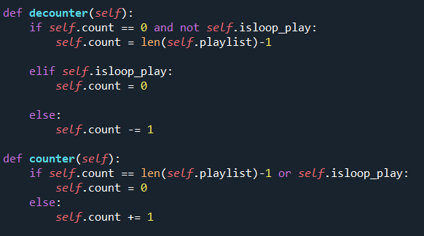

Slide 25
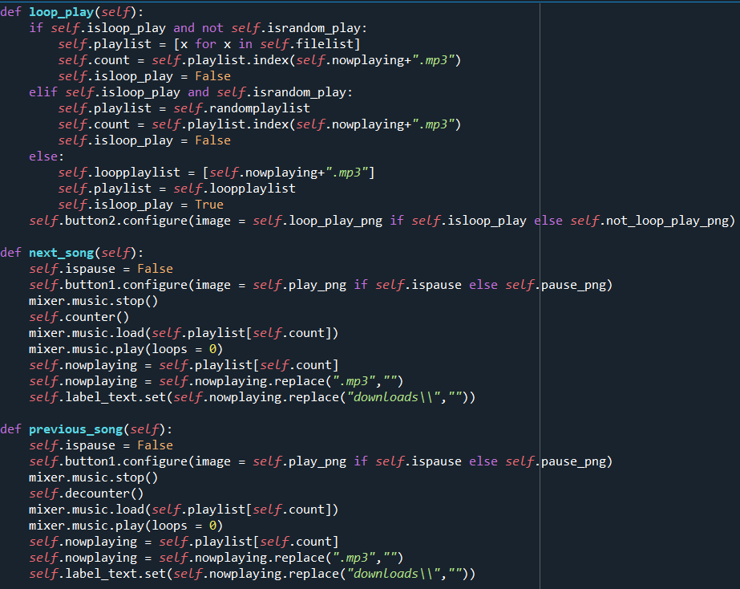
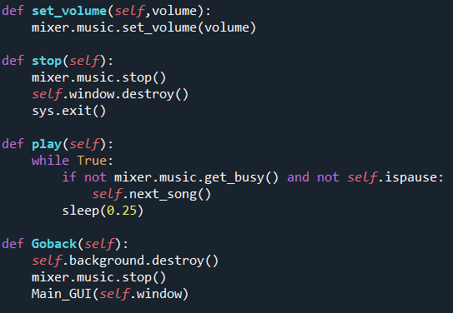

Slide 26
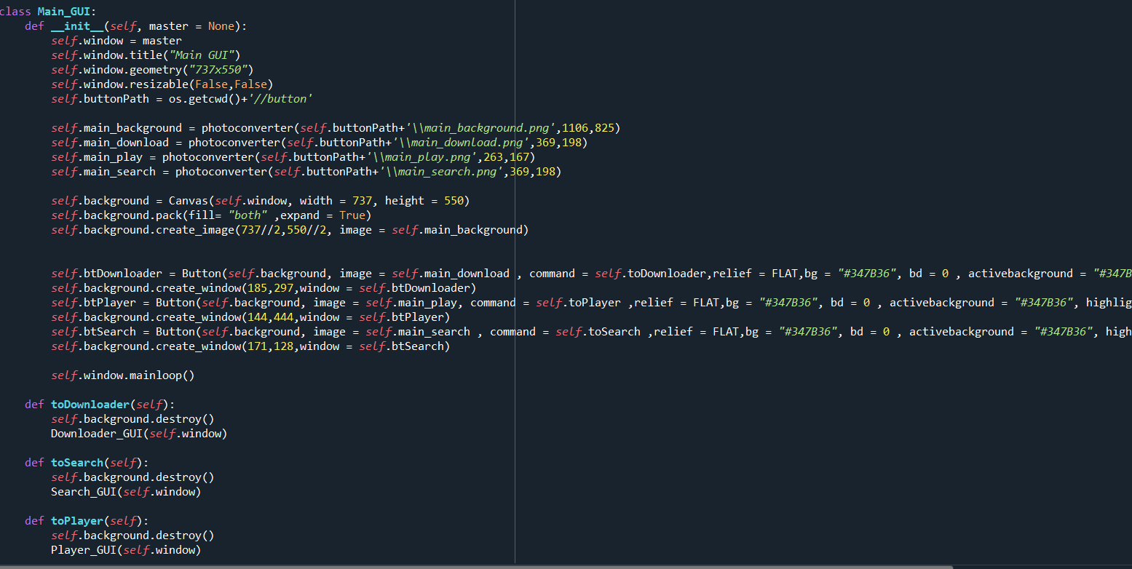

Slide 27
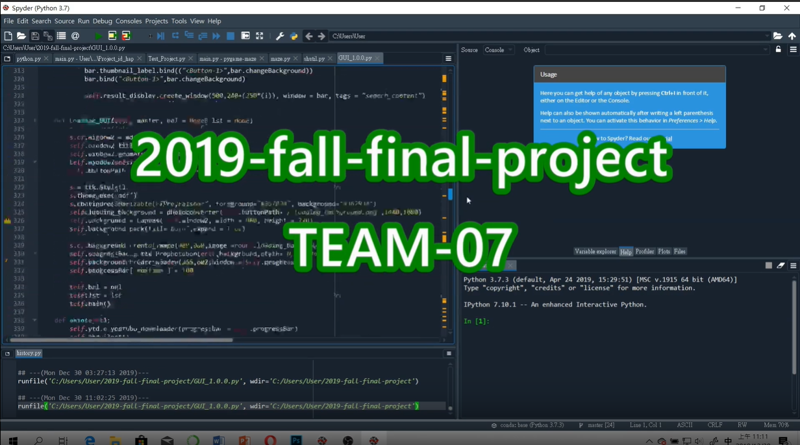
DEMO Video
https://www.youtube.com/watch?v=gdyvQ38CozE&feature=youtu.be

Slide 28
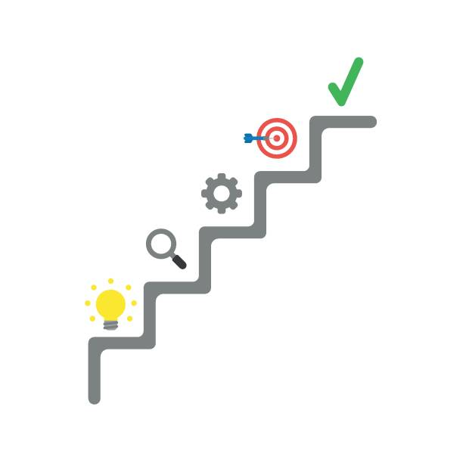
Further Application and Perspective…
Serve as a convenient program by handling multiple functions in just few clicks.
Help the program to reach an accurate search result by adding more parameters to give a relatively detailed description to what the user expects.
Remake GUI by using more powerful module to reach the desired appearance of the program.
Improve the quality of mp3.

Slide 29
Assignment of workload
YT,WANG
Web crawler
Automatic browsing
A part of GUI
TEAM-07
JX, ZHAN
Typesetting
Connect with function
A part of Web crawler
MH,HE
Design fancy appearance
PPT making
Video editor

Slide 30
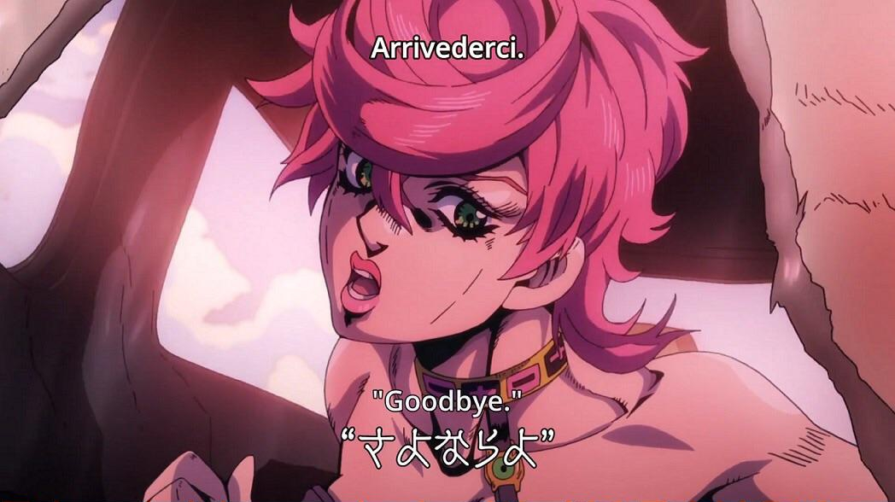
Thank you for listening

