Slide 2
Start
Go straight
True
Go straight to turn right point
Turn right check
Crush check
True
Turn right a small angle
False
True
False
False
Turn check
True
Go straight for a distance(for loop)
True
False
Crush check
for loop end
Turn right check
Turn left a large angle
False
Turn right a small angle

Slide 3
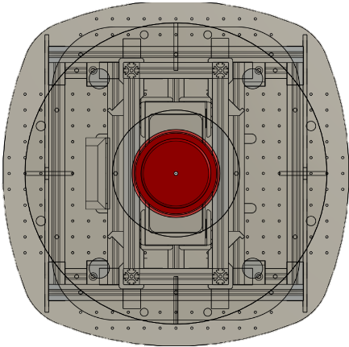
Turning Point!!
check point
vision field
safe distance

Slide 4
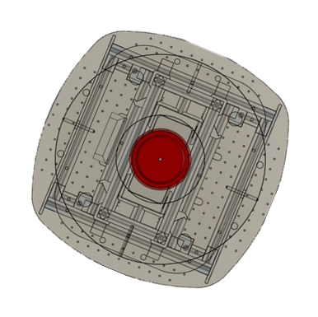
safe distance

Slide 6
Searching Queue
6
1 5
6
1 5
7
1 6
Searching Queue
6
2 4
6
1 5
7
1 6
Current Shortest Path

Slide 7
Current Shortest Path

