Slide 1
Internet Censorship and Online Speech Chapter 3: Active Attacks
Nick Feamster University of Chicago

Slide 2
Internet Censorship and Online Speech Chapter 3.1: Denial of Service
Nick Feamster University of Chicago

Slide 3
Attack on Availability
Destroy hardware (cutting fiber) or software
Modify software in a subtle way (alias commands)
Corrupt packets in transit
Blatant denial of service (DoS):
Crashing the server
Overwhelm the server (use up its resource)
A
B

Slide 4
Denial of Service: What is it?
Attacker
Victim
Attempt to exhaust resources
Network: Bandwidth
Transport: TCP connections
Application: Server resources
Typically high-rate attacks, but not always

Slide 5
Early Denial of Service
DoS Tools
Single-source, single target tools
IP source address spoofing
Packet amplification (e.g., smurf)
Deployment
Widespread scanning and exploitation via scripted tools
Hand-installed tools and toolkits on compromised hosts (unix)
Use
Hand executed on source host

Slide 6
TCP Layer Attacks

Slide 7
TCP: 3-Way Handshake
C
S
SYN_{C}
Listening
Store data
SYN_{S}, ACK_{C}
Wait
ACK_{S}
Connected

Slide 8
TCP handshake
Each arriving SYN stores state at the server
TCP Control Block (TCB)
~ 280 bytes
FlowID, timer info, Sequence number, flow control status, out-of-band data, MSS, other options agreed to
Half-open TCB entries exist until timeout
Fixed bound on half-open connections
Resources exhausted ⇒ requests rejected

Slide 9
TCP SYN Flood
Exploit state allocated at server after initial SYN packet
Send a SYN and don’t reply with ACK
Server will wait for for ACK
Finite queue size for incomplete connections (1024)
Once the queue is full it doesn’t accept requests

Slide 10
TCP SYN flooding
Problem: No client authentication of packets before resources allocated
Attacker sends many connection requests
Spoofed source addresses
RSTs quickly generated if source address exists
No reply for non-existent sources
Attacker exhausts TCP buffer to w/ half-open connections

Slide 11
SYN Flooding
C
S
SYN_{C1}
Listening
SYN_{C2}
Store data
SYN_{C3}
SYN_{C4}
SYN_{C5}

Slide 12
A classic SYN flood example
MS Blaster worm (2003)
Infected machines at noon on Aug 16th:
SYN flood on port 80 to windowsupdate.com
50 SYN packets every second.
each packet is 40 bytes.
Spoofed source IP: a.b.X.Y where X,Y random.
MS solution:
new name: windowsupdate.microsoft.com
Win update file delivered by Akamai
Notes:
Infected IP: a.b.c.d. a.b.X.Y avoids ingress filtering ISPs. Note: evades Savage’s /8 backscatter monitor.

Slide 13
Low rate SYN flood defenses
Non-solution:
Increase backlog queue size or decrease timeout
Correct solution:
Syncookies: remove state from server
Small performance overhead
Notes:
Syncache: global hash table for all half open connections on all sockets.

Slide 14
Idea: TCP SYN cookies
General idea
Client sends SYN w/ ACK number
Server responds to Client with SYN-ACK cookie
sqn = f(src addr, src port, dest addr, dest port, rand)
Server does not save state
Honest client responds with ACK(sqn)
Server checks response
If matches SYN-ACK, establishes connection

Slide 15
TCP SYN cookie
TCP SYN/ACK seqno encodes a cookie
32-bit sequence number
t mod 32: counter to ensure sequence numbers increase every 64 seconds
MSS: encoding of server MSS (can only have 8 settings)
Cookie: easy to create and validate, hard to forge
Includes timestamp, nonce, 4-tuple
32
0
t mod 32
MSS
Cookie=HMAC(t, N_{s}, SIP, SPort, DIP, DPort)
5 bits
3 bits

Slide 16
Summary
Denial of Service attacks exhaust some limited resource:
Network bandwidth
Server resources
These attacks are typically (but not always) high-volume
Early DoS attacks involved TCP (e.g., “SYN Flood” attacks)

Slide 17
Common Example Today (First seen around May 2006)
DNS Amplification attack: ( ×40 amplification )
DNS Query SrcIP: Dos Target
(60 bytes)
EDNS Reponse
(3000 bytes)
DoS Source
DNS Server
DoS Target
580,000 open resolvers on Internet (Kaminsky-Shiffman’06)
Prevention: reject DNS queries from external addresses
Notes:
Other measurements: (MeasurementFactory):
There are an estimated 7.5 million external DNS servers on the public Internet. Over 75% of domain
name servers (of roughly 1.3 million sampled) allow recursive name service to arbitrary queriers.

Slide 18
DNS DoS Attacks
DNS runs on UDP port 53
DNS entry for victim.com hosted at victim_isp.com
DDoS attack:
flood victim_isp.com with requests for victim.com
Random source IP address in UDP packets
Takes out entire DNS server: (collateral damage)
bluesecurity DNS hosted at Tucows DNS server
DNS DDoS took out Tucows hosting many many sites
Notes:
TLD DNS servers: each root server on 200 machines. Requests use IP any cast.

Slide 19
Root Level DNS Attacks
Feb. 6, 2007:
Botnet attack on the 13 Internet DNS root servers
Lasted 2.5 hours
None crashed, but two performed badly:
g-root (DoD), l-root (ICANN)
Most other root servers use anycast
Notes:
Root servers specify where the TLDs are (.com, .net, …)
f-root is supported by 42 different locations.
Only one root server is sufficient to make the Internet work.

Slide 20
DoS of SSL/TLS
SSL/TLS handshake [SD’03]
RSA-encrypt speed ≈ 10× RSA-decrypt speed
⇒ Single machine can bring down ten web servers
Similar problem with application DoS:
Send HTTP request for some large PDF file
⇒ Easy work for client, hard work for server.
Client Hello
Web
Server
Server Hello (pub-key)
RSA
Encrypt
Client key exchange
RSA
Decrypt

Slide 21
TCP Session Hijack
When is a TCP packet valid?
Address/Port/Sequence Number in window
How to get sequence number?
Sniff traffic
Guess it
Many earlier systems had predictable ISN
Inject arbitrary data to the connection

Slide 22
TCP Session Poisoning
Send RST packet
Will tear down connection
Do you have to guess the exact sequence number?
Anywhere in window is fine
For 64k window it takes 64k packets to reset

Slide 23
Internet Censorship and Online Speech Chapter 3.2: DNS (and Amplification) Attacks
Nick Feamster University of Chicago

Slide 24
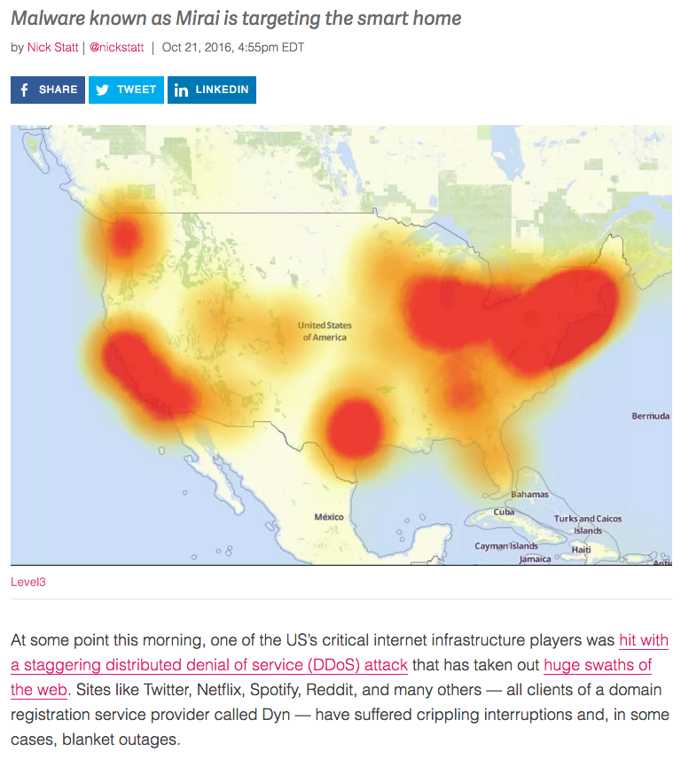
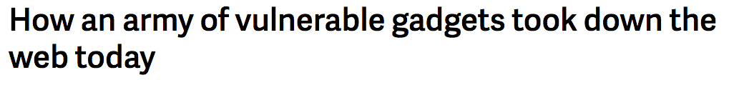
IoT-Based Denial of Service

Slide 25


Slide 26
Mirai DDoS Post-Mortem
“During a DDoS which uses the DNS protocol it can be difficult to distinguish legitimate traffic from attack traffic. For example, the impact of the attack generated a storm of legitimate retry activity as recursive servers attempted to refresh their caches, creating 10-20X normal traffic volume across a large number of IP addresses. When DNS traffic congestion occurs, legitimate retries can further contribute to traffic volume.
We saw both attack and legitimate traffic coming from millions of IPs across all geographies. It appears the malicious attacks were sourced from at least one botnet, with the retry storm providing a false indicator of a significantly larger set of endpoints than we now know it to be. We are still working on analyzing the data but the estimate at the time of this report is up to 100,000 malicious endpoints. We are able to confirm that a significant volume of attack traffic originated from Mirai-based botnets.

Slide 27
Basic Amplification Attack
1. ICMP Echo Request Src: DoS Target
Dest: broadcast address
3 ICMP Echo Reply Dest: Dos Target
Send ping request to broadcast address (ICMP Echo Req)
Lots of responses:
Every host on target network generates a ping reply (ICMP Echo Reply) to victim
Network switch
DoS Target
DoS Source

Slide 28
DNS Amplification (Common Today)
DNS Amplification attack: ( ×40 amplification )
DNS Query SrcIP: Dos Target
(60 bytes)
EDNS Reponse
(3000 bytes)
DoS Source
DNS Server
DoS Target
Prevention: reject DNS queries from external addresses
Notes:
Other measurements: (MeasurementFactory):
There are an estimated 7.5 million external DNS servers on the public Internet. Over 75% of domain
name servers (of roughly 1.3 million sampled) allow recursive name service to arbitrary queriers.

Slide 29
DNS Reflection Attacks
DNS
Src: DNS
Dst: Victim
Src: Victim
Dst: DNS
DNS
Src: DNS
Dst: Victim
Src: Victim
Dst: DNS
Attacker
Victim

Slide 30
Summary
DNS is a common target for denial of service (DoS) attacks
Centralization of DNS services has made it more vulnerable to attack
DNS is also prone to amplification, whereby a small initial packet results in larger response packets that can be directed at the victim

Slide 31
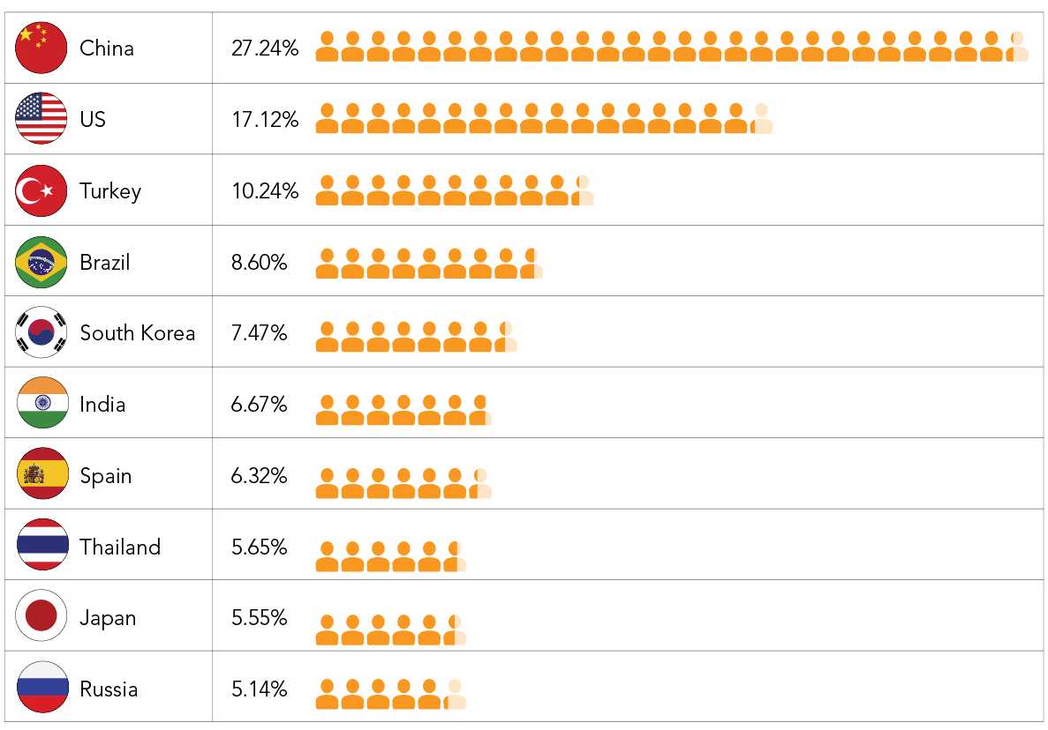
Top 10 Source Countries for DDoS Attacks in Q1 2016
China was the top source of non-spoofed DDoS attacks in the first quarter, followed by the US.
Source: Akamai
Notes:
China was the top source country for DDoS attacks in Q1, accounting for 27% of all activity.
The US was the second-largest source of attacks (17%) while Turkey accounted for 10%.
Turkey’s high placement on the list continues a trend we’ve seen in recent months where Eastern European countries are filling a void that had been occupied by Russia in recent years. One theory is that many attackers who had been operating from Russia have spread out to the Eastern European nations.
NOTE: While the packets we receive are from IP addresses in these countries, it is likely that a certain number of attackers used proxies or Virtual Private Servers (vps) to hide their true originating ip addresses. This source information is further muddied by the fact that some of the available attack scripts rely on sending GET flood attacks from other websites, as is the case with pingback attacks, or are relayed through proxies.

Slide 32
Internet Censorship and Online Speech Chapter 3.3: Great Cannon
Nick Feamster University of Chicago

Slide 33
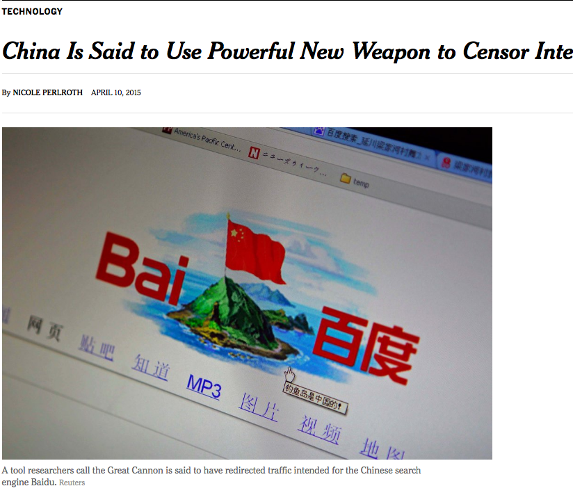
China’s Great Cannon
March 26, 2015: Github pages run by Greatfire.org are victims of DoS attack
Malicious traffic directed from Baidu servers
Baidu said that their servers were not compromised…
Instead: Traffic manipulation of “bystander” systems (i.e., client browsers)

Slide 34
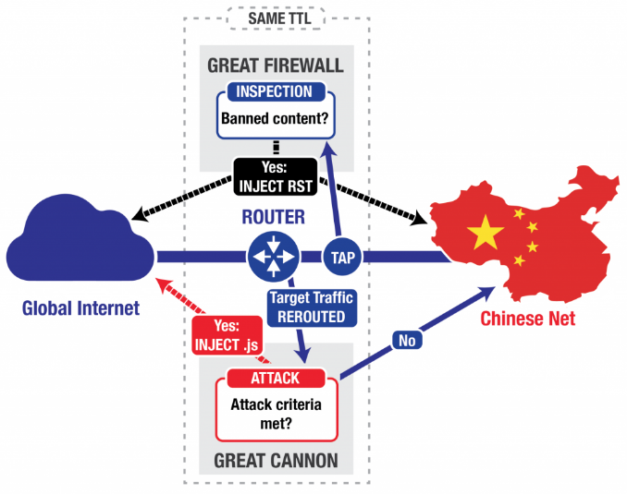
“On-Path” Attack System
Eavesdrop traffic between China & rest of world
Terminate requests for banned content with TCP RST
Appears to be co-located with the “Great Firewall”, load-balanced
Differences: probabilistic, no packet reassembly

Slide 35
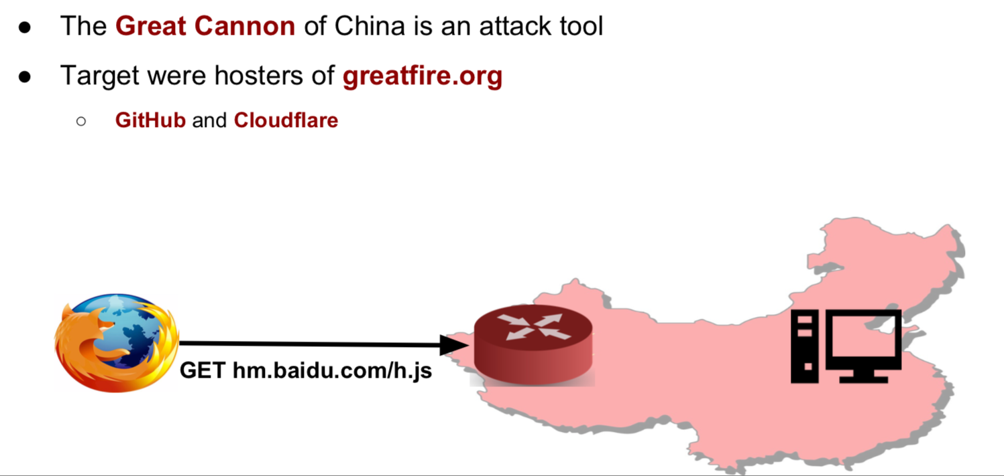
China’s Great Cannon

Slide 36
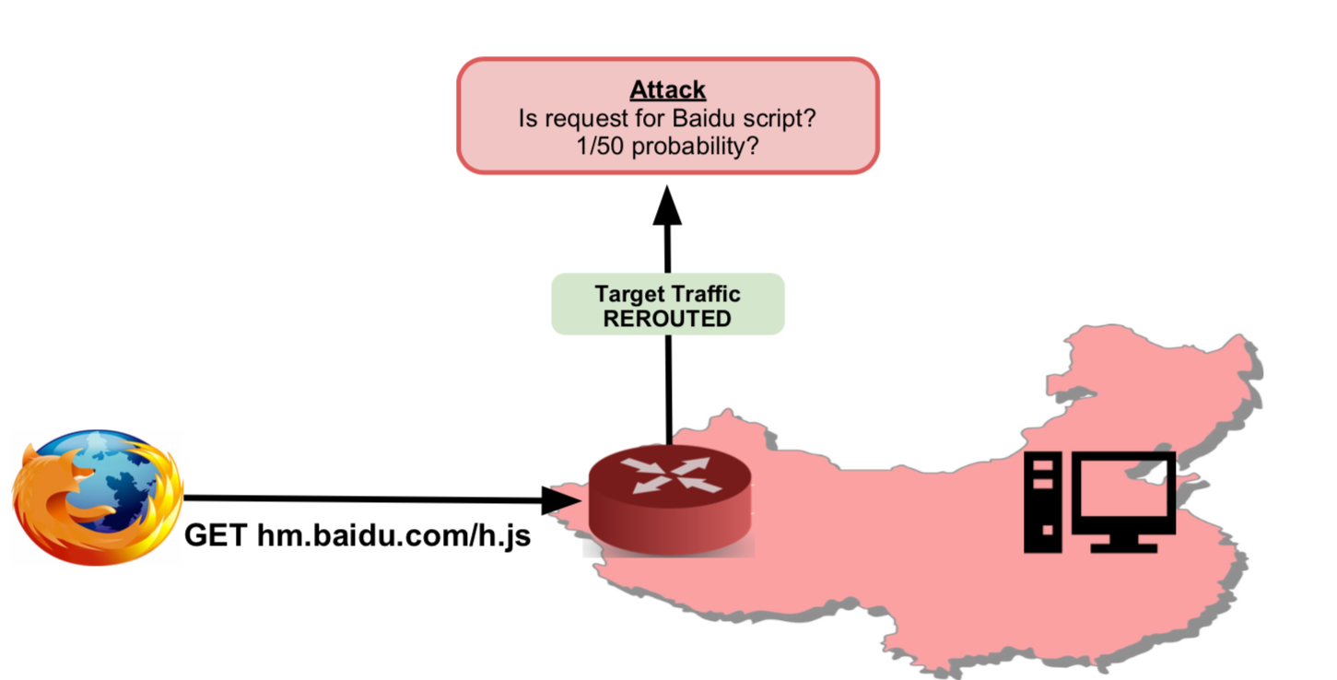
Great Cannon: Javascript Injection

Slide 37
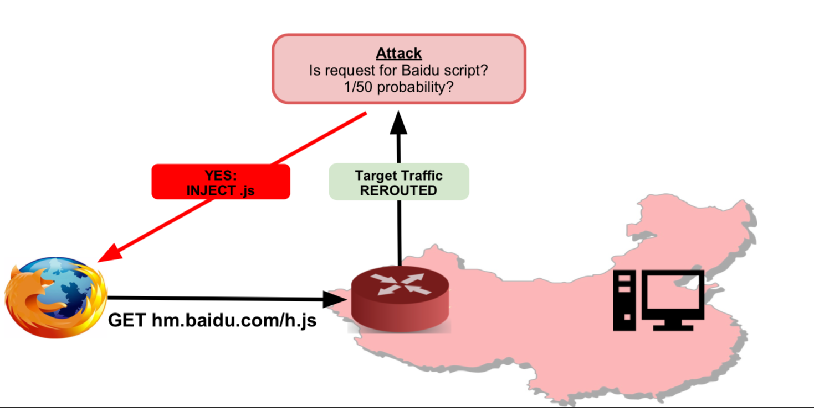
Great Cannon: Javascript Injection

Slide 38
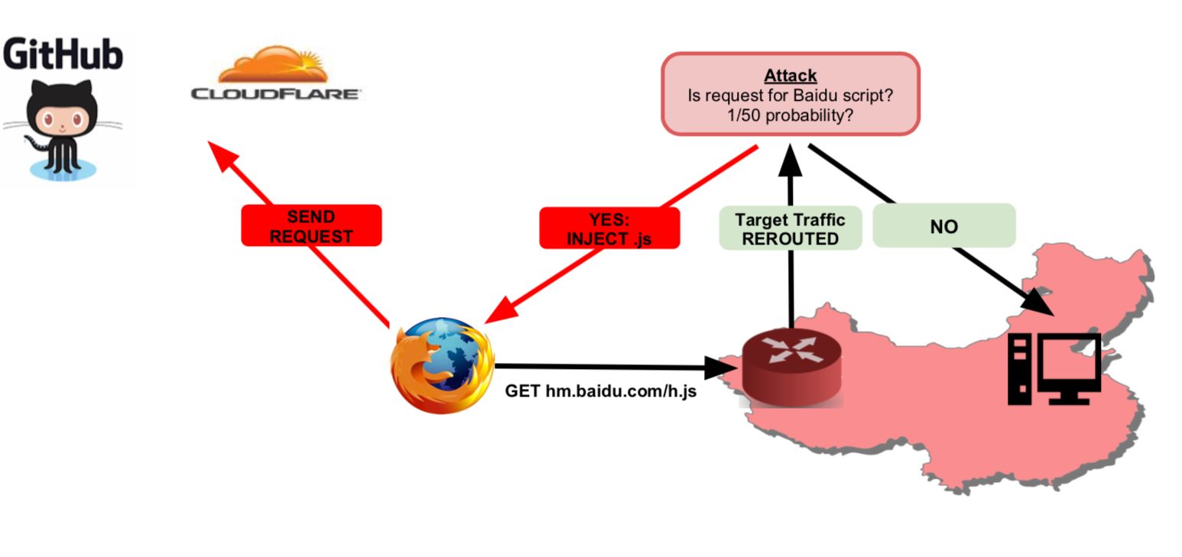
Great Cannon: Browser Sends Requests to Victim

Slide 39
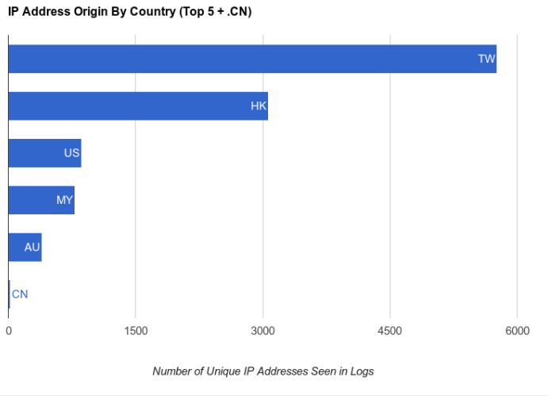
Where Were the Attacking Clients?

Slide 40
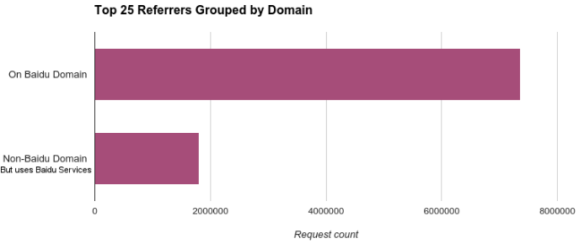
What Domains Had Code Injected?
Most common: pos.baidu.com
Baidu is fourth most-visited site globally

Slide 41
Denial of Service: Common Themes
Asymmetry
Reflection and Amplification
Botnets
Difficulty of distinguishing legitimate traffic from attack traffic
(Often) Spoofing of IP addresses

Slide 42
Summary
Denial of service is a mechanism to deny availability of a service to people trying to use it.
The Great Cannon (2015) was the first known example of a volumetric DDoS attack against target websites.
Nation states now continue to use DDoS as a mechanism for disrupting communications and access to content.

Slide 43
Internet Censorship and Online Speech Chapter 3.4: Active Probing
Nick Feamster University of Chicago

Slide 44

Assume an Encrypted Tunnel
Client in China
Server in Germany
TLS connection
Notes:
GFW has hard time figuring out what’s inside encrypted connection
type of encryption can reveal it, but that’s not always possible
blocking on hunches and guesses introduces collateral damage

Slide 45


GFW does DPI
Client in China
Server in Germany
TLS connection
Notes:
GFW has hard time figuring out what’s inside encrypted connection
type of encryption can reveal it, but that’s not always possible
blocking on hunches and guesses introduces collateral damage

Slide 46
GFW does DPI
c02bc02fc00ac009c013c014c012c007c0110033003200450039003800880016002f004100350084000a0005000400ff
Client in China
Server in Germany
TLS connection
Cipher list in TLS client hello looks like circumvention system (e.g., Tor)!
Notes:
GFW has hard time figuring out what’s inside encrypted connection
type of encryption can reveal it, but that’s not always possible
blocking on hunches and guesses introduces collateral damage

Slide 47
2. GFW launches active probe
Client in China
Server in Germany
TLS connection
Tor handshake
Active prober
Notes:
GFW has hard time figuring out what’s inside encrypted connection
type of encryption can reveal it, but that’s not always possible
blocking on hunches and guesses introduces collateral damage

Slide 48
2. GFW launches active probe
Client in China
Server in Germany
TLS connection
Tor handshake
Tor handshake
Active prober
Notes:
GFW has hard time figuring out what’s inside encrypted connection
type of encryption can reveal it, but that’s not always possible
blocking on hunches and guesses introduces collateral damage

Slide 49
3. GFW blocks server
Client in China
Block server
Server in Germany
TLS connection
Yes, it was…
Tor handshake
Tor handshake
Active prober
Notes:
GFW has hard time figuring out what’s inside encrypted connection
type of encryption can reveal it, but that’s not always possible
blocking on hunches and guesses introduces collateral damage
sounds relatively easy, but lots of engineering behind this system!
mentioned that this is a research project to understand it better. started with dataset.

Slide 50
Where are the probes coming from?
202.108.181.70
Collected 16,083 unique prober IP addresses
95% of addresses seen only once
Reverse DNS suggests ISP pools
adsl-pool.sx.cn
kd.ny.adsl
online.tj.cn
Majority of probes come from three autonomous systems
ASN 4837, 4134, and 17622
Sybil
1,090
Shadow
135
Log
14,802
Notes:
a single address shows up a lot, in all three datasets.
takeaway from this is that IP address filters won’t work on proxy servers. you would block legitimate clients.

Slide 51
Physical infrastructure
Leakage of connection state information shows that probes are controlled by centralised entity
Not clear how central entity controls probes
Proxy network?
Geographically distributed set of proxy machines
Off-path device in ISP’s data center?
Machines connected to switch mirror ports
Notes:
fingerprinting and state leakage shows that probes are controlled by central authority -- despite large number of IP addrs

Slide 52
Protocols that are probed or blocked
SSH
In 2011, not anymore?
VPN
OpenVPN occasionally
SoftEther
Tor
"Vanilla” Tor
obfs2 and obfs3
AppSpot
To find GoAgent?
TLS
Anything else?
Notes:
interestingly, probed does not mean blocked. some protocols probed but not blocked.

Slide 53
Summary
Censors sometimes actively scan the Internet to identify services that they can subsequently censor
Past research has explored the nature of this active probing in the context of certain circumvention systems such as Tor
Whether it applies to other systems (e.g., specific VPNs) is less well understood, but such interference is likely

