Slide 1
Random Forest-Based Network Intrusion Detection
Jiong Zhang, Mohammad Zulkernine, Anwar Haque
Presented By Mohammad Arsalan Javed

Slide 2
About Paper
Published in 2008
Have more than 300 citations
Published in: IEEE Transactions on Systems, Man, and Cybernetics

Slide 3
3 Parts to paper
Hybrid System
Misuse Detection
ANOMALY DETECTION

Slide 4
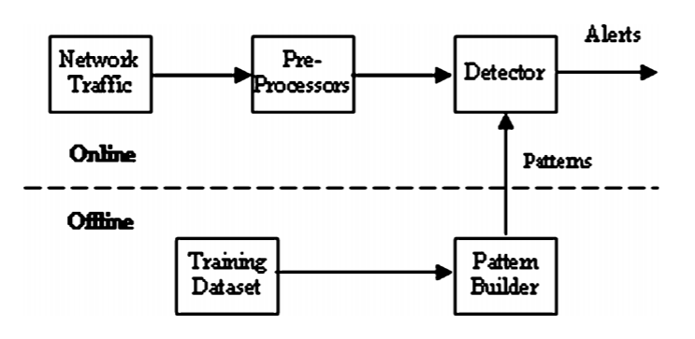
Misuse Detection

Slide 5
Offline Phase
Build the patterns of intrusions.

Slide 6
Offline Phase
Build the patterns of intrusions.
Feature selection algorithm.

Slide 7
Offline Phase
Build the patterns of intrusions.
Feature selection algorithm.
Handles imbalanced intrusions.

Slide 8
Offline Phase
Captures the packets from network traffic.
Features are constructed by the preprocessors.
Detector module classifies the connections as different intrusions or normal traffic using the patterns built in the offline phase

Slide 9
Three MAjor PArts to Misuse Detection
Optimization Of Error Rate
Minority Intrusion Detection
Feature Selection

Slide 10
Optimization Of Error Rate Correlation and Strength
Correlation between any two trees Error Rate
The Strength of a tree Error Rate

Slide 11
Optimization Of Error Rate Correlation and Strength
The number of features employed in splitting each node for each tree is the primary tuning parameter - Mtry
Increase Strength
Decrease Correlation

Slide 12
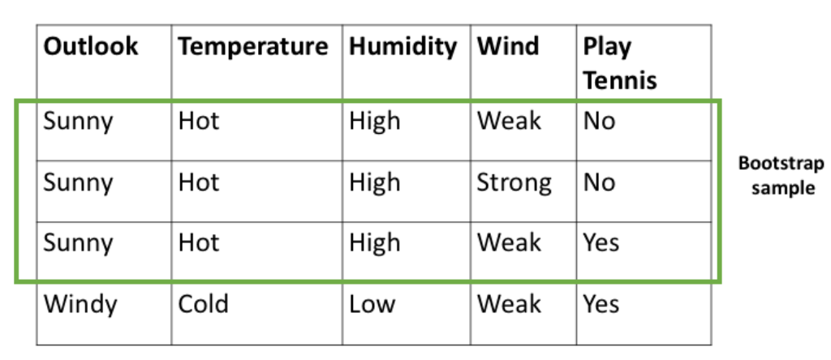
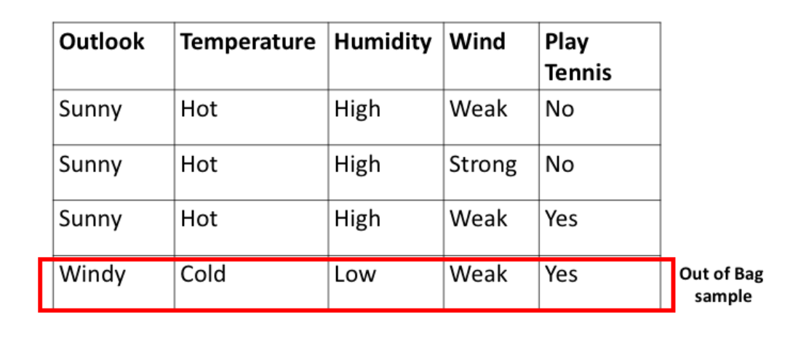
Optimization Of Error Rate Evaluate Error Rate
Training on Training Set and evaluating on test sets
Out of bag error estimate(OOB)

Slide 13
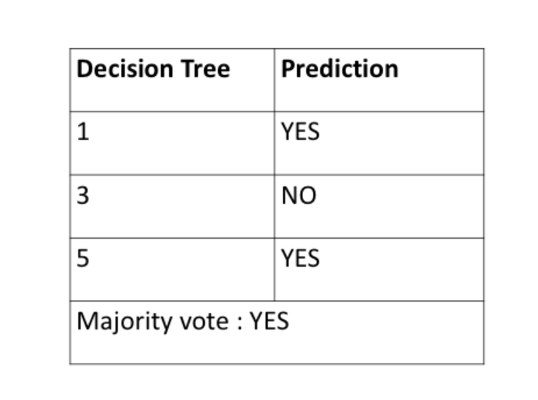

Slide 14
Minority Intrusions Detection
Intrusions are imbalanced
The random forests algorithm tries to minimize the overall error rate by lowering the error rate on majority classes (e.g., majority intrusions) while increasing the error rate of minority classes (e.g., minority intrusions)
Cost of damage of minority intrusions is much higher than the damage cost of majority intrusions.

Slide 15
two solutions to deal with the imbalanced intrusions problem
1 - Set different weights for different intrusions
Minority intrusions are assigned higher weights
Majority intrusions are assigned Lower weights
The overall error rate goes up, the error rate of minority intrusions is
This can be achieved by changing weight parameters.

Slide 16
two solutions to deal with the imbalanced intrusions problem
2 - Sampling techniques
Oversampling the minority intrusions(e.g., user to root and remote to local)
Downsampling the majority intrusions(e.g., normal traffic and DoS)
Combination of oversampling and downsampling was used to solve the imbalanced class problem

Slide 17
Feature Selection
Raw audit data of network traffic are not suitable for intrusion detection
Hundreds of traffic and content features can be designed
Only some of them are essential for separating intrusions from normal traffic.
Unessential features increase not only the computational cost but also the error rate, especially for some algorithms that are sensitive to the number of features

Slide 18
Feature Selection
Deciding upon the right set of features is difficult and time consuming
Thus we need to automate this process of Feature Selection
Variable importance calculated by the random forests algorithm can be used for feature selection
We will talk more about how to compute Variable importance in a bit....

Slide 19
Experiments and Results
KDD’99 have been used.
It includes the full training set, the 10% training set, and the test set
The full training set has ~5 million connections.
The 10% training set has ~0.5million connections
All minority classes (U2R and R2L)
Part of the majority classes (normal, DoS, and probing).
Test set contains ~0.31 million connections
Five classes: normal, probe, DoS, U2R, and R2L

Slide 20
Experiments and Results Downsampling and Oversampling
Dataset: The original dataset (the 10% training set) is imbalanced
e.g., DoS has ~0.3 million connections but U2R has only 52 connections
Downsample the Normal and DoS classes by randomly selecting 10% of connections from normal and DoS
Oversample U2R and R2L by replicating their connections. The balanced training set with ~61k connections is much smaller than the original one

Slide 21
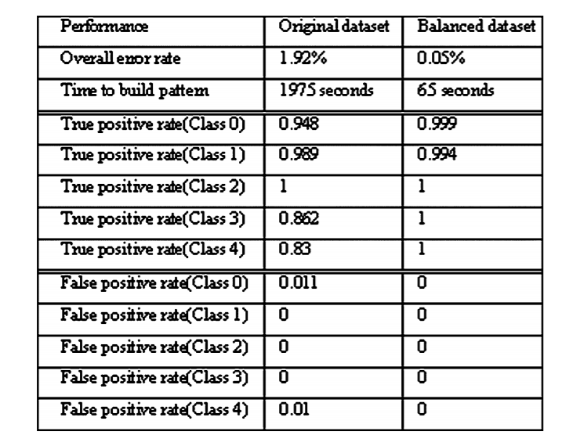
Experiments and Results Performance Comparison on Balanced and Imbalanced
Sensitivity
TPR = TP/(TP + FN)
Specificity
FPR = FP/(FP + TN)

Slide 22
Experiments and Results Performance Comparison on Balanced and Imbalanced
66% samples as training data
34% samples as test data
Ten trees in the forest
Six random features to split the nodes.
WEKA Default Parameters

Slide 23
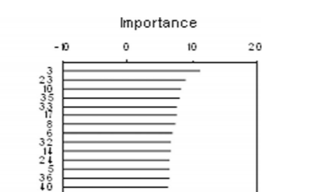

Experiments and Results Selection of Important Features
There are 41 features in the KDD’99 dataset
Feature selection algorithm supported by the random forests algorithm to calculate the value of variable importance

Slide 24
Experiments and Results Selection of Important Features
Feature 3 (service type such as http, telnet, and ftp) is the most important feature to detect intrusions. It means that the intrusions are sensitive to service type.
Feature 7 (land) is used to indicate if a connection is from/to the same host. Features 20 (number of outbound commands in an ftp session) and 21 (hot login to indicate if it is a hot login) do not show any variation for intrusion detection in the training set.

Slide 25
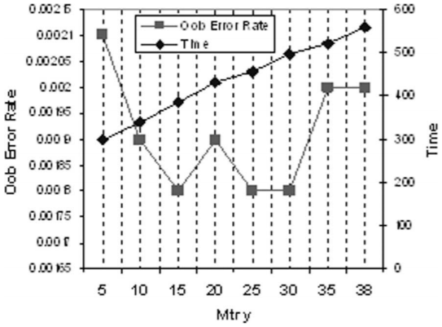
Experiments and Results Parameter Optimization
Optimize the number of the random features (Mtry) to improve the detection rate Mtry (5, 10, 15, 20, 25, 30, 35, and 38)

Slide 26

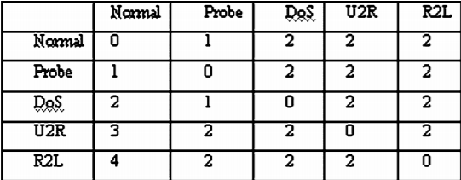
Experiments and Results Evaluation and Discussion
Different misclassifications have different levels of consequences. For example, misclassifying R2L as normal is more dangerous than misclassifying DoS as normal

Slide 27
Experiments and Results Evaluation and Discussion
Evaluating our approach with the test dataset that contains ~0.3 million examples.
Carry out our experiment with 50 trees and 15 random features.

Slide 28
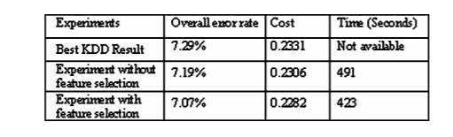

Slide 29
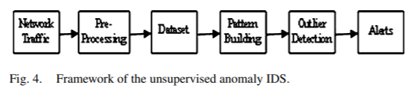
Anomaly Detection
The IDS captures the network traffic and constructs dataset by preprocessing. Service-based patterns are built over the dataset using the random forests algorithm.
With the built patterns, we can find the outliers related to each pattern. The system raises alerts when any of the outliers are detected.

Slide 30
Building Patterns of Network Services
Network traffic can be categorized by services (e.g., http, telnet, and ftp).
We can build patterns of network services using the random forests algorithm.
Network traffic can be labeled by the services automatically instead of time consuming manual processing

Slide 31
Unsupervised Outlier Detection
2 Types of Outlier Detection
Activity that deviates significantly from the others in the same network service.
Activity whose pattern belongs to the services other than their own service.

Slide 32

How is it Done?
Random forests algorithm uses proximities to find the outliers whose proximities to all other cases in the entire data are generally small.
Outlierness indicates a degree of being an outlier.

Slide 33
Complexity of the Algorithm will be NxN
We do not care about the proximity between two cases that belong to different services.
Si denotes the number of cases in service i, the complexity will be reduced to Si × Si.

Slide 34
Final Outlierness
M = Median of all outlierness in a certain class
S = Absolute deviation of all raw outlier-ness
Each Outlierness = (each_raw_outlierness - M)/S

Slide 35
Experiments and Results
Generate a normal dataset dataset ftp, pop,telnet, 5% http, and 10% smtp normal connections
By injecting Anomalies we create 1%, 2%, 5%, and 10% datasets

Slide 36
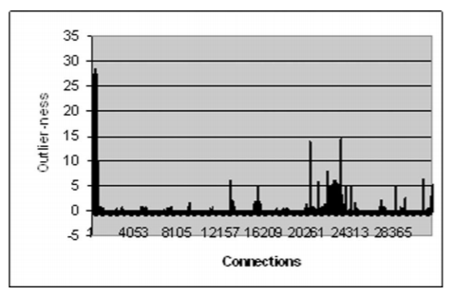
Experiments and Results
Result over 1% attack dataset.

Slide 37
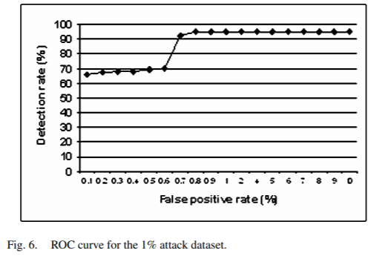
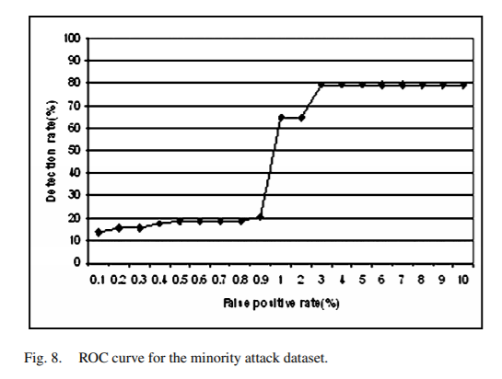
Experiments and Results

Slide 38
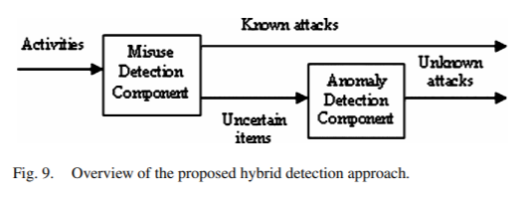
HYBRID INTRUSION DETECTION
Anomaly detection followed by misuse detection
Misuse and anomaly detection in parallel
Misuse detection followed by anomaly detection.
The hybrid system is used to detect known intrusions in real time and to detect unknown intrusions offline.

Slide 39
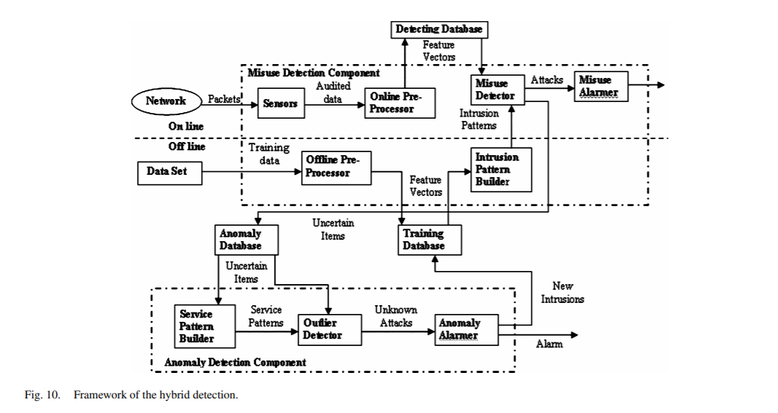

Slide 40
The experimental results show that the proposed hybrid approach can achieve high detection rate with low false positive rate and can detect novel intrusions.
The overall detection rate of the hybrid system is 94.7%. The overall false positive rate is 2%. The result shows that the anomaly approach detects some intrusions that are missed by the misuse approach.

