Slide 1
Internet Censorship and Online Speech Chapter 2: Technical Controls
Nick Feamster University of Chicago

Slide 2
Forms of Internet Protocol Interference
Internet Protocol (IP) / Transmission Control Protocol (TCP) Blocking
Domain Name System (DNS) Blocking and Manipulation
Border Gateway Protocol (BGP) Hijacking
Web (HTTP) Block Pages / Redirection
Throttling

Slide 3
Internet Censorship and Online Speech Chapter 2.2.1: Domain Name System
Nick Feamster University of Chicago

Slide 4
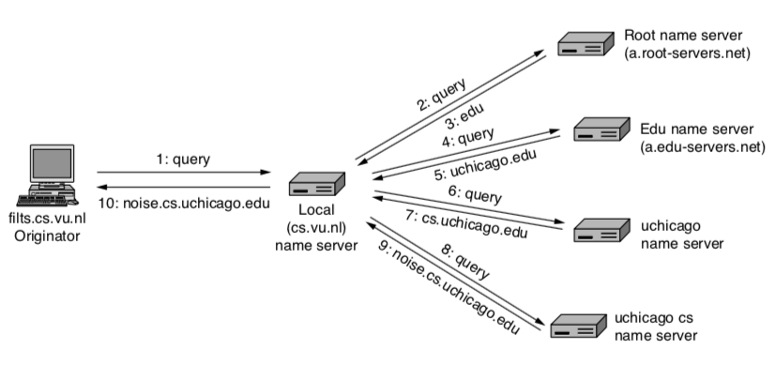
DNS: Mapping Names to Addresses

Slide 5
Using DNS
Local DNS server (“default name server”)
Usually near the end hosts who use it
Local hosts configured with local server (e.g., /etc/resolv.conf) or learn the server via DHCP
Client application
Extract server name (e.g., from the URL)
Do gethostbyname() or getaddrinfo() to get address
Server application
Extract client IP address from socket
Optional gethostbyaddr() to translate into name
5

Slide 6
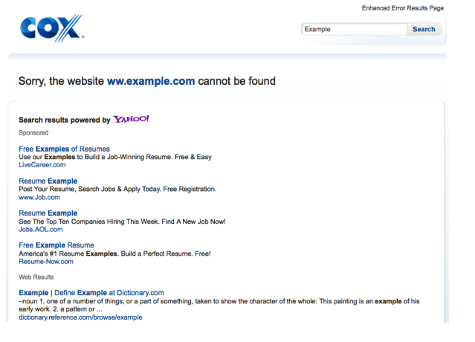
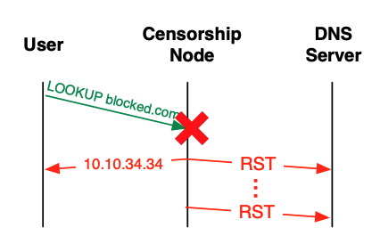
DNS Manipulation: Resolver
Resolver simply returns the wrong answer
Initially used for monetization of DNS errors, “no such domain” responses.
If the censor controls the resolver, it can return any answer to the client. Without DNSSEC, the response is not verified
Observed “on path” in Iran in May 2013.

Slide 7
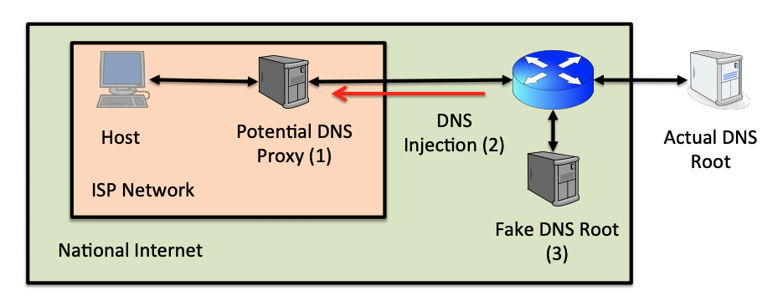
DNS Manipulation: Root Server

Slide 8
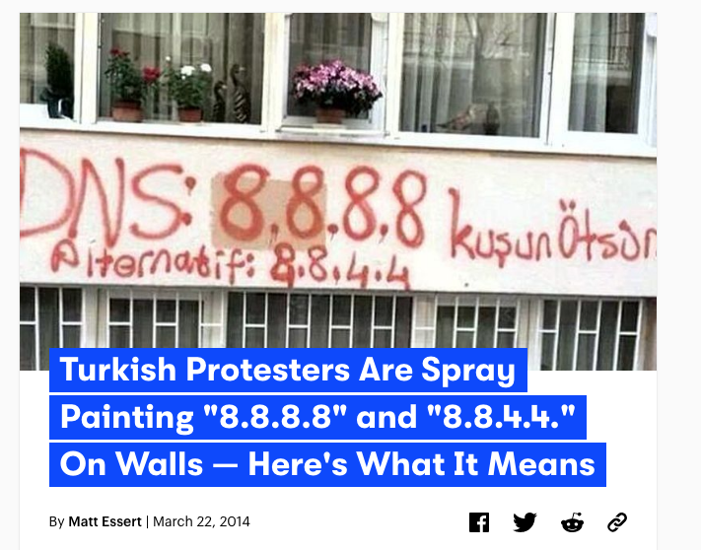
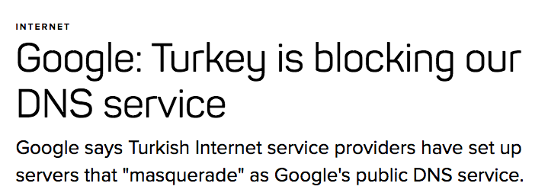

Slide 9
DNSSEC: Signing the DNS Reecords
Protects against data spoofing and corruption
Also provides mechanisms to authenticate servers and requests
Provides mechanisms to establish authenticity and integrity of individual responses

Slide 10
DNSSEC: New Resource Records to DNS
Two Public Key-related RRs
RRSIG: signature over RRset made using private key
DNSKEY/DS: public key, needed for verifying a SIG over a RRset, signed by the parent’s private key
One RR for internal consistency (authenticated denial of data)
NXT RR to indicate which RRset is the next one in the zone
Notes:
RFC 2535 discusses these RRs in detail.
CERT RR is outside the scope of this course.

Slide 11
RRSIG
Cover each resource record set with a public-key signature which is stored as a resource record called SIG RR
SIG RRs are computed for every RRset in a zone file and stored
Add the corresponding pre-calculated signature for each RRset in answers to queries
Must include the entire RRset in an answer, otherwise the resolver could not verify the signature

Slide 12
DNSSEC: Verifying the Tree
Question: uchicago.edu
. (root)
uchicago.edu A?
resolver
ask .edu server
SIG (the IP address and PK of .edu server)
by its private key
stub
resolver
uchicago.edu A ?
xxx.xxx.xxx.xxx
.edu
transaction
signatures
add to cache
ask uchicago.edu server
SIG(the IP address and PK of princeton.edu server)
by its private key
SIG(xxx.xxx.xxx.xxx)
by its private key
uchicago.edu
uchicago.edu
Notes:
RRSIG - Contains a cryptographic signature
DNSKEY - Contains a public signing key
DS - Contains the hash of a DNSKEY record
NSEC and NSEC3 - For explicit denial-of-existence of a DNS record
In DNSSEC, each zone has a public/private key pair. The zone's public key is published using DNS, while the zone's private key is kept safe and ideally stored offline. A zone's private key signs individual DNS data in that zone, creating digital signatures that are also published with DNS.
When an end user wants to access a website, a stub resolver on the user's computer requests the website's IP address from a recursive name server. After the server requests this record, it also requests the DNSSEC key associated with the zone. This key allows the server to verify that the IP address record it receives is identical to the record on the authoritative name server.
If the recursive name server determines that the address record has been sent by the authoritative name server and has not been altered in transit, it resolves the domain name and the user can access the site. This process is called validation. If the address record has been modified or is not from the stated source, the recursive name server does not allow the user to reach the fraudulent address. DNSSEC can also prove that a domain name does not exist. As a result of this process, DNS queries and responses are protected from man-in-the-middle (MITM) attacks and the kind of forgeries that could possibly redirect Internet users to phishing and pharming sites.

Slide 13
Summary
DNS is the protocol that maps Internet names to IP addresses
DNS has historically not had any integrity or confidentiality protections and so can often be manipulated
Manipulation can occur at multiple levels of the DNS hierarchy
DNSSEC is one defense against manipulation of DNS responses

Slide 14
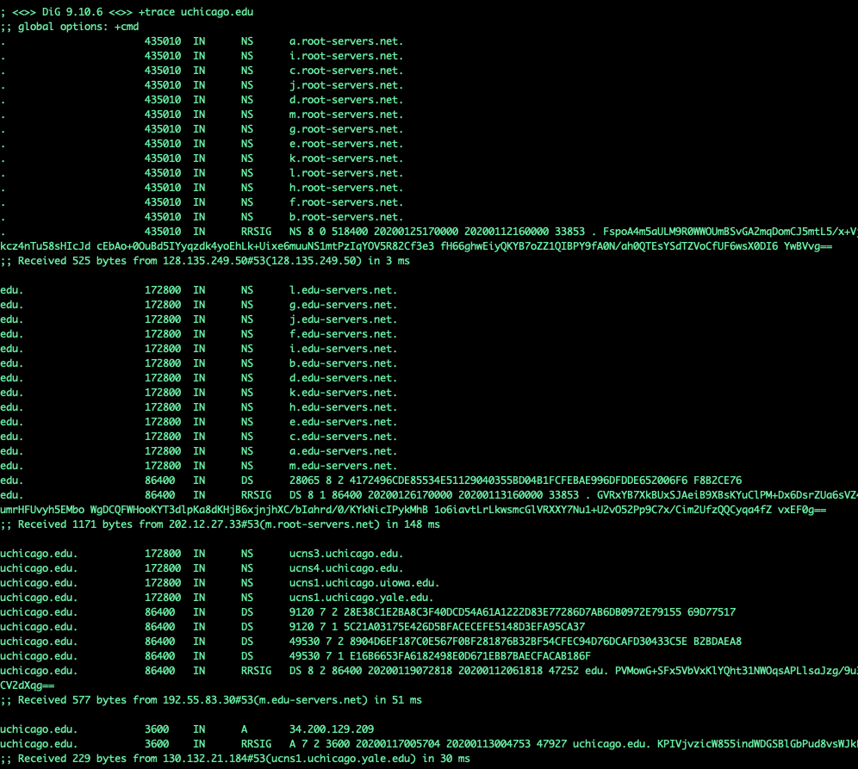

Slide 15
Internet Censorship and Online Speech Chapter 2.2.2: TCP/IP
Nick Feamster University of Chicago

Slide 16
IPv4 Addresses
Topological Addressing
32-bit number in “dotted-quad” notation
www.cs.uchicago.edu --- 128.135.164.125
128
135
164
125
10000000
10000111
10001100
01111101
Network (16 bits)
Host (16 bits)
Problem: 2³² addresses is a lot of table entries
Solution: Routing based on network and host
130.135.0.0/16 is a 16-bit prefix with 2¹⁶ IP addresses

Slide 17
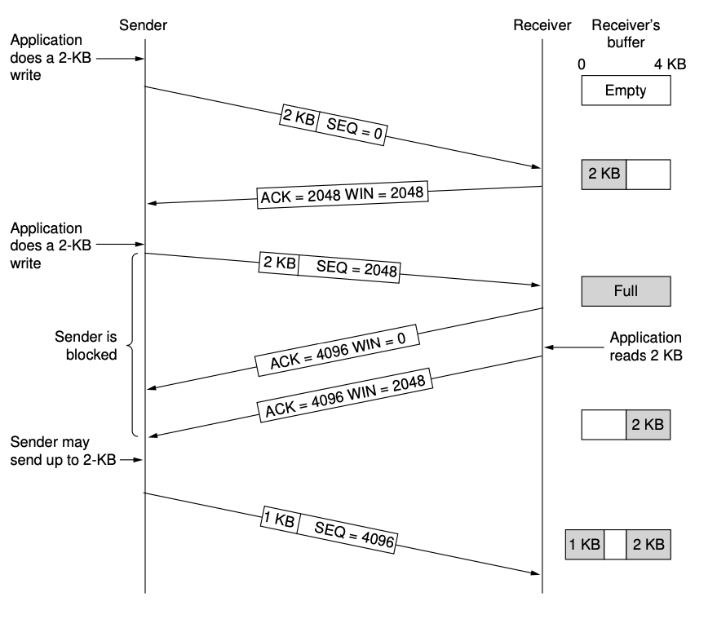
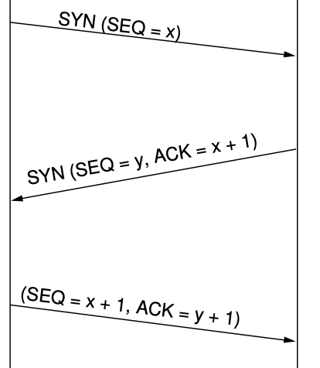
TCP/IP: Background
Setup: Three-Way Handshake
Data Exchange
Notes:
First some backgrounds:
Remember the TCP uses a three way handshake. Though You might not remember that each packet has IPID field, a 16 bits that is used for fragmentation reasons. I will use this field later.
Following tcp protocol states if I send an unsolicited SA to a host , then it should respond with a RST.
And finally if I send a syn to site with open port, it responds with SA. If I don’t send Ack or RST, because TCP is reliable the site retransmit synack multiple times
These are the properties of network protocol that I plan to leverage in Spooky scan and consequently Auger.

Slide 18

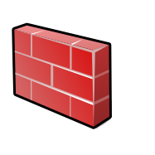

TCP/IP Firewalls
Alice
Block Traffic
Bob
Censored net
Uncensored net
Need a topological “chokepoint”
If the network is a graph, the firewall is a cut in the graph that partitions the graph into two or more disjoint components
Firewalls are often used to protect devices in the presence of a network perimeter where there is an easy way to separate “good” from “bad” devices.
Common firewall software
Snort
iptables
Commercial Software: Blue Coat

Slide 19
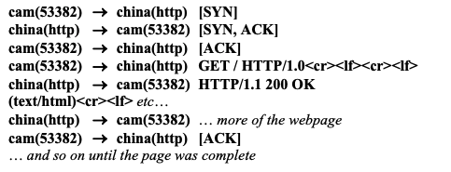
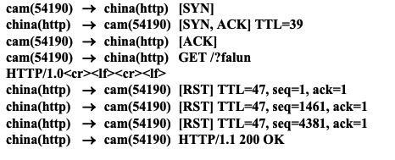
TCP Reset Injection
Normal Web Download
On-path firewall system can detect content that should be censored and inject traffic that resets the TCP connection.
Causes client to abort the connection or report some kind of generic error.
Based on content, between two hosts the firewall wishes to block, …
Can be done in either direction
Initial circumvention was to simply ignore the RST packets!
Connection Reset
Discovered by Clayton et al. (2007)
Notes:
The first three reset packets had sequence values that corresponded to the sequence number at the start of the GET packet; that value plus 1460, and that value plus 4380 (3 × 1460).23 We believe that the firewall sends three different values to try and ensure that the reset is accepted by the sender, even if the sender has already received ACKs for “full-size” (1460 byte) packets from the destination. Setting the sequence value of the reset packet “correctly” is necessary because many implementations of TCP/IP now apply strict checks that the value is within the expected “window.”24 The security vulnerabilities inherent in failing to check for a valid sequence value were first pointed out by Watson in 2004.2

Slide 20
TCP Packet Injection
If an end-host receives two packets with the same sequence number, the operating system will discard the second packet.
Traffic can thus be suppressed by injecting a packet “ahead” of the valid response.

Slide 21
Summary: TCP/IP
TCP/IP is the protocol that most Internet applications rely on for reliable Internet transport.
A common way to interfere with a TCP/IP connection is to simply reset the connection.
Blocking can occur in either direction, or both directions.
Blocking can be based on content (after initial packet exchange), or based on communication endpoints.

Slide 22
Internet Censorship and Online Speech Chapter 2.2.3: Border Gateway Protocol
Nick Feamster University of Chicago

Slide 23
Internet Routing Protocol: BGP
Autonomous Systems (ASes)
Route Advertisement
Destination Next-hop AS Path
128.135.0.0/16
Traffic
192.5.89.89
10578..160
128.135.0.0/16
66.250.252.44
174… 160
Session
Notes:
Diagram of routing table is very confusing because it’s not pointing to anything
Green arrow shorter, and too thick… green is a msg
More intuition about how the system actually works.
Don’t say “interdomain”
DESTINATION-BASED Routing
Tables look like a set of possible routes and a rankings over these routes
(pop up a simplified table fragment)

Slide 24
Border Gateway Protocol
Internet’s interdomain routing protocol, BGP, essentially has no security — will believe any routes advertised by neighboring router.
Different ways to interfere with Internet routing:
Cut-off (Egypt case)
BGP “route hijacking”

Slide 25
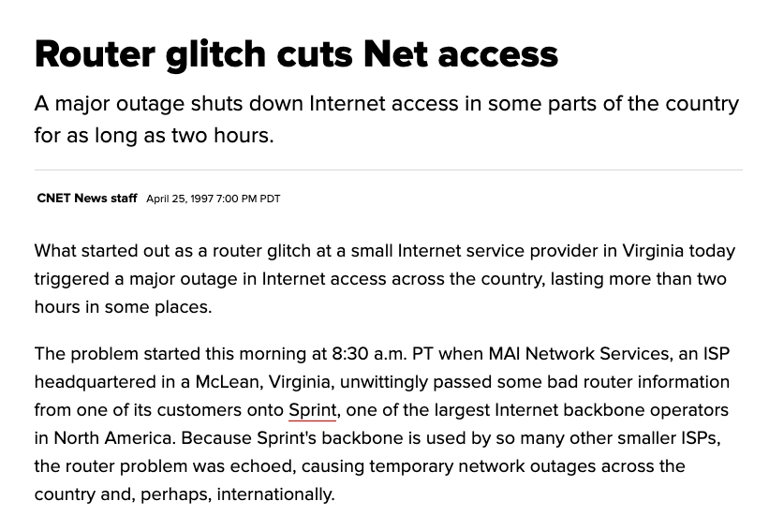

Slide 26
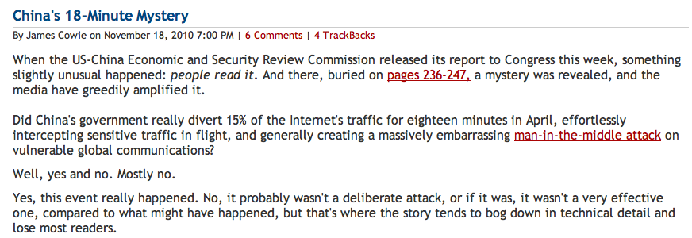
China’s Accidental Hijack

Slide 27
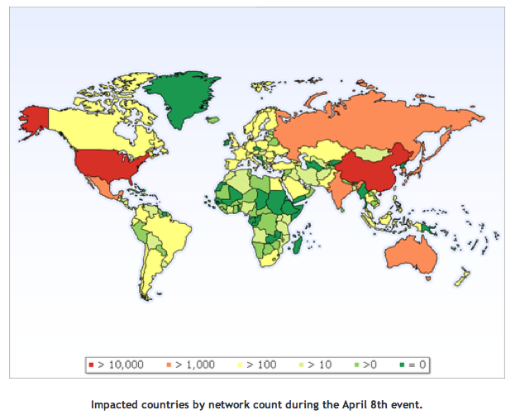
China Hijack: Sequence of Events
On April 8, 2010, China advertised about 50,000 blocks of IP addresses from 170 different countries
60,000 prefixes from the US
Event lasted for 20 minutes
Why did most people not notice?
How might more traffic have been intercepted?
http://www.renesys.com/blog/2010/11/chinas-18-minute-mystery.shtml

Slide 28
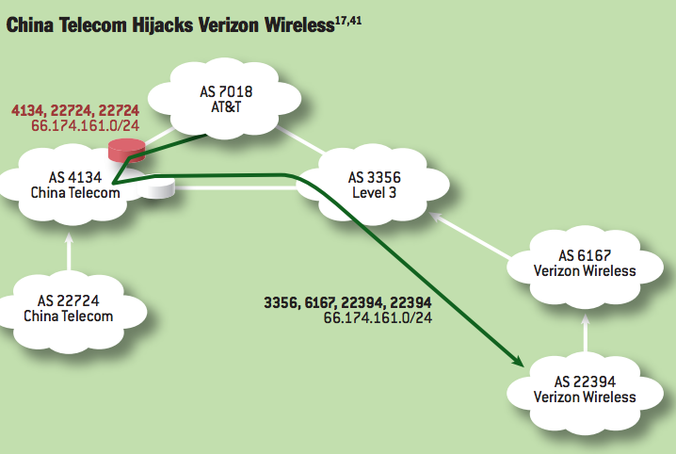
Notes:
China Telecom’s AS 22724 hijacks Verizon Wireless’s prefix 66.174.161.0/24. The bogus route originated by AS 22724 propagates through the AS-level graph and is eventually selected by AT&T because it is shorter than the legitimate route originating at Verizon Wireless’s AS 22394. Meanwhile, Level3 selects the legitimate route, because it is shorter than the bogus route. Thus, network traffic splits between the hijacking AS and the legitimate origin AS, with the nature of the split depending on routing policies used by individual ASes and the topology of the AS-level graph.

Slide 29
Other “Famous” Hijack Events
February 24, 2008: Pakistan advertises a small part of YouTube’s AS 36561
Likely as a botched attempt to block YouTube in Pakistan, following a government order
January 22, 2006: Con Edison (AS 27605) mistakenly advertises lot of networks (Level 3, UUNet, Panix ISP, …)
April 25, 1995: AS 7007 incident
“Ultimately, though, the problem remains on of transitive trust. A provider can and should limit the advertisements it will accept from a customer.”

Slide 30
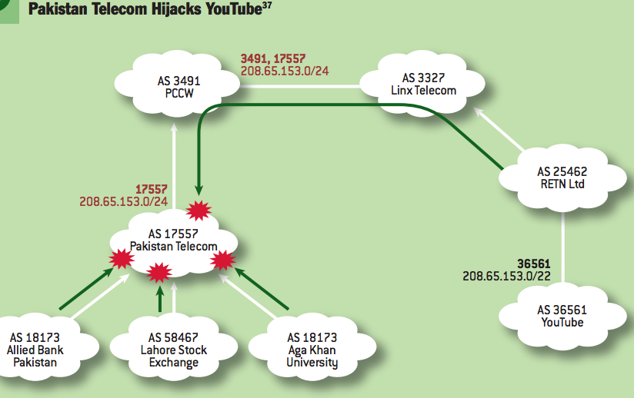
Notes:
Perhaps the most famous subprefix hijack occurred on February 24, 2008, when Pakistan Telecom took YouTube offline. The incident2 began when Pakistani authorities demanded that YouTube to be censored within Pakistan. To accomplish this, Pakistan Telecom’s AS 17557 launched a subprefix hijack by originating the subprefix 208.65.153.0/24 of YouTube’s prefix 208.65.153.0/22 to its customer ASes in Pakistan (e.g., Aga Khan University, Lahore Stock Exchange, Allied Bank Pakistan), as in figure 3.37,41 This meant that traffic destined for YouTube’s servers in AS 36561 would instead be forwarded to the longer IP prefix originated by Pakistan Telecom’s AS 17557, where traffic could then be dropped. Events took an unexpected turn when Pakistan Telecom’s bogus BGP announcement leaked out of Pakistan. PCCW, a large ISP that provides global network connectively to Pakistan Telecom, received the bogus routing announcement, selected the bogus route, and announced it to its own neighbors. Because the bogus route was for a longer prefix (/24) than the legitimate route (/22), longest-prefixmatch routing meant the bogus route was always more preferred by the legitimate route, and within minutes, at least two-thirds of the Internet was sending its YouTube traffic to Pakistan.2

Slide 31
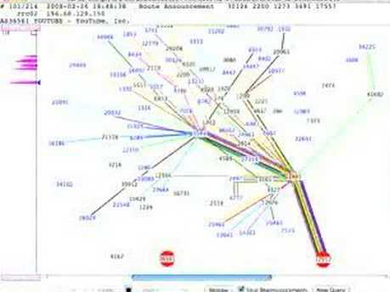

Slide 32
Summary
The Border Gateway Protocol (BGP) is the Internet’s interdomain routing protocol, used to connect tens of thousands of independently operated networks
BGP is notoriously insecure and susceptible to “route hijacks”.
Route hijacks occur accidentally through misconfiguration but also can be exploited by censors to interfere with connectivity to specific Internet sites.

Slide 33
Internet Censorship and Online Speech Chapter 2.2.4: Web Page Blocking
Nick Feamster University of Chicago

Slide 34
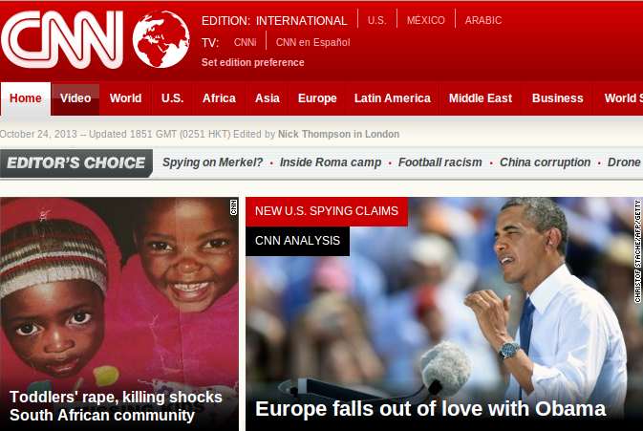

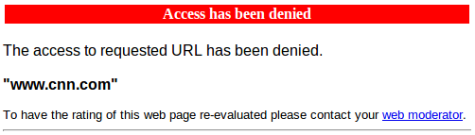
Block Pages: Common Form of Censorship

Slide 35
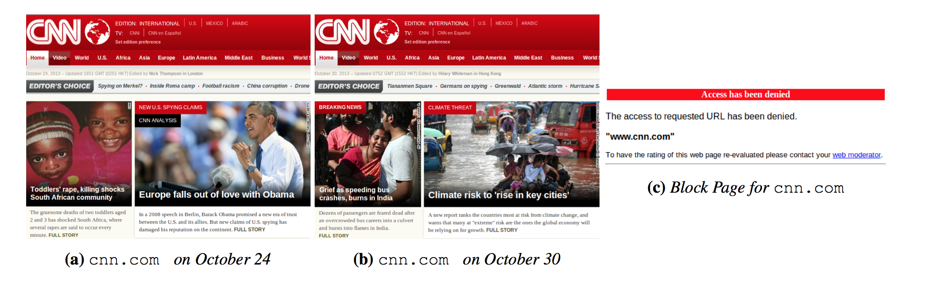
HTTP/Web Filtering: Block Pages
Differences in accessible pages inhibit block page detection
Pages are structurally similar, but contain different content

Slide 36
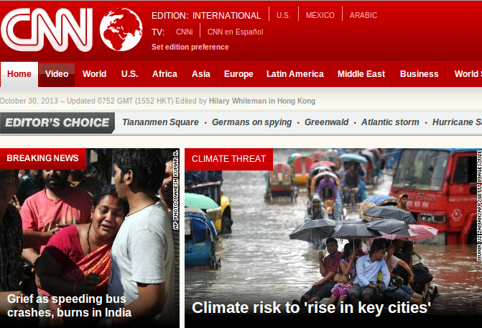
Block Page Detection is Tricky, but Length Comparisons Can Work

Slide 37
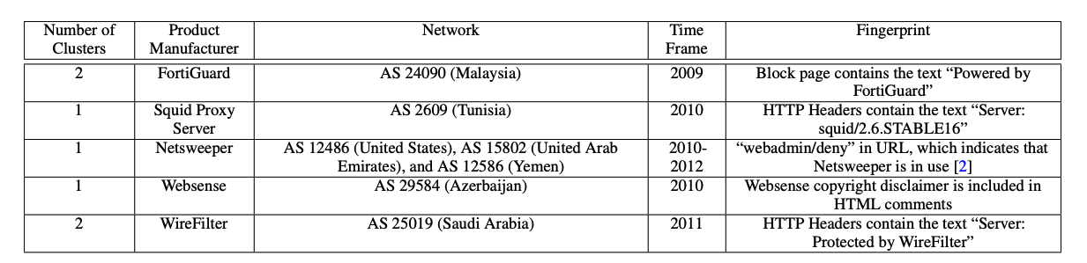
Some Common Web Filtering and Block Pages

Slide 38
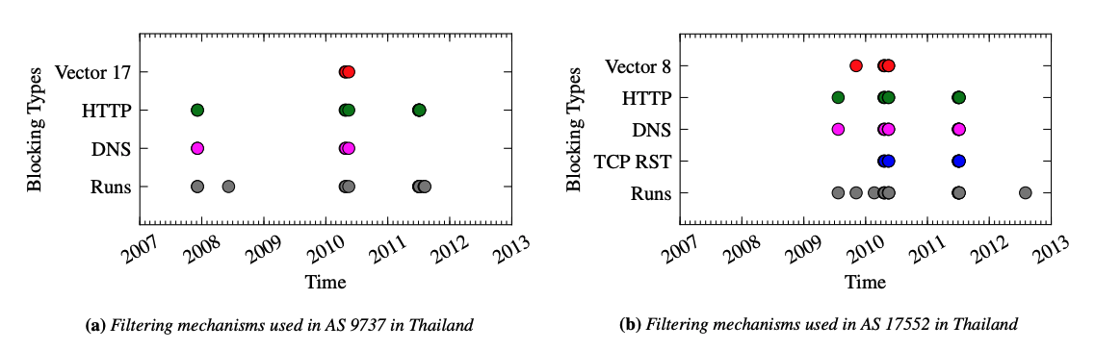
Mechanisms Differ Over Time and by ISP

Slide 39
Summary
Web page blocking is conceptually simple
Very easy for a user to spot: They know they’ve been blocked because they see a block page
Lots of software exists for delivering a block page to a user
Historically a simple “on path” mechanism.
More challenging with encryption, but can be done
Modern versions of HTTPS will make block page insertion more challenging

Slide 40
Internet Censorship and Online Speech Chapter 2.5: Throttling And Rate Limiting
Nick Feamster University of Chicago

Slide 41
Throttling
Slow down access to a site or service
Used not only in censorship, but also a common network management task (e.g., resource management)
Can be difficult for a user to distinguish intentional censorship from normal practice, congestion, etc.

Slide 42
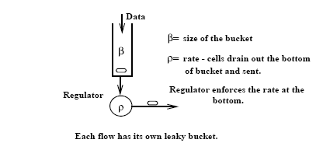
Leaky Bucket Traffic Shaper
Developed by Jon Turner, 1986 (Washington University, St. Louis)

Slide 43
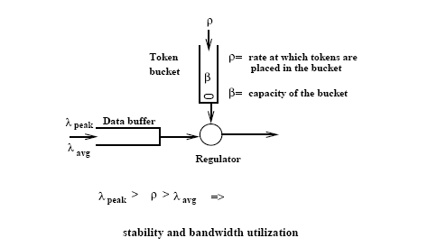
Token Bucket Traffic Shaper

Slide 44
Comparison between TB and LB
Token Bucket | Simple Leaky Bucket
TB permits burstiness, but bounds it | LB forces bursty traffic to smooth out
Burstiness is bounded as follows: - Flow never sends more than β+τ*ρ tokens worth of data in interval τ and - Long-term transmission rate will not exceed ρ | Flow never sends faster than ρ worth of packets per second
TB does not have discard or priority policy | LB has priority policy
TB more flexible | LB is rigid
TB is easy to implement Each flow needs counter to count tokens, each flow needs timer to determine when to add new tokens to the counter | LB is easy to implement

Slide 45
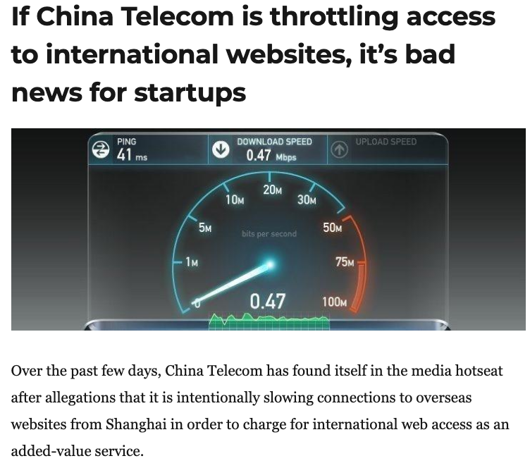
Throttling and Rate Limiting
An example of what Roberts calls “friction”: Increase the cost of accessing a site or service by slowing it down.
Very hard to detect reliably! (There have been some attempts to document the practice in certain countries, though experiments are limited.)

Slide 46
Summary: Protocol Censorship
Protocol manipulation: Interferes with communication
TCP/IP: Blocking, packet injection
DNS: Manipulation, redirection, …
BGP: Blocking, hijacking
Throttling/rate limiting: Increases friction for accessing sites and services
Open problems: Detecting different types of manipulation

