Slide 1
Internet Censorship and Online Speech Chapter 5: Circumventing Censorship
Nick Feamster University of Chicago

Slide 2
Technical Overview of Circumvention Techniques
Virtual Private Networks
Attacks: Privacy leaks from VPNs
Tor
Attacks: DNS leaks, traffic analysis, rogue exit nodes
Domain Fronting
Blocking domain fronting
Steganography
Attacks: “Parrot” attack
Decoy Routing

Slide 3
Virtual Private Networks

Slide 4
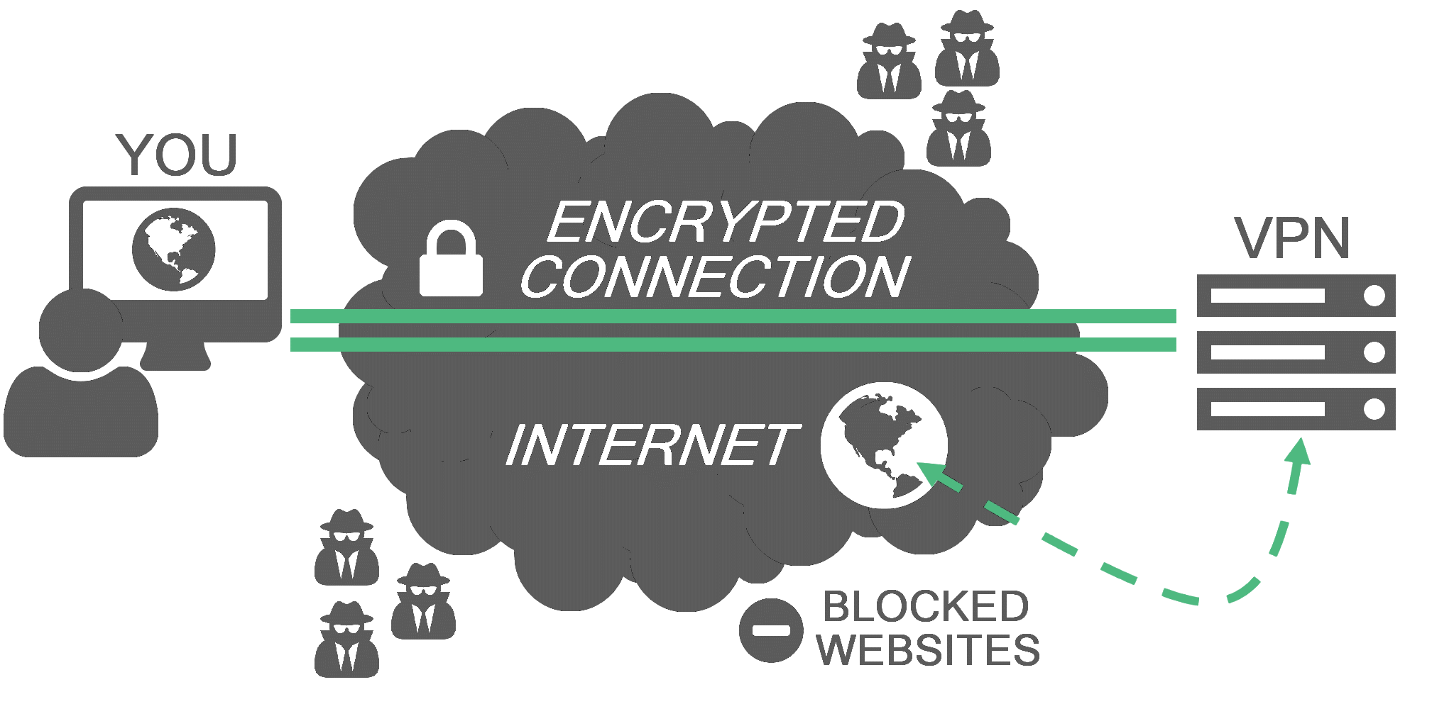
Virtual Private Networks (VPNs)
Encrypt and tunnel user’s traffic through proxy server.

Slide 5
Tor

Slide 6
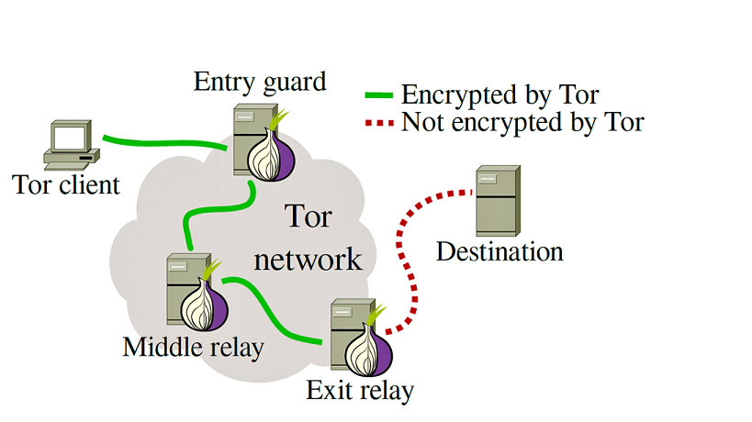
Tor
Route traffic through sequence of “onion” relay nodes.

Slide 7

The Tor Project
Main software: an onion routing protocol/tool to evade surveillance
Originally sponsored by the US Naval Research Laboratory.
From 2004 to 2006 was supported by EFF
Since 2006 has been 501(c)(3) nonprofit

Slide 8
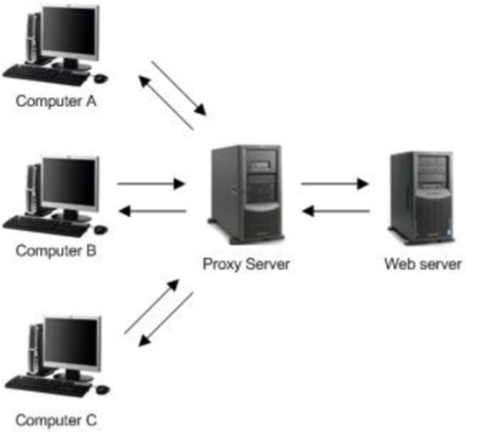
Q: What is an onion routing protocol?
A: Like a proxy. But better.

Slide 9
So How Does an Onion Routing Protocol Work?
The user creates a “circuit” leading to their destination.
At each hop, the node “unwraps” a layer from the packet via symmetric keys, revealing the next destination.
Full technical details: http://www.torproject.org/tor-design.pdf

Slide 10
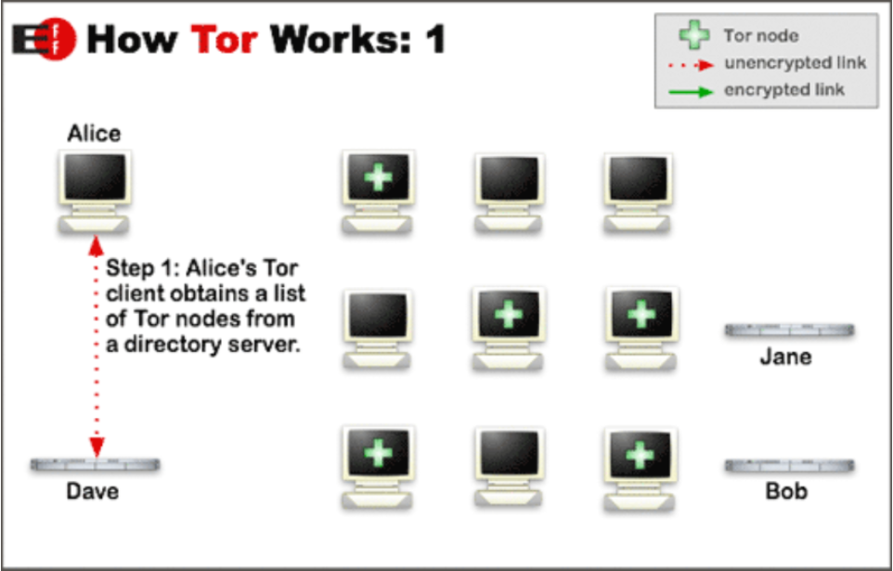

Slide 11
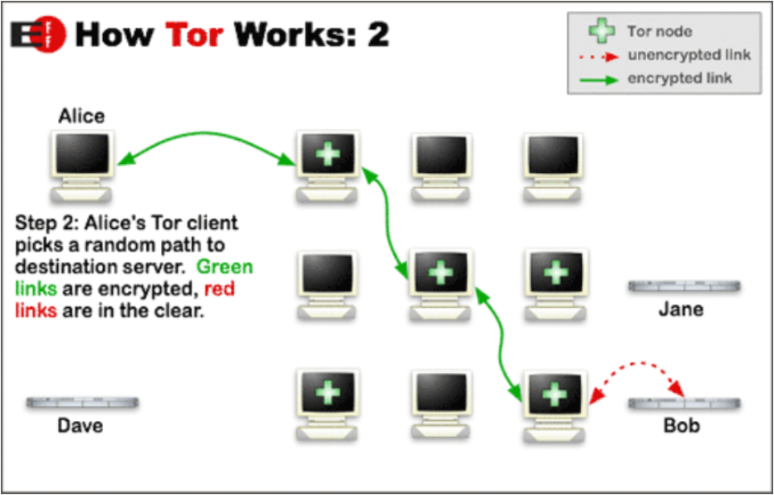

Slide 12
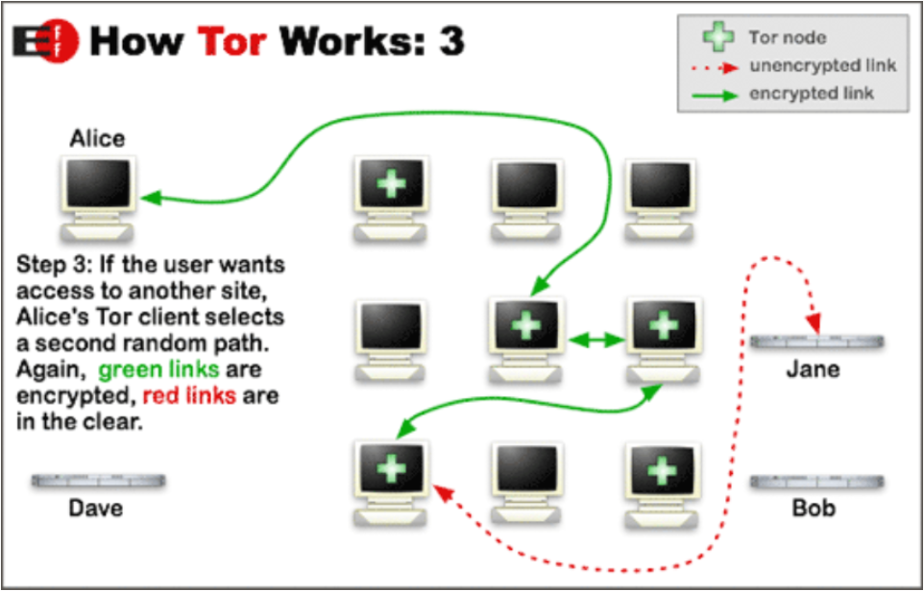

Slide 13
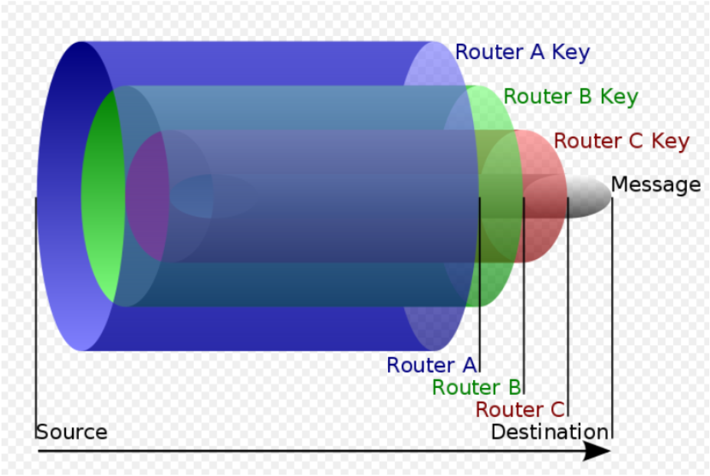
Onion Encryption

Slide 14
Threats to Privacy in Tor
DNS leaks
Traffic analysis
Website fingerprinting
Timing analysis
Rogue exit nodes

Slide 15





Using Tor Circuits
Clients begin all circuits with a selected guard
Relays define individual exit policies
Clients multiplex streams over a circuit

Slide 16
Using Tor Circuits
Clients begin all circuits with a selected guard
Relays define individual exit policies
Clients multiplex streams over a circuit
New circuits replace existing ones periodically

Slide 17


Node Adversaries

Slide 18

Link Adversaries
Some ASes and IXPs
handle much more
traffic than others!
AS8
AS6
AS6
AS7
AS1
AS2
AS3
AS4
AS5
Adversary has fixed location, may control one or more
autonomous systems or Internet exchange points (IXP)

Slide 19
Domain Fronting

Slide 20
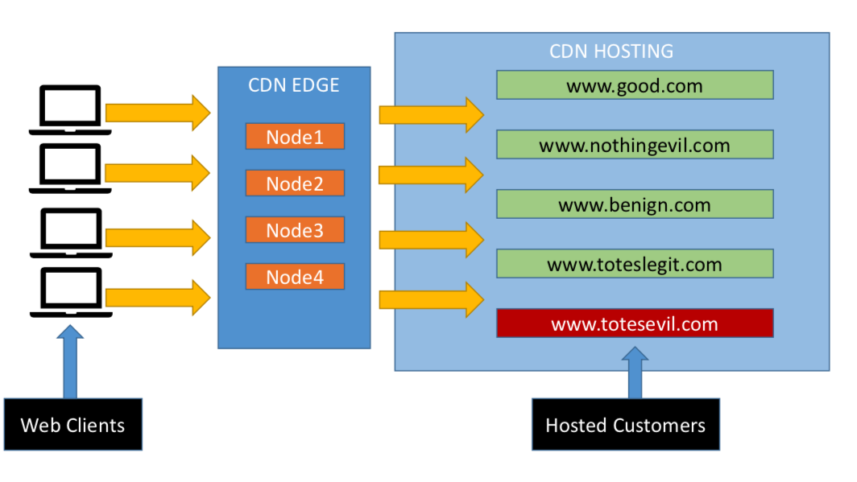
Domain Fronting

Slide 21
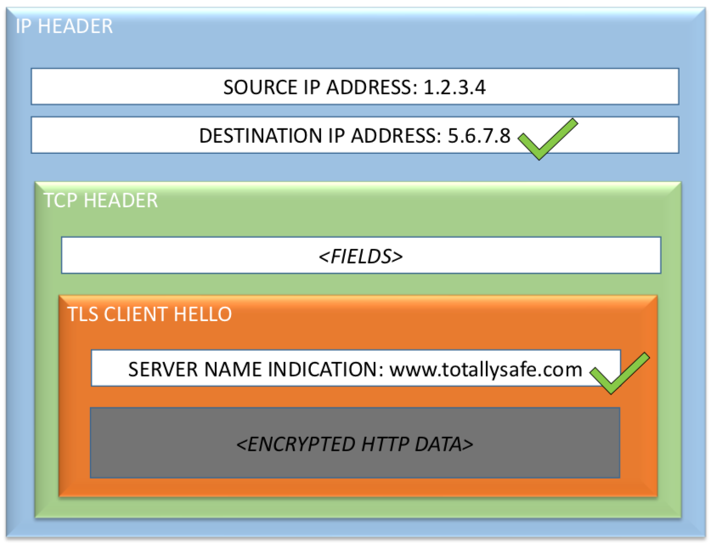
Domain Fronting: What Routers See

Slide 22
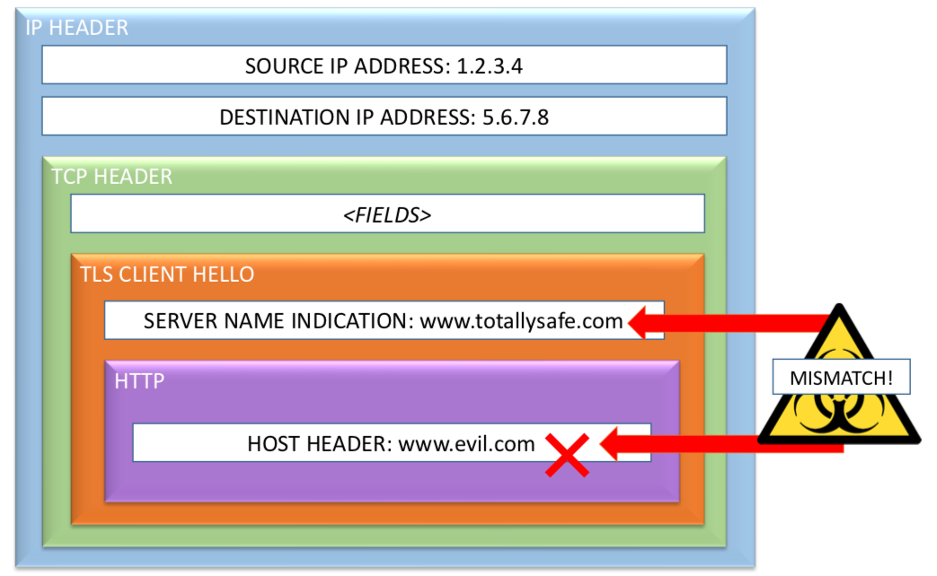
Domain Fronting: What Servers See

Slide 23
Use Cases for Domain Fronting
Messaging
Signal, Telegram, …
Proxy Networks
Tor (via Meek “pluggable transport”), Psiphon, Lantern, …

Slide 24
Steganography

Slide 25
Steganography: Overview
Goal: Hide the existence of any communication
Methods: Make one form of traffic look like another
Challenges: Performance, traffic analysis attacks

Slide 26
Steganography: Requirements
Client deniability
Detection could be embarrassing or worse
Client statistical deniability
Even suspicion could be a problem
Server covertness/statistical deniability
If server detected, can be blocked
Communication robustness
Even without detecting, censor could scramble covert channel
Performance (bandwidth, latency)

Slide 27
Receiving Content is Easier Half
Responder is a normal web server, serving images (among other things)
Encrypt data using requestor key
Embed in “unimportant, random” bits of images
E.g., high order color bits
Watermarking
Encrypted data looks random---only requestor can tell it isn’t (and decrypt)

Slide 28
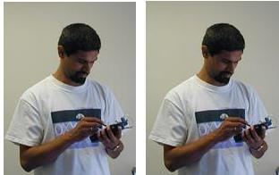
Example
One image has embedded content
You can’t tell which (shows it’s working)

Slide 29
Upstream (Requests) is Harder
No “random content bits” that can be fiddled to send messages to responder
Solution: let browsing pattern itself be the message
Suppose web page has k links.
GET on i^{th} link signifies symbol “i” to requestor
Result: log₂(k) message bits from link click
Can be automated
To prevent censor from seeing message, encrypt with responder key

Slide 30
Higher Performance
Idea: arithmetic coding of requests
If request i has probability p_{i}, then entropy of request distribution is –Σ p_{i} log p_{i}
Arithmetic coding encodes request i using log p_{i} bits
Result: expected request size equals entropy
Optimal
Problem: requestor doesn’t know probability distribution of requests
Doesn’t have info needed for encoding

Slide 31
Solution: Range Mapping
Adler-Maggs
Exploit asymmetric bandwidth
Responder sends probability distribution to requester using easy, downstream path
Requestor uses this “dictionary” to build arithmetic code, send encoded result
Variation for non-binary
Our messages aren’t bits, they are clicks
And server knows different clicks should have different probabilities

Slide 32
Toy Example
Suppose possible requests fewer than links on page
Responder sends dictionary:
“link 1 means http://mit.edu”
“link 2 means http://stanford.edu”
Assigns common requests to common GETs
Requestor GETs link matching intended request
One GET sends full (possibly huge) request
Problem: in general, ∞ possible requests
Can’t send a dictionary for all

Slide 33
Generalize: Twenty Questions
Order all strings lexicographically
Identify “split string” such that
Strings up to split have total probability <1/2
Strings after split have total probability <1/2
Responder sends split string
Requestor sends 0/1 as desired request precedes/follows split string
Recurse on half of distribution selected
Result: requestor sends O(entropy) bits

Slide 34





What About Covert Channels? (e.g., Infranet)
usenix.org
Unblocked host
Firewall
Alice
Bob
Censored net
Uncensored net
Not entirely robust against blocking
More deniable because messages are hidden
Requires dedicated infrastructure (Web servers)
Notes:
“Another approach is for Alice to establish a covert channel. One system that does this is Infranet, where a site like usenix.org hides messages from Bob its Web pages. When Alice uses Infranet, it appears that she is just browsing USENIX’s Web site, while in fact she is also receiving Bob’s messages. This system is nice because it prevents the censor from identifying users, but it still faces deployment hurdles and may be easily identified and blocked unless adopted by popular Web sites.”

Slide 35





Collage: Let User-Generated Content Help Defeat Censorship
User-generated content hosts
Alice
Bob, a Flickr user
Robust by using redundancy
Users generate innocuous-looking traffic
No dedicated infrastructure required
Notes:
“To meet our design goals, we have built Collage, which uses user-generated content to help circumvent censorship firewalls. To the best of our knowledge, Collage is the first system to satisfy all three of the design goals I have proposed.”
“Here is an example of how Collage works. Suppose Bob has an account on the popular photo-sharing site Flickr and has a fresh batch of photos that he wants to upload. Before uploading his photos, he fetches the blocked content for Alice, then hides it inside his photos. Afterward, he uploads these photos to Flickr. Later, Alice goes to Flickr, downloads the photos and extracts the content from them.”
“The first thing to notice is that Collage requires no dedicated infrastructure. Photos are stored on Flickr, which is an existing content host that already serves millions of photos every day.”
“Secondly, notice that both Alice and Bob generate plausible traffic. Bob uploads photos to Flickr just as he always would, and Alice simply browses Flickr and downloads some photos.”
“Note that although I used Flickr for this example, Bob could just as well use Collage with another content host like YouTube.”

Slide 36
Why Might Collage Work?
Lots of User-Generated Content (UGC)
More than 4 billion Flickr images
A day of video uploaded to YouTube every minute
Many sites host UGC
We have tools to store censored data in UGC
Steganography, watermarking
Notes:
“You may be skeptical that Collage can work in practice. There are several reasons to believe that it can.”
“First, there is a massive amount of user-generated content available. Flickr has over 4 billion images and an entire day of video is uploaded to YouTube every minute.”
“Second, there are many sites that host user-generated content. Aside from the famous examples like Flickr and YouTube, there are many blogs and forum sites that Collage could use. All the content could potentially serve an additional purpose by holding censored data”
“Finally, we do in fact have existing tools for hiding data inside user-generated content. These technologies are steganography and watermarking, which I’ll discuss later.”

Slide 37
Outline
Background and Design Goals
Collage Design
Performance and Demo
Notes:
“Ok, by now I have hopefully convinced you that Internet censorship is an interesting problem and that we have a new idea that can help solve it.”
“I’m now going to explain how Collage works in detail. Afterward, I will discuss its performance and show a demonstration of an application written using Collage.”

Slide 38
Collage, Step-by-Step
Embedded Vector
Vector
Message
Alice
Bob
Collage steps:
Obtain message
Pick message identifier
Obtain cover media
Embed message in cover
Upload UGC to content host
Find and download UGC
Decode message from UGC
Content host
Step 2: Pick message identifier
Application specific
Only intended recipient should know it
Step 3: Obtain cover media
Your personal photos
Generous users
Step 5: Upload UGC to content host
Step 7: Decode message from UGC
Step 1: Obtain message
Step 4: Embed message in cover
Next slide
Step 6: Find and download UGC
Notes:
“Ok, now I’m going to quickly take you through how Collage works step by step. After I’ve given you a general idea, I’ll go into detail on several steps.”
“So, suppose that Bob wants to send a message to Alice. The first thing he does is figure out what message he wants to send. For example, if he wants to send her a censored Web page he’ll fetch that Web page.”
“Next, Bob chooses a message identifier. I’ll discuss the specifics of this later in the talk, but briefly, the identifier is known only by Alice and Bob, and is used to agree on where Alice will find Bob’s message.”
“After picking the identifier, step 4 is to get some cover media. For example, some pictures from Bob’s digital camera. For the remainder of the talk, we are going to refer to any user-generated media as vectors, to convey the fact that they can hold censored data.”
“He then hides the message inside these vectors, which I go over in the next slide.”
“After the message is embedded inside the vectors, Bob uploads the vectors to a content host and Alice fetches these vectors from the content host. I’ll discuss this details of these steps in a few minutes.”
“After Alice has Bob’s vectors, she reverses the embedding process that Bob performed in step 4 and recovers the message.”
“Ok, so I’m now going to give you more detail on several of these steps.”

Slide 39
Embedding Messages in Vectors
Encrypt the message using the identifier
Generate chunks using erasure coding
Generate many chunks, recover from any k-subset
Allows splitting among many vectors, robustness
Embed chunks into vectors
Collage steps:
Obtain message
Pick message identifier
Obtain cover media
Embed message in cover
Upload UGC to content host
Find and download UGC
Decode message from UGC
Steganography: hard to detect
Watermarking: hard to remove
Do the reverse to decode
Notes:
“First I’m going to discuss how Bob embeds his message into his vectors.”
“First, he encrypts the message using the message identifier. Because we assumed that only Alice and Bob know the identifier, this prevents adversaries from recovering the message.”
“Next Bob runs the message through a rateless erasure coder. This will generate a large set of chunks, such that Alice can retrieve any smaller subset of these chunks and reconstruct the original message. For example, Bob might generate a thousand chunks, but Alice might only need 50 of them to recover the message.”
“Next, Bob embeds chunks into his vectors using information hiding techniques. The goal of this step is to store the chunks inside the vectors without visibly changing the cover vector. With steganography, the goal is to hide the existence of chunks, while in watermarking it is to make these chunks difficult to remove. I emphasize that the purpose of using information hiding is to store censored data into the vectors.”
“In step 7, after Alice downloads the vectors she performs the reverse operations to recover the message.”
“The nice thing to notice about this scheme is that by using erasure coding, we ensure a level of robustness, since Alice will only need to obtain some subset of Bob’s vectors in order to recover the message.”

Slide 40
Where Are Bob’s Vectors?
Crawling all of Flickr is not an option
Must agree on a subset of a content host without any immediate communication
Solution: A predictable way of mapping message identifiers to subsets of content hosts
Collage steps:
Obtain message
Pick message identifier
Obtain cover media
Embed message in cover
Upload UGC to content host
Find and download UGC
Decode message from UGC
Notes:
“Now, going back to Bob, after he embeds the message in his vectors, he uploads them to a content host. The question now is how does Alice find these vectors. It’s not as simple as it might sound. Without guidance, she might have to crawl the entire content host, or even several content hosts, before finding Bob’s vectors. Clearly, that’s impractical.”
“The solution is an algorithm that Bob and Alice can use to identify a small subset of a content host.”

Slide 41
Solution: Task Mapping
Tasks
Message Identifier
1
Hash the identifier
Hash the tasks
Map identifier to closest tasks
http://nytimes.com
11
Receivers perform these tasks to get vectors
Senders publish vectors so that when receivers perform tasks, they get the sender’s vectors
11
Search for blue flowers on Flickr
9
9
3
Look at JohnDoe’s videos on YouTube
Collage steps:
Obtain message
Pick message identifier
Obtain cover media
Embed message in cover
Upload UGC to content host
Find and download UGC
Decode message from UGC
Tasks
6
Notes:
“Our algorithm is called task mapping. It produces a list of actions, which we call tasks, that specify a set of vectors on the content host.”
“To begin, we hash the message identifier. For example, the message identifier nytimes.com might hash to 1. Next, assuming that Alice and Bob both have a collection of tasks, we get the hashes of each task. We hash the identifier and the tasks to the same message space, so we can map the message identifier to a set of tasks by, for example, picking the next two tasks in the space.”
“These tasks are actions that Alice can perform to get some vectors on the content host. For example, a task might be to search for blue flowers on Flickr.”
“Bob must upload vectors so that Alice will find them when she performs these tasks. Therefore, if Alice searches for pictures of blue flowers on Flickr, then Bob should upload pictures of blue flowers.”
“Ok, so to recap, if Bob wants to send Alice a message using Collage, he picks a message identifier and embeds the message into a set of vectors using erasure coding and information hiding. He then performs task mapping using the message identifier to discover where to upload the vectors. After he’s uploaded them, Alice will also perform task mapping to get a set of tasks that will yield Bob’s vectors.”

Slide 42


How Does Collage Meet the Design Goals?
Robust against blocking
Erasure coding
Many content hosts
Deniable against user identification
Traffic only to/from content hosts
Depends upon task construction
Require no dedicated infrastructure
Messages stored on content hosts
Notes:
“Let’s take a step back and see if Collage meets the design goals I proposed at the beginning of the talk.”
“First, because Collage uses erasure coding and an assortment of content hosts, messages are robust to blocking. Even if a censor blocks some vectors and content hosts, receivers can recover the message by fetching the remaining vectors from the remaining content hosts.”
“Second, at least at first glance Collage users generate deniable traffic because they only upload and download content from user-generated content hosts. However, the real-world deniability depends a lot on the types of tasks they perform and how frequently they perform them. Specifically, we provide a framework with which you can construct deniable applications.”
“Finally, Collage relies on user-generated content hosts to store transfer messages and so requires no dedicated infrastructure.”

Slide 43
How Do You Start Using Collage?
Send & Receive Messages
Help Censored Users
Distribute software
CDROM
Spam everyone
A secure network
Refresh task list
Receive using Collage
Online resource
Message identifier
Application specific
Donate your UGC vectors
Photos on Flickr
Tweets on Twitter
Etc.
Write Collage applications
Notes:
“So you may be wondering how users actually begin using Collage.”
“If a users want to send messages using Collage, they must get a hold of the Collage software. They must do this out of band, such as from a CD, from Spam e-mail, by bringing their computer to a secure network.”
“Because content hosts are dynamic by nature, users may also periodically need to update their list of tasks as tasks become invalid or new tasks become available. They might receive these updates using Collage itself or they could derive their tasks from some online resource such as a publically available list of popular search terms.”
“Finally, as we said before, Alice and Bob must agree on a message identifier for each message. There are application-specific algorithms for agreeing on message identifiers ahead of time. For example, using the date or a rotation scheme. We discuss this much more in the paper.”

Slide 44
Outline
Background and Design Goals
Collage Design
Performance and Demo
Notes:
“At this point I’m done discussing how Collage works.”
“Now I’m going to discuss Collage’s performance and show you a short demo.”

Slide 45
Performance Metrics
Sender and receiver traffic overhead
Sender and receiver transfer time
Storage required on content hosts
But these metrics can vary a lot:
Different content hosts
Different tasks
Different applications
Notes:
“We care about three performance metrics for collage: The traffic overhead and overall transfer times required by Alice and Bob, and the amount of storage required on content hosts.”
“Unfortunately, I can’t give you concrete numbers for these metrics in the general case because the implementation details of each application and content host vary so widely.”
“Instead, I’ll show you performance metrics for two example applications.”

Slide 46
Case Study
 | News Articles | Covert Tweets
Content host | Flickr | Twitter
Message size | 30 KB | 140 Bytes
Vectors needed | 5 | 30
Storage needed | 600 KB | 4 KB
Sending traffic | 1,200 KB | 1,100 KB
Sending time | 5 minutes | 60 minutes
Receiving traffic | 6,000 KB | 600 KB
Receiving time | 2 minutes | ½ minute
Experiments performed on a 768/128 Kbps DSL connection
Notes:
“The first application embeds news articles inside photos hosted on Flickr. For a 30 kilobyte message, we require 5 photographs and use about 7 megabytes of traffic over 6 minutes. A main cause of the large overhead for Flickr are extra advertisements and photo thumbnails.”
“The second application stores covert tweets inside other tweets on Twitter. To send a single 140 byte message, we need 30 tweets and under 2 megabytes of traffic. We spread out the posting of these tweets over the span of an hour to more closely approximate real Twitter usage.”
“These two applications give a idea of the performance you can expect from Collage. The take home message here is that Collage applications can have reasonable performance even if the capacity of the message channel itself is very limited.”
“I’m now going to show a demo of the first application, which publishes BBC news articles inside photos hosted on Flickr.”

Slide 47
Comparison to Other Systems
Technique | System | Robustness | Deniability | Infrastructure
Onion routing | Tor | Layered encryption; bridges | Encryption | Network of relay servers
Anonymous remailing | Mixminion | Many hops; mixing | Encryption | Network of remailers
Covert channels | Infranet | Could use many proxy forwarders | Browsing regular Web sites; Steganography | Custom Web servers
 | CovertFS | Multiple content hosts | Browsing regular Web sites; Steganography | None
 | Collage | Erasure coding; Many content hosts | Browsing content hosts; Info hiding | None

Slide 48
Imitating a Real System Is Hard
Not enough to mimic a "protocol," need to mimic
a specific implementation with all its quirks
A complex protocol in it entirety
Inter-dependent sub-protocols with
complex, dynamic behavior
Bugs in specific versions of the software
User behavior

Slide 49


Slide 50
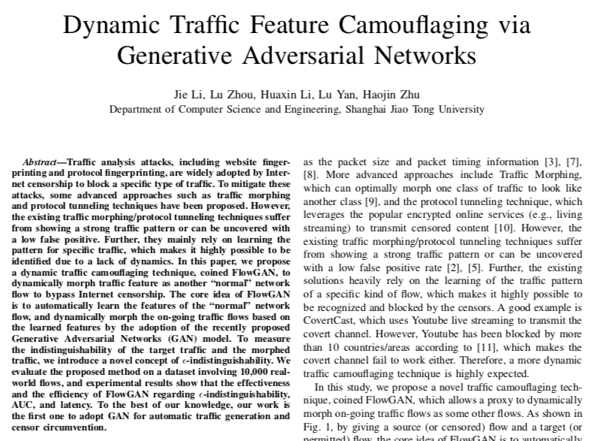
Looking Ahead: Generative Adversarial Networks?

Slide 51
Decoy Routing

Slide 52
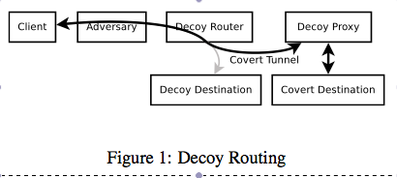
Decoy Routing
Decoy router can sit on any network path and act as a proxy (or forward client traffic to a decoy proxy).
But how can the client connect to the proxy?
Why can it not just address a packet to the proxy destination?
Solution: Connect to a decoy destination
Once connected covertly signal over TCP/IP flow that the decoy router should forward the packet to the proxy
Proxy then intercepts the TCP connection (drop connection to decoy destination) and act as a regular proxy.

Slide 53
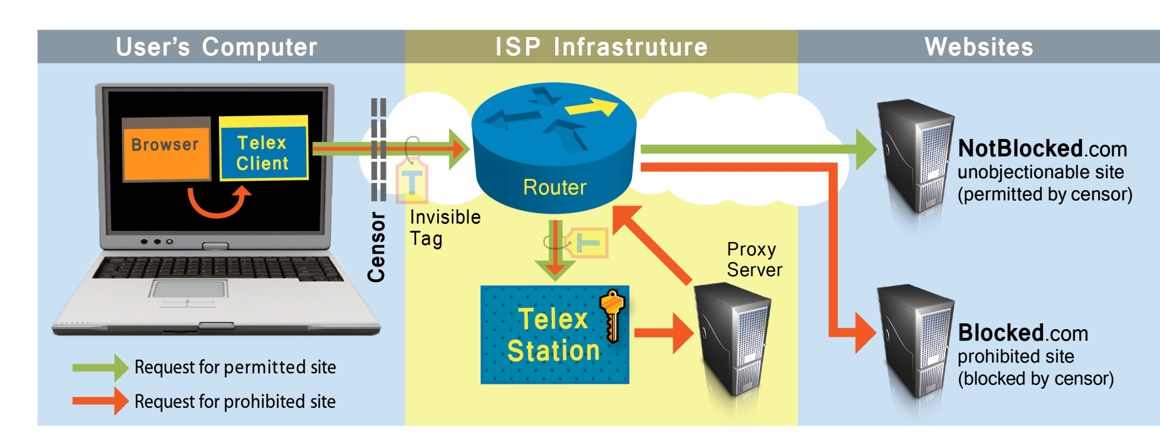

Decoy Routing
Notes:
Telex station forwards true request to a local proxy server. Telex injects responses into the original connection between client and NotBlocked.
Telex station not addressed by IP, but by position in the network – “end-to-middle” proxying; we use DPI and MITM to do _anti_censorship

Slide 54

Advanced Decoy Routing: Passive ISP Monitoring
Client
ISP Proxy
Server
TLS Handshake
Plaintext:
Ciphertext:
“GET / HTTP/1.1\r\nX-Ignore: \x81\x28\x66 …”
“\x95\x1f\x6b\x27\xe2 … \xc8\x3f\x22 …”
Tag:
ACK [seq=Y, ack=X]
“PROXY OK” [seq=Y, ack=X, len=M]
Plaintext:
ACK [seq=X, ack=Y+M]
ack != Y?
Plaintext:
“GET http://blocked.com/ …” [seq=X, ack=Y+M]
“HTTP/1.1 200 OK … <html> ….”
Plaintext:

Slide 55
Decoy Routing Deployment Requirements
Pros
No inline blocking required, only passive tap
Works with asymmetric flows (client -> server)
Cons
Censor can use active attacks
Requires ISP cooperation/deployment

