Slide 1
Internet Censorship and Online Speech Chapter 4: Measuring Censorship
Nick Feamster University of Chicago

Slide 2
Internet Censorship and Online Speech Chapter 4.1: Why Measure Censorship?
Nick Feamster University of Chicago

Slide 3
Questions from Political Scientists
Can we establish variation?
variation within authoritarian regimes (juntas, etc.? Does the country allow elections.)
is censorship uniform across countries? (e.g., western China is more unstable)
certain calendar days (May 4, June 5) have particular sensitive days. could do temporal study around those particular days.
what about triggers like movements in neighboring countries (Hong Kong)
Can we explain it?
relates to point of intent
reasons for censorship
cultural (norms, stigma, etc.)
political ("authoritarian phenomenon”) - prevent citizens from engaging in political reform.
can we tie descriptions of regime to the methods that a particular country?
why and when do we observe shifts?
Does the state ever have an incentive to decrease censorship?
are these methods complements? substitutes?
technological diffusion across countries (“China is the thought leader in repression”)
Notes:
----- Meeting Notes (4/14/17 13:42) -----
Ideational
Demonstration
Set of criteria for measuring how "free" a country is. Should we include "how free is the Internet?"
Freedom House metrics.
Grainger causality. Political repression has an impact on impeding connectivity. Repression -> Impeding Internet connectivity. (not operating on income).
Portmanteau measurements of censorship.

Slide 4
Types of Internet Filtering to Measure
DNS
Inconsistent responses
Blocked responses
TCP/IP
HTTP(S)
Circumvention tools
VPNs
Tor

Slide 5




Types of Filtering
Domains
NXDOMAIN
Drop request
Inject response
Q: twitter.com?
R: 185.45.5.43
DNS
resolver
IP addresses
TCP SYN
Censor
Send RST
Drop SYN
User
TCP SYN-ACK
HTTP GET /
URLs
HTTP 200 OK
Send RST
Drop GET
HTTP 302
twitter.com
Web server

Slide 6
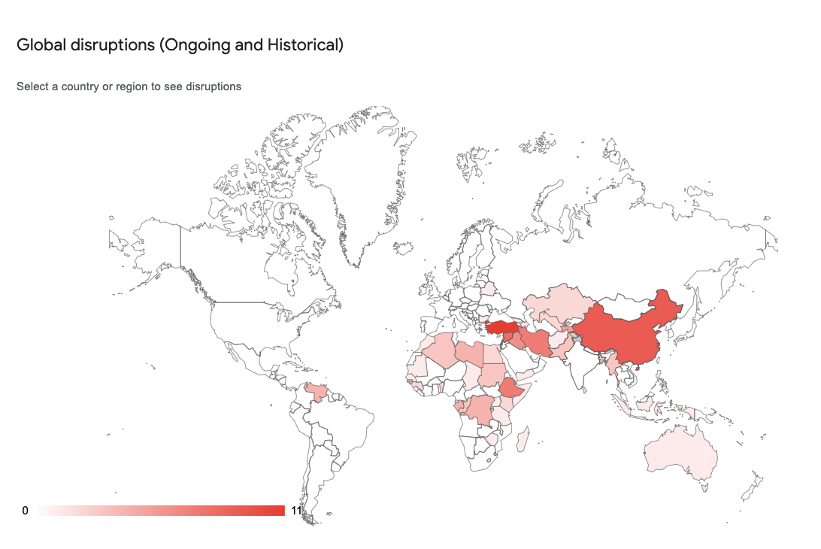
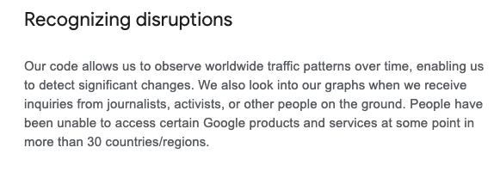
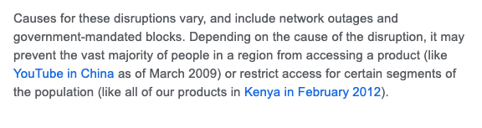
Google Transparency Report

Slide 7
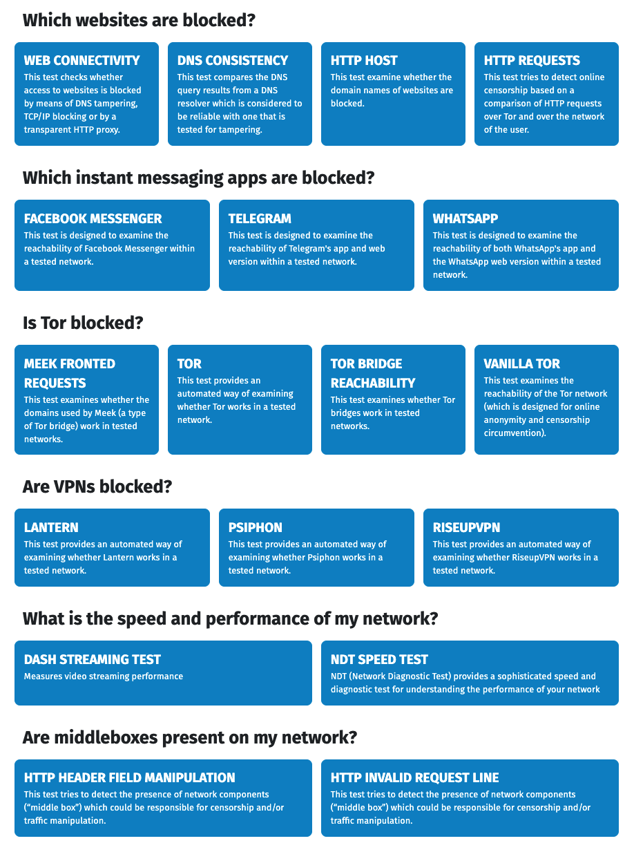
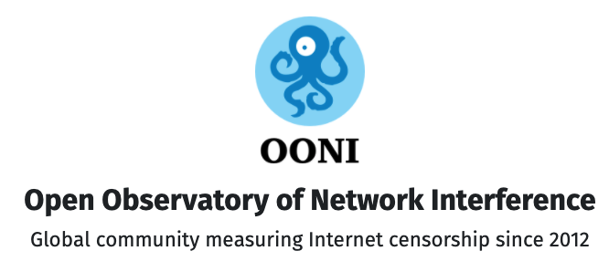
OONI: Open Observatory of Network Interference

Slide 8
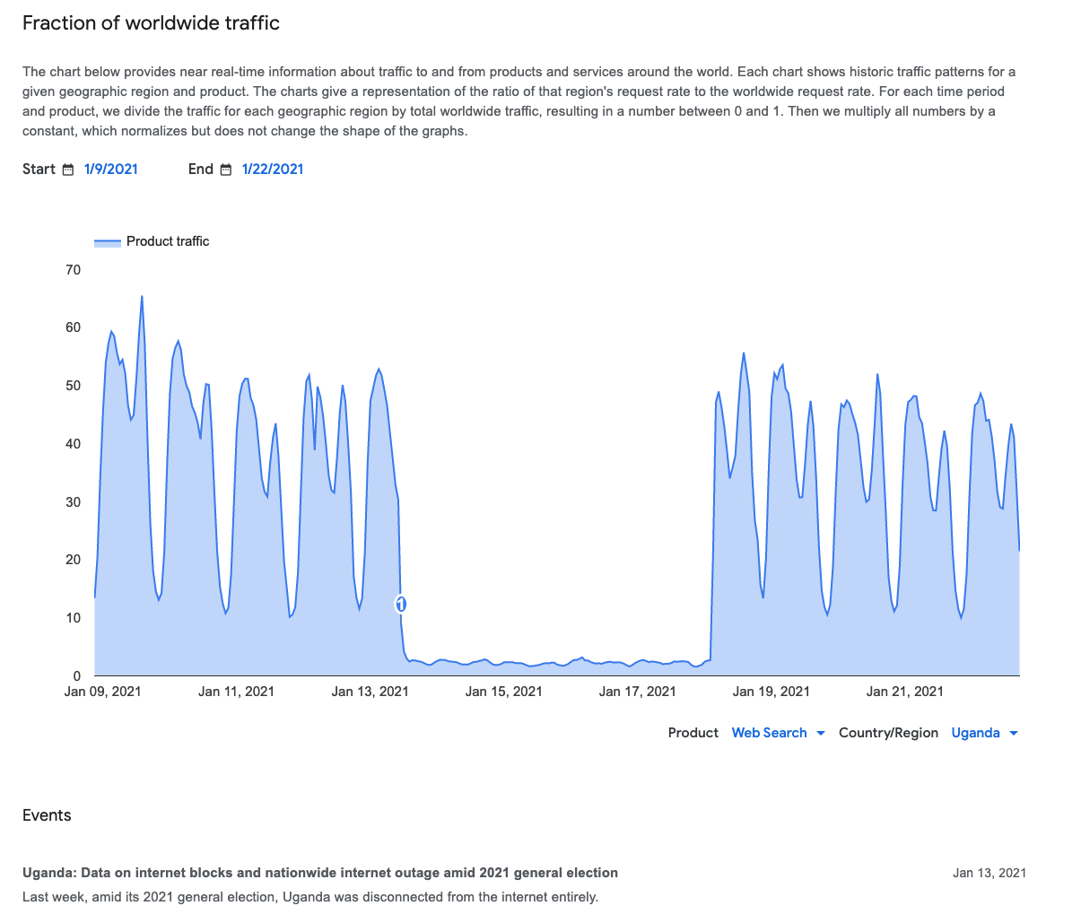
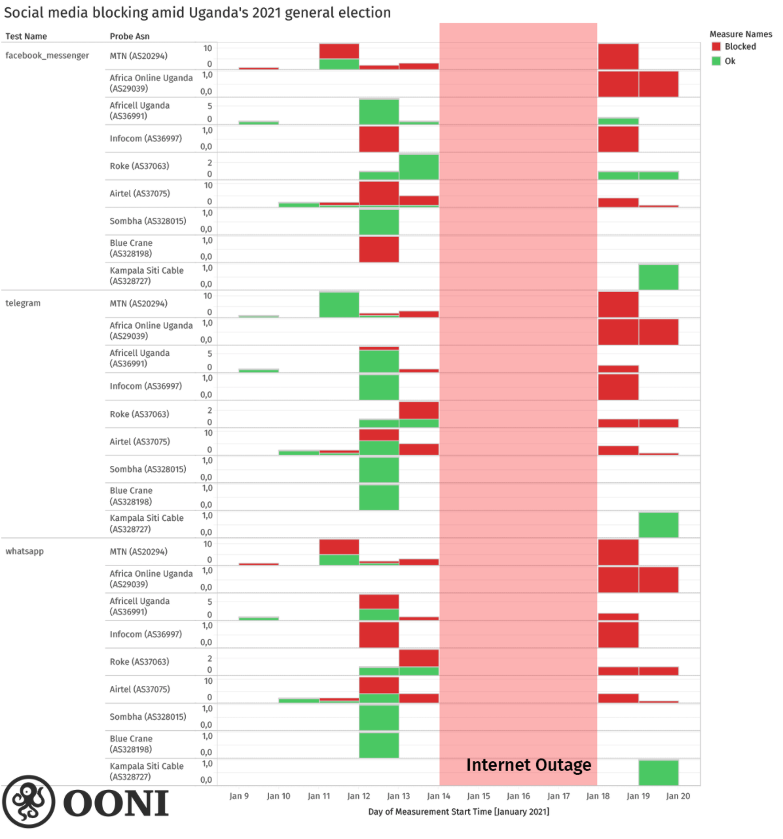
Case Study: Uganda Election (2021)
https://transparencyreport.google.com/traffic/overview
https://ooni.org/post/2021-uganda-general-election-blocks-and-outage/images/social-media-chart.png

Slide 9
Censorship Measurement is an Imperfect Process
Measurement at scale is always challenging.
Gathering measurements from locations where censorship is occurring is even more challenging.
It is possible to measure filtering/blocking directly with certain tools (Tor’s Open Observatory of Network Interference, OONI, is the leading tool).
The techniques we will explore largely involve remote measurement.

Slide 10
Internet Censorship and Online Speech Chapter 4.2: Measuring DNS Manipulation
Nick Feamster University of Chicago

Slide 11
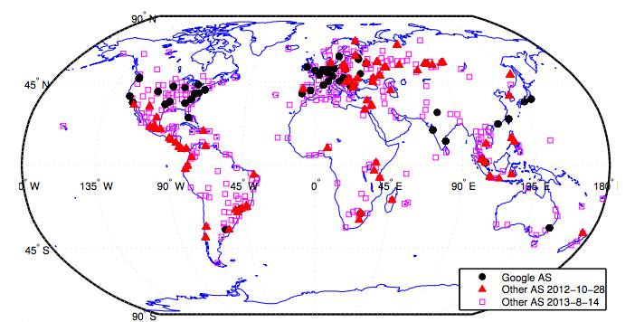
Detecting DNS Manipulation
Strawman: Find instances where the IP address returned does not agree with the “right answer”.
Problem: There is not a single right answer…
Extreme example: IP addresses returned for google.com (Katz-Bassett et al.)
Pearce, Paul, et al. "Global Measurement of DNS Manipulation." 26th {USENIX} Security Symposium ({USENIX} Security 17). USENIX} Association, 2017.

Slide 12
Type #1: Consistency Metrics
IP Address
Autonomous System (“ISP”)
HTTP Content returned
Consistency of HTTPS certificate
Reverse DNS lookup (IP address to name)

Slide 13
Type #2: Independently Verifiable Metrics
Content of HTTPS Certificate
Does the IP address present a correct domain in a valid, browser-trusted certificate
Same test, but with certificate fetched with SNI (the domain name)

Slide 14
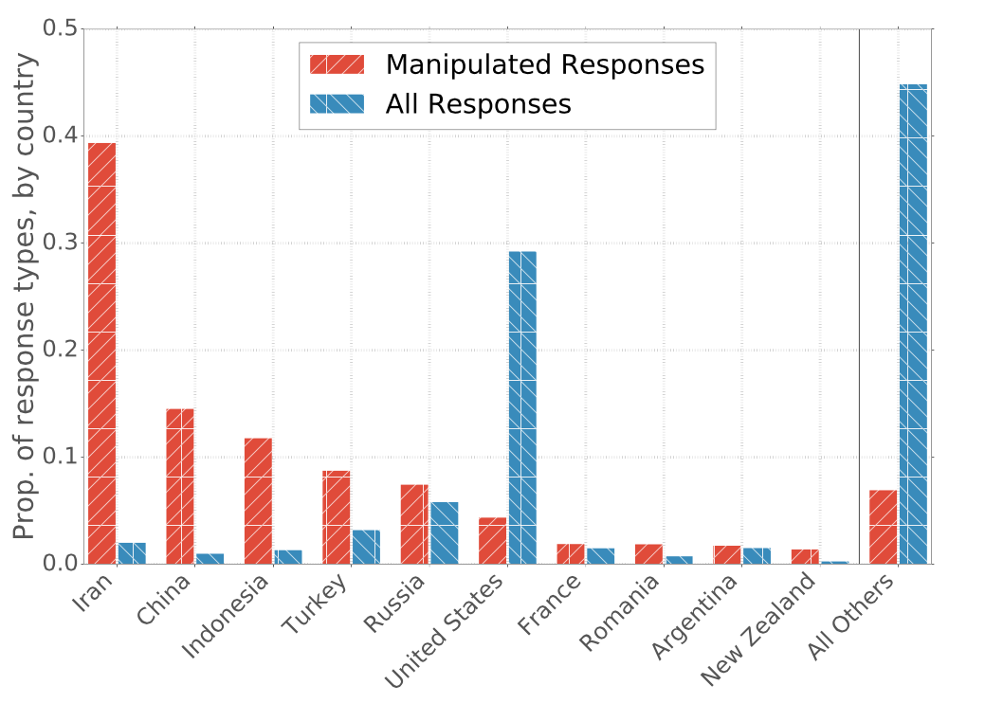
Prevalence of Manipulation by Country

Slide 15
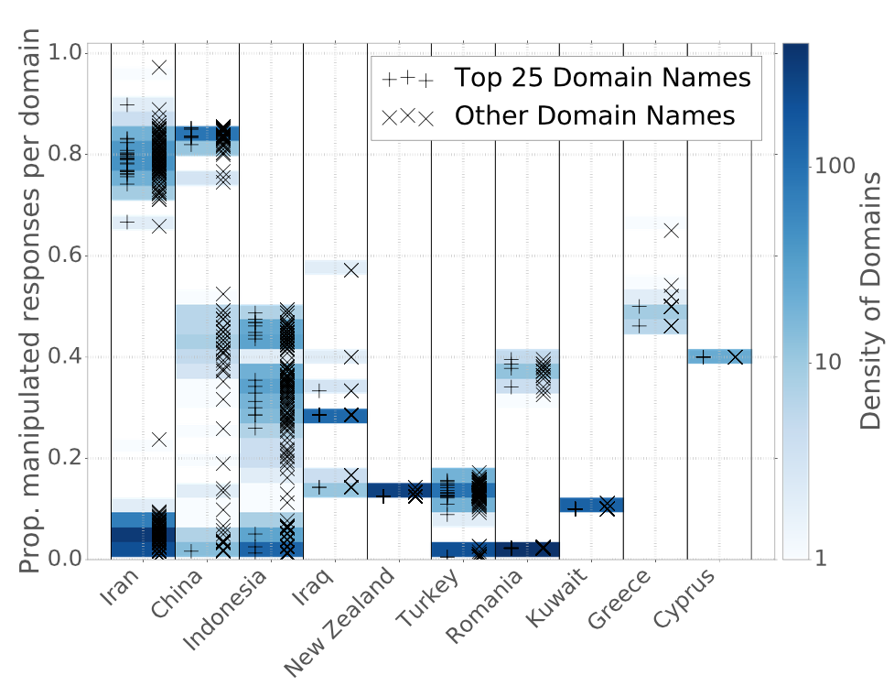
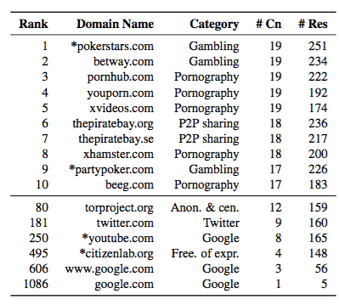
Manipulation of Domains within Countries
Notes:
----- Meeting Notes (4/14/17 13:50) -----
Need a version of this plot by category.

Slide 16
Summary
Inconsistent DNS responses do occur.
Attributing causality (e.g., to overt manipulation) is challenging.
DNS inherently gives “inconsistent” responses due to localization.
Responses may differ over time, by ISP, etc.
Balance between ethics and representativeness of sample.

Slide 17
Internet Censorship and Online Speech Chapter 4.3: Measuring TCP/IP Censorship
Nick Feamster University of Chicago

Slide 18
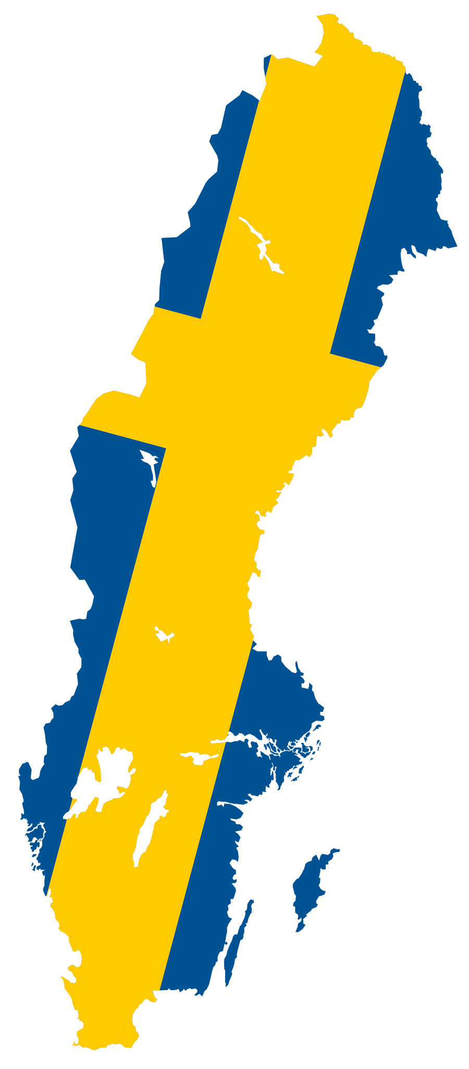


Solving the Vantage Point Problem
Side channels turn ordinary machines into vantage points!
Target
???
Origin
Notes:
Basically it is indirectly scanning. Using side channels don’t require root privileges and/or installation of any softwares in any hosts or any machine between them. It solves the vantage points problem of traditional approach, but it lack consent from the hosts to do measurment from them.

Slide 19
Idle Scan
Idle Scan uses side channel techniques to bounce scans off of a “Target” host to stealthily scan an “Origin” [2]
Spooky scan a.k.a Hybrid Idle scan can detect the direction of blocking between an Origin and a Target [3]
Target
Origin
[2] Idle Port Scanning and Non-interference Analysis of Network Protocol Stacks Using Model Checking by Roya Ensafi, J.Park, D. Kapur, and J. Crandall (In: USENIX Sec’ 2010)
[3] Detecting Intentional Packet Drops on the Internet via TCP/IP Side Channels by Roya Ensafi, Jeffrey Knockel, Geoffrey Alexander, and Jedidiah R. Crandall (In: PAM’14)

Slide 20
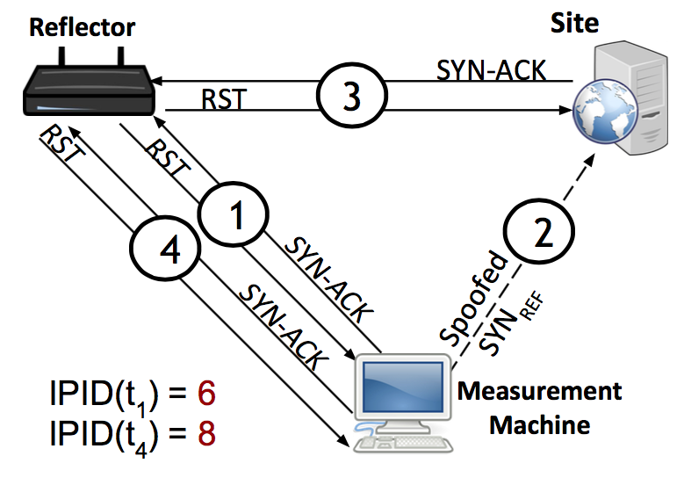
Key Observation: IP ID Increment
Global IP ID for reflector
Increments for each packet sent
We can perturb this counter from a remote location
Continually probe reflector for IP ID value
Spoof packets from the measurement machine
Appear to come from reflector
Behavior under “normal” reachability
Notes:
The strategy behind our method is to leverage the fact that when an Internet host generates and sends IP packets, each generated packet contains a 16-bit IP identifier (“IP ID”) value that is intended to assist endpoints in re-assembling fragmented IPv4 packets.

Slide 21
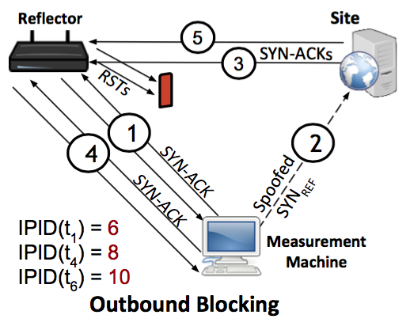
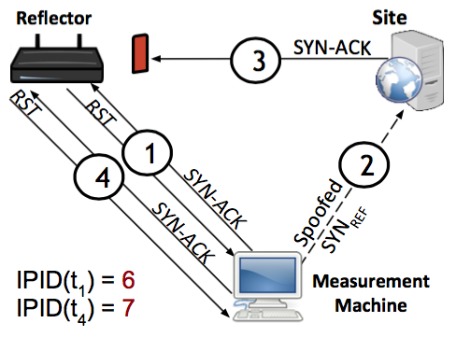
Scan Behavior: Blocking
Reflector to Site Blocked
Site to Reflector Blocked

Slide 22


Statistical Detection: Max Likelihood
Random variable: IP ID acceleration
Detect the presence or absence of a prior (in this case, our perturbation), based on the separation of distributions of values under the prior.
Detection framework: Statistical Hypothesis Testing
Assumptions: IP ID acceleration is stationary, i.i.d.
Randomization of trail order, run trials over a course of weeks
Likelihood ratio:

Slide 23
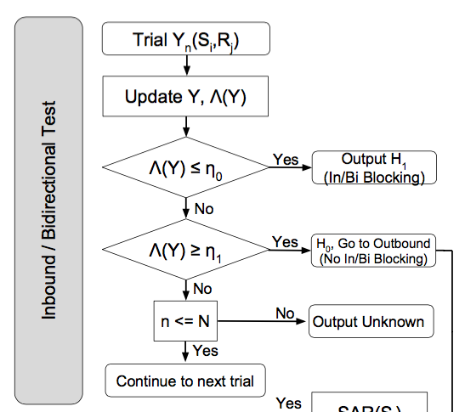
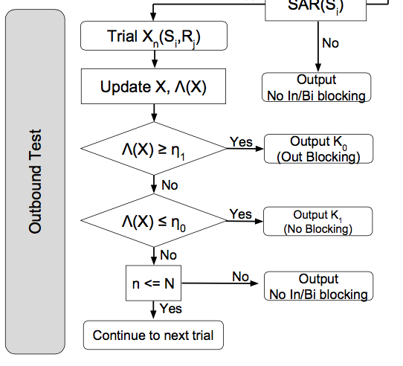
Statistical Hypothesis Testing

Slide 24
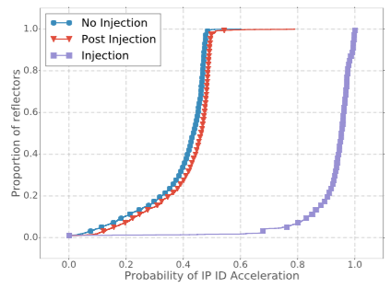
Measurement Vantage Points
Ethics: Restrict to “infrastructure” machines.
53,000 vantage points in about 180 countries
Measure ~ 2,200 sites (Alexa, Citizen Lab, etc.)
Prior probabilities of IP ID acceleration.

Slide 25
Validation: Macro and Micro
Comparisons against Citizen Lab block list (about half of our URL test list)
Similar proportions to the amount of blocking we observe in aggregate across our test set
Comparisons against Tor bridges that were known to be blocked from previous studies
Notes:
we observe that for 99% of reflectors, more than 56.7% of inbound filtering is towards CLBL sites.
Our findings are consistent with this ground truth. Both TB1 and TB2 experienced inbound filtering in China only, while connectivity to TB3 was never disrupted. Of the 36 reflectors in China, we detected inbound filtering of TB1 for 8 reflectors, no filtering for 8 reflectors, and inconclusive evidence for the remaining 20.

Slide 26
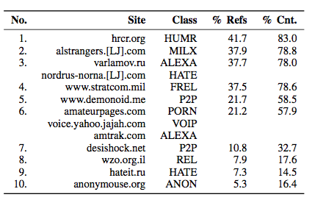
Inbound Blocking
Notes:
ANON Anonymizers and censorship circumvention EMAIL Free email FEXP Freedom of expression and media freedom FREL Foreign relations and military
HATE Hate speech HOST Web hosting services HUMR Human rights MILX Militants extremists and separatists MINF Minority faiths P2P Peer-to-peer file sharing POLR Political reform PORN Pornography REL Religious conversion, commentary and criticism USMIL US government-run military website VOIP Voice over Internet Protocol (VoIP)

Slide 27
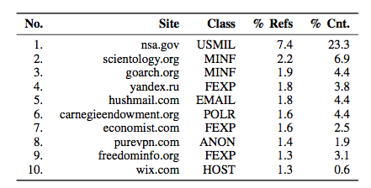
Outbound Blocking
Notes:
ANON Anonymizers and censorship circumvention EMAIL Free email FEXP Freedom of expression and media freedom FREL Foreign relations and military
HATE Hate speech HOST Web hosting services HUMR Human rights MILX Militants extremists and separatists MINF Minority faiths P2P Peer-to-peer file sharing POLR Political reform PORN Pornography REL Religious conversion, commentary and criticism USMIL US government-run military website VOIP Voice over Internet Protocol (VoIP)

Slide 28
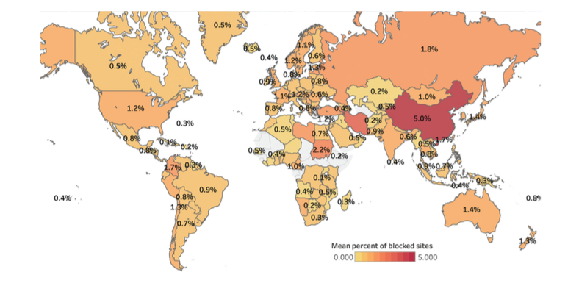
Notes:
Global heat map showing the percentage of sites filtered for any client in countries around the world. China experiences the highest average amount of filtering, at 5% of measurable sites filtered by a resolver within the country.

Slide 29
Summary
Measuring censorship from third-party vantage points presents unique challenges.
Certain protocols leak state information through side channels that allow certain types of filtering to be observed from third-party vantage points.
Such techniques are often indirect and statistical, and introduce ethical considerations.

Slide 30
Internet Censorship and Online Speech Chapter 4.4: Measuring Web Filtering
Nick Feamster University of Chicago

Slide 31
How Encore Works
Origin Web site
GET /
Vantage point
“Can you access http://twitter.com?”
http://encore.gatech.edu
Web browser
in Iran
Cross-origin
GET /favicon.ico
Measurement target
How?
Censor
http://twitter.com

Slide 32
The same-origin policy makes this harder
An origin is a tuple: (protocol, hostname, port)
https://twitter.com → (https, twitter.com, 443)
Browsers prevent cross-origin data reads:
AJAX requests
Inspection of iframe contents
Cookies and local storage

Slide 33
Encore Doesn’t Need to Read Data
It only needs to know whether a URL loaded.
Restrictions on resource embedding are looser.
Examples:
Images with <img>
Style sheets with <style>
Arbitrary content with <iframe>

Slide 34
Inferring censorship
Domains
NXDOMAIN
Drop request
Inject response
Many images, same domain
Q: twitter.com?
R: 185.45.5.43
DNS
resolver
IP addresses
TCP SYN
Many images, same IP
Send RST
Drop SYN
User
TCP SYN-ACK
HTTP GET /
URLs
HTTP 200 OK
Send RST
Drop GET
HTTP 302
Load URLs in iframe
twitter.com
Web server

Slide 35
Potential Risks
Encore loads potentially censored URLs
Possibly dangerous to users
Informed consent is infeasible
Encore is opt-out

Slide 36
Reducing Risks
Risk depends on usage
What URLs we ask users to measure
Which users run those measurements
Low-risk use cases
URLs often loaded with cross-origin requests
Scalable network availability monitoring

Slide 37
Summary
Key contributions
Encore enables measurement of Web censorship using ordinary Web browsers as vantage points
A technique for measuring censorship at scale
A censorship emulation testbed
Open source software

Slide 38
Additional Resources/Data
Internet Censorship Lab (ICLab) https://iclab.org/
Censored Planet https://www.censoredplanet.org/
Open Observatory of Network Interference (OONI) https://ooni.org/data/

Slide 39
Internet Censorship and Online Speech Chapter 4.5: Ethics of Censorship Measurement
Nick Feamster University of Chicago

Slide 40
What is “Ethics”?
“Ethics (or moral philosophy) involves systematizing, defending, and recommending concepts of right and wrong behavior.”
Normative ethics, is concerned with developing a set of morals or guiding principles intended to influence the conduct of individuals and groups within a population (i.e., a profession, a religion, or society at large).
Consequentialism
Deontology

Slide 41
Computer Ethics
“A typical problem in computer ethics arises because there is a policy vacuum about how computer technology should be used.
Computers provide us with new capabilities and these in turn give us new choices for action. Often, either no policies for conduct in these situations exist or existing policies seem inadequate.
A central task of computer ethics is to determine what we should do in such cases, i.e., to formulate policies to guide our actions.”
-Moor

Slide 42
Ethics vs. Law
“Law can be defined as a consistent set of universal rules that are widely published, generally accepted, and usually enforced”
Related but by no means identical (e.g., legal but not ethical, ethical but not legal)
Adherence to ethical principles may be required to meet regulatory requirements surrounding academic research
A law may illuminate the line between beneficial acts and harmful ones.
If the computer security research community develops ethical principals and standards that are acceptable to the profession and integrates those as standard practice, it makes it easier for legislatures and courts to effectively perform their functions.

Slide 43
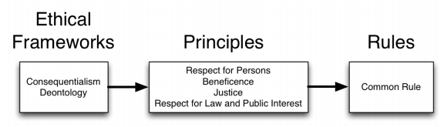
Salganik’s Principles-Based Approach

Slide 44
Questions and Concerns for Censorship Measurement
When is consent necessary? Do the benefits of widespread measurement outweigh the need for consent?
Can we mitigate or eliminate the need for consent by tagging measurements with some indication that they were collected without the user’s consent?
Does identifying intermediary machines that arguably constitute “infrastructure” (e.g., an ISP’s DNS resolver, a CDN cache node), and thus presumably have no direct associations with the actions of individuals, sufficiently mitigate risk?
Are there tradeoffs we face by restricting ourselves to only measuring from such infrastructure machines?
What considerations should censorship measurement incorporate to respect the resources that the measurement imposes on third parties, and the time sites spend investigating measurement traffic?
If a given country deems the network traffic associated with censorship measurements itself in violation of the country’s laws, on what basis can such measurements ethically proceed? Are some forms of illegal measurements more ethical in this regard than others?
How do we manage the uncertainty in risk to users due to differing technical abilities and adherence to the rule of law across countries? Is it reasonable to assume that a censor who analyzes network logs for malfeasance will fully understand (i.e., have “clue”) what the logs contain, and take the time and effort to look more broadly than just at specific infringing actions?
Along with considering risks, what are apt ways to assess the benefits provided by censorship measurements?

