Slide 1
Measuring the Availability and Response Times of Public Encrypted DNS Resolvers
Nick Feamster, Austin Hounsel, Ranya Sharma University of Chicago Princeton University

Slide 2
Contributions
We developed and released an open-source tool for measuring encrypted DNS performance to replicate and extend these results, and to support further research on DoH performance.
We measure DoH response times a large list of resolvers, including both mainstream DoH resolvers that are included in major browser vendors and a large collection of non-mainstream resolvers.
We study how the performance of various DoH resolvers differ based on vantage point.
The first study of DoH performance measurements for non-mainstream resolvers, as well as the first comparison of DoH performance across a variety of vantage points, for a large number of resolvers.

Slide 3
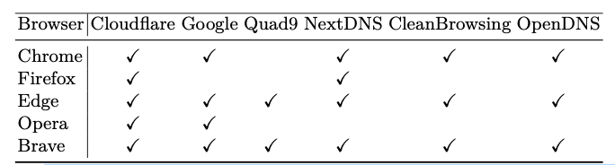
Context
Modern browsers provide only a few choices for encrypted DNS resolver, which we define as mainstream resolvers.

Slide 4
Metrics
Availability: Which DoH resolvers are active and responding to queries?
Latency: What is the round-trip latency to each server?
DNS query response time: What is the end- to-end time it takes for a client to initiate a query and receive a response?

Slide 5
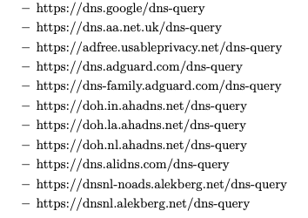
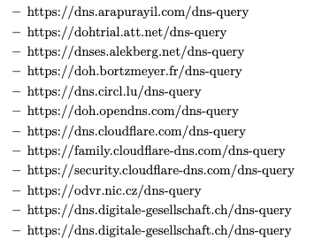
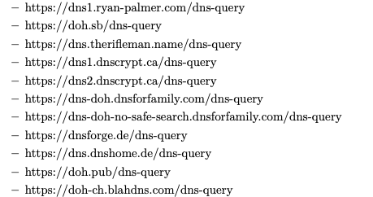
Experiment Setup
Vantage Points: Three global vantage points in Amazon EC2
Ohio, United States (North America)
Seoul, North Korea (Asia)
Frankfurt, Germany (Europe)
Queries: google.com, netflix.com
Resolvers

Slide 6
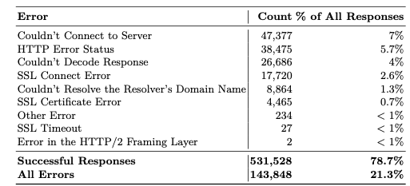
Are Non-Mainstream Resolvers Available?
Notes:
The most common errors were related to a failure to establish a connection.

Slide 7
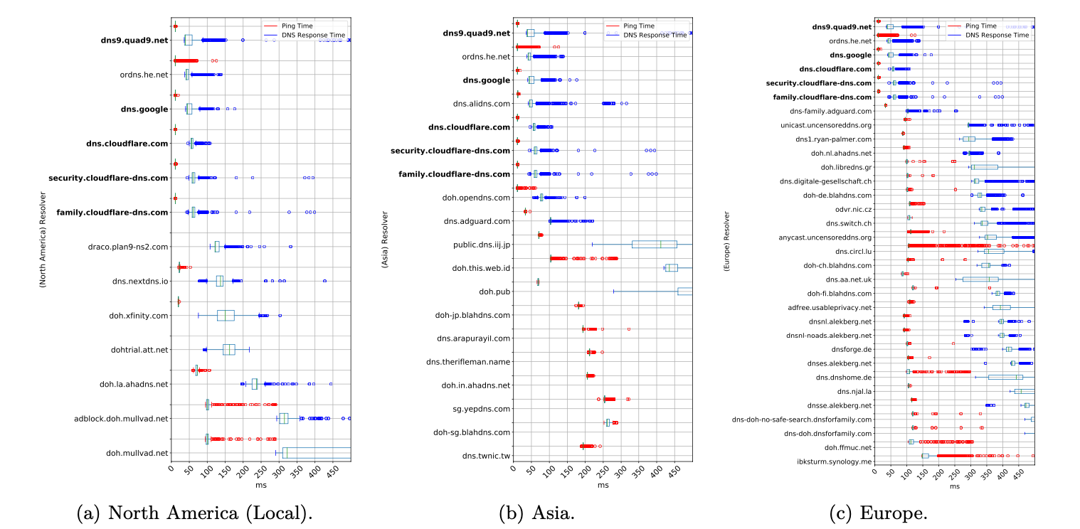
How Do Non-Mainstream Resolvers Perform?

Slide 8
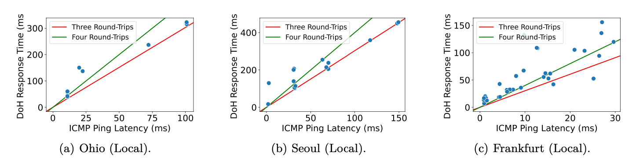
Median DoH Query Response Times vs. Latency

Slide 9
Conclusion
Non-mainstream resolvers have higher median response times than mainstream ones, particularly if the resolvers are not local to the region.
Most mainstream resolvers appear to be replicated and provide better response times across different geographic regions
A local non-mainstream resolver can exhibit equivalent performance as compared mainstream resolvers (e.g., ordns.he.net in North America, dns.alldns.com in Europe, and doh.libredns.gr in Europe).
There is an opportunity to invest in deploying and maintaining reliable, performant, global encrypted DNS infrastructure operated by a greater diversity of organizations

