Slide 1
Machine Learning for Computer Systems
Nick Feamster University of Chicago

Slide 2
Principal Component Analysis

Slide 3
What is Principal Component Analysis (PCA)?
Each data point can be represented as a linear combination of vectors/features.
PCA changes the set of component vectors to align in the directions that capture the most variance.
Principal components are linear combinations of the original vectors
Importance of principal components represented by “loading” vector.
In linear algebra terms, it is a “change in basis”.

Slide 4
Why Principal Component Analysis (PCA)?
Goal: Represent data in higher dimensions in a smaller number of dimensions.
Motivation: Why is Principal Component Analysis helpful?
Simplification: Reduce the dimension/complexity of the data while preserving variance (“interesting” properties of the data)
Visualization: Easiest to visualize data in two dimensions, but visualizing all pairs may be prohibitive.
Noise reduction: Keeping principal components that capture variance and removing the rest effectively filters noise.
Clustering: Spectral clustering attempts to map data points into principal components with the highest contributions.

Slide 5
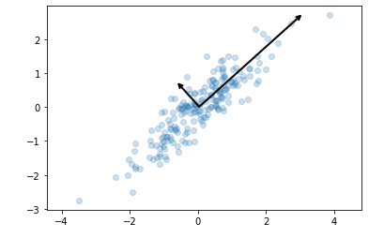
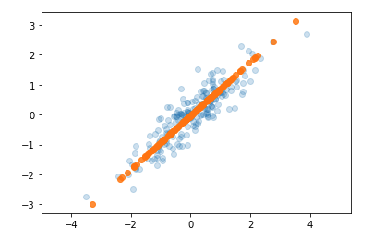
Two Views of Principal Component Analysis
Capturing Maximum Variance
Minimizing Distance to Projection
Principal component is the vector that captures the most variance in the dataset.
Principal component is the vector that is closest to the data points. (Minimize squared error to projection.)
Notes:
These vectors represent the principal axes of the data, and the length shown in Figure 5-81 is an indication of how “important” that axis is in describing the distribu‐ tion of the data—more precisely, it is a measure of the variance of the data when pro‐ jected onto that axis. The projection of each data point onto the principal axes are the “principal components” of the data.

Slide 6
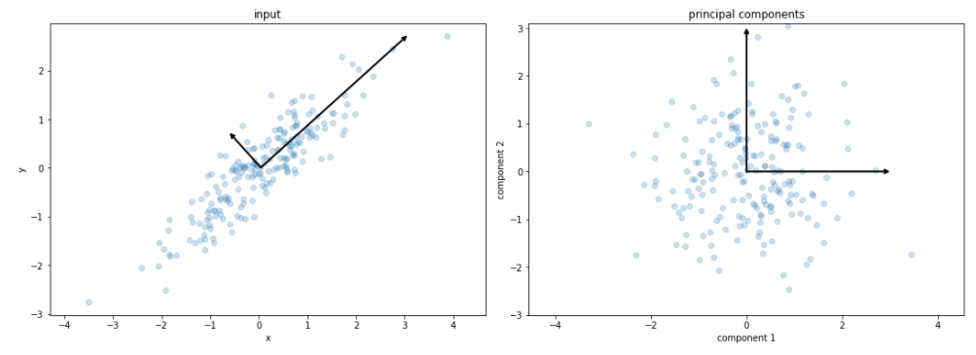
Interpreting Principal Component Projections
Projecting the data points onto the principal component yields the principal components themselves.

Slide 7

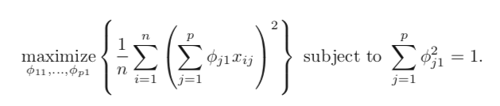
How to Compute Principal Components?
Given: An n x p dataset, X.
Want: n x m vectors where m << p, that capture most variance in X.
How: Project onto the sorted eigenvectors of the covariance matrix of X.
Notes:
https://towardsdatascience.com/pca-and-svd-explained-with-numpy-5d13b0d2a4d8

Slide 8
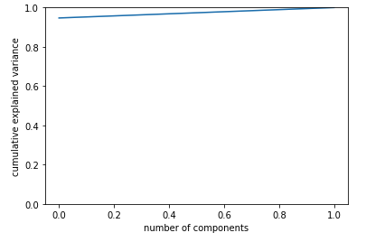
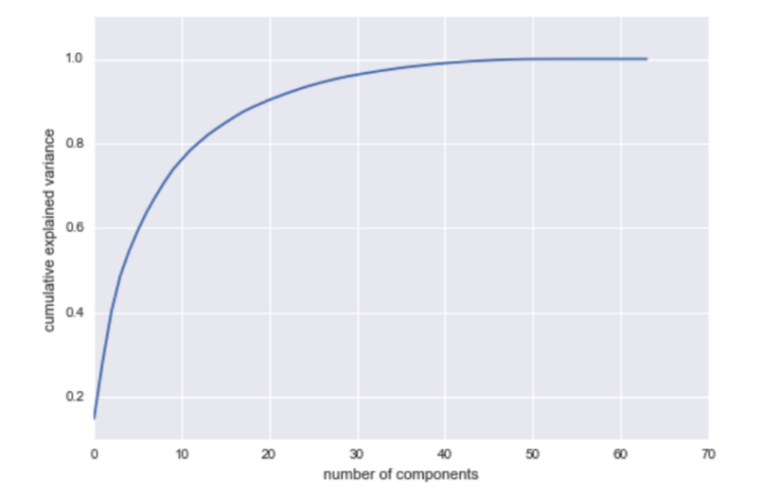
How Many Principal Components?
Scree plot shows the distribution of explained variance for the number of principal components (typically shown with eigenvalues).
Aim is to find a small number of principal components that capture the most variance.

Slide 9
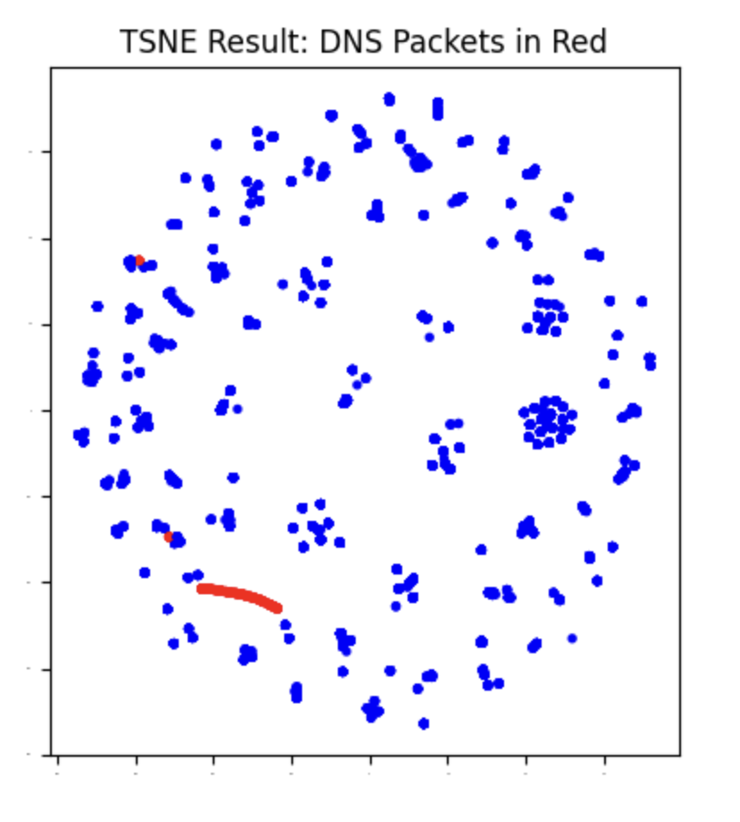
T-SNE (t-Distributed Stochastic Neighbor Embedding)
T-SNE is a non-linear dimensionality reduction technique primarily used for data visualization.
Fitting a normal (Gaussian) distribution to the distances between pairs of points in the original data
Mapping the normal distribution in the original high-dimensional space to a T-distribution in the target dimensional space that minimizes the divergence between the distributions
Selecting new locations for the points in the target dimensional space by drawing from this T-distribution.
Key Features:
Maps high-dimensional data to a 2D or 3D space.
Captures relationships and clusters in data by preserving local structure.
Widely used for exploring large datasets visually.
Example Use Cases:
Image recognition: Visualizing feature embeddings.
Text data: Visualizing word embeddings.

Slide 10
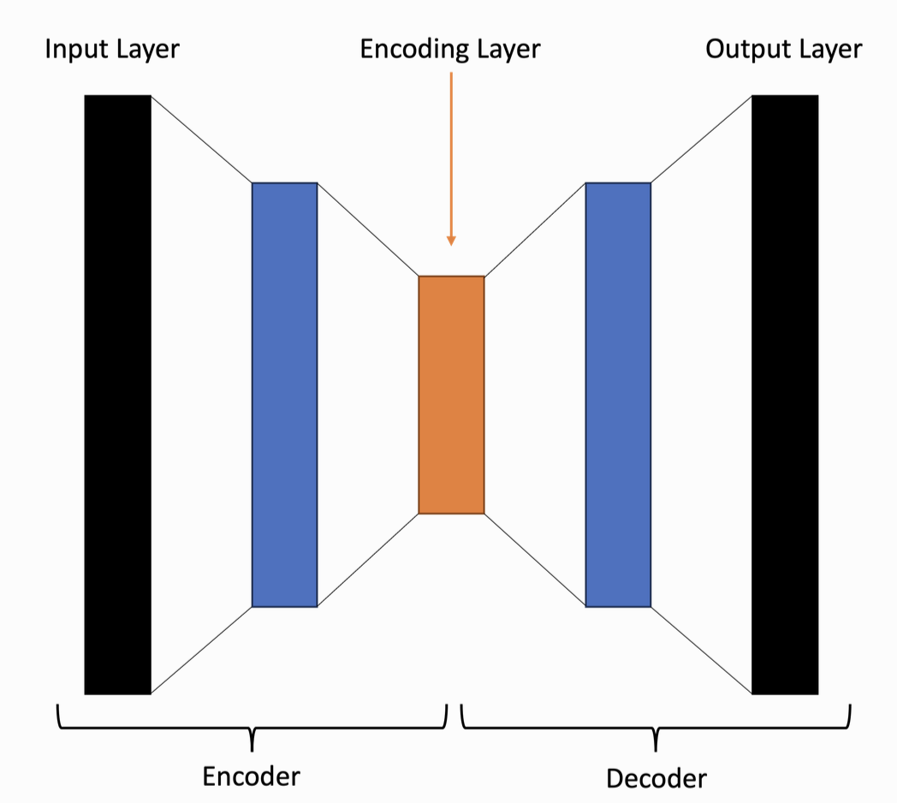
Autoencoders
Autoencoders are neural networks designed for unsupervised dimensionality reduction.
Key Features:
Composed of encoder and decoder networks.
Encoder compresses data into a lower-dimensional representation.
Decoder reconstructs data from the compressed representation.
Objective: Minimize reconstruction loss.
Applications:
Noise reduction: Removing noise from images or signals.
Feature extraction: Learning compact data representations for downstream tasks.

