Slide 1
Machine Learning for Computer Systems
Nick Feamster University of Chicago

Slide 2
Deep Neural Nets

Slide 3

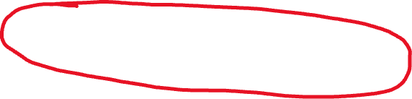



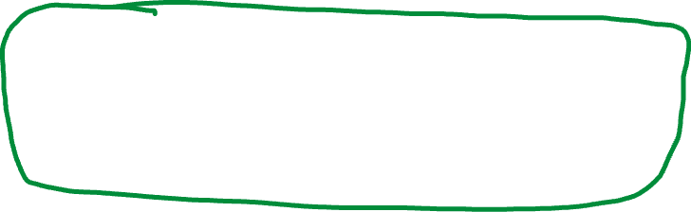
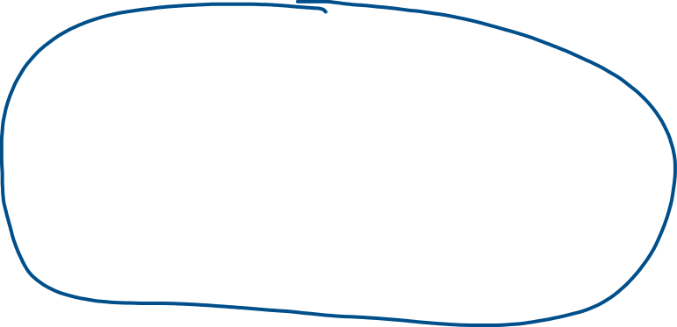

Overview of Deep Learning

Slide 4
The Goal of Deep Learning
Overcoming the limitations of linear models by applying the linear model to transformations on the features, x.
One approach: Apply a generic transformation (polynomial expansion, kernel machines such as radial basis, etc.)
Deep learning approach: Learn the transformation through multiple layers of transformations whose weights are adjusted in the training process.
Does not assume convexity. Often will not find the globally optimal result, but this is OK.

Slide 5







Basic Unit of Deep Learning: Neuron

Slide 6


















Multi-Layer Perceptron (Feed-Forward NN)

Slide 7
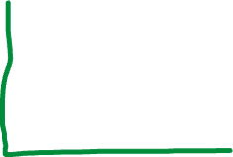


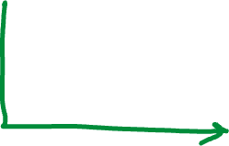
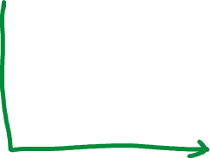


Activation Functions

Slide 8
Training Process: Backward/Forward Propagation
Training consists of iterations over epochs. One epoch:
Back propagation: Adjusting weights to correct error
Forward propagation: Evaluate outputs with adjusted weights
Steps
Select/compute weights (typically small initial weights)
Run model/compute output
Compute loss
Adjust weights to reduce loss (“back propagation”)

Slide 9
Output Activation
Output Activation Functions
Binary Classification: Sigmoid
Multiclass Classification: Softmax
Regression: No activation function
Loss Functions
Binary classification: Binary cross-entropy
Multiclass classification: Categorical cross-entropy
Regression: Mean squared error

Slide 10


Updating Weights (Backpropagation)
Change weight(s) a small amount to reduce loss after each iteration
How to change weights?
Back propagation (chain rule):

Slide 11


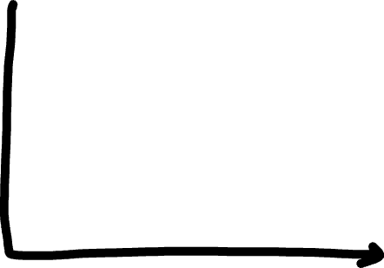

Gradient Descent

Slide 12












Slide 13
Summary
Deep learning overcomes limitations in some linear models by performing (a series) of transformations (layers).
Unlike transformations we’ve seen (e.g., logistic regression, polynomial expansion, kernel trick), deep learning learns the best representation.
Powerful class of methods for learning complex relationships.

Slide 14
Representation Learning in Network Traffic

Slide 15




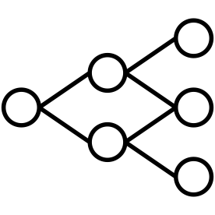
Classic ML Pipeline
Hypothesize
Problem
Gather
Traffic
Data
Processing
Engineer
Features
Train
Models
Motivation

Slide 16
Bespoke Solutions
Application Identification
Hypothesize
Problem
Gather
Traffic
Data
Processing
Engineer
Features
Train
Models
Anomaly Detection
Hypothesize
Problem
Gather
Traffic
Data
Processing
Engineer
Features
Train
Models
Motivation

Slide 17
Generalizable Solutions?
Hypothesize
Problem
Gather
Traffic
Data
Processing
Engineer
Features
Train
Models
Motivation
Notes:
Do animation for all three parts

Slide 18
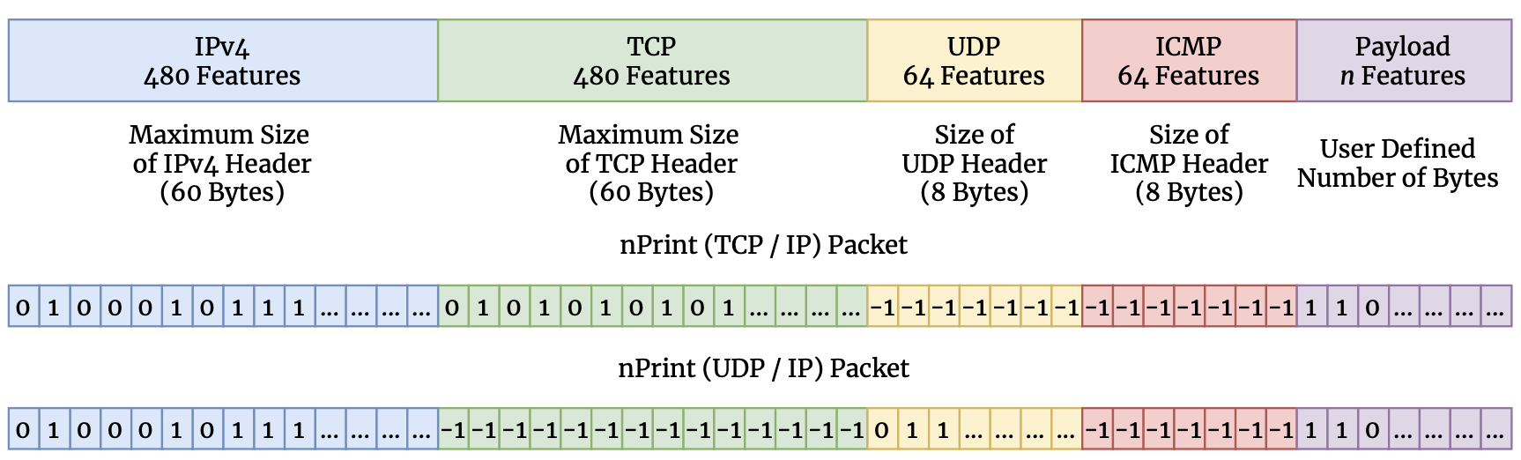
nPrint
nPrint
Notes:
nPrint represents a hybrid between a semantic representation and a binary representation
- best from both

Slide 19
Complete
nPrint
Notes:
nPrint represents a hybrid between a semantic representation and a binary representation
- best from both

Slide 20
Constant Size Per Problem
nPrint
Notes:
nPrint represents a hybrid between a semantic representation and a binary representation
- best from both

Slide 21
Inherently Normalized
nPrint
Notes:
nPrint represents a hybrid between a semantic representation and a binary representation
- best from both

Slide 22
Aligned
nPrint
Notes:
nPrint represents a hybrid between a semantic representation and a binary representation
- best from both

Slide 23
Automated Machine Learning
Model selection
Feature selection
Hyperparameter search
Training
Models

Slide 24
AutoGluon AutoML
Model ensembling achieves higher performance than other AutoML techniques[8]
Train models from 7 base classes
Random forests
DNN
KNN
Training
Models
Notes:
Random forest
Deep neural networks
Knn

Slide 25
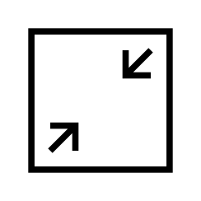


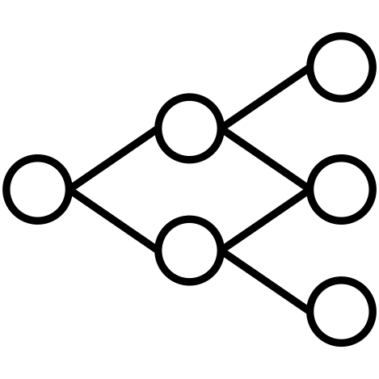
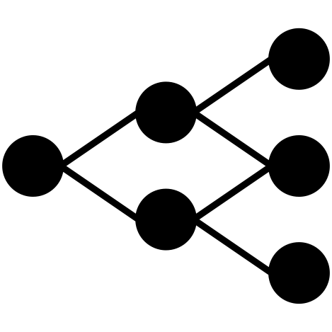

nPrintML Combines Both!
Feature
Selection
Model
Selection
Input
(Packets)
Packet
Transformation
Data
Representation
Parameter
Tuning
Optimized
Model
nPrint
AutoML
nPrintML
nPrintML

Slide 26
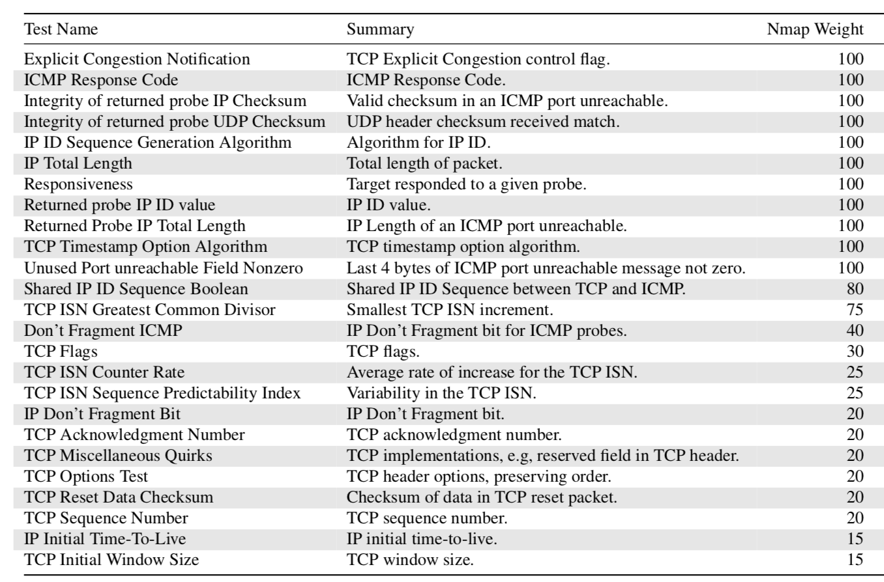
Nmap Packet Transformation
Active
Device
Fingerprinting
Notes:
Nmap features are advanced - computed across both sent and received probes, in nPrint, we only consider received probes and do not examine the sent probes as part of our representation

Slide 27
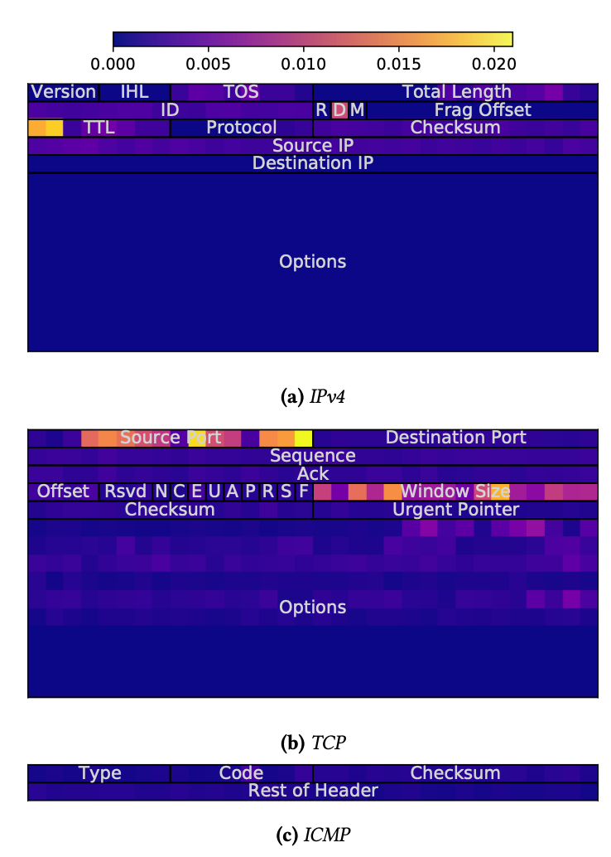
nPrint Enables Interpretable Machine Learning
Map features to packet header semantics!
Automatically learn
IP TTL
TCP options, window size
Source port identifies IoT vs Routers
Active
Device
Fingerprinting
Notes:
Automatically learn this!

Slide 28
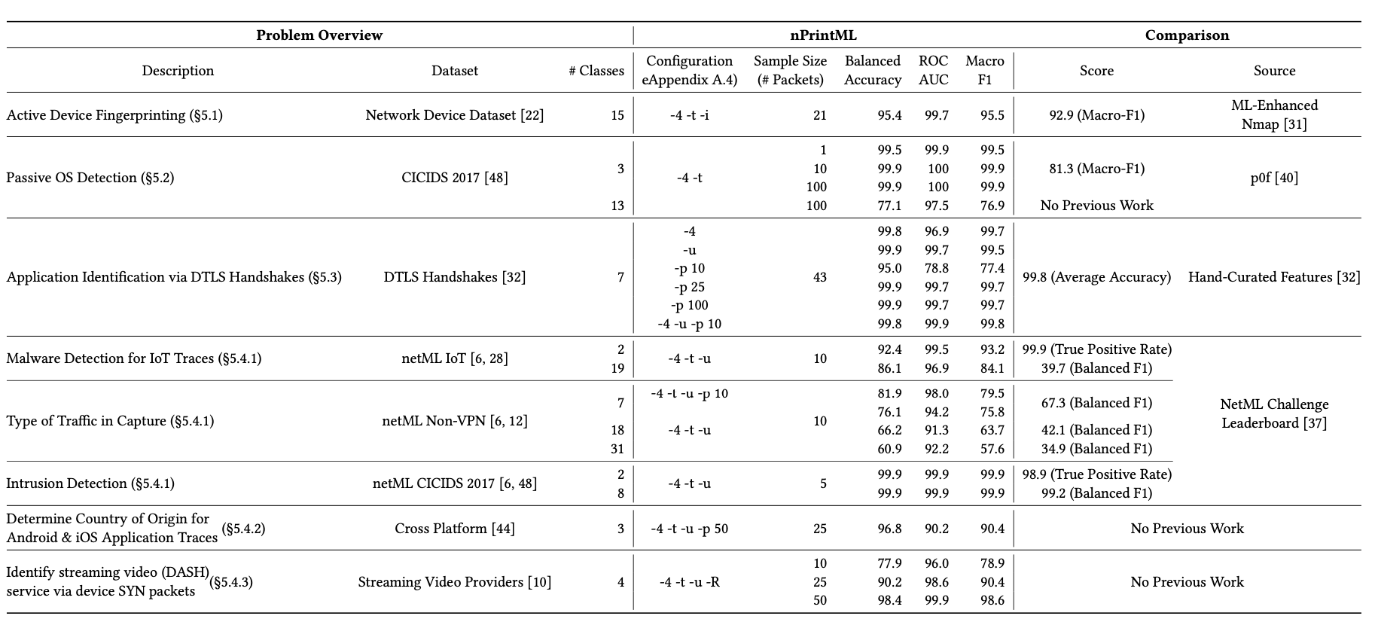
nPrintML’s Breadth
nPrintML
Results

Slide 29
Intrusion Detection, Malware Detection, Video Service Identification, …
nPrintML
Results
Notes:
Take your time here

Slide 30
nPrintML
Results

Slide 31
Convolutional Neural Nets

Slide 32





Convolution
An operation on two functions of a real-valued argument.
Very common in signal processing (smoothing, de-noising, etc.)
Example: Weighted average.

Slide 33
Convolutional Neural Networks (CNNs)
Very popular neural network that is effective for computer vision, image recognition.
Sometimes also called ConvNets.
Advantages over standard feed-forward neural net for images
Incorporating/considering spatial structure of the pixels
Ability to learn local patterns in the dataset.
Pixels that are close together in the image are represented as such

Slide 34
Applications of Convolutional Neural Nets
Recognition
Retrieval
Captioning
Detection and segmentation
Pose estimation
Diagnosis (e.g., radiology)
Style transfer

Slide 35


Individual Image Data
Three dimensions: height, width, depth
Depth is the color of a pixel.
Greyscale: Depth is the intensity of the pixel
Color: Three values (RGB, or YUV)
Data for an image can thus be represented as a 3D tensor.

Slide 36





Convolution Layers
A spatial averaging mechanism, sliding a window over the individual pixel as well as its neighbors.
Raw image is then turned into a new 3D tensor
Third dimension contains patterns (“filters”) to which that pixel “belongs”.
For example, corners, gradients, …

Slide 37


Pooling Layers: Reduce Spatial Dimensions
Move a window over the data, summarizing the statistics.
Common approach: Max pooling.
Send the maximum value of each window to the next layer.
Also makes the problem a bit more scalable/practical.
Akin to “zooming out” of an image.
Reduces overfitting, spatial complexity.

Slide 38
Other Layers
Dropout layer: Removes/deactivates certain fraction of neurons in the neural network.
Helps avoid overfitting
Typically applied after a max pooling layer
Flatten layer: converts a pooled feature map into a column.
Useful for changing the shape of the input for input into a fully connected artificial neural net.

Slide 39
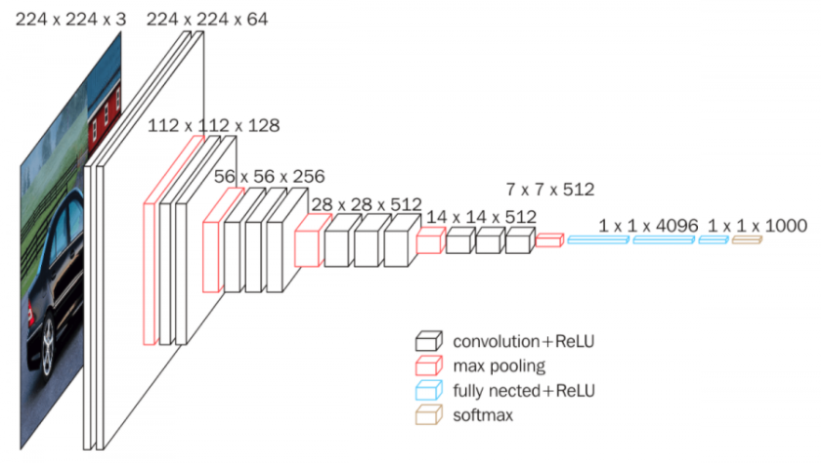
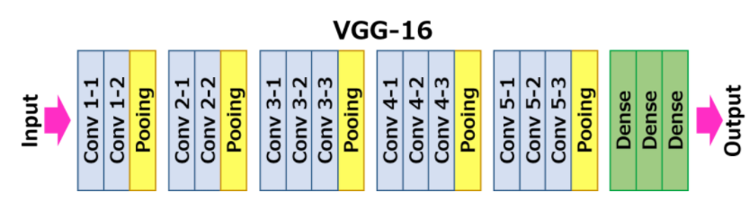
Example: VGG16
https://neurohive.io/en/popular-networks/vgg16/
Notes:
https://neurohive.io/en/popular-networks/vgg16/

Slide 40
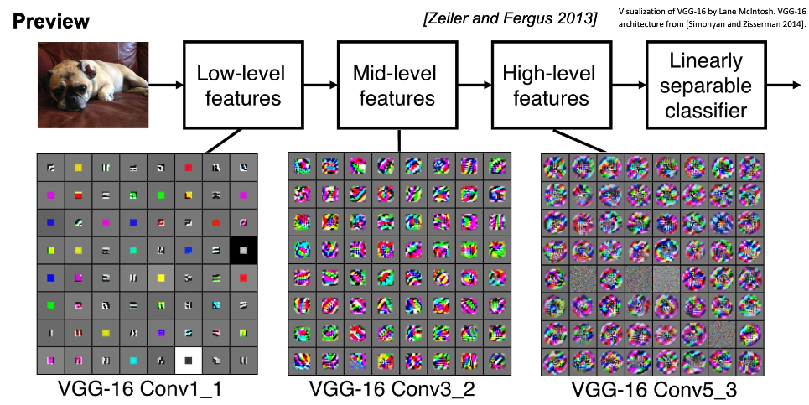

Slide 41
Summary
Convolutional Neural Network (a.k.a., CNN, ConvNet) is effective for computer vision, image recognition.
Advantages over standard feed-forward neural net for images
Incorporating/considering spatial structure of the pixels
Ability to learn local patterns in the dataset.
Pixels that are close together in the image are represented as such

