Slide 1
Machine Learning for Computer Systems
Nick Feamster University of Chicago

Slide 2
Feature Extraction

Slide 3
Motivation
Many machine learning problems require representations of network traffic that are amenable for model input
Raw packet captures:
Are large
May not reflect the most informative features
Need to develop a standard representation of features

Slide 4
Statistical Features (STAT)
flow duration,
number of packets sent per second,
number of bytes per second,
various statistics on packet sizes within each flow: mean, standard deviation, inter-quartile range, minimum, and maximum
How might each of these features be useful?

Slide 5
Other Features
SIZES: A flow is represented as a timeseries of packet sizes in bytes, with one sample per packet.
IAT: A flow is represented as a timeseries of inter-arrival times between packets, i.e., elapsed time in seconds between any two packets in the flow.
SAMP-NUM: A flow is partitioned into small intervals of equal length 𝛿𝑡, and the number of packets in each interval is recorded; thus, a flow is represented as a timeseries of packet counts in small time intervals, with one sample per time interval. Here, 𝛿𝑡 might be viewed as a choice of sampling rate for the timeseries, hence the nomenclature.
SAMP-SIZE: A flow is partitioned into time intervals of equal length 𝛿𝑡, and the total packet size (i.e., byte count) in each interval is recorded; thus, a flow is represented as a timeseries of byte counts in small time intervals, with one sample per time interval.

Slide 6
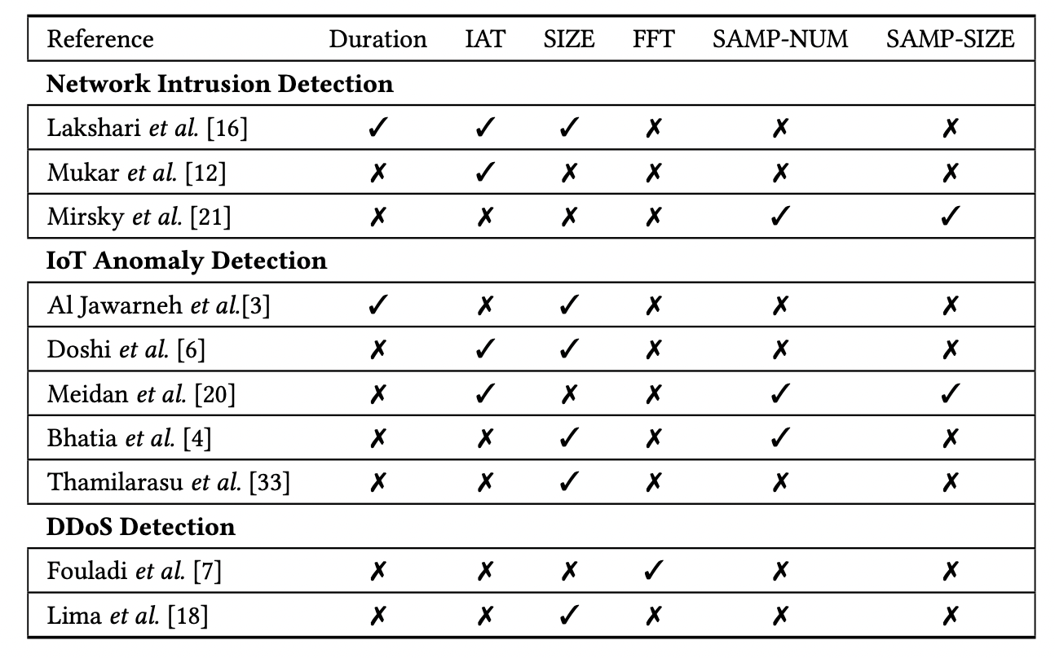
Use of Features in Different Anomaly Detection Approaches

Slide 7
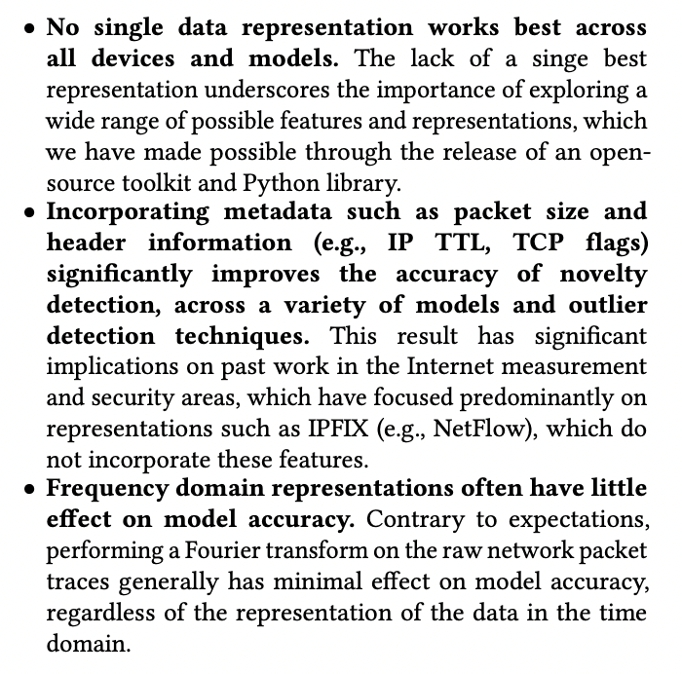
Summary

