Slide 1
Machine Learning for Computer Systems
Nick Feamster University of Chicago

Slide 2



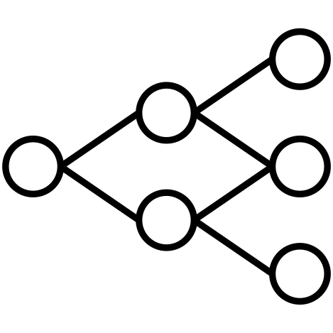
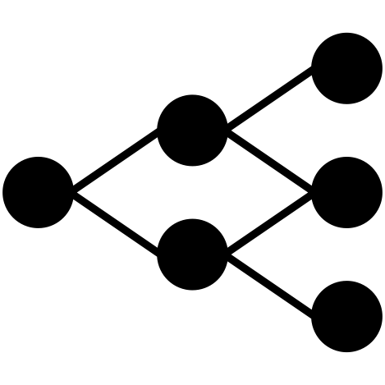
Machine Learning Framework
Labels
Representation
Compression
(Optional)
Input
(Packets)
Packet
Transformation
Data
Representation
Model
Training
Output
(Trained Model)
Each step has an associated cost.
Goals:
Explore general capabilities, capturing the limits of what is possible in traffic analysis
Consider cost-accuracy tradeoffs
Notes:
Our pipeline works, but what if we want to make the representation even smaller?
Faster training
Faster transformation

Slide 3
Data Preparation: Features and Labels

Slide 4
Modeling: Data Representation
We aim for general representations, with consideration of cost/complexity as part of the optimization.
Many challenges for representing the data
Scale (constantly generated)
Sequential dependencies (handshakes, parameter negotiation)
Non-uniform timeseries (network traffic is “bursty”)
Cross-flow dependencies (applications don’t use one flow)
Many choices for representing traffic data, with different costs.
Packet: Each packet is raw input to the model.
Event: Each “traffic event” is a data point (e.g., spike in traffic). (Could also sub-select on only anomalous events, such as deviation from moving average.)
Time: Traffic statistics are grouped/binned in time (challenge: bin size)
Volume: Bins based on volume (non-uniform intervals). (Standardizes events.)

Slide 5
(Looking Ahead) Modeling: Model Selection
Consider problems with different levels of complexity.
Simple Detectors: Non-Temporal Models
Random forest, SVM
Convolutional Neural Network
Work on some representations (volume based)
Challenge: Do not capture temporal features
More Complex Detectors: Temporal Models
Long Short-Term Memory (LSTM), Gated Recurrent Units (GRU)
Can be used to capture temporal information from the features

Slide 6
Features: What and Why?
Features are hints/rules of thumb you give your model
Encoding domain knowledge for the model to use
Feature generation is one of the most important part of the machine learning modeling process.
Reducing complexity in features may allow us to use less complex models that are faster to run, easier to understand, and easier to maintain.

Slide 7
Generating Features
Categorical to Binary (Dummies)
Features for missing values
Discretization
Date/Time Features
Scaling/Normalizing
Transformations
Aggregations (space, time, space and time)
Relative (compared to the average…)
Interactions
One-Hot Encoding

Slide 8
Categorical to Binary
One vs. All (Dummy Variables)
Groups
Presence vs. Absence

Slide 9
Discretization
Equal width bins
Equal size bins
Entropy-based bins
Domain-Specific bins to incorporate domain specific discontinuities
Age in general
Education/school data
High school data
Lead poisoning problem

Slide 10

Normalization
Often a good idea to scale features to have similar range: [-1,1] or [0,1] for example
Be careful with outliers
Standardize/Normalize
Zero mean and unit variance
Sklearn.preprocessing.normalize

Slide 11
Feature Transformations
Non-linear
Log (decreasing marginal utility)
(Square) Root
Squared

Slide 12
Aggregation
Date differences (# of days since…)
Aggregates over different time periods
Relative aggregates
Distances
Aggregates over different distances
Seasonality

Slide 13
Combining Features
Generate features for combination of features (product of two features)
Can use linear models but still model non-linear relationships
Random Forests are one way of discovering useful interactions

Slide 14
Pitfalls with Training Data

Slide 15
Challenges with Machine Learning
Insufficient quantity of training data
Nonrepresentative training data
Poor quality data
Irrelevant features
Overfitting/Underfitting

Slide 16
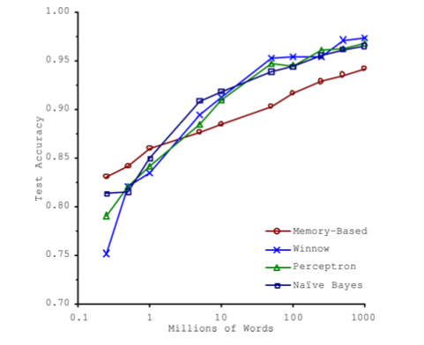
Insufficient Quantity of Training Data
Michele Banko and Eric Brill. 2001. Scaling to very very large corpora for natural language disambiguation. In Proceedings of the 39th Annual Meeting on Association for Computational Linguistics (ACL '01). Association for Computational Linguistics, USA, 26–33.
Machine learning models learn patterns from data to predict future outcomes
Most models require significant amounts of data to train (especially deep learning models)

Slide 17
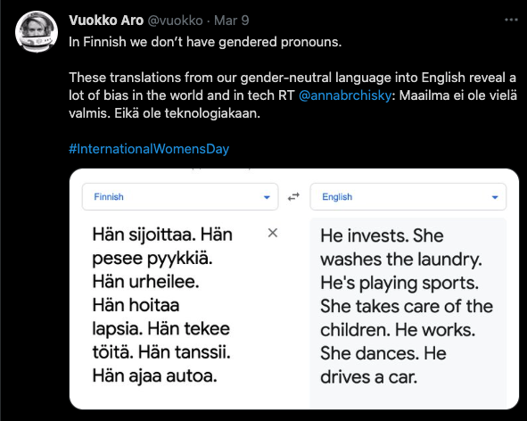
Non-Representative Training Data
Data must be representative of the new cases one wants to generalize to.
Datasets that are missing certain populations, segments, or are otherwise not representative can lead to poor predictions.
Well-studied phenomenon in statistics.
Also affects predictions in machine learning. Becoming especially more prominent in areas of algorithmic fairness.

Slide 18
Poor Quality Training Data
Erroneous or corrupt data
Data with obvious outliers
Try to understand the outliers
Are they systemic? Can they be explained by a phenomenon you want to model? If not, consider fixing or removing them.
Data with missing attributes
Either you need to fill these in (impute) or perhaps ignore the feature altogether

Slide 19
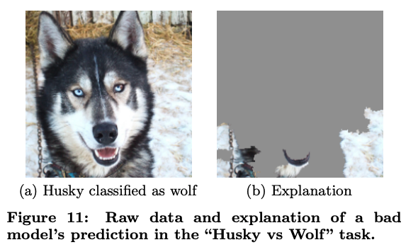
Irrelevant Features
Machine learning models that are fed features that are irrelevant to the underlying prediction.
When combined with non-representativeness, can be fatal to a good model.
Example: Computer vision algorithm that only had pictures of wolves in snow. Algorithm learned to see snow rather than distinguish huskies vs. wolves
Marco Tulio Ribeiro, Sameer Singh, and Carlos Guestrin. 2016. "Why Should I Trust You?": Explaining the Predictions of Any Classifier. In >Proceedings of the 22nd ACM SIGKDD International Conference on Knowledge Discovery and Data Mining (KDD '16. Association for Computing Machinery, New York, NY, USA, 1135–1144. DOI:https://doi.org/10.1145/2939672.2939778

