Slide 1
Machine Learning for Computer Systems
Nick Feamster University of Chicago

Slide 2
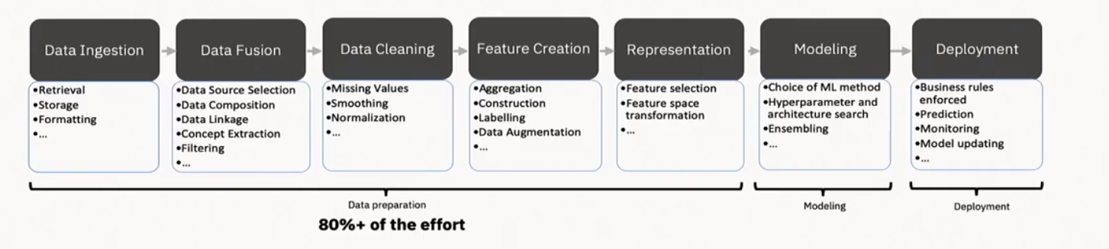
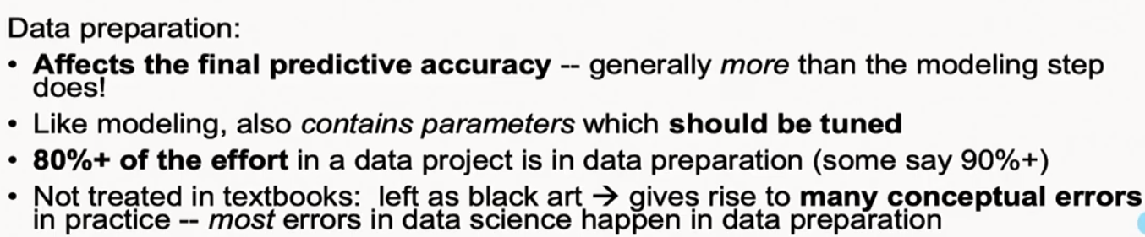
The Machine Learning Pipeline
Credit: Alex Gray

Slide 3
Security and Privacy Ideals
Monitoring: Gather only what’s needed
Use queries to drive data collection (IPFIX, packet traces, payload, DNS)
Trigger “deep dives” based on lightweight thresholds (script de-obfuscation)
Inference: Detect attacks in real-time (not just offline traces)
“Compile” machine learning-based inference models to line-rate targets
Trigger gathering of more information as needed (networking meets active learning)
Control: Automate (some) decisions
Rate limiting decisions (DNS response rate-limiting in-network)
Traffic redirection (e.g., to scrubbers, middleboxes)
On-the-fly placement of virtual middleboxes
Notes:
Example: monitoring high-level stats to trigger binary unpacking

Slide 4
How Networks Run: Measure, Model, Control
Inference/ML
Protocol modeling
Statistical inference
Network-wide
“what if” model (analytical, statistical)
Topology/
Configuration
Failures/ Attacks
Traffic Demands
Changes to
the network
measure
control
Operational Network

Slide 5
The Machine Learning Control Loop
Machine Learning
Measurement
Control
Raw traffic
Flow records
Summary statistics
User feedback

Slide 6
The Network Management “Cycle”
Inference
Control
Monitoring
More fine-grained and programmable
measurements
Streaming capabilities, distributed inference
Customizable
Actions
“Data Plane”
Programmable, protocol-independent data planes

Slide 7
Many Cybersecurity Problems Involve Large-Scale Predictive Analytics
Rare events
Time-series analysis
Analysis of heterogenous data
Analysis of communication graphs
Need to analyze data in real time
Need to detect outliers

Slide 8
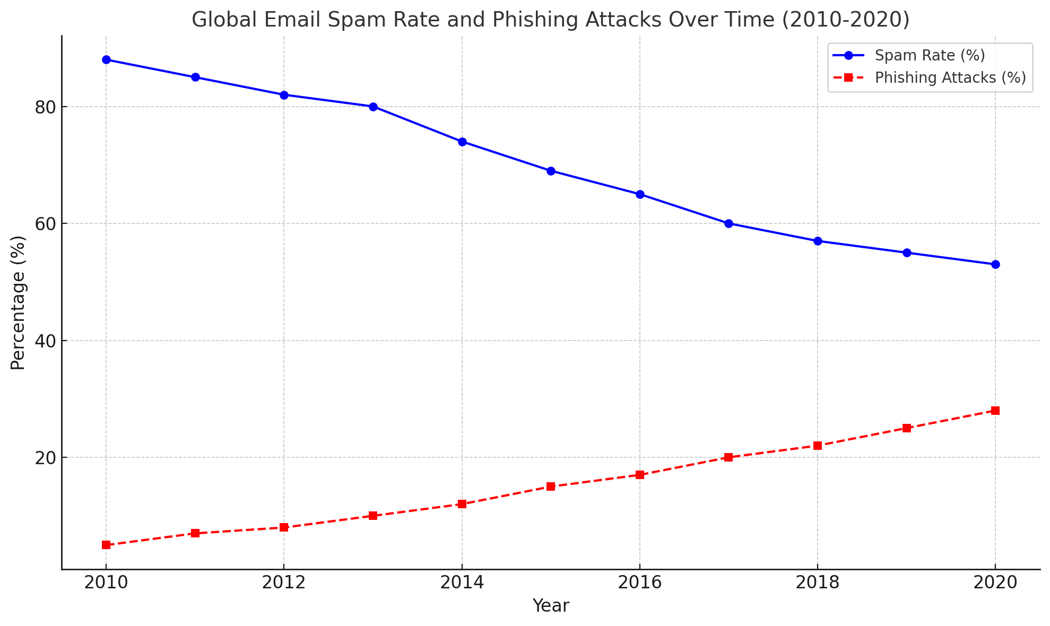
Unwanted Traffic: Spam, Phishing, Attacks
Spam rates are declining, but phishing attacks are on the rise.
Spam volume has declined, but phishing and spear-phishing attacks are increasing.
Attackers now use AI-generated content and deepfake media.
Evasion tactics: Fast-flux DNS, disposable domains, encrypted payloads.
Modern challenge: Detecting malicious content in encrypted traffic.
(Sources: Symantec, MAAWG, Cisco)
Notes:
The data is based on general trends reported by organizations like Symantec and MAAWG over the past decade.
For a more accurate and sourced chart, you would need to access up-to-date reports from these companies or organizations that publish detailed threat intelligence, such as:
- **Symantec Internet Security Threat Report**
- **MAAWG Email Metrics Report**
- **Cisco Annual Cybersecurity Report**

Slide 9

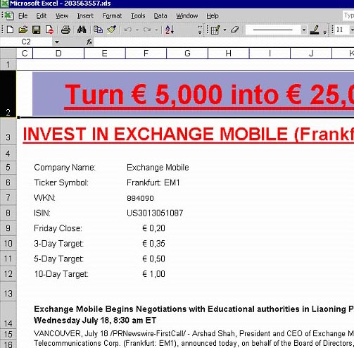

Conventional Approach #1: Content Filters
PDFs
Excel sheets
Images
...even mp3s!

Slide 10
Conventional Approach #2: IP Addresses
Received: from mail-ew0-f217.google.com (mail-ew0-f217.google.com [209.85.219.217])
by mail.gtnoise.net (Postfix) with ESMTP id 2A6EBC94A1
for <feamster@gtnoise.net>; Fri, 21 Oct 2011 10:08:24 -0400 (EDT)
Problem: IP addresses are ephemeral
Every day, 10% of senders are from previously unseen IP addresses
Possible causes
Dynamic addressing
New infections

Slide 11
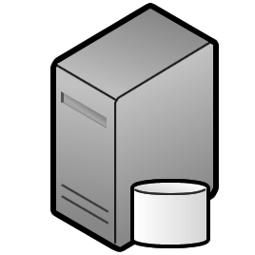



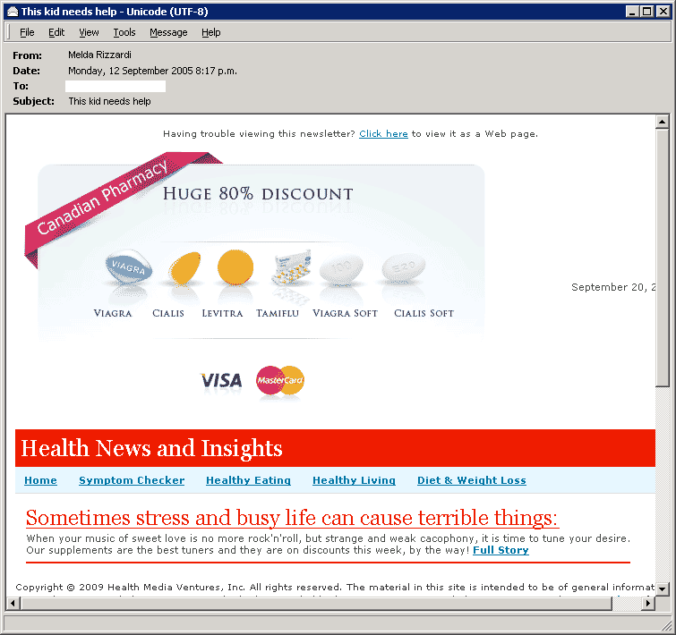



A Lot Happens Before Spam is Sent!
Time
Distribute spam messages
Maintain hosting infrastructure
Acquire network resources
DNS server
Register .com domains
Botnet
Web server
Registrar
Registry
ICANN
Spam message
Spam-advertised page

Slide 12
Predictive Analytics: Detection Based on Network-Level Behavior
Filter email based on how it is sent, (in addition to simply what is sent and who sent it).
First Step: Define Behaviors (In other words, What’s different about spammers?)
Agility. Spammers need to move to escape detection.
Exposure. Spammer sending behavior differs from normal user behavior.
Coordination. Spammers behave like each other.

Slide 13
Predicting Anomalous Behavior
Agility: Spammers must escape detection
Understanding network-level behavior
Challenge: Detecting agility (BGP, DNS)
Exposure: Spammers behave differently
Supervised learning based on features
Challenge: Which features to use?
Coordination: Spammers behave like each other
Clustering based on common behavior
Challenge: What behaviors cluster well?

Slide 14
Example Feature: Analysis of Sending Patterns
Intuition: Spammers will “cluster” together in IP address space, because many compromised hosts may exist on a single network.
For spammers, k nearest senders are much closer in IP space
Notes:
XXX Fix This XXX

Slide 15
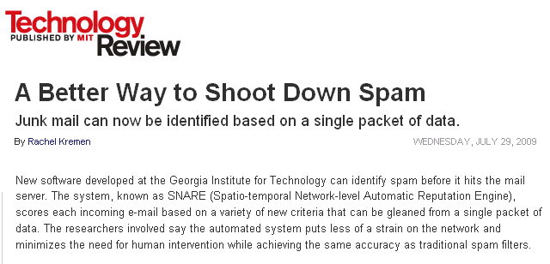

Combining Features: RuleFit
Put features into the RuleFit classifier
10-fold cross validation on one day of query logs from a large spam filtering appliance provider
Using only network-level features
Anirudh Ramachandran, Nick Feamster, and Santosh Vempala, “Filtering Spam with Behavioral Blacklisting”, ACM CCS, 2007
Shuang Hao, Nick Feamster, Alex Gray and Sven Krasser, “SNARE: Spatio-temporal Network-level Automatic Reputation Engine”, USENIX Security, August 2009

Slide 16
Going Back Earlier in Time: Attackers Use the Domain Name System
Attackers use URLs to propagate scams and malware
Idea: Use properties of the registered domains to identify spam, scams, etc.
Problem: How to identify the reputation of a domain?
Previous work relies on observing record changes, which may take time to observe.
Alternative: Look for query patterns within short time of registration.

Slide 17
Predictive Analytics and DNS
Domain registration and resource record establishment occur before attacks take place
DNS infrastructure for scam domains is located in different address space regions and autonomous systems than the infrastructure for legitimate domains.
Early lookup patterns for a newly registered malicious domain differ significantly from the patterns for a legitimate domain
S. Hao, N. Feamster, R. Pandrangi. “Monitoring the Initial DNS Behavior of Malicious Domains”, ACM SIGCOMM Internet Measurement Conference, November 2011.

Slide 18
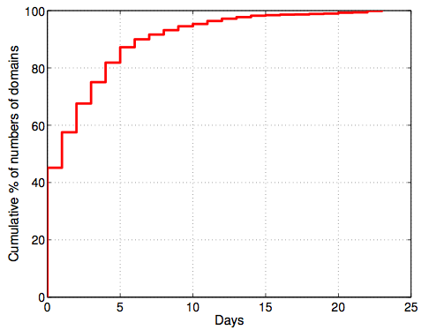
Prediction: Registration Occurs Before Attack!
More than 55% of the malicious domains appeared in spam campaigns more than one day after they were registered.

Slide 19
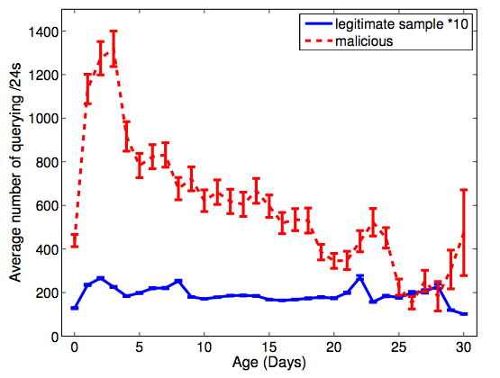
DNS Lookups Precede Attacks!
Queries to the scam domains increased quickly after the domains were registered, and usually reach the peak in the first 3–4 days.

Slide 20
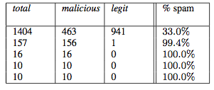
Early Lookup Behavior
Different malicious domains are looked up by similar group of network blocks, which may indicate that they are part of the same spamming campaign.

Slide 21
With Better Data, Possible to Predict Attacks Even Earlier!

Slide 22




DNS Predictive Analytics for Attack Prediction
Proactive Recognition and Elimination of
Domain Abuse at Time-of-Registration
Registration
Use
Detection
Life Cycle

Slide 23
Domain Profile Features
Data from registration event
Registrar, nameserver, character tri-grams, etc.
Includes edit distance to known bad domains
Insertion:
abcdef
abcHdef
Deletion:
abcHdef
abcdef
Substitution:
abCdef
abHdef

Slide 24
Registration History Features
Data from previous registration
Previous registrar, re-registration latency, etc.
Separate reuse into drop-catch and retread
Notes:
BUILD SUSPENSE: How quickly can this happen?

Slide 25
Batch Correlation Features
Data from registrations in same time interval
batch size, rate and types of reuse, etc.
Name cohesiveness using edit distance
Registration Batch
asklenderhome.com
askhomelendersnow.com
stationary.com
asklendershome.com
bestcooks.com
askhomelenders.com
Cohesive
Uncohesive
Notes:
Make clear that batch cohesion is a property of individual domains

Slide 26
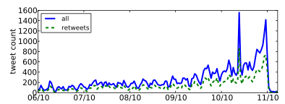
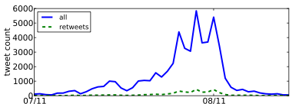
Automated Detection of Propaganda (2012)
Nevada Senate Race
Higher fraction of retweets
More bursty tweeting volumes
Higher daily volumes
Quick retweeting
Debt Ceiling Debate
#bias: Measuring the Tweeting Behavior of Propagandists
by Cristian Lumezanu, Nick Feamster, and Hans Klein.
In the Sixth International AAAI Conference on Weblogs and Social Media (ICWSM), 2012.
Notes:
Note: This study likely no longer works.

Slide 27
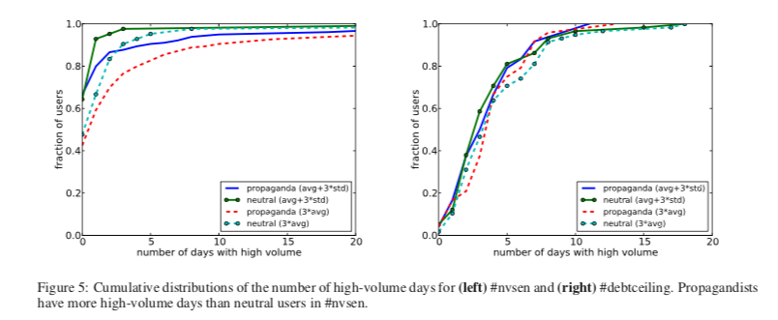
High-Volume Days

Slide 28
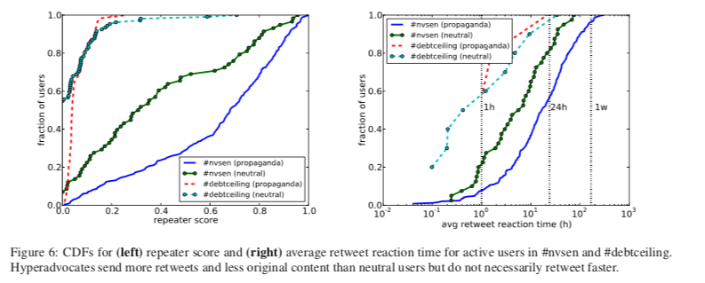
Retweet Fraction and Frequency

Slide 29
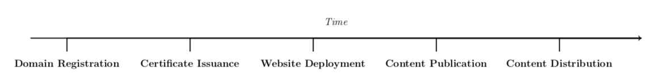
Question: Does Disinformation “Infrastructure” Look Different?
Apply similar ideas to disinformation that were previously effective on spam, phishing, etc.
Look for analogous infrastructure invariants.

Slide 30
Challenges
Defining “disinformation” in the first place
Everything that’s false?
Information that is false but is made to look true?
What about motives? (profit, political, otherwise, …)
Partisan bias is not the same as disinformation
Importance of early detection
Once misinformation spreads, in some sense it may already be too late

Slide 31
Dataset
769 disinformation websites from a combination of sources (FactCheck, Buzzfeed, Snopes, Politifact, Wikipedia, Newsguard)
533 authentic news sites from Amazon Web Information Services (AWIS)

Slide 32
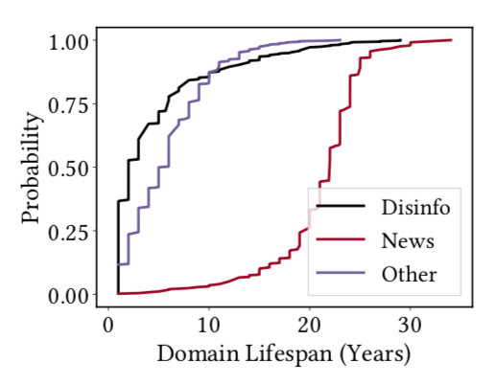
Domain Name Infrastructure
Public websites need domain name / DNS infrastructure
Possible signals
Registrar / Registrant
Registration characteristics (e.g., expiration)
Domain name(s)
Authoritative nameserver

Slide 33
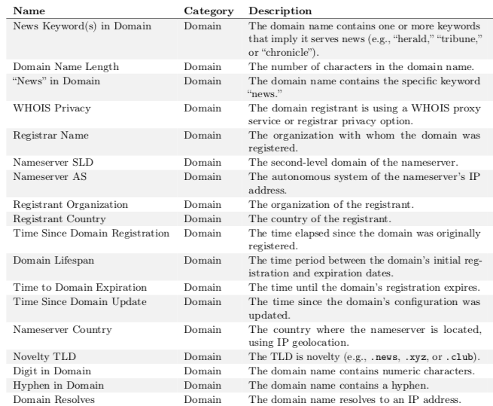
Domain Features

Slide 34
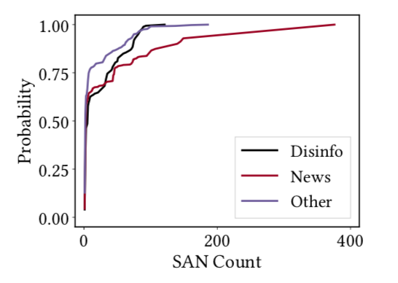
Certificate Infrastructure
Subject Alternate Name (SAN)
Enables sharing a certificate across multiple domain names
Surprise: Legitimate news organizations have long SAN count
Configuration errors
Misconfigured certificates
Unsigned certificates

Slide 35
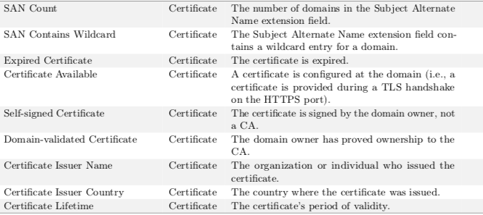
Certificate Features

Slide 36
Hosting Infrastructure
Content management systems (CMS) and plugins
WordPress (82% of disinformation sites, 20% of news sites)
Inexpensive WordPress themes (e.g., mts-best)
Distribution of plugins sufficiently different
Many news sites use custom plugins
Disinformation sites use simple plugins, feedback forms, …

Slide 37
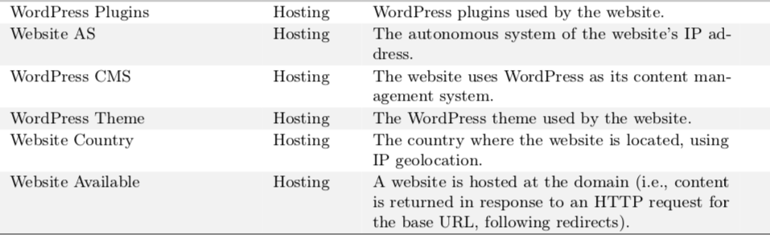
Hosting Features

Slide 38
Security and Privacy Ideals
Monitoring: Gather only what’s needed
Use queries to drive data collection (IPFIX, packet traces, payload, DNS)
Trigger “deep dives” based on lightweight thresholds (script de-obfuscation)
Inference: Detect attacks in real-time (not just offline traces)
“Compile” machine learning-based inference models to line-rate targets
Trigger gathering of more information as needed (networking meets active learning)
Control: Automate (some) decisions
Rate limiting decisions (DNS response rate-limiting in-network)
Traffic redirection (e.g., to scrubbers, middleboxes)
On-the-fly placement of virtual middleboxes
Notes:
Example: monitoring high-level stats to trigger binary unpacking

