Slide 1
Machine Learning for Computer Systems
Nick Feamster
University of Chicago

Slide 2
Automation

Slide 3




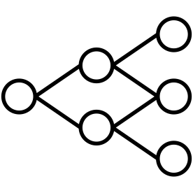
Bespoke Solutions
Application Identification
Hypothesize
Problem
Gather
Traffic
Data
Processing
Engineer
Features
Train
Models
Anomaly Detection
Hypothesize
Problem
Gather
Traffic
Data
Processing
Engineer
Features
Train
Models
Motivation

Slide 4
Generalizable Solutions?
Hypothesize
Problem
Gather
Traffic
Data
Processing
Engineer
Features
Train
Models
Motivation
Notes:
Do animation for all three parts

Slide 5
Features Are Expensive
Hypothesize
Problem
Gather
Traffic
Data
Processing
Engineer
Features
Train
Models
Feature
Engineering
Notes:
How is it expensive?
Time
Domain Expertise
Human Effort
Generally Custom to the problem

Slide 6
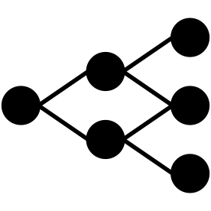
Data Processing
Hypothesize
Problem
Gather
Traffic
Data
Processing
Automated
Traffic Analysis
Data
Processing
Notes:
Explain metadata

Slide 7

Diverging Branches
Feature Extraction A
Model A
Model B
Feature Extraction B
Model A
Released Dataset
Metadata
Attachment A
Model B
Metadata
(CSV)
Traffic
(PCAP)
Model C
Feature Extraction C
Model D
Model C
Metadata
Attachment B
Feature Extraction D
Model D
Diverging
Branches

Slide 8
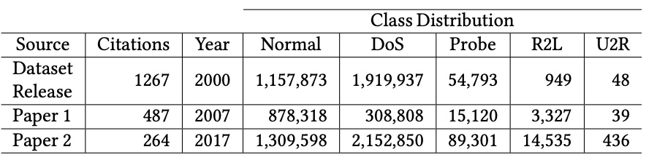
Diverging In Practice - KDD98
Branching
In
Practice
Notes:
Find original distribution

Slide 9
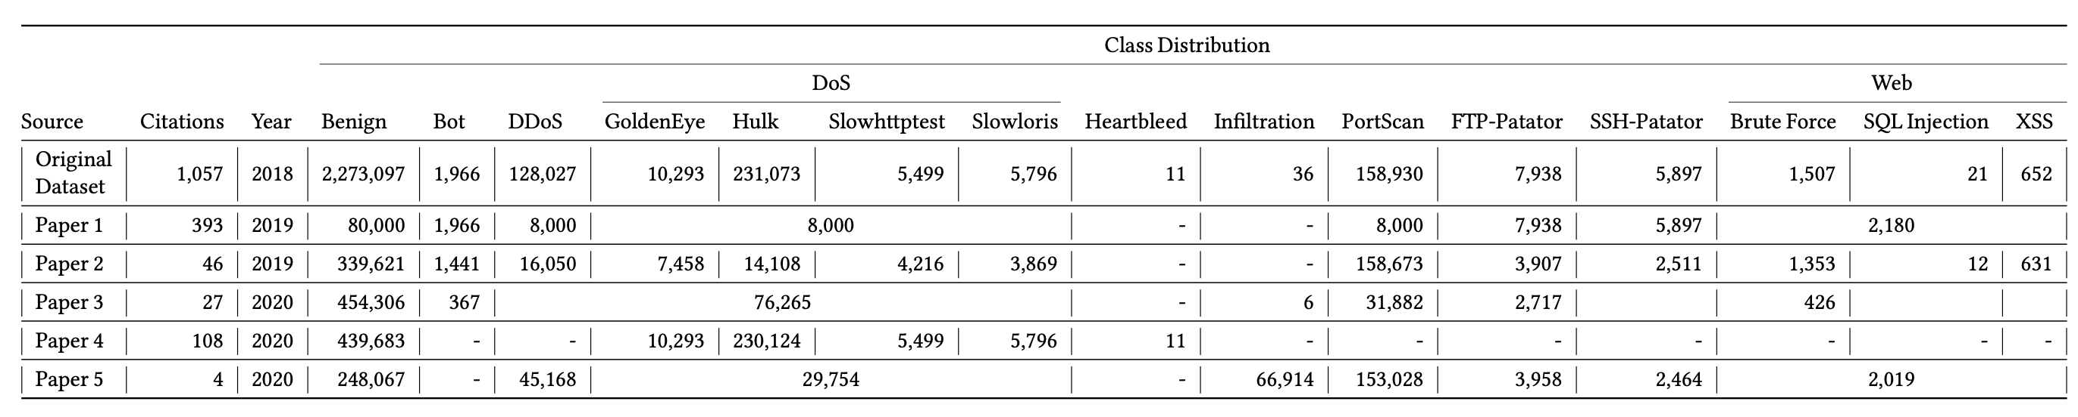
Diverging In Practice - CICIDS2017
Branching
In
Practice
Notes:
Sure, that dataset is old and it’s just 2 papers, right?

Slide 10
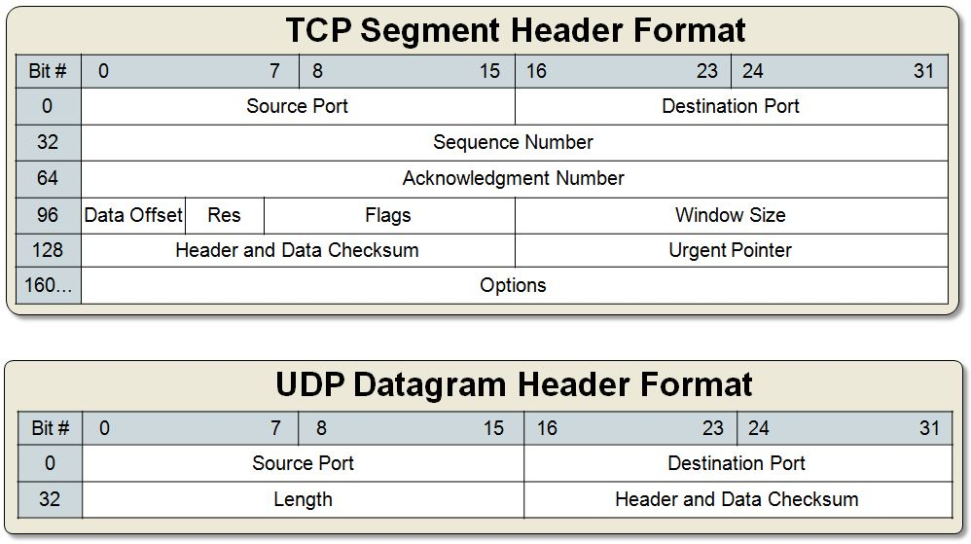
Different Protocols
[3]
Packet
Problems
Notes:
Different headers themselves
Different values in headers
UDP has no flags!!
3. Even worse, they’re all different length

Slide 11
Different Values
Packet
Problems
Notes:
Different values in headers
UDP has no flags!!

Slide 12
Different Lengths
Packet
Problems
Notes:
3. Even worse, they’re all different length

Slide 13
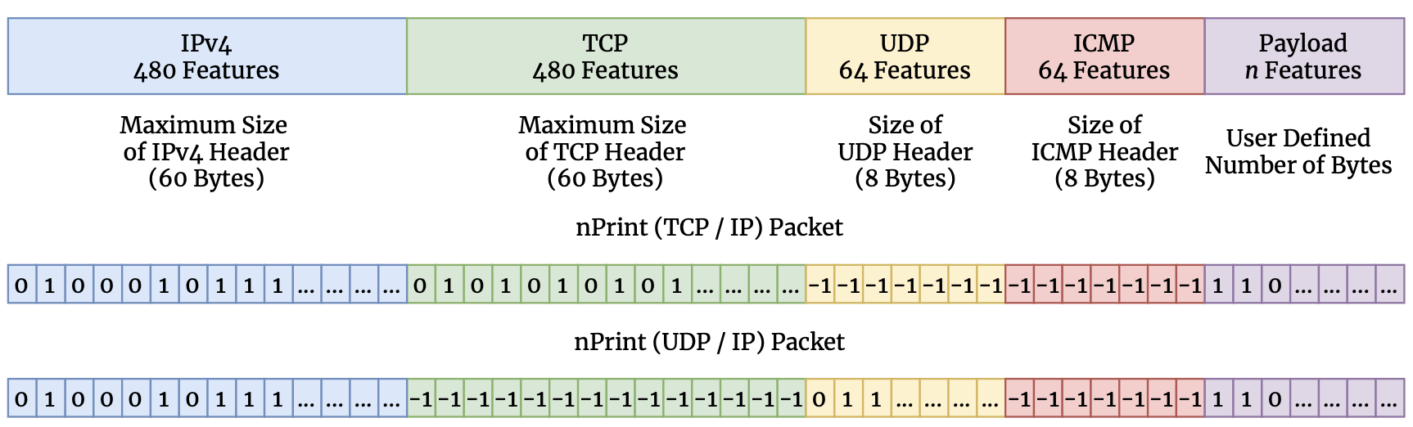
nPrint
nPrint
Notes:
nPrint represents a hybrid between a semantic representation and a binary representation
- best from both

Slide 14
Complete
nPrint
Notes:
nPrint represents a hybrid between a semantic representation and a binary representation
- best from both

Slide 15
Constant Size Per Problem
nPrint
Notes:
nPrint represents a hybrid between a semantic representation and a binary representation
- best from both

Slide 16
Inherently Normalized
nPrint
Notes:
nPrint represents a hybrid between a semantic representation and a binary representation
- best from both

Slide 17
Aligned
nPrint
Notes:
nPrint represents a hybrid between a semantic representation and a binary representation
- best from both

Slide 19
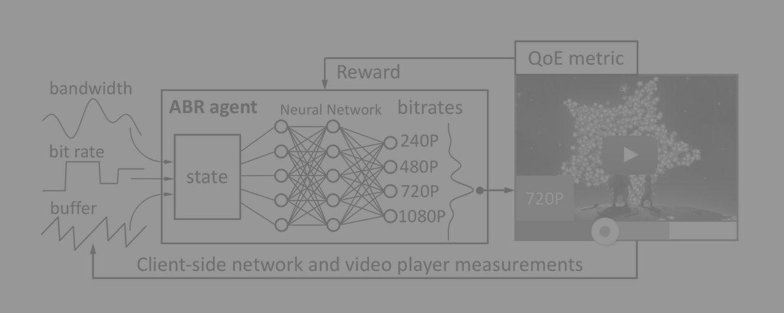
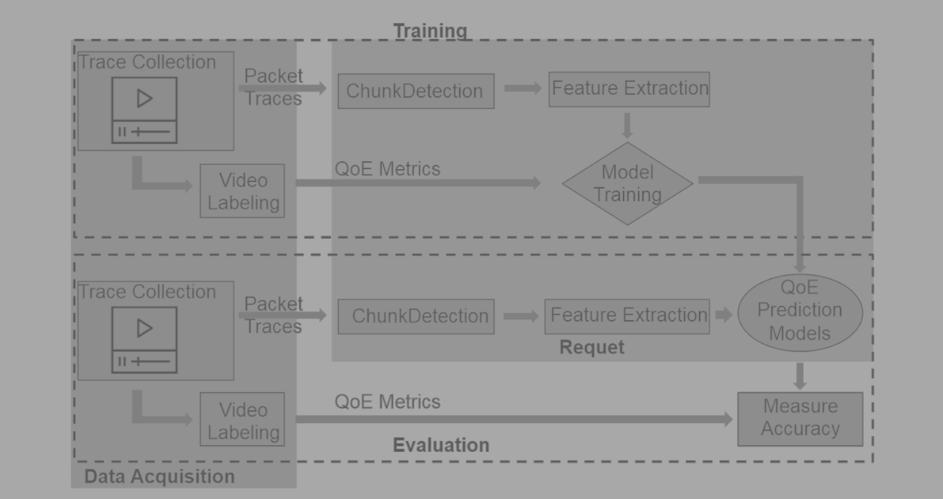
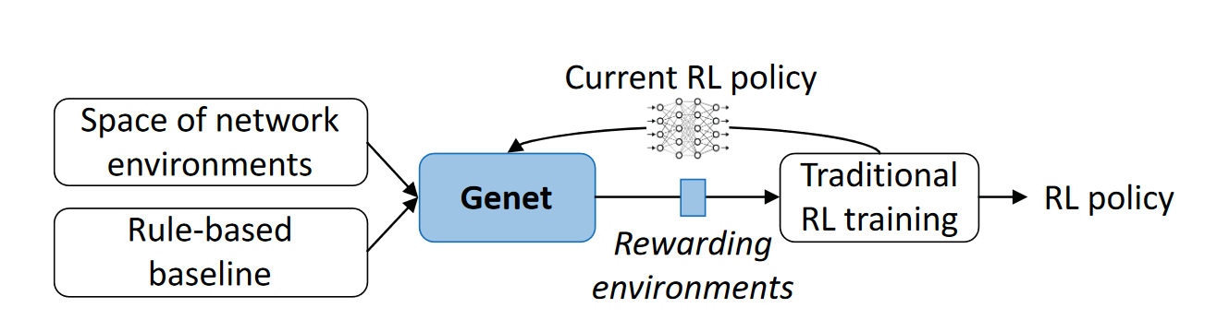
Shifting towards ML based solutions
Pensieve, SIGCOMM 2017
Requet, MMSys 2019
Genet, SIGCOMM 2022
Machine Learning is a valid and powerful tool
Notes:
asdasdasdasd

Slide 20


ML in Networking
Data
Production
Typical problems:
Out of distribution
Lack of generalization
Spurious correlations
Underspecified failure modes
Plain overfitting
…
Train ✅
Test✅
Deploy❓
Failure reasons: problems in data used for training

Slide 21


How to increase data quality?
Experiment #1
Different target infrastructures
For data collection
For artifacts testing
Code reusability
Reduced implementation time
More stable and error-free
Easier reproducibility and testing
Infrastructure #1
Infrastructure #2
Experiment #1
Experiment #2
Infrastructure #1
Solution: modular experiments

Slide 22
Roadblocks and solutions
Typical data collection pipeline:
Non-modular
  development + deployment + execution
Written for a specific infrastructure
Pipelines’ subtasks are similar
Let’s split pipelines
Pipelines could be platform agnostic
We need an abstraction layer
Pipeline
Data Collection Infrastructure
Pipeline
Data Collection Infrastructure
Pipeline
Abstraction layer
Data Collection Infrastructure
Data Collection Infrastructure

Slide 23
Ideal solution: supported modes
Deployment modification:
Change deployment mode for the same infrastructure
Deploy the experiment to different infrastructure
Code modification:
Modify the pipeline’s code
Reuse parts of the pipeline

Slide 24
Ideal solution: supported modes
Deployment modification:
Change deployment mode for the same infrastructure
Deploy the experiment to different infrastructure
Code modification:
Modify the pipeline’s code
Reuse parts of the pipeline

Slide 25
Illustrative example: CIC-IDS2017
Intrusion Detection Dataset
5 days, 52 GB of traffic
Benign/attack traffic classification
  Reported result: F1 0.99

Slide 26
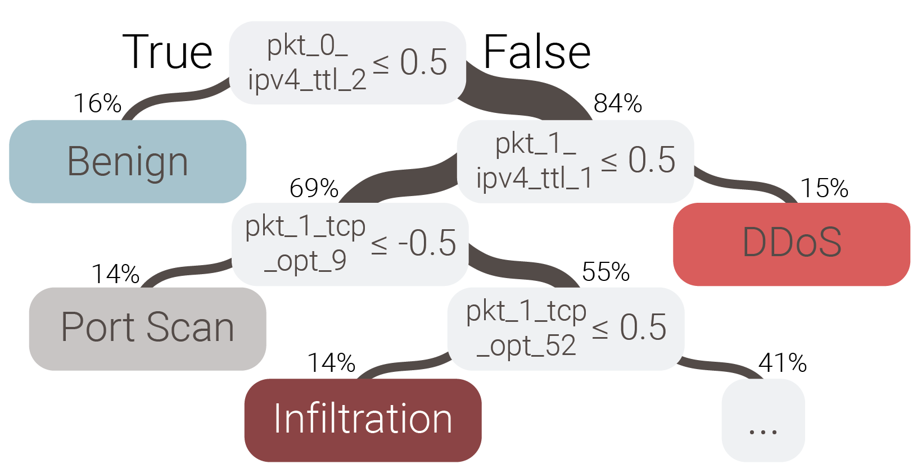
Illustrative example: CIC-IDS2017
Intrusion Detection Dataset
5 days, 52 GB of traffic
Benign/attack traffic classification
  Reported result: F1 0.99

Slide 27
Illustrative example: fixing CIC-IDS2017
Reasons:
  All victims are inside of the ‘internal’ network: TTLs are 64/128
  All attackers are outside of the ‘internal’ network: TTLs are 63/127
  Though this is often valid, we want attackers and victims to present in all (both inside and outside) networks
Deployment modification of the experiment
  Add attackers from internal network
  Add benign traffic from outside network

Slide 28
Ideal solution: supported modes
Deployment modification:
Change deployment mode for the same infrastructure
Deploy the experiment to different infrastructure
Code modification:
Modify the pipeline’s code
Reuse parts of the pipeline

Slide 29
Illustrative example: Heartbleed @ CIC-IDS2017
Particular attack classification (Heartbleed)
78 pre-computed features from flow statistics (e.g. flow duration, mean IA)
Reported F1 score: 0.99

Slide 30
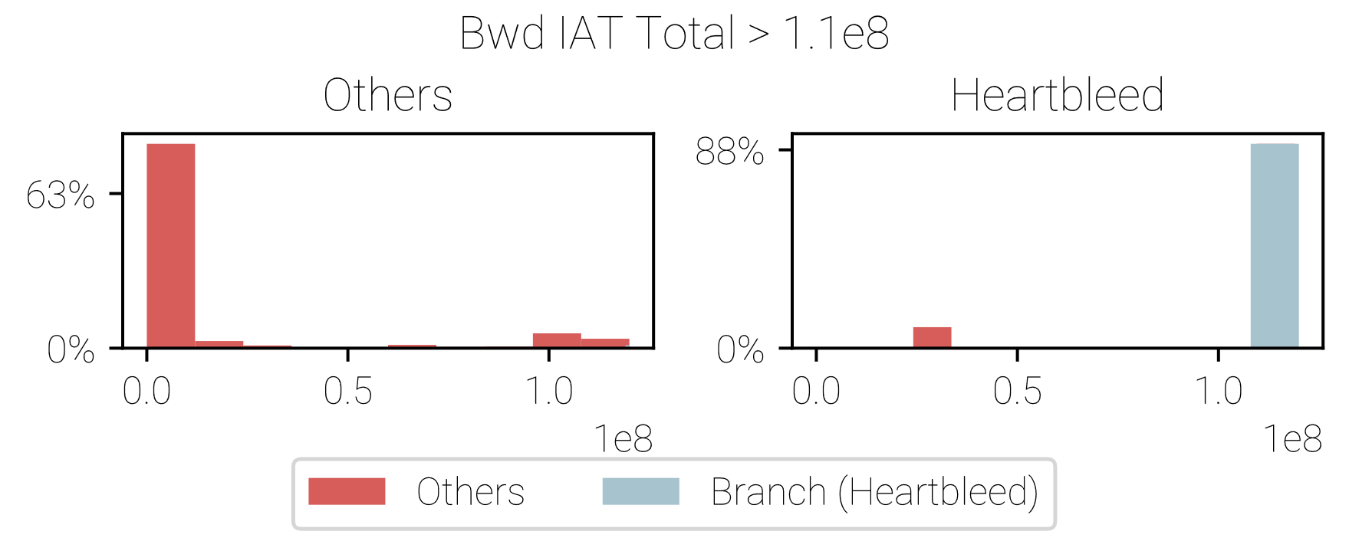
Illustrative example: Heartbleed @ CIC-IDS2017
Particular attack classification (Heartbleed)
78 pre-computed features from flow statistics (e.g. flow duration, mean IA)
Reported F1 score: 0.99

Slide 31
Illustrative example: fixing Heartbleed @ CIC-IDS2017
Reasons:
  Heartbleed triggers with a single-packet request-response pattern
  TCP connections were never closed between different requests from attacker
  Result: very big inter-arrival packet time
Pipeline modification of the experiment
  Close TCP connections immediately after receiving the response

Slide 32
Illustrative examples: takeaways
Data collection is a complicated process
Errors are hardly predictable and usually to be found empirically
Researcher often doesn’t know all problems and data they want to collect
Result:
We want to iteratively collect datasets
We want deployment modification
We want code modification

Slide 33
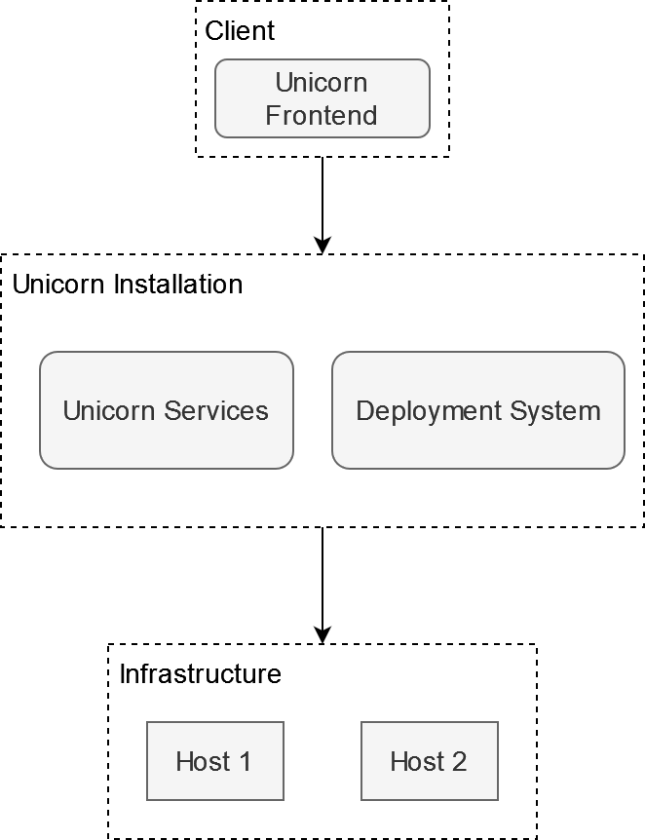
netUnicorn – general description

Slide 34
netUnicorn – typical workflow
User defines what, where, and when to execute
  Arbitrary Python code
  Node selection capabilities
  Experiments synchronization capabilities
The platform prepares the experiment (compilation & distribution)
User starts the experiment
On a target host environment starts with an executor and code inside
Executor on a target host controls experiment’s flow
Executor reports results

Slide 35

netUnicorn – supporting modularity for tasks
Programming abstractions for experiment creation
Task

Slide 36
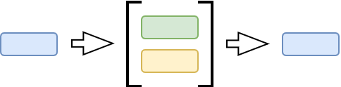
netUnicorn – supporting modularity for tasks
Programming abstractions for experiment creation
Task
Pipeline

Slide 37
netUnicorn – supporting modularity for tasks
Programming abstractions for experiment creation
Task
Pipeline
Node

Slide 38
netUnicorn – supporting modularity for tasks
Programming abstractions for experiment creation
Task
Pipeline
Node
Deployment (Node + Pipeline)

Slide 39
netUnicorn – supporting modularity for tasks
Programming abstractions for experiment creation
Task
Pipeline
Node
Deployment (Node + Pipeline)
Experiment (List of Deployments)
…

Slide 40
netUnicorn – providing encapsulated environment
Docker containers as a virtual environment
Pipeline encapsulation
  Integrated dependencies
  Easy cleanup
  Reproducible environment
Hardware protection
  No sudo access to the host
  No ability to turn on undesirable features
    E.g. Wi-Fi promiscuous mode
  Possible resources constraints

Slide 41
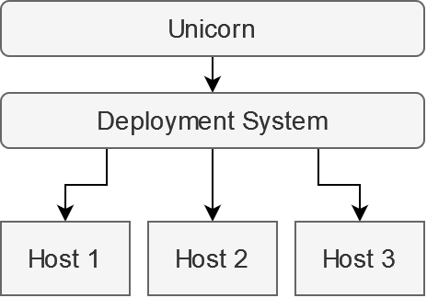
netUnicorn – supporting different infrastructures
Using “deployment systems” as a source of truth
netUnicorn integrates with existing infrastructure, not modify it
  System as an overlay
  Ability to work even in restricted environments
Connectors system
  Extendable
  Minimalistic
  Secure

Slide 42
netUnicorn – possible target platforms
Local-based configuration management systems
  SaltStack
  Ansible
Cloud-based deployment systems
  AWS EC2 & ECS
  Azure VMs and Container
Local virtual systems
  Mininet (Containernet)
  NS-3
Global networking experiment systems
  Chameleon Cloud
  EdgeNet

Slide 43
Dos and Don’ts
Active measurements
Passive measurements
Rapid prototyping
Iterative and changing code / deployment scenarios
Not:
  A magic pill for trustworthy ML
  Data analytics system
  Pre-defined fixed-size set of metrics / measurements
    netunicorn.library

