Slide 1
Interdomain Routing
Nick Feamster Computer Networks

Slide 2
Internet Routing
Abilene
Comcast
Princeton
The Internet
AT&T
Cogent
Large-scale: Thousands of autonomous networks
Self-interest: Independent economic and performance objectives
But, must cooperate for global connectivity
See http://nms.lcs.mit.edu/~feamster/papers/dissertation.pdf (Chapter 2.1-2.3) for optional coverage of the topic.

Slide 3
Overview
The Internet is a global network of networks.
Connectivity is achieved by routers and routing protocols.
Interconnection refers to the various ways networks attach and exchange traffic.
A collection of business practices and technical mechanisms that allow individually managed networks to connect together for this purpose.

Slide 4
Internet Routing Protocol: BGP
Autonomous Systems (ASes)
Route Advertisement
Destination Next-hop AS Path
130.207.0.0/16
Traffic
192.5.89.89
10578..2637
130.207.0.0/16
66.250.252.44
174… 2637
Session
Notes:
Diagram of routing table is very confusing because it’s not pointing to anything
Green arrow shorter, and too thick… green is a msg
More intuition about how the system actually works.
Don’t say “interdomain”
DESTINATION-BASED Routing
Tables look like a set of possible routes and a rankings over these routes
(pop up a simplified table fragment)

Slide 5
Two Flavors of BGP
iBGP
eBGP
External BGP (eBGP): exchanging routes between ASes
Internal BGP (iBGP): disseminating routes to external destinations among the routers within an AS
Question: What’s the difference between IGP and iBGP?

Slide 6
Example BGP Routing Table
The full routing table
> show ip bgp
Network Next Hop Metric LocPrf Weight Path
*>i3.0.0.0 4.79.2.1 0 110 0 3356 701 703 80 i
*>i4.0.0.0 4.79.2.1 0 110 0 3356 i
*>i4.21.254.0/23 208.30.223.5 49 110 0 1239 1299 10355 10355 i
* i4.23.84.0/22 208.30.223.5 112 110 0 1239 6461 20171 i
Specific entry. Can do longest prefix lookup:
> show ip bgp 130.207.7.237
BGP routing table entry for 130.207.0.0/16
Paths: (1 available, best #1, table Default-IP-Routing-Table)
Not advertised to any peer
10578 11537 10490 2637
192.5.89.89 from 18.168.0.27 (66.250.252.45)
Origin IGP, metric 0, localpref 150, valid, internal, best
Community: 10578:700 11537:950
Last update: Sat Jan 14 04:45:09 2006
Prefix
AS path
Next-hop

Slide 7

BGP: Path-Vector Routing
Extension of distance-vector routing
Support flexible routing policies
Key idea: advertise the entire path
Distance vector: send distance metric per dest d
Path vector: send the entire path for each dest d
“d: path (2,1)”
“d: path (1)”
3
2
1
data traffic
data traffic
d
Used in BGP
7

Slide 8
Path-Vector: Flexible Policies
Each node can apply local policies
Path selection: Which path to use?
Path export: Which paths to advertise?
Node 2 prefers “2, 3, 1” over “2, 1”
Node 1 doesn’t let 3 hear the path “1, 2”
2
3
2
3
1
1
8

Slide 9
Topology (and Business)

Slide 10
Loose Coordination
There is no central authority that manages Internet interconnection:
Overall system arises because of the many bilateral and multilateral decisions made by various actors that interconnect.
High bandwidth applications and changes in the number of sources of content is altering traffic growth rates on the Internet and the methods to deliver traffic.

Slide 11
Interconnection Pre-1995
Network interconnection in the U.S. has evolved significantly since the early days of the Internet.
Notes:
The initial form of the Internet was a single, wide area or backbone network (the Internet equivalent of a long-distance provider) that was operated by the U.S. government.
Smaller, regional networks connected to this network forming a simple hierarchical structure.
Traffic from one part of the Internet to another was handed off to this backbone network, which carried it to the destination network.
For many years, the technical requirements on the routing protocol providing this function were simple, and there was no need to deal with business issues.

Slide 12
Interconnection Circa 1995
The backbone eventually transitioned from a single government-operated backbone to a federated backbone model comprised of multiple commercial network operators.
Notes:
As a result of the commercial transition, the routing protocol responsible for maintaining the map of destination networks required improvement.
A new routing protocol, called Border Gateway Protocol (BGP), was created, allowing for commercial provision of backbone connectivity by multiple parties.
BGP allowed network operators to manage this more complex and competitive space, and to express at least a limited set of business constraints on routing.
For example, using BGP a network operator could specify how it preferred traffic flow into and out of its network. At the time of this report, BGP remains the standard routing protocol used to exchange information about IP routing between networks.

Slide 13
Interconnection Today
Interconnection today has evolved into a complex amalgam of models incorporating new connectivity options, delivery options, traffic management requirements and business practices. (“Flattening” of the hierarchy.)
Notes:
The diagram shows the “flatter,” highly interconnected Internet of today.

Slide 14
Routing Attributes and Route Selection
BGP routes have the following attributes, on which the route selection process is based:
Local preference: numerical value assigned by routing policy. Higher values are more preferred.
AS path length: number of AS-level hops in the path
Multiple exit discriminator (“MED”): allows one AS to specify that one exit point is more preferred than another. Lower values are more preferred.
eBGP over iBGP
Shortest intradomain path cost to next hop: implements “hot potato” routing
Router ID tiebreak: arbitrary tiebreak, since only a single “best” route can be selected

Slide 15
Other BGP Attributes
Next-hop: 192.5.89.89
iBGP
Next-hop: 4.79.2.1
4.79.2.2
4.79.2.1
Next-hop: IP address to send packets en route to destination. (Question: How to ensure that the next-hop IP address is reachable?)
Community value: Semantically meaningless. Used for passing around “signals” and labelling routes. More in a bit.

Slide 16
Local Preference
Higher local pref
Primary
Destination
Backup
Lower local pref
Control over outbound traffic
Not transitive across ASes
Coarse hammer to implement route preference
Useful for preferring routes from one AS over another (e.g., primary-backup semantics)

Slide 17
Communities and Local Preference
Primary
Destination
Backup
“Backup” Community
Customer expresses provider that a link is a backup
Affords some control over inbound traffic
More on multihoming, traffic engineering in Lecture 7

Slide 18
AS Path Length
Traffic
Destination
Among routes with highest local preference, select route with shortest AS path length
Shortest AS path != shortest path, for any interpretation of “shortest path”

Slide 19
Hot-Potato Routing
Prefer route with shorter IGP path cost to next-hop
Idea: traffic leaves AS as quickly as possible
Dest.
New York
Atlanta
Traffic
Common practice: Set IGP weights in accordance with propagation delay (e.g., miles, etc.)
5
10
I
Washington, DC

Slide 20
Problems with Hot-Potato Routing
Small changes in IGP weights can cause large traffic shifts
Dest.
San Fran
New York
Traffic
Question: Cost of sub-optimal exit vs. cost of large traffic shifts
11
5
10
I
LA

Slide 21
BGP is Really About Routing Money

Slide 22
Peering
If an AS “peers” with another AS, the two ASes agree to exchange traffic only between their own endpoints and the endpoints in their customers’ networks.
This agreement can be formal or informal.
Where a peering agreement is formalized, it will usually include confidentiality and non-disclosure terms
Peering relationships may be settlement-free or paid, involving either monetary or other types of value exchange.
These are essentially barter transactions where both sides negotiate until they perceive equal value in the relationship.
The customer routes that are exchanged in a paid peering relationship are the same as in a settlement-free peering relationship.
Notes:
Peering agreements have historically been informal “hand shake” agreements but appear to increasingly involve contractual relationships.
Where a peering agreement is formalized, it will usually include confidentiality and non-disclosure terms – most operators do not make their interconnection arrangements public.
In a transit relationship, a transit provider will typically advertise all of its routes to a customer, whereas in a peering relationship, a peer will only advertise its customer routes to another peer.

Slide 23
Basic Requirements to Peer
A network looking to peer must have:
A public AS number assigned by a Regional Internet Registry (RIR).
Without this, the network will not have a unique “identity” on the Internet for the purposes of routing traffic.
At least one block of public IP addresses (independent of any upstream provider) assigned by an RIR.
These addresses are what the network “announces” or “advertises” to other networks it interconnects with.
A network edge router capable of running the BGP protocol, and the technical capability to configure and manage BGP interconnections.
Notes:
In order to participate in a peering relationship on the Internet with any party, some basic technical requirements need to be fulfilled.
These basic requirements to peer may also apply to a network purchasing transit service, for example from multiple ISPs.
This advanced network configuration is often used by larger enterprises for redundancy and traffic management purposes.

Slide 24
Motivation for Peering
Network effects
Increased redundancy
Increased routing control
Reduced latency
Reduced congestion
Improved traffic management and predictability of traffic
Reduced costs
Notes:
Network operators may be motivated to peer for a variety reasons, both business and technical. For some complex transit relationships, similar motivations may apply.
Network effects – Put simply, a network (or a network of networks) is not particularly useful if no one is connected to it or those who are connected to it cannot reach each other. A related concept is that a network becomes more valuable to the connected participants as more and more connect to the network.
Increased redundancy – Network operators strive for as redundant and as resilient a network connectivity map (called a “topology”) as economically possible. If one network interconnects to another in a single location this poses some risk, as a single point of interconnection has a higher likelihood of failure compared to two or more points. Increasing the number of interconnection points between networks results in a more resilient and reliable network for both parties.
Increased routing control – The ability of a network operator to influence path selection between endpoints in the network can lead to lower latency, decreased packet loss and increased quality of experience for network users. Each new peering connection increases network operator’s control over the traffic routed between them, given that their traffic no longer has to traverse intermediary networks.
Reduced latency – Users’ quality of experience generally improves with decreased latency, especially for applications that communicate time-sensitive data, such as interactive voice or video. Relying upon intermediaries for traffic exchange between two networks means that latency characteristics of the connection cannot be as tightly controlled, which can lead to degraded quality of experience for network users. Introducing direct interconnection between the networks provides for well-known and clearly measurable paths between each network’s users. With these clear pathways under the control of the network operators who have an interest in optimizing the quality of experience, latency can be reduced.
Reduced congestion – Congestion along the path between the source and destination through intermediaries can degrade the quality of experience for network users. Direct interconnections between the networks allows for both networks to ensure sufficient bandwidth is available between network users for consistent performance.
Improved traffic management and predictability of traffic – When networks interconnect, they have direct control in managing the flow of traffic between them. Because of this, both networks may reduce the need to maintain spare capacity on their transit and other connections to the Internet, as the traffic that is directly peered is now less likely to appear on other routes.
Reduced costs – Peering can reduce the costs of routing traffic between certain endpoints. For example, if an AS exchanges a significant amount of customer traffic with another AS, rather than sending that traffic up through its transit provider and into the other network through their transit connection, the two networks could peer at a common facility and each will eliminate the transit cost for that traffic exchange. In the case of paid peering, the new cost may be cheaper for the AS that is paying than its previous transit cost.

Slide 25
Peering Policies
Each network operator establishes a set of criteria to determine the networks with which they will interconnect or peer.
PeeringDB categorizes policies as:
Open
Selective
Restrictive
Notes:
These peering policies can reflect how the technical and often contractual arrangements that network operators negotiate with each other to interconnect are influenced by the business objectives and policies of each of the parties.
PeeringDB categorizes policies as:
Open – An open peering policy is where the party will peer with any other party.
Selective – A selective peering policy is where the party will peer with any other party that meets the criteria spelled out in the peering policy such as minimum traffic exchanged, number of peering points, staffed network operations center (NOC), etc. (see below).
Restrictive – A restrictive peering policy is where the party does not generally peer with other parties, or in other words where peering is the exception and not the norm.

Slide 26
Peering Policies
Network operators will often include in their peering policy a set of technical requirements and operational requirements.
These may also include:
Network capacity
Geographic scope
Routing
Network operations centers (NOCs)
Network traffic ratios and volumes
Filtering
Many policies are publicly available online.
Notes:
Network capacity: ASes may impose minimal requirements on the size of a potential peer’s network capacity. ASes sometimes additionally require that the potential peer AS operate a fully redundant backbone network. In addition to imposing capacity requirements at peering links, an AS might also impose requirements on links between major hubs.
Geographic scope: ASes may impose requirements that state the potential peer must have a backbone presence in an expansive and diverse set of geographies. This requirement is often expressed in terms of metropolitan statistical areas (MSAs), time zones, or census bureau divisions. In addition to having a backbone network in these locations, the peering requirements often additionally stipulate that the AS peer in some fraction of these locations where the potential peer AS operates its backbone network, and that each interconnection point have a minimum throughput of a certain traffic rate.
Routing: A potential peer is generally required to operate an IP network between the interconnection points and use the Border Gateway Protocol (BGP) to exchange routes at the interconnection points where the peering occurs. Typically, the potential peer AS must use the same AS number at all peering points and announce a consistent set of routes at all peering points, thus ensuring that each AS can implement “hot potato” routing – a form of “shortest-path” routing that allows each network to minimize carriage costs (see Section 3.1.4 below) – at any of the peering points where the agreement is in place.
Network operations centers (NOC): The potential peer AS must typically maintain a network operations center, where staff is on duty at all times to resolve any problems that may arise within a reasonable timeframe. Cooperation to resolve security incidents is required in many peering agreements.
Network traffic ratios and volumes: Peering policies may stipulate that the potential peer not exceed an aggregate traffic ratio in a certain direction (e.g., “traffic ratios must not exceed 2:1”, meaning that aggregate outbound traffic on the peering links must be no more than twice the volume of aggregate inbound traffic). Peering agreements sometimes also impose requirements that the potential peer send a minimum volume of traffic over the peering links. Some peers may have preference as to how they exchange traffic, depending on traffic volume – typically small volumes use Internet Exchanges, large volumes use private interconnections.
Filtering: Peering policies may also require the peer AS to filter route announcements from its customers by prefix, to ensure that incorrect route announcements do not “leak” across the peering link and that no transit or third-party routes are announced.

Slide 27
Transit
If an AS provides “transit” service for a customer AS, it can carry traffic between that customer’s network and all other Internet endpoints.
Transit relationships may be:
“full” – the customer receives routes for all Internet destinations from its transit provider), or
“partial” – the customer receives routes for some subset of all Internet endpoints.
Transit is always a service offered for a fee.

Slide 28
Internet Business Model (Simplified)
Preferences implemented with local preference manipulation
Provider
Pay to use
Free to use
Peer
Get paid to use
Destination
Customer
Customer/Provider: One AS pays another for reachability to some set of destinations
“Settlement-free” Peering: Bartering. Two ASes exchange routes with one another.

Slide 29
Implementing Transit
Filtering
Routes from customer: to everyone
Routes from provider: only to customers
From other destinations
To the customer
From the customer
To other destinations
providers
providers
advertisements
traffic
customer
customer

Slide 30
Implementing Peering
Filtering
Routes from peer: only to customers
No routes from other peers or providers
advertisements
peer
peer
traffic
customer
customer

Slide 31
Physical Facilities for Interconnection
For networks to interconnect, they have to physically connect their networking equipment with each other.
This requires the networks to meet in a common location, in facilities capable of supporting the equipment required for interconnection.
These colocation facilities lease their customers secure space to locate and operate equipment
Point of Presence (PoP)
An access point to a communication provider’s network.
Notes:
The secure space often in the form of lockable rack cabinets or cages.
In addition to floor space, a colocation facility provides power, cooling, structured cabling to support network connection, real-time physical security monitoring, and fire protection.
Colocation facilities are provided by commercial enterprises to house multiple network providers in the same or adjacent buildings.
POPs:
In order for two (or more) networks to interconnect, their networks need PoPs in close proximity to one another for local interconnection.
Another option is the acquisition of a circuit providing the extra network reach needed to connect with other PoPs.
Network operators often maintain PoPs located in multiple colocation facilities across the country and/or globe.

Slide 32
Interconnection: Public & Private
Interconnecting two networks requires both:
(1) physical connectivity, and
(2) network connectivity.
Common options for interconnection are either:
Direct interconnection:
Private bilateral arrangement between two networks using a dedicated physical connection
Public connection:
A multilateral arrangement where all networks connect into a public Internet Exchange switch.
Notes:
A private interconnect is accomplished using one or more dedicated physical cables to interconnect two networks in close proximity, and it is used exclusively for the exchange of traffic between those two networks.
The physical media that connects the two networks at that site is often referred to as a “cross-connect” and can be copper or fiber.
Data speed of a cross-connect can range from Mbps up to many Gbps.
It is common in larger networks for the traffic volume between networks at a single location to exceed the capabilities of any single router interface.
This limit is typically overcome through the combination of multiple physical connections into a single logical one.
The downside of this arrangement is the additional operational overhead of having to manage multiple (sometimes dozens) physical connections as well as added complexity in troubleshooting faults in the connections.
Alternatively, multiple networks can interconnect through a public Internet Exchange.
An Internet Exchange is a service that uses a switch infrastructure (sometimes referred to as a switch fabric or peering exchange) to provide connectivity between multiple networks.
The multi-party switching fabric often comprises one or more Layer 2 Ethernet switches and provides an alternative to the dedicated cross-connect required for private interconnection.
For some networks the ability to reach multiple networks using only a single connection into the IX is advantageous, resulting in lower operating expenses.
Conversely, for very large networks with large data flows with a few networks, it may be more advantageous to use private interconnects.

Slide 33
Public and Private Interconnection
At left: Simple colocation facility with direct interconnects
At right: colocation facility that also offers IX through a public switch (or “switching fabric”)
Notes:
This diagram illustrates the differences between the types of connections at a colocation facility where ASes can privately interconnect and a colocation facility that provides a public Internet Exchange switch.

Slide 34
IXPs
Physical connectivity to an Internet Exchange does not automatically entitle access to every other network on the exchange.
Or even mean that any traffic will flow over that connection at all.
Network operator must also establish network connectivity with other network(s) present on the exchange
Notes:
Some Internet Exchanges have mandatory multilateral peering agreements as part of the service and therefore require no additional approval for connectivity with the other networks at that exchange, while other Internet Exchanges will require each network to establish a separate peering agreement with each other network.
Internet Exchanges can be operated as for-profit businesses, as cooperative non-profits, or even as voluntary arrangements between operators with no formal organizational structure – though this normally occurs only in the “startup” phase of an exchange.
The for-profit IX model is dominant in the United States, while the non-profit cooperative model is dominant in other parts of the world.
For-profit IXes are commercial operations, often run by the colocation company that houses them and offered as an additional value-added service to incent companies to colocate their equipment there.
Network operators pay a fee to connect to the IX, with pricing determined by the colocation provider operating the exchange.
Conversely, exchanges outside the United States are typically operated as non-profit cooperatives, owned and operated for the benefit of the member ISPs, and funded by the membership and connection fees paid by the connected ISPs.
Most European IXes are separate organizations from the colocation facilities that host them, and they typically only provide public peering services.
Fees paid to the organization cover the peering exchange infrastructure costs and the costs of running the IX itself. Many European IXes have a broader “community” remit to undertake activities for the benefit of their members, for example engaging with policymakers and regulators on Internet policy and governance issues.
One notable exception being LINX, who provides a “private interconnect” service to its members as an alternative to purchasing private interconnect cross-connects from certain colocation vendors.

Slide 35
Costs of Peering
Connecting two networks in a peering relationship does not come without costs.
These can include:
Networking equipment for interconnecting the networks (add’l router/switch ports, additional router/switch capacity – chassis, CPUs, etc., and equipment racks);
The leasing costs for space and power at the colocation site for the network equipment;
Interconnection fees charged by the colocation site or IX;
Network connectivity (transit, leased circuits, and/or fiber) capacity from the PoP to the rest of the network for the additional peered traffic;
Operational fees; and
Engineering labor to design and deploy the network for the new interconnect.
Notes:
Both networks must have PoPs at a common colocation facility or purchase connectivity to the colocation facility in order to be able to interconnect.
This may mean that one or both networks must create a PoP that may require laying or leasing fiber-optic cable, purchasing network infrastructure and installing that equipment in a colocation facility.

Slide 36
Traffic and Interconnection
Internet traffic has grown rapidly since the Internet’s inception.
Often been driven by the growth of popular applications.
Video has emerged as a key driver shaping current consumer bandwidth consumption.
Video resolution impacts bandwidth requirements (Ex: 4K)
Residential broadband traffic is characterized by asymmetric patterns.
Due to the nature of consumer data consumption.
Notes:
Recent evolution in Internet traffic patterns can be attributed to numerous factors including:
advent of new consumer devices (smartphones, tablets) with intelligent features and functionalities.
The increasing popularity of streaming music services (Spotify) and streaming video games as a spectator sport (Twitch.TV) are also traffic drivers.
The growth in connections is being driven by:
introduction of mobile-to-mobile (M2M) applications in vertical markets such as energy (smart meters), security (video surveillance), fitness (wearables), healthcare, and transportation industries.
Video -- Netflix/Youtube:
Nearly half of the peak downstream traffic on fixed access networks in North America in the first half of 2014 was attributed to streaming video from Netflix and YouTube.
Asymmetric Traffic:
The current trend in traffic volume shows a greater percentage increase in the inbound direction towards the broadband user vs. outbound away from the broadband user.
As seen in the peak upstream & downstream trends reported in North America in the first half of 2014, the mean monthly upstream traffic (7.6 GB) is significantly lower than the downstream traffic (43.8 GB).
It is expected that residential Internet traffic will remain asymmetric for the foreseeable future.

Slide 37
Traffic and Interconnection
The changes in Internet traffic patterns have coincided with a dramatic change in the Internet connectivity model.
In 2009 half of all Internet traffic from approx. 150 companies.
In 2014, only 30 companies account for half of traffic.
Notes:
Changes in the connectivity model are also due to the underlying technological advances and market forces.

Slide 38
Modern-Day Interconnection

Slide 39

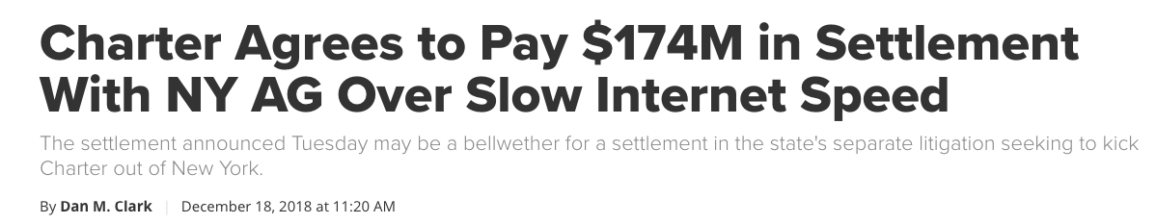

Slide 40
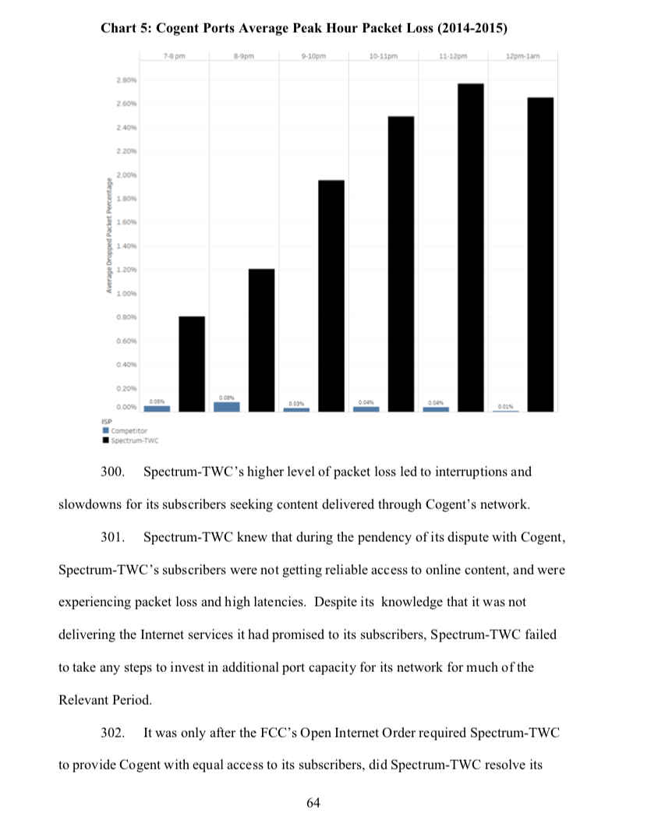
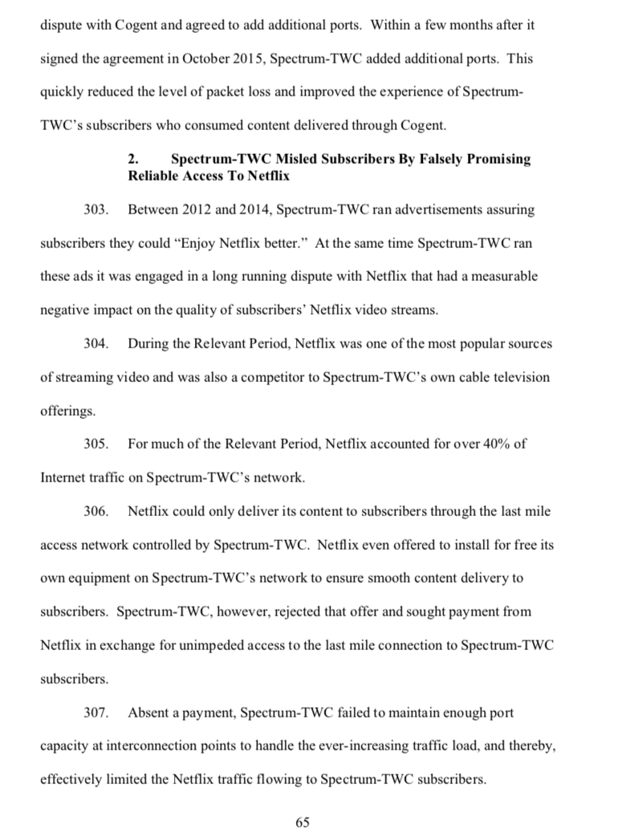
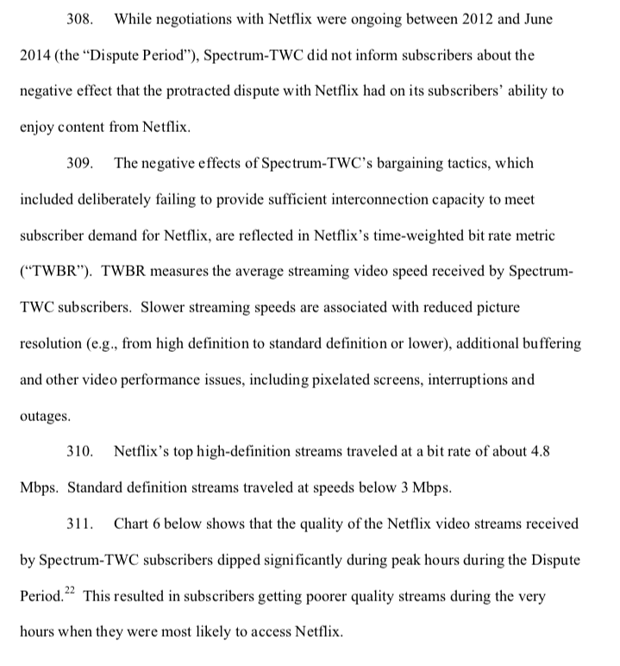

Slide 41
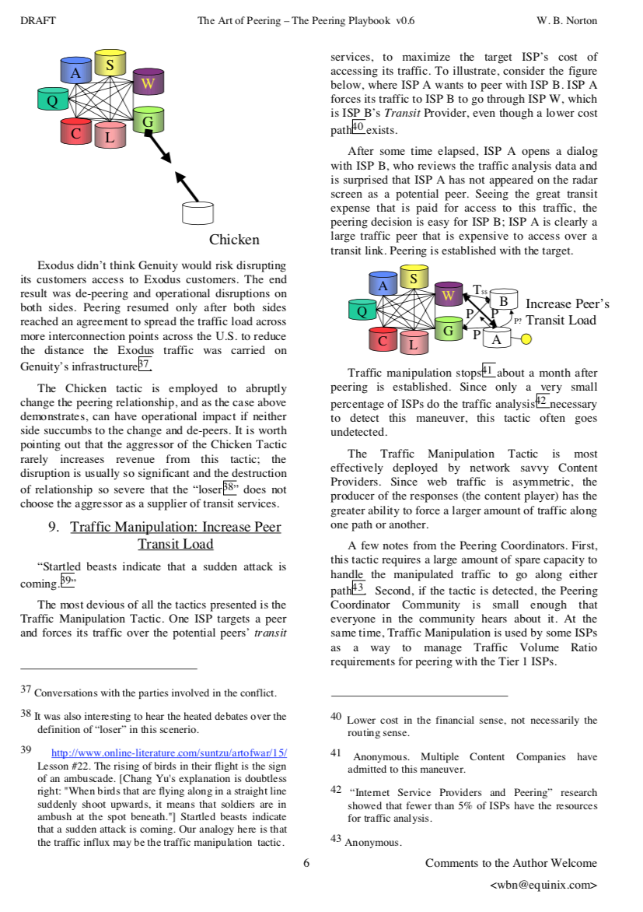

Slide 42
Peering Disputes and Outcomes
Peering disputes are not new, though a number of peering disputes in the U.S. have been increasingly publicized in recent years.
A peering relationship represents an agreement between two networks to exchange traffic in some agreed upon manner.
If one or both of the networks determine that the peering relationship no longer meets the agreed upon terms or is no longer mutually beneficial, several things can happen.
Notes:
Peering disputes over traffic imbalances, or other reasons, are not new, a number of peering disputes in the U.S. have been increasingly publicized in recent years.
A peering relationship represents an agreement between two networks to exchange traffic in some agreed upon manner.

Slide 43
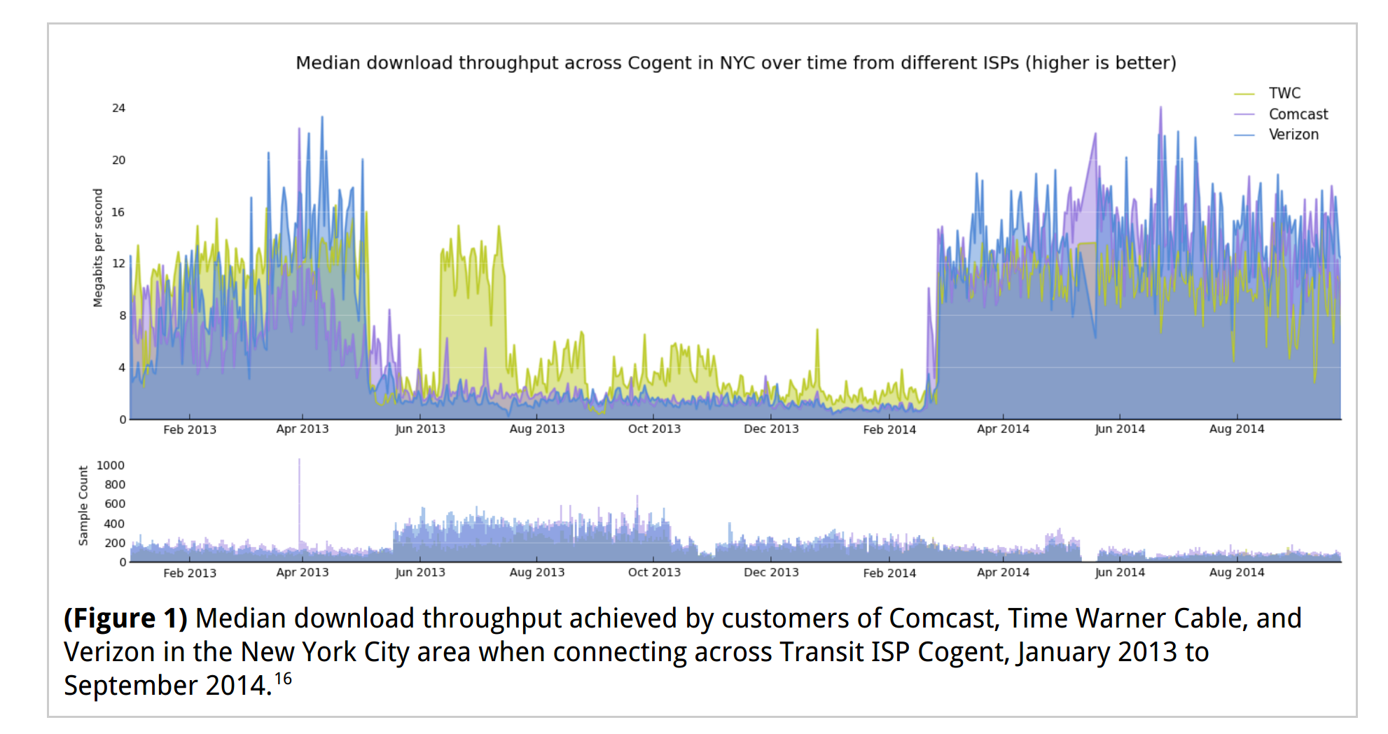
Congestion: Cogent as Transit
ISP Interconnection and Its Impact on Consumer Internet Performance. Measurement Lab Report. October 2014.

Slide 44
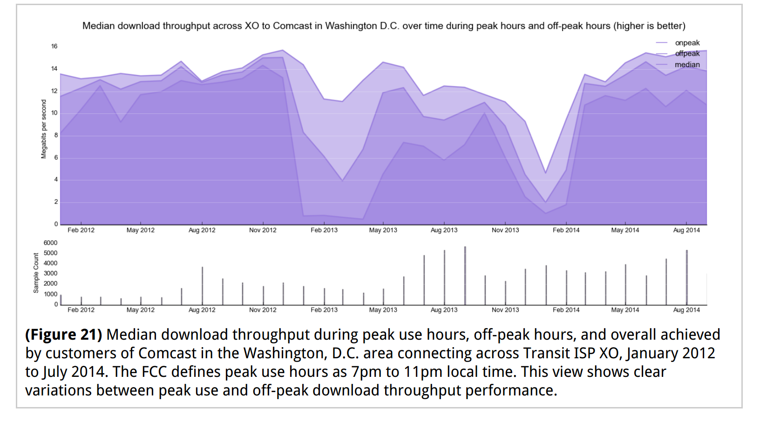
Congestion: Comcast
ISP Interconnection and Its Impact on Consumer Internet Performance. Measurement Lab Report. October 2014.

