Slide 1
Evaluation and Experimentation Skills
Nick Feamster and Alex Gray
College of Computing
Georgia Tech

Slide 2
This Lecture
Designing an experiment
Different types of experiments
How to evaluate a “big claim”
  What goes into the evaluation section?
Methods and pitfalls
  Experimental design
Repeatable experimentation
Analysis and data presentation

Slide 3
Why Evaluate?
Validate claims: Support the claims laid out earlier in the paper
  Test a hypothesis
  Demonstrate improvement over previous work
  Proof-of-concept (deployment)
Understand complex systems
Be specific in claims and evaluation

Slide 4
Principles
Select appropriate evaluation techniques, performance metrics, workloads
Conduct performance metrics correctly
Use proper statistical techniques
Give most information with the least effort
Perform simulations correctly

Slide 5
State the Goal
Not trivial!
  Most performance problems are vague when first presented
  “When the goal is stated, the problem is half-solved.”
The goal defines the metrics, workload, and method
Clear statement of the goal typically makes the solution and evaluation more clear

Slide 6
Performance Analyst as Juror
Your evaluation section should be
  Focused
  Objective
“Once the evaluation questions are formulated, the problem is half-solved.”
Do not indicate an implicit (or explicit) bias in stating the goals of the evaluation

Slide 7
Select the Factors to Study
Start with a small number of factors for which you will perform your evaluation
You should study parameters that are likely to have a significant effect on performance

Slide 8
Choose the Correct Metrics
Metrics: Quantitative measurement that demonstrates performance, forms the basis of comparison, etc.
Depends on the services provided by the system being modeled
Examples
  Goodput vs. throughput
  Throughput vs. packet forwarding rate
  Wall clock time vs. system time

Slide 9
Choose an Appropriate Workload
Your workload should be
  representative of the workload that would be seen by an actual system
  timely: note that many features change
Examples
  User arrival patterns
  Mobility
  Packet sizes

Slide 10
Performance Benchmarks
Goal: Compare apples to apples
  Common way of comparing two systems
Many fields have commonly accepted performance benchmarks
Two types
  Microbenchmark: Understand behavior of a specific component
  Macrobenchmark: Understand behavior of system as a whole

Slide 11
Common Benchmarking Mistakes
Only testing average case in workload
Not resetting initial conditions
Ignoring monitoring/experiment overhead
Not validating results
  Misplaced probe, loose probe, etc.
Ignoring variance and outliers

Slide 12
Example Factors
Performance metrics
  Response time (distribution)
  Availability (MTTR/MTTF)
  Throughput (throughput vs. load)
  Utilization/Idle time
  Capacity
  Scalability
    Key question: What factors are likely to scale or not scale? (What is being scaled?)
Accuracy metrics
  False positive / Detection rate

Slide 13
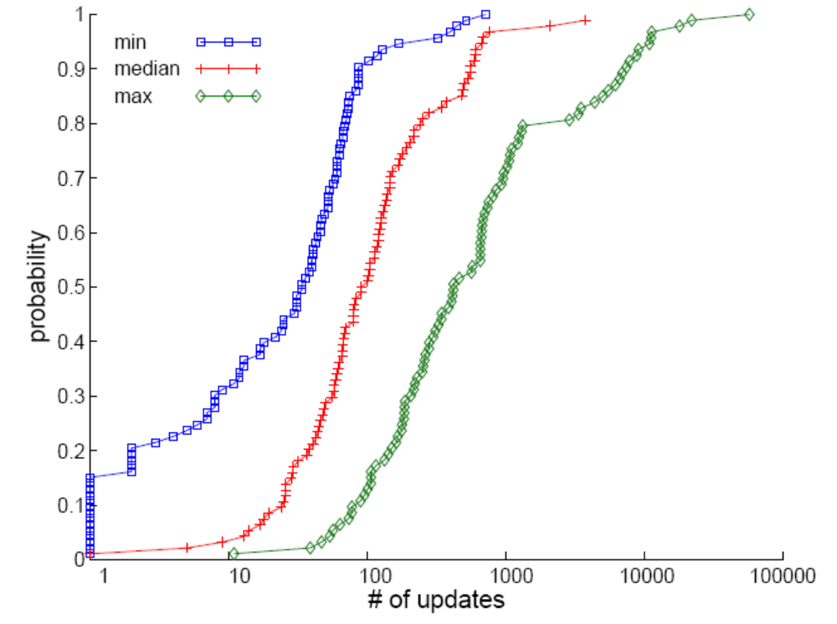
Evaluating Distributions
Cumulative Distribution Function
  Concise summary of distribution
  Uses: Response times, etc.

Slide 14
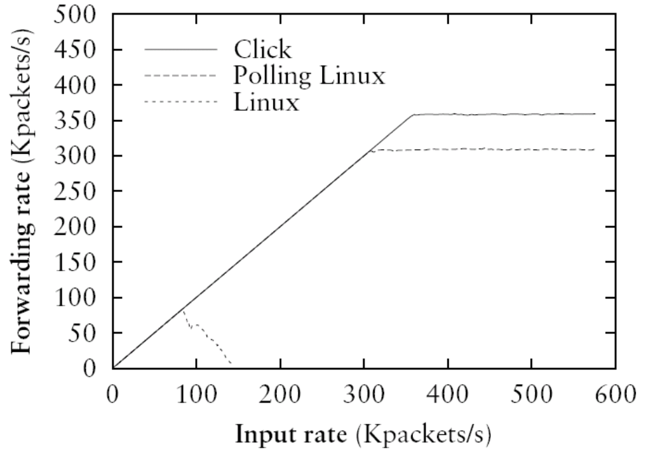
Evaluating Throughput
Input rate on x-axis
Output/throughput on y-axis

Slide 15
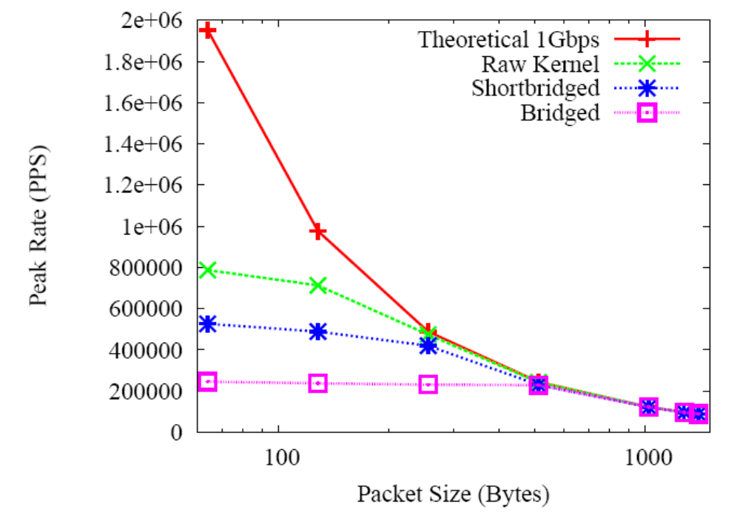
Evaluating Throughput (cont)
Factor to vary on x-axis
Often helpful to place theoretical/analytical bound to understand result

Slide 16
Workload Selection
Services exercised
  Determine the components that are most likely to affect performance
Level of detail
  Parameterized workloads
  Traces
Representativeness of workload
Repeatability

Slide 17
Choose the Evaluation Technique
Three types of evaluation
  Simulation
  Measurement/Deployment
  Analytical modeling
Potential pitfall: Omitting phenomena that could affect the final result

Slide 18
Importance of Cross-Validation
Until validated, all evaluation results are suspect!
Cross-validation: Measure the same phenomenon using multiple techniques, datasets, etc.
  Measurements are susceptible to experimental errors
  Simulation and analytical models can omit important phenomena that may affect outcomes

Slide 19
Why Simulation?
Capture complexity that analytical models miss
  Can also validate network models
Validation
  Quantitative results
  Exploration of dynamics
Controlled experimental conditions
Low cost/barrier to entry
  Time
  Collaboration
  Complexity

Slide 20
Simulation:
Advantages and Disadvantages
Advantages
Disadvantages
Ease of use
Often possible to achieve large scale (federation, etc.)
Low cost in time, money, etc.
Many “accepted” models available
Models may be (and have previously been shown to be) incorrect
Doesn’t run actual protocols, software implementations, etc.
Parameter exploration creep

Slide 21
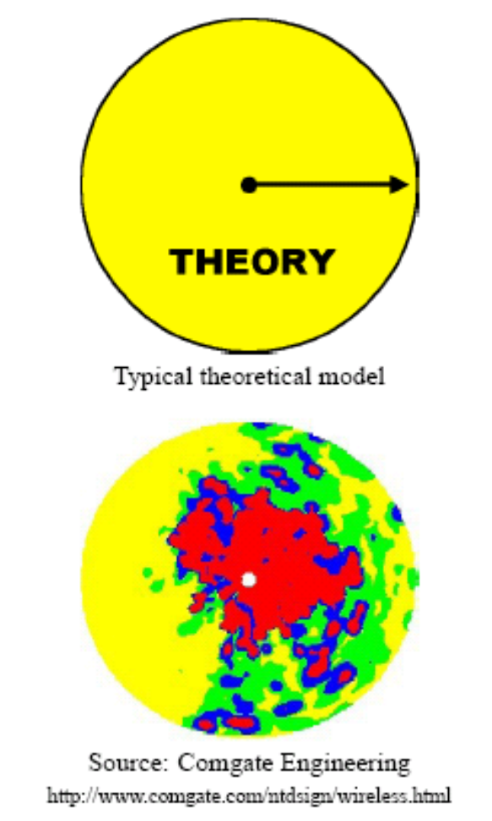
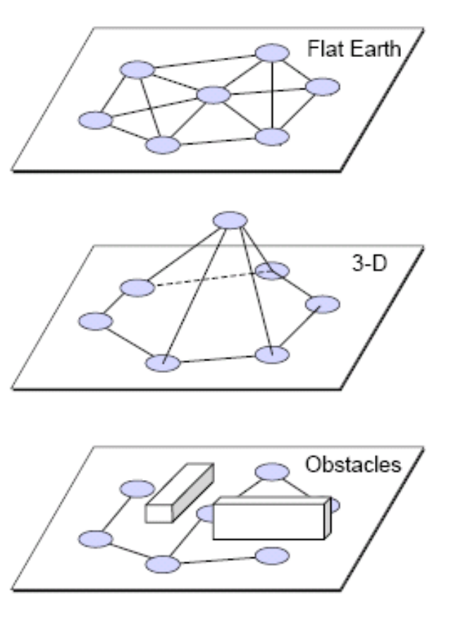
Case Study: Wireless
The earth is not flat
Radio transmission range is not circular
Radios have unequal ranges
Communication is asymmetric
Reachability does not imply perfect communication
Signal strength is not only a function of distance
“Mistaken Axioms of Wireless Networking Research”, Dartmouth TR

Slide 22
Why Analysis?
Solidify intuition
Principled approach to understanding the factors that affect performance
  Can help explain results, or deviations from those results
Can help understand complex factors (e.g., scaling behavior)

Slide 23
Why Deployment?
Realistic evaluation scenarios
  Real workloads and users
  Field deployment / proof of concept
Disadvantages
  Realistic, large-scale deployments can be tough to achieve
  Deployment scenario may not achieve full “coverage”

Slide 24
Avoiding Evaluation Pitfalls

Slide 25
Common Pitfalls
Measuring system vs. artifacts
  Where were the measurements collected?
  What was the method?
Bugs in data collection
Bugs in analysis

Slide 26
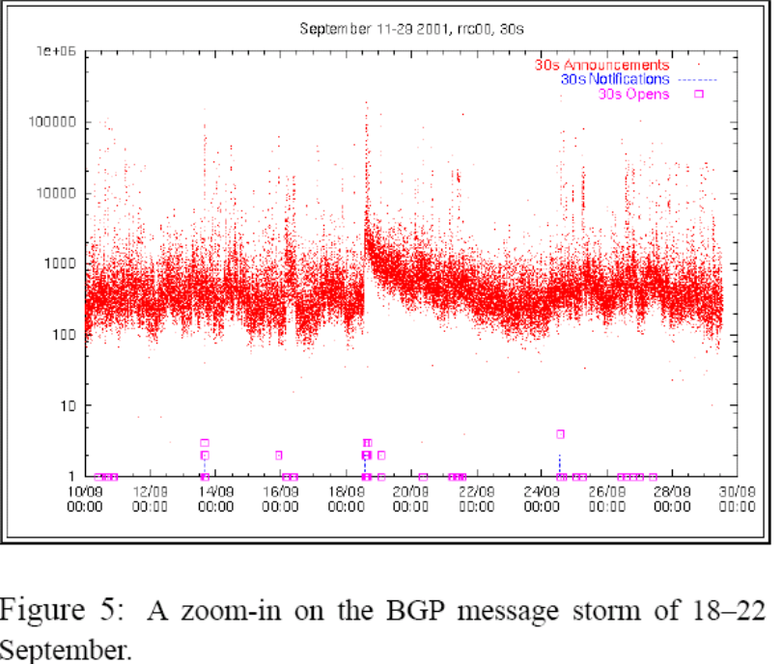
Measuring Artifacts
Question: Does worm propagation cause routing instability?
Strawman approach:
  Observe routing data
  Correlate routing traffic in logs with time of worm spread
  Finding: Lots of routing updates at the time of the worm spreading!
  (Bogus) conclusion: Worm spreading causes route instability
Cowie et al., “Global Routing Instabilities Triggered by Code Red II and Nimda Worm Attacks”

Slide 27
Bugs in Data Collection
Missing log files
  Process dies
  Machine crashes
Machines with unsynchronized clocks

Slide 28
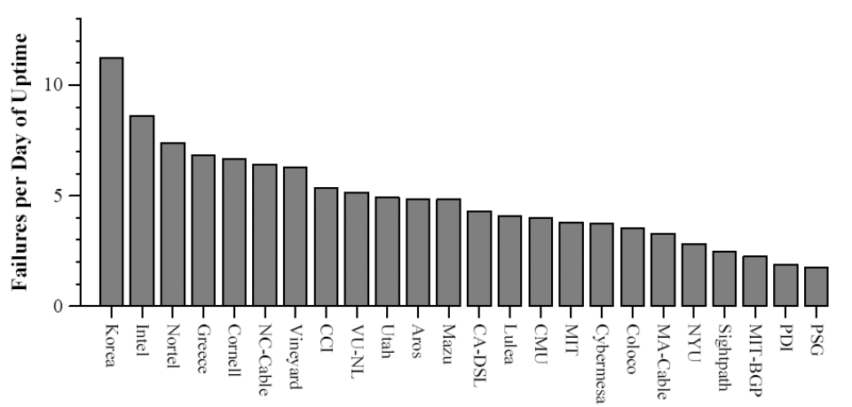
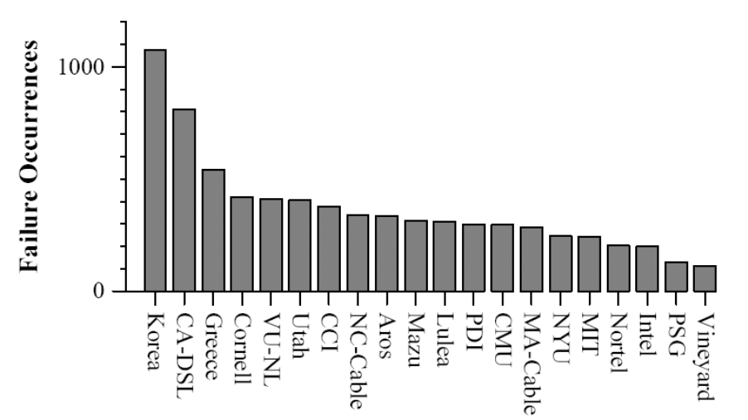
Bugs in Analysis
Final Version
Submitted Version
select srchost.name, dsthost.name, count(*) from hosts as srchost, hosts as dsthost, outages where srchost.ip=outages.src and dsthost.ip=outages.dst …

Slide 29
Analyze and Interpret Data
Importance: Repeatability of experimental results
Outcomes of measurements are random quantities that may be different upon a different run of the experiment
Take into account variability

Slide 30
Examine the Zeroth-Order
Do not ignore spikes and outliers
More general: Look at the data, not just aggregate statistics
  Don’t blindly compute aggregates
  Timeseries plots are telling (gaps, spikes, etc.)
  Basics
    Are the raw trace files empty?
      Need not be 0-byte files (e.g., BGP update logs have state messages but no updates)
    Metadata/context: Did weird things happen during collection (machine crash, disk full, etc.)

Slide 31
Presenting Evaluation Results

Slide 32
Writing the Evaluation Section
First section: Data and experimental setup
  Where, how data collected
  Machines used + specification
  Other exogenous factors
Remainder: One section per key result
Helpful: Table that summarizes results

Slide 33
Pictorial Games
Non-zero origins to emphasize difference
¾ rule: height of highest point at least ¾ of the horizontal offset of rightmost point
Wrong
Wrong
Right
2610
5200
2600
2600
0
0

Slide 34
Other Common Pitfalls
Too much information on one graph
  Plotting many y-variables on a single graph
  Presenting many alternatives on a single graph
Selecting scale or ranges incorrectly
Presenting average values without confidence intervals

Slide 35
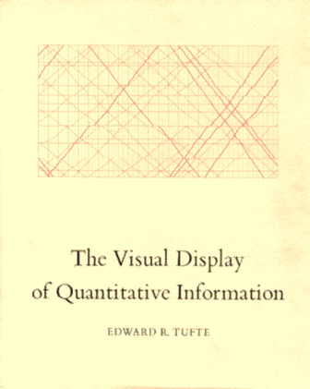
Presenting data
Goals of data presentation
Avoiding distorting/lying
Avoiding clutter/distraction
Clarity and aesthetics
Modeling data
Other topics
Main source: The Visual Display of Quantitative Information, by Edward Tufte

Slide 36
Purpose: tables vs. graphics
Purpose of tables: show absolute numbers
  Good for less than about 20 numbers
Purpose of data graphics (plots, etc): Show relationships, or comparisons
  Pick one (or more!) relationships to show, and show them clearly
  Encourage the eye to compare different pieces of data

Slide 37
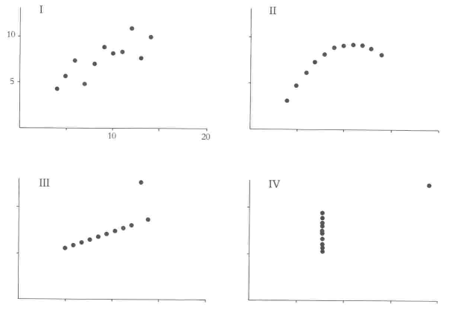
Same summary statistics, different relationships

Slide 38
Maximize information transfer
Tufte: “Graphical excellence is that which gives the viewer the greatest number of ideas in the shortest time with the least ink in the smallest space”
  e.g. reveal the data at several levels of detail; reveal the data conditioned on salient things, like types or clusters; etc.
Goal: Present as many numbers (actually their relationships) as possible per sq. inch

Slide 39
Maximize information transfer
Using empty space
Multifunctioning graphical elements
  e.g. can put marginals, summary statistics, table values on the axes
  e.g. numbers as the ‘points’
Supertable – has many subtables

Slide 40
Visual quantities
A graphic maps a data quantity to a visual quantity, e.g. relative positions, colors, etc
Can simultaneously show different kinds of relationships, using different modalities
  Many ways to do this – becomes a creative activity

Slide 41
Visual quantities
Particularly natural/compelling:
  Maps
    if there’s a natural spatial map, show it
    Label important points in the map
  Time series
    multiple time series side by side encourage comparison
    label times for important events
  Snapshots over time
    Like frames of a movie
    Tells a story

Slide 42
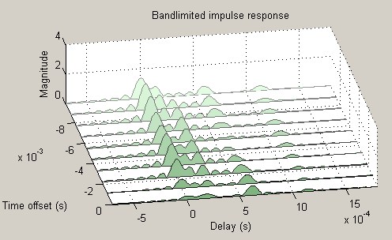
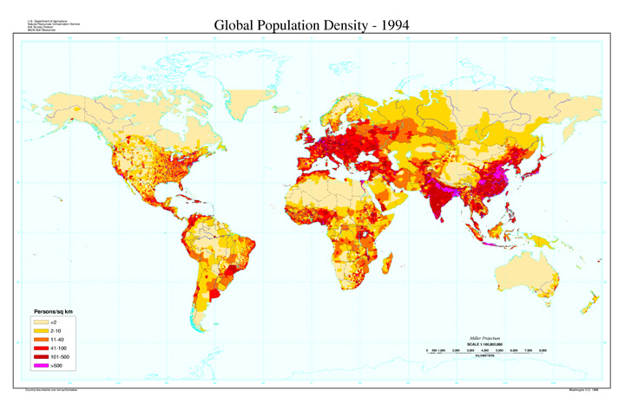
Visual quantities

Slide 43
Lying/distorting with graphics
Make the context clear:
  Ideally make bars start at origin; can show percentages on y-axis
  Show baseline for comparison
  Time series: show part before and after
Compare apples to apples
  Scales must be regular
  Choice of length of each axis affects slope
Isolate an effect, e.g. adjust for inflation
Control for visual illusions, e.g. by showing random data

Slide 44
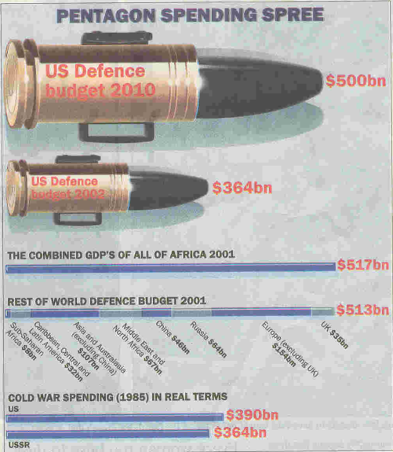
Lying/distorting with graphics
Should be a 1-to-1 correspondence between the data and visual quantities, not 1-to-many
Don’t create a puzzle for the viewer by making the mapping between data and visual quantities unclear

Slide 45
Clarity
Eliminate anything unnecessary
  Clutter distracts from the content; want fewer things for the eye to focus on
  Most of the ink should be “data ink”
  Eliminate redundant lines, content-free decoration
  Avoid cross-hatching
Graphics should be closely integrated with the text description
  avoid having to go back and forth between words and picture

Slide 46
Clarity
Size/emphasis according to importance
What’s easy to see/read?
  Left-to-right, not sideways
  Serifs
  Mixed case
  Include text, but not too much text
  Accessible level of detail
  Avoid having to scan for decoding abbreviations

Slide 47
Aesthetics
Thick lines are better than thin lines
Horizontal is better than vertical (about 50% wider than tall)
Use words, numbers, plots, drawing all together
Good balance, proportion, use of space… gets into graphic design (particularly useful for posters)

Slide 48
Modeling data
General issues that get slightly technical…
  Fit using what principle? (estimation)
  Ignoring/identifying outliers (robustness)
  Overfitting this finite sample (generalization)
  What’s the error of the fit? (confidence band)
  Overfitting a conclusion, like A>B (hypothesis testing)
  Large dataset (computation)
Now some modeling methods…

Slide 49
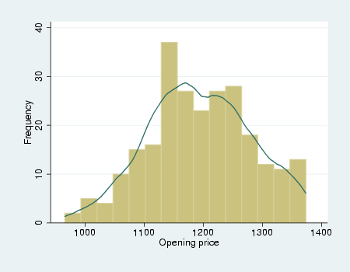
Distributions
How many bins? Density estimation

Slide 50
Modeling data
Some other types of modeling:
  Anomalies/outliers: L2E, etc
  Summary statistics: mean/median/mode, variance, skewness, etc.
  Directions of variation: PCA, etc
  Sub-patterns for different parts of the data: mixture models, rules, etc
  Sub-sampling for plotting: Monte Carlo theory
  Correlated or causal variables: graphical models, contingency tables

