Slide 1
Finding Good Ideas and Problems
Nick Feamster and Alex Gray
CS 7001
August 28, 2006

Slide 2
Questions
What’s a good idea?
What makes a good research problem?
How to find a good research problem?

Slide 3
What’s a good idea?
Advance in the field
Needs to address some need (real problem)
  Need could be immediate or longer term
  Specific need, connected to practice
  Can address the needs of some specific group
  May not be immediately obvious today that it’s useful
Needs to offer new perspective/angle
“I should have thought of that!” (strong emotions)
Market value
Can you explain it to mom? (should be simple and coherent)
Elegance, simplicity, generality, practicality
Opens a new direction
Many interpretations, applications to other areas not previously thought of

Slide 4
What’s a Bad Idea/Problem?
(and where to find them)
Your imagination
  Comic books, cartoons
Ideas/Problems that are solved
  Literature reviews are important
Those that can’t be solved or validated
When your advisor tries to talk you out of it…when should you listen?
  “Problem is too hard.” Can you figure out how to leverage help, make some new assumptions, new subproblem that people hadn’t thought of, a new perspective to the problem (new technique, approach, etc.)…?
  “Field/problem area is dead.” Don’t completely accept this. You may know something that your advisor doesn’t. Find a connection with another field… Ask yourself: Has the situation changed? (e.g., memory cheaper, CPU faster, etc.)
  “Problem area is ‘too crowded’.” Can you say something new?
When to bail out on an idea?
  Solution is impractical

Slide 5
What’s a good idea?
Looking backward, from n years from now
Opens up new thinking
Treats fundamental issues better
Elegance

Slide 6
What Makes a Good Research Problem?
Problem needs a solution/must be tractable
  Solutions need not be complete, but they should offer new insight
  Solution sometimes distills a problem to its essence
Problem should be challenging
Clearly differentiated from previous work. Context is clearly defined.

Slide 7


The Problem Must be Important
How to judge this?
  Matter of taste (maybe)
  Requires seeing good and bad to help get a sense
Test 1: critical mass
  Is there some group of people that would benefit from a solution? Is it a group you care about?
  Examples: network operators, citizens in developing countries, other researchers, etc.
Test 2: time travel
  Will the problem go away on its own? (e.g., memory is getting cheaper, CPUs faster, etc.)

Slide 8
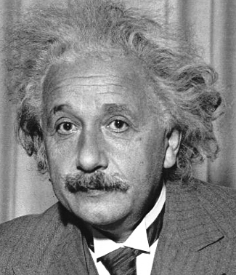

The Problem Must Be Difficult
There is no point in solving easy problems
Recognize the difference between research and a “simple matter of engineering”
“We can’t solve problems by using the same kind of thinking we used when we created them.”

Slide 9
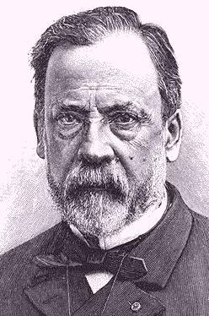
The Problem Must Create Knowledge
Research: the process of creating knowledge
  Building systems, tools, etc.: not research unless you devise new techniques or lessons along the way
  Good questions to ask
    Do I know the answer to this before I start?
    Are there places to expect surprises?
Starting points
  Hypothesis
  A new approach
  Serendipity sometimes takes over!

Slide 10
Problem Should Have a Solution
Solution need not always be complete
  Opening up a new direction for others to explore
Negative results are OK sometimes
  If you knew you’d come up with a positive result, then you wouldn’t be creating knowledge ☺
  Prevents others from going down the same path

Slide 11
What’s a good problem?
(to work on)
Current hype (short-term)
Actual impact (long-term)
  Question: How to measure impact?
Need some reason you think you can make progress
Clear objective and success criterion

Slide 12
Secret weapons
Bigger brain
Mastery of a technique or theory
Fresh perspective
  From another field or culture
  From much later

Slide 13
Where to find research ideas/problems?
Could draw on ideas from multiple areas
  New connections between multiple areas that people hadn’t thought of before
Other people have tried and failed

Slide 14
How do you find ideas/problems?
Frustrations
  Your own
  Others’… how to find out about these?
Read, read, read to stay relevant
  Mailing lists
  Conferences (“real world” ones, in particular)
  Certain news rags (Economist, Tech Review, etc.)
    Can often be a good source of ideas for applying one problem domain to another, etc.

Slide 15
How do you find ideas/problems?
The recent literature
The old literature
Other literatures
Analogies
Elegance as a guide

Slide 16
Where not to find ideas/problems
Your imagination
  Don’t make problems up. Plenty of real ones out there…
  The new approach, question, etc., should come from your thoughts. The problem itself should not.
  Asking for feedback is key
Conference proceedings (sometimes)
  The last 80% of papers on a topic solve the last 5% of the problem
  Often, that 5% “doesn’t matter”
    Engineering or time travel will solve it…

Slide 17
How to solve a big problem?
Baby steps: simplifications of the problem
Special cases of the problem
Multiple perspectives on the same problem
Surrounding the problem by knowing all aspects; massive knowledge
Big analogical leaps

