Slide 1
What is a Ph.D.?
Nick Feamster and Alex Gray
College of Computing
Georgia Institute of Technology
“The reason I got my Ph.D. is so that I’d never have to wake up before 9 a.m. wear a suit to work”

Slide 2
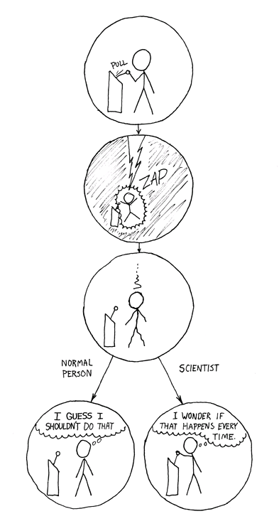
“How could you choose avoiding a little pain over understanding a magic lightning machine?”
Normal
Person
Scientist
Source: http://xkcd.com/c242.html

Slide 3
Why Ph.D.?
Respect, prestige, Money
New career opportunities
  Teaching
  Research
  Entrepreneurship
Other job opportunities (marketability, outsourcing, etc.)
  Crossover to other areas: Policy
  Alternative to industry
Challenge
  Developing discipline
  Realizing your potential
  Testing your own limits
  Thrill of achievement
Fascination with a certain topic

Slide 4
Why Ph.D.? Your Answers…
Impact on industry and research/academia
  Value to the world, change the world
  New paradigms
  Helping women, disabled people, country, humanity, everyday people, etc.
  Be a role model
Innovation and Problem Solving
  Thrill of discovery: conquest
  “Experiencing the mysterious”
  Excitement beyond “just being a coding monkey” (“industry sucks”!)
  Advancement of technology in a specific field
  Solving puzzles
Learning: satisfy strong desire of knowledge
  Searching for things that nobody knows: creation of new knowledge
  To become the world’s expert on a topic (get to the “bottom”of something)
  Freedom, new limits, escape from boredom
  Diversity: learn and think about many things

Slide 5
What research do you admire?
Simple solutions to complex problems
New paradigms
Direct (or sometimes immediate) impact
  On industry/practical world
  Intellectual/academic world
Cross-disciplinary work
  (Researchers who contributed significantly to different fields)
“an inspiration for further work, because it showed, or rather implied through its showing, just what was possible in procedural graphics. That, I believe, is just as important as the results themselves because where would research be without inspiration?”

Slide 6
What researchers do you most strive to emulate?
Historical examples
  Einstein, Galileo, Hippocrates, Turing, Dijkstra
  Shannon, Polyani, Conti, …
Contemporaries (or near-contemporaries)
  Jim Gray
  David Patterson
  Ion Stoica
  Tim Berners-Lee
  Jane Margolis

Slide 7
What is a Ph.D.?
Answer 1: A degree
  Signifies the capability to conduct research
What is research?
  The creation of knowledge
  This differs significantly from anything you’ve ever done before: you will become a producer of knowledge

Slide 8
What is a Ph.D?
Answer 2: An opportunity
  To become an expert
    What is an expert? Someone who knows more about some topic than anyone else in the world
    Daunting, but not as hard as it sounds: you will be the only one focusing time and energy on a single problem
  To be your own boss
    Flexible hours
    As long as you are making progress, you can typically work at your own pace
    You have the flexibility to define what you work on
You will never get this opportunity again!

Slide 9
What is a Ph.D.?
Answer 3: An entry card
  …into a community
  By the time you graduate, you will be well-known and respected as an expert
Question: What community do you want to join when you are done?
  Academics
  Industry experts
  …

Slide 10
What is a Ph.D.?
Answer 4: A process
  On average, 5 years
  Many logistical aspects
    Qualifiers: oral and written
    Classes
    Dissertation
    Papers
  The process is at least as important as the final outcome. People will come to know you and your research, even if they never read your dissertation.

Slide 11
What is a Ph.D.?
Answer 5: A signal
  Signifies that you know how to discover, solve, etc. important unsolved problems
Many positions (e.g., professor, research scientist, etc.) only hire Ph.D.’s
(There is a business school analog here.)

Slide 12
What can you do with your Ph.D.?
Academia
  Tenure-track faculty
  Research faculty
Industrial Research Lab
  e.g., Microsoft Research, Intel Research
Start a company
  Your groundbreaking Ph.D. topic may also have a good business model
  Example: Google started from Stanford’s Digital Library Project (but…it is still good to finish)
National labs
Wall street
Notes:
Note: many jobs to not require a Ph.D. If you are going after one of those, you should recognize this.

Slide 13
What can you do without a Ph.D.?
Many jobs
You should recognize if you want one of those jobs
Opportunity cost is high

Slide 14
What the Ph.D. is not
Lucrative (at least not immediately)
A chance to take more classes
A “meanwhile” activity
Well-defined
  No assignments and “checklists”
  Don’t think of your work as homework. If you only do what your advisor asks and no more, you will have missed the point of the Ph.D.

Slide 15
The End State
A successful career
  Ability to have real impact (more in later lectures about how to have “impact”)
  A lifetime of learning and advancement of knowledge
  A job you love
  Freedom: much less structure than other jobs
  Many people are not so lucky
High-quality research
  You will be evaluated on your publication record and contributions to science, not on your dissertation
  You have an opportunity to fundamentally change the world we live in. Dissertation is a minimal requirement…think BIG!
More good reading: A Ph.D. is Not Enough

Slide 16
Getting you there: The Big Picture
Step 1: This class
  Tools for having a successful research career
Step 2: A research project, start-to-finish
  e.g., Your first 8903
  Does not have to be your thesis topic
  …but it should be publication-worthy
Step 3: Developing (and marking) your “research area”
  Publish in top conferences.
  (Operative words: 1. publish 2. top)
  Establish your expertise in an area
  Carve out your niche/expertise. Differentiation is key
  By the end of this process, someone should be able to say, “John is the world expert on X.”, where X is significant
  There is no single way to accomplish this step. It will also require significant thought on your part

Slide 17
Getting you there (cont.)
Step 4: The job hunt
  Actually, this can (and should) begin very early in your graduate career
  Never too early to start networking, self-promotion, etc.
  The big “push” will come once you have established your area of expertise/main contribution
Step 5: Dissertation
  A coherent collection of contributions to a single problem area
    Every good dissertation has a thesis
  This step should be relatively easy after Step 3 (except for perhaps the writing)
  It may only include a small fraction of the publications from your graduate career
  Although the dissertation is the last “step”, it is not the critical one. Remember: nobody reads your dissertation.

Slide 18
The Key: Self-Confidence
Rejection is a part of life…it is also a part of research
  A litany of failures lurks behind every spectacular success
  You will be primarily evaluated by your peaks
  To have even one spectacular success, you will endure many failures
What separates great researchers from the mediocre
  Willingness to take risks
  Reaction to failure (“fire in the belly”, not dejection)
You must believe in yourself, because others will doubt you (this is a natural part of the process)…and they will sometimes be wrong
  Your capabilities
  Your research

Slide 19
“We are sorry to inform you…”
“this paper purports to present a practical implementation of Diffie and Hellman's public-key cryptosystem for applications in the electronic mail realm…the paper should be rejected both for a failure to live up to it and for its irrelevance…Finally, there is the question of the application. Electronic mail on the Arpanet is indeed a nice gizmo, but it is unlikely it will ever be diffused outside academic circles and public laboratories—environments in which the need to maintain confidentiality is scarcely pressing.”
“The author is a proponent of the so-called "structured programming" style, …Structured programming is a nice academic exercise, but I doubt that any real-world program will ever be written in such a style. More than 10 years of industrial experience with Fortran have proved conclusively to everybody concerned that, in the real world, the goto is useful and necessary: its presence might cause some inconveniences in debugging, but it is a de facto standard and we must live with it.”
“We are sorry to inform you ..." by Simon Santini, IEEE Computer, December 2005, pp 126--128

Slide 20
Self-Promotion
Your opportunities when you graduate depend heavily on people’s opinions of you and your work
You must market yourself and your research
  Nobody can use your expertise, your results, etc. if they don’t know they exist
  Do not expect people to read your papers (especially unsolicited)…they are too busy
Promotion of your research, especially to people more senior than you, is essential
  Reputation is, in many ways, the currency of research. Hard to gain, very easy to lose
  You must generate one…hopefully positive
  Take great care not to trash it (e.g., with a bad paper, plagiarism, personal insults, gossip, love affairs)

Slide 21
Passion and Interest
Q: “Am I smart enough to get a Ph.D.?”
  A. Wrong question. Instead, ask yourself if you are passionate enough to get a Ph.D.
By virtue of the fact that you are sitting here, you have the intellectual horsepower
If you are passionate about some problem, with enough tenacity, you can make a meaningful contribution

Slide 22
So…do you really want a Ph.D.?
Evaluate
  What type of career do you want?
  Do you have the elements (personality, drive, passion) to succeed?
  Is this the best use of your time?
If not, it is OK to leave
  Now
  At any time (recall the “sunk cost fallacy”)
If so, optimize your decisions (life, career, research choices) around making the most of it
  If you’re going to “half ass” it, why bother?

Slide 23
Next Steps
You’ve decided you want to be here (we hope), and, more importantly, why
Use the goals you set out for yourself as an anchor for all decisions you make
  Choosing research problems
    Research directions
  Time management
    Whether to write a particular paper, attend some conference, etc.
  Balance between learning, research, presentation, promotion, etc.
Depending on the goals you wrote down, you may make different choices

