Slide 1
A Case Study in Great Ideas
Nick Feamster and Alex Gray
CS 7001

Slide 2
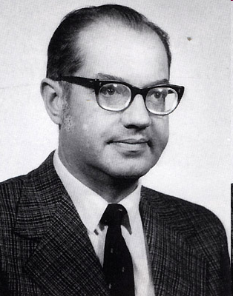
Paul Baran
Inventor of packet-switched networks
Born April 29, 1926
Undergraduate at Drexel,
Masters at UCLA
Work at RAND
Founded Metricom (metro-area networks)

Slide 3
Biographical/Research Notes
Going to UCLA to work with Estrin was somewhat accidental
Note how Baran started working on the problem of survivable networks
  He had already convinced himself that survivable networks is/was a problem
  Figured out how to fit his beliefs about important problems into RAND’s mission

Slide 4
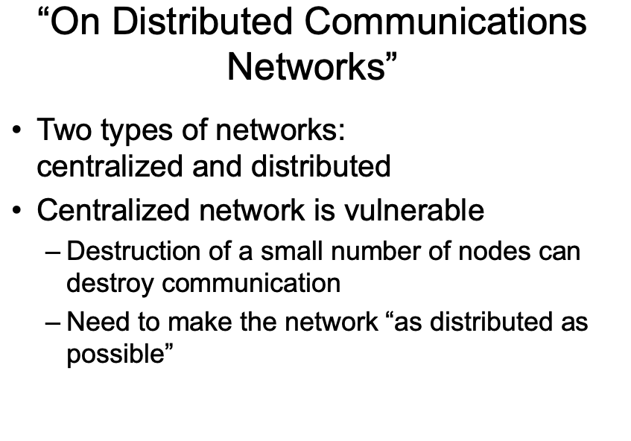
“On Distributed Communications Networks”
Two types of networks:
centralized and distributed
Centralized network is vulnerable
  Destruction of a small number of nodes can destroy communication
  Need to make the network “as distributed as possible”

Slide 5
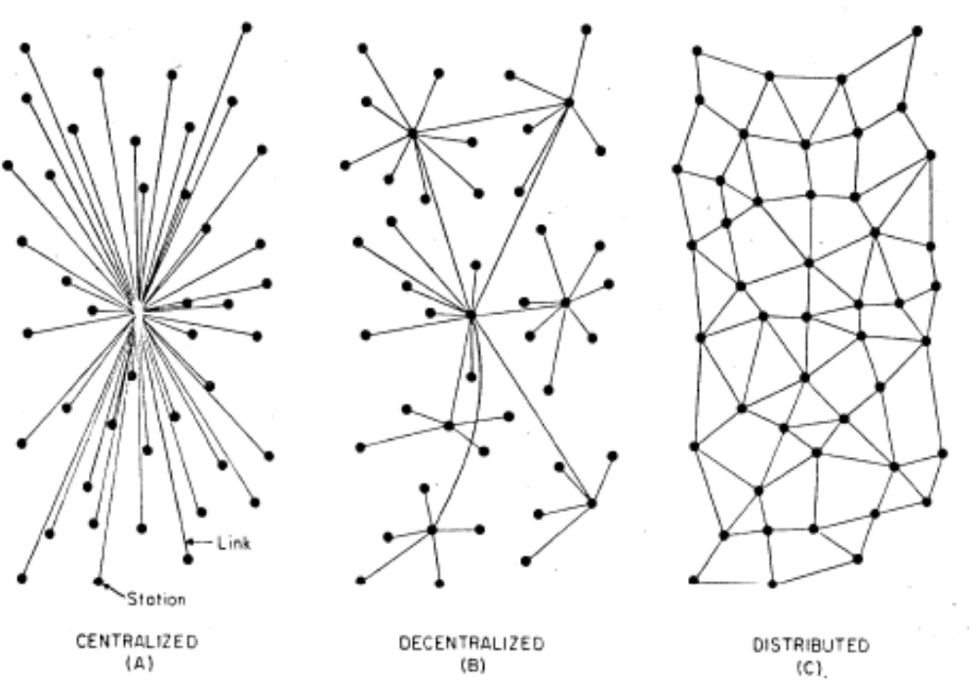
Figures of Each Type of Network

Slide 6
Defining Connectivity
Nodes are said to be connected if, after some fraction of nodes and links
Analysis involves the ability of an adversary to bisect a network given the successful probability of attack on nodes/links

Slide 7
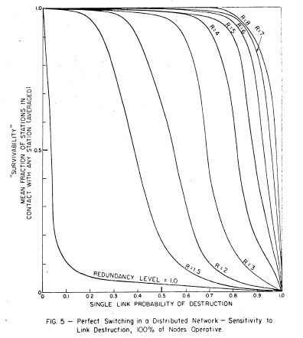
Reliability

Slide 8
Origins of Packet Switching
Conventional systems try only a small subset of potential paths
What if, instead, the communications system could try a larger percentage of paths?
Goal: Building reliable systems out of unreliable components at lowest cost

Slide 9
Media for Setting Up Links
Some synchronous low-cost links
  Repeaters
  Microwave
  TV
  Satellite

Slide 10
Problems
Transmission bandwidths for each link must be matched
Switching time exceeds transmission time
No way to economically share a network made up of varied data rates

Slide 11
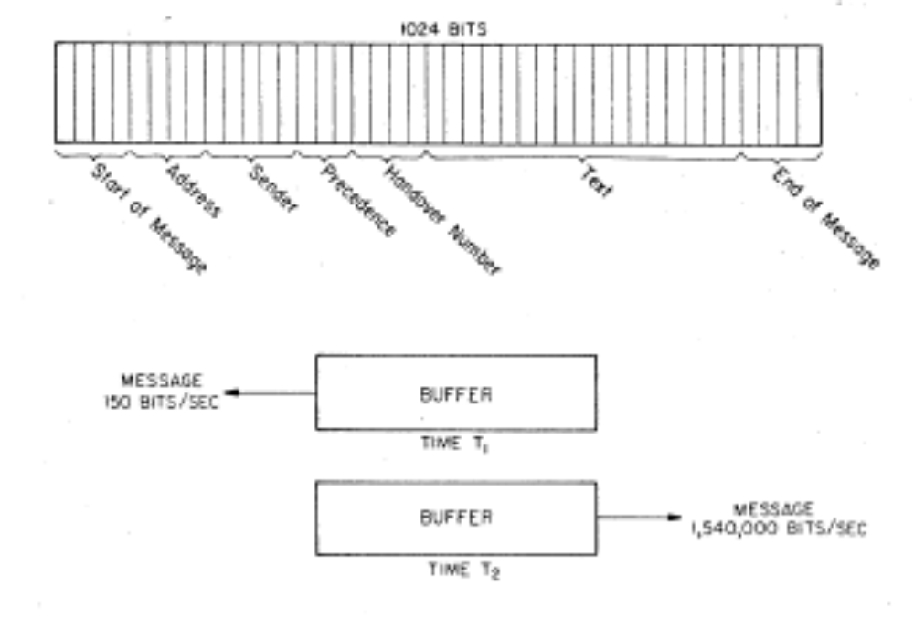
Idea: Message Blocks (“Packets”)
No centralized routing mechanism
Analogy to postman sorting mail

Slide 12
Genesis of the Packet-Switching Idea
Using AM broadcast to relay messages from one station to the other
  Idea sparked by off-hand comment by president of RAND

Slide 13
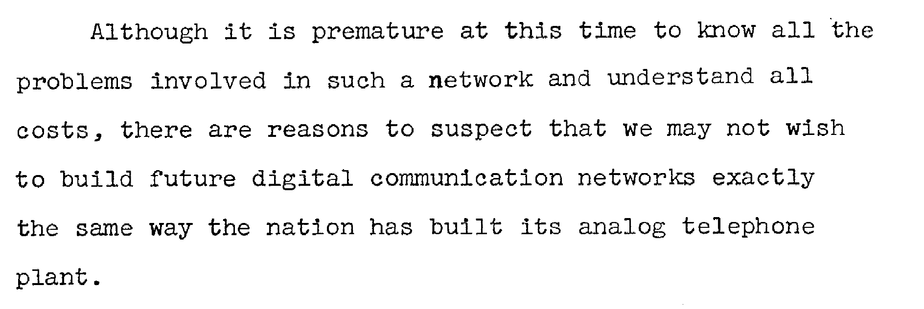
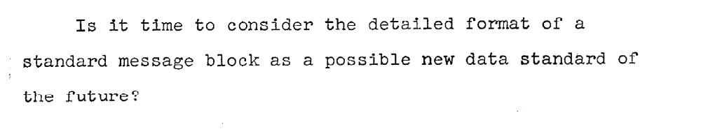
Wrap-Up

Slide 14
Inertia
Hard to integrate radical new technology into the existing analog transmission system
Would have created competition
Heretical view was difficult for some to accept
One of the older analog transmission guys said, "Wait a minute son,
let's try that again. You mean you open the switch here before the traffic has emerged from the end of the cross-country circuit." I would say, "Yes." He raised his eyebrows, looked at the others shaking their heads and said, "Son, this is how a telephone works." It was pretty patronizing from time to time, until I learned to use Western Electric part numbers. This greatly improved the interaction.

Slide 15
Baran’s Reaction
“And then you had to tell them that each packet will find its own route on a statistical basis to get where it wants to go. After I heard the melodic refrain of "bullshit" often enough I was motivated to go away and write papers to show that algorithms were possible that did in fact allow a short message to contain all the information it needs to know where to go.”

Slide 16
Baran’s MS Advisor
“He kept me continually challenged. He has a wonderful way of finding out what you knew and what you didn't. He would gently, but firmly, focus you into your weakest areas.”

Slide 17
Discussion Questions
How did Baran start with a simple, narrow problem and create a great idea?
Was Baran's idea “too risky”?
How did Baran perform sanity checks? When and why are sanity checks useful?
How did Baran apply analogies to his research?
How important was Baran's research environment?
How and when did Baran transition from thinking about high-level ideas to details? Or, was it the other way around?
How could Baran have done things differently so that he would have been a household name?

