Slide 1
Cross-Disciplinary Thinking
Nick Feamster and Alex Gray
CS 7001

Slide 2
Patterns
Multi-disciplinary problems
Cross-disciplinary research
  Hammer-and-nail (apply a technique from another field)
  Model transfer (apply a model meant for another problem)
  Analogy (map abstract features of a problem/solution)
  Mimicry (make a system having the abstract features of another system)

Slide 3
Many fields are inherently
multi-disciplinary
Examples:
  Robotics (computer vision, AI, ML, mechanical engineering, systems)
  Graphics (art, computational physics, perception)
  HCI (systems, psychology, humanities)
  Language translation (linguistics, ML)
  Computational biology (algorithms, genomics, ML)

Slide 4
Doing cross-disciplinary research
How to do it
  To find the problems and opportunities: read widely, talk to people outside your area
  Know something well first – then bring your deep experience/knowledge of a tool or set of concepts to a new area
Avoiding pitfalls
  Always target each presentation of your work to exactly one specific audience
  A cross-disciplinary researcher must still pick a home - there needs to be a main community that supports you, where you build your name

Slide 5
Genetic algorithms
Pattern: analogy/mimicry
Idea: Make an optimization algorithm based on the idea of nature evolving the most ‘fit’ individuals
Analogy part 1: Evolution, in which weak individuals die with some probability and more fit individuals reproduce (combining good aspects) with some probability, is a kind of optimization process, or search for better solutions.

Slide 6
Genetic algorithms
Analogy part 2: Can we encode complex real-world problems in this abstract framework to obtain effective optimizers? (An interesting example is where the population consists of program ASTs, and we are trying to find better programs – called genetic programming.)
Possible breakthrough
  This has certainly spawned thousands of papers, and can do some kinds of problems that conventional optimizers can’t, but comparisons today are seldom rigorous, so solid conclusions can’t be made

Slide 7
Spam Filtering
Prevent unwanted traffic from reaching a user’s inbox by distinguishing spam from ham
Question: What features best differentiate spam from legitimate mail?
  Content-based filtering: What is in the mail?
  IP address of sender: Who is the sender?
  Behavioral features: How the mail is sent?

Slide 8
Network-Based Filtering
Filter email based on how it is sent, in addition to simply what is sent.
Network-level properties are less malleable
  Network/geographic location of sender and receiver
  Set of target recipients
  Hosting or upstream ISP (AS number)
  Membership in a botnet (spammer, hosting infrastructure)

Slide 9
Why Network-Level Features?
Lightweight: Don’t require inspecting details of packet streams
  Can be done at high speeds
  Can be done in the middle of the network
Robust: Perhaps more difficult to change some network-level features than message contents

Slide 10
Finding the Right Features
Goal: Sender reputation from a single packet?
  Low overhead
  Fast classification
  In-network
  Perhaps more evasion resistant
Key challenge
  What features satisfy these properties and can distinguish spammers from legitimate senders?

Slide 11
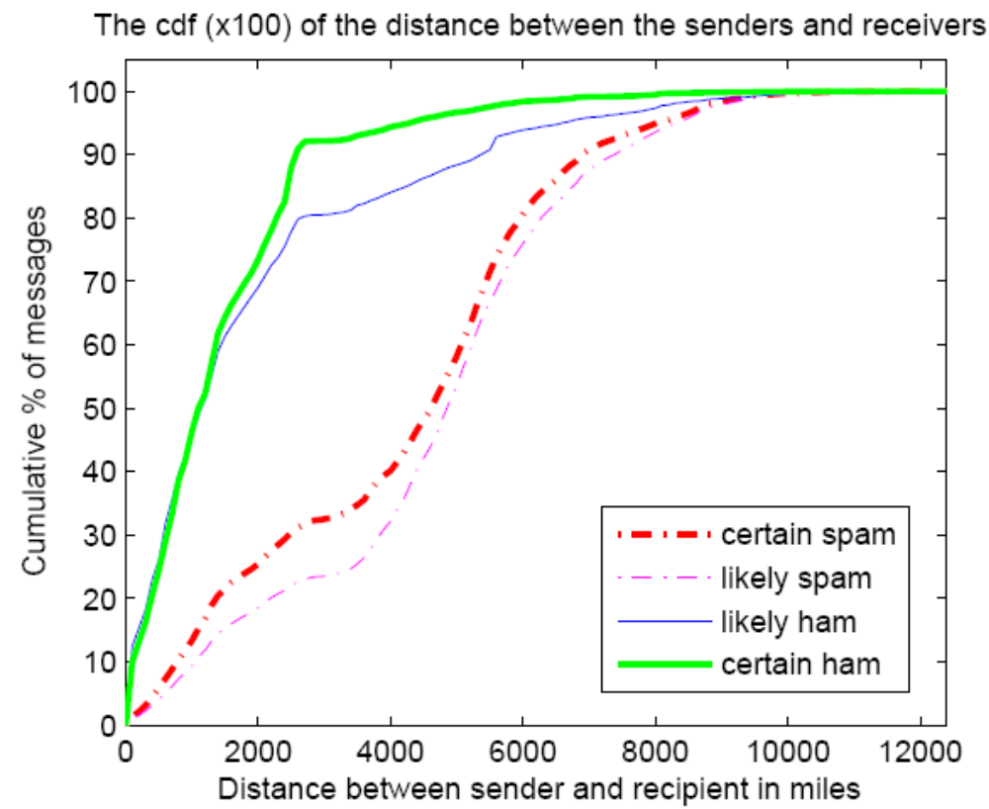
Sender-Receiver Geodesic Distance
90% of legitimate messages travel 2,200 miles or less

Slide 12
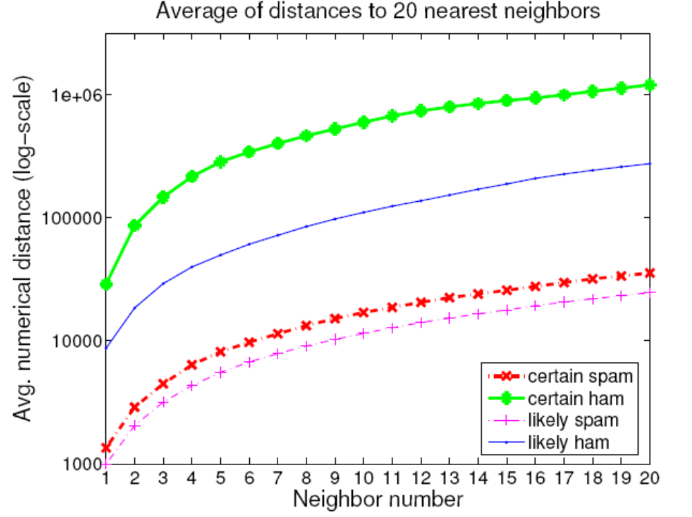
Density of Senders in IP Space
For spammers, k nearest senders are much closer in IP space
Notes:
XXX Fix This XXX

Slide 13
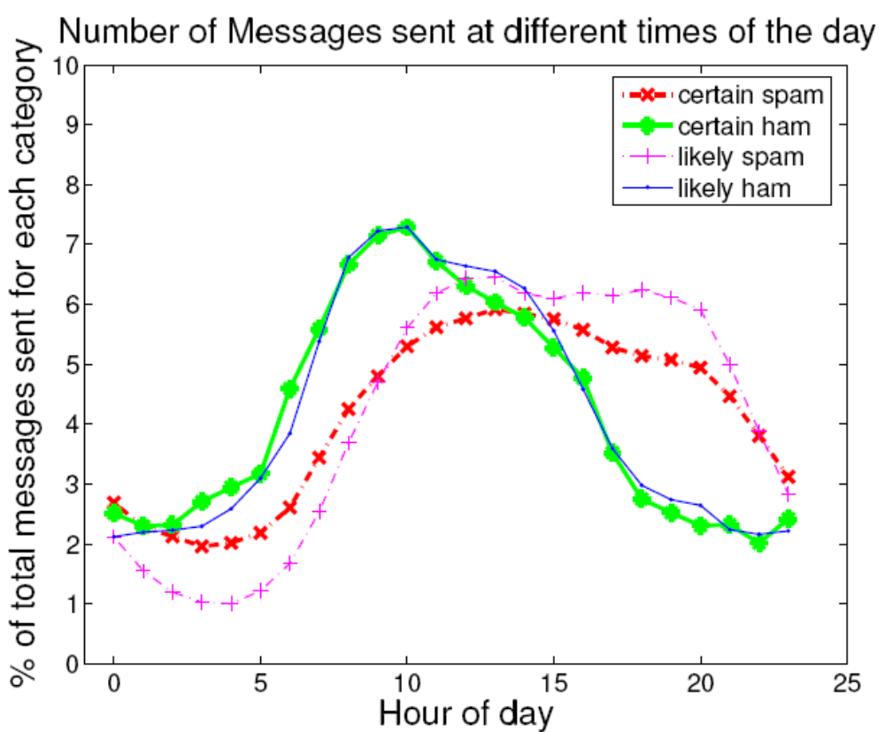
Local Time of Day at Sender
Spammers “peak” at different local times of day

Slide 14
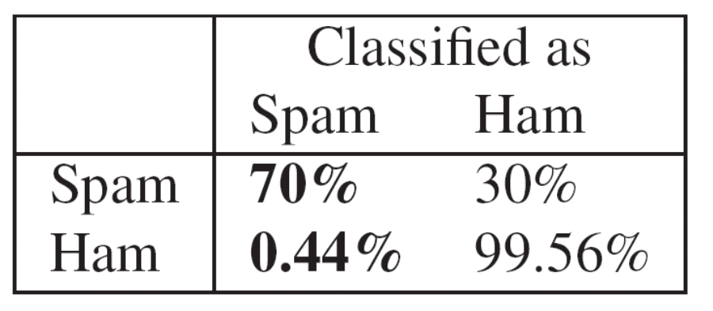
Combining Features: RuleFit
Put features into the RuleFit classifier
10-fold cross validation on one day of query logs from a large spam filtering appliance provider
Comparable performance to SpamHaus
  Incorporating into the system can further reduce FPs
Using only network-level features
Completely automated

Slide 15
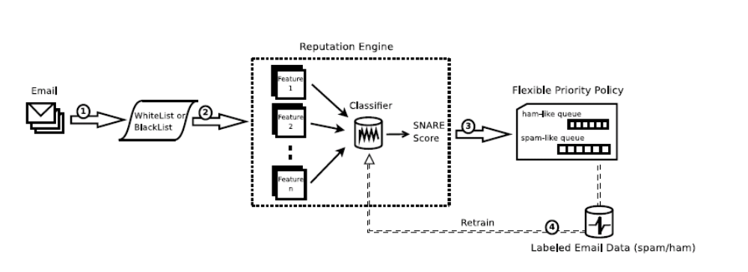
SNARE: Putting it Together
Email arrival
Whitelisting
  Top 10 ASes responsible for 43% of misclassified IP addresses
Greylisting
Retraining

Slide 16
What is a Worm?
Code that replicates and propagates across the network
  Often carries a “payload”
Usually spread via exploiting flaws in open services
  “Viruses” require user action to spread
First worm: Robert Morris, November 1988
  6-10% of all Internet hosts infected (!)
Many more since, but none on that scale until July 2001

Slide 17
The Internet Worm
What it did
  Determine where it could spread
  Spread its infection
  Remain undiscovered and undiscoverable
Effect
  Resource exhaustion – repeated infection due to a programming bug
  Servers are disconnected from the Internet by sys admin to stop infection

Slide 18
The Internet Worm
How it worked
  Where to spread
    Exploit security flaws
      Guess password (encrypted passwd file readable)
      fingerd: buffer overflow
      sendmail: trapdoor (accepts shell commands)
  Spread
    Bootstrap loader to target machine, then fetch rest of code (password authenticated)
  Remain undiscoverable
    Load code in memory, encrypt, remove file
    Periodically changed name and process ID

Slide 19
Morris Worm Redux
1988: No malicious payload, but bogged down infected machines by uncontrolled spawning
  Infected 10% of all Internet hosts at the time
Multiple propagation vectors
  Remote execution using rsh and cracked passwords
    Tried to crack passwords using small dictionary and publicly readable password file; targeted hosts from /etc/hosts.equiv
  Buffer overflow in fingerd on VAX
    Standard stack smashing exploit
  DEBUG command in Sendmail
    In early Sendmail versions, possible to execute a command on a remote machine by sending an SMTP (mail transfer) message

Slide 20
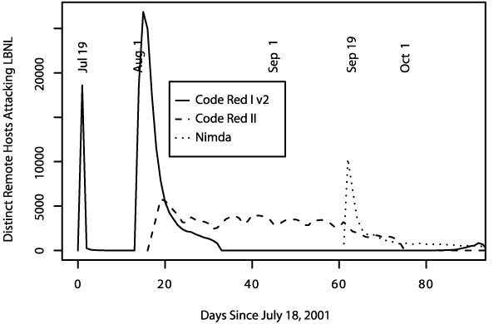
Summer of 2001
Three major worm
outbreaks

Slide 21
Example Worm: Code Red
Initial version: July 13, 2001
Exploited known ISAPI vulnerability in Microsoft IIS Web servers
1st through 20th of each month: spread
20th through end of each month: attack
Payload: Web site defacement
Scanning: Random IP addresses
Bug: failure to seed random number generator

Slide 22
Code Red I
July 13, 2001: First worm of the modern era
Exploited buffer overflow in Microsoft’s Internet Information Server (IIS)
1st through 20th of each month: spread
  Find new targets by random scan of IP address space
    Spawn 99 threads to generate addresses and look for IIS
  Creator forgot to seed the random number generator, and every copy scanned the same set of addresses ☺
21st through the end of each month: attack
  Deface websites with “HELLO! Welcome to http://www.worm.com! Hacked by Chinese!”

Slide 23
Code Red: Revisions
Released July 19, 2001
Payload: flooding attack on www.whitehouse.gov
  Attack was mounted at the IP address of the Web site
Bug: died after 20th of each month
Random number generator for IP scanning fixed

Slide 24
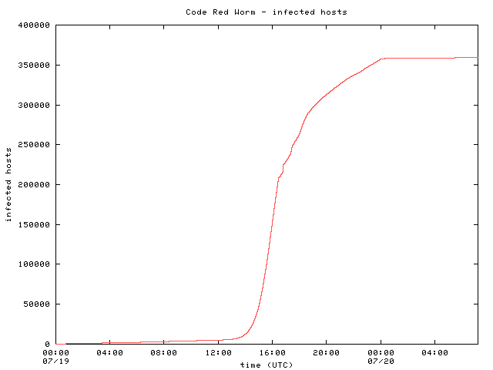
Code Red: Host Infection Rate
Measured using backscatter technique
Exponential infection rate

Slide 25

Modeling the Spread of Code Red
Random Constant Spread model
  K: initial compromise rate
  N: number of vulnerable hosts
  a: fraction of vulnerable machines already compromised
Newly infected machines in dt
Machines already infected
Rate at which uninfected machines are compromised

Slide 26

Modeling the Spread of Code Red
Growth rate depends only on K
Curve-fitting: K ~ 1.8
Peak scanning rate was about 500k/hour

