Slide 1
Examples of
Research Patterns
Nick Feamster and Alex Gray
CS 7001

Slide 2
General Approach
Find a problem
Understand a problem
Solve a problem
Review solution

Slide 3
Finding Problems

Slide 4
Finding Problems
Hop on a trend
Find a nail that fits your hammer
Revisit old problems (with new perspective)
Making life easier
  Pain points
  Wish lists
“*-ations”
  Generalization
  Specialization
  Automation

Slide 5
Hop on a Trend
Need places to discover trends
Funding agencies
  Funded proposals
  Calls for proposals
Conference calls for papers
Industry/technology trends: trade rags

Slide 6
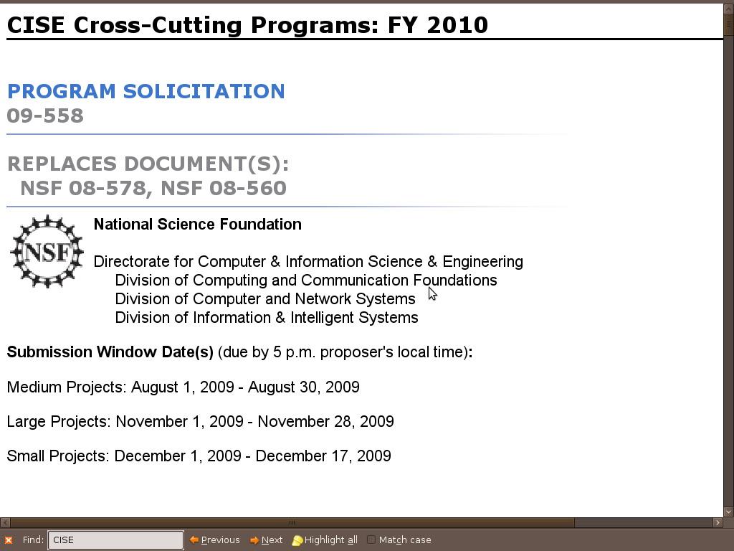
Funding Agencies
Example call for proposals: CISE Cross-Cutting Proposal
  http://www.nsf.gov/pubs/2009/nsf09558/nsf09558.htm

Slide 7
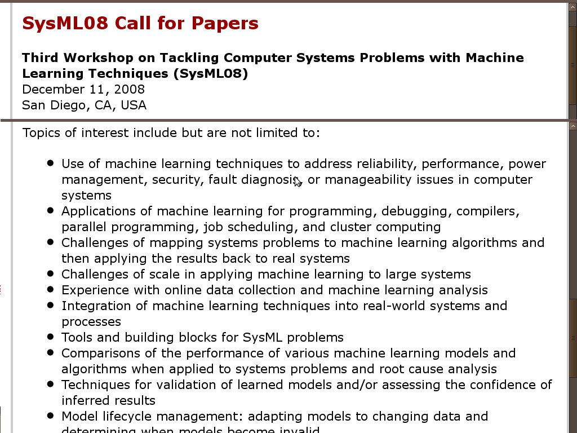
Call for Papers
Examples: Workshop Call for Papers

Slide 8
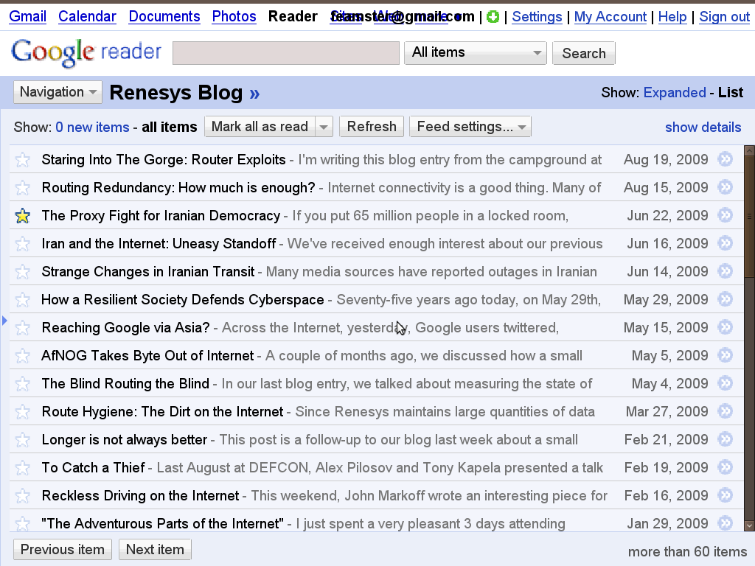
Example: Trade Rag
http://www.renesys.com/blog/2009/06/iran-and-the-internet-uneasy-s.shtml

Slide 9
Finding a Nail for Your Hammer
Become an expert at something
  You’ll become valuable to a lot of people
Develop a system that sets you ahead of the pack
Apply your “secret weapon” to one or more problem areas
  Algorithm
  System
  Expertise
“Turn the crank”

Slide 10
Example Hammer:
Generalized n-body Problem
NIPS 2000 paper: “N-body Problems in Statistical Learning” – identifies a common type of computational bottleneck appearing in ML: problems involving pairwise distances between points
Hammer: Generalized N-body algorithm
New nails, 2009: Hartree-Fock quantum simulation (distances between all quadruples)

Slide 11
Revisiting Problems
Previous solutions may have assumed certain problem constraints
What has changed since the problem was “solved”?
  Processing power
  Cost of memory
  New protocols
  New applications
  …

Slide 12
Example: New Protocols
Refactoring of networking devices: the separation of “control” from the box that forwards packets
Examples of this refactoring:
  Routing Control Platform(implemented in AT&T)
  OpenFlow (deployed by 8 switch vendors)
How does refactoring the device make solving old problems easier?

Slide 13
Pain Points
Look to industry, other researchers, etc. for problems that recur
In programming, if you have to do something more than a few times, script!
In research, if the same problem is recurring and solved the same silly way, there may be a better way…

Slide 14
New Assumptions
Reducing the gap between theory and practice
Well-known textbook theoretical result: 'Distribution-free' density estimation requires a number of samples which is exponential in the dimension – 1970's
In fact, such methods somehow do work in high dimensions
NIPS 2009: Actually, real high-dimensional data can be assumed to live on a manifold – then the complexity depends on this much lower dimension

Slide 15
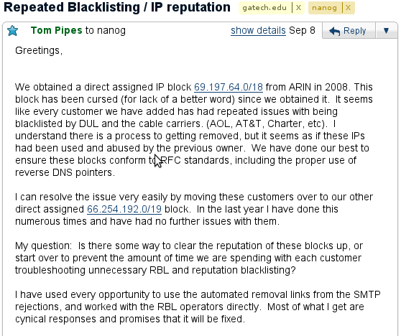
Example Pain Point

Slide 16
Wish Lists
What systems do you wish you had that would make your life easier?
  Less spam?
  Faster file transfer, automatic file sync?
  …
What questions would you like to know the answer to?
  Chances are there is data out there to help you find the answer…

Slide 17
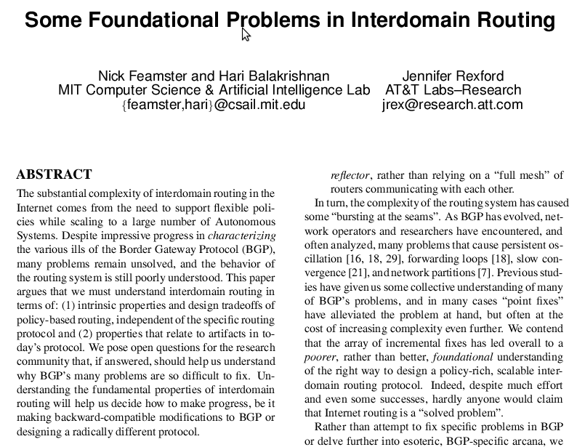
Example Wish List

Slide 18
Generalize From Specific Problems
Previous work may outline many points in the design space
There may be a general algorithm, system, framework, etc., that solves a large class of problems instead of going after “point solutions”

Slide 19
Examples: In-Class Exercise

Slide 20
Specialize a General Problem
Finding general problems
  Look for general “problem areas”
  Look for taxonomies and surveys that lay out a problem space
Applying constraints to the problem in different ways may yield a new class of problems
  Example: Routing (in wireless, sensor networks, wired, delay-tolerant networks, etc.)

Slide 21
Specialization: In-Class

Slide 22
Automation
Some existing problems, tasks, etc. are manual and painful
  Automation could make a huge difference
  It’s also often very difficult because it requires complex reasoning
Related to pain points

Slide 23
AutoBayes
Deriving an optimizer for a new statistical model is hard, error-prone, and time-consuming... but ultimately mechanical, given certain encoded knowledge
AutoBayes (NIPS 2002): Given a high-level spec for a statistical model, automatically derives the EM (expectation-maximization) algorithm for it and generates the code

Slide 24
Understanding Problems

Slide 25
Formalization
Define metrics
  Consider ways to measure the quality of various solutions
  What constitutes a “good solution”
  Objective functions can be optimized
Formalization/modeling can lead to simplifying assumptions (hopefully not over-simplifying)
  Can also suggest ways to attack the problem
  …or an algorithm itself

Slide 26
Today ….
Small number of routing protocols
Design, implementation, deployment, standardization → long, slow process
BGP is being pressed into service as an IGP
  No convergence guarantees
  BGP Wedgies (RFC 4264)
Endless stream of BGP extensions
  Cost Communities

Slide 27
… Tomorrow
Distinction between router configuration and protocol definition will vanish
Network Operators will define their own routing protocols
  operator community will define standards when needed
Vendors will no longer implement routing protocols, but rather a standardized metalanguage for their specification.
Routing metalanguage and associated components are standardized in the IETF.

Slide 28
Metarouting
(Griffin & Sobrinho, SIGCOMM 2005)
Routing Algebras (Sobrinho 2003)
  Expressive framework
  Specific algebraic properties required for correctness of each algorithm (Path-Vector, Link-State+Dijkstra)
A meta-language for Routing Algebras
  Base algebras
  Constructors
Property Preservation Rules
  Properties of base algebras known,
  Preservation rules for each constructor
  Properties are derived much as types in a programming language
Metalanguage can be implemented on a router
  Protocols defined via configuration

Slide 29



Routing Algebras
“Network Routing with Path Vector Protocols: Theory and Applications” João Sobrinho. SIGCOMM 2003
m
m + n
n
Generalize
Shortest Paths

Slide 30
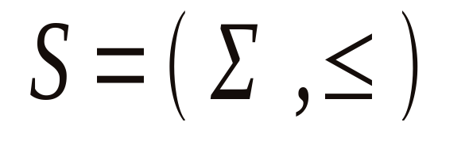
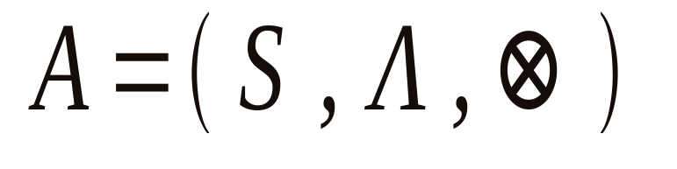



Routing Algebras
An ordered set of signatures
is a set of policy labels
Is policy application
function

Slide 31
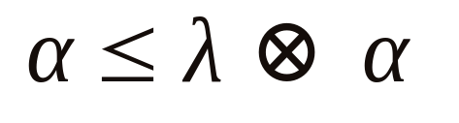
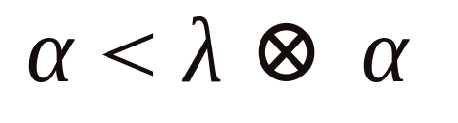
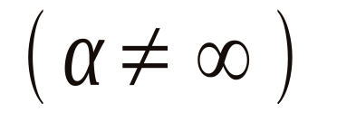
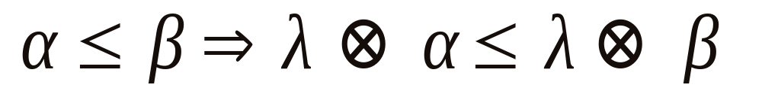
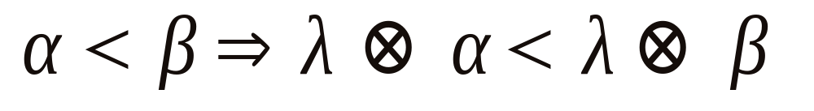
Important Properties
Monotonicity
(M)
Strict monotonicity
(SM)
Isotonicity
(I)
Strict isotonicity
(SI)

Slide 32
Decomposition
Given a model, it often becomes easier to break a solution into smaller parts
Solve (or at least understand) each piece individually and how they interact
Even if you cannot solve the whole problem in toto, you can make progress

Slide 33
Examples of Decomposition
Artificial Intelligence
  Vision
  Planning
  Machine Learning
  ...
Network Architecture
  Security
  Management
  Availability
  Troubleshooting
  ...

