Slide 1
Revolutionaries
Nick Feamster and Alex Gray
CS 7001

Slide 2
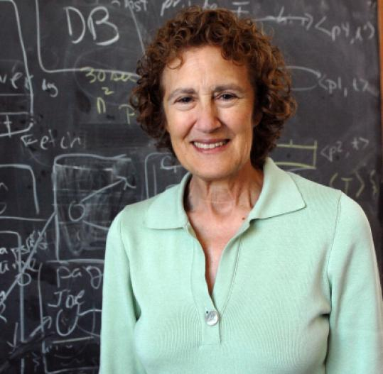
Barbara Liskov
2009 Turing Award Winner
Major projects
  Data abstraction
  Object-oriented databases
  Byzantine fault tolerance

Slide 3
Why Engineering?
“I didn't have a plan for where I was going. Instead I reacted to obstacles and opportunities. I believe that some of this was due to being a woman. I focused on work that was interesting, but expected to stop working when I had a family.
I got into research in software systems and realized that I was really committed to my work and would not give it up. Later, when my husband and I had a family, I continued to work full time.”

Slide 4
How to Select Problems
“I've changed research areas over time. The common thread has been my interest in working on problems whose solutions were needed at the time.
“There were points in my career where I had to choose whether to go on to a new research area or spend time solidifying and selling earlier results.I always chose to go on, and I don't regret that.”
“My main advice is to avoid incremental work.”
“It's good to question the assumptions that others make. This can often lead insights into better ways of doing things.”

Slide 5
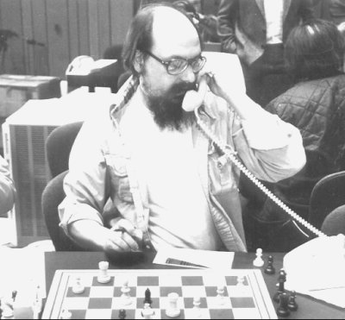
Ken Thompson
1983 Turing Award Winner
Projects
  Multics
  C
  Belle (world champion
  chess computer)

Slide 6
The UNIX Revolution
What accounted for the success of UNIX, ultimately?
Thompson: I mostly view it as serendipitous. It was a massive change in the way people used computers, from mainframes to minis; we crossed a monetary threshold where computers became cheaper. People used them in smaller groups, and it was the beginning of the demise of the monster comp center, where the bureaucracy hidden behind the guise of a multimillion dollar machine would dictate the way computing ran. People rejected the idea of accepting the OS from the manufacturer ...

Slide 7
Perseverance... and Luck
It's hard to give advice in a product kind of world when what I do, I guess, is some form of computer Darwinism: Try it, and if it doesn't work throw it out and do it again.
Plus I am not sure there are real principles involved as opposed to serendipity: You happened to require this as a function before someone else saw the need for it. The way you happen upon what you think about is just very lucky. My advice to you is just be lucky. Go out there and buy low and sell high, and everything will be fine.

Slide 8
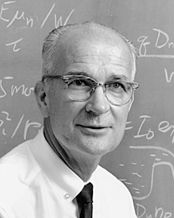
William Shockley
1956 Nobel Prize in Physics
Co-inventor of the
transistor
Notes:
http://www.youtube.com/watch?v=LWGVuoisDbI

Slide 9
Role of Serendipity

Slide 10
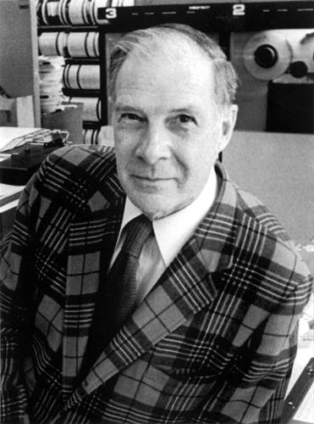
Richard Hamming

Slide 11
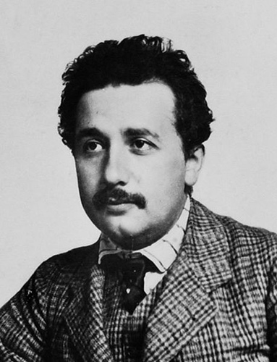
Albert Einstein
1921 Nobel Prize in Physics
Photoelectric effect
Relativity
Statistical physics
Photons
Cosmology
Unified theory
Notes:
http://www.youtube.com/watch?v=LWGVuoisDbI

Slide 12
Working Style
Hard work
  Over 300 publications
  Patent clerk position gave him undistracted time
  Collapsed from exhaustion at one point
Very wide knowledge of physics
  Connected many pieces of physics, resolved many anomalies of physics
Discussion with others
  Formed a weekly discussion group on science and philosophy, early in his career

Slide 13
Working Style
Discussion with others
  Formed a weekly discussion group on science and philosophy, early in his career
  Enlisted mathematicians to complete his theory
Not afraid to take risks
  Was wrong a few times
Believed in himself, not the establishment
  Couldn’t get a job at first
  Was initially met with great resistance, though a few top scientists supported him

Slide 14
Problem selection
Started with fundamental problems of the time
  At first, wanted to show that atoms exist
Was driven by explaining experimental results and anomalies, as well as theoretical inconsistencies
Was not limited by sub-field boundaries
  His quest led him to thermodynamics, statistical physics, specific heats of solids…

Slide 15
Quotes
We can't solve problems by using the same kind of thinking we used when we created them.
The only thing that interferes with my learning is my education.
Any man who reads too much and uses his own brain too little falls into lazy habits of thinking.
Imagination is more important than knowledge. For knowledge is limited to all we now know and understand, while imagination embraces the entire world, and all there ever will be to know and understand.

Slide 16
Quotes
If we knew what it was we were doing, it would not be called research, would it?
It's not that I'm so smart , it's just that I stay with problems longer.
(cf. Gauss: If others would but reflect on mathematical truths as deeply and continuously as I have, they would make my discoveries.)

Slide 17
Quotes
Small is the number of people who see with their eyes and think with their minds.
Everything should be as simple as it is, but not simpler.
Anyone who doesn't take truth seriously in small matters cannot be trusted in large ones either.

Slide 18
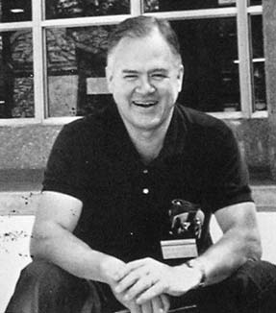
John Tukey
1982 IEEE Medal of Honor
Spectral analysis
Fast Fourier Transform
Jackknife
ANOVA
Modern statistics: robust, computational, graphical, exploratory, non-parametric

Slide 19
Working Style
Hard work
  Over 600 publications
  Held three jobs at same time (prof, AT&T, govt)
Highly collaborative
  127 co-authors
Generous with his time and ideas

Slide 20
Working Style
Communicated ideas well
  Coined many memes: “bit”, “software”, …
Had a habit of questioning assumptions and back-and-forth debate rather than giving answers

Slide 21
Problem selection
Changed problems and even fields opportunistically
  Chemistry → topology → statistics
Driven by real problems (war-time, govt, etc) and also theoretical problems
Worked successful on both large-scale and small-scale problems

Slide 22
Quotes
Far better an approximate answer to the right question, which is often vague, than an exact answer to the wrong question, which can always be made precise.

