Slide 1
Generating Ideas Part 1:
Research Patterns
Nick Feamster
University of Chicago

Slide 2
General approach
Find a problem
Understand the problem
Somehow make a plan for a solution, carry it out
Review the solution

Slide 3
General approach
Find a problem
Understand the problem
Somehow make a plan for a solution, carry it out
Review the solution

Slide 4
Finding Problems
Hop on a trend
Find a nail that fits your hammer
Revisit old problems (with new perspective)
Making life easier
  Pain points
  Wish lists
“*-ations”
  Generalization
  Specialization
  Automation

Slide 5
Hop on a Trend
Need places to discover trends
Funding agencies
  Funded proposals
  Calls for proposals
Conference calls for papers
Industry/technology trends: trade rags

Slide 6
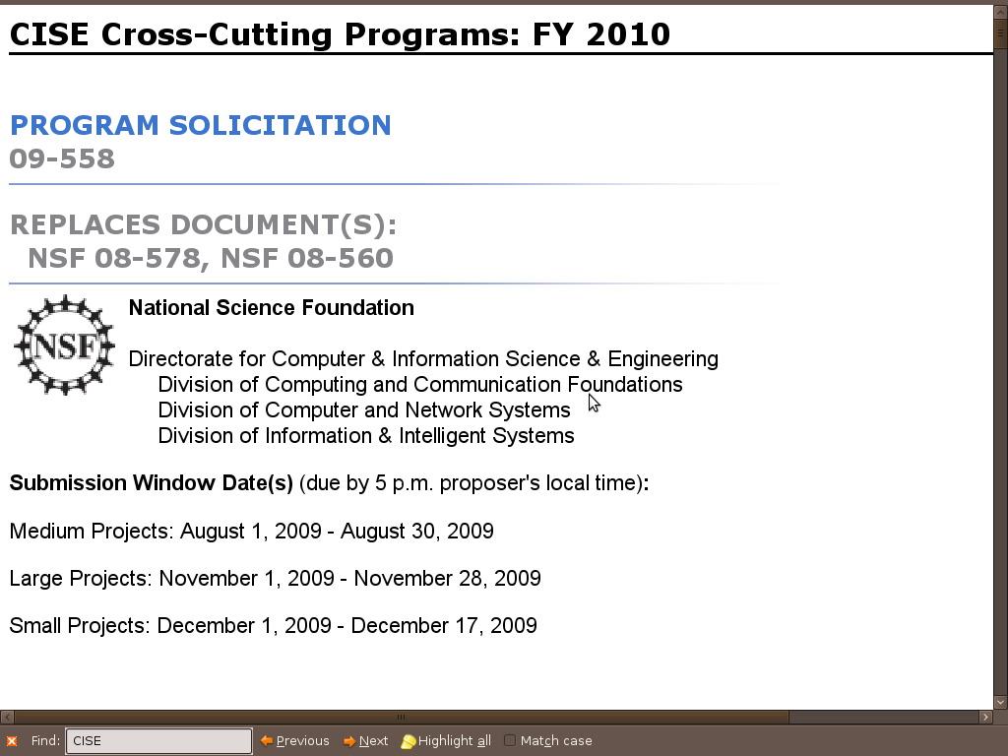
Funding Agencies
Example call for proposals: CISE Cross-Cutting Proposal
  http://www.nsf.gov/pubs/2009/nsf09558/nsf09558.htm

Slide 7
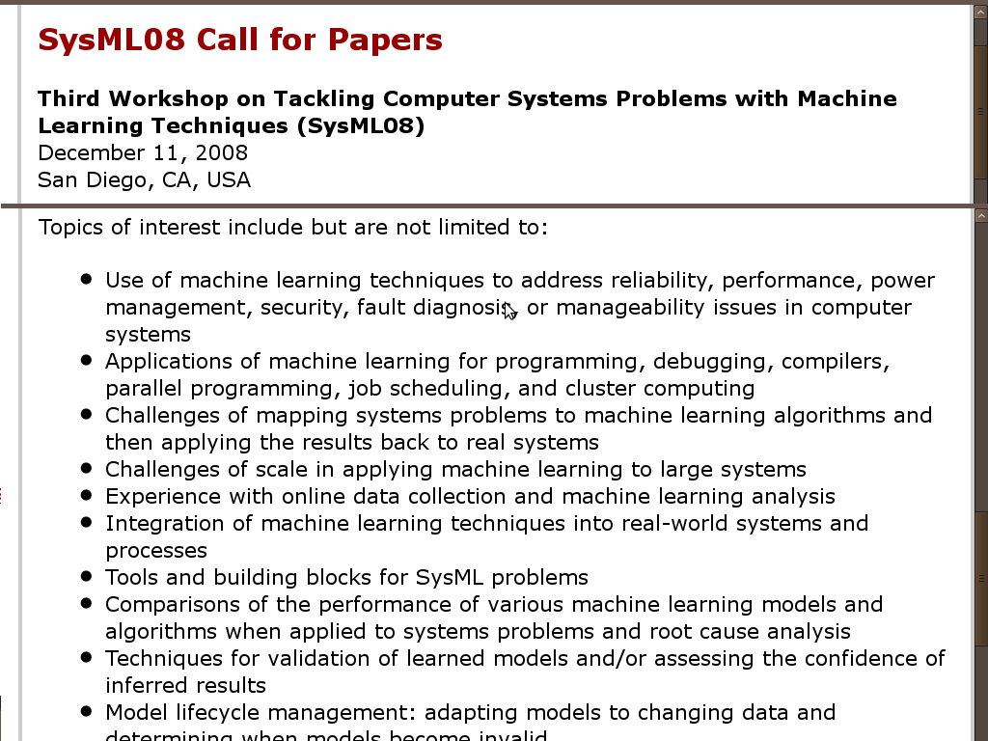
Call for Papers
Examples: Workshop Call for Papers

Slide 8
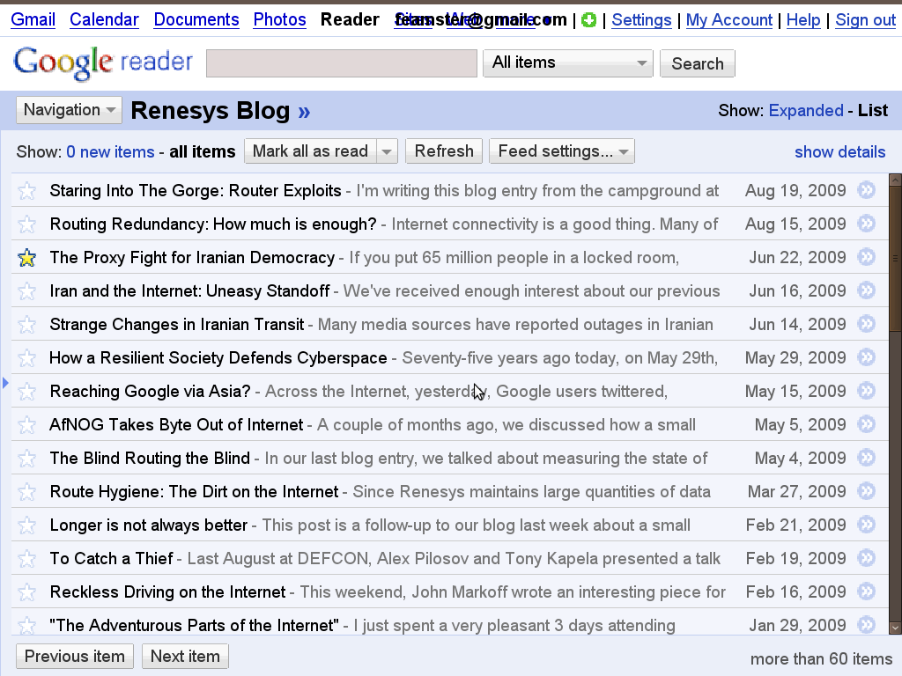
Example: Trade Rag
http://www.renesys.com/blog/2009/06/iran-and-the-internet-uneasy-s.shtml

Slide 9
Finding a Nail for Your Hammer
Become an expert at something
  You’ll become valuable to a lot of people
Develop a system that sets you ahead of the pack
Apply your “secret weapon” to one or more problem areas
  Algorithm
  System
  Expertise
“Turn the crank”

Slide 10
Revisiting Problems
Previous solutions may have assumed certain problem constraints
What has changed since the problem was “solved”?
  Processing power
  Cost of memory
  New protocols
  New applications
  …

Slide 11
Pain Points
Look to industry, other researchers, etc. for problems that recur
In programming, if you have to do something more than a few times, script!
In research, if the same problem is recurring and solved the same silly way, there may be a better way…

Slide 12

Example Pain Point

Slide 13
Automation
Some existing problems, tasks, etc. are manual and painful
  Automation could make a huge difference
  It’s also often very difficult because it requires complex reasoning
Related to pain points

Slide 14
Wish Lists
What systems do you wish you had that would make your life easier?
  Less spam?
  Faster file transfer, automatic file sync?
  …
What questions would you like to know the answer to?
  Chances are there is data out there to help you find the answer…

Slide 15
Generalize From Specific Problems
Previous work may outline many points in the design space
There may be a general algorithm, system, framework, etc., that solves a large class of problems instead of going after “point solutions”

Slide 16
Specialize a General Problem
Finding general problems
  Look for general “problem areas”
  Look for taxonomies and surveys that lay out a problem space
Applying constraints to the problem in different ways may yield a new class of problems
  Example: Routing (in wireless, sensor networks, wired, delay-tolerant networks, etc.)

Slide 17
General approach
Find a problem
Understand the problem
Somehow make a plan for a solution, carry it out
Review the solution

Slide 18
Exhaustive Search
Collect data
  Often this can enhance your expertise as a side effect
Model the problem
  List all of the constraints to a problem space
  Consider all of the different angles within your model that you might be able to attack the problem (example: phishing attacks, routing configuration errors)
Consider many other examples
  May suggest general framework or approach
  You may also see a completely different approach

Slide 19
Formalization
Define metrics
  Consider ways to measure the quality of various solutions
  What constitutes a “good solution”
  Objective functions can be optimized
Formalization/modeling can lead to simplifying assumptions (hopefully not over-simplifying)
  Can also suggest ways to attack the problem
  …or an algorithm itself

Slide 20
Decomposition
Given a model, it often becomes easier to break a solution into smaller parts
Understand each part in detail, and how they interact
Then revisit the whole

Slide 21
General approach
Find a problem
Understand the problem
Somehow make a plan for a solution, carry it out
Review the solution

Slide 22
Consider related problems
Try to restate the problem, or create an equivalent problem
  Consider different terminologies and representations
See if your problem matches a general form already formalized
Can you use the solution to a related problem?

Slide 23
Make analogies
Make an analogy to another problem, then look at its solution
  “structural transference”
  look for “symmetries”, or interchangeable parts

Slide 24
Change the problem to one you can solve
Make simplifying assumptions
  Violate some of the constraints of the problem
  Define a sense of approximation to the ideal solution
Then revisit the original problem
Make the minimally-simpler problem; then relate the solutions to the two problems
  “mathematical induction”

Slide 25
Just start, with anything
Start with a strawman solution, then modify as needed
  e.g. (in algorithms): Propose a simple algorithm, check its correctness
  e.g. (in data modeling): Look at simple statistics of a dataset, then dive into anomalies
  e.g. (in systems): Just whip up some code

Slide 26
Consider nature
Introspection: How does a human naturally solve this problem?
How does nature solve this problem?

Slide 27
Work backward from the goal
Visualize the solution, and what it must look like, or probably looks like
See what’s needed to get there
Consider all the solutions that can’t work

Slide 28
Solve a part, or each part
Solve each part separately, then stitch the solutions together
  Start with the part which is most tractable
  “divide-conquer-merge”
  Be careful: it’s always best to avoid separate objective functions when possible
Perhaps finding a good solution to a part is a good problem in itself

Slide 29
Think in speech or pictures
Use dialogues with others
  Or yourself
  Talk to people who approach things differently from yourself
Draw pictures
  Add auxiliary elements, to be able to relate to other problems/solutions

Slide 30
Come from all angles
Keep coming with a new twist on the problem
  Break out of a thinking pattern or dead end
  A new twist renews motivation
  “Where there’s a will, there’s a way”
Keep track of all your ideas and partially-completed paths

Slide 31
Let your subconscious work
Immersion
Stay relaxed
Or: use deadlines to force shortcuts

Slide 32
General approach
Find a problem
Understand the problem
Somehow make a plan for a solution, carry it out
Review the solution

Slide 33
Look back at your solution
Check that it really works
  If it works, note the key to why, more abstractly
  Were all of the constraints, difficulties, and facts used and accounted for
Try to improve upon it
  Can you achieve the same thing more directly or easily

Slide 34
What else can your solution do?
Now you have a hammer
Can you use the solution for some other problem?
  A more general form of the problem?
  An interesting special case?
  A related problem or analogous problem?

Slide 35
Making a “theory”
If you’re very successful, you may have a “theory” = a framework for characterizing problems and/or solutions
  Says when it applies, when it doesn’t
  Characterizes the hardness of different problems
    May identify simple special cases
  Characterizes the quality of different solutions
    How long it takes, amount of resources it uses
  Show/characterize solution meeting criteria
    correctness, convergence, etc.

Slide 36
Generating Ideas Part 2:
Clear and Creative Thinking
(Conceptual Blockbusting)
Nick Feamster
University of Chicago

Slide 37
Modify your thinking algorithms
Clear thinking: avoiding conceptual blocks
  Perceptual blocks
  Emotional blocks
  Cultural and environmental blocks
  Intellectual and expressive blocks
Creative/expansive thinking
  General techniques
  Techniques for groups

Slide 38
Conceptual blocks

Slide 39
Perceptual blocks
Problem: Seeing what you expect to see, based on stereotypes (overly simple models)
  Lets you complete incomplete data; experience creates templates
  But leads to inaccurate conclusions
  You tend to reinforce what is already in your brain; may devalue info that doesn’t ‘fit’
Solution: Be aware of stereotypes, go deeper

Slide 40
Perceptual blocks
Problem: Seeing things the way someone already framed it
  e.g. architect asked to put in a better latch for a door between two rooms
Solution: Be the problem stater; be childlike and ask the most basic questions

Slide 41
Perceptual blocks
Problem: Solving it the way people have been solving it
  e.g. “we need a better graph-cut algorithm”
Solution: Think about it yourself first, without reading any of the literature – come with a clean mind

Slide 42
Perceptual blocks
Problem: Delimiting the problem too closely
  e.g. nine-dot puzzle – consider folding, making spiral, cutting, problem on sphere, crumple and stab, use a fat line…
Solution: Cheat! Negotiate!

Slide 43
Perceptual blocks
Problem: Not defining the problem well enough
  Too fuzzy to make progress
  Framing the problem at different scales of specificity leads to different solutions
Solution: Solve a very constrained version, then reconsider the general problem

Slide 44
Perceptual blocks
Problem: Seeing the problem from one limited viewpoint
  e.g. in a personal dispute, see from both sides
Solution: Look at the problem from the standpoint of different theories, or wearing different hats

Slide 45
Perceptual blocks
Problem: Seeing the problem from one limited viewpoint
  e.g. in a personal dispute, see from both sides
  e.g. artists looking upside-down, or looking away from a nice sunset
Solution: Look at the problem from the standpoint of different theories, or wearing different hats; look at the parts normally ignored

Slide 46
Perceptual blocks
Problem: Ignoring some valuable inputs
  Often in the form of people
Solution: Be open-minded: keep door open; eat at other lunch tables

Slide 47
Emotional blocks
Problem: Fear of making a mistake, failing, taking a risk
  We’re taught to live safely; punished for mistakes; “bird in the hand”
  But need to go toward the mysterious, the unknown, the puzzling, the difficult
Solution: Realize that others are also ignorant, self-conscious, afraid; think out the worst case – it’s not as bad as you think

Slide 48
Emotional blocks
Problem: Inability to tolerate ambiguity, chaos
  Control over your environment can give efficiency, aesthetic satisfaction, security
  Solution of a complex problem is a messy process
  Must usually wallow in misleading and ill-fitting data, hazy and difficult-to-test concepts, opinions, etc.
  Problem-solving is bringing order to chaos; the ability to tolerate chaos is a must
Solution: Let loose!

Slide 49
Emotional blocks
Problem: Preference for judging ideas, rather than generating ideas
  Freud: Ideas come from unconscious mind, ego/superego filter them
  Criticism, tough-mindedness, and practicality are essential – but not too early
  Newly formed ideas are fragile and imperfect; need time to acquire the detail needed to make them believable

Slide 50
Emotional blocks
Cont’d:
  Ideas often lead to other ideas; brainstorming depends on maintaining way-out ideas long enough to let them mature and spawn more realistic ideas
  But judgement is easier, makes you look smarter, and is thus rewarded in society
Solution: Withhold dismissal; encourage crazy ideas; work for your own satisfaction instead of external motivations

Slide 51
Emotional blocks
Problem: Lack of challenge, or excessive zeal
  Can’t do your best unless sufficiently motivated
  But excessive motivation to succeed, especially quickly, can lead to poor solutions; tortoise vs. hare
Solution: Get excited, but pace yourself.

Slide 52
Emotional blocks
Problem: Your ego doesn’t like the real solution
  e.g. competitors’ solutions are better
Solution: Always approach people as if they probably have something to teach you; don’t take criticism badly.

Slide 53
Cultural blocks
Problem: Cultural taboos and traditions
  e.g. defying authority
Problem: Cultural roles
  e.g. reason vs. intuition, left-handed vs. right-handed thinking, science vs. humanities, single-answer vs. multi-answer

Slide 54
Environmental Blocks
Problem: Interruptions and distractions
  Can take 15 minutes to get into a task, and sometimes several hours to enter “creative flow” state
  Solution: Protected times of day, isolated work environment
Problem: Environment not supportive or comfortable
  Solution: Spend time making it nice, just how you like it

Slide 55
Environmental Blocks
Problem: Advisor/boss too autocratic, judgmental, unsupportive, etc.
Solution: Make sure advisor/boss matches in terms of:
  Goals/interests
  Feedback style
  Amount of direction
  Personality, humor, life perspective
If not, negotiate with him/her; failing that, switch

Slide 56
Imagination Blocks
Problem: lack of access to areas of imagination
  Solution: daydream; read science fiction; stretch reality; use humor
Problem: lack of control over your imagination
  Solution: use others as filter

Slide 57
Things you can do

Slide 58
Achieve Basic Competency
If you are constantly working on just “getting by”, your mind won’t find the spare cycles to be creative
Put in the time to master the mechanics
  Math skills
  Programming skills
  Human-centered skills

Slide 59
Build intuition
This comes from experience
Creativity requires the manipulation and recombination of experience

Slide 60
Let it incubate (“sleep on it”)
Often: you work for weeks on something, complete a solution for a deadline, then at a random time later, get a better idea
Often: you get the right idea right before the deadline
This was incubated in the unconscious mind
Technique: Immerse yourself for enough time for incubation; forget about something for a while then return

Slide 61
Use multiple modes
Visual: big sheet of paper
Verbal: dialogue, negotiation
Other senses help to imagine something

Slide 62
Morphological analysis
List the attributes of the situation
Below each, list many alternatives
Look at different combinations
e.g. improve a pen:
  Attributes: cylindrical, plastic, separate cap
  Alternative 1: faceted, metal, attached cap
  Alternative 2: beaded, wood, no cap
  Etc.

Slide 63
Questions list
Put to other uses?
What’s similar?
Modify?
Magnify? Minify?
Substitute?
Rearrange/transpose?
Reverse/negate?
Combine?
Etc.

Slide 64
Go wild
Force yourself to connect two random things somehow.
In your wildest dream, what does the solution look like?

Slide 65
Analogies
Establish an abstract sense in which your problem/situation is “like” some other one
Then list the attributes of the metaphorical version, and make correspondences
Create the three-of-four parts of an analogy with something

Slide 66
Escape
Take a break from the problem
Hike
Take a trip
Get out of a whole area

Slide 67
Take notes
Don’t forget old trains of thought
You may return to them now able to fill in some missing pieces

Slide 68
Keep going with innovations
Don’t stop at first ‘good’ idea
Multiple (connected) elements of innovation simultaneously – what makes great papers

Slide 69
Creativity in groups
Difficulties: group-think, lowest-common-denominator, committees
  Everyone needs to be happy; consensus is the goal, not optimality
Affiliation needs vs. ego needs – some want to dominate
Brainstorming in groups:
  Lack of judgment is key
  Go for quantity
  Recorder
  Keep going after lull

Slide 70
Being “In the Zone” (“Flow”)
Creativity often comes in spurts
  For a long time, nothing
  In one week, you may come up with a flood of ideas. Important to have writing devices around when this happens
Big question: Is this a fluke?
  How to actually create this state of mind?

Slide 71
Purpose
Vague intentions and goals will make it tough for you to focus
Be very specific about what you want to “create”
  What specific research problem would you like to come up with a solution to?
  Write it down if need be

Slide 72
Find the Motive
Doing what you want to do vs. what you have to do will make a big difference
  We had a lecture on motivation. This is important!
Often, it helps to pick a project that will both help you and other people
Intrinsic motivation is important!

