Slide 1
Naming (DNS) and Wireless Security COS 432: Information Security
Nick Feamster

Slide 2
Naming (DNS) Security

Slide 3


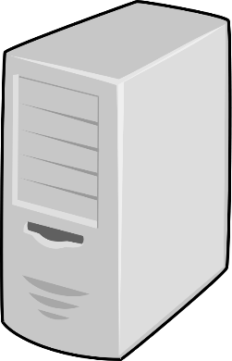
How DNS Works
Root
Resolver
www.foo.com
.com
.net
.org
…
1.2.3.4
foo.com
Authoritative
name server
Notes:
Typically ISP runs the resolver
Other parties also offer DNS resolver services, example Google offers one at 8.8.8.8. You can stick that in your browser if your ISP’s DNS server ever goes down…

Slide 4
DNS Spoofing
Basic DNS uses no crypto.
No way to prevent MITM from arbitrarily altering packets.
Client sends 16-bit transaction ID for authentication.
Attacker can spoof responses by guessing this ID

Slide 5

DNS Cache Poisoning
Root
Resolver
www.foo.com
.com
.net
.org
…
foo.com
www.foo.com: 7.7.7.7
Authoritative
name server
Goal: inject bad value for www.foo.com into resolver cache
Pretend to be authoritative nameserver (spoof sender IP) try to win race
Notes:
http://www.cs.cornell.edu/~shmat/shmat_securecomm10.pdf

Slide 6
DNS Cache Poisoning
Root
Resolver
www.foo.com
.com
.net
.org
…
foo.com
www.foo.com: 7.7.7.7
Authoritative
name server
Problem: resolver’s request has 16-bit ID
Solution: flood responses, hope you win

Slide 7
DNS Cache Poisoning
Root
Resolver
www.foo.com
.com
.net
.org
…
foo.com
www.foo.com: 7.7.7.7
Authoritative
name server
Problem: www.foo.com result may already be cached
Solution: ask for nonexistent.foo.com, use trigger cache miss, stuff spoofed information into “additional info”

Slide 8
DNSSEC (vs. TLS)
 | TLS | DNSSEC
Roots of trust | Root CAs | Root name servers
Intermediate nodes | Intermediate CAs | TLD & other name servers
Leaves | Domains | Authoritative name servers
Verification | Browsers | DNS resolvers & (some) clients
Uses | Authentication & encryption | Only authentication
Notes:
Each name server signs PK’s of servers it delegates to

Slide 9
Wireless Security

Slide 10
“WiFi”: IEEE 802.11 Family of Standards
Old Standards
802.11b (1999): 2.4 GHz spectrum, 11 Mbps
802.11a (1999): 5 GHz, 54 Mbps
802.11g (2003): 2.4 GHz, 54 Mbps
Newer Standards
802.11n (2009): MIMO, both bands, 150+ Mbps
802.11ac (2013): 5 GHz, … close to 1 Gbps
Two modes of operation
Infrastructure mode (to access point)
Ad hoc mode (to each other)

Slide 11
Why is WiFi Different From Ethernet?
Same threats as over wired networks also exist on WiFi
Malware, phishing, DoS, …
…but Ethernet typically depended on physical barriers to prevent certain kinds of attacks
Radio transmissions are more difficult to contain!

Slide 12
How We Connect to a WLAN
Access points provide WLAN access
“Stations” can be laptops, smartphones, tablets, …
Infrastructure: Stations connect to APs
Ad hoc: Stations connect to each other
APs send beacons containing WLAN’s Service Set Identifier (SSID)
Stations scan all channels looking for AP beacons
Can also send probes and listen for responses
Stations then associate to best available AP

Slide 13
SSID: Service Set Identification
Identifies a particular wireless network
SSID may or may not be broadcast
Beacon always broadcasts
Spectrum analyzers can always see the SSID

Slide 14
Disconnection
Three ways to disconnect
Sending a disassociate frame
Sending a deauthenticate frame
Roaming to a new AP
Disconnection and other management frames are not protected (source of many attacks)
802.11w fixed this loophole

Slide 15
Authentication
Takes place after association
Two Modes of WiFi Protected Access (WPA)
Personal/Pre-shared key: Station demonstrates it knows a passphrase
Enterprise: 802.1X Port Access Control
Radius-based authentication
Authentication performed over EAP

Slide 16
IEEE 802.11 Security
War-driving: drive around, see what 802.11 networks available…
Many accessible from public roadways
Many use no encryption/authentication
packet-sniffing and various attacks easy!
Securing 802.11
encryption, authentication
first attempt at 802.11 security: Wired Equivalent Privacy (WEP): a failure
current attempt: 802.11i

Slide 17
Attacks on WiFi

Slide 18
WiFi Security Requirements
Access control
Prevent unauthorized access or use
Confidentiality
Prevent disclosure of data to unauthorized parties
Authentication
Verify identity
Integrity
Detect insertion, deletion, forgery
Availability
Ensure service to authorized users

Slide 19
Access Control: Things That Don’t Work
Eliminating SSIDs from AP Broadcasts
SSID is still sent in many frames (beacons)
Not completely hidden
Decreasing transmit power
802.11n has quite long range…

Slide 20
Access Control Lists
Whitelist of allowed network interfaces, identified by hardware (“MAC”) address
Require a list of known MAC addresses, enumerated at the access point
One problem: MAC addresses are easily spoofed.

Slide 21
WiFi Security Requirements
Access control
Prevent unauthorized access or use
Confidentiality
Prevent disclosure of data to unauthorized parties
Authentication
Verify identity
Integrity
Detect insertion, deletion, forgery
Availability
Ensure service to authorized users

Slide 22
Confidentiality Attacks
Eavesdropping
Sniffers can capture traffic (addresses, headers)
Encryption defends against this
“Evil Twin” attack
Phishing attacks
Cookie stealing attacks
Man in the middle/interception attacks
… many of these are already a problem on open networks.
Key cracking

Slide 23
Protection (i.e., “Encryption”)
Every data frame contains
MAC address
IP packet (“body”)
AP decides whether “protection” is required (encryption or not)
WEP
TKIP -> WPA
AES -> WPA2

Slide 24
Ways of Protecting Wireless Networks
Wired Equivalent Privacy (WEP)
WiFi Protected Access (WPA)
TKIP
MIC
802.1x
WPA-PSK
802.11i (AES) (most new hardware now supports)

Slide 25
Wired Equivalent Privacy (WEP)
First link-level security option for 802.11
Initial goal: Confidentiality
Every client shares the same key with the access point
Shared key has 24-bit “initialization vector”; rest is the shared key.

Slide 26
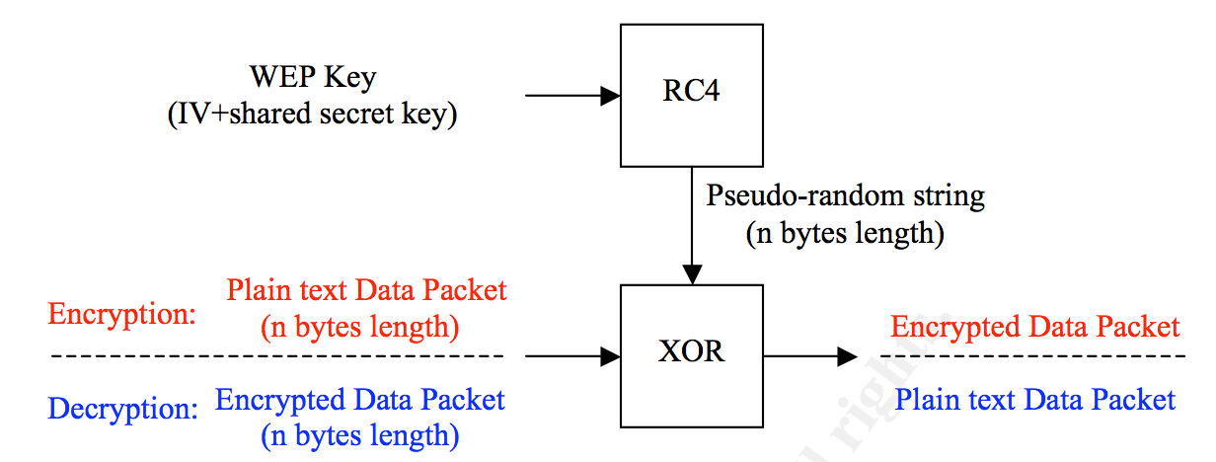
Steps in WEP Encryption
Interface chooses IV value and concatenates with shared secret to form key
Key is passed to stream cipher (RC4) to produce a random string
Message is XOR’d with random string.
IV value and encrypted packet is transmitted to the recipient.

Slide 27
WEP is Broken
Some IV values are known to produce weak keys that reveal part of the secret key
Lots of tools around to exploit this weakness (requires capturing 5-10 million packets, however)
Occasionally, two packets may be encrypted with the same WEP key
XORing these two packets together produces the XOR or of the two data packets
May eventually be able to back out the two data packets…
One solution: Change secret key frequently

Slide 28
WPA Pre-Shared Key (PSK)
Shared key authentication
Somewhat limited
Cannot identify individuals using WiFi
Cannot tell whether the AP is an imposter
Short keys can be cracked
Shared, lost, stolen keys threaten everyone
Better: 802.1X port access control

Slide 29
WiFi Security Requirements
Access control
Prevent unauthorized access or use
Confidentiality
Prevent disclosure of data to unauthorized parties
Authentication
Verify identity
Integrity
Detect insertion, deletion, forgery
Availability
Ensure service to authorized users

Slide 30
802.1X Pros and Cons
Pros
Has user authentication
Enables fine-grained access control, accounting, etc.
Cons
Complex and potentially costly
Requires certificate infrastructure
… possible to make it easier

Slide 31
Authentication Attacks
Guessing keys
Cracking keys (less of an issue now)
Stealing authenticators
Downgrade attacks (on 802.1X)

Slide 32
Approaches
Captive Portals
Pre-Shared Keys (PSKs)
Supported by all products since 2003
Pros: Easy to distribute, use
Cons: Sharing, social engineering, theft, no user authentication
Mostly OK for homes, devices that can’t use 802.1X
802.1X

Slide 33
WiFi Security Requirements
Access control
Prevent unauthorized access or use
Confidentiality
Prevent disclosure of data to unauthorized parties
Authentication
Verify identity
Integrity
Detect insertion, deletion, forgery
Availability
Ensure service to authorized users

Slide 34
Availability Attacks: Physical DoS Vulnerabilities
WiFi competes for unlicensed spectrum
2.4 GHz: Bluetooth, microwave, phones
5 GHz: Radar
Neighboring businesses, visitors, etc. (Also, old 802.11b networks, which degrade performance.)
Jamming…
Dynamic frequency selection can be used to automatically avoid interference in channels

Slide 35
Availability Attacks (DoS)
Beacon Flood
Makes it difficult to find legitimate AP
Association Flood
Fills AP’s MAC table
Disassociation/Deauthentication Flood
Disconnect legitimate users from AP
Sending malformed packets

Slide 36
Wired Equivalent Privacy (WEP):
authentication as in protocol ap4.0
host requests authentication from access point
access point sends 128 bit nonce
host encrypts nonce using shared symmetric key
access point decrypts nonce, authenticates host
no key distribution mechanism
authentication: knowing the shared key is enough

Slide 37
WEP Data Encryption
Host/AP share 40 bit symmetric key (semi-permanent)
Host appends 24-bit initialization vector (IV) to create 64-bit key
64 bit key used to generate stream of keys, kiIV
kiIV used to encrypt ith byte, di, in frame:
ci = di XOR kiIV
IV and encrypted bytes, ci sent in frame

Slide 38
Breaking 802.11 WEP encryption
Security hole:
24-bit IV, one IV per frame, -> IV’s eventually reused
IV transmitted in plaintext -> IV reuse detected
Attack:
Trudy causes Alice to encrypt known plaintext d1 d2 d3 d4 …
Trudy sees: ci = di XOR kiIV
Trudy knows ci di, so can compute kiIV
Trudy knows encrypting key sequence k1IV k2IV k3IV …
Next time IV is used, Trudy can decrypt!

Slide 39
Firewalls

Slide 40
Principle: Don’t connect (most) machines directly to Internet

Slide 41
Firewall
Goals
Stop (some) network attacks
Centralize security policy for easy administration
Impose restrictions on network use by insiders
Make decisions based on: IPs, ports, direction, contents
Can be software, hardware, or a combination

Slide 42
Firewalls
firewall
isolates organization’s internal net from larger Internet, allowing some packets to pass, blocking others.
administered
network
public
Internet
firewall

Slide 43
Firewalls: Simple Use Cases
Only allow connections from inside to outside
Block IP spoofing (external packet that claims to be from intranet)
Notes:
Even when NAT is not used, the Firewall has list of IPs for the company’s machines.
If a packet from outside is spoofed and has an IP of an internal machine, the firewall at the network boundary simply drops it.

Slide 44
Firewalls: Why
prevent denial of service attacks:
SYN flooding: attacker establishes many bogus TCP connections, no resources left for “real” connections.
prevent illegal modification/access of internal data.
e.g., attacker replaces CIA’s homepage with something else
allow only authorized access to inside network (set of authenticated users/hosts)
two types of firewalls:
application-level
packet-filtering

Slide 45
Packet Filtering
Should arriving packet be allowed in? Departing packet let out?
internal network connected to Internet via router firewall
router filters packet-by-packet, decision to forward/drop packet based on:
source IP address, destination IP address
TCP/UDP source and destination port numbers
ICMP message type
TCP SYN and ACK bits

Slide 46
Stateful and Stateless Firewalls
Original firewalls were stateless
Maintain static filter list, but no per flow state
For TCP, only look at SYN
Means that non-SYN TCP packets are allowed even if should be blocked
No concept of conversation
Modern firewalls are typically stateful
Maintains dynamic list of all allowed flows
Better capability, harder to scale

Slide 47
Stateless Packet Filtering
What can be used for filtering
IP src, dst address
Protocol identifier
Source and destination port
TCP flags

Slide 48
Stateless Packet Filtering
Example: block all incoming connections
Block all incoming traffic, other than TCP
Block TCP SYN packets
Allow all other TCP packets
Notes:
This works because TCP connections have to begin with a SYN handshake packet.
We block UDP because we can’t tell if it’s incoming or outgoing – there are no connections in UDP.

Slide 49
Stateful Packet Filtering
Example: Only allow incoming packet if in response to previous outgoing packet
Notes:
This is because you don’t even want to take the chance that a packet can cause damage even if it’s not a SYN and not part of an existing open connection.
Also allows Deep Packet Inspection, i.e., looking inside the contents of packets.

Slide 50
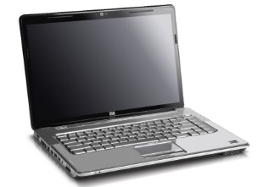
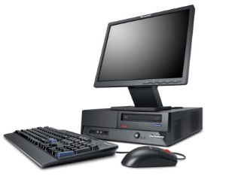
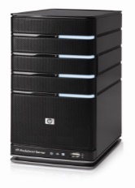

Demilitarized Zone
Web
server
DNS proxy
Email
server
Internet
Notes:
Problem: Firewalls blocks incoming DNS replies
Solution: DNS proxy (application-level gateway)
Problem: Need to serve web & other content
Solution: Put servers outside firewall (DMZ)
Problem: Firewall blocks incoming email
Solution: Drop server outside firewall Siphon mail in after filtering

Slide 51
Simple Firewall Policy Configuration
Source | Dest | App | Action
any-inside | dmz-mail | SMTP | allow
any-inside | any-outside | SMTP | drop
any-inside | any-outside | HTTP | allow
any-inside | any-outside | FTP | allow
any-inside | any-outside | any | drop
any-outside | any-inside | any | drop

Slide 52
Firewalls not just protection from outside attackers
Bandwidth control
Block high bandwidth applications
Pointcast, Napster
Employee network usage control
Block games, pornography, non-business uses
Privacy
Don’t let outside see what you have, how big you are, etc.
Similar to making corporate phone directory proprietary

Slide 53
Limitations of Firewalls
Speed can be a bottleneck
Many ways to bypass
Packet fragmentation attacks
Attachments in email
Physical media
No defense against malicious insiders
Notes:
Insiders can almost always find ways around firewalls because it is possible to masquerade malicious outgoing connections as legitimate outgoing connections.

Slide 54
Limitations of Firewalls
Lots of connectivity through and around firewalls
Enterprises have hundreds of business partners
Telecommuting, remote working, etc.?
Malware makes its way into networks througn email, removable storage, …

Slide 55
Theory of Firewalls (Does Not Hold Today)
There must exist a topological chokepoint
The nodes on the “inside” of the firewall must share the same security policy.
Nodes on the “inside” are good; “outside”, bad or at least untrusted.
Notes:
Property 1 fails because of the number of links a typical company has, links that do not go through “the” firewall. These links may be to suppliers, customers, joint venture partners, outsourcees, what have you.
Property 2 fails because of the number of computers used today. With so
many nodes, the policies have to differ drastically. When firewalls
first became popular, only a small subset of employees needed Internet
connectivity. For all practical purposes, there was no web. Email was
not the way business was done. Documents were faxed rather than scanned
and attached.
Property 3 fails, too, partly because of the large population on the
inside, and partly because of mobile nodes: if they get infected when
they’re on the outside, they’re effectively bad guys when inside the
firewall.

Slide 56
Degenerate Cases for Firewalls
Single machines
Department print server
…software updates?
Point firewalls
Notes:
The solution is a point firewall, a simple firewall in front of a
limited set of resources. Point firewalls work because of their scope:
they are not trying to protect arbitrarily many devices, they are not
enforcing complex rules, they are not dealing with thousands of
exceptions. There is also a more subtle philosophical difference: their
primary function is not just bug deflection; rather, they are add-on
access control mechanisms. Nevertheless, since they are enforcing a
policy they qualify as firewalls.

Slide 57
Some Conclusions (Bellovin)
Small-scale firewalls that protect a network run by a single system admin are still useful
Complex serer applications are rarely amenable to firewall protection.
Mobile devices present a new set of risks.
Wireless LAN outside the firewall (?)

