Slide 2
Intrusion Detection Systems

Slide 3
Intrusion Detection
“Burglar alarms for the network.”
Idea: make systems sensitive to threatening actions, and make them capable of alerting authorities when they notice anomalies
Necessarily post-hoc
Broad types
Statistical analyzers (anomaly based)
Rules-based systems, Attack-signature detectors (misuse)
Others

Slide 4
Know Your Attacker
Most attackers run scripts to probe for vulnerabilities, then return later to exploit them
Probes tend to come in waves as new holes are discovered
Probes look very different than typical network use
Actual attack may come long after probe

Slide 5
Types of Intrusion Detection
Signature-Based
define “what is abnormal” using attack signatures
traffic that matches an attack signature as attack traffic
Anomaly-Based
define “what is normal” using profiles
traffic that does not match the profile as abnormal

Slide 6
Simple IDS
v=listen(frequently-exploited-unused-port);
while(1) {
s=accept(v, who, howbig);
notify_the_authorities(s, who, howbig);
close(s);
}
This won’t catch stealth scanners
Doesn’t have a global view
Can’t detect attacks on systems in use
Surprisingly effective at catching scans nonetheless

Slide 7
Statistical Analysis
Constantly capture packets, watch logs, note typical flows
“95% of traffic flows from inside the firewall to outside web services”
Trigger alarms when traffic not matching typical flows is seen
Can be a first alert against configuration problems
Tends to rely on a more global view

Slide 8
Rule-based Systems
Monitor logs and network for behavior violating or matching static rules
Require some knowledge of attack behaviors
Less prone to false alarms
Often combined with anomaly detectors

Slide 9
Using an IDS
Plan your incident response process well before you install the system
Know what you’re looking for
Make the system comprehensive
Don’t overreact to alarms
If using a rules-based system, keep up with vulnerability reports

Slide 10
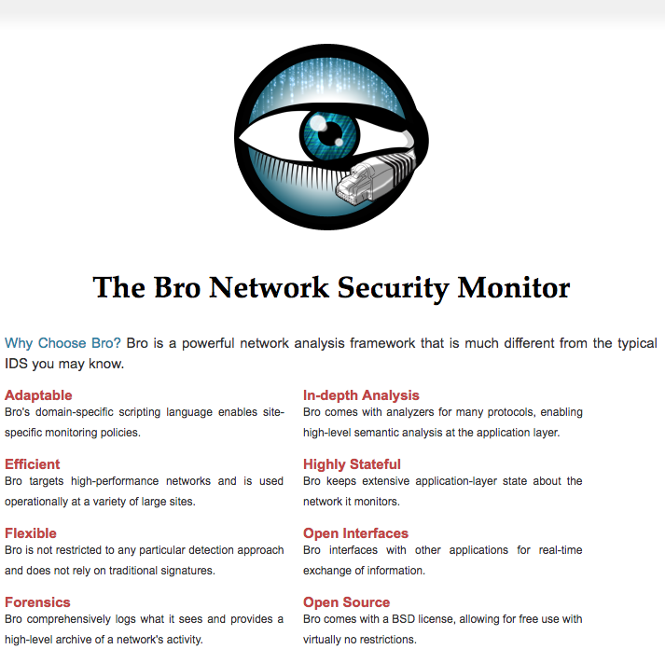

Slide 11
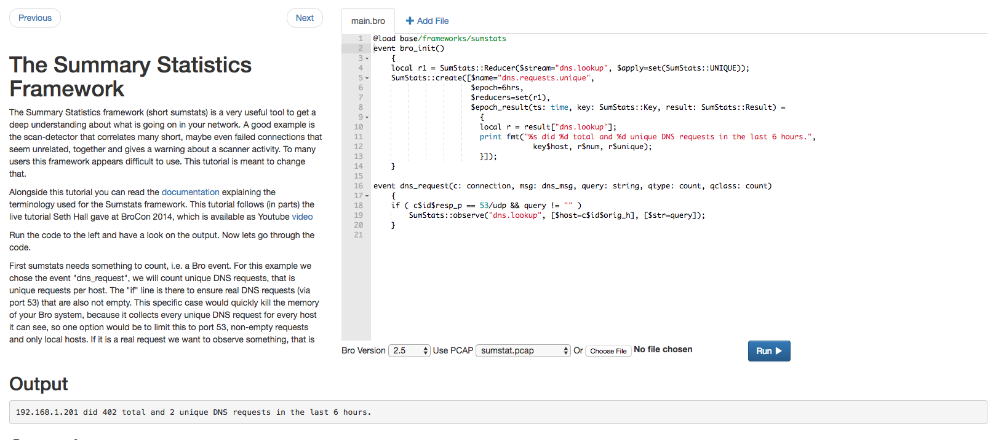
Notes:
http://try.bro.org/

Slide 12
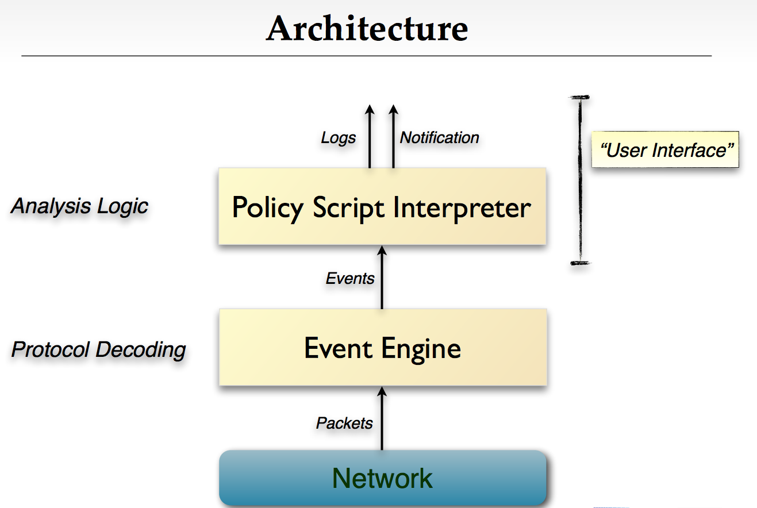

Slide 13
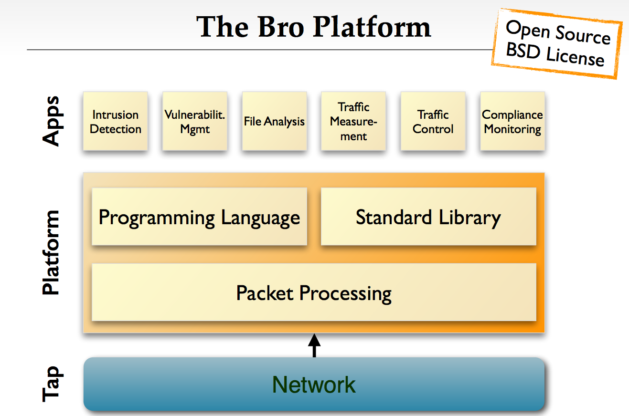

Slide 14
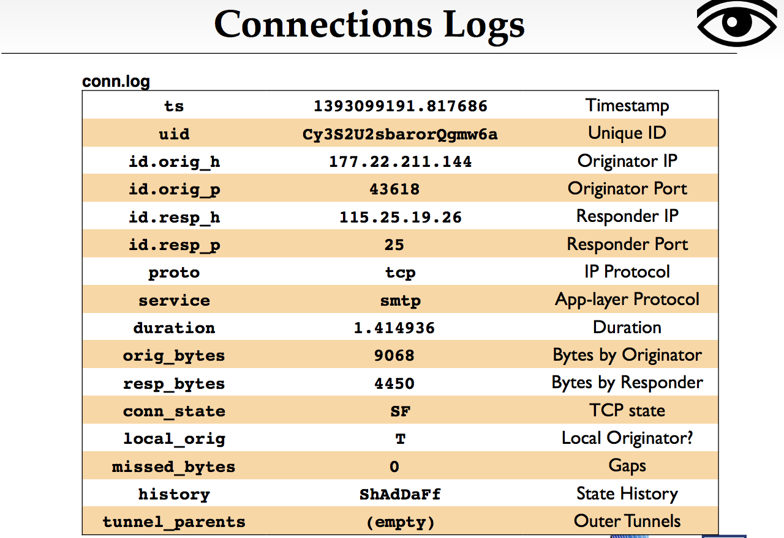

Slide 15
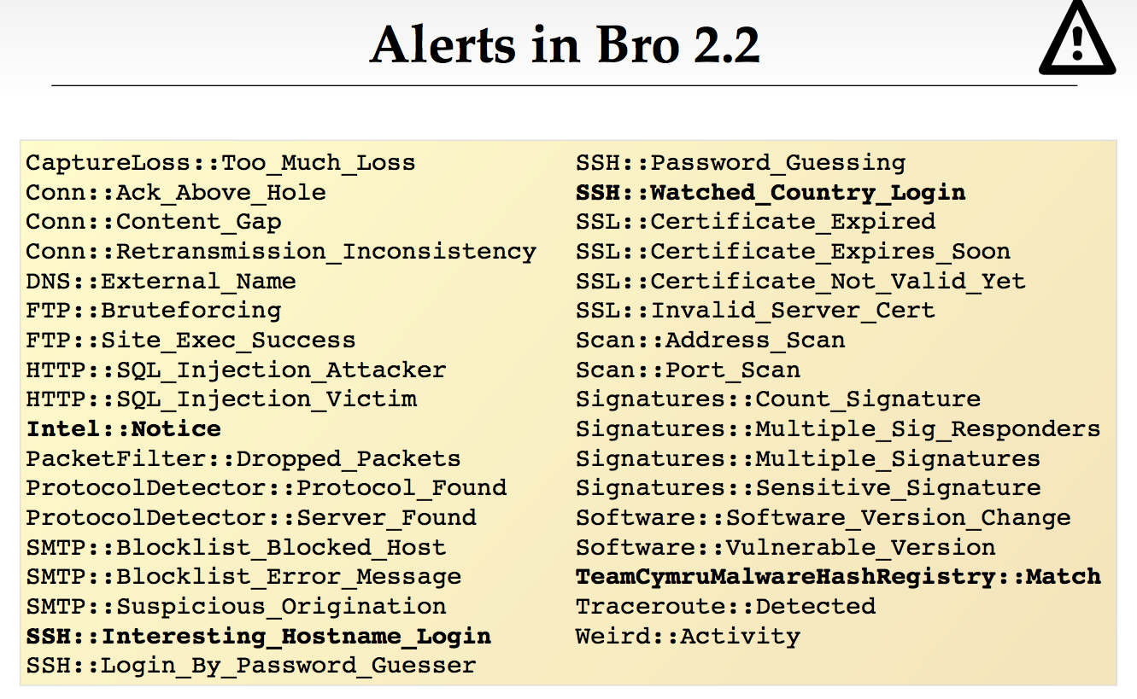

Slide 16
Virtual Private Networks

Slide 17
What is a VPN?
Making a shared network look like a private network.
Why do this?
Private networks have all kinds of advantages
But building a private network is expensive
(cheaper to have shared resources rather than dedicated)

Slide 18
VPN
“Extend the perimeter”
Uses crypto
Goal: make branch offices behave as if they’re on the same private network w.r.t. security

Slide 19


IPSec VPN – Setup
VPN Server is on the firewall, has dual interface
Internal IP: 192.168.1.1
External IP: 11.22.33.44
User at home on laptop
IP: 55.66.77.88
User starts VPN client
Authenticates to VPN server using username/password or (better) client certificate
Obtains shared session key
Client connected to VPN server’s external interface
VPN server assigns intranet IP to client: 192.168.1.50
VPN server adds mapping 192.168.1.50 ↔ 55.66.77.88 to routing table
“Tunnel” established
192.168.1.1
11.22.33.44

Slide 20



IPSec VPN
192.168.1.50
Routing table
55.66.77.88 ↔ 192.168.1.50
From: A_{pub} To: dst
[Content]
From : A_{pub} To: FW_{pub}
From: A_{priv}
To: dst
[Content]
192.168.1.1
From: A_{priv}
To: dst
[Content]
55.66.77.88
11.22.33.44
NAT or
Intranet
From: src
To: A_{pub}
[Content]
From : FW_{pub} To: A_{pub}
From: src
To: A_{priv}
[Content]
From: src
To: A_{priv}
[Content]

Slide 21
IPSec VPN – Tunnel operation
Client on laptop generates an IP packet
Could be bound for intranet or external destination
VPN client securely encapsulates it in another IP packet
Outer packet: src = 55.66.77.88; dst = 11.22.33.44
Inner packet: src = 192.168.1.50; dst = whatever
VPN server decrypts outer packet, forwards inner packet
Receives a response addressed to 192.168.1.50
Looks at routing table, realizes this is via VPN
Encapsulates it in an outer packet with src = whatever, dst = 55.66.77.88 and forwards it
VPN client decrypts outer packet, passes on inner packet to application software
Result: client applications think and act as if they are on Intranet
Notes:
VPN also used for anonymity

Slide 22
VPNs
Tunneling, security, QoS
Can also tunnel through SSH instead of IP
Encryption, tunneling, firewall all possible in different layers!

Slide 23
Benefits of VPNs
IP not really global (private addresses)
VPN makes separated IP sites look like one private IP network
Security
Bandwidth guarantees across ISP
QoS, SLAs
Simplified network operation
ISP can do the routing for you

Slide 24
End-to-end VPNs
Solves problem of how to connect remote hosts to a firewalled network
Site (private network)
Site
Host
Internet
FW/
VPN
IPsec
Tunnels
Remote
Host
Site
Host
Remote
Host

Slide 25
Customer-based Network VPNs
Site
Site
CE
CE
Internet
CE
CE
Site
Site
Customer buys own equipment, configures IPsec tunnels over the global internet, manages addressing and routing. ISP plays no role.

Slide 26
Provider-based Network VPNs
Site
Site
CE
CE
PE
PE
ISP
PE
PE
Site
CE
CE
Site
Provider manages all the complexity of the VPN. Customer simply connects to the provider equipment.

Slide 27
Network-Layer Security

Slide 28
IPSec: Network layer security
 | TLS | IPsec
What’s authenticated | Hostnames | IP addresses
What’s encrypted | Sessions over TCP | IP packets
How keys are distributed/verified | Certificate authorities | Delegate to DNSSEC or manual sharing
Deployment status | Widely deployed, works decently | N/A…
Notes:
Homework: think about how/why/when one would delegate to DNS when doing IPSec.
Example of why IPSec is a clusterf*ck:
From http://tools.ietf.org/html/draft-ietf-ipsec-isakmp-04
Certificates require an infrastructure for generation, verification, management and distribution. The Internet Policy Registration Authority (IPRA) [RFC-1422] has been established to direct this infrastructure for the IETF. The IPRA certifies Policy Certification Authorities (PCA). PCAs control Certificate Authorities (CA) which certify users and subordinate entities. Current certificate related work includes the Domain Name System (DNS) Security Extensions [DNSSEC] which will provide signed entity keys in the DNS. The Public Key Infrastucture (PKIX) working group is specifying an Internet profile for X.509 certificates. There is also work going on in industry to develop X.500 Directory Services which would provide X.509 certificates to users. The U.S. Post Office is developing a (CA) hierarchy. The NIST Public Key Infrastructure Working Group has also been doing work in this area. The DOD Multi Level Information System Security Initiative (MISSI) program has begun deploying a certificate infrastructure for the U.S. Government. Alternatively, if no infrastructure exists, the PGP Web of Trust certificates can be used to provide user authentication and privacy in a community of users who know and trust each other.
Too many options, but none of them works well

Slide 29
IPsec: Network Layer Security
Network-layer secrecy:
sending host encrypts the data in IP datagram
TCP and UDP segments; ICMP and SNMP messages.
Network-layer authentication
destination host can authenticate source IP address
Two principle protocols:
authentication header (AH) protocol
encapsulation security payload (ESP) protocol
For both AH and ESP, source, destination handshake:
create network-layer logical channel called a security association (SA)
Each SA unidirectional.
Uniquely determined by:
security protocol (AH or ESP)
source IP address
32-bit connection ID

Slide 30
Authentication Header (AH) Protocol
provides source authentication, data integrity, no confidentiality
AH header inserted between IP header, data field.
protocol field: 51
intermediate routers process datagrams as usual
AH header includes:
connection identifier
authentication data: source- signed message digest calculated over original IP datagram.
next header field: specifies type of data (e.g., TCP, UDP, ICMP)
IP header
AH header
data (e.g., TCP, UDP segment)

Slide 31
Encapsulating Security Payload (ESP) Protocol
provides secrecy, host authentication, data integrity.
data, ESP trailer encrypted.
next header field is in ESP trailer.
ESP authentication field is similar to AH authentication field.
Protocol = 50.
authenticated
encrypted
IP header
ESP
header
ESP
trailer
ESP
authent.
TCP/UDP segment

Slide 32
IPsec vs. TLS
IPsec idea: don’t change applications or API to applications, just OS
TLS idea: don’t change OS, only change application (if they run over TCP)

Slide 33
IPsec vs. TLS
IPsec has technical advantages
Rogue packets in TLS: TCP doesn’t participate in crypto, so attacker can inject bogus packet, no way for TCP to recover
easier to do outboard hardware processing (since each packet independently encrypted)
TLS easier to deploy

Slide 34
Problems with IPSec
IP is stateless, but keeping state is required for encryption
Routers need to modify IP packets
e.g. Fragmentation, NAT
Many security problems can only be solved in application-specific way

Slide 35
Why IPSec?
Automatically tunnel all traffic independent of application
Some applications may not even support encryption
Well-suited for:
VPN
Datacenter-to-datacenter security

