Slide 1
Net Neutrality
Security, Privacy, and Consumer Protection Nick Feamster University of Chicago

Slide 2
Internet Business Model (Simplified)
Preferences implemented with local preference manipulation
Provider
Pay to use
Free to use
Peer
Get paid to use
Destination
Customer
Customer/Provider: One AS pays another for reachability to some set of destinations
“Settlement-free” Peering: Bartering. Two ASes exchange routes with one another.

Slide 3
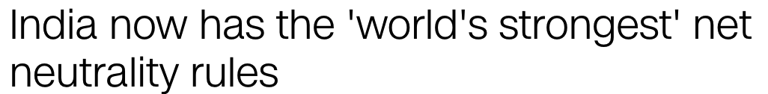

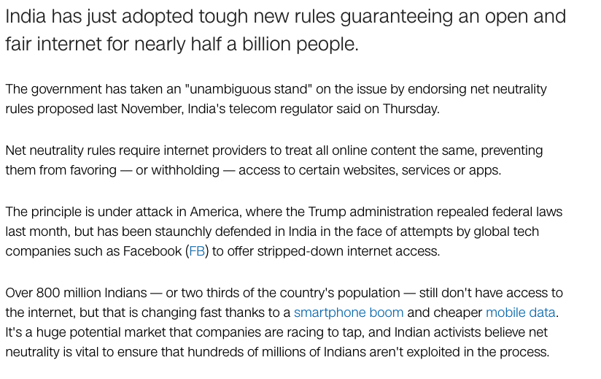
Other Countries: India

Slide 4

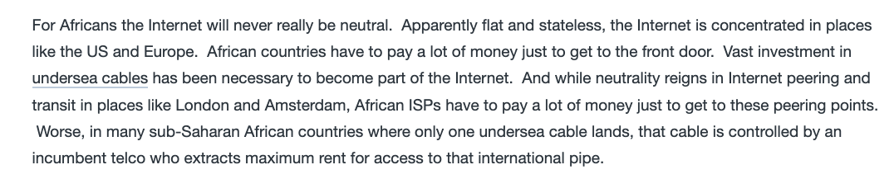
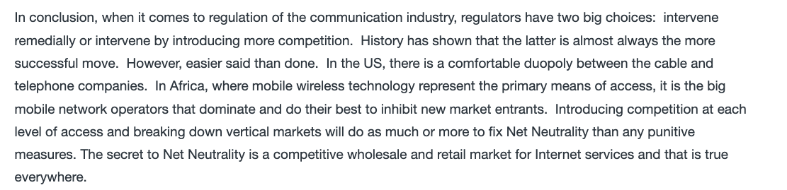
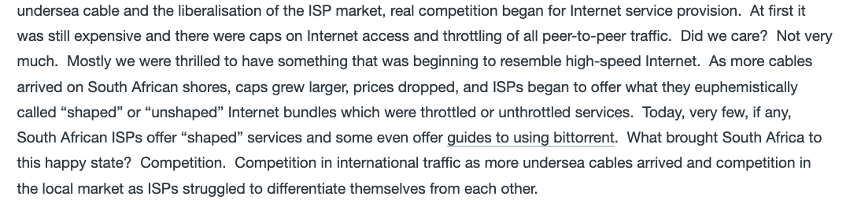
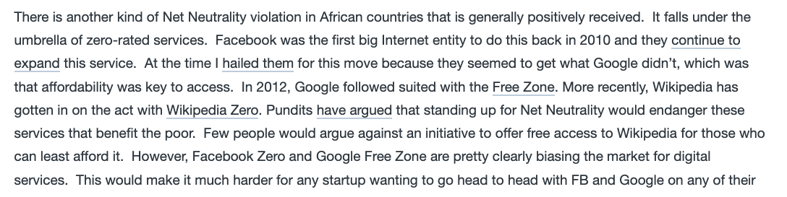

Slide 5
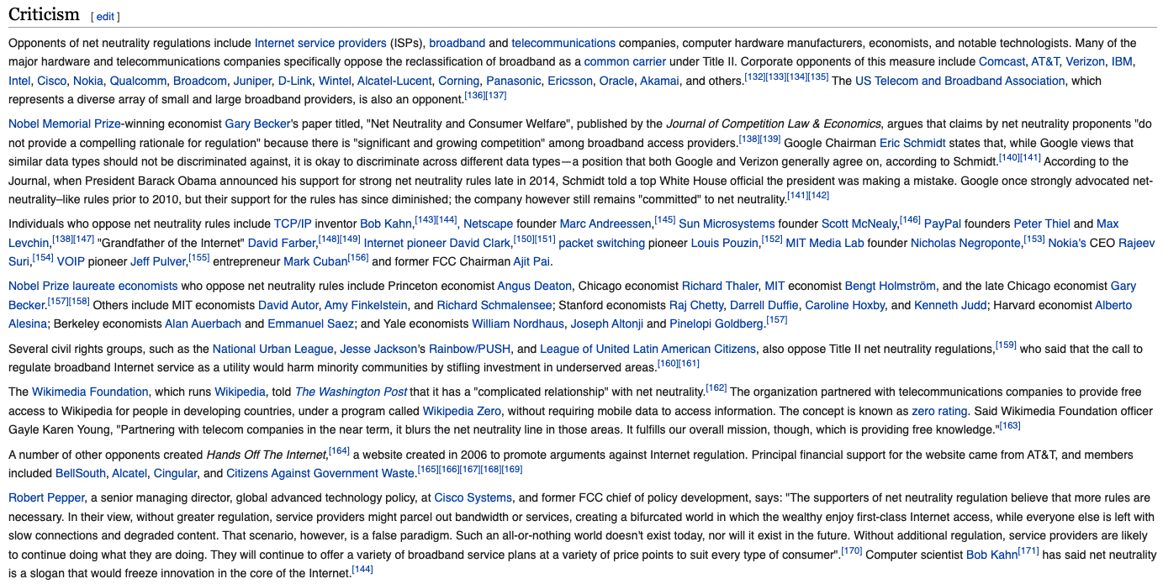

Slide 6
The Many Faces of Net Neutrality
The “bright line rules” (colloquial net neutrality)
Title II Classification (ISPs as telecom provider)
Regulatory oversight and authority
Various random taxes (telecom access fees)
Outage reporting requirements
Data collection and privacy constraints
… all very different than the rules that Google, Facebook, etc. are subject to.

Slide 7
Open Internet Order (2015; Invalidated): Reclassification of ISPs Under Title II
Bright Line Rules
No blocking
No throttling
No paid prioritization
No unreasonable interference or disadvantage
Transparency
… various exceptions for “reasonable network management” practices

Slide 8
The Open Internet Order (March 2015)
Reclassification of ISPs as “title 2” common carrier (forbearing many of the common clauses for title 2 providers). (Like a public utility.)
Upshot: ISPs prevented from discriminating.
Interestingly, content distribution networks were exempted from the process.
Perhaps we are barking up the wrong tree…

Slide 9
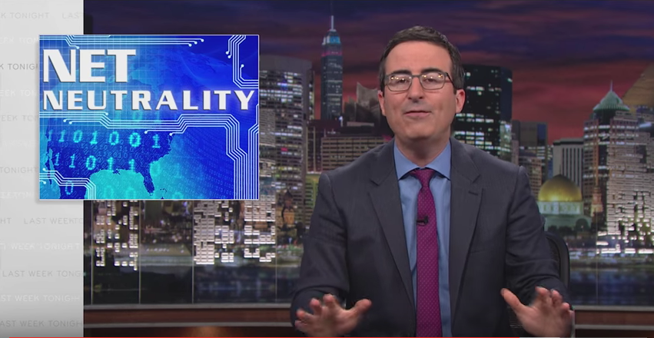
Internet Congestion and Network Neutrality

Slide 10
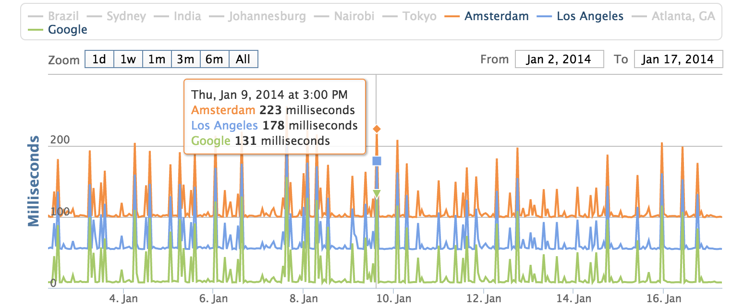
Internet Congestion at Home

Slide 11
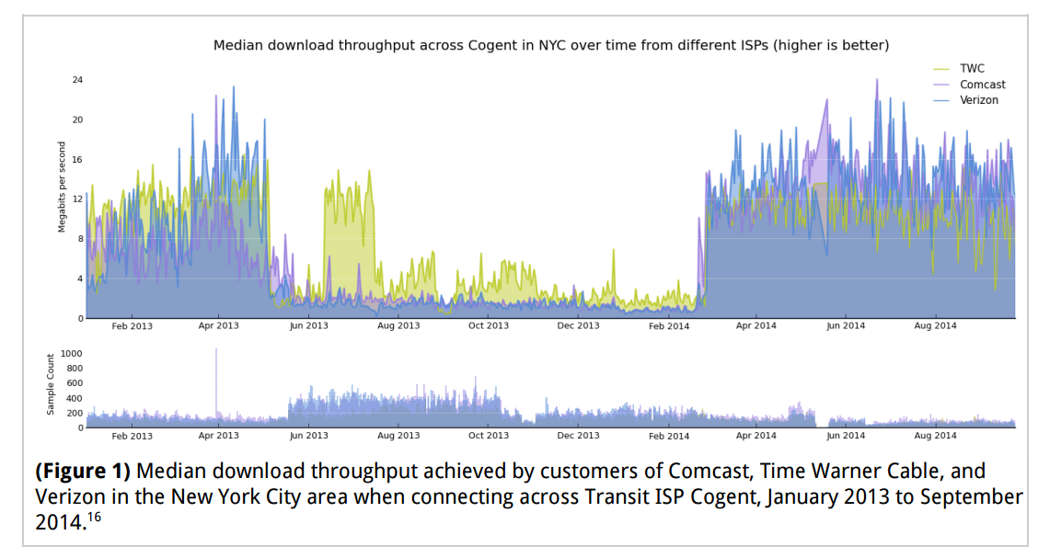
Another View: Across a Transit Provider

Slide 12
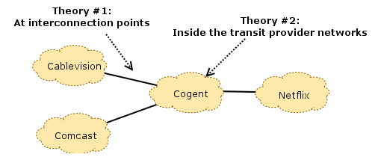
What’s Causing This?

Slide 13
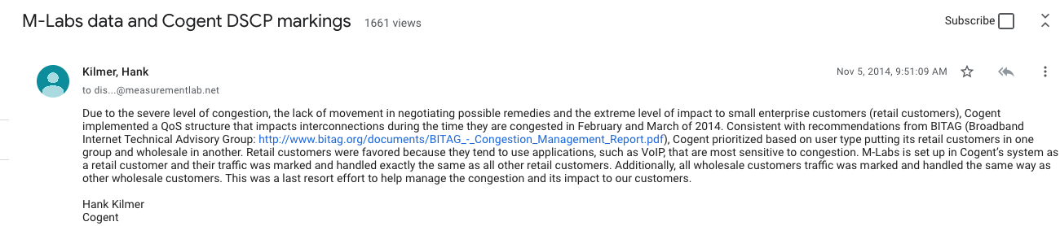

Slide 14
So… Was Comcast “Blocking” Netflix?

Slide 15
Two (or More) Sides…
Netflix asserts that, by paying their transit providers, they have already paid for access to Comcast’s consumers (the “eyeballs”), and that it is the responsibility of Comcast and their transit providers to ensure that these links are provisioned well enough to avoid congestion. The filings assert that Comcast “let the links congest” (effectively, by not paying for upgrades to these links).
Comcast, on the other hand, asserts that Netflix has enough traffic to congest any link they please, at any time, as well as the flexibility to choose which transit provider they use to reach Comcast.
… and then there was the Cogent dynamic in play.

Slide 17
Net Neutrality: Summary
Net neutrality regulation in the U.S. is “dead” (for the time being)
Some provisions of net neutrality pertain to Internet censorship (e.g., blocking, throttling, paid prioritization).
Some aspects of Internet access relate to provisioning/economics/Internet peering and are somewhat fuzzy.

