Slide 1
Naming Security
Nick Feamster
CS 6262
Spring 2009

Slide 2

DNS: Mapping Names to Addresses
www.cc.gatech.edu
root, .edu
www.cc.gatech.edu
NS troll-gw.gatech.edu
NS burdell.cc.gatech.edu
troll-gw.gatech.edu
Client
Local
DNS resolver
A 130.207.7.36
Recursive query
burdell.cc.gatech.edu
Iterative queries
Note the diversity of Georgia Tech’s authoritative nameservers

Slide 3
Some Record Types
A
NS
MX
CNAME
TXT
PTR
AAAA
SRV

Slide 4
Caching
Resolvers cache DNS responses
  Quick response for repeated translations
  Other queries may reuse some parts of lookup
    NS records for domains typically cached for longer
  Negative responses also cached
    Typos, “localhost”, etc.
Cached data periodically times out
  Lifetime (TTL) of data controlled by owner of data
  TTL passed with every record
What if DNS entries get corrupted?

Slide 5
Root Zone
Generic Top Level Domains (gTLD)
  .com, .net, .org,
Country Code Top Level Domain (ccTLD)
  .us, .ca, .fi, .uk, etc…
Root server ({a-m}.root-servers.net) also used to cover gTLD domains
  Increased load on root servers
  August 2000: .com, .net, .org moved off root servers onto gTLDs

Slide 6
Some gTLDs
.info → general info
.biz → businesses
.name → individuals
.aero → air-transport industry
.coop → business cooperatives
.pro → accountants, lawyers, physicians
.museum → museums

Slide 7
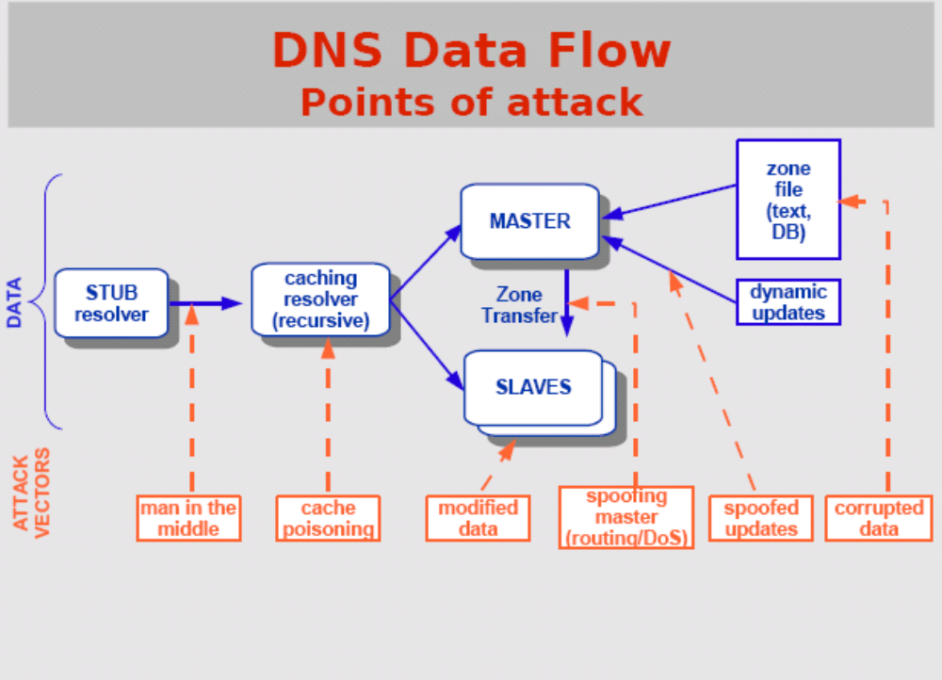
Source: http://nsrc.org/tutorials/2009/apricot/dnssec/dnssec-tutorial.pdf

Slide 8
Root level DNS attacks
Feb. 6, 2007:
  Botnet attack on the 13 Internet DNS root servers
  Lasted 2.5 hours
  None crashed, but two performed badly:
    g-root (DoD), l-root (ICANN)
    Most other root servers use anycast
Notes:
Root servers specify where the TLDs are (.com, .net, …)
f-root is supported by 42 different locations.
Only one root server is sufficient to make the Internet work.

Slide 9
Do you trust the TLD operators?
Wildcard DNS record for all .com and .net domain names not yet registered by others
  September 15 – October 4, 2003
  February 2004: Verisign sues ICANN
Redirection for these domain names to Verisign web portal
What services might this break?

Slide 10
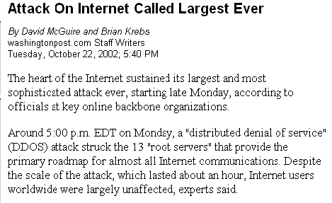
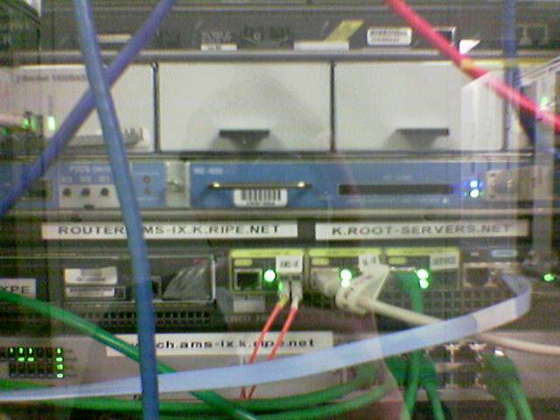
Protecting the Root Nameservers
Sophisticated?
Why did nobody notice?
gatech.edu. 13759 NS trollgw.gatech.edu.
Defense Mechanisms
Redundancy: 13 root nameservers
IP Anycast for root DNS servers {c,f,i,j,k}.root-servers.net
  RFC 3258
  Most physical nameservers lie outside of the US

Slide 11
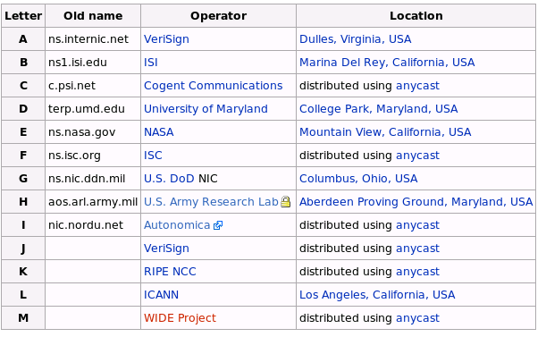
Defense: Replication and Caching
source: wikipedia

Slide 12
Other Vulnerabilities
DNS Amplification Attacks
Kaminsky DNS Cache Poisoning
Comcast.net hijack

Slide 13

DNS Amplification Attack
DNS Amplification attack: ( ×40 amplification )
DNS Query
SrcIP: Dos Target
(60 bytes)
EDNS Reponse
(3000 bytes)
DoS
Source
DNS
Server
DoS
Target
580,000 open resolvers on Internet (Kaminsky-Shiffman’06)
Prevention: reject DNS queries from external addresses
Notes:
Other measurements: (MeasurementFactory):
There are an estimated 7.5 million external DNS servers on the public Internet. Over 75% of domain
name servers (of roughly 1.3 million sampled) allow recursive name service to arbitrary queriers.

Slide 14


DNS Amplification Attack
DNS
root-servers
stub-resolvers
full-resolvers
Command&Control
DNS
DNS
DNS
tld-servers
IP spoofed
DNS queries
DNS
example-servers
botnet
victim

Slide 15
Solutions
attacker
ip spoofed packets
open
amplifier
replies
prevent
ip spoofing
disable
open amplifiers
victim

Slide 16
Why DNSSEC
DNSSEC protects against data spoofing and corruption
DNSSEC also provides mechanisms to authenticate servers and requests
DNSSEC provides mechanisms to establish authenticity and integrity

Slide 17
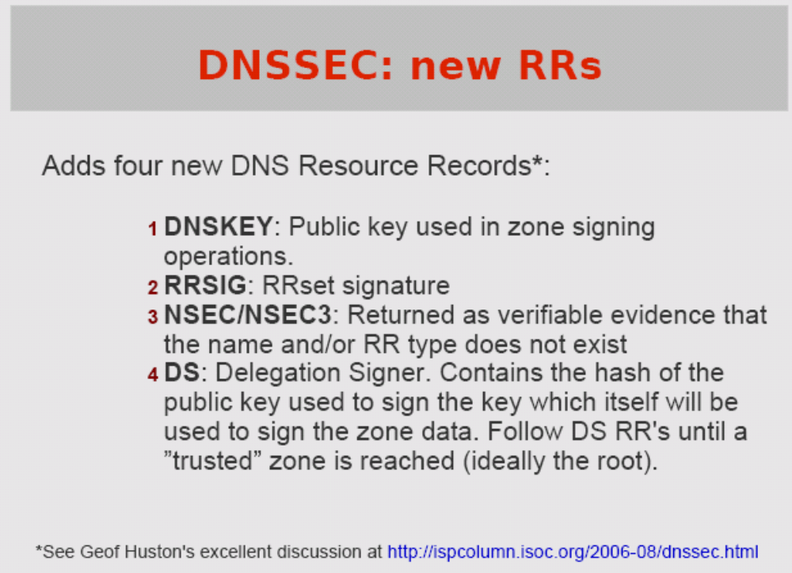

Slide 18
PK-DNSSEC (Public Key)
The DNS servers sign the hash of resource record set with its private keys
Resouce record set: The set of resource records of the same type.
Public keys can be used to verify the SIGs
The authenticity of public keys is established by a SIGnature over the keys with the parent’s private key
In the ideal case, only one public key needs to be distributed out-of-band (the root’s public key)

Slide 19
DNSSEC: new RRs
2 Public key related RRs
  SIG signature over RRset made using private key
  KEY public key, needed for verifying a SIG over a RRset, signed by the parent’s private key
One RR for internal consistency (authenticated denial of data)
  NXT RR to indicate which RRset is the next one in the zone
For non DNSSEC public keys: CERT
Notes:
RFC 2535 discusses these RRs in detail.
CERT RR is outside the scope of this course.

Slide 20
SIG RRs
Cover each resource record set with a public-key signature which is stored as a resource record called SIG RR
SIG RRs are computed for every RRset in a zone file and stored
Add the corresponding pre-calculated signature for each RRset in answers to queries
Must include the entire RRset in an answer, otherwise the resolver could not verify the signature

Slide 21
Verifying the tree
Question: www.cnn.com
. (root)
www.cnn.com A ?
dns.cs.umass.edu
lab.cs.umass.edu
resolver
ask .com server
SIG(the ip address and PK of .com server)
by its private key
stub
resolver
www.cnn.com A ?
xxx.xxx.xxx.xxx
www.cnn.com A ?
.com
transaction
signatures
ask cnn.com server
SIG(the ip address and PK of cnn.com server)
by its private key
add to cache
www.cnn.com A ?
slave servers
SIG(xxx.xxx.xxx.xxx)
by its private key
transaction
signatures
www.cnn.com
cnn.com

Slide 22
Verifying
Verify a SIG over data using the public KEY
DNS data is signed with the private key
Verify the SIG with the KEY mentioned in the SIG record
The key can be found in the DNS or can be locally configured

