Slide 1
Botnets: Infrastructure and Attacks
Nick Feamster
CS 6262
Spring 2009

Slide 2
Botnets
Bots: Autonomous programs performing tasks
Plenty of “benign” bots
  e.g., weatherbug
Botnets: group of bots
  Typically carries malicious connotation
  Large numbers of infected machines
  Machines “enlisted” with infection vectors like worms (last lecture)
Available for simultaneous control by a master
Size: up to 350,000 nodes (from today’s paper)

Slide 3
Botnet History: How we got here
Early 1990s: IRC bots
  eggdrop: automated management of IRC channels
1999-2000: DDoS tools
  Trinoo, TFN2k, Stacheldraht
1998-2000: Trojans
  BackOrifice, BackOrifice2k, SubSeven
2001- : Worms
  Code Red, Blaster, Sasser
Fast spreading capabilities pose big threat
Put these pieces together and add a controller…

Slide 4
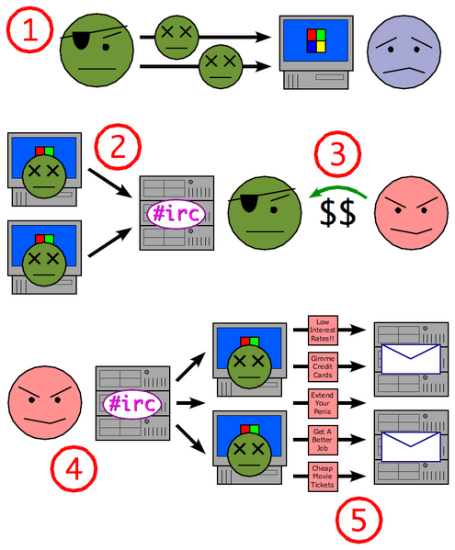
Putting it together
Miscreant (botherd) launches worm, virus, or other mechanism to infect Windows machine.
Infected machines contact botnet controller via IRC.
Spammer (sponsor) pays miscreant for use of botnet.
Spammer uses botnet to send spam emails.

Slide 5
Botnet Detection and Tracking
Network Intrusion Detection Systems (e.g., Snort)
  Signature: alert tcp any any -> any any (msg:"Agobot/Phatbot Infection Successful"; flow:established; content:"221
Honeynets: gather information
  Run unpatched version of Windows
  Usually infected within 10 minutes
  Capture binary
    determine scanning patterns, etc.
  Capture network traffic
    Locate identity of command and control, other bots, etc.

Slide 6
“Rallying” the Botnet
Easy to combine worm, backdoor functionality
Problem: how to learn about successfully infected machines?
Options
  Email
  Hard-coded email address

Slide 7
Botnet Application: Phishing
“Phishing attacks use both social engineering and technical subterfuge to steal consumers' personal identity data and financial account credentials.” -- Anti-spam working group
Social-engineering schemes
  Spoofed emails direct users to counterfeit web sites
  Trick recipients into divulging financial, personal data
Anti-Phishing Working Group Report (Oct. 2005)
  15,820 phishing e-mail messages 4367 unique phishing sites identified.
  96 brand names were hijacked.
  Average time a site stayed on-line was 5.5 days.
Question: What does phishing have to do with botnets?

Slide 8
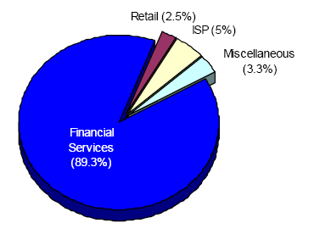
Which web sites are being phished?
Source: Anti-phishing working group report, Dec. 2005
Financial services by far the most targeted sites
New trend: Keystroke logging…

Slide 9


Phishing: Detection and Research
Idea: Phishing generates sudden uptick of password re-use at a brand-new IP address
H(pwd)
etrade.com
H(pwd)
Rogue Phisher
Distribution of password harvesting across bots can help.

Slide 10
Botnet Application: Click Fraud
Pay-per-click advertising
  Publishers display links from advertisers
  Advertising networks act as middlemen
    Sometimes the same as publishers (e.g., Google)
Click fraud: botnets used to click on pay-per-click ads
Motivation
  Competition between advertisers
  Revenue generation by bogus content provider

Slide 11
Botnet Application: Click Fraud
Pay-per-click advertising
  Publishers display links from advertisers
  Advertising networks act as middlemen
    Sometimes the same as publishers (e.g., Google)
Click fraud: botnets used to click on pay-per-click ads
Motivation
  Competition between advertisers
  Revenue generation by bogus content provider

Slide 12
Open Research Questions
Botnet membership detection
  Existing techniques
    Require special privileges
    Disable the botnet operation
  Under various datasets (packet traces, various numbers of vantage points, etc.)
Click fraud detection
Phishing detection

Slide 13
Botnet Detection and Tracking
Network Intrusion Detection Systems (e.g., Snort)
  Signature: alert tcp any any -> any any (msg:"Agobot/Phatbot Infection Successful"; flow:established; content:"221
Honeynets: gather information
  Run unpatched version of Windows
  Usually infected within 10 minutes
  Capture binary
    determine scanning patterns, etc.
  Capture network traffic
    Locate identity of command and control, other bots, etc.

Slide 14
Detection: In-Protocol
Snooping on IRC Servers
Email (e.g., CipherTrust ZombieMeter)
  > 170k new zombies per day
  15% from China
Managed network sensing and anti-virus detection
  Sinkholes detect scans, infected machines, etc.
Drawback: Cannot detect botnet structure

Slide 15
Using DNS Traffic to Find Controllers
Different types of queries may reveal info
  Repetitive A queries may indicate bot/controller
  MX queries may indicate spam bot
  PTR queries may indicate a server
Usually 3 level: hostname.subdomain.TLD
Names and subdomains that just look rogue
  (e.g., irc.big-bot.de)

Slide 16
DNS Monitoring
Command-and-control hijack
  Advantages: accurate estimation of bot population
  Disadvantages: bot is rendered useless; can’t monitor activity from command and control
Complete TCP three-way handshakes
  Can distinguish distinct infections
  Can distinguish infected bots from port scans, etc.

Slide 17
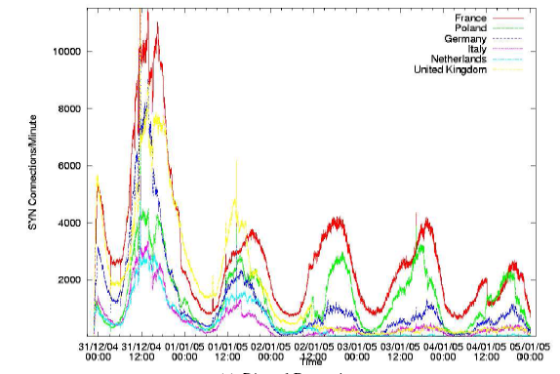
Modeling Botnet Propagation
Heterogeneous mix of vulnerabilities
Diurnal patterns
Diurnal patterns can have an effect on the rate of propagation
Can model spread of the botnet based on short-term propagation.

Slide 18


Modeling Propagation: Single TZ
Pairwise infection rate:
scanning rate/size of IP space
Removal rate: some fraction of online infected machines
Infected hosts
Online infected hosts
Online vulnerable hosts
Useful for modeling the spread of “regional worms”
Question: How common is this?
Extension to multiple timezones is (reasonably) straightforward

Slide 19

Spread across multiple timezones
Online vulnerable hosts in timezone i
Newly infected
hosts in timezone i
Infection from zone j to i
Question: What assumption is being made regarding scanning rates and timezones?

Slide 20
Experimental Validation
How to capture various parameters?
  Derive diurnal shaping function by country
  Monitor scanning activity per hour, per day (24 bins)
  Normalize each day to 1 and curve-fit
How to estimate N(t) per timezone?

Slide 21
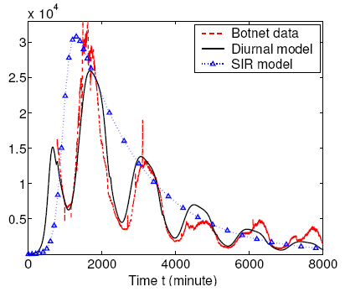
Fitting the model to the data
Diurnal shaping function yields more accurate model.

Slide 22
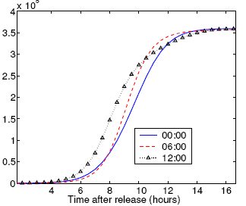
Applications of the model
Forecasting the spread of botnets
Improved monitoring and response capabilities
  A faster spreading worm may be “stealth” depending on the time of day that the worm was released

Slide 23
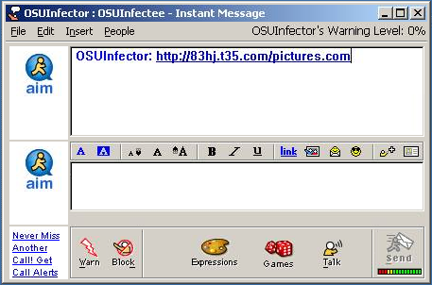
New Trend: Social Engineering
Bots frequently spread through AOL IM
  A bot-infected computer is told to spread through AOL IM
  It contacts all of the logged in buddies and sends them a link to a malicious web site
  People get a link from a friend, click on it, and say “sure, open it” when asked

Slide 24
Early Botnets: AgoBot (2003)
Drops a copy of itself as svchost.exe or syschk.exe
Propagates via Grokster, Kazaa, etc.
Also via Windows file shares

Slide 25
Botnet Operation
General
  Assign a new random nickname to the bot
  Cause the bot to display its status
  Cause the bot to display system information
  Cause the bot to quit IRC and terminate itself
  Change the nickname of the bot
  Completely remove the bot from the system
  Display the bot version or ID
  Display the information about the bot
  Make the bot execute a .EXE file
IRC Commands
  Cause the bot to display network information
  Disconnect the bot from IRC
  Make the bot change IRC modes
  Make the bot change the server Cvars
  Make the bot join an IRC channel
  Make the bot part an IRC channel
  Make the bot quit from IRC
  Make the bot reconnect to IRC
Redirection
  Redirect a TCP port to another host
  Redirect GRE traffic that results to proxy PPTP VPN connections
DDoS Attacks
  Redirect a TCP port to another host
  Redirect GRE traffic that results to proxy PPTP VPN connections
Information theft
  Steal CD keys of popular games
Program termination

Slide 26
PhatBot (2004)
Direct descendent of AgoBot
More features
  Harvesting of email addresses via Web and local machine
  Steal AOL logins/passwords
  Sniff network traffic for passwords
Control vector is peer-to-peer (not IRC)

Slide 27
Peer-to-Peer Control
Good
  distributed C&C
  possible better anonymity
Bad
  more information about network structure directly available to good guys IDS,
  overhead,
  typical p2p problems like partitioning, join/leave, etc

Slide 28
Defense: DNS-Based Blackhole Lists
First: Mail Abuse Prevention System (MAPS)
  Paul Vixie, 1997
Today: Spamhaus, spamcop, dnsrbl.org, etc.
Different addresses refer to different reasons for blocking
% dig 91.53.195.211.bl.spamcop.net
;; ANSWER SECTION:
91.53.195.211.bl.spamcop.net. 2100 IN A 127.0.0.2
;; ANSWER SECTION:
91.53.195.211.bl.spamcop.net. 1799 IN TXT "Blocked - see http://www.spamcop.net/bl.shtml?211.195.53.91"

Slide 29
A Model of Responsiveness
Possible Detection
Opportunity
Infection
Time
S-Day
RBL Listing
Response Time
Lifecycle of a spamming host
Response Time
  Difficult to calculate without “ground truth”
  Can still estimate lower bound

Slide 30
Measuring Responsiveness
Data
  1.5 days worth of packet captures of DNSBL queries from a mirror of Spamhaus
  46 days of pcaps from a hijacked C&C for a Bobax botnet; overlaps with DNSBL queries
Method
  Monitor DNSBL for lookups for known Bobax hosts
    Look for first query
    Look for the first time a query response had a ‘listed’ status

Slide 31
Responsiveness
Observed 81,950 DNSBL queries for 4,295 (out of over 2 million) Bobax IPs
Only 255 (6%) Bobax IPs were blacklisted through the end of the Bobax trace (46 days)
  88 IPs became listed during the 1.5 day DNSBL trace
  34 of these were listed after a single detection opportunity
Both responsiveness and completeness appear to be low.
Much room for improvement.

Slide 32
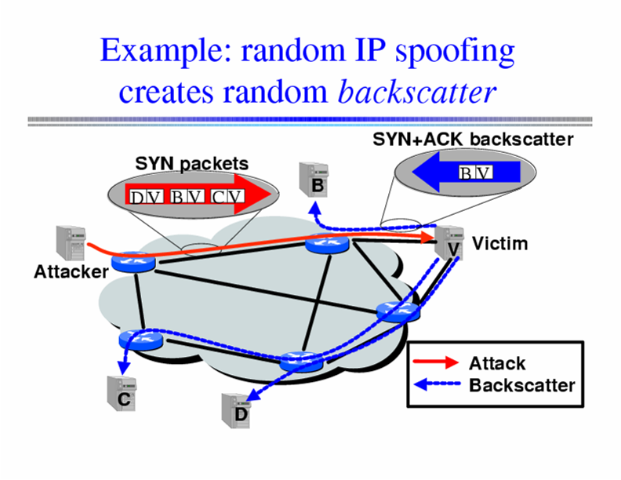
Inferring DoS Activity
IP address spoofing creates random backscatter.

Slide 33
Backscatter Analysis
Monitor block of n IP addresses
Expected # of backscatter packets given an attack of m packets:
  E(X) = nm / 2³²
  Hence, m = x * (2³² / n)
Attack Rate R >= m/T = x/T * (2³² / n)

Slide 34
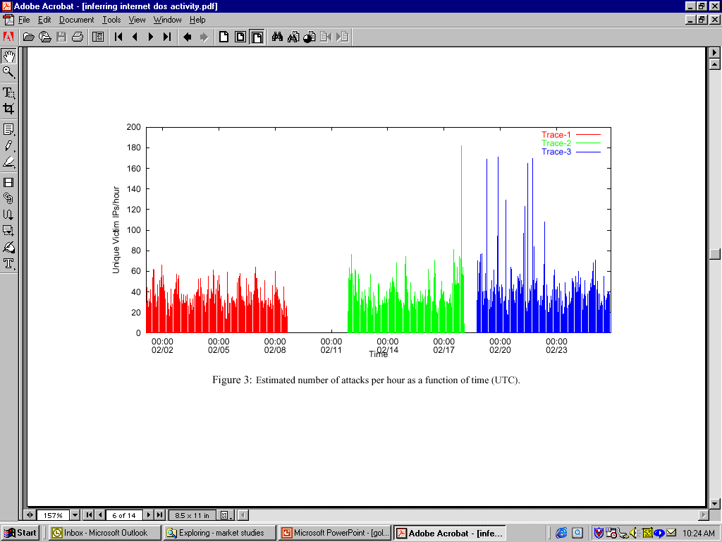
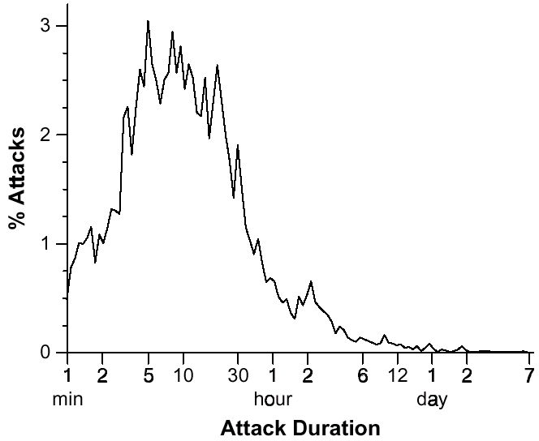
Inferred DoS Activity
Over 4000 DoS/DDoS attacks per week
Short duration: 80% last less than 30 minutes
Moore et al. Inferring Internet Denial of Service Activity

Slide 35
DDoS: Setting up the Infrastructure
Zombies
  Slow-spreading installations can be difficult to detect
  Can be spread quickly with worms
Indirection makes attacker harder to locate
  No need to spoof IP addresses

Slide 36
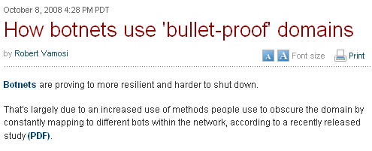
Online Scams
Often advertised in spam messages
URLs point to various point-of-sale sites
These scams continue to be a menace
  As of August 2007, one
  in every 87 emails constituted a phishing attack
Scams often hosted on bullet-proof domains
Problem: Study the dynamics of online scams, as seen at a large spam sinkhole

Slide 37
Online Scam Hosting is Dynamic
The sites pointed to by a URL that is received in an email message may point to different sites
Maintains agility as sites are shut down, blacklisted, etc.
One mechanism for hosting sites: fast flux

Slide 38
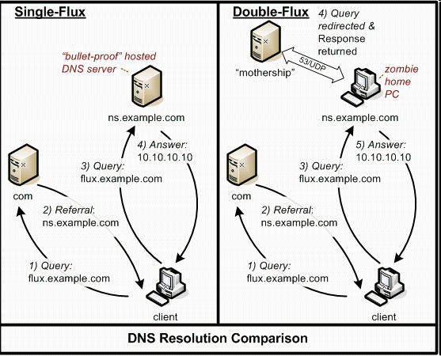
Overview of Dynamics
Source: HoneyNet Project

Slide 39
Why Study Dynamics?
Understanding
  What are the possible invariants?
  How many different scam-hosting sites are there?
Detection
  Today: Blacklisting based on URLs
  Instead: Identify the network-level behavior of a scam-hosting site

Slide 40
Summary of Findings
What are the rates and extents of change?
  Different from legitimate load balance
  Different cross different scam campaigns
How are dynamics implemented?
  Many scam campaigns change DNS mappings at all three locations in the DNS hierarchy
    A, NS, IP address of NS record
Conclusion: Might be able to detect based on monitoring the dynamic behavior of URLs

Slide 41
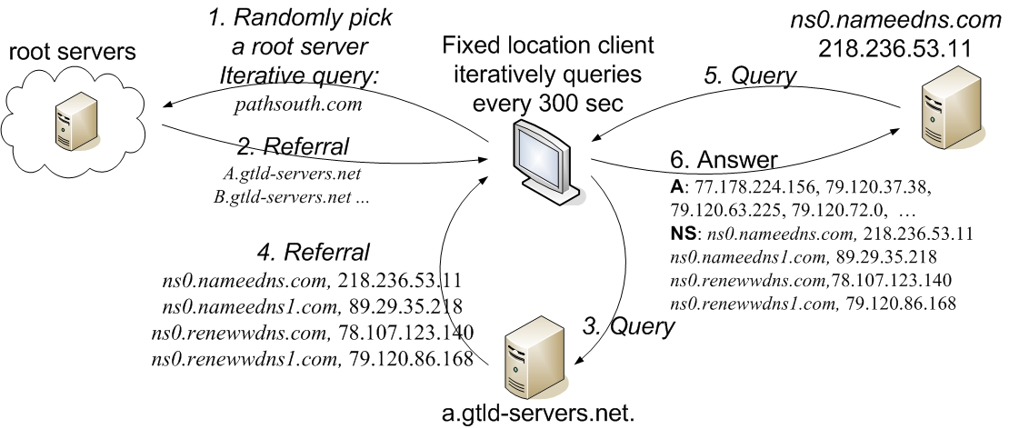
Data Collection
One month of email spamtrap data
  115,000 emails
  384 unique domains
  24 unique spam campaigns

Slide 42
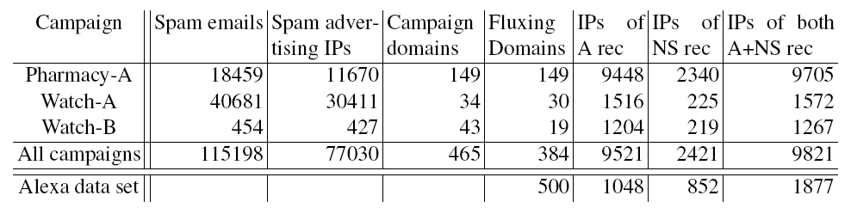
Top 3 Spam Campaigns
Some campaigns hosted by thousands of IPs
Most scam domains exhibit some type of flux
Sharing of IP addresses across different roles (authoritative NS and scam hosting)

Slide 43
Time Between Changes
How quickly do DNS-record mappings change?
Scam domains change on shorter intervals than their TTL values
Domains within the same campaign exhibit similar rates of change

Slide 44
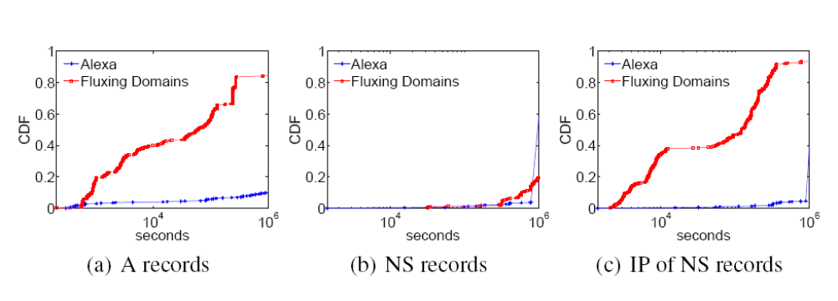
Rates of Change
Domains that exhibit fast flux change more rapidly than legitimate domains
Rates of change are inconsistent with actual TTL values

Slide 45
Rates of Accumulation
How quickly do scams accumulate new IP addresses?
Rates of accumulation differ across campaigns
Some scams only begin accumulating IP addresses after some time

Slide 46
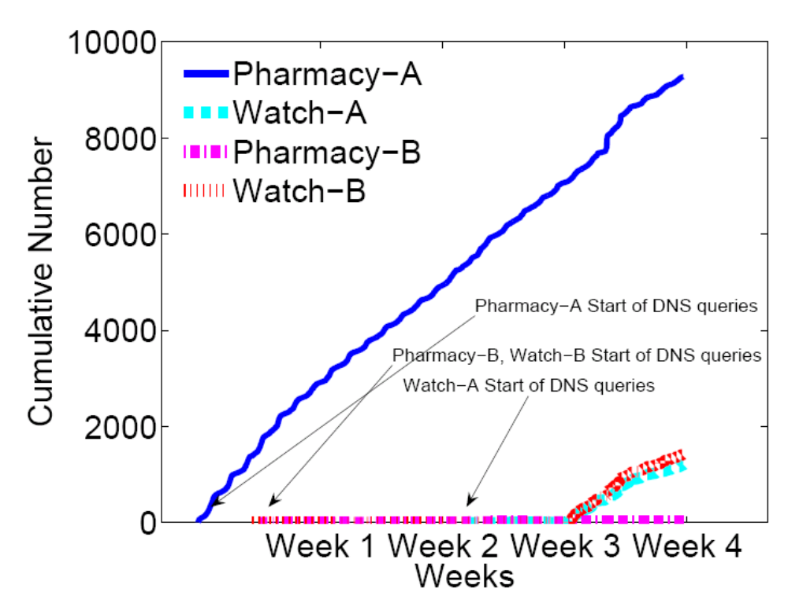
Rates of Accumulation

Slide 47
Location of Change in Hierarchy
Scam networks use a different portion of the IP address space than legitimate sites
  30/8 – 60/8 --- lots of legitimate sites, no scam sites
DNS lookups for scam domains are often more widely distributed than those for legitimate sites

Slide 48
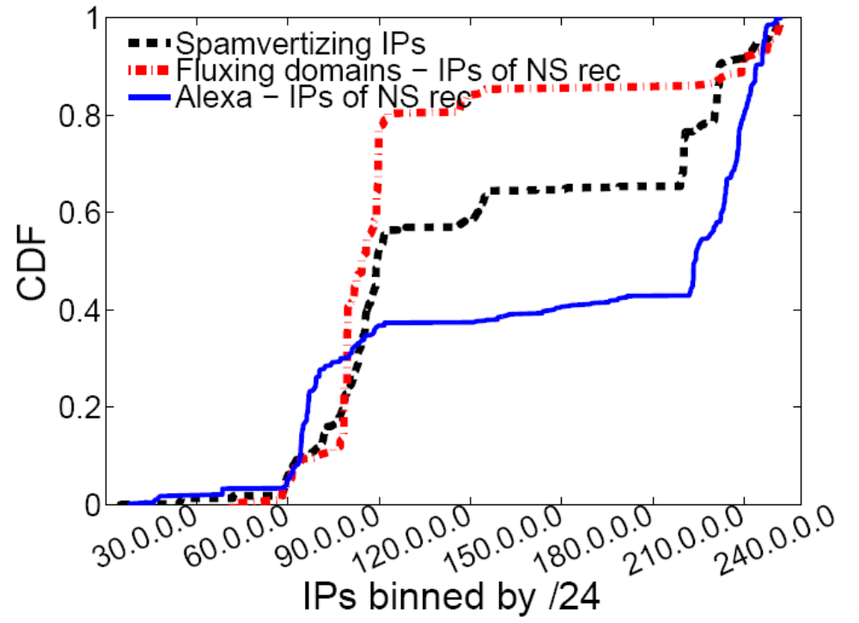
Location in IP Address Space
Scam campaign infrastructure is considerably more concentrated in the 80/8-90/8 range

Slide 49
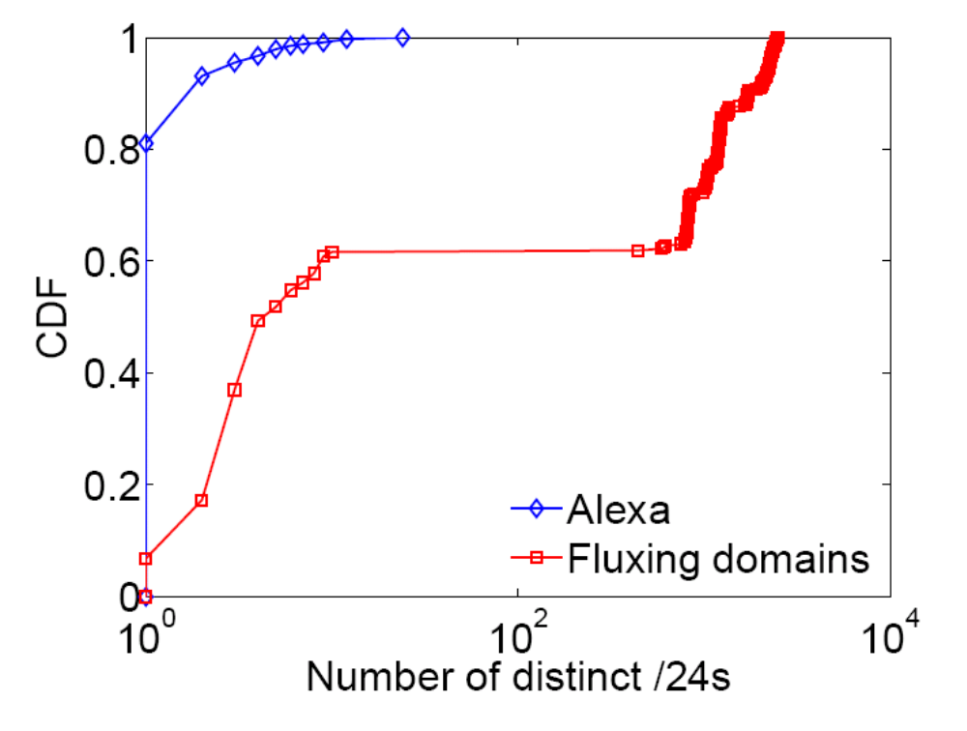
Distribution of DNS Records

Slide 50
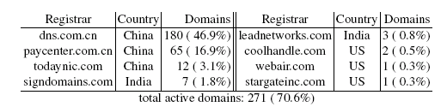
Registrars Involved in Changes
About 70% of domains still active are registered at eight domains
Three registrars responsible for 257 domains
(95% of those still marked as active)

Slide 51
Conclusion
Scam campaigns rely on a dynamic hosting infrastructure
Studying the dynamics of that infrastructure may help us develop better detection methods
Dynamics
  Rates of change differ from legitimate sites, and differ across campaigns
  Dynamics implemented at all levels of DNS hierarchy
Location
  Scam sites distributed more across IP address space
http://www.cc.gatech.edu/research/reports/GT-CS-08-07.pdf

