Slide 1
Monitoring and Intrusion Detection
Nick Feamster
CS 4251
Fall 2008

Slide 2
Passive vs. Active Measurement
Passive Measurement: Collection of packets, flow statistics of traffic that is already flowing on the network
  Packet traces
  Flow statistics
  Application-level logs
Active Measurement: Inject “probing” traffic to measure various characteristics
  Traceroute
  Ping
  Application-level probes (e.g., Web downloads)

Slide 3
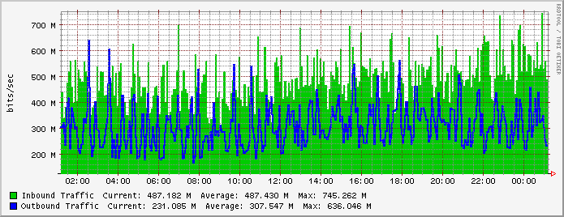
Monitoring Internet Traffic
Hundreds of megabits per second
Cannot afford to look at all traffic
Goals
  High-speed monitoring
  Low false positives

Slide 4
Passive Traffic Data Measurement
SNMP byte/packet counts: everywhere
Packet monitoring: selected locations
Flow monitoring: typically at edges (if possible)
  Direct computation of the traffic matrix
  Input to denial-of-service attack detection
Deep Packet Inspection: also at edge, where possible

Slide 5
Two Main Approaches
Packet-level Monitoring
  Keep packet-level statistics
  Examine (and potentially, log) variety of packet-level statistics. Essentially, anything in the packet.
  Timing
Flow-level Monitoring
  Monitor packet-by-packet (though sometimes sampled)
  Keep aggregate statistics on a flow

Slide 6
Packet-level Monitoring
Passive monitoring to collect full packet contents (or at least headers)
Advantages: lots of detailed information
  Precise timing information
  Information in packet headers
Disadvantages: overhead
  Hard to keep up with high-speed links
  Often requires a separate monitoring device

Slide 7
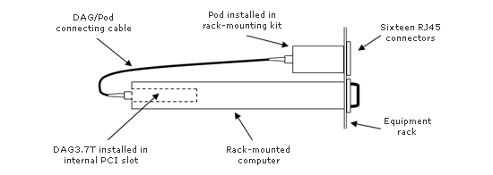
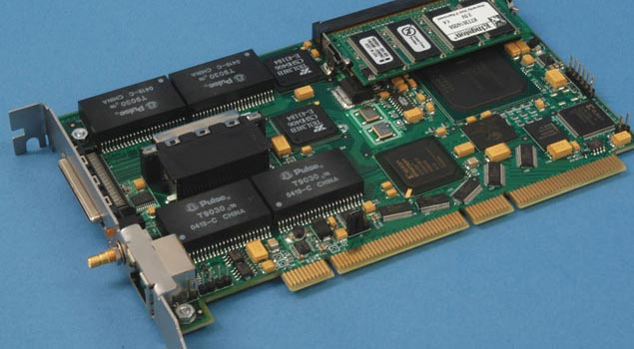
Full Packet Capture (Passive)
Example: Georgia Tech OC3Mon
Rack-mounted PC
Optical splitter
Data Acquisition and Generation (DAG) card
Source: endace.com

Slide 8
What is a flow?
Source IP address
Destination IP address
Source port
Destination port
Layer 3 protocol type
TOS byte (DSCP)
Input logical interface (ifIndex)

Slide 9

Cisco Netflow
Basic output: “Flow record”
  Most common version is v5
Current version (9) is being standardized in the IETF (template-based)
  More flexible record format
  Much easier to add new flow record types
Core Network
Collector
(PC)
Collection and Aggregation
Approximately 1500 bytes
20-50 flow records
Sent more frequently if traffic increases

Slide 10
Flow Record Contents
Basic information about the flow…
Source and Destination, IP address and port
Packet and byte counts
Start and end times
ToS, TCP flags
…plus, information related to routing
Next-hop IP address
Source and destination AS
Source and destination prefix

Slide 11
Aggregating Packets into Flows
flow 1
flow 2
flow 3
flow 4
Criteria 1: Set of packets that “belong together”
  Source/destination IP addresses and port numbers
  Same protocol, ToS bits, …
  Same input/output interfaces at a router (if known)
Criteria 2: Packets that are “close” together in time
  Maximum inter-packet spacing (e.g., 15 sec, 30 sec)
  Example: flows 2 and 4 are different flows due to time

Slide 12
Reducing Measurement Overhead
Filtering: on interface
  destination prefix for a customer
  port number for an application (e.g., 80 for Web)
Sampling: before insertion into flow cache
  Random, deterministic, or hash-based sampling
  1-out-of-n or stratified based on packet/flow size
  Two types: packet-level and flow-level
Aggregation: after cache eviction
  packets/flows with same next-hop AS
  packets/flows destined to a particular service

Slide 13
Packet Sampling for Flow Monitoring
Packet sampling before flow creation (Sampled Netflow)
  1-out-of-m sampling of individual packets (e.g., m=100)
  Create of flow records over the sampled packets
Reducing overhead
  Avoid per-packet overhead on (m-1)/m packets
  Avoid creating records for a large number of small flows
Increasing overhead (in some cases)
  May split some long transfers into multiple flow records
  … due to larger time gaps between successive packets
time
not sampled
timeout
two flows

Slide 14
Sampling: Flow-Level Sampling
Sampling of flow records evicted from flow cache
  When evicting flows from table or when analyzing flows
Stratified sampling to put weight on “heavy” flows
  Select all long flows and sample the short flows
Reduces the number of flow records
  Still measures the vast majority of the traffic
Flow 1, 40 bytes
Flow 2, 15580 bytes
Flow 3, 8196 bytes
Flow 4, 5350789 bytes
Flow 5, 532 bytes
Flow 6, 7432 bytes
sample with 0.1% probability
sample with 100% probability
sample with 10% probability

Slide 15
High-Speed Packet Sampling
Traffic arrives at high rates
  High volume
  Some analysis scales with the size of the input
Possible approaches
  Random packet sampling
  Targeted packet sampling

Slide 16
Approach
Idea: Bias sampling of traffic towards subpopulations based on conditions of traffic
Two modules
  Counting: Count statistics of each traffic flow
  Sampling: Sample packets based on (1) overall target sampling rate (2) input conditions
Instantaneous sampling probability
Overall sampling rate
Input conditions
Traffic stream
Traffic
subpopulations
Counting
Sampling

Slide 17
Challenges
How to specify subpopulations?
  Solution: multi-dimensional array specification
How to maintain counts for each subpopulation?
  Solution: rotating array of counting Bloom filters
How to derive instantaneous sampling probabilities from overall constraints?
  Solution: multi-dimensional counter array, and scaling based on target rates

Slide 18
Specifying Subpopulations
Idea: Use concatenation of header fields (“tupples”) as a “key” for a subpopulation
  These keys specify a group of packets that will be counted together
Count groups of packets with the same source and destination IP address
# base sampling rate
sampling_rate = 0.01
# number of tuples
tuples = 2
# number of conditions
conditions = 1
# tuple definitions
tuple_1 := srcip.dstip
tuple_2 := srcip.srcport.dstport
# condition : sampling budget
tuple_1 in (30, 1] AND
tuple_2 in (0, 5]: 0.5
Count groups of packets with the same source IP, source port, and destination port

Slide 19
Sampling Rates for Subpopulations
Operator specifies
  Overall sampling rate
  Conditional rate within each class
Flexsample computes instantaneous sampling probabilities based on this
# base sampling rate
sampling_rate = 0.01
# number of tuples
tuples = 2
# number of conditions
conditions = 1
# tuple definitions
tuple_1 := srcip.dstip
tuple_2 := srcip.srcport.dstport
# condition : sampling budget
tuple_1 in (30, inf] AND
tuple_2 in (0, 5]: 0.5
Sample one in 100 packets on average
Within the 1/100 “budget”, half of sampled packets should come from groups satisfying this condition

Slide 20
Examining the Condition
Biases sampling towards packets from (source IP, destination IP) pairs which
  Have sent at least 30 packets
  Have sent packets to at least 5 distinct ports
Application:
Portscan
# base sampling rate
sampling_rate = 0.01
# number of tuples
tuples = 2
# number of conditions
conditions = 1
# tuple definitions
tuple_1 := srcip.dstip
tuple_2 := srcip.srcport.dstport
# condition : sampling budget
tuple_1 in (30, inf] AND
tuple_2 in (0, 5]: 0.5

Slide 21
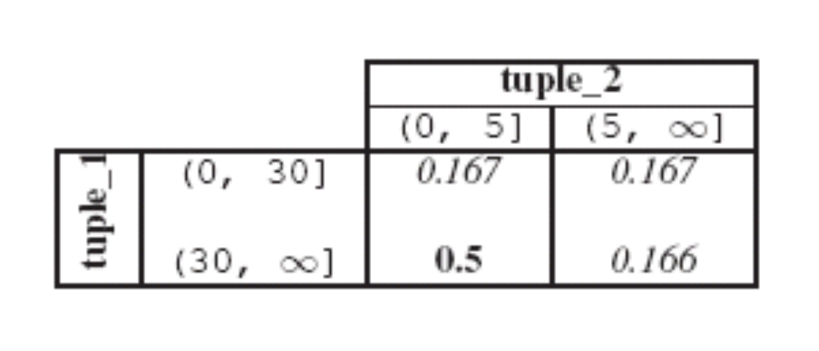
Sampling Lookup Table
Problem: Conditions may not be completely specified
Solution: Sampling budget lookup table
  Lookup table for allocating sampling “budget” to each class
Deduced values
# tuple definitions
tuple_1 := srcip.dstip
tuple_2 := srcip.srcport.dstport
# condition : sampling budget
tuple_1 in (30, inf] AND
tuple_2 in (0, 5]: 0.5
Next problem: Determining which condition each packet satisfies

Slide 22
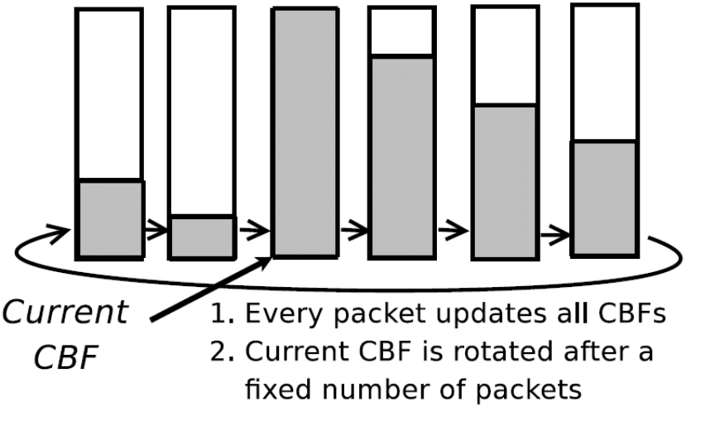
Counting Subpopulations
Each packet belongs to a particular range in n-dimensional space
Counts for each condition
  Maintain counter (counting Bloom filter) for each tuple in every subcondition
  Rotate counters to expunge “stale” values
Details:
1. Number of counters
2. How often to rotate

Slide 23
Deriving Instantaneous Sampling Rates
Problem: Traffic rates are dynamic
  Relative fractions of packets in each class may change
Solution: Count packets in each sampling class, and adjust probabilities to rebalance according to the lookup table
  Instantaneous rate =
  overall rate * (target rate) / (actual rate)
  Keep track of actual rate using Bloom filter array and EWMA

Slide 24
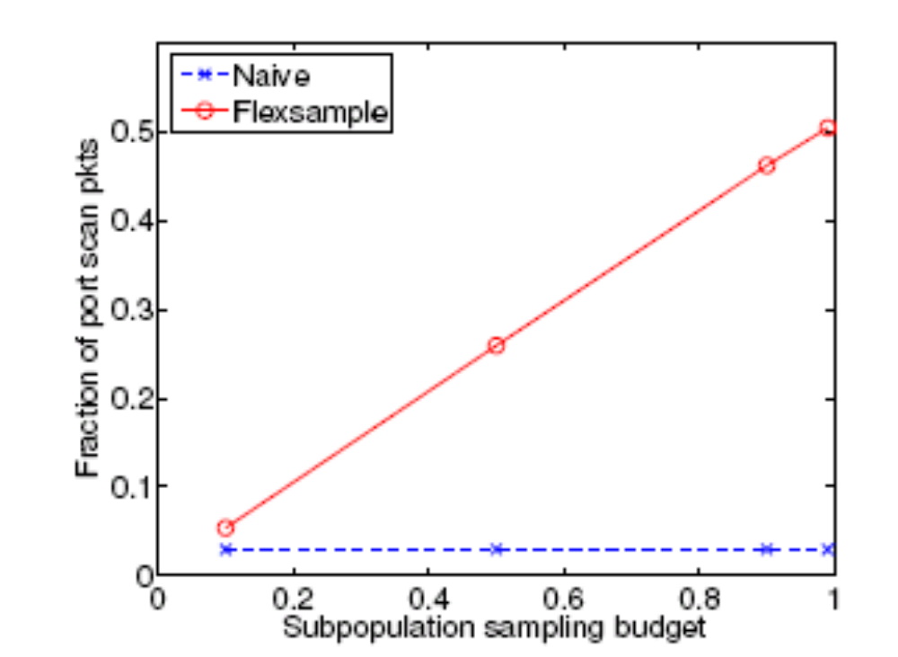
Example Evaluation: Portscan
Setup
Parameters as above
Nmap scan injected into ful one-hour trace from department network
Results
FlexSample can capture 10x more of the portscan packets if all sampling budget is allocated to portscan class
Bias can be configured

Slide 25
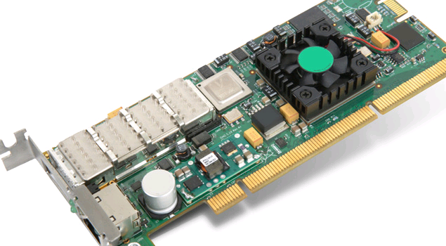
Packet Capture on High-Speed Links
Example: Georgia Tech “OC3Mon”
Rack-mounted PC
Optical splitter
Data Acquisition and Generation (DAG) card
Source: endace.com

Slide 26
Characteristics of Packet Capture
Allows inpsection on every packet on 10G links
Disadvantages
  Costly
  Requires splitting optical fibers
  Must be able to filter/store data

Slide 27
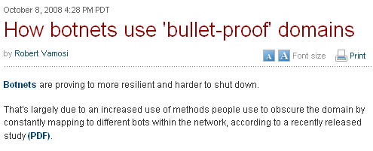
Online Scams
Often advertised in spam messages
URLs point to various point-of-sale sites
These scams continue to be a menace
  As of August 2007, one
  in every 87 emails constituted a phishing attack
Scams often hosted on bullet-proof domains
Problem: Study the dynamics of online scams, as seen at a large spam sinkhole

Slide 28
Online Scam Hosting is Dynamic
The sites pointed to by a URL that is received in an email message may point to different sites
Maintains agility as sites are shut down, blacklisted, etc.
One mechanism for hosting sites: fast flux

Slide 29
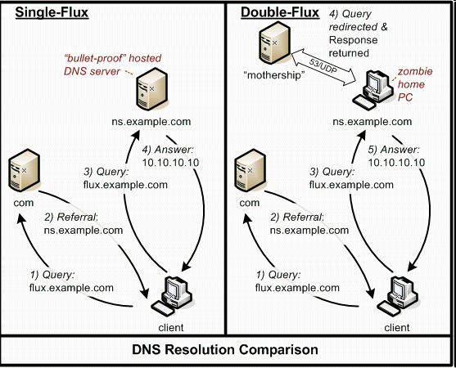
Overview of Dynamics
Source: HoneyNet Project

Slide 30
Why Study Dynamics?
Understanding
  What are the possible invariants?
  How many different scam-hosting sites are there?
Detection
  Today: Blacklisting based on URLs
  Instead: Identify the network-level behavior of a scam-hosting site

Slide 31
Summary of Findings
What are the rates and extents of change?
  Different from legitimate load balance
  Different cross different scam campaigns
How are dynamics implemented?
  Many scam campaigns change DNS mappings at all three locations in the DNS hierarchy
    A, NS, IP address of NS record
Conclusion: Might be able to detect based on monitoring the dynamic behavior of URLs

Slide 32
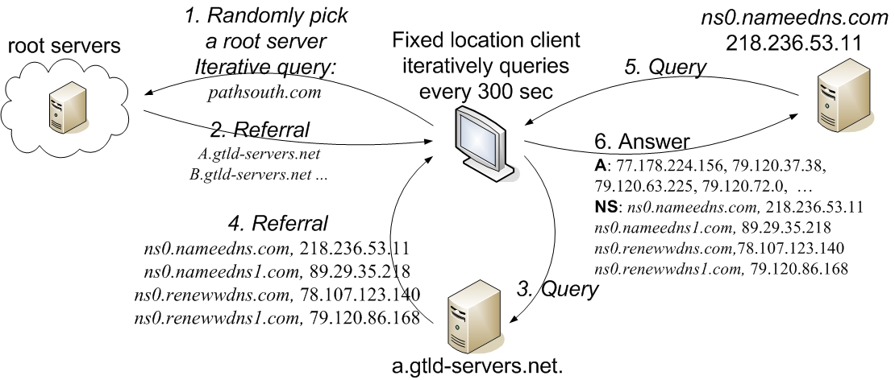
Data Collection
One month of email spamtrap data
  115,000 emails
  384 unique domains
  24 unique spam campaigns

Slide 33
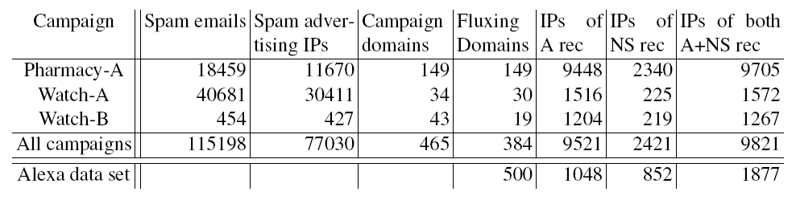
Top 3 Spam Campaigns
Some campaigns hosted by thousands of IPs
Most scam domains exhibit some type of flux
Sharing of IP addresses across different roles (authoritative NS and scam hosting)

Slide 34
Time Between Changes
How quickly do DNS-record mappings change?
Scam domains change on shorter intervals than their TTL values
Domains within the same campaign exhibit similar rates of change

Slide 35
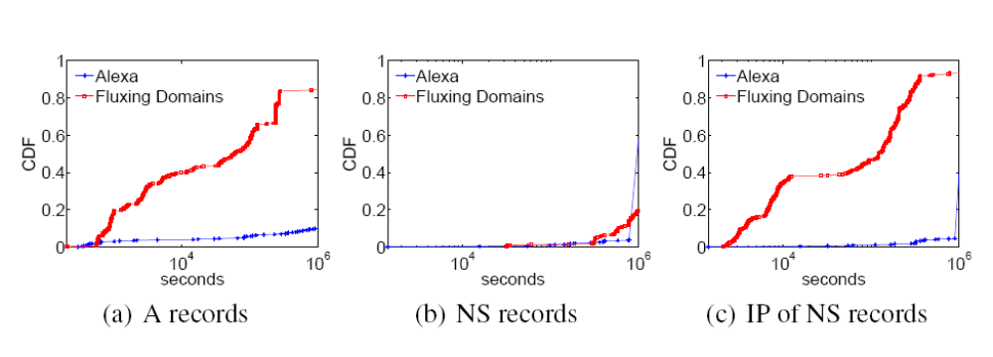
Rates of Change
Domains that exhibit fast flux change more rapidly than legitimate domains
Rates of change are inconsistent with actual TTL values

Slide 36
Rates of Accumulation
How quickly do scams accumulate new IP addresses?
Rates of accumulation differ across campaigns
Some scams only begin accumulating IP addresses after some time

Slide 37
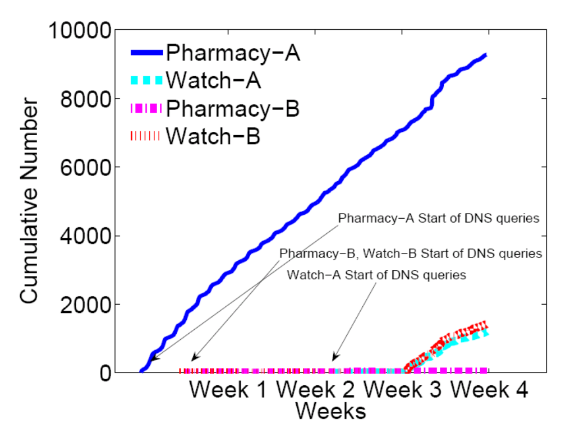
Rates of Accumulation

Slide 38
Location of Change in Hierarchy
Scam networks use a different portion of the IP address space than legitimate sites
  30/8 – 60/8 --- lots of legitimate sites, no scam sites
DNS lookups for scam domains are often more widely distributed than those for legitimate sites

Slide 39
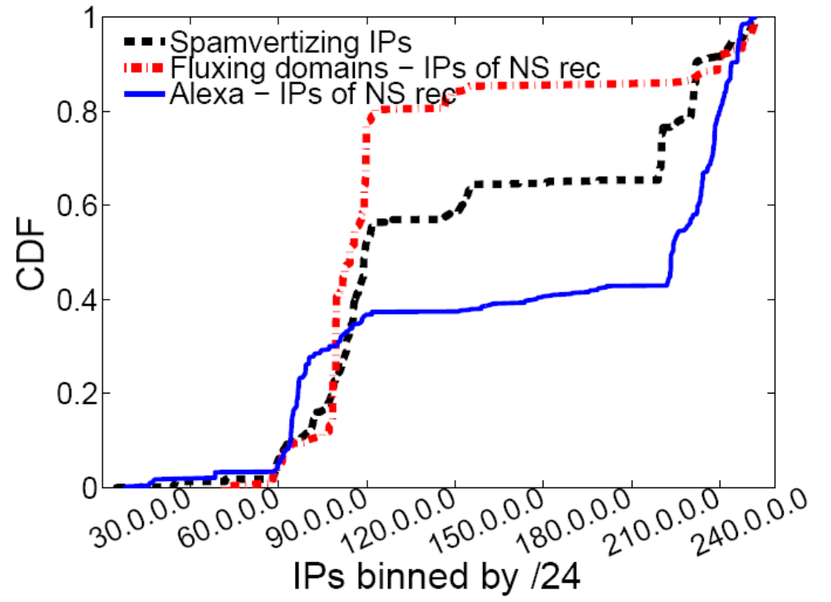
Location in IP Address Space
Scam campaign infrastructure is considerably more concentrated in the 80/8-90/8 range

Slide 40
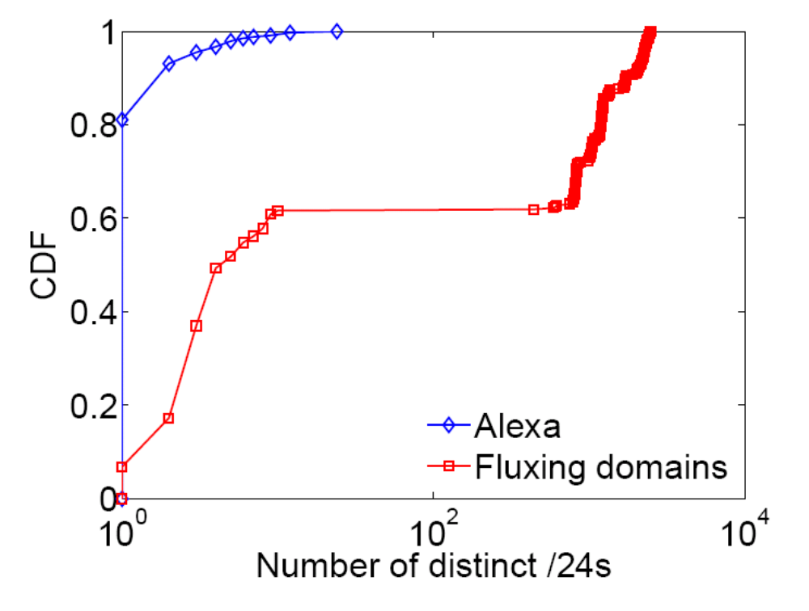
Distribution of DNS Records

Slide 41
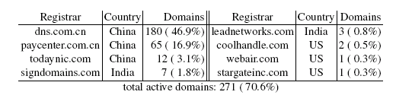
Registrars Involved in Changes
About 70% of domains still active are registered at eight domains
Three registrars responsible for 257 domains
(95% of those still marked as active)

Slide 42
Conclusion
Scam campaigns rely on a dynamic hosting infrastructure
Studying the dynamics of that infrastructure may help us develop better detection methods
Dynamics
  Rates of change differ from legitimate sites, and differ across campaigns
  Dynamics implemented at all levels of DNS hierarchy
Location
  Scam sites distributed more across IP address space
http://www.cc.gatech.edu/research/reports/GT-CS-08-07.pdf

