Slide 1
Authentication
Nick Feamster
CS 6262
Spring 2009

Slide 2
What is Authentication?
Reliably verifying the identity of someone (or something).
Examples
  Voice
  Pictures
  Mother’s maiden name
  Etc.

Slide 3
Authentication of People
What you know (passwords)
What you have (keys)
What you are (biometric devices)
Where you are (physical)

Slide 4
Password
Proof by knowledge, sharing
Password guessing
  On-line: limit tries, alarm
  Off-line: dictionary attack
Storing passwords
  Per-node: /etc/passwd
  Server: authentication storage server, retrieved by node (yp/NIS)
  Facilitator: server says yes/no

Slide 5
Address-based
.rhosts
  node, user name
/etc/hosts.equiv
  trusted hosts
Threats:
  break in one, break in all
  often: A trusts B, then B trusts A
  address spoofing

Slide 6
Humans and Computers
Humans:
  Short, memorable key (8 characters, 48 bits), directly or as key for longer key
  No need to store it
Computers:
  (Long) high-quality secret
  Hidden key (encrypted by password), directly (e.g., hash of the password)
  Need to store it

Slide 7
Eavesdropping and Server Database Reading
Public key
  Need to protect private key
Use good password
  Eavesdropping
Use random challenge with signing/encryption using secret
  Server database reading
Lamport hash

Slide 8
Lamport Hash
Alice knows password
Bob knows H^n(password), n
Bob sends n
Alice computes H^(n-1)(password)

Slide 9
Trusted Intermediaries
Can’t do pair-wise authentication with secret key: key explosion
Key distribution center (KDC)
  Single point of failure, performance bottleneck
Certification authorities (CAs)
  Can be off-line
  Single point of failure
  Need to manage revocation list (CRL)

Slide 10
Key Distribution Center
A wants to talk to B
  A gets gets random number “ticket” from KDC
  KDC does same thing to B

Slide 11
Key Distribution Centers
Simplifies key distribution
Drawbacks
  Can impersonate anyone to anyone
  Single point of failure
  Possible performance bottleneck

Slide 12
Trojan Horses
A faked login prompt to capture passwords
Countermeasures
  Make it hard to have the appearance of login prompt
  Use interrupts
  Prevent login by user programs

Slide 13
Authentication Tokens
What you have
Smart cards
  Challenge/response
Cryptographic calculator:
  Interaction through a user (typing ...)

Slide 14
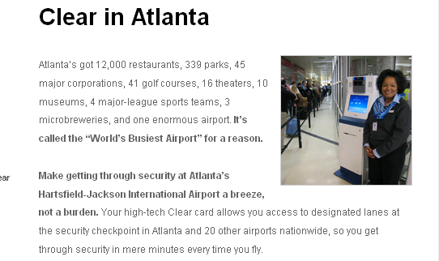
Biometrics
Accuracy:
  False acceptance
  False rejection
  Can adversary select imposters?
    Identical twins, family members, etc.
Retinal scanner, fingerprint reader, handprint reader, voiceprint, keystroke timing, signature.

Slide 15
Fingerprints
Vulnerability:
  Dummy fingers and dead fingers
Suitability and stability:
  Not for people with high probability of damaged fingerprints
  Not for kids growing up

Slide 16
Voice Recognition
Single phrase:
  Can use tape recorder to fake
Stability:
  Background noise
  Colds
  Use with public phones

Slide 17
Keystroke Timing
Each person has a distinct typing timing/style
  Hand/finger movements
Suitability:
  Best done for “local” authentication
    Avoid network traffic delay

Slide 18
Signatures
Machines can’t match human experts in recognizing shapes of signatures
Add information of timing (dynamics) of movements
  Signing or an electronic tablet

Slide 19
Authentication Protocols
Used to convince parties of each others identity and to exchange session keys
May be one-way or mutual
Issues are
  Confidentiality: to protect session keys
  Timeliness: to prevent replay attacks
Published protocols are often found to have flaws and need to be modified
Notes:
Authentication Protocols are used to convince parties of each others identity and to exchange session keys. They may be one-way or mutual.
Central to the problem of authenticated key exchange are two issues: confidentiality and timeliness. To prevent masquerade and to prevent compromise of session keys, essential identification and session key information must be communicated in encrypted form. This requires the prior existence of secret or public keys that can be used for this purpose. The second issue, timeliness, is important because of the threat of message replays.
Stallings discusses a number of protocols that appeared secure but were revised after additional analysis. These examples highlight the difficulty of getting things right in the area of authentication.

Slide 20
Authentication Applications
Authentication functions
  developed to support application-level authentication & digital signatures
will consider
  X.509 - a public-key directory authentication service
  Kerberos – a private-key authentication service
Notes:
This chapter examines some of the authentication functions that have been developed to support application-level authentication and digital signatures.
Will first look at one of the earliest and most widely used services: Kerberos. Then examine the X.509 directory authentication service.

Slide 21
Kerberos
Trusted key server system from MIT
Provides centralised private-key third-party authentication in a distributed network
  allows users access to services distributed through network
  without needing to trust all workstations
  rather all trust a central authentication server
Two versions in use: 4 & 5
Notes:
Kerberos is an authentication service developed as part of Project Athena at MIT, and is one of the best known and most widely implemented trusted third party key distribution systems.
Kerberos provides a centralized authentication server whose function is to authenticate users to servers and servers to users. Unlike most other authentication schemes, Kerberos relies exclusively on symmetric encryption, making no use of public-key encryption. Two versions of Kerberos are in common use: v4 & v5.

Slide 22
What Is Kerberos?
Recommended reading:
  http://web.mit.edu/kerberos/www/dialogue.html
Provide cryptographic authentication in network environment
  Enable secure access control of networked resources
  Relieve users/administrators the burden of managing potentially many accounts and passwords

Slide 23
Kerberos Requirements
Its first report identified requirements as:
  secure
  reliable
  transparent
  scalable
Implemented using an authentication protocol based on Needham-Schroeder
Notes:
The first published report on Kerberos [STEI88] listed the requirements shown above. To support these requirements, Kerberos is a trusted third-party authentication service that uses a protocol based on that proposed by Needham and Schroeder [NEED78], which was discussed in Chapter 7.

Slide 24
Kerberos Realms
A Kerberos environment consists of:
  a Kerberos server
  a number of clients, all registered with server
  application servers, sharing keys with server
This is called a realm
  typically a single administrative domain
  if have multiple realms, their Kerberos servers must share keys and trust
Notes:
A full-service Kerberos environment consisting of a Kerberos server, a number of clients, and a number of application servers is referred to as a Kerberos realm. A Kerberos realm is a set of managed nodes that share the same Kerberos database, and are part of the same administrative domain. If have multiple realms, their Kerberos servers must share keys and trust each other.

Slide 25
Kerberos v4 Overview
a basic third-party authentication scheme
have an Authentication Server (AS)
  users initially negotiate with AS to identify self
  AS provides a non-corruptible authentication credential (ticket granting ticket TGT)
have a Ticket Granting server (TGS)
  users subsequently request access to other services from TGS on basis of users TGT
Notes:
The core of Kerberos is the Authentication and Ticket Granting Servers – these are trusted by all users and servers and must be securely administered. The protocol includes a sequence of interactions between the client, AS, TGT and desired server.

Slide 26
Kerberos v4 Dialogue
Obtain ticket granting ticket from AS
  once per session
Obtain service granting ticket from TGT
  for each distinct service required
Client/server exchange to obtain service
  on every service request
Notes:
The full Kerberos v4 authentication dialogue is shown in Stallings Table 14.1, divided into the 3 phases shown above. The justification for each item in the messages is given in Stallings Table 14.2.

Slide 27
Tickets ...
Every principal has a main shared secret with the KDC - principal’s master key
Any secure communication/access among principals must be “mediated” by KDC through tickets
How would Alice talk to Bob?

Slide 28
Example: Alice, Bob, and KDC
KDC
2
1
K_{A}{K_{AB}, K_{B}{K_{AB}, “Alice”,...}}
Alice
3
Bob
Ticket to Bob: K_{B}{K_{AB}, “Alice”,...}

Slide 29
Session Key and Ticket-Granting Ticket (TGT)
Messages between a host and the KDC can be protected using the principal’s master key
For every request to KDC from the principal:
  Insists on principal retyping in the password
  Remember the principal’s password
  Remember the principal’s master key derived from the password
  All options are equally inadequate!

Slide 30
Session Key and TGT...
To avoid potentially too much exposure to password/master key
  At initial login, a per-principal session key S_{B} (for Bob) is requested from KDC
  S_{B} has a limited valid time period
  A TGT for Bob is also issued by the KDC, which includes the session key S_{B} and Bob’s identification information, all encrypted using the KDC’s master key

Slide 31
Session Key and TGT...
Bob’s Kerberos client (e.g., the login host) decrypts and remembers:
  S_{B}, for subsequent message with KDC
  TGT, for reminding/convincing KDC to use S_{B} with it as well
  No need for remembering/storing password
New request to KDC must include TGT in the request message
New tickets from KDC must be decrypted with S_{B}

Slide 32
Login
1.
<Bob,passwd>
2. AS_REQ
3. create S_{B}
and TGT_{B} =
K_{KDC}{Bob, S_{B} }
Bob
Bob’s
Local
Host
KDC
5. local host
decrypts and
saves S_{B} and
TGT_{B}
4. AS_REP
K_{B}{S_{B} ,TGT_{B}}

Slide 33
Obtaining a Ticket for a Service
2. TGS_REQ
[access to hp1,
TGT_{B}, S_{B}{timestamp}]
1.
“lpr -Php1”
Bob
Bob’s
Local
Host
3. create K_{BP}
decrypt TGT_{B}
verify authenticator
generate Ticket to printer for Bob:
T_{P} = K_{P}{Bob,K_{BP}}
KDC
5. local host
decrypts and
obtaining service
using K_{BP} & T_{P}
4. TGS_REP
S_{B}{Bob, K_{BP}, T_{P}}
Notes:
Signed timestamp is authoenticator.
Authenticator has a short lifetyime

Slide 34
Accessing the Service
1. AP_REQ
[T_{P},
K_{BP}{timestamp}]
Bob
Bob’s
Local
Host
2. decrypt T_{P} for
K_{BP}
verify authenticator
Printer Server
3. AP_REP
K_{BP}{timestamp+1}

Slide 35
Authentication and Global Clock Synchronization
Authenticator == K_{X}{timestamp}
Global clock sync is implied
Is the authenticator for TGS_REQ necessary?
What about the AP_REQ?
Main purposes of authenticator is to avoid
  replay of old requests to the same server
  replay of request on one server to another (server farm, shared principal’s master key)

Slide 36
Will It Be Effective?
KDC dynamic state consists of outstanding TGTs and tickets.
Kerberos puts the burden of “maintaining” them on the clients - hosts/servers/grantees.
  Convince me that I did this for you...
KDC is only involved in the initial “mediation” and it stays “out of the picture” once a ticket is issued.
Only static state information is principals’ database - read only for all replica KDCs.

Slide 37
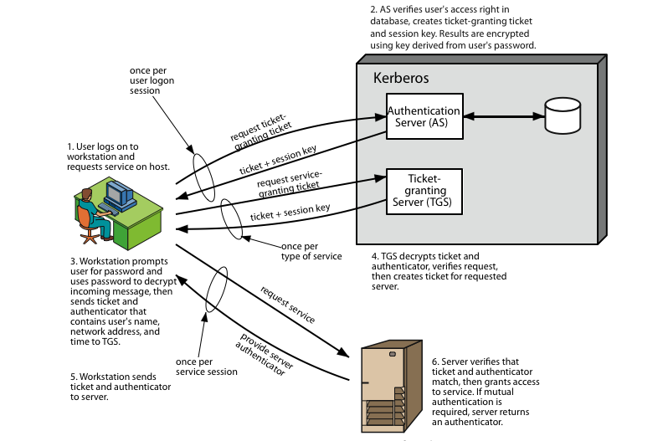
Kerberos 4 Overview
Notes:
Stallings Figure 14.1 diagrammatically summarizes the Kerberos v4 authentication dialogue, with 3 pairs of messages, for each phase listed previously.

Slide 38
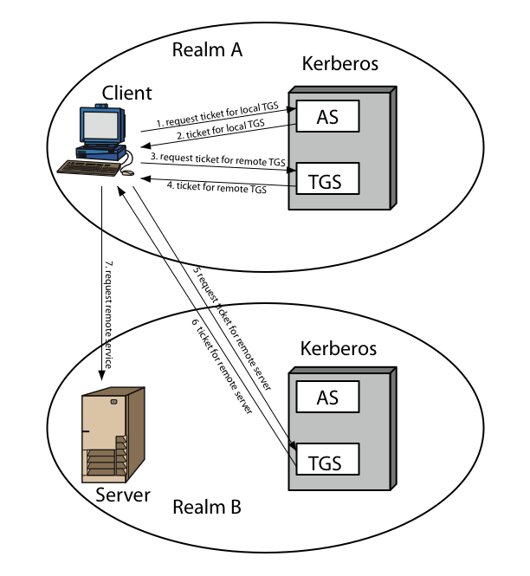
Kerberos Realms
Notes:
Stallings Figure 14.2 shows the authentication messages where service is being requested from another domain. The ticket presented to the remote server indicates the realm in which the user was originally authenticated. The server chooses whether to honor the remote request. One problem presented by the foregoing approach is that it does not scale well to many realms, as each pair of realms need to share a key.

Slide 39
Kerberos Version 5
developed in mid 1990’s
specified as Internet standard RFC 1510
provides improvements over v4
  addresses environmental shortcomings
    encryption alg, network protocol, byte order, ticket lifetime, authentication forwarding, interrealm auth
  and technical deficiencies
    double encryption, non-std mode of use, session keys, password attacks
Notes:
Kerberos Version 5 is specified in RFC 1510 and provides a number of improvements over version 4 in the areas of environmental shortcomings and technical deficiencies, in areas as noted. See Stallings Table 14.3 for details of the Kerberos v5 authentication dialogue.

Slide 40
X.509 Authentication Service
Distributed servers maintaining user info database
Defines framework for authentication services
  directory may store public-key certificates
  with public key of user signed by certification authority
also defines authentication protocols
uses public-key crypto & digital signatures
  algorithms not standardised, but RSA recommended
X.509 certificates are widely used
Notes:
X.509 is part of the X.500 series of recommendations that define a directory service, being a server or distributed set of servers that maintains a database of information about users.
X.509 defines a framework for the provision of authentication services by the X.500 directory to its users. The directory may serve as a repository of public-key certificates. In addition, X.509 defines alternative authentication protocols based on the use of public-key certificates. X.509 is based on the use of public-key cryptography and digital signatures. The standard does not dictate the use of a specific algorithm but recommends RSA.
The X.509 certificate format is widely used, in for example S/MIME, IP Security and SSL/TLS and SET.

Slide 41
X.509 Certificates
issued by a Certification Authority (CA), containing:
  version (1, 2, or 3)
  serial number (unique within CA) identifying certificate
  signature algorithm identifier
  issuer X.500 name (CA)
  period of validity (from - to dates)
  subject X.500 name (name of owner)
  subject public-key info (algorithm, parameters, key)
  issuer unique identifier (v2+)
  subject unique identifier (v2+)
  extension fields (v3)
  signature (of hash of all fields in certificate)
notation CA<<A>> denotes certificate for A signed by CA
Notes:
The X.509 certificate is the heart of the standard. There are 3 versions, with successively more info in the certificate - must be v2 if either unique identifier field exists, must be v3 if any extensions are used. These user certificates are assumed to be created by some trusted certification authority (CA) and placed in the directory by the CA or by the user. The directory server itself is not responsible for the creation of public keys or for the certification function; it merely provides an easily accessible location for users to obtain certificates. The certificate includes the elements shown.
The standard uses the notation for a certificate of: CA<<A>> where the CA signs the certificate for user A with its private key.

Slide 42
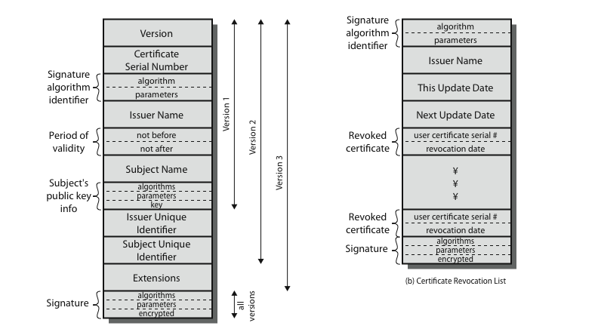
X.509 Certificates
Notes:
Stallings Figure 14.4 shows the format of an X.509 certificate and CRL.

Slide 43
Obtaining a Certificate
Any user with access to CA can get any certificate from it
Only the CA can modify a certificate
Because cannot be forged, certificates can be placed in a public directory
Notes:
User certificates generated by a CA have the characteristics that any user with access to the public key of the CA can verify the user public key that was certified, and no party other than the certification authority can modify the certificate without this being detected. Because certificates are unforgeable, they can be placed in a directory without the need for the directory to make special efforts to protect them.

Slide 44
CA Hierarchy
If both users share a common CA then they are assumed to know its public key
Otherwise CA's must form a hierarchy
Use certificates linking members of hierarchy to validate other CA's
  each CA has certificates for clients (forward) and parent (backward)
Each client trusts parents certificates
Enable verification of any certificate from one CA by users of all other CAs in hierarchy
Notes:
If both parties use the same CA, they know its public key and can verify others certificates. If not, then there has to be some means to form a chain of certifications between the CA's used by the two parties, by the use of client and parent certificates. It is assumed that each client trusts its parents certificates.

Slide 45
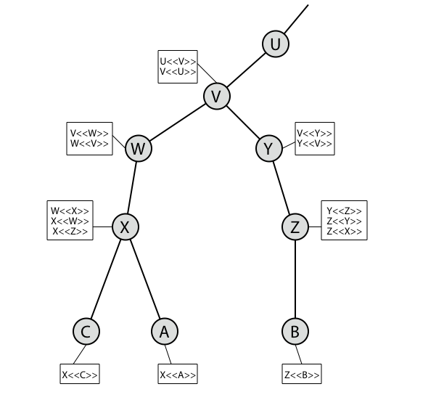
CA Hierarchy Use
Notes:
Stallings Figure 14.5 illustrates the use of an X.509 hierarchy to mutually verify clients certificates.
Track chains of certificates:
A acquires B certificate using chain: X<<W>>W<<V>>V<<Y>>Y<<Z>>Z<<B>>
B acquires A certificate using chain: Z<<Y>>Y<<V>>V<<W>>W<<X>>X<<A>>

Slide 46
Certificate Revocation
certificates have a period of validity
may need to revoke before expiry, eg:
  user's private key is compromised
  user is no longer certified by this CA
  CA's certificate is compromised
CA’s maintain list of revoked certificates
  the Certificate Revocation List (CRL)
users should check certificates with CA’s CRL
Notes:
A certificate includes a period of validity. Typically a new certificate is issued just before the expiration of the old one.
In addition, it may be desirable on occasion to revoke a certificate before it expires, for one of a range of reasons, such as those shown above.
To support this, each CA must maintain a list consisting of all revoked but not expired certificates issued by that CA, known as the certificate revocation list (CRL).
When a user receives a certificate in a message, the user must determine whether the certificate has been revoked, by checking the directory CRL each time a certificate is received, this often does not happen in practice.

Slide 47
Authentication Procedures
X.509 includes three alternative authentication procedures:
One-Way Authentication
Two-Way Authentication
Three-Way Authentication
all use public-key signatures
Notes:
X.509 also includes three alternative authentication procedures that are intended for use across a variety of applications, used when obtaining and using certificates. 1-way for unidirectional messages (like email), 2-way for interactive sessions when timestamps are used, 3-way for interactive sessions with no need for timestamps (and hence synchronised clocks). See Stallings Figure 14.6 for details of each of these alternatives.

Slide 48
One-Way Authentication
1 message ( A->B) used to establish
  the identity of A and that message is from A
  message was intended for B
  integrity & originality of message
message must include timestamp, nonce, B's identity and is signed by A
may include additional info for B
  eg session key
Notes:
One way authentication involves a single transfer of information from one user (A) to another (B), and establishes the details shown above. Note that only the identity of the initiating entity is verified in this process, not that of the responding entity. At a minimum, the message includes a timestamp ,a nonce, and the identity of B and is signed with A’s private key. The message may also include information to be conveyed, such as a session key for B.

Slide 49
Two-Way Authentication
2 messages (A->B, B->A) which also establishes in addition:
  the identity of B and that reply is from B
  that reply is intended for A
  integrity & originality of reply
reply includes original nonce from A, also timestamp and nonce from B
may include additional info for A
Notes:
Two-way authentication thus permits both parties in a communication to verify the identity of the other, thus additionally establishing the above details. The reply message includes the nonce from A, to validate the reply. It also includes a timestamp and nonce generated by B, and possible additional information for A.

Slide 50
Three-Way Authentication
3 messages (A->B, B->A, A->B) which enables above authentication without synchronized clocks
has reply from A back to B containing signed copy of nonce from B
means that timestamps need not be checked or relied upon
Notes:
Three-Way Authentication includes a final message from A to B, which contains a signed copy of the nonce, so that timestamps need not be checked, for use when synchronized clocks are not available.

