Slide 1
Web Security COS 432: Information Security
Nick Feamster

Slide 2
What is SSL/TLS?
Transport Layer Security protocol, version 1.2
De facto standard for Internet security
“The primary goal of the TLS protocol is to provide privacy and data integrity between two communicating applications”
In practice, used to protect information transmitted between browsers and Web servers
Based on Secure Sockets Layers protocol, v. 3.0
Same protocol design, different algorithms
Deployed in nearly every Web browser

Slide 3
Application-Level Protection
email, Web, NFS
application
presentation
Protects against application-level threats (e.g., server impersonation), NOT against IP-level threats (spoofing, SYN flood, DDoS by data flood)
RPC
session
TCP
transport
IP
network
802.11
data link
physical

Slide 4
History of the Protocol
SSL 1.0
Internal Netscape design, early 1994?
Lost in the mists of time
SSL 2.0
Published by Netscape, November 1994
Several weaknesses
SSL 3.0
Designed by Netscape and Paul Kocher, November 1996
TLS 1.0
Internet standard based on SSL 3.0, January 1999
Not interoperable with SSL 3.0
TLS uses HMAC instead of MAC; can run on any port

Slide 5
Request for Comments
Network protocols are usually disseminated in the form of an RFC (https://www.ietf.org/rfc/)
TLS version 1.0 is described in RFC 2246
Intended to be a self-contained definition of the protocol
Describes the protocol in sufficient detail for readers who will be implementing it and those who will be doing protocol analysis
Mixture of informal prose and pseudo-code

Slide 6
TLS Basics
TLS consists of two protocols
Familiar pattern for key exchange protocols
Handshake protocol
Use public-key cryptography to establish a shared secret key between the client and the server
Record protocol
Use the secret key established in the handshake protocol to secure communication between client and server
Notes:
We will focus on the handshake protocol

Slide 7
SSL Protocol Architecture
SSL Handshake Protocol
SSL Change Cipher Spec Protocol
SSL Alert Protocol
HTTP, other apps
SSL Record Protocol
TCP

Slide 8
TLS Handshake Protocol
Two parties: client and server
Negotiate version of the protocol and the set of cryptographic algorithms to use
Ensure interoperability between different implementations of the protocol
Authenticate server and (optionally) client
Use digital certificates to learn each other’s public keys and verify each other’s identity
Use public keys to establish a shared secret

Slide 9
Handshake Protocol Structure
ClientHello
S
C
ServerHello,
[Certificate],
[ServerKeyExchange],
[CertificateRequest],
ServerHelloDone
[Certificate],
ClientKeyExchange,
[CertificateVerify]
Finished
switch to negotiated cipher
switch to negotiated cipher
Record of all sent and
received handshake messages
Finished

Slide 10
ClientHello
ClientHello
S
C
Client announces (in plaintext):
Protocol version it is running
Cryptographic algorithms it supports

Slide 11
ClientHello (RFC 5246)
Highest version of the protocol supported by the client
struct {
ProtocolVersion client_version;
Random random;
SessionID session_id;
CipherSuite cipher_suites;
CompressionMethod compression_methods;
} ClientHello
Session id (if the client wants to resume an old session)
Set of cryptographic algorithms supported by the client (e.g., RSA or Diffie-Hellman)
Notes:
https://tools.ietf.org/html/rfc5246

Slide 12
ServerHello
Version_{c}, suite_{c}, N_{c}
S
C
ServerHello
Server responds (in plaintext) with:
Highest protocol version supported by
both client and server
Strongest cryptographic suite selected
from those offered by the client

Slide 13
ServerKeyExchange
Version_{c}, suite_{c}, N_{c}
S
C
Version_{s}, suite_{s}, N_{s},
ServerKeyExchange
Server sends his public-key certificate
containing either its RSA, or
Diffie-Hellman public key
(depending on chosen crypto suite)

Slide 14
ClientKeyExchange
Version_{c}, suite_{c}, N_{c}
S
C
Version_{s}, suite_{s}, N_{s},
sig_{ca}(S,K_{s}),
“ServerHelloDone”
ClientKeyExchange
Client generates some secret key material
and sends it to the server encrypted with
the server’s public key (if using RSA)

Slide 15
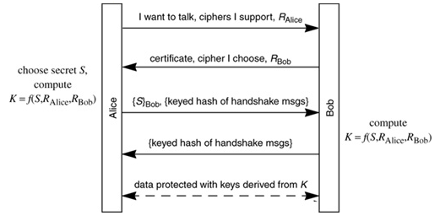
“Core” SSL 3.0 Handshake
The reading shows the above protocol which is the same as the protocol in the previous slide. Find out the correspondence between the different notations that denote the same thing in these two protocols.

Slide 16
“Core” SSL 3.0 Handshake
Version_{c}=3.0, suite_{c}, N_{c}
C
S
Version_{s}=3.0, suite_{s}, N_{s},
sig_{ca}(S,K_{s}),
“ServerHelloDone”
{Secret_{c}}_{Ks}
If the protocol is correct, C and S share
some secret key material (secret_{c}) at this point
switch to key derived
from secret_{c}, N_{c}, N_{s}
switch to key derived
from secret_{c}, N_{c}, N_{s}

Slide 17
Version Downgrade Attack
Version_{c}=2.0, suite_{c}, N_{c}
S
C
Server is fooled into thinking it communicating with a client who supports only SSL 2.0
Version_{s}=2.0, suite_{s}, N_{s},
sig_{ca}(S,K_{s}),
“ServerHelloDone”
{Secret_{c}}_{Ks}
C and S end up communicating using SSL 2.0
(weaker earlier version of the protocol that
does not include “Finished” messages)

Slide 18
SSLv2 Weaknesses (Fixed in SSLv3)
Downgrade attack
Cipher suite preferences are not authenticated
“Cipher suite rollback” attack is possible
Truncation attack
Weak MAC construction
MAC hash uses only 40 bits in export mode
Notes:
No support for certificate chains or non-RSA algorithms, no handshake while session is open

Slide 19
“Chosen-Protocol” Attacks
Why do people release new versions of security protocols?
New version must be backwards-compatible
Not everybody upgrades right away
Attacker can fool parties into using the old, broken version and exploit known vulnerability
Similar: fool victim into using weak crypto algorithms
Defense is hard: must authenticate version early
Many protocols had “version rollback” attacks
SSL, SSH, GSM (cell phones)

Slide 20
Version Check in SSL v3
Version_{c}=3.0, suite_{c}, N_{c}
S
C
Version_{s}=3.0, suite_{s}, N_{s},
sig_{ca}(S,K_{s}),
“ServerHelloDone”
“Embed” version number into secret
Check that received version is equal to the version in ClientHello
{Version_{c},Secret_{c}}_{Ks}
If the protocol is correct, C and S share
some secret key material secret_{c} at this point
switch to key derived
from secret_{c}, N_{c}, N_{s}
switch to key derived
from secret_{c}, N_{c}, N_{s}

Slide 21
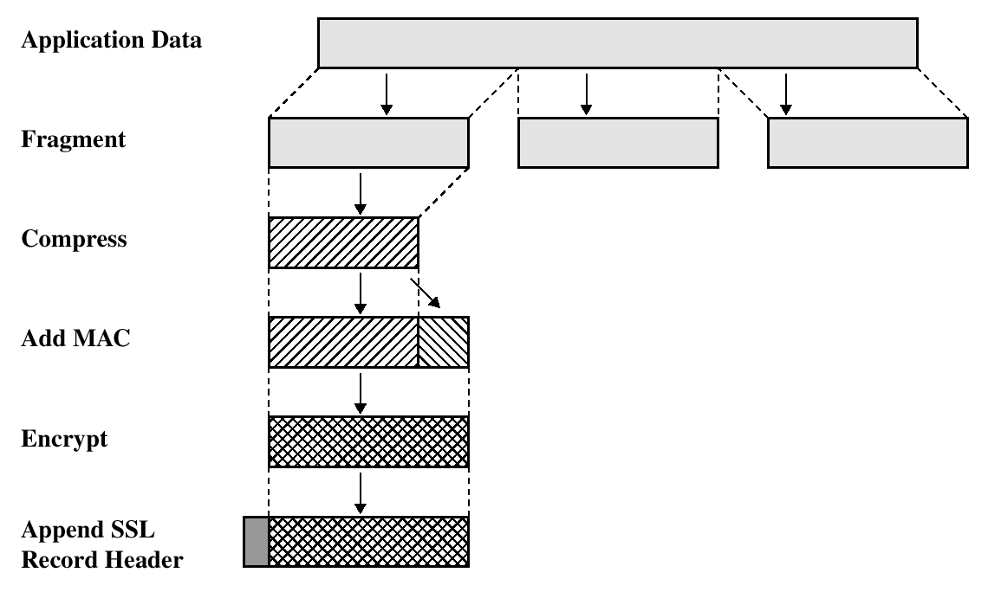
SSL/TLS Record Protection
Use symmetric keys
established in handshake protocol

Slide 22
SSL Handshake Protocol: Additional Features
SSL Handshake Protocol supports session resumption and ciphersuite re-negotiation.
Allows authentication and shared secrets to be reused across multiple connections.
Eg, next webpage from same website.
Allows re-keying of current connection using fresh nonces.
Allows change of ciphersuite during session.
ClientHello quotes old SessionID.
Both sides contribute new nonces, update secret_{c.}
All protected by existing Record Protocol.

Slide 23
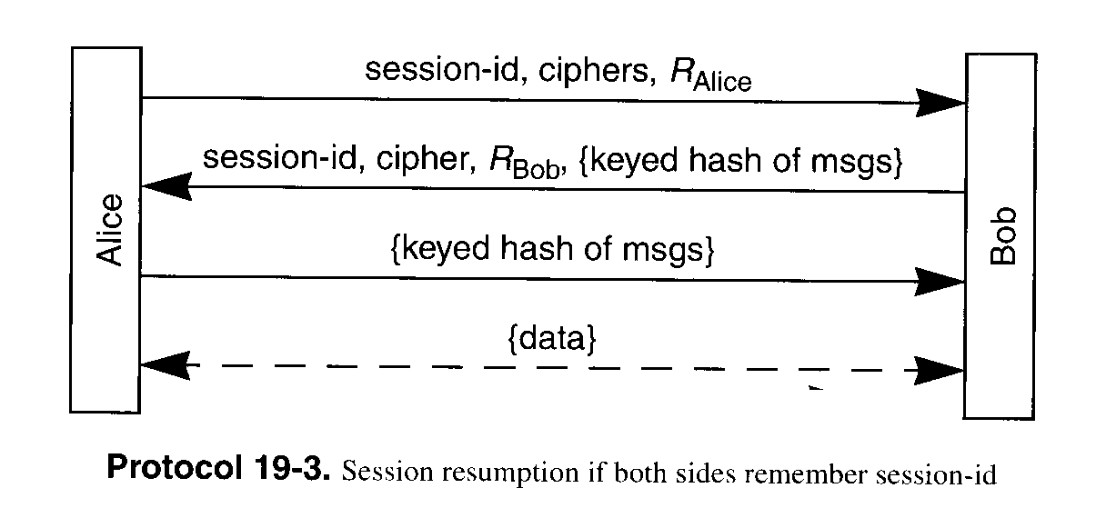
Session Resumption
Avoid public key operation if both sides remember session ID

Slide 24
Some SSL/TLS Security Flaws
(Historical) flaws in random number generation for SSL
Low quality RNG leads to predictable session keys.
Goldberg and Wagner, Dr. Dobb’s Journal, Jan. 1996.
Flaws in error reporting
(differing response times by server in event of padding failure and MAC failure) + (analysis of padding method for CBC-mode) = recovery of SSL plaintext.
Canvel, Hiltgen, Vaudenay and Vuagnoux, Crypto2003.
Timing attacks
analysis of OpenSSL server response times allows attacker in same LAN segment to derive server’s private key!
Boneh and Brumley, 12th Usenix Security Symposium.

Slide 25


Slide 26
TLS Heartbeat Extension
DTLS is designed to secure traffic running on top of unreliable
transport protocols. Usually, such protocols have no session
management. The only mechanism available at the DTLS layer to figure
out if a peer is still alive is a costly renegotiation, particularly
when the application uses unidirectional traffic. Furthermore, DTLS
needs to perform path MTU (PMTU) discovery but has no specific
message type to realize it without affecting the transfer of user
messages.
TLS is based on reliable protocols, but there is not necessarily a
feature available to keep the connection alive without continuous
data transfer.
The Heartbeat Extension as described in this document overcomes these
limitations. The user can use the new HeartbeatRequest message,
which has to be answered by the peer with a HeartbeartResponse
immediately.

Slide 27
OpenSSL “Heartbleed” Bug
Announced April 2014.
Exploits a programming mistake in the OpenSSL implementation of the TLS ``heartbeat hello’’ extension.
Heartbeat protocol is used to keep a TLS connection alive without continuously transferring data.
One endpoint (e.g., a Web browser) sends a HeartbeatRequest message containing a payload to the other endpoint (e.g. a Web server). The server then sends back a HeartbeatReply message containing the same payload.
“Buffer over-read” error caused by a failure to check for an invalid read-length parameter.

Slide 28
From RFC 6520
Heartbeat Request and Response Messages
The Heartbeat protocol messages consist of their type and an arbitrary
payload and padding.
struct {
HeartbeatMessageType type;
uint16 payload_length;
opaque payload[HeartbeatMessage.payload_length];
opaque padding[padding_length];
} HeartbeatMessage;
The total length of a HeartbeatMessage MUST NOT exceed 2^14 or
max_fragment_length when negotiated as defined in [RFC6066].
type: The message type, either heartbeat_request or heartbeat_response.
payload_length: The length of the payload.
payload: The payload consists of arbitrary content.
padding: The padding is random content that MUST be ignored by the receiver.
Problem: no check that payload_length matches the actual length of the payload

Slide 29
Browser Security
Goal: Prevent a malicious site from spying on or tampering with (1) my information or (2) interactions with other websites
Browsing to evil.com should not let evil.com spy on my emails in Gmail or buy stuff with my Amazon account
Defense: the same-origin policy
A security policy grafted on after-the-fact, and enforced by web browsers
Intuition: each web site is isolated from all others

Slide 30
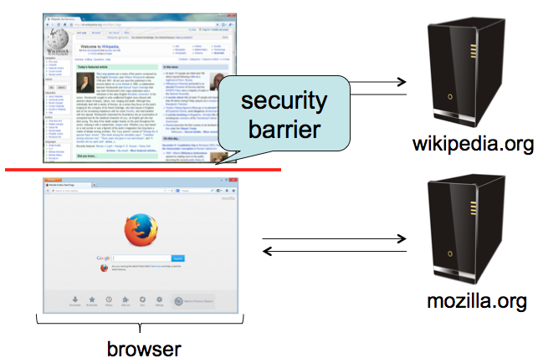
Same-Origin policy
Each site is isolated from all others

Slide 31
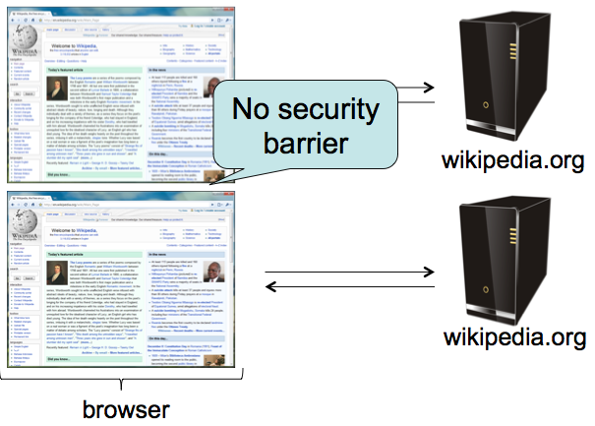
Same-Origin Policy
Multiple pages from same site aren’t isolated

Slide 32
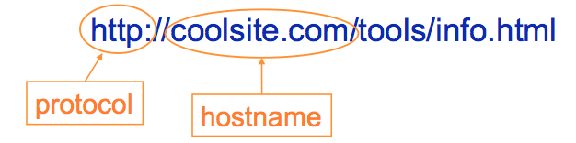
Same-Origin Policy
Granularity of protection: the origin
Origin = protocol + hostname + port
Javascript on one page can read, change, and interact freely with all other pages from the same origin

Slide 33
Same-Origin Policy
Browsers provide isolation for JS scripts via the Same Origin Policy (SOP)
Simple version:
Browser associates web page elements (layout, cookies, events) with a given origin ≈ web server that provided the page/cookies in the first place
Identity of web server is in terms of its hostname, e.g., bank.com
SOP = only scripts from a web page’s origin have access to page’s elements
XSS: Subverting the Same Origin Policy

Slide 34
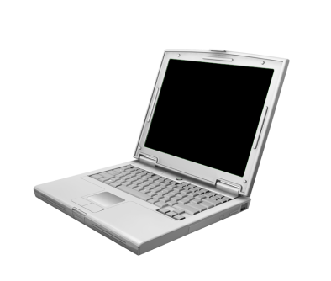




Web Overview (HTTP)
GET / HTTP/1.1 Host: gmail.com
HTTP/1.1 200 OK … <html>
<head>
<script>alert(‘Hi!’)</script>
</head>
<img src=“//gmail.com/img.png”/>
http://gmail.com/ says: Hi!
gmail.com
GET /img.png HTTP/1.1 Host: gmail.com
HTTP/1.1 200 OK … <89>PNG^M ...
Notes:
Fetching image, not script

Slide 35

AJAX (jQuery Style)
GET / HTTP/1.1 Host: gmail.com
HTTP/1.1 200 OK …
<script> $.get(‘http://gmail.com/msgs.json’, function (data) { alert(data) }); </script>
http://gmail.com/ says: { new_msgs: 3}
gmail.com
$.get(‘http://gmail.com/msgs.json’, function (data) { alert(data) });
GET /msgs.json HTTP/1.1 Host: gmail.com
HTTP/1.1 200 OK … { new_msgs: 3 }
Notes:
Fetching and executing script from same origin

Slide 36



Same-Origin Policy: Scripts
(evil!) facebook.com
GET / HTTP/1.1 Host: facebook.com
HTTP/1.1 200 OK … <script> $.get(‘http://gmail.com/msgs.json’,
function (data) { alert(data); }
</script>
$.get(‘http://gmail.com/msgs.json’,
function (data) { alert(data); }
GET /msgs.json HTTP/1.1 Host: gmail.com
gmail.com
HTTP/1.1 200 OK … { new_msgs: 3 }
Notes:
Trying to execute script from different origin.
XMLHttpRequest cannot load https://gmail.com/. No 'Access-Control-Allow-Origin' header is present on the requested resource. Origin 'null' is therefore not allowed access.

Slide 37
Same-Origin Policy: Objects
GET / HTTP/1.1 Host: facebook.com
facebook.com
HTTP/1.1 200 OK … <img src=“http://gmail.com/img.png”/>
?
gmail.com
Notes:
Not a script, just an image: OK.

Slide 38

Same-Origin Policy: Images
GET / HTTP/1.1 Host: facebook.com
facebook.com
HTTP/1.1 200 OK … <img src=“http://gmail.com/img.png”/>
GET /img.png HTTP/1.1 Host: gmail.com
gmail.com
HTTP/1.1 200 OK … <89>PNG^M ...
Notes:
XMLHttpRequest cannot load https://gmail.com/. No 'Access-Control-Allow-Origin' header is present on the requested resource. Origin 'null' is therefore not allowed access.

Slide 39
Same-Origin Policy: <script>
GET / HTTP/1.1 Host: facebook.com
facebook.com
HTTP/1.1 200 OK … <script src=“http://gmail.com/chat.js”/>
?
gmail.com
Notes:
XMLHttpRequest cannot load https://gmail.com/. No 'Access-Control-Allow-Origin' header is present on the requested resource. Origin 'null' is therefore not allowed access.

Slide 40

Same-Origin Policy: <script>
GET / HTTP/1.1 Host: facebook.com
facebook.com
HTTP/1.1 200 OK … <script src=“http://gmail.com/chat.js”/>
$.get(‘http://gmail.com/chat.json’, function (data) { alert(data); })
GET /chat.js HTTP/1.1 Host: gmail.com
gmail.com
HTTP/1.1 200 OK … $.get(‘http://gmail.com/chat.json’, function (data) { alert(data); })
Notes:
XMLHttpRequest cannot load https://gmail.com/. No 'Access-Control-Allow-Origin' header is present on the requested resource. Origin 'null' is therefore not allowed access.

Slide 41
Same-Origin Policy: <script>
gmail.com
$.get(‘http://gmail.com/chat.json’, function (data) { alert(data); })
GET /chat.json HTTP/1.1 Host: gmail.com
HTTP/1.1 200 OK … { new_msg: { from: “Bob”, msg: “Hi!”}}
Notes:
XMLHttpRequest cannot load https://gmail.com/. No 'Access-Control-Allow-Origin' header is present on the requested resource. Origin 'null' is therefore not allowed access.

Slide 42
Same-Origin Policy: IFrame
GET / HTTP/1.1 Host: facebook.com
facebook.com
HTTP/1.1 200 OK … <iframe src=“http://gmail.com/chat”/>
?
gmail.com
Notes:
XMLHttpRequest cannot load https://gmail.com/. No 'Access-Control-Allow-Origin' header is present on the requested resource. Origin 'null' is therefore not allowed access.

Slide 43

Same-Origin Policy: IFrame
GET / HTTP/1.1 Host: facebook.com
facebook.com
$.get(‘http://gmail.com/chat.json’, function (data) { alert(data); })
HTTP/1.1 200 OK … <iframe src=“http://gmail.com/chat”/>
GET /chat HTTP/1.1 Host: gmail.com
gmail.com
HTTP/1.1 200 OK … <script> $.get(‘http://gmail.com/chat.json/’, function (data) { alert(data); }); </script>
Notes:
XMLHttpRequest cannot load https://gmail.com/. No 'Access-Control-Allow-Origin' header is present on the requested resource. Origin 'null' is therefore not allowed access.

Slide 44
Same-Origin Policy
http://gmail.com/ says: { new_msgs: { from: “Bob”, msg: “Hi!”}}
gmail.com
$.get(‘http://gmail.com/chat.json’, function (data) { alert(data); })
GET /chat.json HTTP/1.1 Host: gmail.com
HTTP/1.1 200 OK … { new_msg: { from: “Bob”, msg: “Hi!”}}
Notes:
XMLHttpRequest cannot load https://gmail.com/. No 'Access-Control-Allow-Origin' header is present on the requested resource. Origin 'null' is therefore not allowed access.

Slide 45
Code Injection
<?php
echo system(“ls ” . $_GET[“path”]);
GET /?path=/home/user/ HTTP/1.1
HTTP/1.1 200 OK … Desktop
Documents
Music
Pictures

Slide 46

Code Injection
<?php
echo system(“ls ” . $_GET[“path”]);
GET /?path=$(rm –rf /) HTTP/1.1
<?php
echo system(“ls $(rm –rf /)”);

Slide 47
Code Injection
<?php
echo system(“ls $(rm –rf /)”);
Confusing Data and Code
Programmer thought user would supply data, but instead got (and unintentionally executed) code
Common and dangerous class of vulnerabilities
Shell Injection
SQL Injection
Cross-Site Scripting (XSS)
Control-flow Hijacking (Buffer overflows)

Slide 48
SQL: Structured Query Language
Language to ask (“query”) databases questions:
How many users live in Princeton?
“SELECT COUNT(*) FROM `users` WHERE location = ‘Princeton’”
Is there a user with username “bob” and password “abc123”?
“SELECT * FROM `users` WHERE username=‘bob’ and password=‘abc123’”
Burn it down!
“DROP TABLE `users`”

Slide 49
SQL Injection
Consider an SQL query where the attacker chooses $city:
SELECT * FROM `users` WHERE location=‘$city’
What can an attacker do?

Slide 50
SQL Injection
Consider an SQL query where the attacker chooses $city:
SELECT * FROM `users` WHERE location=‘$city’
What can an attacker do?
$city = “Princeton’; DELETE FROM `users` WHERE 1=‘1”
SELECT * FROM `users` WHERE location=‘Princeton’; DELETE FROM `users` WHERE 1=‘1’

Slide 51
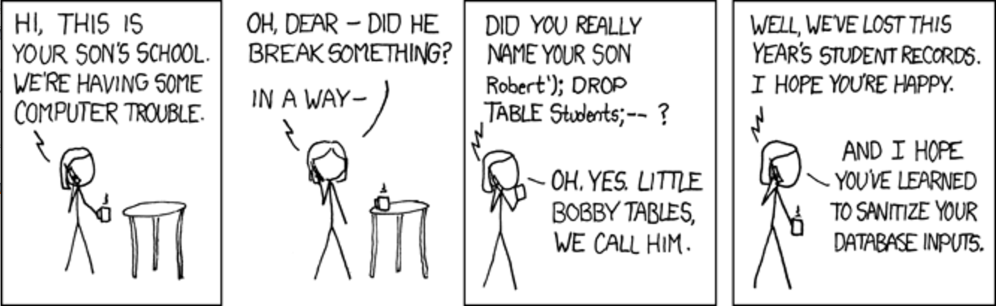
Notes:
https://imgs.xkcd.com/comics/exploits_of_a_mom.png

Slide 52
SQL Injection Defense
Make sure data gets interpreted as data!
Basic approach: escape control characters (single quotes, escaping characters, comment characters)
Better approach: Prepared statements – declare what is data!
$pstmt = $db->prepare(
"SELECT * FROM `users` WHERE location=?");
$pstmt->execute(array($city)); // Data

