Slide 1
Why Cryptosystems Fail (1993) COS 432: Information Security
Nick Feamster

Slide 2
Differences Between Cryptology and Other Forms of Engineering
By contrast, hard to get public feedback about how cryptosystems fail.
Hence, the same mistakes are made repeatedly.
Cryptosystem designers are at a disadvantage.

Slide 3
Case Study: Banking and ATMs
Banks carry risks of new technology in the US.
In the UK, not so…
Court cases resulted…
Study of ATM failures.

Slide 4
How ATM Fraud Takes Place
Insider attacks
Bank clerk who issued extra card.
Complaints stonewalled.
Outsiders
Observe PINs, copy account numbers to blank cards, …
Replay attack of “pay” response from bank to ATM. (Jackpotting)
Insertion of telephone card.
False terminals

Slide 5
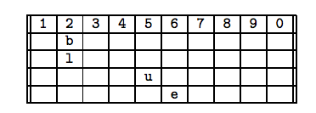
How ATM Fraud Takes Place
PINs
Checksums reducing entropy
Issuing same PIN to all customers
Writing PIN down
…
Bogus ATMs

Slide 6
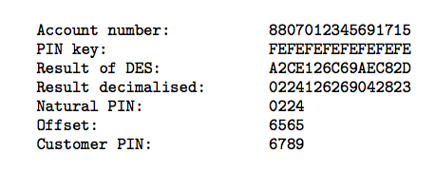
More Sophisticated Attacks
PIN Derived from account number.
Problems
PIN key must be kept secret. (Yet, it must be distributed.)
Key must be available for use at all times.
Poor software implementations and sloppy operating procedures (open files, sharing).

Slide 7
Takeaways
Operating procedures often weakest link
Suppliers overestimate customers’ level of security design sophistication
Security functions implemented at application level often neglected

Slide 8
Options for Equipment Vendors
to design products which can be integrated into systems, and thereafter maintained and managed, by computer staff with a realistic level of expertise
to train and certify the client personnel who will implement the product into a system, and to provide enough continuing support to ensure that it gets maintained and managed adequately
to supply their own trained and bonded personnel to implement, maintain and manage the system.

Slide 9
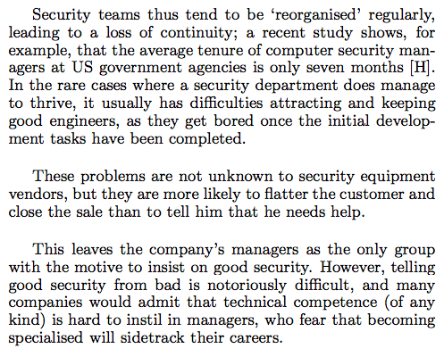

Slide 10
Specifications
Should list all possible failure modes.
Should make prevention strategies clear.
Explain how these strategies are implemented.
Test whether the equipment can be operated by people with the level of skill and experience assumed in the specification.

Slide 11

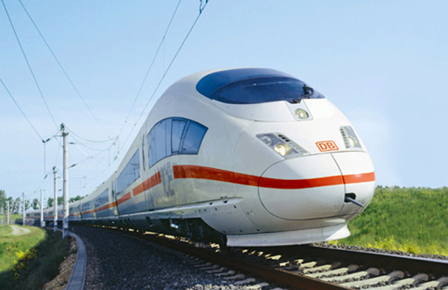
Constant feedback
Incremental improvement
Pilot in control
Redundant interlocks
Formal verification
System in control

Slide 12
