Slide 1
Symmetric Cryptography: Stream and Block Ciphers COS 432: Information Security
Nick Feamster

Slide 2
Confidentiality

Slide 3



Alice wants to send Bob a message
Alice
Network
Eve
Bob
Focus on confidentiality
Assume worst case: Eve can read transmitted message
Notes:
For now, Eve can only read the message, not modify it (eavesdropper)

Slide 4
Alice wants to send Bob a message
E(k,m)
k,m
k
D(k, E(k, m))
Correctness: D(k, E(k, m)) = m
Security: ?
Notes:
Once again, we will formulate security a game

Slide 5
Review
Problem: Integrity of message from Alice to Bob over an untrusted channel
Alice must append bits to message that only Alice (or Bob) can make
Solution: Random function
Practical solution:
(Hash-based) MAC f_{k} is (we hope!) indistinguishable in practice from a random function, unless you know k
k
k
Alice
m, v := f_{k}(m)
Mallory
m′, v′ =? f_{k}(m′)
Bob
e.g. “Attack at dawn”, 628369867…

Slide 6
Confidentiality
Goal: Keep contents of message p secret from an eavesdropper
Terminology
p plaintext c ciphertext k secret key E encryption function D decryption function
k
k
Alice
c
Bob
c := E_{k}(p)
Eve
p := D_{k}(c)

Slide 7
Encryption game against Eve (simplified)
Eve chooses plaintexts x & y We encrypt either x or y randomly
Eve guesses whether we encrypted x or y
Encryption is secure if Eve can’t do better than random guessing
(+ negligible advantage)
Many variations of this “indistinguishability game”:
chosen-plaintext attack, chosen-ciphertext attack
For mathematically rigorous version see COS 433
Notes:
This is a simplified definition.
Different definitions have been refined over many years.

Slide 8
Why this definition?
Why not
“Eve can’t learn the key” or “Eve can’t decrypt the message”?
These definitions are far too weak!
We need to give Eve extremely strong powers to model practical attacks
Notes:
Very strong attack models do materialize in practice. WW2 allied cryptanalysts had “considerable familiarity with German military jargon and the communication habits of the operators” which they used to look for known plaintexts. https://en.wikipedia.org/wiki/Bombe

Slide 9
Caesar Cipher
First recorded use: Julius Caesar (100-44 BC)
Replaces each plaintext letter with one a fixed number of places down the alphabet
Encryption: c_{i} := (p_{i} + k) mod 26
Decryption: p_{i} := (c_{i} - k) mod 26
e.g. (k=3):
Plain: ABCDEFGHIJKLMNOPQRSTUVWXYZ
+Shift: 33333333333333333333333333
=Cipher: DEFGHIJKLMNOPQRSTUVWXYZABC
Plain: fox go wolverines +Key: 333 33 3333333333 =Cipher: ira jr zroyhulqhv
[Break the Caesar cipher?]
Notes:
k=3 – This happens to be the key Caesar always used.

Slide 10
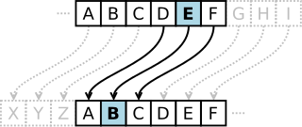
History: Caesar cipher
Notes:
cryptanalysis: just brute force the key.
Plaintext generally has patterns (e.g., English text), so you can tell when you have the right key, because with the wrong key the decrypted text will look like gibberish.

Slide 11
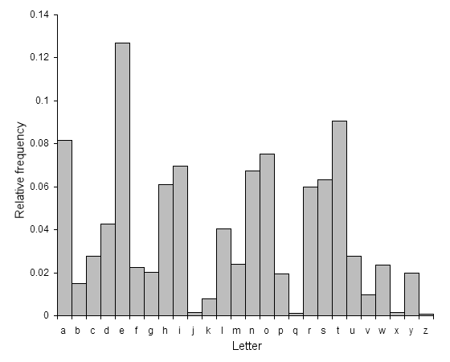
Cryptanalysis of the Caesar Cipher
Only 26 possible keys: Try every possible k by “brute force”
Can a computer recognize the right one?
Use frequency analysis: English text has distinctive letter frequency distribution
Recognize with (for example) chi-square test
ABCDEFGHIJKLMNOPQRSTUVWXYZ

Slide 12
Later advance: Vigènere Cipher
First described by Bellaso in 1553, later misattributed to Vigenère
Called « le chiffre indéchiffrable » (“the indecipherable cipher”)
Encrypts successive letters using a sequence of Caesar ciphers determined by the letters of a keyword
For an n-letter keyword k,
Encryption: c_{i} := (p_{i} + k_{i mod n}) mod 26 Decryption: p_{i} := (c_{i} – k_{i mod n}) mod 26
Example: k=ABC (i.e. k₀=0, k₁=1, k₂=2)
Plain: bbbbbb amazon +Key: 012012 012012 =Cipher: bcdbcd anczpp
[Break le chiffre indéchiffrable?]

Slide 13
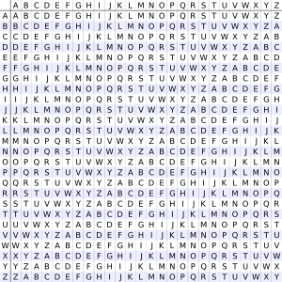
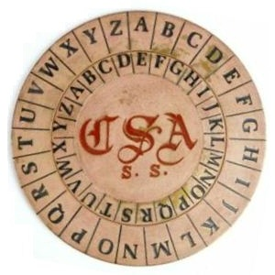
Vigenere Cipher: "le chiffre indéchiffrable”
Plaintext: | ATTACKATDAWN
Key: | LEMONLEMONLE
Ciphertext: | LXFOPVEFRNHR
Notes:
Blaise de Vigenere, diplomat who served Charles IX. (1500s)
Repeatedly add key into the plaintext
C = P + K mod 26
(read plaintext letter from column, key from row; or vice versa)
ciphermachines.com
“the undecipherable cipher”
Stretch the key by repeating it
shift each plaintext letter by the amount given by the corresponding letter of the key stream (A = no shift, B = 1 letter, etc.)
Today it is trivial to crack. In the computer era, much of the ancient wisdom on ciphers has been rendered naïve.

Slide 14
Cryptanalysis of the Vigènere Cipher
Simple, if we know the keyword length, n:
1. Break ciphertext into n slices 2. Solve each slice as a Caesar cipher
How to find n? One way: Kasiski method
Published 1863 by Kasiski (earlier known to Babbage?)
Repeated strings in long plaintext will sometimes, by coincidence, be encrypted with same key letters
Plain: CRYPTOISSHORTFORCRYPTOGRAPHY
+Key: ABCDABCDABCDABCDABCDABCDABCD
=Cipher: CSASTPKVSIQUTGQUCSASTPIUAQJB
Distance between repeated strings in the ciphertext is likely a multiple of key length
e.g., distance 16 implies n is 16, 8, 4, 2, or 1
Find multiple repeats to narrow down
[What if key is as long as the plaintext?]
Distance: 16
Notes:
Charles Babbage

Slide 15
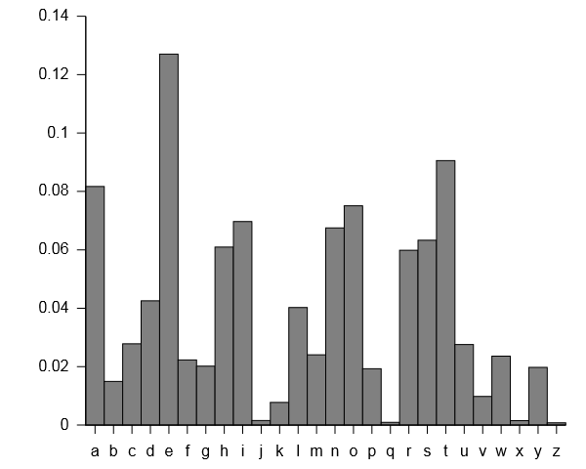
How to Break: Frequency Analysis
Notes:
How to break:
First, determine key length. To do this, look at letters a distance ℓ apart, for each ℓ. If ℓ is different from the key length, the histogram of letters will be somewhat evenly distributed. If ℓ equals the key length, it will be highly uneven, as in the slide.
After finding the correct ℓ, do separate frequency analysis for positions ℓ apart. That is, look at every ℓ’th letter starting from the first letter. This will let you figure out the first letter of the key. Then look at every ℓth letter starting from the second letter, which will tell you the second letter of the key, and so on.

Slide 16
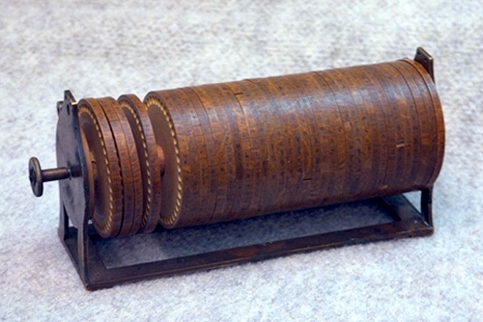
Thomas Jefferson Wheel Cipher
Notes:
Back in the day, presidents were nerds!
a set of wheels or disks, each with the 26 letters of the alphabet arranged around their edge. The order of the letters is different for each disk and is usually scrambled in some random way.
Each disk is marked with a unique number. A hole in the center of the disks allows them to be stacked on an axle.
The disks are removable and can be mounted on the axle in any order desired.
The order of the disks is the cipher key, and both sender and receiver must arrange the disks in the same predefined order. Jefferson's device had 36 disks.
Number of possible permutations is factorial in the number of disks. 36! ~ 2^238
Cryptanalysis:
Known plaintext attack (e.g., known starting message)
First find the offset (most common offset element when looking at the known plaintext->ciphertext mapping for each disk)
Then arrange disks so that the offsets come in order

Slide 17
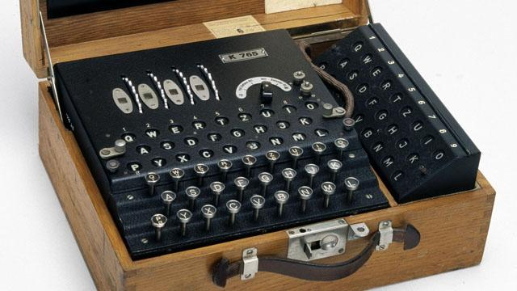
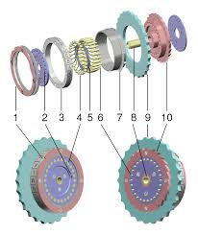
Enigma Machine
Notes:
Look it up online, very interesting history of cryptanalysis of the German Enigma code at Bletchley Park in England that was an important event in WW2.
A German Enigma operator would be given a plaintext message to encrypt. For each letter typed in, a lamp indicated a different letter according to a pseudo-random substitution, based upon the wiring of the machine. The letter indicated by the lamp would be recorded as the enciphered substitution. The action of pressing a key also moved the rotor so that the next key press used a different electrical pathway, and thus a different substitution would occur. For each key press there was rotation of at least the right hand rotor, giving a different substitution alphabet.

Slide 18
One-time Pad (OTP)
Alice and Bob jointly generate a secret, very long, string of random bits (the one-time pad, k)
To encrypt: c_{i} = p_{i} xor k_{i}
To decrypt: p_{i} = c_{i} xor k_{i}
“one-time” means you should never reuse any part of the pad. If you do:
Let k_{i} be pad bit Adversary learns (a xor k_{i}) and (b xor k_{i}) Adversary xors those to get (a xor b), which is useful to him [How?]
Provably secure [Why?]
Usually impractical [Why? Exceptions?]
a b a xor b
0 0 0
0 1 1
1 0 1
1 1 0
a xor b xor b = a
a xor b xor a = b
Notes:
As many possible keys as possible plaintexts, 2. every key is equally likely. (proof by Shannon)
Only kind of system that offers perfect secrecy.
Note: Does not provide message integrity (why?)

Slide 19



Can’t Ever Reuse the Key
Discussion.
Two images m₁ and m₂ are encrypted with the same key
How can Eve exploit this? Assume images are bitmaps
E_{k}(m₁) = k ⊕ m₁
E_{k}(m₂) = k ⊕ m₂
E_{k}(m₁) ⊕ E_{k}(m₂) = m₁ ⊕ m₂
Images have a lot of redundant content. XOR gives info about both
⊕
=
Notes:
Even though we defined adversary to be an algorithm, if human can figure it out, then it is still broken
Guess a word that might appear in one of the messages
Encode the word from step 1 to a hex string
XOR the two cipher-text messages
XOR the hex string from step 2 at each position of the XOR of the two cipher-texts (from step 3)
When the result from step 4 is readable text, we guess the English word and expand our crib search.
If the result is not readable text, we try an XOR of the crib word at the next position.

Slide 20
Need a Really Long Key
As long as the sum of lengths of messages you plan to send
In fact, OTP does not even meet standard definitions of security
Need key to be fixed length, message to be arbitrary length
But we can stretch randomness!
Start with a small key (seed), stretch it, then XOR
Notes:
OTP was somewhat useful in the traditional context of pairs of spies communicating
But useless on the modern Internet
As before, we can assume that Alice and Bob have a shared secret random key k

Slide 21

One-time Pad + PRG = Stream Cipher
Alice and Bob have a shared secret key k
E(k, x) = g(k) ⊕ x
Alice computes g(k) to needed length
D(k, y) = g(k) ⊕ y
Same procedure recovers plaintext
Secure if PRG is secure
Homework: verify this
m
⊕
=
Notes:
XORing a predictable message (or a message with patterns) with a pseudorandom or unpredictable string results in an unpredictable output

Slide 22
Confidentiality + Integrity
Want both at the same time
Encrypt, then add integrity
Not the other way round
Subtle reasons
Use separate keys for encryption and MAC
For Bob → Alice messages, 2 more separate keys
Need 4 shared keys?! That’s what PRGs are for!
Notes:
Note two different uses of a PRG: for stretching a seed into many seeds, and for generating the random pad for a stream cipher.

Slide 23
Problems with Stream Ciphers
Some weird security issues
Uses PRF for unintended purposes (due to iterated application)
If f is weaker than a PRF, the result is even worse
Can’t ever reuse key
Easily solved in theory: always use a nonce In practice: many ways to get it wrong
Bit flipping attack:
Flipping 1 bit of ciphertext flips 1 bit of decrypted plaintext
Again easily prevented: use a MAC
session_key = f(master_key, nonce)
Notes:
Why can’t you reuse the key?
Remember the two xor’d images. From same key get same random sequence, that when applied to two different messages, attacker can get m1 XOR m2.
Nonce: important concept, often used when we have same master_key and want unique session key.
Nonce can be sent in public, still secure.
Example of bug in practice: machine crashed, restarted from same state.

Slide 24
Idea: Use a pseudorandom generator instead of a truly random pad
(Recall: Secure PRG inputs a seed k, outputs a stream that is practically indistinguishable from true randomness unless you know k)
Called a stream cipher:
Start with shared secret key k
Alice & Bob each use k to seed the PRG
To encrypt, Alice XORs next bit of her generator’s output with next bit of plaintext
To decrypt, Bob XORs next bit of his generator’s output with next bit of ciphertext
Works nicely, but: don’t ever reuse the key, or the generator output bits

Slide 25
Another approach: Block Ciphers
Function that encrypts fixed-size blocks with a reusable key.
Inverse function decrypts when used with same key.
The most commonly used approach to encrypting for confidentiality.
A block cipher is not a pseudorandom function [Why?]
Plaintext
Key
E_{k}
Ciphertext
Notes:
Answer: With a PRF, diff. inputs can generate same output
Random functions will have collisions, so will PRF

Slide 26
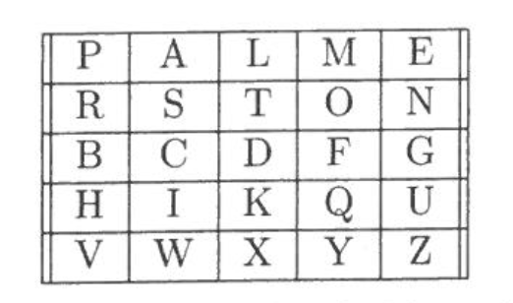
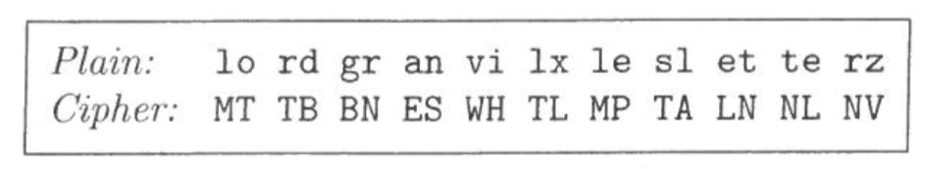
Playfair: Early Block Cipher
Notes:
Invented in 1854 by Charles Wheatstone
Known plaintext attack is trivial.
Known ciphertext exploits the fact that digraphs decrypt to same letter pairs. Can be made more difficult to crack by choosing a block length longer than two letters.

Slide 27
Block Ciphers
Encrypt block-by-block
Invertible, length preserving function ➔ permutation
Ideal block cipher is a random permutation
Practical approach: pseudorandom permutation (PRP)
Notes:
Block cipher is keyed family of PRPs

Slide 28
Pseudorandom Permutation (PRP)
function from n-bit input to n-bit output
distinct inputs yield distinct outputs
Defined similarly to PRF: practically indistinguishable from a random permutation without secret k
Basic challenge: Design a hairy function that is invertible, but only if you have the key
Minimal properties of a good block cipher:
Highly nonlinear (“confusion”)
Mixes input bits together (“diffusion”)
Depends on the key
Notes:
Design challenges:
When designing a PRF: pile on the hairy nonlinearity; more is better
However, can’t use that here, since need invertibility-with-key
Ideally, changing one bit of plaintext or key should change about half the bits of the ciphertext
Simple definition of nonlinear:
having no simple proportional relation between cause and effect
Confusion means that each character of the ciphertext should depend on several parts of the key.
Diffusion means that if we change a character of the plaintext, then several characters of the ciphertext should change, and similarly, if we change a character of the ciphertext, then several characters of the plaintext should change.[1]
In Shannon's original definitions, confusion refers to making the relationship between the ciphertext and the symmetric key as complex and involved as possible; diffusion refers to dissipating the statistical structure of plaintext over bulk of ciphertext. T

Slide 29
Generating a PRP from a PRF
First step:
Construct any permutation from a given PRF f_{k}
Must use f_{k} in an nontrivial way
Must be invertible (so that decryption is possible)
(Don’t worry about pseudorandomness for now)

Slide 30
Invertible Permutation from PRF
At first glance, seems impossible As soon as you apply PRF, some outputs collide
Strategy: Apply PRF to half of input Combine result with other half of input
Discussion: (L, R) ➡ (f_{k}(R) ⊕ L, ??) What’s the second half to make it invertible? Note: f is not invertible!
(L, R) ➡ (f_{k}(R) ⊕ L, R) or (R, f_{k}(R) ⊕ L)
Notes:
Input to permutation is (L, R) or L || R
We end up with a permutation whose input/output length is twice the output length of the PRF
We use (R, f_{k}(R) ⊕ L) instead of (f_{k}(R) ⊕ L, R) because we’re going to start iterating this permutation
Note: this is not about encryption here yet, only about constructing permutation from prf. Need additional steps to be able to use it for encryption.

Slide 31
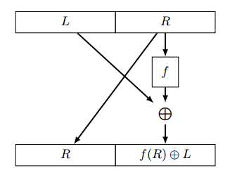
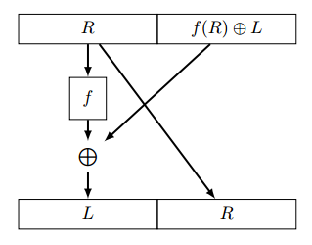
Feistel Round
Discussion:
is this a permutation?
is this pseudorandom?
Hint: given an input/output pair, can you distinguish from random?
Round
Inverse
Notes:
Note: dropping subscript k, denote PRF by just f
Note that inversion doesn’t require inverting f!
The great thing about permutations is that you can apply them iteratively
Solution: it’s a permutation because we’ve shown how to invert it
It’s not pseudorandom because half of the input is replicated in the output, which won’t happen in a truly random function

Slide 32
Two Feistel Rounds
Notation:
Round function is
FTL_{f}(L, R) = (R, f(R) ⊕ L)
Discussion: write the formula for FTL_{f}²(L, R)
Answer: ( f(R) ⊕ L , f(f(R) ⊕ L) ⊕ R )
Round
Inverse
Notes:
Note to self -- Standard terminology seems to be: f is the round function, not FTL_f

Slide 33
Two Feistel Rounds
FTL_{f}²(L, R) = ( f(R) ⊕ L , f(f(R) ⊕ L) ⊕ R )
Is this pseudorandom?
Hint: adversary queries FTL_{f}² twice.
Uses one of the outputs of first as one of the inputs of second query.
Notes:
Solution:
First query: L, R
Response: f(R) ⊕ L, f(f(R) ⊕ L) ⊕ R
Second query: R, f(R) ⊕ L
Reponse: f(f(R) ⊕ L) ⊕ R, [some horrible thing]
Adversary observes that Second half of first response = First half of second response, so it’s not pseudorandom

Slide 34
More Feistel Rounds
A 3-round Feistel cipher is a PRP
Proved in 1988
A 4-round Feistel cipher is a PRP even if the adversary can ask to invert values of her choice.
5- and 6-round Feistel ciphers have additional security properties e.g., resistance to partial leakage of internal state
Notes:
Rough analogy to riffle shuffle, where one has to shuffle 7 times for deck to be perfectly shuffled http://www.nytimes.com/1990/01/09/science/in-shuffling-cards-7-is-winning-number.html
The theorem is not the reason we use DES. Note that it was proved over a decade after DES was standardized. But retrospectively it gives us confidence in the design principle of the Feistel network. It tells us nothing about the underlying function f. That’s still just based on intuition.

Slide 35
Types of Proof (rough, for intuition)
Reduction between primitives
If f is a PRF then g is a PRG
Reduction to a fundamental hard problem
e.g., if discrete log is hard then system is secure
Proof of some aspect of construction
3-round Feistel cipher is a PRP

Slide 36
DES (Data Encryption Standard)
First modern cipher (mid 1970s)
16-round Feistel construction
NSA reduced key size from 64 to 56 bits
Notes:
Initial design around 1973 (known as Lucifer at the time), Standardized in 1978.
Horst Feistel at IBM was one of the main designers.
The NSA had a significant impact on the design. Their excuse for the key size reduction was padding or error correction, but it’s widely believed that they wanted to make it easier to brute force (which it did, except not just for the NSA, but for everyone).

Slide 37
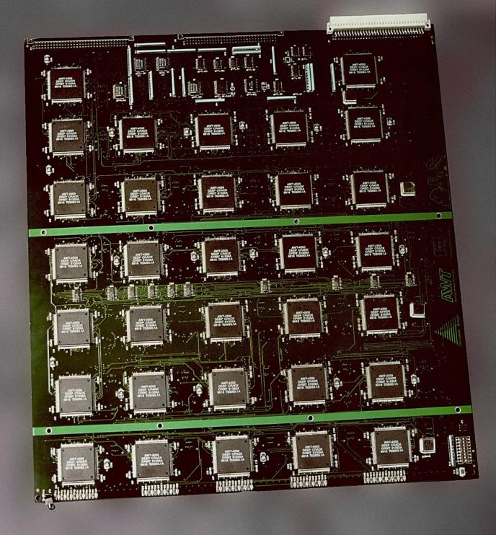
EFF Deepcrack (1998) — $250,000
Notes:
EFF is a volunteer funded non-profit civil liberties organization.
Deepcrack was made out of 1856 ASIC chips (about 30 of the boards shown in the picture).
Could crack DES in a few days. Made clear the need for a new standard.
How much is 2^56?

Slide 38
Small Key Size
56 bits is too few
What about 2 keys: DES_{k2}(DES(_{k1}(m)))?
Can still be attacked with about 2⁵⁶ complexity!
(Meet in the middle attack)
Safe(r): use 3 keys — “Triple DES”
Notes:
Triple DES is still used and not known to be insecure, but by the late 90s the community had agreed upon the need for a new standard with a more modern algorithm.
The attacker can then compute ENC_{k1}(P) for all possible keys k₁ and then decrypt the ciphertext by computing DEC_{k2}(C) for each k₂. Any matches between these two resulting sets are likely to reveal the correct keys. (To speed up the comparison, the ENC_{k1}(P) set can be stored in an in-memory lookup table, then each DEC_{k2}(C) can be matched against the values in the lookup table to find the candidate keys) .
This attack is one of the reasons why DES was replaced by Triple DES — "Double DES" does not provide much additional security against exhaustive key search for an attacker with 2⁵⁶ space.^{[3]} However, Triple DES with a "triple length" (168-bit) key is vulnerable to a meet-in-the-middle attack in 2⁵⁶ space and 2¹¹² operations.^{[4]}
If the keysize is k, this attack uses only 2^{k+1}encryptions (and decryptions) (and O(2^{k}) memory in case a look-up table have been built for the set of forward computations) in contrast to the naive attack, which needs 2^{2·k} encryptions but O(1) space.
-------------
Setup: there is double-DES, where a data block is encrypted with key K₁, then again with K₂. The attacker could have access to two plaintext/ciphertext blocks: attacker knows A, B, C = E_{K2}(E_{K1}(A))and D = E_{K2}(E_{K1}(B)).
Then the attacker can compute all E_{K}(A) for all values of K (there are 2⁵⁶ of them). Then he can also compute all D_{K'}(C) for all values of K' (again, 2⁵⁶ keys to try). At that point, he will have about 2⁴⁸ candidates for the (K₁,K₂) pair: these are all the pairs (K,K') for which E_{K}(A) = D_{K'}(C). The "2⁴⁸" comes from the fact that we are encrypting 64-bit blocks, so about 1 block value every 256 is one of the E_{K}(A) values, so about 1 value K' every 256 will yield a matching D_{K'}(C).
The 2⁴⁸ candidates can then be tried with the plaintext B and ciphertext D; it is expected that only the right one will pass that test.
Cost: 2⁵⁷ invocations of DES (plus an extra average of 2⁴⁸ for the verification of candidates, but that's negligible), and some memory storage able to hold 2⁵⁶ intermediate values, and sorted. Since the values are sorted, each will differ from the previous by only 8 bits on average, but it must also store the corresponding K, so let's say that a practical implementation would use 10 bytes per value. That's then 10*2⁵⁶ bytes of storage, which is rather large (about 650 thousands of terabytes) but can be envisioned with existing technology (it would not be cheap, though). The sorting step would be the biggest cost in an "academic" way (about 2⁶⁴ comparisons) but the 2⁵⁷ DES invocations would still be, in practice, more expensive.
I don't see any "80 bits" here. In fact, security of Double-DES should be considered to be close to "57 bits". The storage requirements make it harder to break than a simple "57-bit block cipher", but nowhere near as hard as an 80-bit block cipher.

Slide 39
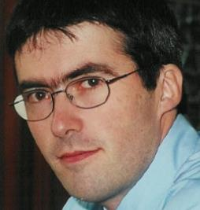
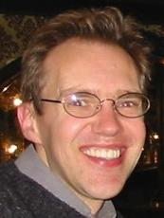
AES: Advanced Encryption Standard
Standardized by NIST
Open competition, 1997-2001
15 submissions
5 finalists
Winner was “Rijndael”
which we now call AES
Security and implementation speed major design criteria
Vincent Rijmen
Joan Daemen

Slide 40
AES (Advanced Encryption Standard)
Today’s most common block cipher
Designed by NIST competition, long public comment/discussion period
Widely believed to be secure, but we don’t know how to prove it
Variable key size and block size
We’ll use 128-bit key, 128-bit block (are also 192-bit and 256-bit versions)
Ten rounds: Split k into ten subkeys, performs set of operations ten times, each with diff. subkey

Slide 41
AES
Uses rounds, but not a PRF
So it’s not a Feistel construction
Mainly tries to avoid known attacks
No proofs analogous to Feistel construction

Slide 42
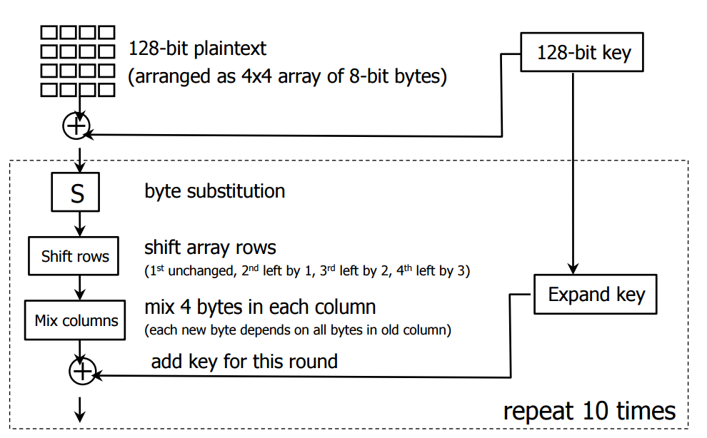
AES is not Based on a PRF
Each operation is invertible
Notes:
Image credit: Yoshi Kohno, UW
The details aren’t important, we’re just highlighting the fact that AES uses components that are individually invertible instead of starting from a PRF and turning it into a permutation

Slide 43

AES Security
When designed, attacks on 6 rounds were known
So designers picked 10 rounds
NSA approved for US gov. data, nonclassified
Later US Gov (CNSS) approved it
128-bit for SECRET
192/256-bit for TOP SECRET
Very minor theoretical attacks
Practical attacks: mainly side-channel
Notes:
AES thought secure mostly because it resists known attacks.
Uses 10 rounds for 128-bit keys and 14 rounds for 256-bit keys.
NSA approval gives us some confidence that there aren’t major attacks known to them, but don’t read too much into it.
CNSS = committee for national security systems.
All modern computers have a “cache” between main memory (RAM) and the CPU. This cache speeds up access to areas of memory that have been used recently. If an area of memory has been accessed recently, it’s probably in the cache, so accessing it again will be quick. If the area hasn’t been accessed in a long time, it has probably been evicted from the cache, so accessing it will be slow. The difference in time can leak information about what a process is doing.
This attack was applied to the AES cipher. Essentially, fast implementations of AES use lookup tables, which are arrays used to quickly convert one value into another. The indexes AES uses into these tables depend on the secret key, so there’s a possibility that the difference in memory access time caused by the cache can leak information about the secret key. That is exactly what the authors demonstrated.
The authors demonstrate two different techniques for extracting the key. I’ll give a simplified explanation of each.
In the first, called the Evict+Time attack, they evict part of one of the lookup tables from the cache, so that all of the AES lookup tables are in the cache except for one index in one table, then they run the encryption. If the encryption accesses that index that has been evicted from the cache, it will run slower, otherwise it will run at a normal speed. So, by timing how long the encryption takes, they can figure out if that table index was accessed or not. Since the table index depends on the key, this leaks information about the key.
The second type of attack, called Prime+Probe, first completely fills the cache with the attacker’s data. The encryption process is run, and as it is running, the parts of the lookup table that it uses are loaded from main memory into the cache. Since the cache is full of the attacker’s data, some of it will have to be evicted to make room for the part of the table. Once the encryption is done, the attacker accesses their data again (to see which parts have been evicted from the cache), and this tells them which table indexes were used by the encryption process, leaking information about the key.

Slide 44
Modes of Operation
Tells you how to handle > 1 block
Provides confidentiality or integrity
Some even combine both
Need padding
Most require IV/nonce
Ensures encryption is randomized
Discussion: why is this important?
Notes:
Padding is needed because message can be of arbitrary length but block cipher works only on fixed sized blocks.

Slide 45
Question: What if plaintext length is not a multiple of the block size?

Slide 46
Padding and Invertability
Can only encrypt in units of cipher blocksize, but message might not be multiples of blocksize.
Solution: Add padding to end of message
Must be able to recognize and remove padding afterward
Common approach: Pad with n bytes, each that have value n
[Caution: What if message ends at a block boundary?]
Notes:
Caution: if message ends at block boundary, have to add whole block of padding. Otherwise might be tricked into interpreting end of message as padding.
What if we just pad with zeroes? This is not reversible, as p and p||0 have the same padded form.
In practice, all padding rules add a minimum of one byte to the plaintext.

Slide 47
Padding and Invertability
Discussion: how to pad reversibly?
If you simply append 0’s, you don’t know where m ends.
Another possible solution:
append 1 followed by 0s
if length(msg) = N*length(blk), add new block of 0s
if length(msg) = N*length(blk)-1, just append a 1

Slide 48
What about messages that are multiple blocks?

Slide 49
Cipher Modes
We know how to encrypt one block, but what about multiblock messages?
Different methods, called “cipher modes”
Straightforward (but bad) approach: ECB mode (encrypted codebook)
Just encrypt each block independently
C_{i} := E_{k}(P_{i})
[Disadvantages?]
Notes:
Disadvantages of ECB mode:
- Same plaintext yields same ciphertext
(at block and message level)
Rearrangeable
If two plaintext blocks are the same, then the corresponding ciphertext blocks will be identical. Leaks a lot of information to the attacker!

Slide 50
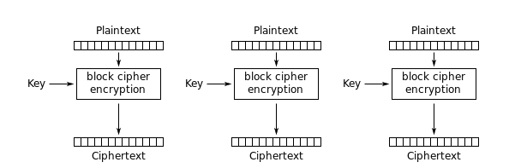
Electronic CodeBook (ECB) — insecure
Notes:
Not secure because if we have same plaintext blocks will get same ciphertext.

Slide 51

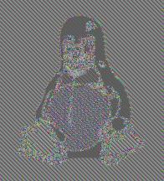
ECB: identical input blocks ➡ identical output blocks
Notes:
Each color value maps to some different color value
But you can still make out the shape of the input image

Slide 52
Better (and common): CBC mode (cipher-block chaining)
Simple-CBC (for illustration only)
For each block P_{i}:
1. Generate random block R_{i}
2. C_{i} := (R_{i} || E_{k}(P_{i} xor R_{i}))
[Pros and cons?]
Notes:
Lame-CBC
pro: same plaintext yields different ciphertext
con: ciphertext is 2x size of plaintext

Slide 53
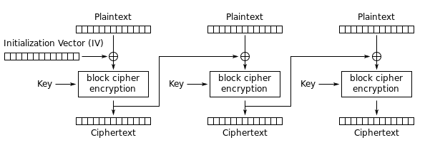
Cipher Block Chaining Mode (CBC)
Unlike hash functions, IV must be picked randomly for each msg
Notes:
Initialization Vector is like a Nonce.
Combining ciphertext block with next plaintext block ensures that identical plaintext blocks don’t map to identical ciphertext blocks
Other modes: Counter (CTR), Output feedback (OFB)
Using a fixed IV is a bad idea, as this introduces the ECB problem for the first block of each message.

Slide 54
Possible Ideas for Initialization Vector
Counter
Not the best idea, as many messages start the same way across multiple blocks.
Differences between two ciphertexts: the attacker could learn something about the plaintext.
Random Value
Need source of randomness
Recipient needs to know the value (longer message)
Nonce

Slide 55
Nonce: Number Used Once
Assign a message number to the nonce
Use the message number to create a unique nonce
Encrypt the nonce with the block cipher to generate the IV
Add enough information to ensure that the receiver can reconstruct the nonce (smaller than random IV)

Slide 56
Assumption we’ve been making so far: Alice and Bob shared a secret key in advance.
Amazing fact: Alice and Bob can have a public conversation to derive a shared key!

Slide 58
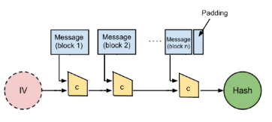
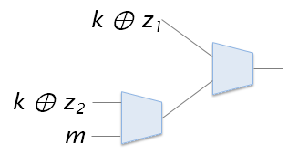
=
HMAC
PRF
MAC
True
randomness
iterate
Hash function
Feistel const’n
PRG
Key gen
⊕
Merkle-Damgard
PRP
Mode of operation
Stream cipher
Compr’n function
Block cipher
Notes:
Key generation also includes nonce generation.
Mode of operation and Merkle-Damgard construction are both concerned with extending security properties from 1-block inputs to multi-block inputs.
PRF is fixed-length primitive…
This chart is useful but it’s an oversimplification in at least two ways:
AES is not based on Feistel construction
When we use a PRF in the Feistel construction, we’re just using a function that takes 1-block inputs. So we’re talking about PRFs as functions with fixed length inputs. Earlier when we constructed PRFs we were interested in arbitrary-length inputs, which is why the Merkle-Damgard construction was necessary.

Slide 59
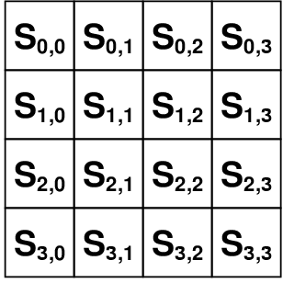
Each AES round 128-bits in, 128-bit sub-key, 128-bits out
Four steps: picture as operations on a 4x4 grid of 8-bit values
1. Non-linear step
Run each byte thru a non-linear function (lookup table)
2. Shift step
Circular-shift each row: i^{th} row shifted by i (0-3)
3. Linear-mix step
Treat each column as a 4-vector; multiply by a constant invertible matrix
4. Key-addition step
XOR each byte with corresponding byte of round subkey
To decrypt, just undo the steps, in reverse order

Slide 60
Real CBC
Replace R_{i} with C_{i-1}
No need to send separately
Must still add one random R₋₁ to start, called “initialization vector” (“IV”)
[Is CBC space-efficient?]
Illustration: CBC Encryption
[Decryption?]
IV
P₀
P₁
P₂
…….
⊕
⊕
⊕
E_{K}
E_{K}
E_{K}
IV
C₀
C₁
C₂
…….
Notes:
space-efficient?
Clearly we need to add something to make same pt yield diff. ct
Here we only add one block

Slide 61
Other modes
OFB, CFB, etc. – used less often
Counter mode
Essentially uses block cipher as a pseudorandom generator
XOR i^{th} block of message with E_{k}(message_id || i)
[Why do we need message_id?]
Notes:
Use non-repeating message_id to prevent pad reuse style attack.

