Slide 1
MP4: Network Security
CS461 / ECE422 – UIUC Spring 2016
Simon Kim

Slide 2
Introduction
Goals
Checkpoint 1
Learn how to use Wireshark
Identify network activities
Identify attacks or vulnerabilities
Checkpoint 2
Attack a network and extract information
Programmatically detect attacks from network traces

Slide 3
Required Tools
Checkpoint 1
Wireshark – any version of Wireshark is fine
Checkpoint 2
Wireshark 32 bit
Aircrack-ng Suite
nmap
Python 2.7
dpkt Python library

Slide 4
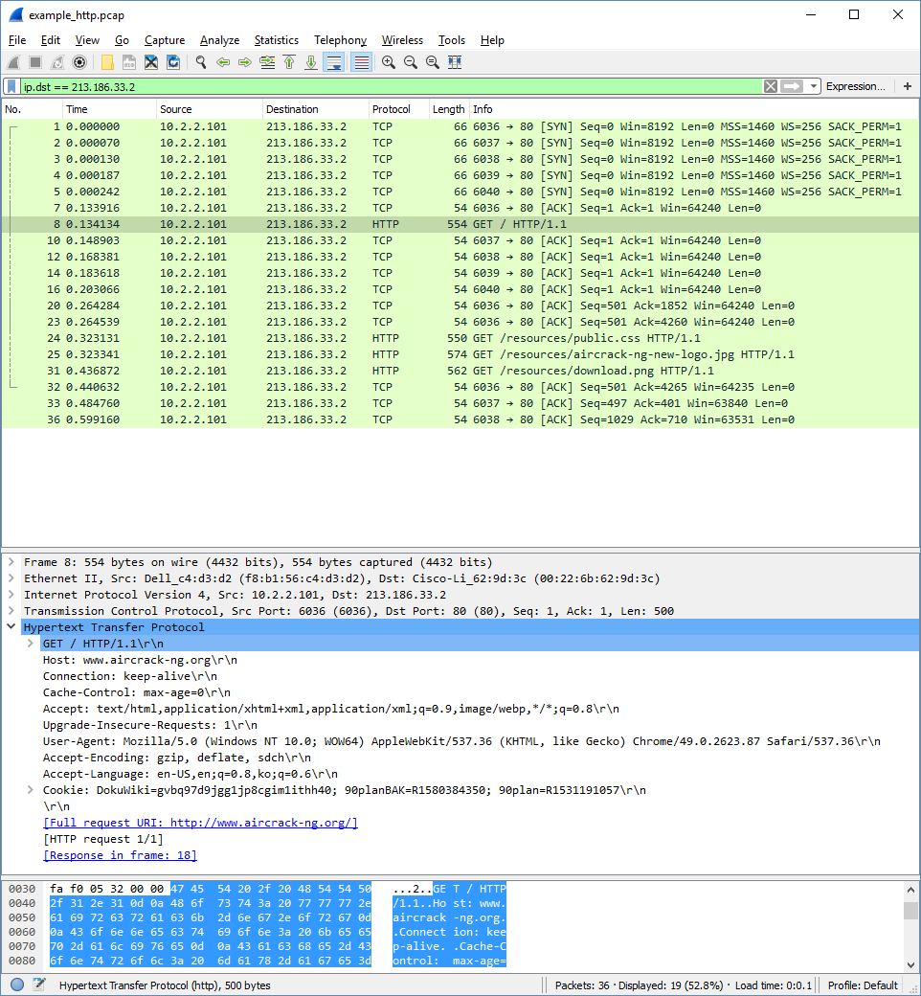
Checkpoint 1: How to use Wireshark
Dig through “Packet Details”
“Apply a display filter”
Add your own columns to display
Use other built-in features found in menus

Slide 5
Packet Details
Everything that Wireshark can tell you about the packet
IP address, port numbers, MAC address, hostname, data, etc.

Slide 6
Apply a display filter
Shows packets that contain the information you are interested
Examples: https://wiki.wireshark.org/DisplayFilters
Filter expression basics and syntax: https://www.wireshark.org/docs/wsug_html_chunked/ChWorkBuildDisplayFilterSection.html
Filter Reference: https://www.wireshark.org/docs/dfref/
Ex) ip.addr, ip.src, ip.dst

Slide 7
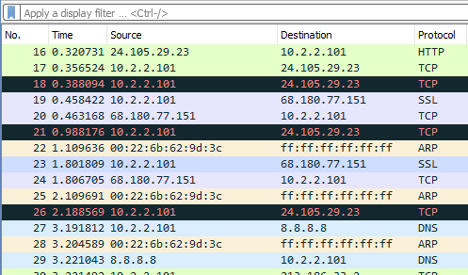
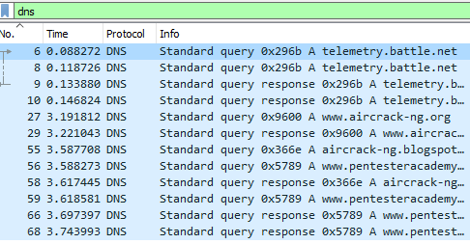
Ex) dns

Slide 8
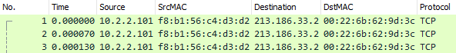
Add your own columns

Slide 9
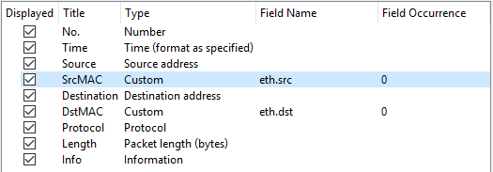
Add your own columns
Right-click column header > Column Preferences or Edit > Preferences > Appearance: Columns

Slide 10
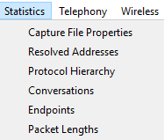
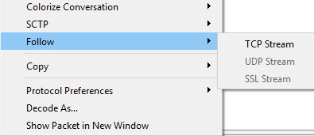
Use built-in features
Menu (e.g. Statistics)
Packet/Packet Details Right-click menu (e.g. Follow TCP Stream)

Slide 11
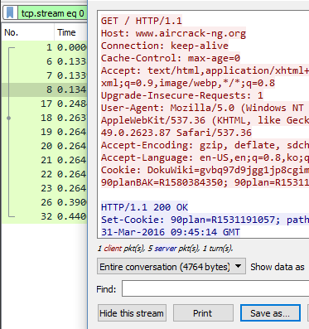
Ex) Follow TCP Stream
Shows all packets in the same TCP stream: tcp.stream eq x
Opens a new window that shows contents of all packets in readable format
Option to save to a file

Slide 12
Checkpoint 1: Identify network activities
What is a gateway?
Active vs. Passive FTP
HTTPS connections

Slide 13
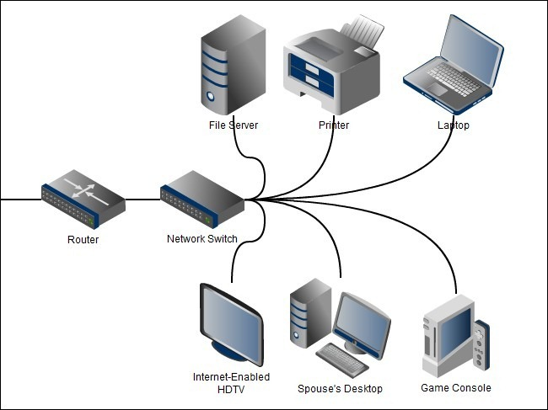
What is a gateway?
“A default gateway … [forwards] packets on to other networks. … The gateway is by definition a router.” (https://en.wikipedia.org/wiki/Default_gateway)
“A router is a networking device that forwards data packets between computer networks.” (https://en.wikipedia.org/wiki/Router_(computing))
Source: http://www.howtogeek.com/wp-content/uploads/2011/11/2011-11-29_132204.jpg

Slide 14
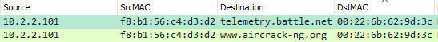
How to identify a gateway
All traffics have to go through the network’s gateway.
Look at the packets between a local host and a number of different external hosts (e.g. websites). Check the MAC addresses of the external hosts. Are they different?
See what other IP addresses are mapped with that MAC address.

Slide 15
Sidenote: IP-MAC address mapping
Not necessarily 1:1 mapping.
1 MAC address can be mapped to multiple IP addresses, as shown in the previous slide.
1 IP address can be mapped to multiple MAC addresses (e.g. IP spoofing).
How to see the complete mapping:
Filter by source/destination MAC address
Sort on IP address
Or use tshark: https://ask.wireshark.org/questions/27577/how-to-see-ip-to-macmapping-from-a-trace

Slide 16
Sidenote: Name Resolution
View > Name Resolution > Resolve Physical/Network/Transport Address
Wireshark converts numerical addresses into (more) human readable formats. (https://www.wireshark.org/docs/wsug_html_chunked/ChAdvNameResolutionSection.html)
While useful, the conversion often fails and may give you wrong information (e.g. wrong hostname).
Try “Resolve Network Address” on 4.1.1.pcap. Try it on IllinoisNet, then try again on different network (e.g. home).

Slide 17
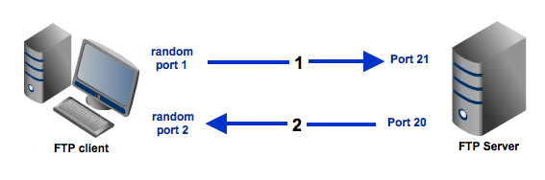
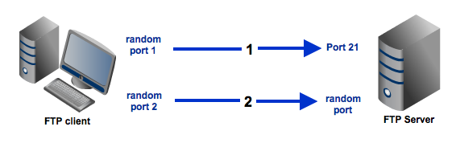
Active vs. Passive FTP
Active FTP
Passive FTP
Explanation: http://www.jscape.com/blog/bid/80512/Active-v-s-Passive-FTP-Simplified
With FTP session examples: http://slacksite.com/other/ftp.html

Slide 18
HTTPS connections
TLS Handshake (https://courses.engr.illinois.edu/cs461/secure/ECE422-Spring2016-Lecture-13-TLS.pdf)
The First Few Milliseconds of an HTTPS Connection (http://www.moserware.com/2009/06/first-few-milliseconds-of-https.html)

Slide 19
Tips
Try to understand the result shown by Wireshark and make sure it is as expected.
Get familiar with filter syntax and take advantage of it. Expressions made of multiple filters will save you from tedious scrolling.
Try capturing your own network traffic and analyze it.
Don’t make assumptions and limit your search from the beginning. For example, an IP address not within the standard private network address space could still be a private IP address in the local network.

Slide 20
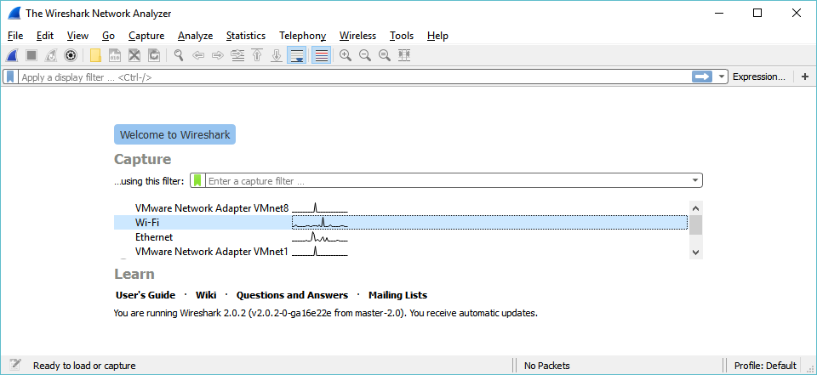
Capturing your own traffic
Make sure you choose the correct network interface.

Slide 21
Reminder
Make sure you read MP4 Release announcement on Piazza (@414).
MP4 office hours will be held at Siebel Center Room 1129.
Try to come on Mondays and Tuesdays, and avoid Thursdays and Fridays.
DO NOT touch anything in that room.
Please read the Checkpoint 2 Setup and start setting up your environment as soon as possible.

