Slide 1
Lecture 15 – Networking Concepts
Michael Bailey
University of Illinois
ECE 422/CS 461 – Spring 2016

Slide 2
Circuit and Packet Switching
Circuit switching
Legacy phone network
Single route through sequence of hardware devices established when two nodes start communication
Data sent along route
Route maintained until communication ends
Packet switching
Internet
Data split into packets
Packets transported independently through network
Each packet handled on a best efforts basis
Packets may follow different routes

Slide 3
Packet Switching
B
F
A
3
2
1
D
C
D

Slide 4
Packet Switching
B
F
1
A
3
2
D
C
D

Slide 5
Packet Switching
B
F
1
2
A
3
D
C
D

Slide 6
Packet Switching
B
F
1
2
3
A
D
C
D

Slide 7
Network Layers
Network models typically use a stack of layers
Higher layers use the services of lower layers via encapsulation
A layer can be implemented in hardware or software
The bottom-most layer must be in hardware
A network device may implement several layers
A communication channel between two nodes is established for each layer
Actual channel at the bottom layer
Virtual channel at higher layers

Slide 8
Reference Models
OSI Model
7
Application
6
Presentation
Internet Model
Internet Protocol Suite
5
Session
Application
FTP, HTTP
4
Transport
Transport
TCP, UDP
3
Network
Internet
IP (ICMP)
ARP, RARP
2
Link
Net. Interface
Not Specified
1
Physical
Physical

Slide 9
Protocols
A protocol defines the rules for communication between computers
Protocols are broadly classified as connectionless and connection oriented
Connectionless protocol
Sends data out as soon as there is enough data to be transmitted
E.g., user datagram protocol (UDP)
Connection-oriented protocol
Provides a reliable connection stream between two nodes
Consists of set up, transmission, and tear down phases
Creates virtual circuit-switched network
E.g., transmission control protocol (TCP)

Slide 10
Layering of protocols
DNS
SSH
FTP
SMTP
NNTP
HTTP
Application layer
UDP
TCP
Transport layer
IP
Network layer
ATM
SONET
Ethernet
Link layer

Slide 11
Encapsulation
A packet typically consists of
Control information for addressing the packet: header and footer
Data: payload
A network protocol N1 can use the services of another network protocol N2
A packet p1 of N1 is encapsulated into a packet p2 of N2
The payload of p2 is p1
The control information of p2 is derived from that of p1
Header
Header
Payload
Footer
Footer
Payload

Slide 12
Internet Layers
Application
Application
Transport
Transport
Network
Network
Network
Network
Link
Link
Link
Link
Ethernet
Fiber Optics
Wi-Fi
Physical Layer

Slide 13
Internet Packet Encapsulation
Application Packet
Application Layer
TCP
Header
TCP Data
Transport Layer
IP
Header
IP Data
Network Layer
Frame
Header
Frame Data
Frame
Footer
Link Layer

Slide 14
Network Interfaces
Network interface: device connecting a computer to a network
Ethernet card
WiFi adapter
A computer may have multiple network interfaces
Packets transmitted between network interfaces
Most local area networks, (including Ethernet and WiFi) broadcast frames
In regular mode, each network interface gets the frames intended for it
Traffic sniffing can be accomplished by configuring the network interface to read all frames (promiscuous mode)

Slide 15
MAC Addresses
Most network interfaces come with a predefined MAC address
A MAC address is a 48-bit number usually represented in hex
E.g., 00-1A-92-D4-BF-86
The first three octets of any MAC address are IEEE-assigned Organizationally Unique Identifiers
E.g., Cisco 00-1A-A1, D-Link 00-1B-11, ASUSTek 00-1A-92
The next three can be assigned by organizations as they please, with uniqueness being the only constraint
Organizations can utilize MAC addresses to identify computers on their network
MAC address can be reconfigured by network interface driver software
Notes:
MAC addresses can be permanently burned in (BIA), or be a locally administered address (LAA) set by an administrator. A MAC address starting out with 00-08-74 for instance is assigned by Dell, while one starting out with 00-0a-95 is assigned by Apple. Despite the IEEE limitations on LAAs, most OSs allow you to specify an arbitrary MAC for an interface.

Slide 16
Switch
A switch is a common network device
Operates at the link layer
Has multiple ports, each connected to a computer
Operation of a switch
Learn the MAC address of each computer connected to it
Forward frames only to the destination computer

Slide 17
Combining Switches
Switches can be arranged into a tree
Each port learns the MAC addresses of the machines in the segment (subtree) connected to it
Fragments to unknown MAC addresses are broadcast
Frames to MAC addresses in the same segment as the sender are ignored

Slide 18
Types of Wireless Networks
Infrastructure
Client machines establish a radio connection to a special network device, called access point
Access points connected to a wired network, which provides a gateway to the internet
Most common type of wireless network
Peer-to-peer
Multiple peer machines connect to each other
Typically used in ad-hoc networks and internet connection sharing
Access Point
Client
Wired LAN
Client
Client
Peer
Peer
Peer
Peer

Slide 19
Internet Protocol
Connectionless
Each packet is transported independently from other packets
Unreliable
Delivery on a best effort basis
No acknowledgments
Packets may be lost, reordered, corrupted, or duplicated
IP packets
Encapsulate TCP and UDP packets
Encapsulated into link-layer frames
Data link frame
IP packet
TCP or UDP packet

Slide 20
IP packet layout
IP header includes
Source address
Destination address
Packet length (up to 64KB)
Time to live (up to 255)
IP protocol version
Fragmentation information
Transport layer protocol information (e.g., TCP)

Slide 21
IPv4 Packet Header Format
usually IPv4
usually 20 bytes (without options)
4-bit
version
4-bit
hdr len (bytes)
8-bit
Type of Service
(TOS)
IP fragmentation
16-bit total length (bytes)
16-bit Identification
3-bit
Flags
13-bit Fragment Offset
max number
remaining hops
(decremented at
each router)
8-bit Time to
Live (TTL)
8-bit Protocol
20-byte
Header
16-bit header checksum
32-bit Source IP Address
upper layer protocol
to deliver payload to,
e.g., ICMP (1), UDP (17), TCP (6)
32-bit Destination IP Address
Options (if any)
e.g. timestamp,
record route
taken, specify
route
error
check
header
Payload (e.g., TCP/UDP packet, max size?)

Slide 22
IP Addressing
IP address used to route datagrams through network.
IPv4 32 bit address, IPv6 128 bit address.
Divided into two parts: network and host.
Network part: Used to route packets. (ZIP code)
Host part: Used to identify an individual host. (House number)
Usually represented in dotted decimal notation: 141.211.144.212
Each number represents 8 bits: 0-255.

Slide 23
Decimal representation of Internet addresses
octet 1
octet 2
octet 3
Range of addresses
Network ID
Host ID
Class A:
1 to 127
0 to 255
0 to 255
0 to 255
1.0.0.0 to
127.255.255.255
Network ID
Host ID
Class B:
128 to 191
0 to 255
0 to 255
0 to 255
128.0.0.0 to
191.255.255.255
Network ID
Host ID
Class C:
192 to 223
0 to 255
0 to 255
1 to 254
192.0.0.0 to
223.255.255.255
Multicast address
Multicast address
Class D (multicast):
224 to 239
0 to 255
0 to 255
1 to 254
224.0.0.0 to
239.255.255.255
Class E (reserved):
240 to 255
0 to 255
0 to 255
1 to 254
240.0.0.0 to
255.255.255.255

Slide 24
Classless Interdomain Routing (CIDR)
Allow division between network and host portion on any bit boundary.
More efficient use of address space.
Allows division/aggregation of sub-assignments.
Networks now identified by network address and the length of the network portion: 141.213.8.0/24
Hosts identified by address and network mask: 141.213.8.1, 255.255.255.0.
WHY? Rapid depletion of class B address space and poor utilization of the assigned address space

Slide 25
IP subnets
CIDR prefix length | Subnet Mask | Number of hosts
/8 | 255.0.0.0 | 2²⁴
/9 | 255.128.0.0 | 2²³
/10 | 255.192.0.0 | 2²²
/24 | 255.255.255.0 | 2⁸ = 256
/25 | 255.255.255.128 | 2⁷ = 128
/26 | 255.255.255.192 | 2⁶ = 64
/27 | 255.255.255.224 | 2⁵ = 32
/28 | 255.255.255.240 | 2⁴ = 16
/29 | 255.255.255.248 | 2³ = 8
/30 | 255.255.255.252 | 2² = 4

Slide 26
Special IP addresses
Prefix | Suffix | Type of Address | Purpose
all-0s | all-0s | this computer | used during bootstrap
network | all-0s | network | identifies a network
network | all-1s | directed broadcast | broadcast on a specified net
all-1s | all-1s | limited broadcast | broadcast on a local net
127 | any | loopback | testing

Slide 27
IP Address Space and ICANN
Hosts on the internet must have unique IP addresses
Internet Corporation for Assigned Names and Numbers
International nonprofit organization
Incorporated in the US
Allocates IP address space
Manages top-level domains
Historical bias in favor of US corporations and nonprofit organizations
Examples
003/8 May 94 General Electric
009/8 Aug 92 IBM
012/8 Jun 95 AT&T Bell Labs
013/8 Sep 91 Xerox Corporation
015/8 Jul 94 Hewlett-Packard
017/8 Jul 92 Apple Computer
018/8 Jan 94 MIT
019/8 May 95 Ford Motor
040/8 Jun 94 Eli Lily
043/8 Jan 91 Japan Inet
044/8 Jul 92 Amateur Radio Digital
047/8 Jan 91 Bell-Northern Res.
048/8 May 95 Prudential Securities
054/8 Mar 92 Merck
055/8 Apr 95 Boeing
056/8 Jun 94 U.S. Postal Service

Slide 28
How To Bootstrap an End Host?
What local DNS server to use?
What IP address the host should use?
How to send packets to remote destinations?
???
1.2.3.7
1.2.3.156
host
host
...
DNS
host
host
...
DNS
1.2.3.0/24
5.6.7.0/24
1.2.3.19
router
router
router

Slide 29
Avoiding Manual Configuration
Dynamic Host Configuration Protocol (DHCP)
End host learns how to send packets
Learn IP address, DNS servers, and gateway
Address Resolution Protocol (ARP)
Others learn how to send packets to the end host
Learn mapping between IP & interface addresses
???
1.2.3.7
1.2.3.156
host
host
...
DNS
host
host
...
DNS
1.2.3.0/24
5.6.7.0/24
1.2.3.19
router
router
router

Slide 30
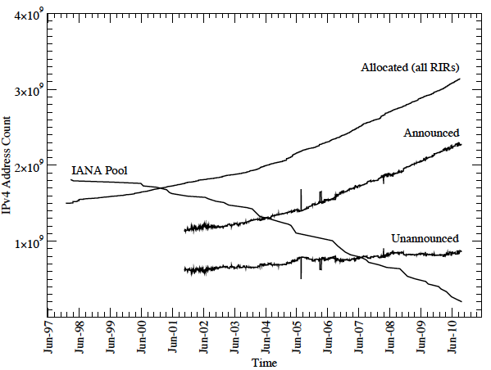
Problem: IP Address Exhaustion
IPv4 Addresses are 32 bits wide: ~3.7Bn usable addresses
All devices on the Internet require an address
Given Internet growth rate, addresses have been diminishing fast…
1988: Started with 3.7Bn usable free;
By 1997: just 1.8Bn left
IANA exhausted free address pool in February 2011

Slide 31
Solution Strategies
Under address scarcity, how do we continue to support Internet growth?
Three ways of mitigating exhaustion of a scarce resource:
Sharing:
Share addresses in time via Dynamic Host Configuration Protocol (DHCP)
Share addresses in port space via, e.g. Carrier-grade NAT (CGN)
More efficient utilization:
Stricter policy for new address allocations
Reallocation of unused or otherwise reclaimed addresses
Address markets for the efficient distribution of addresses
Transition to another resource:
Replace IPv4 with IPv6, which provides the ultimate long-term solution with a practically inexhaustible address space
Notes:
This is the space of possible solutions... working on address scarcity and will talk about two of the solutions
Why study efficient util if will transition off v4?
IPv4 will last a long time, we will have coexistence, for availability and security of the Internet...
Why study v6 adoption?:
The Internet has never experienced a change so fundamental and large scale. From a Science perspective, studying this event is unique opportunity.

Slide 32
Network Address Translation
Introduced in the early 90s to alleviate IPv4 address space congestion
Relies on translating addresses in an internal network, to an external address that is used for communication to and from the outside world
NAT is usually implemented by placing a router in between the internal private network and the public network.
Saves IP address space since not every terminal needs a globally unique IP address, only an organizationally unique one
While NAT should really be transparent to all high level services, this is sadly not true because a lot of high level communication uses things on IP
Notes:
Whenever the router encounters a datagram it translates the address depending on what way the packet is headed
Usually any given internal IP address is bound to one of many IP addresses dynamically when it creates a session
NAT often needs to handle certain protocols like FTP in a special manner
While most NAT routers can handle popular protocols well, even when they need special attention, well, there are protocols which these routers cannot handle, and hence not all applications can run transparently through NAT.

Slide 33
Translation
Router has a pool of private addresses 192.168.10.0/24
private realm
global realm
s=192.168.10.237 d=128.148.36. 11
s=128.148.36.179
d=128.148.36.11
s=128.148.36.11
d=192.168.10.237
s=128.148.36.11
d=128.148.36.179
192.168.10.237
128.148.36.11
NAT route

Slide 34
A typical NAT-based home network (CDK Figure 3.18)

Slide 35
IP Packet Modifications
0
31
vers
len
type of service
total length
Computed
ident
flags
fragment offset
Modified on output
time to live
proto
header checksum
source IP address
destination IP address
Modified on input
options
padding
data
????

Slide 36
What is the Internet?

Slide 37
What’s the Internet: “nuts and bolts” view
millions of connected computing devices: hosts, end-systems
PCs workstations, servers
PDAs phones, toasters
running network apps
communication links
fiber, copper, radio, satellite
transmission rate = bandwidth
routers: forward packets (chunks of data)
router
workstation
server
mobile
local ISP
regional ISP
company
network

Slide 38
What’s the Internet: “nuts and bolts” view
protocols control sending, receiving of msgs
e.g., TCP, IP, HTTP, FTP, PPP
Internet: “network of networks”
loosely hierarchical
public Internet versus private intranet
Internet standards
RFC: Request for comments
IETF: Internet Engineering Task Force
router
workstation
server
mobile
local ISP
regional ISP
company
network

Slide 39
What’s the Internet: a service view
communication infrastructure enables distributed applications:
Web, email, games, e-commerce, database., voting, file (MP3) sharing
communication services provided to apps:
connectionless
connection-oriented

Slide 40
Internet design
Put the intelligence in the end hosts and keep the network simple.
Packet switched instead of circuit switched.
Best effort delivery.
Force transport layer to deal with delay and loss.
Reliable in the face of failures.
No session state on routers.
Allows routers to be added and removed without causing large disturbances.

Slide 41
Autonomous Systems (AS)
R3
R4
R2
R1
R5
R6
The Internet is a collection of autonomous systems.
AS: A set of routers and networks under the same administrative control.
Inter-domain vs. intra-domain routing.

Slide 42
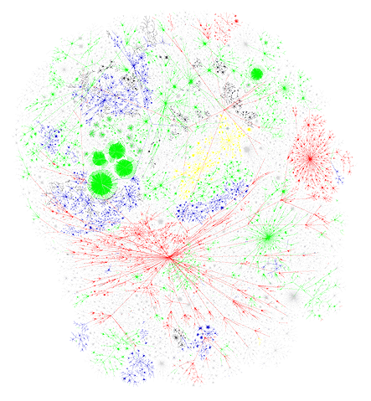
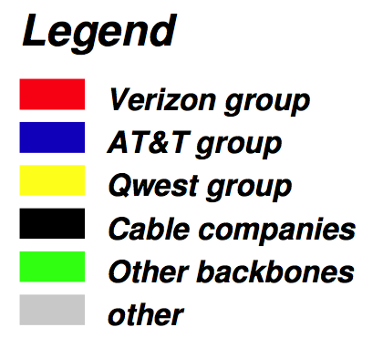
The Internet Backbone
http://advice.cio.com/node/209

Slide 43
Internet structure: network of networks
roughly hierarchical
at center: “tier-1” ISPs (e.g., UUNet, BBN/Genuity, Sprint, AT&T), national/international coverage
treat each other as equals
Tier-1 providers also interconnect at public network access points (NAPs)
Tier-1 providers interconnect (peer) privately
Tier 1 ISP
NAP
Tier 1 ISP
Tier 1 ISP

Slide 44
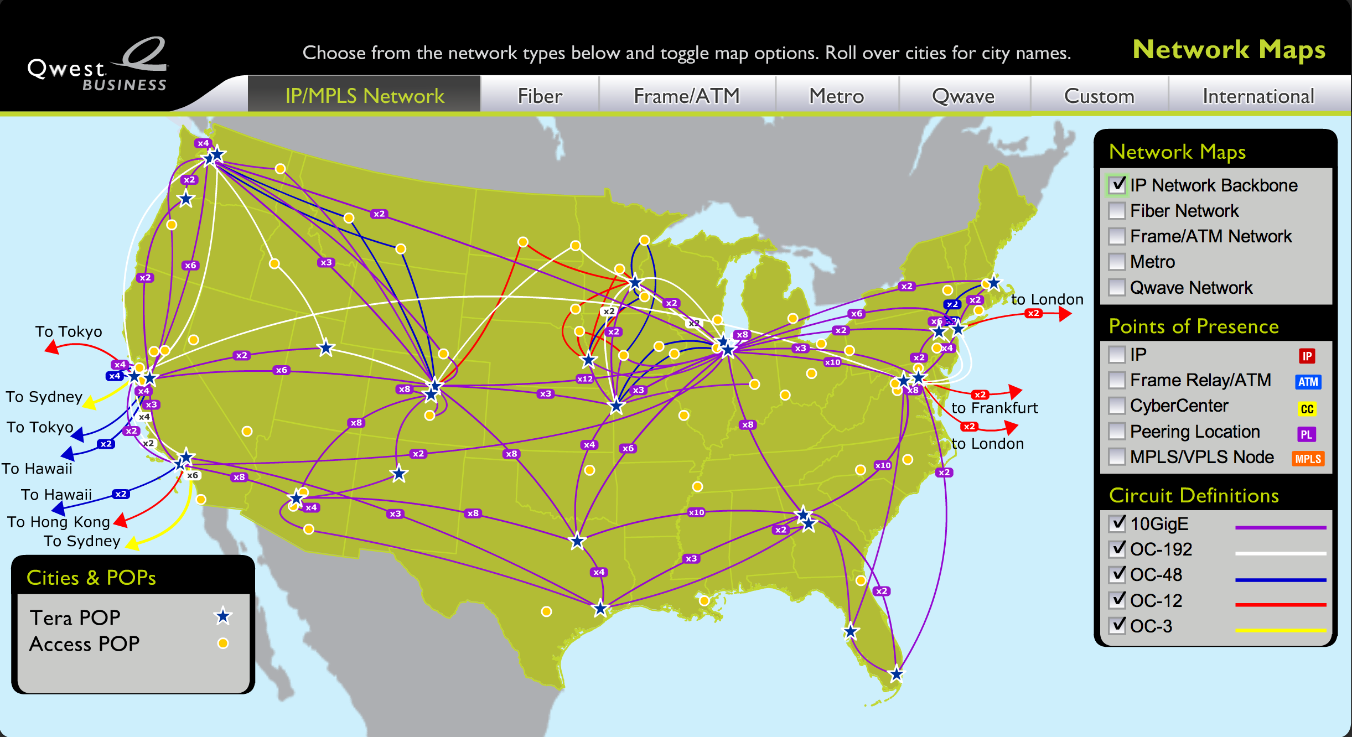
Qwest’s backbone

Slide 45
Internet structure: network of networks
“Tier-2” ISPs: smaller (often regional) ISPs
Connect to one or more tier-1 ISPs, possibly other tier-2 ISPs
Tier-2 ISPs also peer privately with each other, interconnect at NAP
Tier-2 ISP pays tier-1 ISP for connectivity to rest of Internet
tier-2 ISP is customer of
tier-1 provider
Tier-2 ISP
Tier-2 ISP
Tier 1 ISP
NAP
Tier 1 ISP
Tier 1 ISP
Tier-2 ISP
Tier-2 ISP
Tier-2 ISP

Slide 46
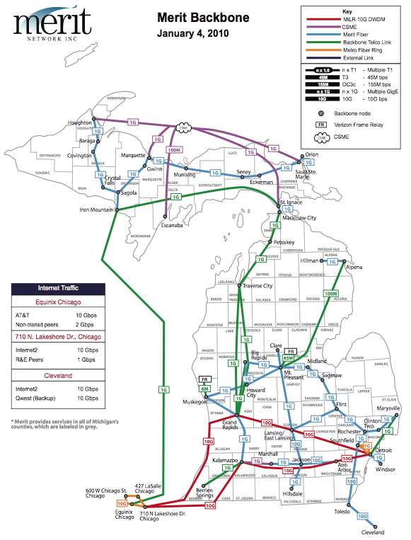

Slide 47
Internet structure: network of networks
“Tier-3” ISPs and local ISPs
last hop (“access”) network (closest to end systems)
local
ISP
Tier 3
ISP
local
ISP
local
ISP
local
ISP
Local and tier- 3 ISPs are customers of
higher tier ISPs
connecting them to rest of Internet
Tier-2 ISP
Tier-2 ISP
Tier 1 ISP
NAP
Tier 1 ISP
Tier 1 ISP
Tier-2 ISP
Tier-2 ISP
Tier-2 ISP
local
ISP
local
ISP
local
ISP
local
ISP

Slide 48
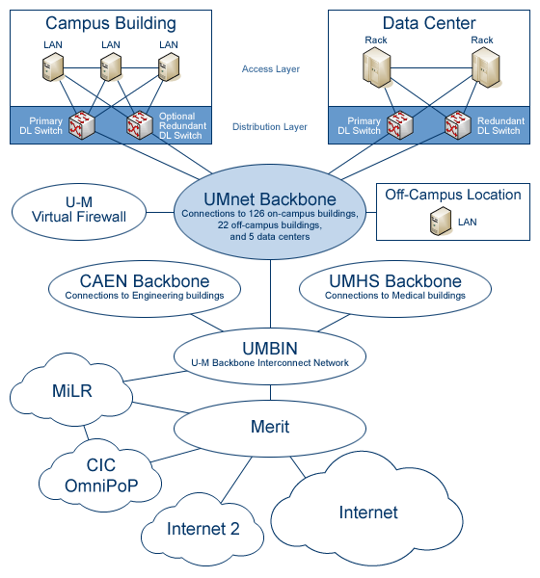
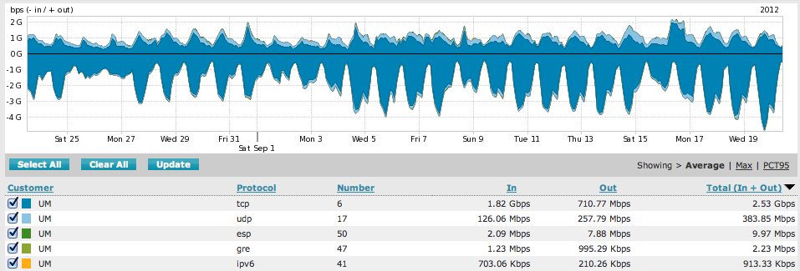
UMnet Backbone

Slide 49
Connection-oriented service
Goal: data transfer between end systems
handshaking: setup (prepare for) data transfer ahead of time
Hello, hello back human protocol
set up “state” in two communicating hosts
TCP - Transmission Control Protocol
Internet’s connection-oriented service
TCP service [RFC 793]
Byte-steam abstraction: reliably delivering a stream of bytes from S to R
reliable, in-order byte-stream data transfer
loss: acknowledgements and retransmissions
flow control:
sender won’t overwhelm receiver
congestion control:
senders “slow down sending rate” when network congested

Slide 50
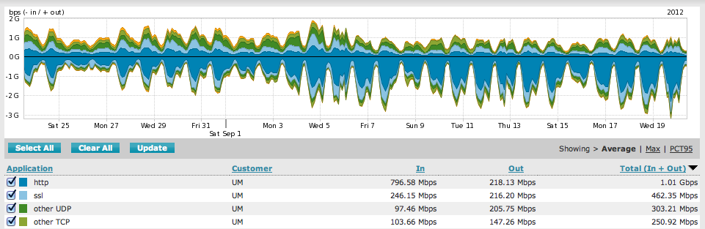
Network edge: connectionless service
Goal: data transfer between end systems
Goal is same as before!
No handshaking
No connection state maintained on end hosts
UDP - User Datagram Protocol [RFC 768]: Internet’s connectionless service
unreliable data transfer
no flow control
no congestion control
Apps using TCP:
HTTP (Web), FTP (file transfer), Telnet (remote login), SMTP (email)
Apps using UDP:
streaming media, teleconferencing, DNS, Internet telephony

Slide 51
IP Routing
A router bridges two or more networks
Operates at the network layer
Maintains tables to forward packets to the appropriate network
Forwarding decisions based solely on the destination address
Routing table
Maps ranges of addresses to LANs or other gateway routers

Slide 52
Interplay between routing and forwarding
routing algorithm
local forwarding table
header value
output link
0100
0101
0111
1001
3
2
2
1
value in arriving
packet’s header
0111
1
3
2

Slide 53
Internet inter-AS routing: BGP
BGP (Border Gateway Protocol): the de facto standard
BGP provides each AS a means to:
Obtain subnet reachability information from neighboring ASs.
Propagate the reachability information to all routers internal to the AS.
Determine “good” routes to subnets based on reachability information and policy.
Allows a subnet to advertise its existence to rest of the Internet: “I am here”

Slide 54
BGP basics
Pairs of routers (BGP peers) exchange routing info over semi-permanent TCP connections: BGP sessions
Note that BGP sessions do not correspond to physical links.
When AS2 advertises a prefix to AS1, AS2 is promising it will forward any datagrams destined to that prefix towards the prefix.
AS2 can aggregate prefixes in its advertisement
3c
3a
2c
3b
2a
AS3
2b
1c
AS2
1a
1b
AS1
1d
eBGP session
iBGP session

Slide 55
DNS: Domain Name System
People: many identifiers:
SSN, name, passport #
Internet hosts, routers:
IP address (32 bit) - used for addressing datagrams
“name”, e.g., www.eecs.umich.edu - used by humans
Q: map between IP addresses and name ?
Domain Name System:
distributed database implemented in hierarchy of many name servers
application-layer protocol host, routers, name servers to communicate to resolve names (address/name translation)
note: core Internet function, implemented as application-layer protocol
complexity at network’s “edge”

Slide 56
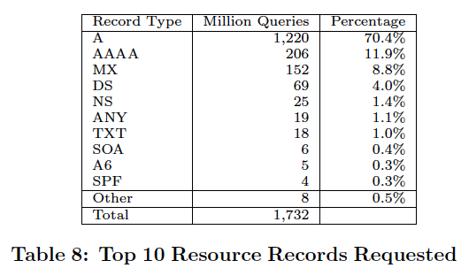
DNS name servers
Why not centralize DNS?
single point of failure
traffic volume
distant centralized database
Maintenance
doesn’t scale!
no server has all name-to-IP address mappings
local name servers:
each ISP, company has local (default) name server
host DNS query first goes to local name server
authoritative name server:
for a host: stores that host’s IP address, name
can perform name/address translation for that host’s name

Slide 57
DNS Hierarchical Name Space
unnamed root
.
.com
.edu
.org
.ac
.uk
.zw
.arpa
generic domains
country domains
bar
ac
in-
addr
west
east
cam
12
foo
my
usr
34
my.east.bar.edu
usr.cam.ac.uk
56
Top-Level Domain (TLD)
12.34.56.0/24

Slide 58
Distributed Hierarchical Database (1st Approx)
Root name servers
.com name servers
.org name servers
.edu name servers
yahoo.com
name servers
amazon.com
name servers
pbs.org
name servers
poly.edu
name servers
umass.edu
name servers
Client wants IP for www.amazon.com:
Client queries a root server to find .com name server
Client queries .com name server to get amazon.com name server
Client queries amazon.com name server to get IP address for www.amazon.com

Slide 59
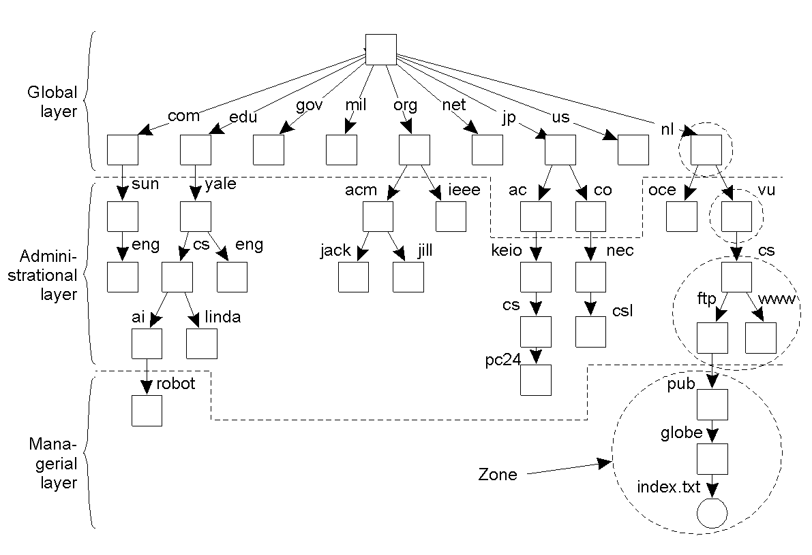
Name Space Distribution
124537172 arin.net
217003127 verisign.com
314529802 apnic.net
414526895 gslb.com
510917319 manitu.net
69167881 sorbs.net
78701029 msft.net
88595104 google.com
97520954 amazon.com
107450839 register.com
117034622 gtld-servers.net
126937887 facebook.com
136779616 coremetrics.com
146574735 msecnd.net
156570337 root-servers.net
165725087 amazonaws.com
175663948 akamai.net
185309527 weather.com
194943117 name-services.com
204902683 yahoo.com

Slide 60
Name Resolution
Zone: collection of connected nodes with the same authoritative DNS server
Resolution method when answer not in cache:
root
name server
Where is www.example.com?
ISP DNS
Server
Try com nameserver
Client
Where is www.example.com?
Where is www.example.com?
com
name server
Try example.com nameserver
208.77.188.166
Where is www.example.com?
208.77.188.166
example.com
name server

Slide 61
Iterative Name Resolution
. (root)
Resolver
cache
1
answer
query
.com
Local Name Server
Resolver
2
query
Application
Resolver
answer
google.com
cache
cache
query
Resolver
answer
3
cache

Slide 62
DNS Caching
Step 1: query yourdomain.org
Local Machine
Local NS
Authoritative
Name Server
Resolver
Application
Resolver
query
query
cache
cache
Step 2: receive reply and cache at local NS and host
Local Machine
Local NS
Authoritative
Name Server
answer
Resolver
answer
Application
Resolver
cache
cache

Slide 63
DNS Caching (con'd)
Step 3: use cached results rather than querying the ANS
Local NS
Local Machine 1
Application
Resolver
Resolver
cache
cache
query
Local Machine 2
Application
Resolver
answer
cache
Step 4: Evict cache entries upon ttl expiration

