Slide 1
Lecture 22 – Forensics
Syed Faisal Hasan, PhD
University of Illinois
ECE 422/CS 461 – Fall 2015

Slide 2
Forensics Investigations
Involves collecting evidence and analyze it to understand crimes, motives behind it or the criminal’s identity.
As computers, mobiles and internet have become integral in our lives more and more evidence collected from digital media are helping the investigators.
Cybercrimes are also causing loss of billions of dollars each year.

Slide 3
Example Case
William Mcguire case
https://www.youtube.com/watch?v=--ZHo0Z2mgY
Many of the techniques used for traditional crime scene investigations have digital counter parts
But there are some unique aspects of computer forensics

Slide 4
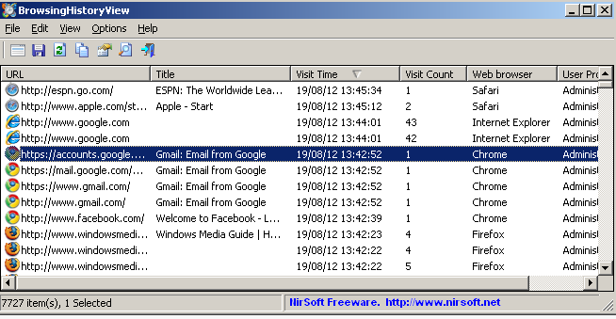
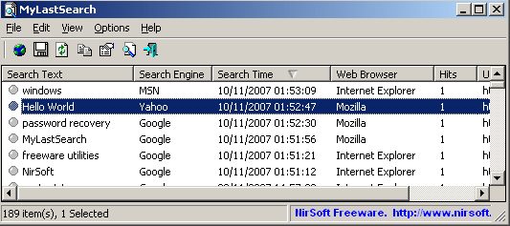
Finding Browsing History

Slide 5
Finding Search History

Slide 6
What is Computer Forensics?
Scientific process of preserving, identifying, extracting, documenting, and interpreting data on a computer
Used to obtain potential legal evidence

Slide 7
Computer Forensics Procedures
The Forensic Paradigm
Identification
Collection
Analysis and
Evaluation
Reporting
Identify specific objects that store important data for the case analysis
Establish a chain of custody and document all steps to prove that the collected data remains intact and unaltered
Determine the type of information stored on digital evidence and conduct a thorough analysis of the media
Prepare and deliver an official report

Slide 8
Identification: Common Mistakes …
You are the investigator, which objects do you think will be useful for investigations?
Computer (case and power supply)
Just the hard drive (without computer)
Monitor
Keyboard and mouse
Media (CD, DVD, USB drives, etc.)
Printer
Digital forensics does not replace traditional forensic analysis
Any action that modifies the crime scene could invalidate evidence in court

Slide 9
Collection
To collect computer evidence, care must be taken not to change the evidence.
Imaging media using a write-blocking tool to ensure the suspect device is not be modified
Establishing and maintaining the chain of custody
Documenting everything that has been done
Using only tools and methods that have been tested and evaluated to validate their accuracy and reliability

Slide 10
Forensic Constraints
Chain of custody
Maintain possession of all objects
Must be able to trace evidence back to source
“Prove” source integrity
Priority by volatility
Some data is more volatile
RAM > swap > disk > CDs/DVDs
Idea: capture more volatile evidence first

Slide 11
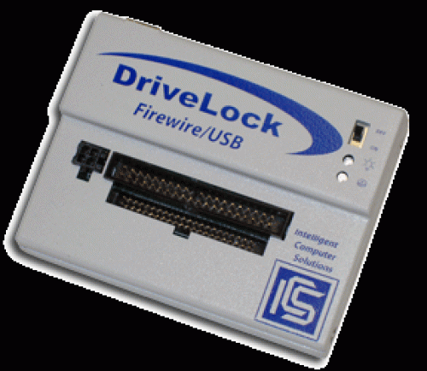
Image Evidence: Laptop
USB ADAPTER
DATA CABLE
LAPTOP at Crime Scene
EVIDENCE DISK

Slide 12
Why Use Images
Information on digital media is easily changed.
Once changed it is usually impossible to detect that a change has taken place (or to revert the data back to its original state) unless other measures have been taken
A common practice is calculate a cryptographic hash to establish a check point
Examining a live file system changes state of the evidence
The computer/media is the “crime scene”
Protecting the crime scene is paramount as once evidence is contaminated, it cannot be decontaminated
Really only one chance to do it right!

Slide 13
Collection: Common Mistakes …
What is the first step to collect evidence, when you find:
A computer turned on
A computer turned off
A computer on a crime scene should be considered fully adversarial

Slide 14
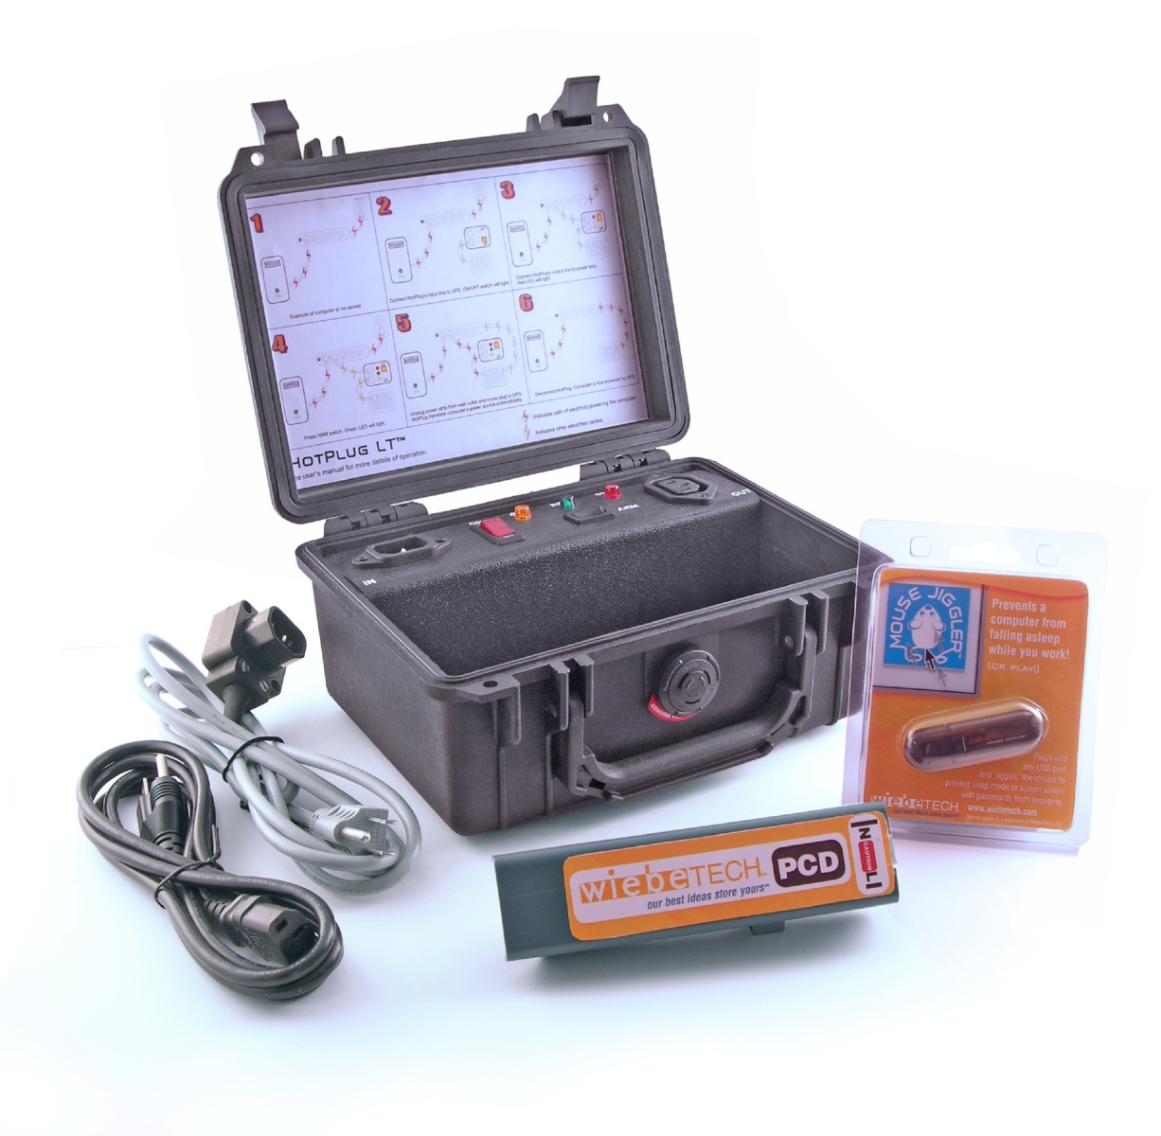
HotPlug!
https://www.youtube.com/watch?v=erq4TO_a3z8

Slide 15
Analysis and Evaluation
Know where evidence can be found
Understand techniques used to hide or “destroy” digital data
Toolbox of techniques to discover hidden data and recover “destroyed” data
Cope with HUGE quantities of digital data…
Ignore the irrelevant, target the relevant
Thoroughly understand circumstances which may make “evidence” unreliable
If you have a hard drive with a broken sector that gives different result, what happens when you hash the entire drive?

Slide 16
Where is the Evidence?
Undeleted files, expect some names to be incorrect
Deleted files
Windows registry
Print spool files
Hibernation files
Temp files (all those .TMP files in Windows!)
Slack space
Swap files
Internet browsing histories
Alternate or “hidden” partitions
On a variety of removable media (USB drives, backup tapes, …)

Slide 17
How to Hide Data?
Cryptography
Steganography
The process of hiding data inside other data (e.g. image files).
Change file names and extensions
E.g. rename a .doc file to a .tmp file
Hidden tracks
most hard disks have # of tracks hidden (i.e. track 0)
They can be used to hide/read data by using a hex editor
Deleted Files
not truly deleted, merely marked for deletion.
During Forensic is important to do not use any tools that write to the disk

Slide 18
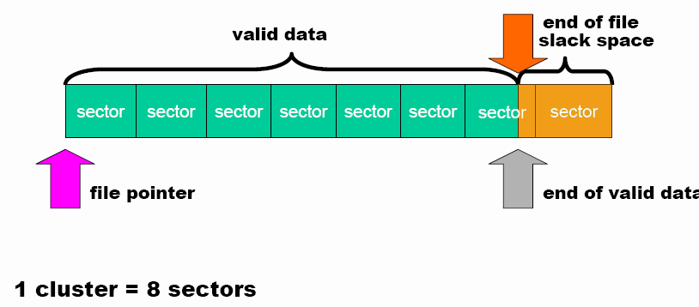
Hidden Data in the Hard Drive Slack Space
Slack space is the space between
The logical end of the file (i.e., the end of the data actually in the file) and
The physical end of the file (i.e., the end of the last sector devoted to the file).

Slide 19
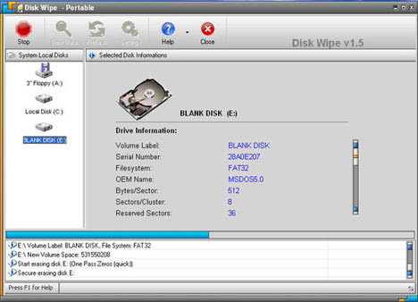
Disk Wiping
Simple erase
The data is still on the drive but the segment has been marked as available
Next time data is written to the drive it MAY overwrite the segment
Destructive erase
First overwrites all data in the file with random data
Next marks the segment as available
It may be possible to find ghost images of what was previously on the disk surface
Overwriting Hard Drive Data: The Great Wiping Controversy, ICISS 2008

Slide 20
File Carving: NTFS
Simple erase
The data is still on the drive but the segment has been marked as available
Next time data is written to the drive it MAY overwrite the segmen
Meta data
File Part1
File Part2
File Part3
Boot Sector
MFT
NTFS Partition

Slide 21
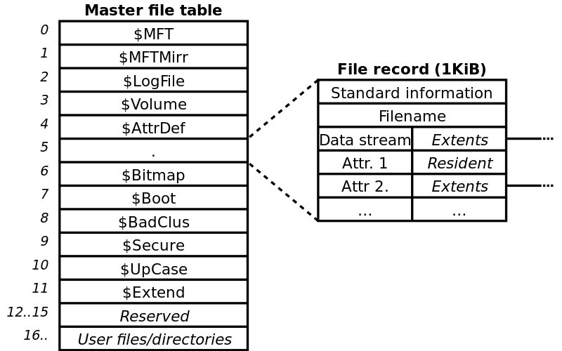
File Carving
https://commons.wikimedia.org/wiki/File:Ntfs_mft.svg

Slide 22
Digital Forensics Tools
Forensics tools are typically command line tools that are guaranteed not to alter the disk:
HELIX a live cd with a plenty of forensic tools ready to be used
ENCASE a series of proprietary forensic software products produced by Guidance Software
AUTOPSY …

Slide 23
Why Create a Duplicate Image?
A file copy does not recover all data areas of the device for examination
Working from a duplicate image
Preserves the original evidence
Prevents inadvertent alteration of original evidence during examination
Allows recreation of the duplicate image if necessary
Notes:
Never do anything that might inadvertently cause something to be written to the suspect’s original media.

Slide 24
Bitstream vs. Backups
Forensic copies (Bitstream)
Bit for bit copying captures all the data on the copied media
Including hidden and residual data (e.g., slack space, swap, residue, unused space, deleted files etc.)
Often the “smoking gun” is found in the residual data.
Logical vs. physical image

Slide 25
Reporting
Accurately describe the details of an incident
Be understandable to decision makers
Be able to withstand legal scrutiny
Be unambiguous and not open to misinterpretation
Be easily referenced
Contain all information required to explain the conclusions
Offer valid conclusions, opinions, or recommendations when needed
Create report in a timely manner

Slide 26
Anti-Forensic and Data Security
Anti-forensic techniques try to frustrate forensic investigators and their techniques
Securely deleting data, so that it cannot be restored with forensic methods
Prevent the creation of certain data in the first place
Data which was never there, obviously cannot be restored with forensic methods.

Slide 27
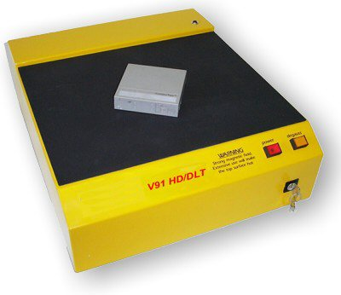
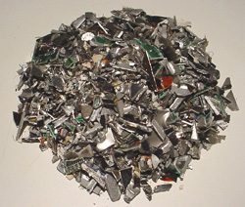
Privacy Through Media Destruction
thermite…
or
or
Degausser Magnetic Field
shredder

Slide 28
Solid-state drives (SSD)
Different deletion/allocation mechanism
E.g. Erase in 256KB blocks, write in 4KB blocks
Wear-leveling and extra space
Specific commands to mark data (TRIM)
SSD forensics is a challenging task. You can learn more about this at:
https://www.youtube.com/watch?v=vLoYduckmuo

Slide 29
Network Forensics
It’s about recovering and analyzing digital evidence from networked sources.
Digital evidence is produced as a result of communication over a network.
Examples: e-mails and IM sessions; browser activity; routinely kept packet logs; /var/log/messages.
Depending on the method of capture, packet capture may be treated as recordings of events. I.e., there are privacy and legal implications, so you must be careful.

Slide 30
Challenges of Network Forensics
Can be extremely volatile.
E.g., you lose data if you turn devices off; limited storage space means limited data are there to begin with.
Seizure of devices usually isn’t an option.
You can’t shut down a company’s Web server the way you’d shut down an employee’s laptop!
Often the source that generated it cannot be identified.
Few court cases have been won based on network forensics evidence!

Slide 31
Sources of Network Based Evidence
Wireless access points.
Easy to eavesdrop on traffic that passes through.
Management and control frames are not encrypted.
Switches (devices that connect computers together).
Contain tables that store, e.g., mappings between physical ports and devices’ MAC addresses.
Traffic can be captured from switches as well.
Routers (devices that connect segments of networks together).
Contain routing tables that map router ports with networks.
Routers may also function as packet filters.

Slide 32
Sources of Network Based Evidence
DHCP servers (which give out IP addresses via a temporary leasing system; every machine needs an IP address to connect to the Internet).
DHCP server logs contain IP address to MAC address mappings and the times the IP addresses were leased.
DNS servers and name servers (which convert domain names to IP addresses).
Logs may reveal connection attempts from internal to external websites, e-mail, or SSH servers, with time stamps.
Authentication servers (which, e.g., validate username & password credentials).
Log successful/failed login attempts for all devices within their authentication domains.

Slide 33
Sources of Network Based Evidence
Network intrusion detection/prevention systems (NIDS/NIPS) (which monitor what’s coming in and going out of a network).
May detect attacks in progress.
Can be tuned to give more granular data.
Firewalls (which block incoming and/or outgoing traffic).
Firewalls can be configured to keep logs, which can serve as digital evidence.
Web proxies (intermediary servers that support clients’ access to Web content).
An enterprise’s Web proxy can store Web surfing logs for the entire organization.
Application servers.
E.g., database, Web, e-mail, chat, and voicemail servers. These can be very important.

Slide 34
A case study
A small software startup suspects that one of its employees, Faisal, has been transferring code to its competitors. So they started capturing packets from the network to determine whether it’s true.
From the captured data, you have to find out:
Online addresses and corresponding account credentials of the suspect, Faisal.
With whom did Faisal communicate? Provide their email address and identifications.
Extract transcripts of Faisal’s conversations.
If he has sent/received any files, recover them

Slide 35
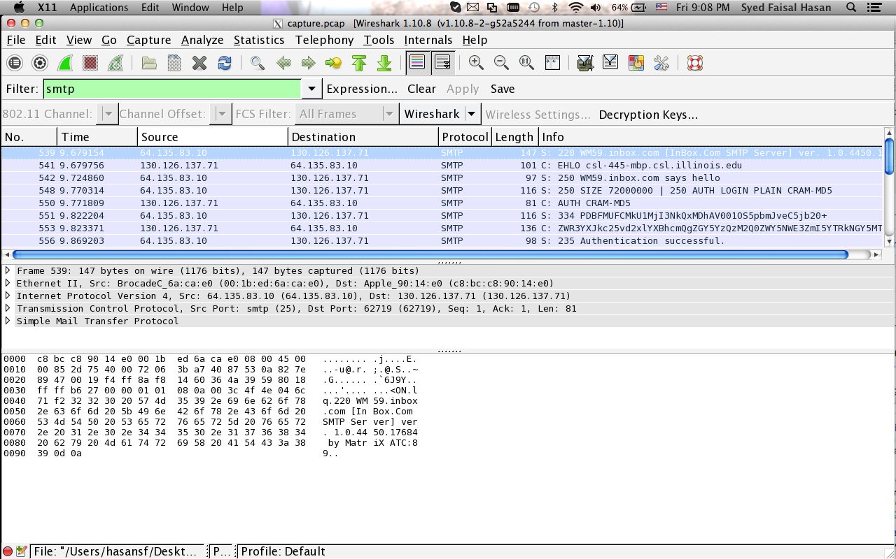
smtp analysis

Slide 36
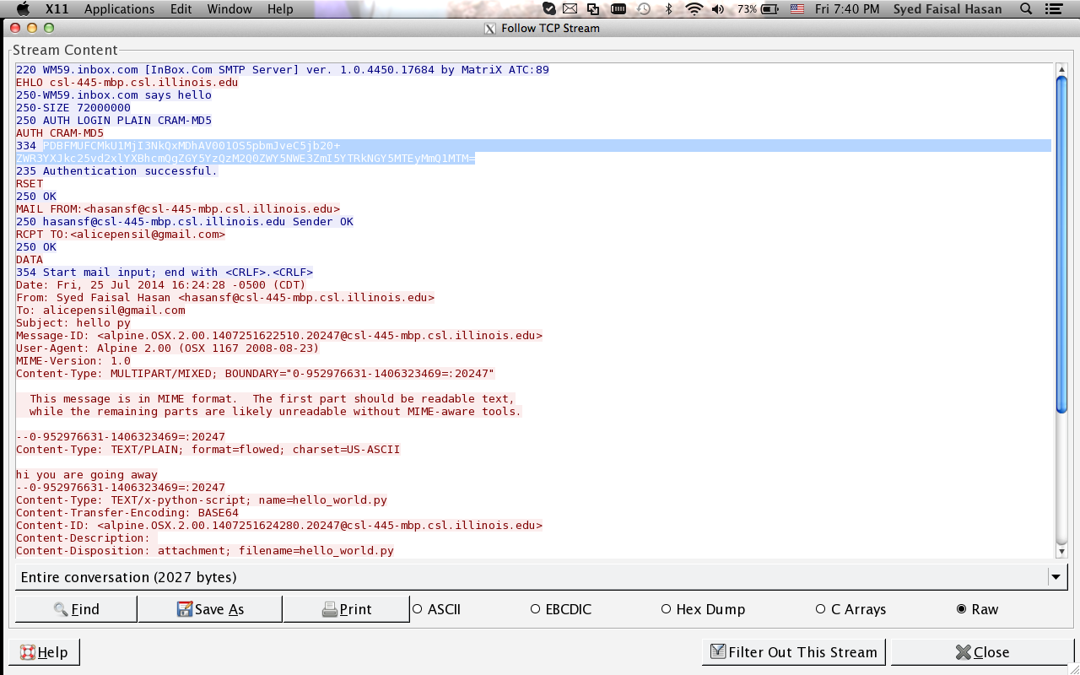
smtp analysis

Slide 37
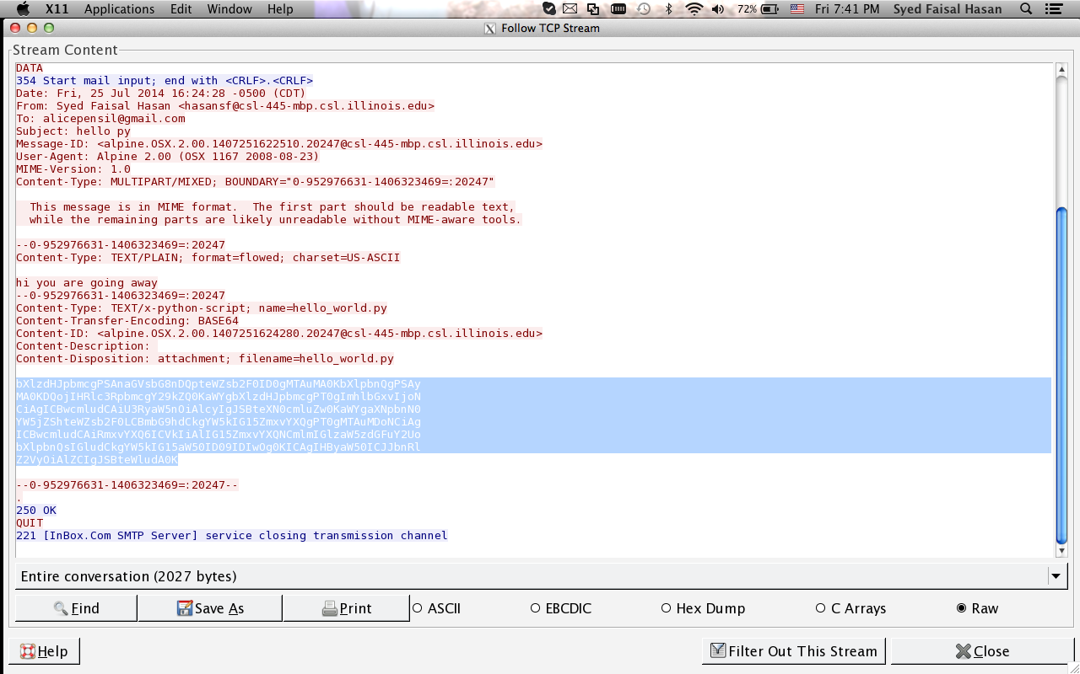
file curving from smtp

Slide 38
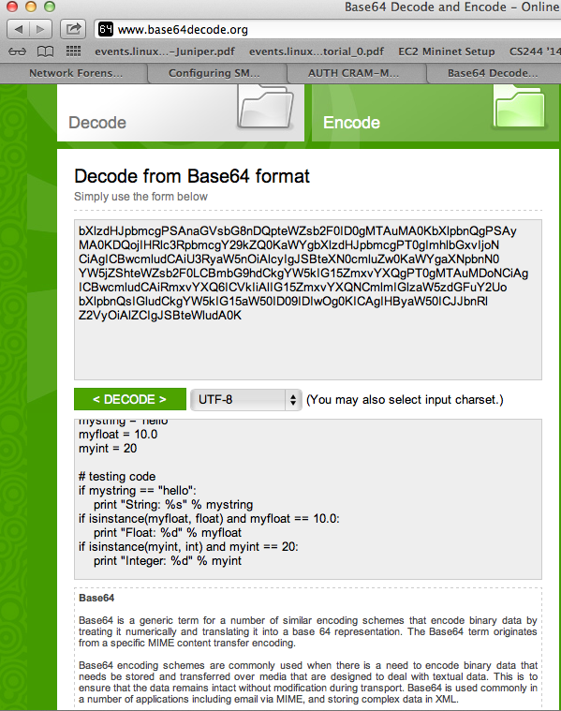
file curving from smtp

