Slide 1
Lecture 3 – Message Integrity
Michael Bailey
University of Illinois
ECE 422/CS 461 – Fall 2015

Slide 2
Message Integrity

Slide 3
Goal: Message Integrity
Alice wants to send message m to Bob
don’t fully trust the messenger or network carrying the message
want to be sure what Bob receives is actually what Alice sent
Threat model:
Mallory can see, modify, forge messages
Mallory wants to trick Bob into accepting a message Alice didn’t send
Alice
m
Mallory
m′
Bob

Slide 4
Solution: Message Authentication Code (MAC)
One approach:
1. Alice computes v := f(m)
2.
3. Bob verifies that v′ = f(m′), accepts message iff this is true
Function f ?
Easily computable by Alice and Bob; not computable by Mallory
(Idea: Secret only Alice & Bob know)
We’re sunk if Mallory can learn f(x) for any x ≠ m!
Alice
m, v
Mallory
m′, v′
Bob
e.g. “Attack at dawn”, 628369867…

Slide 5
Candidate f: Random function
Input: Any size up to huge maximum
Output: Fixed size (e.g. 256 bits)
Defined by a giant lookup table that’s filled in by flipping coins
Completely impractical
Provably secure
0 → 0011111001010001… 1 → 1110011010010100… 2 → 0101010001010000…
…
…
[Why?]
[Why?]

Slide 6
Want a function that’s practical but “looks random”… Pseudorandom function (PRF)
Let’s build one:
Start with a big family of functions f₀, f₁, f₂, … all known to Mallory
Use f_{k}, where k is a secret value (or “key”) known only to Alice/Bob
k is (say) 256 bits, chosen randomly
Kerckhoffs’s Principle
Don’t rely on secret functions
Use a secret key, to choose from a function family
[Why?]
Notes:
Auguste Kerckhoffs (1883)
Why Kerchoffs’s Principle?
can quantify probability that adversary will guess key because chosen randomly from known space
different people can use same system, different keys: Alice and Bob use one key, Charlie and Diane use another
can change key if something goes wrong
• The system must be practically, if not mathematically, indecipherable;
• It should not require secrecy, and it should not be a problem if it falls into enemy hands;
• It must be possible to communicate and remember the key without using written notes, and correspondents must be able to change or modify it at will;
• It must be applicable to telegraph communications;
• It must be portable, and should not require several persons to handle or operate;
• Lastly, given the circumstances in which it is to be used, the system must be easy to use and should not be stressful to use or require its users to know and comply with a long list of rules.
Kerckhoffs's principle was reformulated (or perhaps independently formulated) by Claude Shannon as "the enemy knows the system", [1] i.e., "one ought to design systems under the assumption that the enemy will immediately gain full familiarity with them". In that form, it is called Shannon's maxim. In contrast to "security through obscurity", it is widely embraced by cryptographers.

Slide 7
Formal definition of a secure PRF:
Game against Mallory
We flip a coin secretly to get bit b
If b=0, let g be a random function If b=1, let g = f_{k}, where k is a randomly chosen secret
Repeat until Mallory says “stop”: Mallory chooses x; we announce g(x)
Mallory guesses b
We say f is a secure PRF if Mallory can’t do better than random guessing*
i.e., f_{k} is indistinguishable in practice from a random function, unless you know k
Important fact: There’s an algorithm that always wins for Mallory
[What is it?] [How to fix it?]
Notes:
*actually, it’s OK if Mallory has a negligible advantage over guessing, so long as it’s vanishingly small
---
Important fact:
There is an algorithm that always wins for Mallory
get a long list of (x, g(x)) pairs
try every value of k to see whether f_{k} matches that list
guess b=1 iff some f_{k} matches
To fix this, need to limit Mallory to “practical” or “efficient” algorithms
Won’t define this precisely in this course (but precise definitions do exist)

Slide 8
A solution for Alice and Bob:
Let f by a secure PRF
In advance, choose a random k known only to Alice and Bob
Alice computes v := f_{k}(m)
Bob verifies that v′ = f_{k}(m′), accepts message iff this is true
[Important assumptions?]
What if Alice and Bob want to send more than one message?
[Attacks?] [Solutions?]
k
m, v
m′, v′
k
Alice
Mallory
Bob
Notes:
Important Assumptions:
Physical security
Key management - Note: key exchange has happened in advance
--
What if Alice and Bob want to send more than one message? - can’t just redo same plan
- replay attacks / reordering attacks
Solutions:
- add sequence number to message
- or, use different key each time

Slide 9

Annoying question: Do PRFs actually exist?
Annoying answer: We don’t know.
So how do we get a MAC?
Well-studied functions where we haven’t spotted a problem yet (e.g. HMAC-SHA256)

Slide 10
New Approach: Hash-based MAC (HMAC)
HMAC-SHA256 see RFC 2104
HMAC_{k}(m) =
XOR
0x3636…
0x5c5c…
Concatenation
SHA256 function takes arbitrary length input, returns 256-bit output

Slide 11
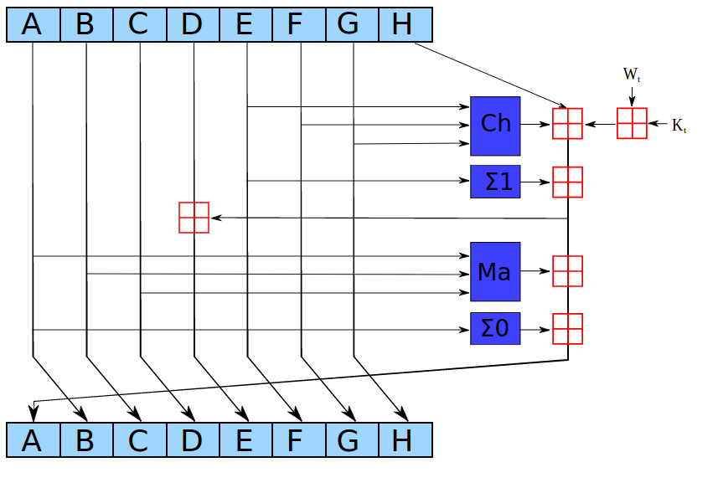
What is SHA256?
“Cryptographic hash function”
Input: arbitrary length data (No key) Output: 256 bits
Built with “compression function” h
(256 bits, 512 bits) in → 256 bits out
Designed to be really hairy (64 rounds of this):
Entire algorithm:
Pad input to multiple of 512 bits (using a fixed algorithm [Why?] )
Break into 512-bit blocks b₀, b₁, … b_{n-1}
y₀ = const, y₁ = h(y₀,b₀), …, y_{i} = h(y_{i-1},b_{i-1})
Return y_{n}
Notes:
Pad using a fixed algorithm – why?
Part of the definition of the function
Otherwise different implementations would calculate different outputs for the same inputs
Compression function h:
designed to be really hairy
lots of bit twiddling
- look up in book if you want; not very enlightening

Slide 12
Merkle–Damgård Construction
- Arbitrary-length input - Fixed-length output
- Built from fixed-size “compression function”
IV
Fixed-length inputs/outputs
b₀
h
pad
b₁
h
M
…
…
Arbitrary length input
b_{n-1}
h
Fixed length output
H(M)

Slide 13
Hash function properties
Good hash functions should make it difficult to find …
First pre-image:
given h(m), find m
Second pre-image:
given m₁, find m₂ s.t. h(m₁) = h(m₂)
Collision:
find any m₁ != m₂ s.t. h(m₁) = h(m₂)

Slide 14
Other hash functions:
MD5
Once ubiquitous
Broken in 2004
Turns out to be easy to find collisions (pairs of messages with same MD5 hash)
You’ll investigate this in MP 1
SHA1
Currently widely used
Suspected to be weak
Don’t use in new applications
SHA3
Different construction: “Sponge”
Not susceptible to length-extension

Slide 15
Message Authentication Code (MAC) e.g. HMAC-SHA256 vs.
Cryptographic hash function e.g. SHA256 not a strong PRF
Used to think the distinction didn’t matter, now we think it does e.g., length extension attacks
Better to use a MAC/PRF (not a hash)
$ openssl dgst -sha256 -hmac <key>
[What if you don’t need a key?]
Notes:
If you don’t need a secret key, pick a key and announce it, use different keys for different purposes to be safe.
--
Also useful to “stretch” a shared secret: given one shared secret key, generate two
Do this trick over and over to generate N shared secret keys “pseudorandom generator” topic of the next lecture

Slide 16
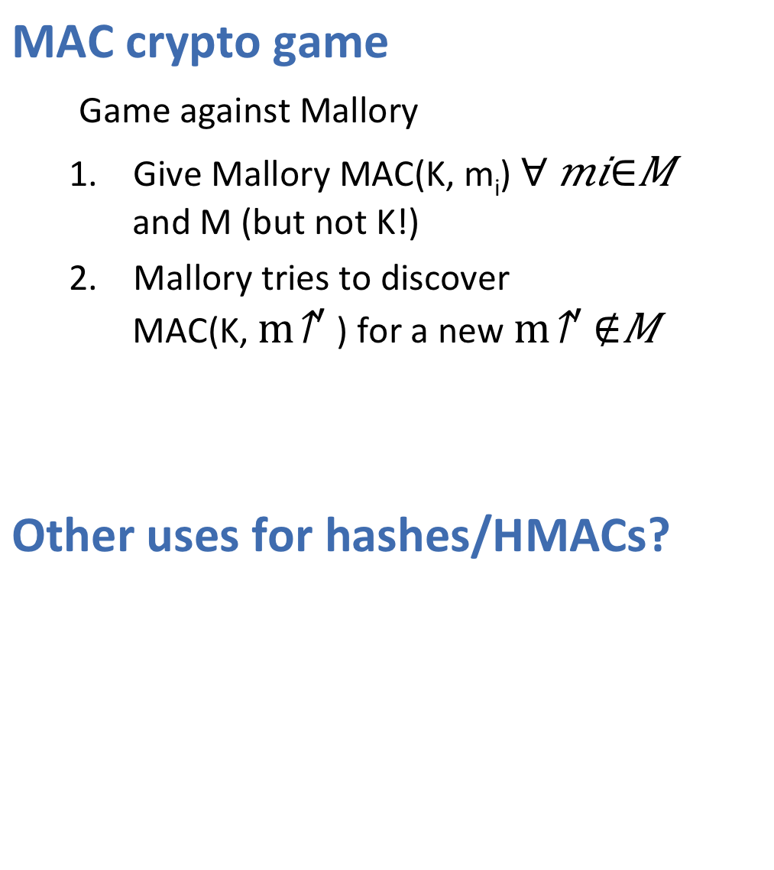
MAC crypto game
Game against Mallory
Give Mallory MAC(K, m_{i}) $∀ mi∈M$ and M (but not K!)
Mallory tries to discover MAC(K, $m^{′}$) for a new$m^{′}∉M$
Other uses for hashes/HMACs?
Notes:
They can also be used as ordinary hash functions, to index data in hash tables, for fingerprinting, to detect duplicate data or uniquely identify files, and as checksums to detect accidental data corruption.
While MAC functions are similar to cryptographic hash functions, they possess different security requirements. To be considered secure, a MAC function must resist existential forgery under chosen-plaintext attacks. This means that even if an attacker has access to an oracle which possesses the secret key and generates MACs for messages of the attacker's choosing, the attacker cannot guess the MAC for other messages (which were not used to query the oracle) without performing infeasible amounts of computation.

Slide 17
So Far
The Security Mindset
Ethics and the Law
Message Integrity
Next time …
The classic problem in crypto:
How can Alice send Bob a message, with confidentiality?

