Slide 1
Key Exchange and Key Management
Nick Feamster

Slide 2
Issue: How do we get a shared key?
Amazing fact: Alice and Bob can have a public conversation to derive a shared key!
Diffie-Hellman (D-H) key exchange
1976: Whit Diffie, Marty Hellman with ideas from Ralph Merkle (earlier, in secret, by Malcolm Williamson of British intelligence agency)
Relies on a mathematical hardness assumption called discrete log problem (a problem believed to be hard)

Slide 3
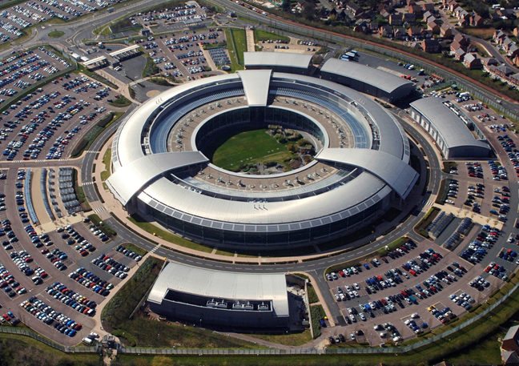
GCHQ, 1973: Invented public-key crypto in secret
Notes:
UK version of NSA
Lineage of Turing, Enigma, etc.
Co-inventors: Clifford Cocks, Malcolm Williamson, James Ellis
Couldn’t talk about it publicly for decades, declassified in 1997

Slide 4


1976: Diffie-Hellman Key Exchange
Paper titled “New directions in cryptography”
Whit Diffie
Marty Hellman
Notes:
RSA is better known outside cryptography circles but Diffie-Hellman was the first public-key crypto (key exchange)

Slide 5
Diffie-Hellman Protocol
Alice and Bob agree on public parameters (maybe in standards doc) p: a large “safe prime” s.t. (p-1)/2 is also prime g: a square mod p (but not 1)
Alice Generates random secret value a. (0 < a < p)
Bob Generates random secret value b. (0 < b < p)
gª mod p
a
b
Alice
Bob
g^{b} mod p
Computes x = (g^{b} mod p)ª mod p = g^{ba} mod p
Computes x′
= (gª mod p)^{b} mod p = g^{ab} mod p
(Notice that x == x′) Can use k := HMAC₀(x) as a shared key.

Slide 6
Passive Eavesdropping Attack
Eve knows: p, g, gª mod p, g^{b} mod p
Eve wants to compute x = g^{ab} mod p
Best known approach: Find a or b, then compute x
Finding y given g^{y} mod p is an instance of the discrete log problem: No known efficient algorithm.
[What’s D-H’s big weakness?]
gª mod p
a
b
Alice
Bob
g^{b} mod p
Eve
Notes:
Notice what we’ve done:
Alice and Bob had public conversation to derive shared secret!
it’s a very short conversation, too

Slide 7
Man-in-the-Middle (MITM) Attack
Alice does D-H exchange, really with Mallory, ends up with g^{au} mod p
Bob does D-H exchange, really with Mallory, ends up with g^{bv} mod p
Alice and Bob each think they are talking with the other, but really Mallory is between them and knows both secrets
Bottom line: D-H gives you secure connection, but you don’t know who’s on the other end!
gª mod p
g^{v} mod p
a
u
v
b
Alice
Mallory
Bob
g^{u} mod p
g^{b} mod p
Notes:
We’ve been talking about confidentiality in terms of a passive eavesdropper, Eve
But some attacks can do more than listen in—remember Mallory, from our discussion of integrity?
* D-H can only give us confidentiality if we already have some assurance of integrity
chess story I know how to play chess against the two best players in the world, and beat one play black vs. Anand on Board 1, white vs. Carlsen on Board 2 algorithm wait for Anand to move on Board 1 copy Anand’s move on Board 2 wait for Carlsen to reply on Board 2 copy Carlsen’s reply on Board 1 etc. Anand and Carlsen are really playing each other but they both think they’re playing me moral of the story:
“in the middle” is a powerful place to be shape the parties’ views of the world

Slide 8
Defending D-H Against MITM Attacks
Cross your fingers and hope there isn’t an active adversary.
Rely on out-of-band communication between users. [Examples?]
Rely on physical contact to make sure there’s no MITM. [Examples?]
Integrate D-H with user authentication.
If Alice is using a password to log in to Bob, leverage the password:
Instead of a fixed g, derive g from the password – Mallory can’t participate w/o knowing password.
Use digital signatures. [More next week.]
Notes:
Out-of-band communication (e.g., SSH)
Example: I call you on the phone, confirm my key – works if we recognize each others’ voices
Physical contact (e.g., smartcards)

Slide 9
Exercise:
What happens if Alice uses the same a and gª for all her communication with Bob?

Slide 10
Key Management
Principles:
0. Always remember, key management is the hard part!
Each key should have only one purpose.
Vulnerability of a key increases:
The more you use it.
The more places you store it.
The longer you have it.
Keep your keys far from the attacker.
Protect yourself against compromise of old keys.
Goal: forward secrecy — learning old key shouldn’t help adversary learn new key.
[How can we get this?]
Notes:
1. Each key should have only one purpose:
- diff RSA keys for signing, encrypting - diff symmetric keys for encrypting, MACing - diff keys for Alice->Bob and Bob->Alice - diff keys for diff protocols reason: prevent attacker from “repurposing” content example: reflection attack
2. Vulnerability of a key increases…
consequences: - change your keys periodically, use session keys - take care to erase keys from memory when you’re done with them - don’t let your keys get swapped out to disk
3. Keep your keys far from the attacker
- memory of networked, unguarded PC: bad - memory of non-networked, guarded PC: not as bad - stored in tamper-resistant device: better - stored in tamper resistant device, locked in safe: best
4. Protect yourself against compromise of old keys - bad practice: Alice tells Bob, “Here’s the new key: ...” encrypted under old key adversary can record this, then attack old key get old key, then he can get new key worse yet: if long chain of keys, he can attack anyone, chain unravels chain as strong as its weakest link!
goal: “forward secrecy” learning old key doesn’t help adversary learn new key how to do?
– use Diffie-Hellman to negotiate a fresh secret
- can use old key to provide integrity
(as long as attacker doesn’t know it today,
learning old key tomorrow won’t let attacker
discover new key)
also: actively destroy old key when you’re done with it find all copies, write zeroes over them

