Slide 1
Access Control and Authentication
Security, Privacy, and Consumer Protection Nick Feamster University of Chicago
Notes:
Assignment 2: Wednesday
Midterm: October 24 (will cover material through this week)
Wednesday’s lecture: Recorded. Extra office hour TBD (Friday afternoon)

Slide 2
General Systems Security Goals
Protect users from each other
Protect apps from each other
Protect the system from network
Allow sharing across these boundaries

Slide 3

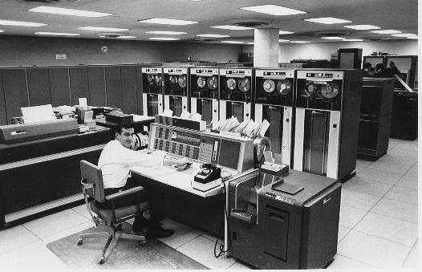
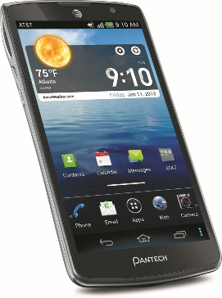
Evolution of Operating System Threat Model
DOS is truly single user.
MacOS, Linux, Windows are multiuser, but typically used by only one user
 | Single user | Multi-user
Trusted apps
Untrusted apps
??
Notes:
In the early days (top right), machines were expensive, so they were shared by many users. Apps are trusted since users were actually creating programs themselves and were responsible for them.
In a typical PC OS, apps are trusted. The rationale for this security model is that the user is responsible for the programs she runs on her computer. PC OSes are spiritual descendants of traditional multi-user OSes.
Smartphone vendors knew that the PC security model would simply kill the platform. So they rethought security from the ground up, and designed the platform to support untrusted apps.
Do you have any examples of the last category?

Slide 4
What’s Old is New Again
Modern multi-user systems:
Cloud Computing
Facebook, Google docs (not operating systems)
What about web browsers?
Single user, untrusted apps (web pages)
Notes:
A lot of the techniques for multi-user systems have now been repurposed for multi-app systems.
One often hears the claim that browsers are the new OS. There is some merit to this, and JavaScript is a full fledged programming environment.

Slide 5
Types of Intruder
Casual prying/spying
Snooping by insiders (“insider attacks”)
Financial motives: Attempts to make money
Data motives: Espionage (Commercial, military)
Notes:
From Tannenbaum OS book (Sec 4.4.1)
Note: passive and active intruders
Security vs. Privacy

Slide 6
Protection and Access Control

Slide 7
Typical Security Sequence
Authorization
Accountability
Identification & authentication
Access control
Logging & auditing
Preventive
Reactive
Notes:
Did we see a method to authenticate users? Passwords
Did we see a method to authenticate apps? Code signing
Accountability is typically in addition to authorization, but can sometimes be instead of authorization
Physical security examples: keys (access control), security camera or sign-in sheet (accountability)
Also useful as defense-in-depth security because access control often breached. e.g., Intrusion detection

Slide 8
How Does Protection Occur? (Example: Operating System)
Operating system controls what users/processes can do
Ins the case of an operating system, control is triggered through interrupts, system calls
CPU supports privilege levels to ensure only OS can execute privileged instructions

Slide 9
An Operating System Protects Resources
User
Resource
OS
User
Resource
Processes
User
Resource
Notes:
Resources: memory, filesystem, peripherals,
OS here mainly refers to kernel

Slide 10
Common Framework: Subject, Verb, Object
Subject = (user, program) pair
Verb = action
Object = resources
Consider Facebook.
Identify as many subjects, verbs and objects as you can.

Slide 11
Access Control Lists
Capabilities
Examples
Door fingerprint reader
Passport control
Identity/authentication needed
Delegation not possible
Lower user/client security risk
Easy to revoke access / change rights
Examples
Regular key
Concert ticket
Identity not needed (more privacy)
Just copy the capability/token
Capabilities can “get away from you”
Difficult to revoke access or change rights
Notes:
Two different ways of doing access control.

Slide 12
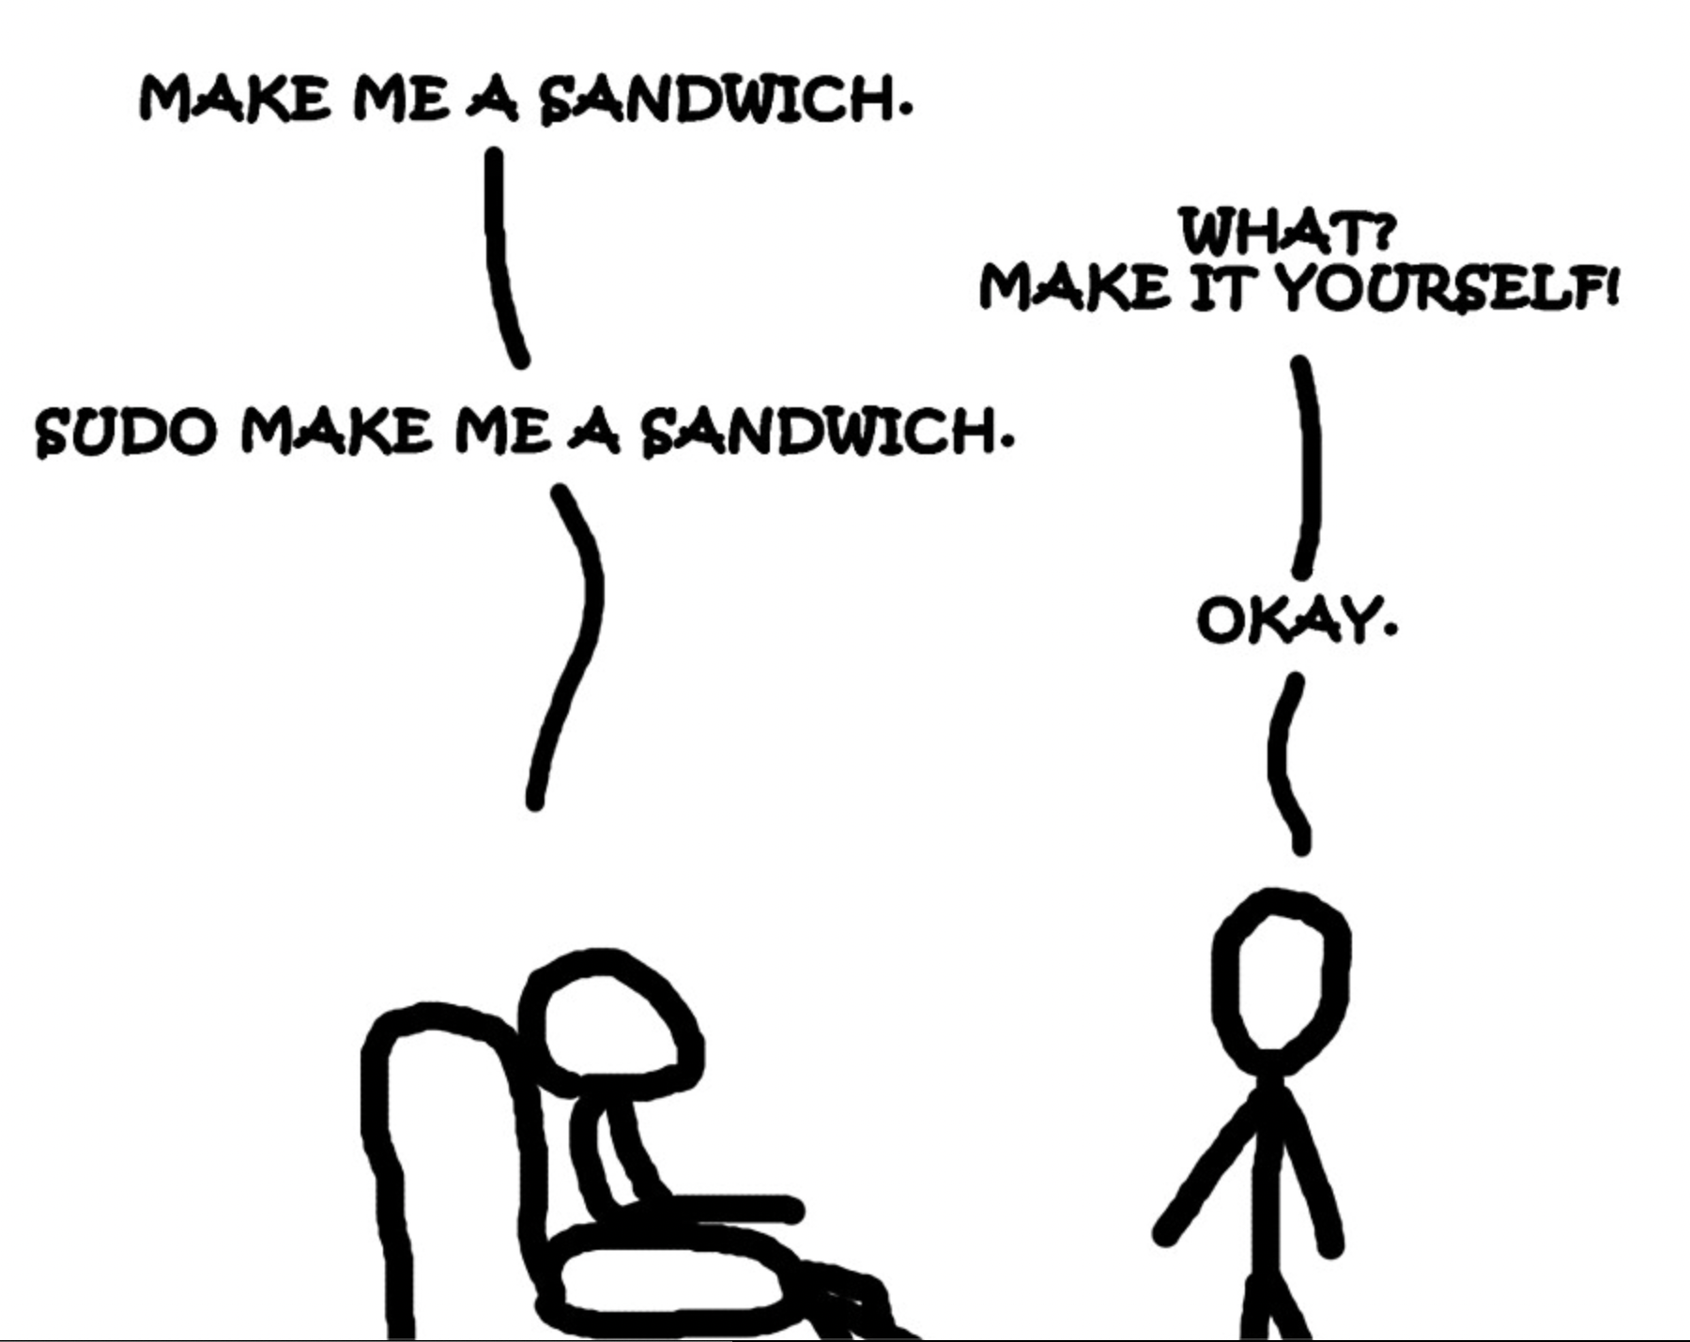
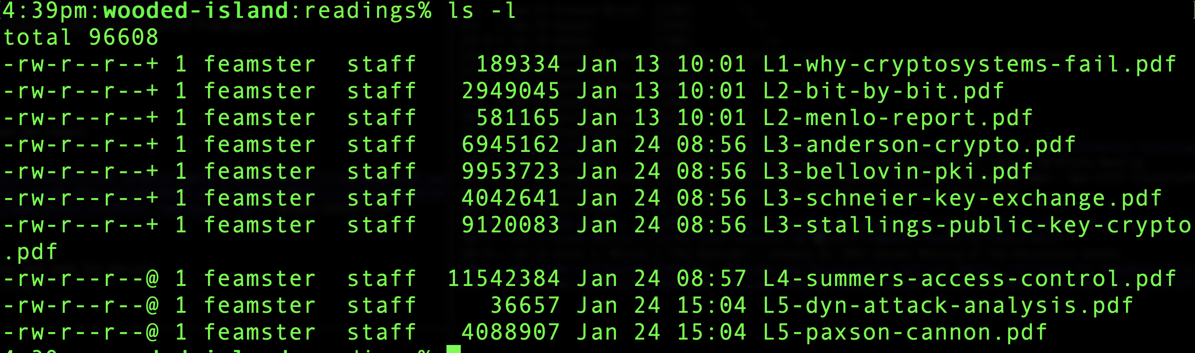
Example: Unix Access Control List
Notes:
This was considered a simplified model compared to other OSes of the day.
Nevertheless, it hasn’t proved very user friendly.
Given any (uid, gid) combination, it is possible to make a complete list of all objects that can be accessed, and whether they can be accessed for read, write, or execute.
Each process has a user part and a kernel part.

Slide 13
Unix: Simplified Access Control Model
Subject: User-space Process
PC OSes are multi-user even if in practice only 1 human user
Some programs run as their own user (e.g., webserver)
Root/administrator/superuser: protects system files
Verb: read/write/execute
Object: files, memory File includes sockets, special OS functions, …
Hack!
Notes:
Simplified access control compared to Multics before it, not compared to (say) Windows.
For the most part all processes initiated by a user have the same permissions. The subject is the user, not (user, program). There are some hacks to get around this limitation, such as treating a web server as its own user. This means that if the server gets hacked, attacker doesn’t have full privileges on the system.
This is an example of repurposing a multi-user security feature for an untrusted-app world.

Slide 14
Various Attacks on Access Control
Requests of memory, disk, etc.
Illegal system calls, or legal system calls with illegal parameters
Modification of OS data structures in user space)
Trapdoor attacks
…

Slide 15
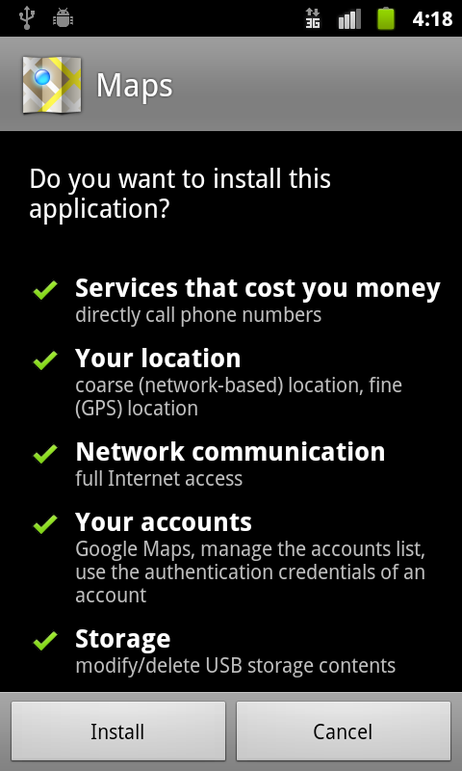
Example: Application Capabilities
Notes:
This was the original version of Android’s ACL.
* there are hundreds of possible sub-permissions
* users don’t understand them, at least not well enough to make informed decisions.
* in fact developers don’t understand them either, and this leads to frustration.
Now it has been greatly simplified. Apps can request groups of permissions (all or nothing for each group). Of course, this comes with its own problems.

Slide 16
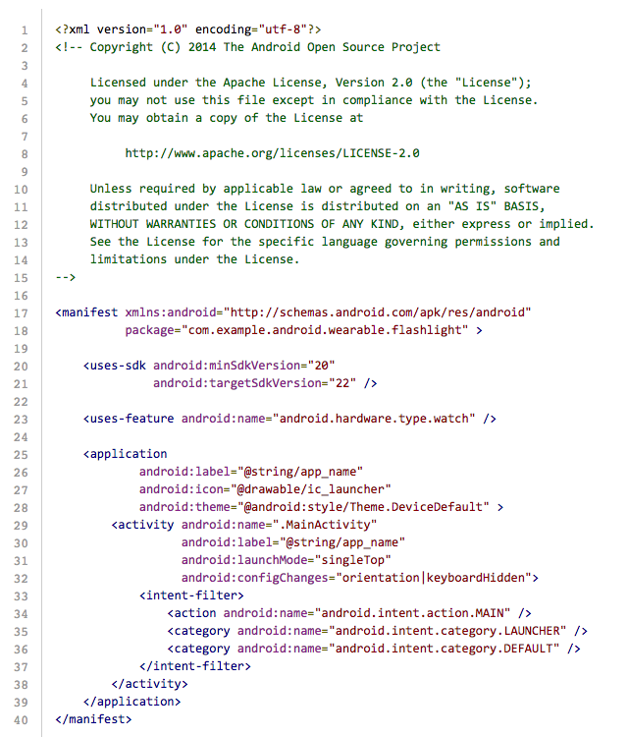
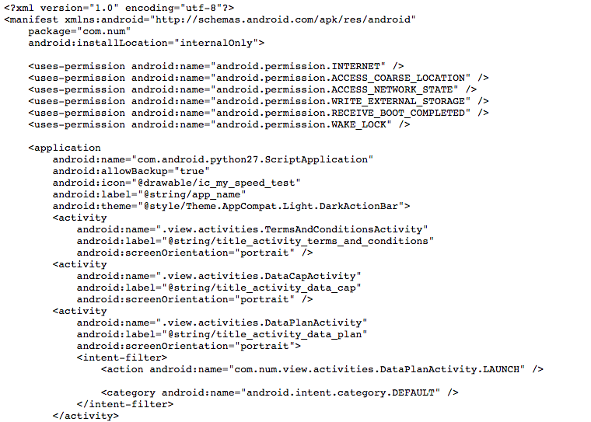
Android Manifest File
Notes:
This is how the app specifies the ACL to the system.

Slide 17
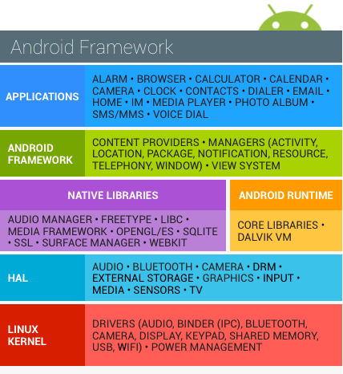
System Layers
Web page
Browser
JVM
OS
VM
Hardware
Notes:
The OS layer in fact contains many layers within itself.

Slide 18
Smartphone Model vs. PC Model
Advantages of smartphone model
OK to run untrusted app from web
Disadvantages of smartphone model
Harder to share between apps
Harder to tinker with system

Slide 19
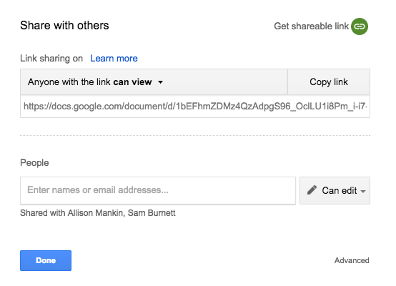
Example: Capability URL
Notes:
It needs to be long so that it’s unforgeable.
What crypto primitive would you use to generate unforgeable URLs?

Slide 20
Android Subject/Verb/Object
Subjects: app Android runs on top of Linux kernel Each app gets its own user ID
Objects: Regular files, other apps, camera, telephony, personal data, …
Verbs: Each object/resource defines its own set of verbs

Slide 21
Third-Party Authorization/Access Control: Capabilities/Tokens

Slide 22
Pre-OAuth Insecure Patterns
Credential sharing and universal passwords
Users entering credentials in third-party apps
Poor scalability and auditability
Notes:
Before OAuth, third-party apps often just asked users for their passwords. That’s terrible for security because it gives away full control and there’s no way to limit access or revoke it cleanly.

Slide 23
What is OAuth 2?
Delegation protocol over HTTP for limited access to resources
Allows access without sharing credentials
Framework, not a full authentication protocol
Implementation-specific cryptography
Notes:
OAuth 2 is fundamentally a delegation protocol. It’s not an authentication system like you’d use for logging in, but rather a way for a user to give an app limited access to their data—say, letting Spotify read your playlists without giving it your Google password.
OAuth separates authentication (user proving who they are) from authorization (allowing limited access). The app never sees the user’s credentials—only tokens that can be limited, revoked, or expired.

Slide 24
Core Roles
Resource Owner – owns protected data
Client – app seeking access
Authorization Server – issues tokens
Resource Server – validates tokens and serves data
Notes:
There are four key roles. The resource owner is the user. The client is the third-party app. The authorization server issues tokens once the user consents. The resource server hosts the protected resource and verifies the token.

Slide 25
Access Tokens & Flow
Access token = delegated rights (scope)
Opaque to client
Flow: authorization → grant → token → resource access
Notes:
The key concept is the access token, which represents limited rights. The typical flow involves the user authorizing, the client receiving a grant, exchanging it for a token, and then using that token to access the resource server.

Slide 26
Why OAuth 2?
Fine-grained delegation (scope, duration)
Supports offline and cross-party access
Requires TLS and strict trust configuration
Authorization server is single point of failure
Notes:
OAuth 2 solved those problems by introducing scopes and time limits. It also supports long-lived access via refresh tokens. But it’s not perfect—it relies on the authorization server being secure and requires HTTPS throughout.

Slide 27
Case Study: Gossip Server
Three Go apps: client, resource server, authorization server
Auth code flow: user login → authorization code → token
Illustrates real-world request/response flow
Notes:
The Gossip Server example in the reading walks through a basic OAuth 2 flow implemented in Go. It shows how the user logs in, gets an authorization code, exchanges it for a token, and uses that token to access data.

Slide 28
JSON Web Tokens (JWT)
Structured access tokens with claims
Header, Payload, Signature
Signed with symmetric/asymmetric keys
Used for stateless validation
Notes:
OAuth doesn’t define the format of tokens. Many systems use JWTs—JSON Web Tokens—which are self-contained and include claims like who issued them, for whom, and when they expire. They can be signed symmetrically or asymmetrically.

Slide 29
Token Validation Examples
Unsigned tokens: verify timestamps and claims
Symmetric: verify with shared secret (HS256)
Asymmetric: verify with public key (RS256)
Short expiry and refresh tokens mitigate risk
Notes:
Unsigned tokens are insecure, so we use signatures. HS256 uses a shared secret between the auth and resource servers; RS256 uses public/private key pairs. We mitigate token leakage by using short-lived tokens and refresh mechanisms.

Slide 30
Common Vulnerabilities
Secret theft and token leakage
CSRF via redirect URI (mitigate with state param)
Redirect URI manipulation → require exact match
Use TLS, minimize scope, and avoid logging tokens
Notes:
OAuth deployments often fail because of implementation errors—leaking tokens in logs, weak redirect URI checks, or missing CSRF protection. The fix is to use TLS everywhere and always validate redirect URIs and state parameters.

Slide 31
Conclusion
OAuth 2 is standard for delegated access
Flexible but security depends on implementation
Requires strict URI matching and secure token handling
Adopt vetted frameworks and monitor usage
Notes:
To sum up, OAuth 2 underpins most of today’s delegated access systems. It’s flexible, but that means implementers must be careful—using vetted frameworks and monitoring for misconfigurations is key to staying secure.

Slide 32
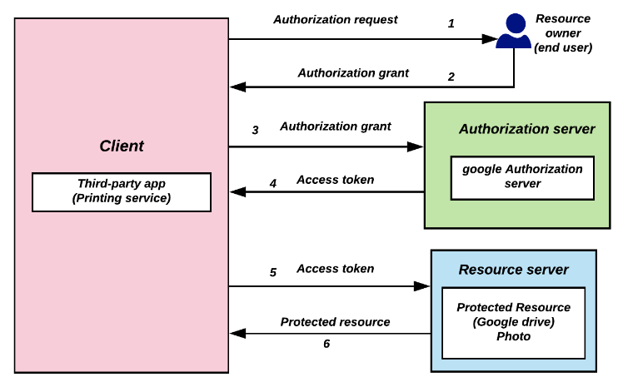
OAuth 2.0
https://en.wikipedia.org/wiki/OAuth#/media/File:Abstract-flow.png
Notes:
Step 1 – Authorization Request
The client (third-party app) asks the resource owner (end user) for permission to access a protected resource. Example: A printing service asks the user to connect their Google Drive account.
→ Outcome: The user is redirected to the authorization server (e.g., Google).
Step 2 – Authorization Grant
The resource owner logs in and approves the request. The authorization server issues an authorization grant (a short code) back to the client.
→ Outcome: The client now holds a temporary code proving user consent.
Step 3 – Authorization Grant Sent to Authorization Server
The client sends that authorization grant to the authorization server (direct server-to-server, not via user). It includes its own client credentials for verification.
Step 4 – Access Token Issued
The authorization server validates the grant and issues an access token to the client. This token represents the permission to access the protected resource on behalf of the user.
→ Outcome: The client now has an access token.
Step 5 – Access Token Used
The client sends the access token to the resource server (e.g., Google Drive API) to request the protected resource.
→ Outcome: The resource server verifies the token’s validity.
Step 6 – Protected Resource Returned
If the token is valid, the resource server returns the requested resource (e.g., a Google Drive photo).
→ Outcome: The client accesses the data securely, without seeing or storing the user’s password.
-------------
Step 1 – User authorizes the app
The user (resource owner) clicks “Log in with Google” (or similar) in the third-party app (the client).
The app redirects the user to the authorization server (e.g., Google).
The user logs in and approves the app’s access request.
→ Outcome: The app gets a short-lived authorization code.
Step 2 – App requests a token
The app sends that authorization code to the authorization server (not the user).
It includes its client ID/secret to prove its identity.
The authorization server verifies everything and returns an access token (and sometimes a refresh token).
→ Outcome: The app now holds an access token that represents permission to act on the user’s behalf.
Step 3 – App uses the token
The app calls the resource server (e.g., Google API) with the token in the HTTP header.
The resource server checks the token’s validity (e.g., with the authorization server).
If valid, it serves the requested data (e.g., calendar, profile info, etc.).
→ Outcome: The user’s data is accessed securely, without sharing passwords.
Step 4 – Token expiration / refresh
Access tokens are short-lived.
When they expire, the app can use a refresh token (if issued) to get a new one from the authorization server.
→ Outcome: Continuous access without re-prompting the user.

Slide 33
Simplified OAuth 2 Flow
1. User authorizes the app → redirected to Authorization Server
2. Authorization Server issues an authorization code
3. App exchanges code for an access token
4. App uses token to access the Resource Server
5. Token expires → refresh token (if issued) allows renewal
Notes:
This slide simplifies OAuth 2 into five core steps. The user authorizes the app, which gets a temporary code. The app exchanges that code for an access token, which it uses to access protected resources. When the token expires, a refresh token can renew access without requiring the user to log in again. This matches the abstract flow diagram on the Wikipedia page.

Slide 34
Example Steps for Third-Party Control
1. Create a project in Google Cloud Platform: https://developers.google.com/nest/device-access/get-started
* Create a project
* Enable the Smart Device Management API
* Get an OAuth 2.0 Client ID
* Enable redirects from https://www.google.com/
2. Create a device access project: https://console.nest.google.com/device-access
https://nestservices.google.com/partnerconnections/XXXXXXX-3a50043e3ecb/auth?redirect_uri=https://www.google.com&access_type=offline&prompt=consent&client_id=XXXXXXXXXX-4cpkcg5unoka2dl12kjkgv2urfplmum5.apps.googleusercontent.com&response_type=code&scope=https://www.googleapis.com/auth/sdm.service
3. Copy access code from the redirect URL and save the tokens:
curl -L -X POST 'https://www.googleapis.com/oauth2/v4/token?client_id=805197790270-4cpkcg5unoka2dl12kjkgv2urfplmum5.apps.googleusercontent.com&client_secret=jE2sOwAzhb3I7jxAesBN-fQf&code=4/0AX4XfWiUvif9iNGCVOar40p8tRcTb3ck-P7rHUM90otgf96vLbdRpM1OmJwXwIU1jVkUhQ&grant_type=authorization_code&redirect_uri=https://www.google.com' > google_tokens.json
4. One time: Authorize the application with a simple request that asks for devices.
Replace the Bearer with the Bearer token from Step 4.
curl -X GET 'https://smartdevicemanagement.googleapis.com/v1/enterprises/XXXXXXXX-3a50043e3ecb/devices' -H 'Content-Type: application/json' -H 'Authorization: Bearer XXXXXX'

Slide 35
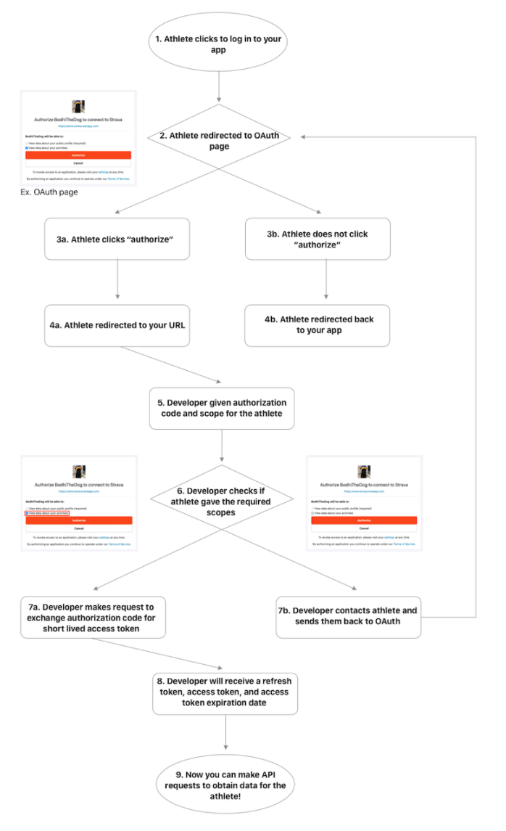
Oauth Example: Strava API Access

Slide 36
Network Access Control: Virtual Private Networks

Slide 37
What is a VPN?
Making a shared network look like a private network.
Why do this?
Private networks have all kinds of advantages
But building a private network is expensive
(cheaper to have shared resources rather than dedicated)

Slide 38
VPN
“Extend the perimeter”
(Typically) uses crypto
There are some exceptions, but we won’t cover them in this class.
Goal: make branch offices behave as if they’re on the same private network w.r.t. security

Slide 39
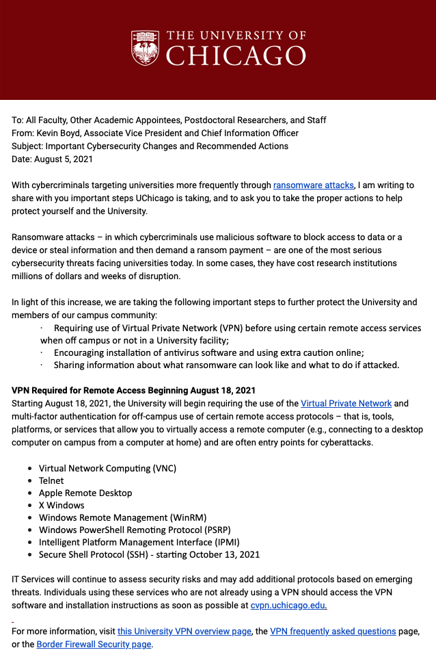

Slide 40
Breakout Session

Slide 41


IPSec VPN – Setup
VPN Server is on the firewall, has dual interface
Internal IP: 192.168.1.1
External IP: 11.22.33.44
User at home on laptop
IP: 55.66.77.88
User starts VPN client
Authenticates to VPN server using username/password or (better) client certificate
Obtains shared session key
Client connected to VPN server’s external interface
VPN server assigns intranet IP to client: 192.168.1.50
VPN server adds mapping 192.168.1.50 ↔ 55.66.77.88 to routing table
“Tunnel” established
192.168.1.1
11.22.33.44

Slide 42
IPSec VPN – Tunnel operation
Client on laptop generates an IP packet
Could be bound for intranet or external destination
VPN client securely encapsulates it in another IP packet
Outer packet: src = 55.66.77.88; dst = 11.22.33.44
Inner packet: src = 192.168.1.50; dst = whatever
VPN server decrypts outer packet, forwards inner packet
Receives a response addressed to 192.168.1.50
Looks at routing table, realizes this is via VPN
Encapsulates it in an outer packet with src = whatever, dst = 55.66.77.88 and forwards it
VPN client decrypts outer packet, passes on inner packet to application software
Result: client applications think and act as if they are on Intranet
Notes:
VPN also used for anonymity.
Client on laptop generates an IP packet
Could be bound for intranet or external destination
VPN client securely encapsulates it in another IP packet
Outer packet: src = 55.66.77.88; dst = 11.22.33.44
Inner packet: src = 192.168.1.50; dst = whatever
VPN server decrypts outer packet, forwards inner packet
Receives a response addressed to 192.168.1.50
Looks at routing table, realizes this is via VPN
Encapsulates it in an outer packet with src = whatever, dst = 55.66.77.88 and forwards it
VPN client decrypts outer packet, passes on inner packet to application software
Result: client applications think and act as if they are on Intranet

Slide 43
VPNs
Tunneling, security, QoS
Can also tunnel through SSH instead of IP
Encryption, tunneling, firewall all possible in different layers!

Slide 44
Benefits of VPNs
IP not really global (private addresses)
VPN makes separated IP sites look like one private IP network
Security
Bandwidth guarantees across ISP
QoS, SLAs
Simplified network operation
ISP can do the routing for you

Slide 45
End-to-end VPNs
Solves problem of how to connect remote hosts to a firewalled network
Site (private network)
Site
Host
Internet
FW/
VPN
IPsec
Tunnels
Remote
Host
Site
Host
Remote
Host

Slide 46
Classic Exploit Examples in UNIX
Core Dump Overwrite
Linking /etc/passwd to a file called “core”
Causing a SETUID program to dump core, subsequently overwriting the passwd file.
Directory Creation Race Condition
Mkdir would create inode as root, then change UID of inode
Race: link to passwd after inode creation but before chown
Notes:
Serious problem: Timesharing system

Slide 47
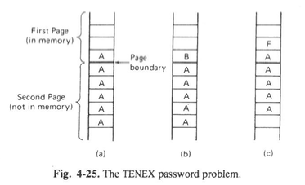
More Examples
Timing attacks (TENEX)
File access required password check
Align password guess across page boundary
OS would abort on incorrect character
Time of check to time of use (OS/360)
Password check
Re-read filename after password check

Slide 48
Stepping Back: Design Principles
Public design
Default is “no access”
Check for current authority
Least privileges
Build security into the lowest system layers possible

Slide 49
Access Control List or Capability?
BufferedReader reader =
new BufferedReader(new FileReader(filename));
String line = reader.readLine();
Both!
Opening a file gives the process a “file descriptor”
Can be passed around to other processes
Preserves permissions even if file permissions change
Notes:
Opening a file involves checking an Access Control List to see if the user has permission to open the file.
Reading from the file involves checking a capability.

Slide 50
Access Control using ACLs
Subject = (user, program)
Verb = action
Object = resources
Policy specifies (subject, verb, object) triples
(User, program)
Monitor
Resource
Action
Policy
Notes:
A subject is a specific program acting on behalf of a specific user.
Monitor is typically the OS.
Policy specifies (subject, verb, object) triples. Answers the question can User U running Program P perform Action A on Resource R?

Slide 51
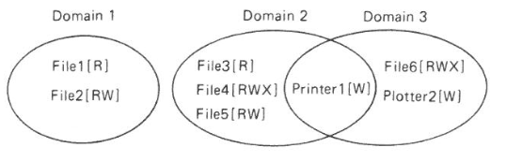
Objects and Protection Domains
Objects: CPUs, memory segments, storage, printers, processes, files, databases, locks
Protection Domain: Set of (object, rights) pairs
Notes:
At every instance of time, each process runs in some protection domain. Processes can switch between domains during execution; the rules for domain switching depend a lot on the system.
“Rights” == “Verb” in our notes here.

Slide 52
Access Control Policy
Who sets policy?
(Theoretically) users, with system defaults and restrictions
How is access control list stored?
Sparse matrix (default deny), store as list
How does OS enforce policy?
OS exposes API to apps, with privileged operations
Checks ACL when API functions are called
Notes:
The matrix of all possible (subject, verb, object) triples may be too big to store, but you can store only the list of allowed triples.
For example, on Google docs there may be millions of users and millions of documents, so Google can’t store it as a matrix, but each user has access to only a few tens to hundreds of documents, so they can store it as a list.

Slide 53
Usability Problems in Access Control
Too much complexity
Too many decisions
#principals x #actions x #objects
Notes:
Think about apps on your phone. You don’t want to mentally keep track of which data each app has access to.

Slide 54
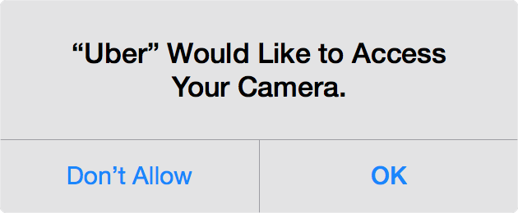
Simplifying Access Control: Emphasize Action over Configuration
Combine with sensible system defaults
Notes:
This is the iOS model.
Why would Uber want to access your camera? It needs it if you want it to automatically scan your credit card instead of typing in the number.
This iOS-style prompt has several advantages over the Android model. If you stuck the camera permission in the app-installation screen, most users would pay no attention; those that did would be confused and annoyed because it’s not obvious why Uber should need your camera. Besides, the prompt allows you to give access only when it’s actually needed, rather than all the time.
We can go farther and combine the user’s request for an action with the granting of the corresponding permission in a single button. This has been proposed but not yet implemented in mainstream OSes http://research.microsoft.com/pubs/152495/user-driven-access-control-nov2011.pdf

Slide 55
Other Abstractions

Slide 56
Other Abstractions: Roles, Groups
Useful in (e.g.) corporate context with various projects, collaborations, privileges

Slide 57
Abstraction: Classification Levels
Cosmic
Top Secret
Secret
Restricted
Unclassified
Each subject (person) has a clearance level
Each object (document) has a classification level
No read up
No write down
Notes:
This is one way to simplify access control, in the military context.
You can’t read above your clearance level, or write below it. You can transfer information from a higher to a lower-level document in special cases, for example, declassification.

Slide 58
Sometimes There’s No Strict Order: Lattice-based Access Control
Top secret (nuclear, bio)
Top secret (nuclear)
Top secret (bio)
Secret (nuclear, bio)
Secret (nuclear)
Secret
(bio)
Public
Notes:
In this example there are two types of secrets, nuclear and biological, and each has a couple of security levels. Of course, being cleared for Secret nuclear documents doesn’t automatically give you any clearance for biological documents. So we need a “lattice” to represent clearance and classification levels.
More info: Denning’s Lattice-based Security

