Slide 1
Malware, Viruses, Worms
Nick Feamster
CS 6262
Spring 2009

Slide 2
Administrivia
Project office hours
  Tomorrow and Thursday 4-5p
  Sign up on the wiki
Project ideas also posted on wiki
Problem Set 2
  Shorter, out before Wednesday
  Due Monday after the quiz
  Possible use: Quiz study

Slide 3
Malicious Programs
Needs host program
  trap doors
  logic bombs
  Trojan horses
  Viruses
Independent
  Worms

Slide 4
Trap Doors
A secret entry point to a program or system
  get in without the usual security access procedures
Recognize some special sequence of inputs, or special user ID

Slide 5
Trojan Horses
Hidden in an apparently useful host program
Perform some unwanted/harmful function when the host program is executed

Slide 6
Viruses
“Infect” a program by modifying it
Self-copied into the program to spread
Four stages:
  dormant phase
  propagation phase
    E.g., attachment to email
  triggering phase
  execution phase

Slide 7
Virus Structure
First line: go to “main” of virus program
Second line: a special mark (infected or not)
Main:
  find uninfected programs
    infect and mark them
  do something damaging to the system
  now “go to” the first line of the original program
    appear to do the normal work
Avoid detection by looking at size of program:
  compress/decompress the original program

Slide 8
Types of Viruses
Parasitic virus
  search and infect executable files
Memory-resident virus
  infect running programs
Boot sector virus
  spreads whenever the system is booted
Stealth virus
Polymorphic virus
  encrypt part of the virus program using randomly generated key

Slide 9
Macro Viruses
Macro
  an executable program (e.g., opening a file, starting an application) embedded in a word processing document, e.g. MS Word
Common technique for spreading
  A virus macro is attached to a Word document
  Document is loaded and opened in the local system
  When the macro executes, it copies itself to the global macro file
  The global macro can be activated/spread when new documents are opened.

Slide 10
Truth and Myths about Viruses
Can only infect Microsoft Windows
Can modify hidden and read-only files
Spread only on disks or in email
Cannot remain in memory after reboot
Cannot infect hardware
Can be malevolent, benign, or benevolent

Slide 11
Antivirus Approach
Prevention
  Limit contact to outside world
Detection and identification
Removal
4 generations of antivirus software
  simple scanners
    use “signatures” of known viruses
  heuristic scanners
    integrity checking: checksum, encrypted hash
  activity traps
  full-featured protection

Slide 12
What is a Worm?
Code that replicates and propagates across the network
  Often carries a “payload”
Usually spread via exploiting flaws in open services
  “Viruses” require user action to spread
First worm: Robert Morris, November 1988
  6-10% of all Internet hosts infected (!)
Many more since, but none on that scale until July 2001

Slide 13
The Internet Worm
What it did
  Determine where it could spread
  Spread its infection
  Remain undiscovered and undiscoverable
Effect
  Resource exhaustion – repeated infection due to a programming bug
  Servers are disconnected from the Internet by sys admin to stop infection

Slide 14
The Internet Worm
How it worked
  Where to spread
    Exploit security flaws
      Guess password (encrypted passwd file readable)
      fingerd: buffer overflow
      sendmail: trapdoor (accepts shell commands)
  Spread
    Bootstrap loader to target machine, then fetch rest of code (password authenticated)
  Remain undiscoverable
    Load code in memory, encrypt, remove file
    Periodically changed name and process ID

Slide 15
Morris Worm Redux
1988: No malicious payload, but bogged down infected machines by uncontrolled spawning
  Infected 10% of all Internet hosts at the time
Multiple propagation vectors
  Remote execution using rsh and cracked passwords
    Tried to crack passwords using small dictionary and publicly readable password file; targeted hosts from /etc/hosts.equiv
  Buffer overflow in fingerd on VAX
    Standard stack smashing exploit
  DEBUG command in Sendmail
    In early Sendmail versions, possible to execute a command on a remote machine by sending an SMTP (mail transfer) message

Slide 16
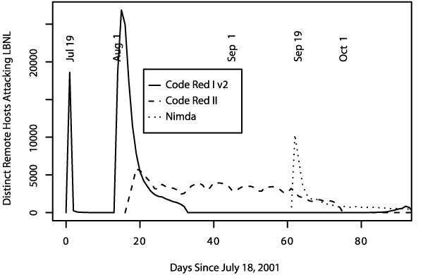
Summer of 2001
Three major worm
outbreaks

Slide 17
Example Worm: Code Red
Initial version: July 13, 2001
Exploited known ISAPI vulnerability in Microsoft IIS Web servers
1st through 20th of each month: spread
20th through end of each month: attack
Payload: Web site defacement
Scanning: Random IP addresses
Bug: failure to seed random number generator

Slide 18
Code Red I
July 13, 2001: First worm of the modern era
Exploited buffer overflow in Microsoft’s Internet Information Server (IIS)
1st through 20th of each month: spread
  Find new targets by random scan of IP address space
    Spawn 99 threads to generate addresses and look for IIS
  Creator forgot to seed the random number generator, and every copy scanned the same set of addresses ☺
21st through the end of each month: attack
  Deface websites with “HELLO! Welcome to http://www.worm.com! Hacked by Chinese!”

Slide 19
Code Red: Revisions
Released July 19, 2001
Payload: flooding attack on www.whitehouse.gov
  Attack was mounted at the IP address of the Web site
Bug: died after 20th of each month
Random number generator for IP scanning fixed

Slide 20
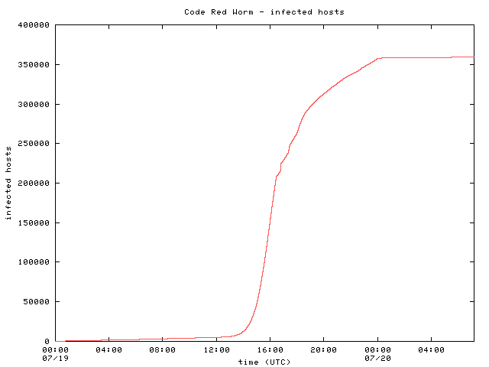
Code Red: Host Infection Rate
Measured using backscatter technique
Exponential infection rate

Slide 21

Modeling the Spread of Code Red
Random Constant Spread model
  K: initial compromise rate
  N: number of vulnerable hosts
  a: fraction of vulnerable machines already compromised
Newly infected machines in dt
Machines already infected
Rate at which uninfected machines are compromised

Slide 22

Modeling the Spread of Code Red
Growth rate depends only on K
Curve-fitting: K ~ 1.8
Peak scanning rate was about 500k/hour

Slide 23
Designing Fast-Spreading Worms
Hit-list scanning
  Time to infect first 10k hosts dominates infection time
  Solution: Reconnaissance (stealthy scans, etc.)
Permutation scanning
  Observation: Most scanning is redundant
  Idea: Shared permutation of address space. Start scanning from own IP address. Re-randomize when another infected machine is found.
Internet-scale hit lists
  Flash worm: complete infection within 30 seconds

Slide 24
Code Red I v2
July 19, 2001: Same codebase as Code Red I, but fixed the bug in random IP address generation
  Compromised all vulnerable IIS servers on the Internet
  Large vulnerable population meant fast worm spread
    Scanned address space grew exponentially
    350,000 hosts infected in 14 hours!!
Payload: distributed packet flooding (denial of service) attack on www.whitehouse.gov
  Coding bug causes it to die on the 20th of each month… but if victim’s clock is wrong, resurrects on the 1st

Slide 25
Code Red II
August 4, 2001: Same IIS vulnerability, completely different code, kills Code Red I
  Known as “Code Red II” because of comment in code
  Worked only on Windows 2000, crashed NT
Scanning algorithm preferred nearby addresses
  Chose addresses from same class A with probability ½, same class B with probability 3/8, and randomly from the entire Internet with probability 1/8
Payload: installed root backdoor in IIS servers for unrestricted remote access
Died by design on October 1, 2001

Slide 26
Nimda
September 18, 2001: Multi-modal worm using several propagation vectors
  Exploit same IIS buffer overflow as Code Red I and II
  Bulk-email itself as an attachment to email addresses harvested from infected machines
  Copy itself across open network shares
  Add exploit code to Web pages on compromised sites to infect visiting browsers
  Scan for backdoors left by Code Red II
Payload: turned-off code deleting all data on hard drives of infected machines

Slide 27
Signature-Based Defenses Don’t Help
Nimda leaped firewalls
Many firewalls passed mail untouched, relying on mail servers to filter out infections
  Most filters simply scan attachments for signatures (code snippets) of known viruses and worms
Nimda was a brand-new infection with unknown signature, and scanners could not detect it
Big challenge: detection of zero-day attacks
  When a worm first appears in the wild, signature is not extracted until minutes or hours later

Slide 28
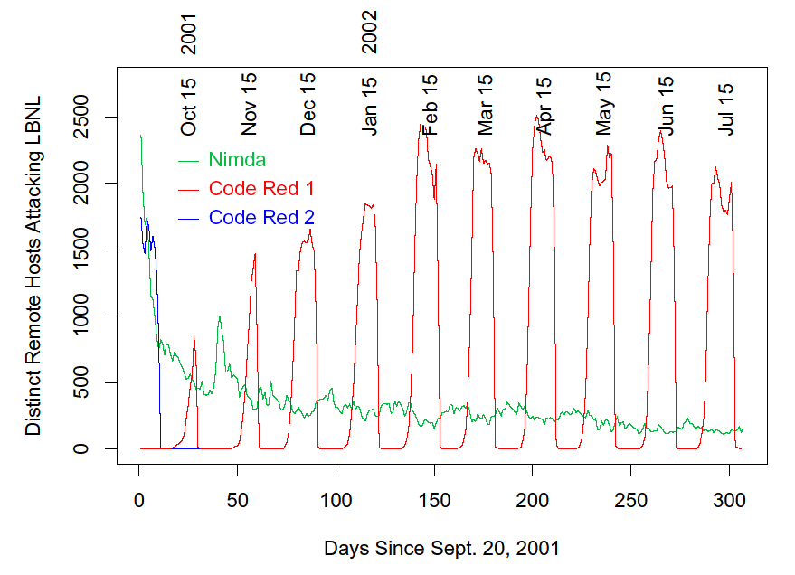
Code Red I and II (Paxson)
With its predator gone, Code Red I comes back, still exhibiting monthly pattern
Code Red II dies off as programmed

Slide 29
Designing Fast-Spreading Worms
Hit-list scanning
  Time to infect first 10k hosts dominates infection time
  Solution: Reconnaissance (stealthy scans, etc.)
Permutation scanning
  Observation: Most scanning is redundant
  Idea: Shared permutation of address space. Start scanning from own IP address. Re-randomize when another infected machine is found.
Internet-scale hit lists
  Flash worm: complete infection within 30 seconds

Slide 30
Code Red Worm Background
Sent HTTP Get request to buffer overflow Win IIS server.
It generated 100 threads to scan simultaneously
  One reason for its fast spreading.
  Huge scan traffic might have caused congestion.
Characteristics:
  Uniformly picked IP addresses to send scan packets.
Code Red worm incident of July 19th, 2001:
  Showed how fast a worm can spread.
    more than 350,000 infected in less than one day.
Notes:
Some background on the Code Red worm. Code Red used HTTP get request to buffer overflow vulnerable Windows IIS servers. It generated 100 threads to scan simultaneously. That’s one reason why it spread so fast. And since each copy of the worm generated so many scan packets, the huge scan traffic on that day might have caused congestion to the Internet.
One important property of the Code Red worm is that it uniformly picked IP addresses to scan. I’ll discuss this property several times later.

Slide 31
Slammer (Sapphire) Worm
January 24/25, 2003: UDP worm exploiting buffer overflow in Microsoft’s SQL Server
  Overflow was already known and patched by Microsoft… but not everybody installed the patch
Entire code fits into a single 404-byte UDP packet
  Worm binary followed by overflow pointer back to itself
Classic buffer overflow combined with random scanning: once control is passed to worm code, it randomly generates IP addresses and attempts to send a copy of itself to port 1434
  MS-SQL listens at port 1434

Slide 32
Slammer Propagation
Scan rate of 55,000,000 addresses per second
  Scan rate = rate at which worm generates IP addresses of potential targets
  Up to 30,000 single-packet worm copies per second
Initial infection was doubling in 8.5 seconds (!!)
  Doubling time of Code Red was 37 minutes
Worm-generated packets saturated carrying capacity of the Internet in 10 minutes
  75,000 SQL servers compromised
  And that’s in spite of broken pseudo-random number generator used for IP address generation

Slide 33
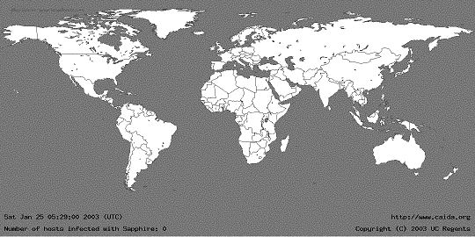
05:29:00 UTC, January 25, 2003
[from Moore et al. “The Spread of the Sapphire/Slammer Worm”]

Slide 34
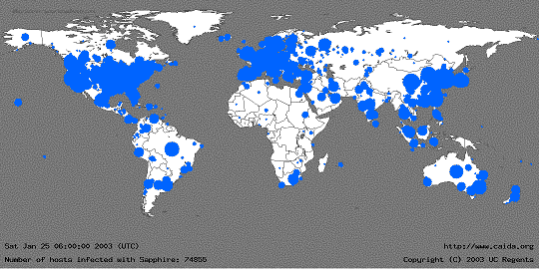
30 Minutes Later
[from Moore et al. “The Spread of the Sapphire/Slammer Worm”]
Size of circles is logarithmic in
the number of infected machines

Slide 35
Slammer Impact
$1.25 Billion of damage
Temporarily knocked out many elements of critical infrastructure
  Bank of America ATM network
  Entire cell phone network in South Korea
  Five root DNS servers
  Continental Airlines’ ticket processing software
The worm did not even have malicious payload… simply bandwidth exhaustion on the network and resource exhaustion on infected machines

Slide 36
Secret of Slammer’s Speed
Old-style worms (Code Red) spawn a new thread which tries to establish a TCP connection and, if successful, send a copy of itself over TCP
  Limited by latency of the network
Slammer was a connectionless UDP worm
  No connection establishment, simply send 404-byte UDP packet to randomly generated IP addresses
  Limited only by bandwidth of the network
A TCP worm can scan even faster
  Dump zillions of 40-byte TCP-SYN packets into link layer, send worm copy only if SYN-ACK comes back

Slide 37
Blaster and Welchia/Nachia
August 11, 2003: Scanning worm exploiting RPC service in Microsoft Windows XP and 2000
  First address at random, then sequential upward scan
    Easy to detect, yet propagated widely and leaped firewalls
Payload: denial of service against MS Windows Update + installing remotely accessible backdoor
Welchia/Nachia was intended as a counter-worm
  Random-start sequential scan, use ICMP to determine if address is live, then copy itself over, patch RPC vulnerability, remove Blaster if found
  Did more damage by flooding networks with traffic

Slide 38
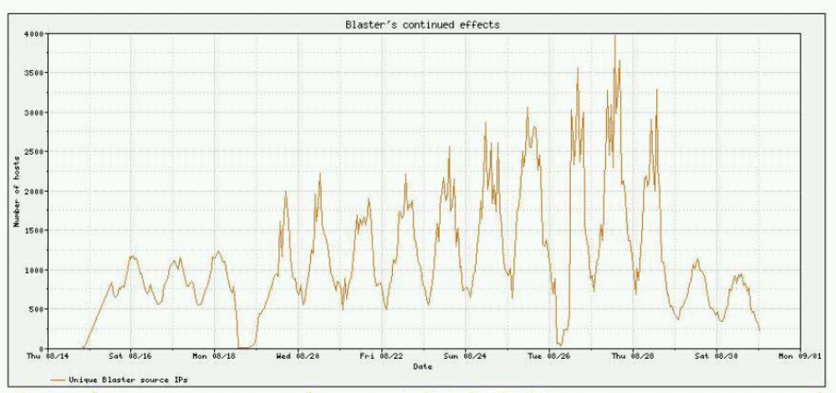
Blaster Worms

Slide 39
Myfip
Myfip was first observed in 2004
Spreads by email
  User clicks on attachment or embedded <iframe> tag downloads the infection
Seems to originate from China
  IP addresses of sending hosts and “document collectors” all based in Tianjin province
  Email headers typical of a Chinese spam tool
Believed to be related to “Titan Rain” attacks
  Massive attacks on DoD Internet sites from Chinese computers (2005)

Slide 40
Myfip Email
From: "hr@boeing.com" <hr@boeing.com>
Subject: Urgent: boeing company date
To: xxx@xxx
<html>
<head>
<meta http-equiv="Content-Type" content="text/html; charset=gb2312">
<title> </title>
</head>
<body>
boeing company date: plane big \ plane table \........
please you download boeingdate.txt
<iframe src="http://www.xpelement.com/sp/swf/search.htm" name="zhu" width="0" height="0" frameborder="0">
</body>
</html>
Attachment: boeing date.txt.exe
May look like a Notepad
file to recipient

Slide 41
Myfip: Spreading and Effects
Copies itself over to networked machines
  Adds itself to registry for automatic boot
  Looks for network shares and copies itself over as iloveyou.txt.exe (no random scanning!)
  Attempts to log in as administrator into remote machines using known weak passwords, upload itself
Steals intellectual property
  Looks for PDF, MS Word, AutoCAD, CirCAD, ORCAD, MS database files on infected machine
  Sends them to “document collector” hosts in China

Slide 42
Search Worms
Generate search query
  Search for version numbers of vulnerable software to find exploitable targets
  Search for popular domains to harvest email addresses
Analyze search results
  Remove duplicates, URLs belonging to search engine
Infect identified targets
  Reformat URLs to include the exploit
    For example, append exploit code instead of username
  Exploit code downloads the actual infection, joins the infected machine to a botnet, etc.

Slide 43
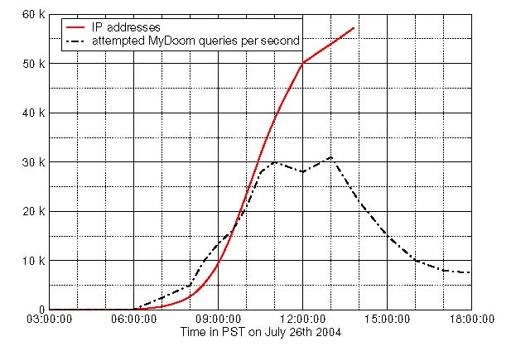
MyDoom
Spreads by email
MyDoom: searches local hard drive for addresses
MyDoom.O: uses Web search engines
  Queries split between Google (45%), Lycos (22.5%), Yahoo (20%) and Altavista (12.5%)
Google’s view
of MyDoom
Number of IP addresses
generating queries
(60,000 hosts infected in
8 hours)
Peak scan rate:
30,000 queries per second
Number of served queries
drops as Google’s anomaly
detection kicks in

Slide 44
Santy
Written in Perl, exploits a bug in phpBB bulletin board system (prior to version 2.0.11)
  Allows injection of arbitrary code into Web server running phpBB
Uses Google to find sites running phpBB
Once injected, downloads actual worm code from a central site, asks Google for more targets and connects infected machine to an IRC botnet
Multiple variants of the same worm
  Polymorphism: actual Perl code changes from infection to infection, so filtering worm traffic is difficult!

Slide 45
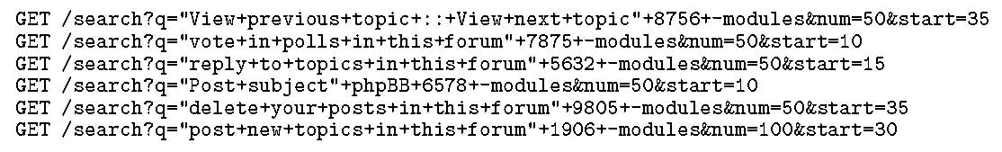
Evading Anomaly Detection
Google will refuse worm-generated queries
Different Santy variants generate different search terms or take them from an IRC botmaster
Google’s solution: if an IP address generates a lot of “rare” queries, ask it to solve a CAPTCHA
  Exploit the fact that different infections of the same worm must use different queries (why?)

Slide 46
Index-Based Filtering
Idea: if worm relies on search results to spread, don’t provide vulnerable targets in search results
During crawl phase, tag all pages that seem to contain vulnerable software or sensitive information such as email addresses
  Can’t drop them from the index because they may contain information useful to legitimate searchers
Do not return the result of a query if it contains (a) pages from many hosts, and (b) high percentage of them are tagged as vulnerable
  What are the limitations of this approach?

Slide 47
Storm Worm / Peacomm (2007)
Spreads by cleverly designed spam campaign
  Arrives as an email with catchy subject
    First instance: “230 dead as storm batters Europe”
    Other examples: “Condoleeza Rice has kicked German Chancellor”, “Radical Muslim drinking enemies’s blood”, “Saddam Hussein alive!”, “Fidel Castro dead”, etc.
Attachment or URL with malicious payload
  FullVideo.exe, MoreHere.exe, ReadMore.exe, etc.
  Also masquerades as flash postcards
Once opened, installs Trojan (wincom32) & rootkit

Slide 48
Storm Worm Characteristics
Infected machine joins botnet
  Between 1 and 5 million machines infected (Sep 2007)
Obfuscated peer-to-peer control structure
  Not like Agobot, which uses simple IRC control channel
  Interacts with peers via eDonkey protocol
Obfuscated code, anti-debugging defenses
  Goes into infinite loop if detects VMware or Virtual PC
  Large number of spurious probes (evidence of external analysis) triggers distributed DoS attack

Slide 49
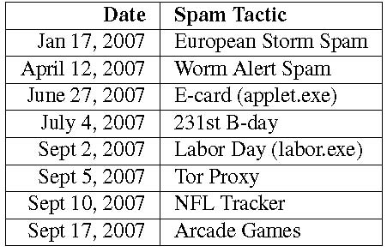
Storm Worm Outbreaks
Spambot binary used to spread new infections in subsequent campaigns
  Looks for email addresses and mailing lists in the files on the infected machines

