Slide 1
An Overview of Computer and Network Security
Nick Feamster
CS 6262
Spring 2009

Slide 2
What do you trust?
Ken Thompson’s compiler hack from “Reflections on Trusting Trust.”
  Modified C compiler does two things:
    If compiling a compiler, inserts the self-replicating code into the executable of the new compiler.
    If compiling login, inserts code to allow a backdoor password
  After recompiling and installing old C compiler:
    Source code for Trojan horse does not appear anywhere in login or C compiler
    Only method of finding Trojan is analyzing binary

Slide 3
Trusting Trust: Stage 1
Write a program that is self-reproducing
Lessons
  Program can be easily written
  Program can also include excess baggage

Slide 4
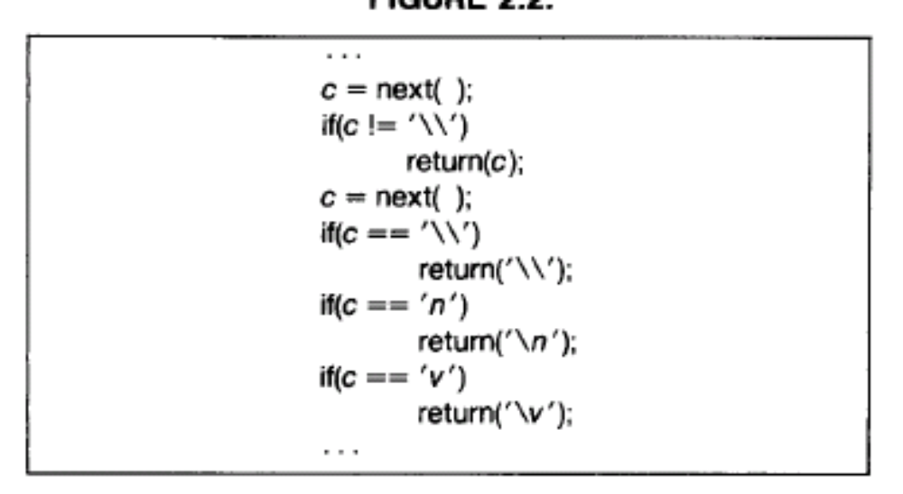
Trusting Trust: Stage 2
Augment compiler to understand new character escape sequence
Cool! Learning compiler

Slide 5
Putting It Together
Place bug in compiler that is executed when UNIX login command is matched
Compile modified source code to generate new compiler binary and install new binary.
Remove bugs from the original source code
Buggy compiler will re-insert buggy code automatically, even when absent from the source!

Slide 6
Lessons
You cannot trust code that you did not totally create yourself.
Attack could have been implemented at any level!

Slide 7
Internet’s Design: Insecure
Designed for simplicity
“On by default” design
Readily available zombie machines
Attacks look like normal traffic
Internet’s federated operation obstructs cooperation for diagnosis/mitigation

Slide 8
Resource Sharing
How? Multiplexing
  Switched network
  Party “A” gets resources sometimes
  Party “B” gets them sometimes
Interior nodes (“Routers” or “Switches”) arbitrate access to resources

Slide 9

Circuit Switching
Resources are reserved
Source first establishes a connection (circuit) to the destination
Source sends the data over the circuit
  Constant transmission rate
Example: telephone network
  Early early versions: Human-mediated switches.
  Early versions: End-to-end electrical connection
  Today: Virtual circuits or lambda switching

Slide 10

Packet Switching
Resources are not reserved
Packets are self-contained
  Each has a destination address
  Source may have to break up single message
Each packet travels independently to the destination host
  Routers and switches use the address in the packet to determine how to forward the packets

Slide 11
Resource Sharing: Packet Switching
Statistical multiplexing
Switches arbitrate between inputs
Can send from any input that’s ready
  Links are never idle when traffic to send
  Efficiency!
  Requires buffering/queues
  Implies a service model/discipline (Lecture 21)

Slide 12
Forwarding: Packet-Switched Networks
Each packet contains a destination in the header
  Much like a postal address on an envelope
Each hop (“router” or “switch”) inspects the destination address to determine the next hop
Will a packet always take the same path?
How do the hops know how to forward packets?

Slide 13
Security: Definition
Security is a state of well-being of information and infrastructures in which the possibility of successful yet undetected theft, tampering, and disruption of information and services is kept low or tolerable
Security rests on confidentiality, authenticity, integrity, and availability

Slide 14
Basic Components
Confidentiality is the concealment of information or resources
Authenticity is the identification and assurance of the origin of information
Integrity refers to the trustworthiness of data or resources in terms of preventing improper and unauthorized changes
Availability refers to the ability to use the information or resource desired

Slide 15
Security Threats and Attacks
A threat is a potential violation of security
  Flaws in design, implementation, and operation
An attack is any action that violates security
  Active vs. passive attacks

Slide 16
Eavesdropping - Message Interception (Attack on Confidentiality)
Unauthorized access to information
Packet sniffers and wiretappers
Illicit copying of files and programs
A
B
Eavesdropper

Slide 17
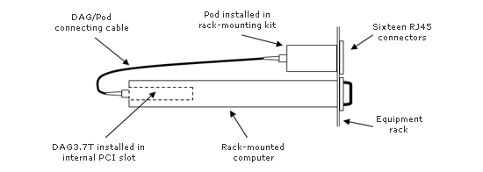
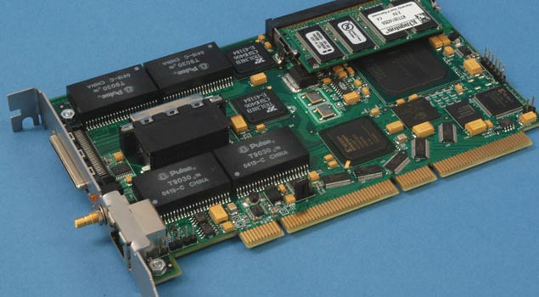
Full Packet Capture (Passive)
Example: Georgia Tech OC3Mon
Rack-mounted PC
Optical splitter
Data Acquisition and Generation (DAG) card
Source: endace.com

Slide 18
Eavesdropping Attack: Example
tcpdump with promiscuous network interface
  On a switched network, what can you see?
What might the following traffic types reveal about communications?
  DNS lookups (and replies)
  IP packets without payloads (headers only)
  Payloads

Slide 19
Integrity Attack - Tampering
Stop the flow of the message
Delay and optionally modify the message
Release the message again
A
B
Perpetrator

Slide 20
Authenticity Attack - Fabrication
Unauthorized assumption of other’s identity
Generate and distribute objects under this identity
A
B
Masquerader: from A

Slide 21
Attack on Availability
Destroy hardware (cutting fiber) or software
Modify software in a subtle way (alias commands)
Corrupt packets in transit
Blatant denial of service (DoS):
  Crashing the server
  Overwhelm the server (use up its resource)
A
B

Slide 22
Impact of Attacks
Theft of confidential information
Unauthorized use of
  Network bandwidth
  Computing resource
Spread of false information
Disruption of legitimate services
All attacks can be related and are dangerous!

Slide 23
Security Policy and Mechanism
Policy: a statement of what is, and is not allowed
Mechanism: a procedure, tool, or method of enforcing a policy
Security mechanisms implement functions that help prevent, detect, and respond to recovery from security attacks
Security functions are typically made available to users as a set of security services through APIs or integrated interfaces
Cryptography underlies many security mechanisms.

Slide 24
Security Services
Confidentiality: protection of any information from being exposed to unintended entities
  Information content
  Parties involved
  Where they are, how they communicate, how often, etc.

Slide 25
Security Services - Cont’d
Authentication: assurance that an entity of concern or the origin of a communication is authentic - it’s what it claims to be or from
Integrity: assurance that the information has not been tampered with
Non-repudiation: offer of evidence that a party indeed is the sender or a receiver of certain information

Slide 26
Security Services - Cont’d
Access control: facilities to determine and enforce who is allowed access to what resources, hosts, software, network connections
Monitor & response: facilities for monitoring security attacks, generating indications, surviving (tolerating) and recovering from attacks

Slide 27
Security Services - Cont’d
Security management: facilities for coordinating users’ service requirements and mechanism implementations throughout the enterprise network and across the Internet
  Trust model
  Trust communication protocol
  Trust management infrastructure

Slide 28
Assumptions and Trust
A security policy consists of a set of axioms that the policy makers believe can be enforced
Two assumptions
  The policy correctly and unambiguously partitions the set of system states into secure and nonsecure states
    The policy is correct
  The security mechanisms prevent the system from entering a nonsecure state
    The mechanisms are effective

Slide 29
Assumptions and Trust – Cont’d
Trusting the mechanisms work require the following assumptions
  Each mechanisms enforces part(s) of the security policy
  The union of the mechanisms enforce all aspects of the policy
  The mechanisms are implemented, installed, and administered correctly

Slide 30
How to Make a System Trustworthy
Specification
  A statement of desired functions
Design
  A translation of specifications to a set of components
Implementation
  Realization of a system that satisfies the design
Assurance
  The process to insure that the above steps are carried out correctly
  Inspections, proofs, testing, etc.

Slide 31
Operational Issues
Risk Analysis
Cost-Benefit Analysis
Laws and Custom

Slide 32
Human Issues
“The data breaches came from a variety of mishaps, including theft of laptops, hacking, employees improperly handling data, accidental disclosure and problems with subcontractors.”
Organizational Problems
People Problems

Slide 33
The Security Life Cycle
Threats
Policy
Specification
Design
Implementation
Operation and maintenance

